Slide 1
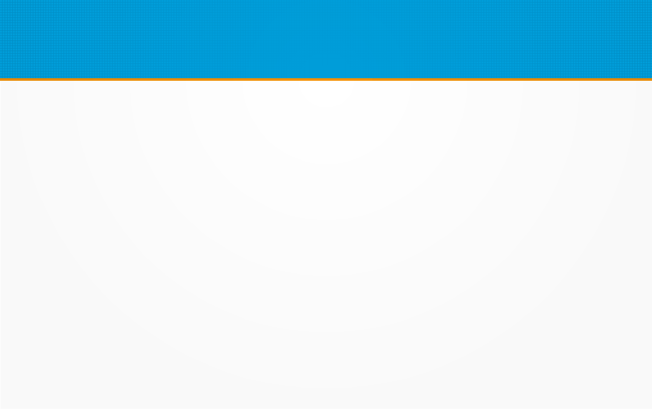
The Stack Terminology
myFunction:
push ra
push s0
# my code
pop s0
pop ra
jr ra
Activation Frame
Stack
Contains:
Arguments (that aren’t in registers)
Saved Registers (ra, s0, etc)
Local Variables
Function Prologue
Function Epilogue

