Slide 1
CS/COE 0447
Logic Minimization and K-Maps
wilkie (with content borrowed from:
Jarrett Billingsley
Dr. Bruce Childers)

Slide 2
Karnaugh Maps
X Marks the Spot … Well it is actually a bunch of rectangles

Slide 3
Gray Code
Gray code is a way of counting in binary where only one bit changes on each count
For our purposes, just knowing the 2-bit code enough.
00
01
11
10
2-bit Gray code (red bits are bits that change)

Slide 4
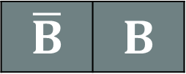

Karnaugh Maps (K-maps) – Setting up
A Karnaugh Map is a tool for minimizing boolean functions
Let's start with a function that has two inputs
Truth Table
K-map
Write input values in Gray code along axes.
(there's only one input on each side here, it's easy)
Fill in cells from truth table.
A | B | Q
0 | 0 | 1
0 | 1 | 0
1 | 0 | 1
1 | 1 | 1
0
1
$$\overline{B}$$ | $$B$$
$$\overline{A}$$
$$A$$
1
0
0
1
1
1

Slide 5


Karnaugh Maps (K-maps) – Finding rects
K-map
Find rectangles of 1s with these rules:
width and height can only be 1, 2, or 4
NEVER 3
overlapping is totally fine! it's good!
use the biggest rectangles possible
use the fewest rectangles possible
$$\overline{B}$$ | $$B$$
$$\overline{A}$$
$$A$$
1 | 0
1 | 1

Slide 6



Karnaugh Maps (K-maps) – Interpreting rects
K-map
For each rectangle, look at the values of the variables along the axes. some variables change, and others don’t.
Which variable changes in the red rectangle? which doesn’t?
What about the blue rectangle?
Each rectangle is an AND term
Write the variables that stay the same for that rect (keeping the NOT bars)
Ignore the variables that change
OR all the terms together
WHEW!
$$\overline{B}$$ | $$B$$
$$\overline{A}$$
$$A$$
1 | 0
1 | 1
Red: $\overline{B}$
Blue: $A$
$$Q=A+\overline{B}$$

Slide 7






I'd like to place an order for the carry-out bit
C_{i} | A | B | C_{o}
0 | 0 | 0 | 0
0 | 0 | 1 | 0
0 | 1 | 0 | 0
0 | 1 | 1 | 1
1 | 0 | 0 | 0
1 | 0 | 1 | 1
1 | 1 | 0 | 1
1 | 1 | 1 | 1
With more than 2 variables, put two along one axis (GRAY CODE!)
Try to make the rectangles as big as possible. overlap is goooood.
00
01
11
10
$$\overline{A}\overline{B}$$ | $$\overline{A}B$$ | $$AB$$ | $$A\overline{B}$$
Red: $AC_{i}$
Green: $AB$
$$\overline{Ci}$$
$$Ci$$
0 | 0 | 1 | 0
0 | 1 | 1 | 1
0
Blue: $BC_{i}$
1
$$C_{o}=AC_{i}+AB+BC_{i}$$

Slide 8





Just like a 2D RPG world map…
rectangles on K-maps can wrap around (left-right AND top-bottom!)
00
01
11
10
$$\overline{X}\overline{Y}$$ | $$\overline{X}Y$$ | $$XY$$ | $$X\overline{Y}$$
Red: $\overline{Y}$
Blue: $\overline{X}\overline{Z}$
0
$$\overline{Z}$$
$$Z$$
1 | 1 | 0 | 1
1 | 0 | 0 | 1
$$Q=\overline{Y}+\overline{X}\overline{Z}$$
1
this is really a 2x2 rectangle. it's just… doing its best.

Slide 9







Okay, maybe it's not perfect.
let's try the Sum output of a full adder
a 1x1 rectangle becomes a term that uses all the variables
00
01
11
10
$$\overline{A}\overline{B}$$ | $$\overline{A}B$$ | $$AB$$ | $$A\overline{B}$$
Red: $\overline{AB}C_{i}$
$$\overline{Ci}$$
$$Ci$$
0 | 1 | 0 | 1
1 | 0 | 1 | 0
Green: $\overline{A}B\overline{C_{i}}$
0
Blue: $ABC_{i}$
1
Purple: $A\overline{BC_{i}}$
$$Sum=\overline{AB}C_{i}+\overline{A}B\overline{C_{i}}+ABC_{i}+A\overline{BC_{i}}$$
wait, didn't we say that we could do it as:
$Sum=A⨁B{⨁C}_{i}$ (that's xor!)

Slide 10
Tradeoffs, tradeoffs
There are extensions to K-maps to detect XORs
but…
XOR gates are slower than AND/OR gates
if area is a concern, an XOR make sense
if speed is a concern, AND/OR gates make sense
What do real hardware designers do?
They use programs to do this stuff for them lol
Things like FPGAs, CPLDs, and GALs are reconfigurable hardware which usually use "sum-of-products" to do logic, so ANDs and ORs are all you've got

Slide 11


(Pst. What if we have lots of 1’s?)
When we select 0’s, we get a product of sums that represents the inverse of our function. It helps when we have less 0s than 1s.
C_{i} | A | B | C_{o}
0 | 0 | 0 | 0
0 | 0 | 1 | 0
0 | 1 | 0 | 0
0 | 1 | 1 | 1
1 | 0 | 0 | 0
1 | 0 | 1 | 1
1 | 1 | 0 | 1
1 | 1 | 1 | 1
00
01
11
10
$$\overline{A}\overline{B}$$ | $$\overline{A}B$$ | $$AB$$ | $$A\overline{B}$$
$$\overline{Ci}$$
$$Ci$$
0 | 0 | 1 | 0
0 | 1 | 1 | 1
0
1
$$\overline{C_{o}}=(\overline{B}+\overline{C_{i}})(\overline{A}+\overline{B})(\overline{A}+\overline{C_{i}})$$
$$C_{o}=(\overline{B}+\overline{C_{i}})(\overline{A}+\overline{B})(\overline{A}+\overline{C_{i}})$$

Slide 12
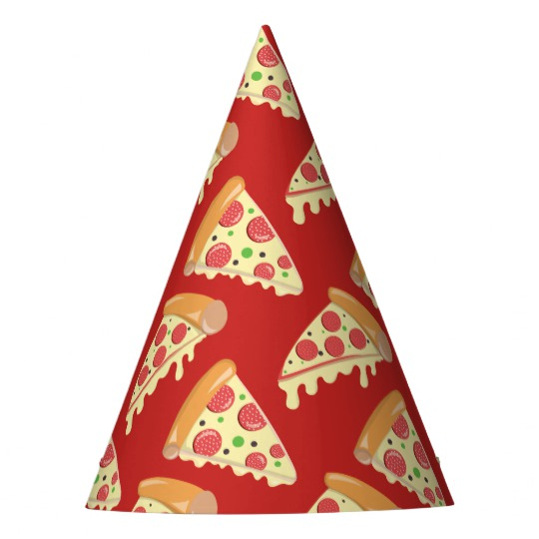
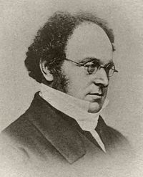






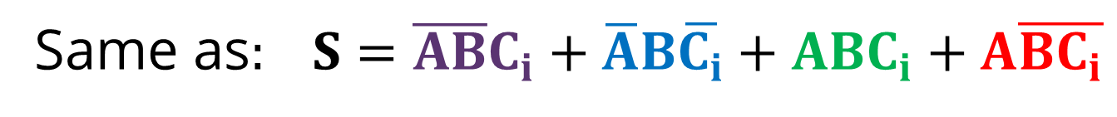
(Doesn’t help in the worst case)
a 1x1 rectangle becomes a term that uses all the variables
let's try the Sum output of a full adder
00
01
11
10
$$\overline{A}\overline{B}$$ | $$\overline{A}B$$ | $$AB$$ | $$A\overline{B}$$
Red: $\overline{A}+B+C_{i}$
$$\overline{Ci}$$
$$Ci$$
0 | 1 | 0 | 1
1 | 0 | 1 | 0
Green:$\overline{A}+\overline{B}+\overline{C_{i}}$
0
Blue: $A+\overline{B}+C_{i}$
1
Purple: $A+B+\overline{C_{i}}$
THANKS DeMORGAN!
(Although everybody already knew this)
$$S=(\overline{A}+B+C_{i})(\overline{A}+\overline{B}+\overline{C_{i}})(A+\overline{B}+C_{i})(A+B+\overline{C_{i}})$$
Same as$: S=\overline{AB}C_{i}+\overline{A}B\overline{C_{i}}+ABC_{i}+A\overline{BC_{i}}$

Slide 13
(Here’s the thing, though)
Both methods are equivalent.
You can get f(a,b,c,d) by selecting 1s
Or the inverse: not(f(a,b,c,d)) by selecting 0s.
You can use DeMorgan’s Law to get f(a,b,c,d) from its inverse
It will be the same.
Just select the 1s.
No need to make things more complicated.
But it is nice to know that logic… works as intended.
And discrete math was not a waste of time ☺
It’s actually really useful. Let’s be honest.

