Slide 1
CS/COE 0447
Implementing Logic:
Teaching the Machine to “think”
wilkie (with content borrowed from:
Jarrett Billingsley
Dr. Bruce Childers)

Slide 2
What's electricity?
(for fun section)

Slide 3
In your orbit
here's a proton. it has a positive charge
here's an electron. it has a negative charge
p⁺
e⁻
it kinda goes around
the proton in an orbit*
protons sit still while electrons can move around
*narrator: that was not true.

Slide 4
Opposites attract…
p⁺
e⁻
two of the same charge repel
opposite charges attract
here's electricity. here it is
p⁺
e⁻
but protons are kinda stuck, so…

Slide 5
Lots of fish electrons in the sea
here's a solid piece of metal
the atoms are in a fixed structure
but some of the electrons are free to move around
right now, the charges are balanced: same number of positive and negative
let's knock it out of whack

Slide 6
Two moles is company, three's a crowd
let's shove more electrons in
packing more electrons in leads to two things:
1. this metal is now negatively charged
2. the electrons are now closer together meaning they're less happy
noo
aaa

Slide 7
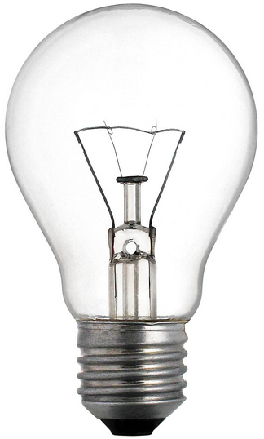

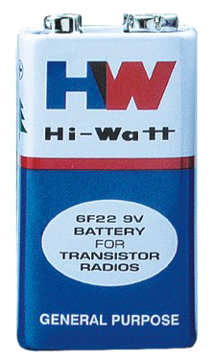
Carousel of unhappiness
wire
wire
if we shove some down a wire
and then give them a (difficult) way out
we'd like to get off mister bones wild ride
and then have something which will squeeze them back together again
well now you have electricity

Slide 8
Watch em go
voltage measures electron unhappiness
current measures how many electrons per second are moving past a point
low
low
high
and that's electricity
high

Slide 9
Logic Basics
Transistors n’at

Slide 10
Transistors
A transistor is like a little valve, or switch
The input, output, and control are all single bits
The bits are represented as voltages (maybe 3.3V = 1, 0V = 0)
input
now just put 3 billion of them together! who said EE was hard?
control
output
it connects its input to its output if control is a 1

Slide 11
Two Types of MOS Transistor
Metal Oxide Semiconductor transistors come in two varieties:
ON
OFF
X
X
X
“N” Type
G
G = 1
G = 0
Y
Y
Y
X
X
X
G
G = 0
G = 1
“P” Type
Y
Y
Y

Slide 12
Gates
We can combine transistors in interesting ways to make gates
A gate implements one of the basic boolean logic functions
Let's start with the simplest: the NOT gate
A is the input
Q is the output
A
Q
this little bubble means "invert"

Slide 13
Time to bundle up
If we want to, say, NOT a 32-bit value, we can draw it like:
32
32
It's a lot nicer than drawing 32 wires with 32 NOT gates
Logisim calls these wire bundles
It doesn't draw the slashes and numbers though…

Slide 14
NOT (With MOS Transistors)
AKA an “Inverter”
Input value “A” manipulates transistors and output “Q”
Voltage goes to ground ( ) unless it goes to Q
“high” voltage == “1"
3.3V
A
Q
X
A | Q
0 | 1
1 | 0
~0.0V

Slide 15
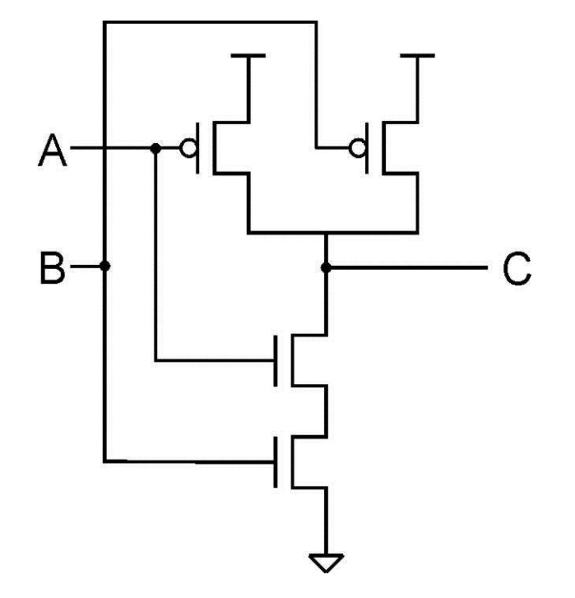
NAND (MOS)
NAND gate
A | B | Q
0 | 0 | 1
0 | 1 | 1
1 | 0 | 1
1 | 1 | 0
AB

Slide 16
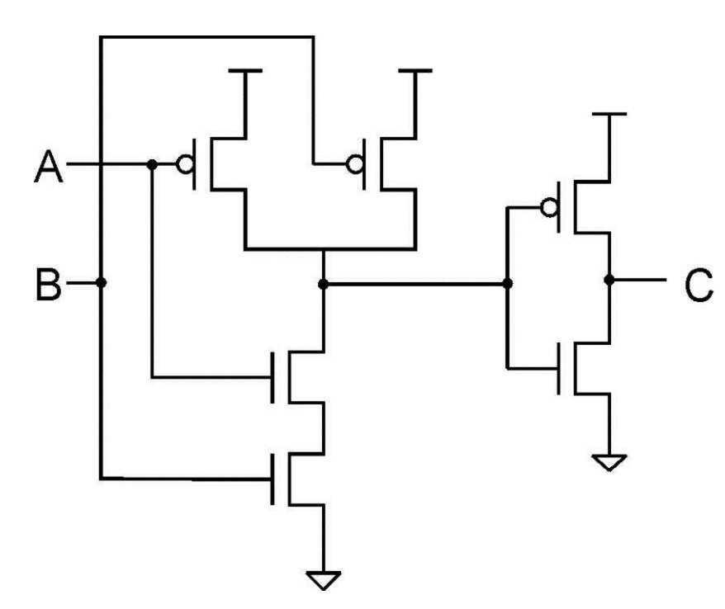
AND (MOS)
A
Q
B
AND gate
A | B | Q
0 | 0 | 0
0 | 1 | 0
1 | 0 | 0
1 | 1 | 1
AB

Slide 17
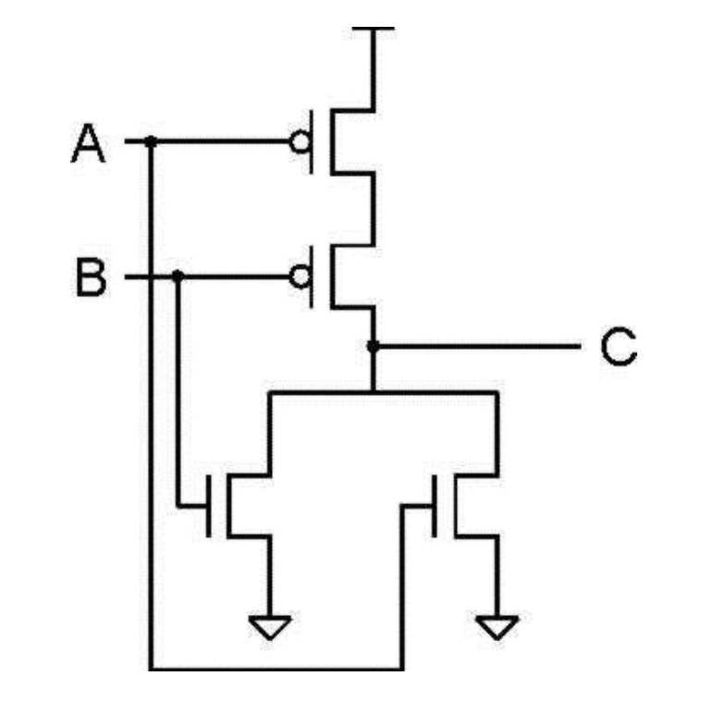
NOR (MOS)
A
Q
B
NOR gate
A | B | Q
0 | 0 | 1
0 | 1 | 0
1 | 0 | 0
1 | 1 | 0
A+B

Slide 18
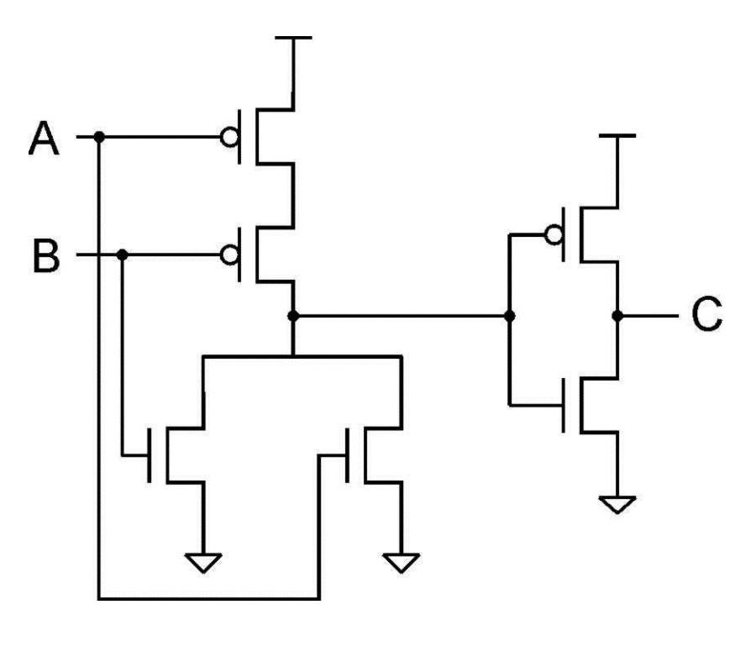
OR (MOS)
A
Q
B
OR gate
A | B | Q
0 | 0 | 0
0 | 1 | 1
1 | 0 | 1
1 | 1 | 1
A+B

Slide 19
AND, OR, and… XOR?
we know about AND and OR, but what's XOR?
A
A
A
Q
Q
Q
B
B
B
AND gate
OR gate
XOR gate
A | B | Q
0 | 0 | 0
0 | 1 | 0
1 | 0 | 0
1 | 1 | 1
A | B | Q
0 | 0 | 0
0 | 1 | 1
1 | 0 | 1
1 | 1 | 1
A | B | Q
0 | 0 | 0
0 | 1 | 1
1 | 0 | 1
1 | 1 | 0
eXclusive OR means "one or the other, but NOT BOTH."
AB A+B AxB

Slide 20
AND (multiple inputs)
A | B | C | Q
0 | 0 | 0 | 0
1 | 0 | 0 | 0
0 | 1 | 0 | 0
1 | 1 | 0 | 0
0 | 0 | 1 | 0
1 | 0 | 1 | 0
0 | 1 | 1 | 0
1 | 1 | 1 | 1
If you have more than 2 inputs… you can just concatenate:
A
Q’
Q’
B
Q
C
AND gate
AND gate

Slide 21
AND and/or OR
A | B | C | Q
0 | 0 | 0 | 0
1 | 0 | 0 | 0
0 | 1 | 0 | 1
1 | 1 | 0 | 0
0 | 0 | 1 | 0
1 | 0 | 1 | 0
0 | 1 | 1 | 1
1 | 1 | 1 | 0
Combining logic is just a matter of combining logic gates:
Look at when Q is “1”
OR each of those by the AND of each term:
ABC + ABC

Slide 22
AND and/or OR
A | B | C | Q
0 | 0 | 0 | 0
1 | 0 | 0 | 0
0 | 1 | 0 | 1
1 | 1 | 0 | 0
0 | 0 | 1 | 0
1 | 0 | 1 | 0
0 | 1 | 1 | 1
1 | 1 | 1 | 0
ABC + ABC
A
Q
B
C

Slide 23
If you give an electrical engineer a NAND gate…
Sum up: If a NOT gate is after an AND gate, you get a NAND gate:
This kind of gate has a cool property: it's universal
In other words, you can build an entire computer with NANDs (or NORs)
Think how to build a NOT from a NAND (Then build an AND, etc)
But this isn't how real circuits are designed, at least not anymore
Digital logic courses use them cause NAND gate chips are cheap
But in Logisim, we have infinite gates for free :D
Use the kind of gate you need for the situation at hand

