Slide 1
A Hands-on Introduction to OpenMP
A summary of the slides presented in
“High Performance for Data and Cybersecurity”
Oscar Plata
Master Ing. Informática

Slide 2
Introduction
OpenMP is one of the most common parallel programming models in use today
It is relatively easy to use
OpenMP: API for writing multithreaded applications
A set of compiler directives and library routines for parallel application programmers
Greatly simplifies writing multithreaded programs in C/C++
Standard for shared memory programming

Slide 3
OpenMP Core Syntax
Most of the constructs in OpenMP are compiler directives
#pragma omp construct [clause [clause] …]
Ejemplo: #pragma omp parallel num_threads(4)
Function prototypes and types in <omp.h>
#include <omp.h>
Most OpenMP constructs apply to a structured block (scope)
A structured block is a block of one or more statements with one point of entry at the top and one point of exit at the bottom
It is OK to have an exit() within the structured block

Slide 4
OpenMP Compiler
Linux with Intel icc:
icc –openmp –o prog prog.c
export OMP_NUM_THREADS=4 (Bash shell)
./prog
Linux with gcc
gcc –fopenmp –o prog prog.c
export OMP_NUM_THREADS=4 (Bash shell)
./prog
Environment variable

Slide 5
Simple Example
Sequential program
Single process, single thread
int main()
{
int ID=0;
printf(“hello(%d)”, ID);
printf(“world(%d)\n”, ID);
}

Slide 6
Simple Example
Multithreaded program
Single process, multiple threads
#include <omp.h>
int main()
{
#pragma omp parallel
{
int ID=omp_get_thread_num();
printf(“hello(%d)”, ID);
printf(“world(%d)\n”, ID);
}
}
Compiler directive
Library function

Slide 7
Simple Example
Multithreaded program
Single process, multiple threads
OpenMP include file
#include <omp.h>
int main()
{
#pragma omp parallel
{
int ID=omp_get_thread_num();
printf(“hello(%d)”, ID);
printf(“world(%d)\n”, ID);
}
}
Parallel region with default
number of threads
Runtime library function to
return a thread ID
End of the parallel region

Slide 8
OpenMP Program
An instance of a program
One process and a lots of threads
Threads interact through reads/writes to a shared address space
OS scheduler decides when to run which threads … interleaved for fairness
Synchronization to assure every legal order results in correct results
private
thread
private
thread
Shared Address Space
private
thread
private
thread
private
thread

Slide 9
OpenMP Programming Model
Fork-Join parallelism
Master thread spawns a team of threads as needed
Parallelism added incrementally until performance goals are met
Spawned
threads
Parallel Regions
Master
thread
A nested
parallel
region
Sequential Regions

Slide 10
Thread Creation: Parallel Regions
Threads can be created with the parallel construct
Example: Creation of a 4 thread parallel region
Each thread calls func(ID,A) with ID from 0 to 3
Runtime function to
request a certain
number of threads
Each thread
executes a
copy of the
code within
the
structured
block
double A[1000];
omp_set_num_threads(4);
#pragma omp parallel
{
int ID=omp_get_thread_num();
func(ID,A);
}
Runtime function
returning a thread ID

Slide 11
Thread Creation: Parallel Regions
Each threads executes the same code redundantly
double A[1000];
#pragma omp parallel num_threads(4)
{
int ID=omp_get_thread_num();
func(ID,A);
}
printf (“all done\n”);
double A[1000];
#pragma omp parallel …
A single
copy of A
is shared
between
all threads
func(0,A)
func(1,A)
func(2,A)
func(3,A)
printf(“all done\n”)
Threads wait here for all threads to finish
before proceeding (barrier)

Slide 12
Major OpenMP Constructs (I)
To create a team of threads
#pragma omp parallel
To distribute work between threads
#pragma omp for
#pragma omp sections
#pragma omp single, #pragma omp master
#pragma omp task
To prevent conflicts: synchronization
#pragma omp critical
#pragma omp atomic
#pragma omp barrier
Data sharing attribute clauses
shared(var1,var2…)
private(var1,var2…)
firstprivate(var1,var2…)
lastprivate(var1,var2…)
reduction(op:var1,var2…)
Environment variables
OMP_NUM_THREADS
OMP_SCHEDULE

Slide 13
Major OpenMP Constructs (II)
Execution environment routines
omp_set_num_threads()
omp_get_num_threads()
omp_get_thread_num()
omp_set_schedule()
omp_get_schedule()
omp_in_parallel()
Timing routines
omp_get_wtime()
omp_get_wtick()
Lock routines
omp_init_lock()
omp_destroy_lock()
omp_set_lock()
omp_unset_lock()

Slide 14
Environment Variables
Sets the default number of threads to use
OMP_NUM_THREADS <num>
Sets the runtime schedule type and chunk size
OMP_SCHEDULE [static,<num>|dynamic|guided|auto]
Control the size of child thread’s stack
OMP_STACKSIZE <size>[B|K|M|G]
Hint to runtime how to treat idle threads
OMP_WAIT_POLICY ACTIVE|PASSIVE
ACTIVE keep threads alive at barriers/locks
PASSIVE try to release processor at barriers/locks
Process binding is enabled if this variable is true (runtime will not move threads around between processors)
OMP_PROC_BIND true|false

Slide 15
Runtime Environment Routines
Execution environment routines
Modify/check the number of threads
omp_set_num_threads(<nth>), omp_get_num_threads(), omp_get_thread_num(), omp_get_max_threads()
Are we in active parallel region?
omp_in_parallel()
Do you want a system to dynamically vary the number of threads from one parallel construct to another?
omp_set_dynamic(), omp_get_dynamic()
How many processors in the system?
omp_get_num_procs()
Schedule applied when runtime is used as schedule kind
omp_set_schedule([1|2|3|4],<num>), omp_get_schedule()
Elapsed wall clock time (in seconds) per thread
omp_get_wtime(), omp_get_wtick()

Slide 16
Data Environment: Storage Attributes
Most variables are shared by default
Global variables are shared among threads depending on scope
A, index, count: shared
temp: private
double A[10];
int main()
{
int index[10];
#pragma omp parallel
work(index);
}
extern double A[10];
void work(int *idx)
{
double temp[10];
static int count;
…
}

Slide 17
Data Environment: Changing Attributes
One can selectively change the storage attributes for constructs using the following clauses:
shared
private
firstprivate
The final value of a private inside a parallel construct can be transmitted to the shared variable outside the construct with:
lastprivate
The default attributes can be overriden with::
default(private|shared|none)

Slide 18
Data Sharing: Private Clauses
private(var) creates a new local copy of var for each thread
The variable is uninitialized and removed after the region
The value of the original variable is unchanged after the region
void wrong()
{
int tmp=0;
#pragma omp parallel for private(tmp)
for (int j=0; j<1000; j++)
tmp += j;
printf(“%d\n”,tmp);
}
tmp was not initialized
tmp is 0 here

Slide 19
Data Sharing: Firstprivate Clause
firstprivate(var) creates a new local copy of var for each thread that is initialized from the corresponding shared variable
int incr=10;
#pragma omp parallel for firstprivate(incr)
for (int i=0; i<1000; i++){
if ((i%2)==0) incr++;
A[i] = incr;
}
Each thread gets its own copy
of incr with the initial value of 10

Slide 20
Data Sharing: Lastprivate Clause
lastprivate(var) creates a new local copy of var for each thread that updates the corresponding shared variable at the end of the parallel region
void sq2(int n, double *lastterm)
{
double x; int i;
#pragma omp parallel for lastprivate(x)
for (int i=0; i<N; i++){
x = a[i]*a[i]+b[i]*b[i];
b[i] = sqrt(x);
}
*lastterm = x;
}
x has the value it held for the last sequential iteration (N-1)

Slide 21
OpenMP: Synchronization
High level synchronization
critical
atomic
barrier
ordered
Low level synchronization
flush
locks

Slide 22
Synchronization: Critical
Mutual exclusion: Only one thread at a time can enter a critical section
float res;
#pragma omp parallel
{
float B;
int i,id,nth;
id = omp_get_thread_num();
nth = omp_get_num_threads();
for (i=id; i<niters; i+=nth){
B = job(i);
#pragma omp critical
res += consume(B);
}
}
Threads wait their
turn – only one
at a time calls
consume()

Slide 23
Synchronization: Atomic
Atomic provides mutual exclusion but only applies to the update of a memory location
#pragma omp parallel
{
double B;
int tmp,X=0.0;
B = doit();
tmp = calc(B);
#pragma omp atomic
X += func(tmp);
}
The single sentence
should be translated
into an atomic machine
instruction
func() is called in paralle by all threads;
only the update of X is made atomically

Slide 24
Synchronization: Barrier
Each thread waits until all threads arrive
#include <omp.h>
int main()
{
#pragma omp parallel
{
int ID=omp_get_thread_num();
A[ID] = calc1(ID);
#pragma omp barrier
B[ID] = calc2(ID,A);
}
}
No threads compute
calc2() until all threads
have computed calc1()

Slide 25
Loop Worksharing Construct
The loop worksharing construct splits up loop iterations among the threads in a team
#pragma omp parallel
{
#pragma omp for
for (i=0; i<N, i++){
compute(i);
}
}
Variable i is made private
to each thread by default

Slide 26
Loop Worksharing Construct
The schedule clause affects how loop iterations are mapped onto threads
schedule(static[,chunk])
Deal-out blocks of iterations of size “chunk” to each thread
schedule(dynamic[,chunk])
Each thread grabs “chunk” iterations off a queue dynamically
schedule(guided[,chunk])
Threads dynamically grabs blocks of iterations of decreasing size
schedule(runtime)
Schedule and block size taken from OMP_SCHEDULE environment variable
schedule(auto)
Schedule is left up to the runtime to choose

Slide 27
Combined Parallel/Worksharing
OpenMP shortcut: Parallel and worksharing constructs can be combined in the same line
double res[MAX];
int i;
#pragma omp parallel
{
#pragma omp for
for (i=0; i<MAX, i++){
res[i] = compute(i);
}
}
double res[MAX];
int i;
#pragma omp parallel for
for (i=0; i<N, i++){
res[i] = compute(i);
}

Slide 28
Working With Loops
Basic approach
Find compute intensive loops
Make the loop iterations independent (if possible)
Place appropriate OpenMP directives and test
Loop index i is private by default
int i,j,A[MAX];
j = 5;
for (i=0; i<MAX, i++)
{
j += 2;
A[i] = compute(j);
}
int i,j,A[MAX];
#pragma omp parallel for private(j)
for (i=0; i<MAX, i++)
{
j = 5+2*(i+1);
A[i] = compute(j);
}
Removed loop-carried dependence

Slide 29
Loops with Reductions
How do we handle this case?
Loop iterations are flow dependent due to the accumulations into variable ave
This common situation is called a reduction
Reduction loops can be safely parallelized through variable privatization
OpenMP includes special support for reductions
double ave=0.0, A[MAX];
int i;
for (i=0; i<MAX, i++){
ave += A[i];}
ave = ave/MAX;

Slide 30
OpenMP Reduction Support
Reduction clause
reduction(op:list)
Inside a parallel or a worksharing construct
A local copy of each list variable is made and initialized depending on the op (e.g., 0 if +)
Updates occur on the local copy
Local copies are reduced into a single value and combined with the original global value
The variable list must be shared and op must be associative
double ave=0.0, A[MAX]; int i;
#pragma omp parallel for reduction(+:ave)
for (i=0; i<MAX, i++){
ave += A[i];}
ave = ave/MAX;

Slide 31
Example: Compute PI – Loop & Redux
Parallel code
Combined parallel and loop constructs
#include <omp.h>
static long num_steps=100000; double step;
int main()
{
int i; double x,pi,sum=0.0;
step = 1.0/(double) num_steps;
#pragma omp parallel for private(x) reduction(+:sum)
for (i=0;i<num_steps;i++){
x = (i+0.5)*step;
sum = sum+4.0/(1.0+x*x);}
pi = sum*step;
}

Slide 32
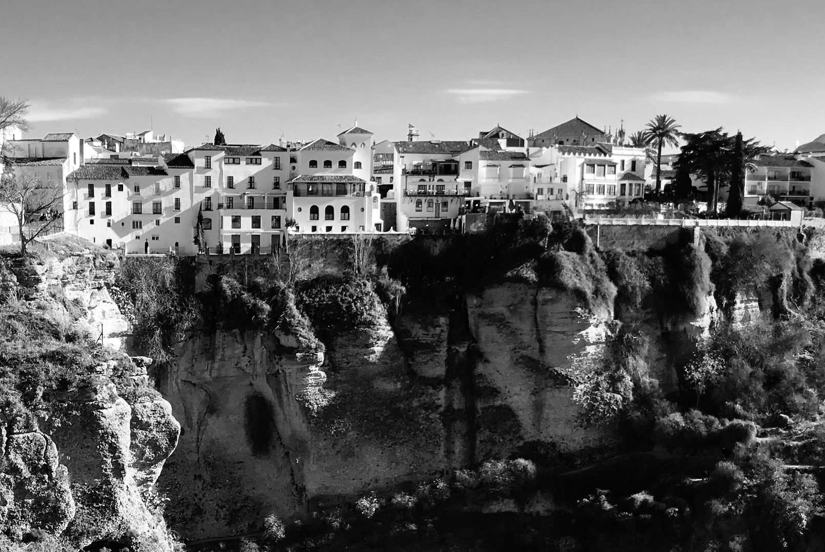
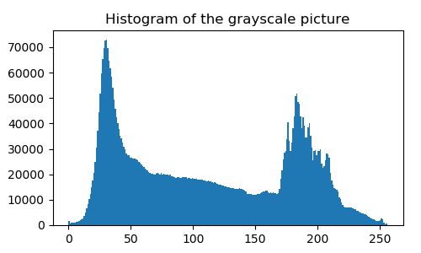
Array reduction
Reduction clause only works for scalar variables
What if we have to reduce an array.
Histogram example:

Slide 33
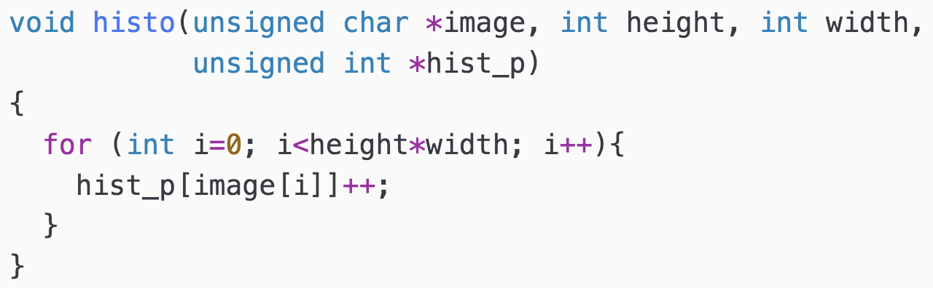
Histogram computation
6 | 3 | 3 | 6
3 | 6 | 1 | 1
1 | 1 | 6 | 3
6 | 3 | 3 | 6
image
6 | 3 | 3 | 6 | 3 | 6 | 1 | 1 | 1 | 1 | 6 | 3 | 6 | 3 | 3 | 6
hist[1]++
(x4)
bin 1
contains 4
because there
are four pixels
with tone 1
0 | 4 | 0 | 6 | 0 | 0 | 6 | 0
0 | 1 | 2 | 3 | 4 | 5 | 6 | 7
hist

Slide 34
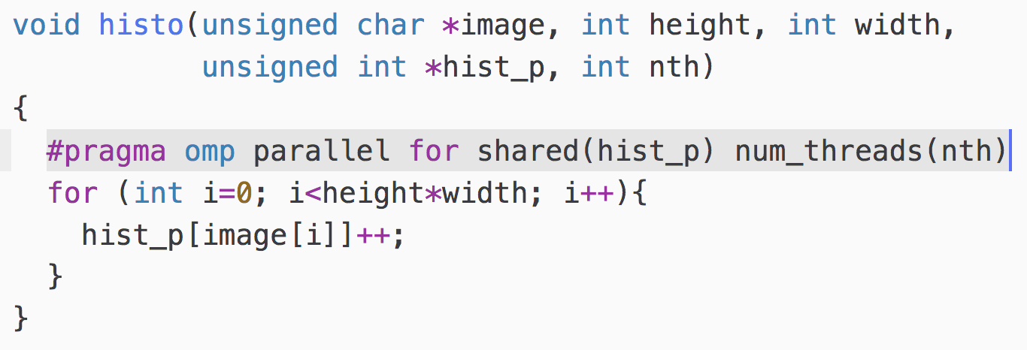
Histogram: unsafe implementation
Thread A
Core 0
hist_p[1]++
hist_p[1]++
Thread B
Core 1
image:
6 | 3 | 3 | 6 | 3 | 6 | 1 | 1 | 1 | 1 | 6 | 3 | 6 | 3 | 3 | 6
bin 1
“shared mutable state”
hist_p:
Wrong
0 | 2 | 0 | 3 | 0 | 0 | 3 | 0
0 | 1 | 2 | 3 | 4 | 5 | 6 | 7

Slide 35

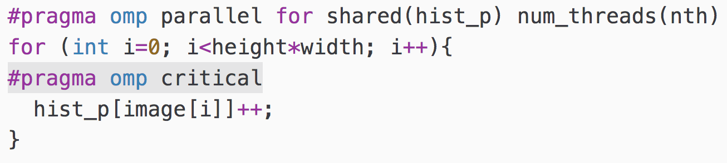
Histogram: coarse-grained lock
Thread A
Core 0
hist_p[1]++
hist_p[6]++
Thread B
Core 1
image:
6 | 3 | 3 | 6 | 3 | 6 | 1 | 1 | 1 | 1 | 6 | 3 | 6 | 3 | 3 | 6
Coarse-grained lock
Serial
hist_p:
0 | 1 | 0 | 3 | 0 | 0 | 3 | 0
0 | 1 | 2 | 3 | 4 | 5 | 6 | 7

Slide 36
Histogram: privatization+reduction
Thread A
Core 0
Parallel
Thread B
Core 1
image:
6 | 3 | 3 | 6 | 3 | 6 | 1 | 1 | 1 | 1 | 6 | 3 | 6 | 3 | 3 | 6
Privatization
0 | 2 | 0 | 3 | 0 | 0 | 3 | 0
0 | 1 | 2 | 3 | 4 | 5 | 6 | 7
0 | 2 | 0 | 3 | 0 | 0 | 3 | 0
0 | 1 | 2 | 3 | 4 | 5 | 6 | 7
myH
myH
Reduction
hist_p:
0 | 4 | 0 | 6 | 0 | 0 | 6 | 0
0 | 1 | 2 | 3 | 4 | 5 | 6 | 7

Slide 37
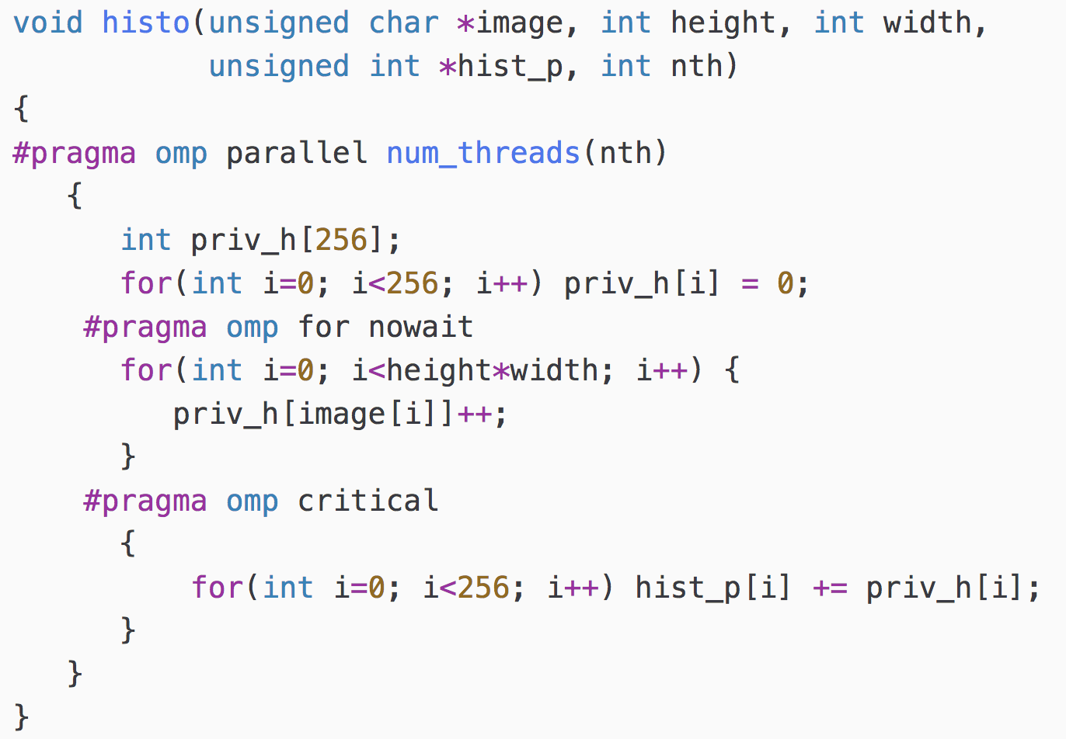
Histogram: privatization+reduction
Private histogram
Initialized
Parallel computation
on private copy
Sequential reduction
on shared array

Slide 38
Synchronization in Loops
Each thread waits until all threads arrive
nowait clause avoids the implicit barrier
#pragma omp parallel shared(A,B,C) private (id)
{
id = omp_get_thread_num();
A[id] = compute1(id);
#pragma omp barrier
#pragma omp for
for (i=0; i<N, i++){
C[i] = compute2(i,A);}
#pragma omp for nowait
for (i=0; i<N, i++){
B[i] = compute3(i,C);}
A[id] = compute4(id);
}
Implicit barrier at the end
of the for construct
No implicit barrier
due to nowait

Slide 39
Encuesta de satisfacción
www.uma.es/calidad
Rafael Asenjo: GABIM

