Slide 1

Data Science Jobs Analysis with Pandas from 2020 to 2023
Luis garcilazo

Slide 2


The Data Set
9356 entries
Data from 2020 to 2023
12 variables: work_year, job_title, job_category, salary_currency, salary, salary_in_usd, employee_residence, experience_level, employment_type, work_setting, company_location, company_size

Slide 3
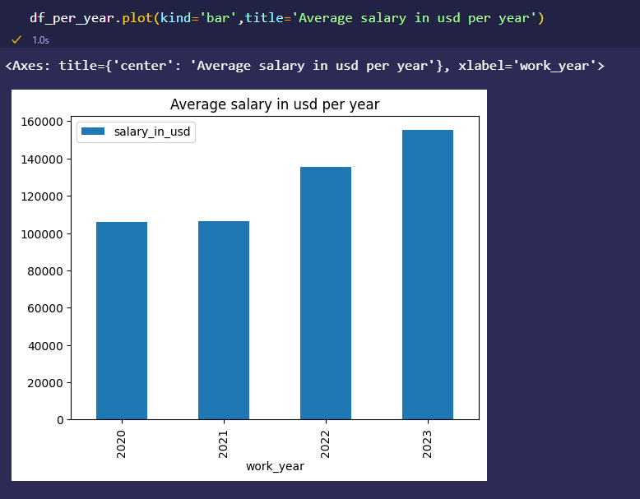
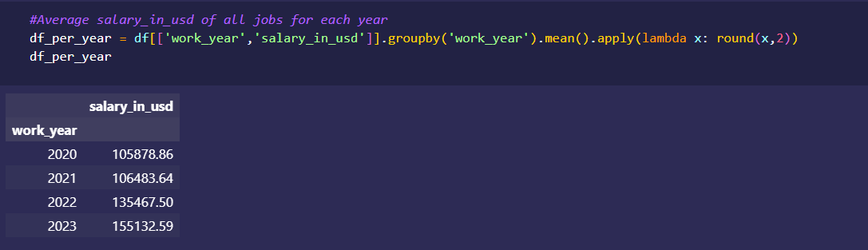
Average salary per year

Slide 4
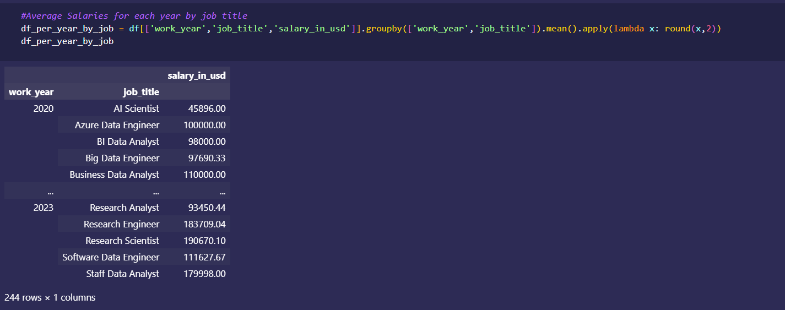
Average salary per year and job title

Slide 5
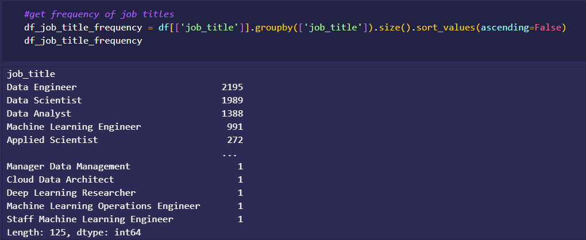
Frequency of job titles

Slide 6
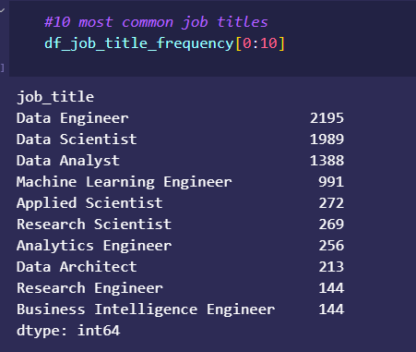
10 Most Common

Slide 7
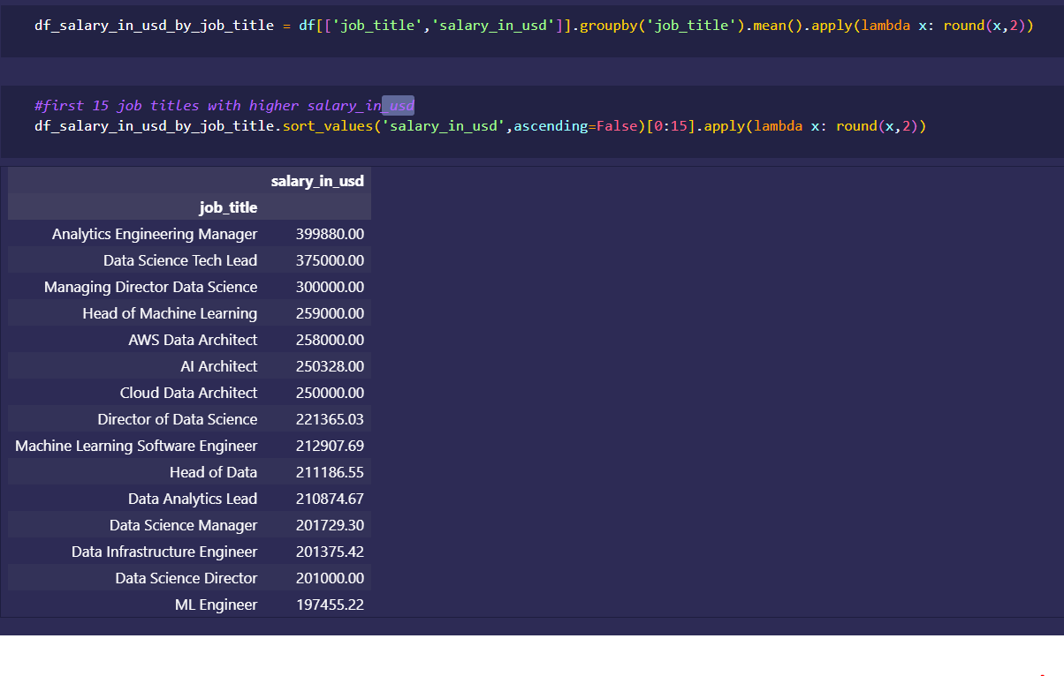
Job titles ordered by most salary

Slide 8
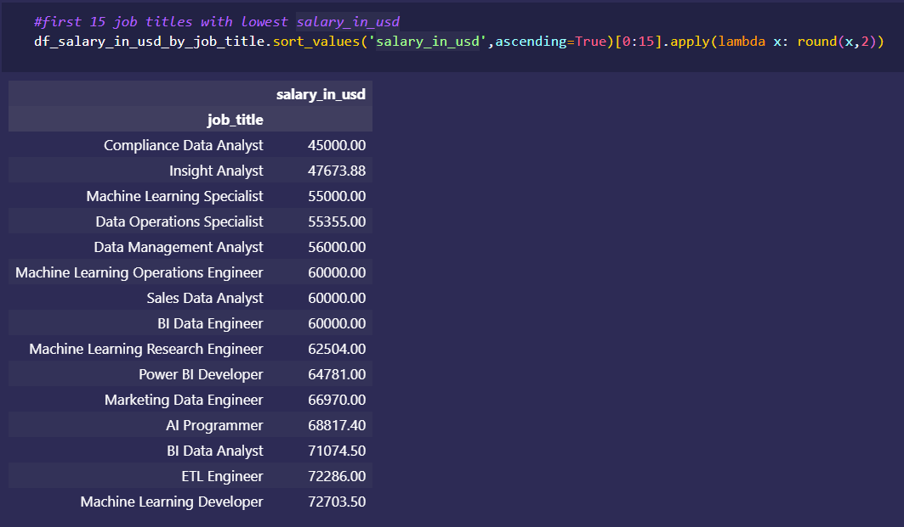
Job titles ordered by least salary

Slide 9
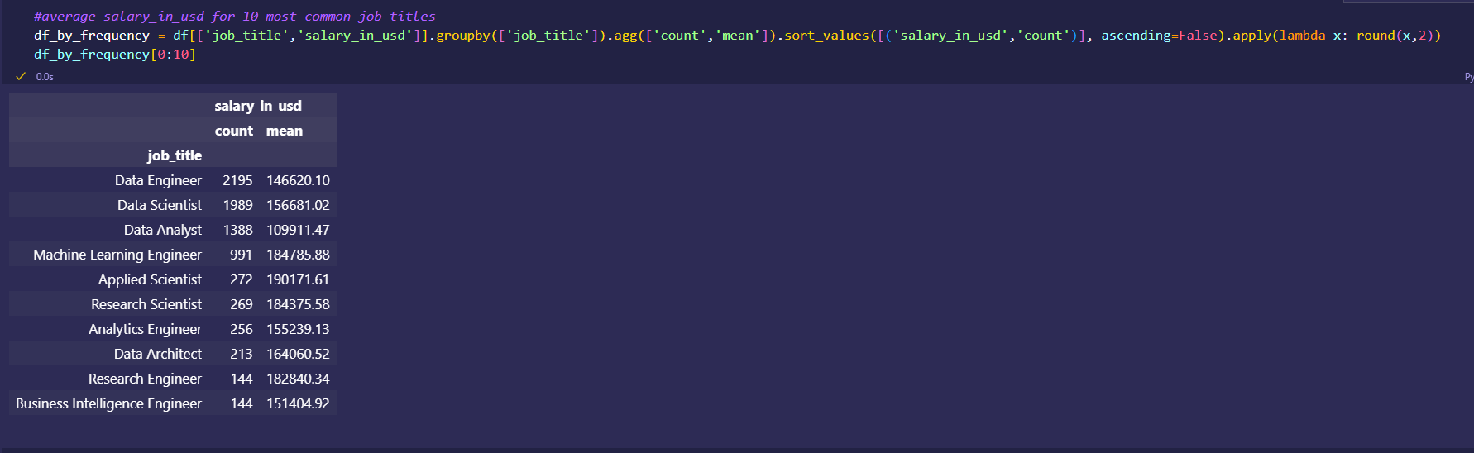
Average salary for the10th most common job titles

Slide 10
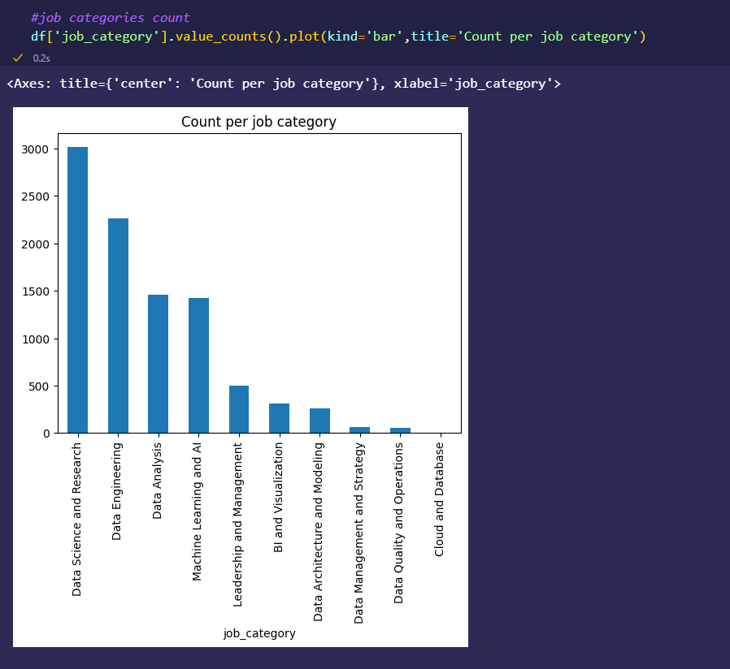
All job categories included

Slide 11
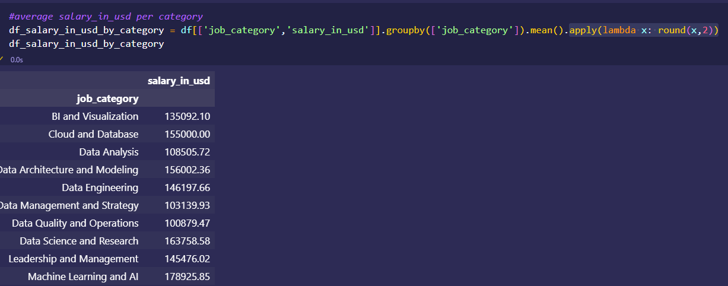
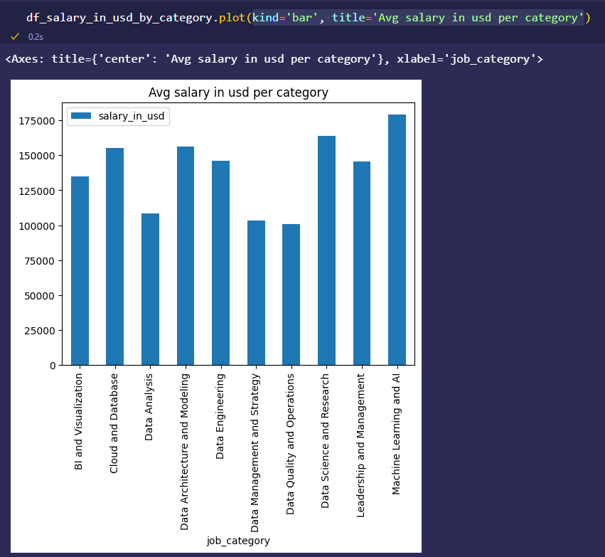
Average salary per job category

Slide 12
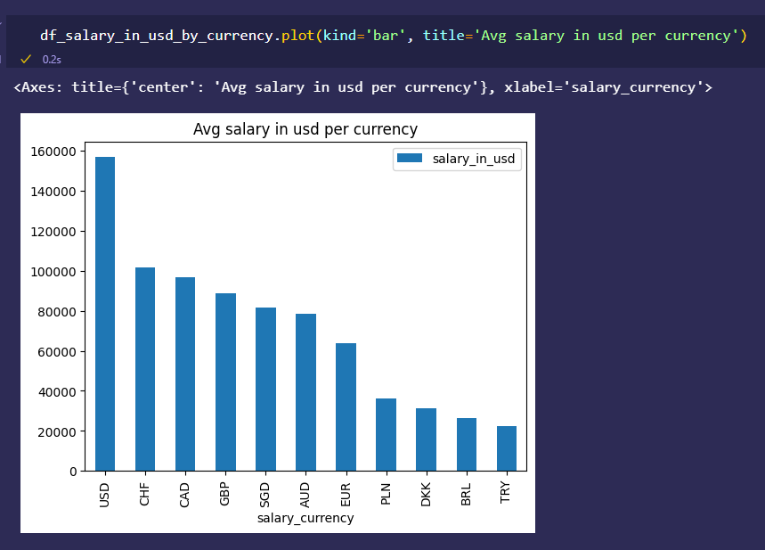
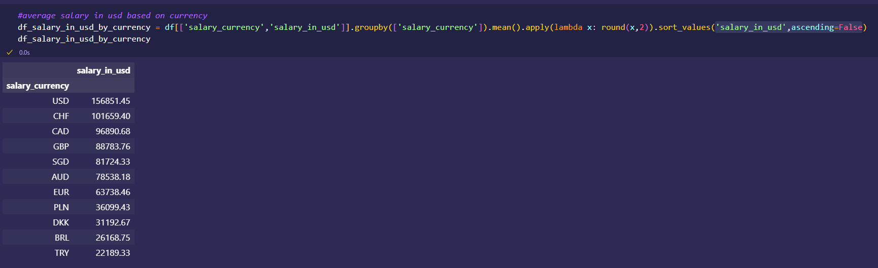
Average salary based in currency

Slide 13
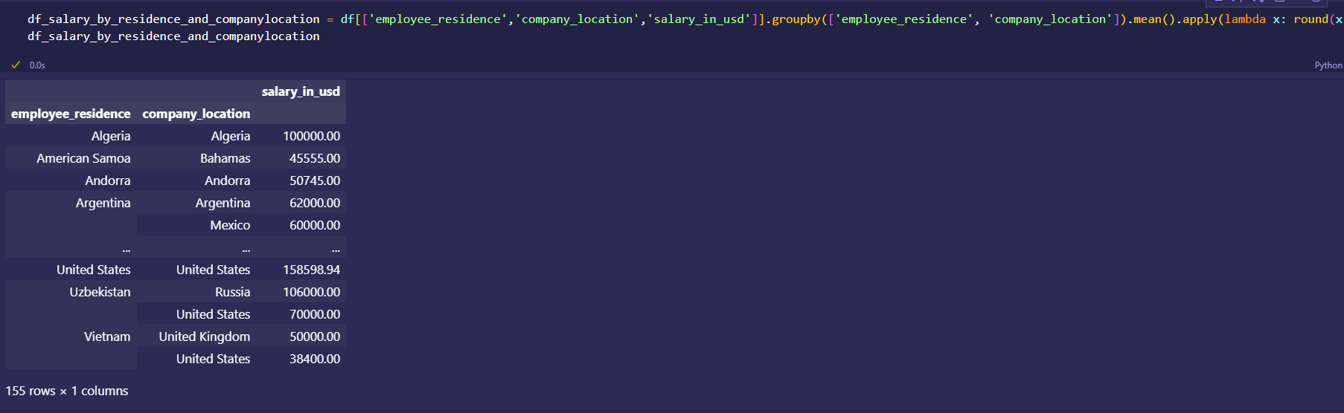
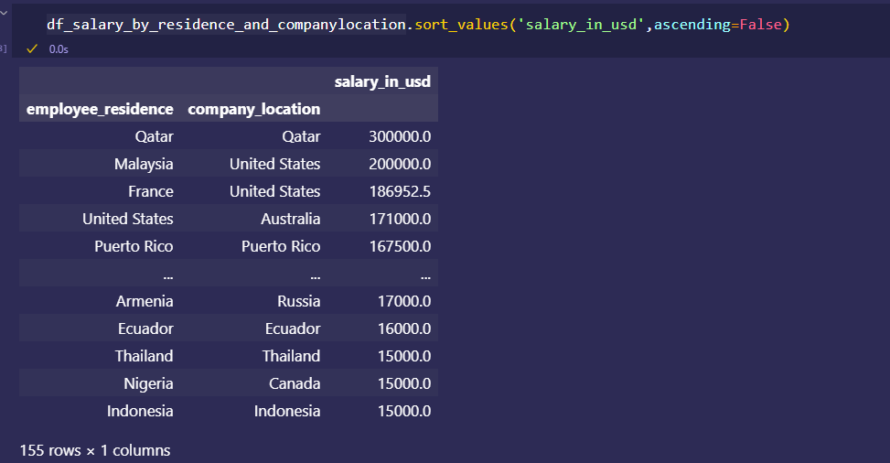
Average salary based on residence and company location

Slide 14
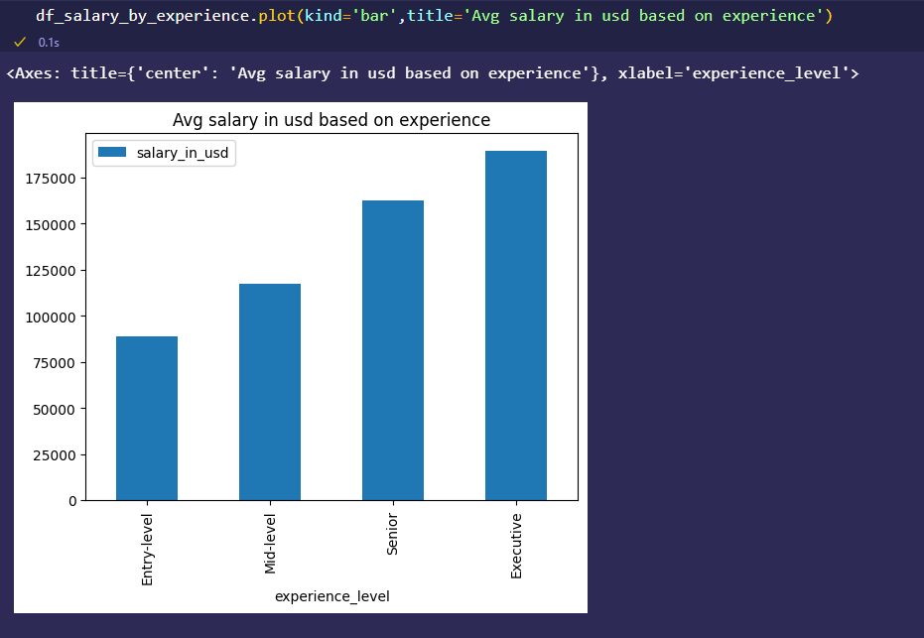
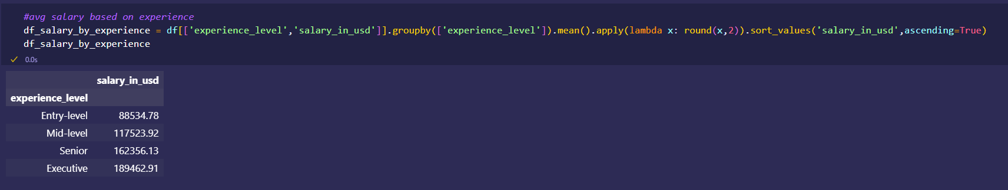
Average salary based on experience level

Slide 15
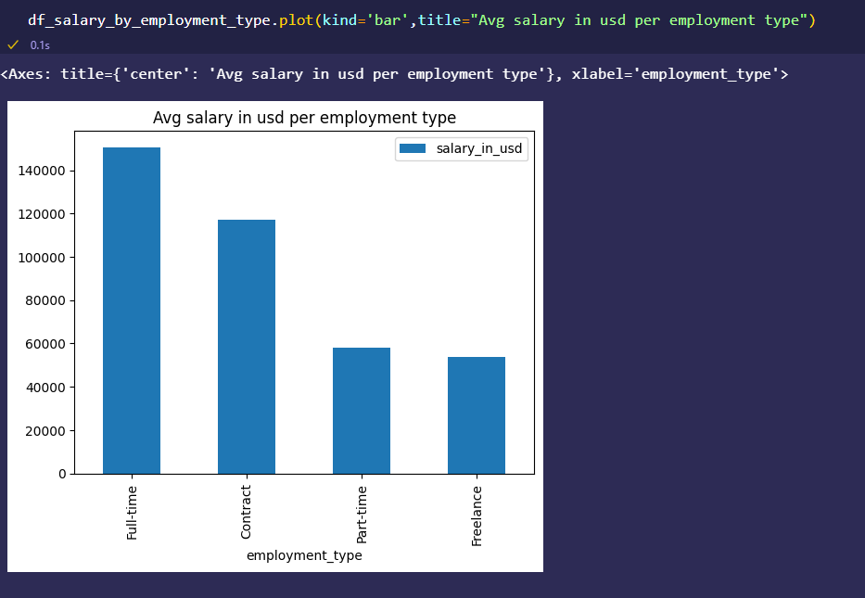
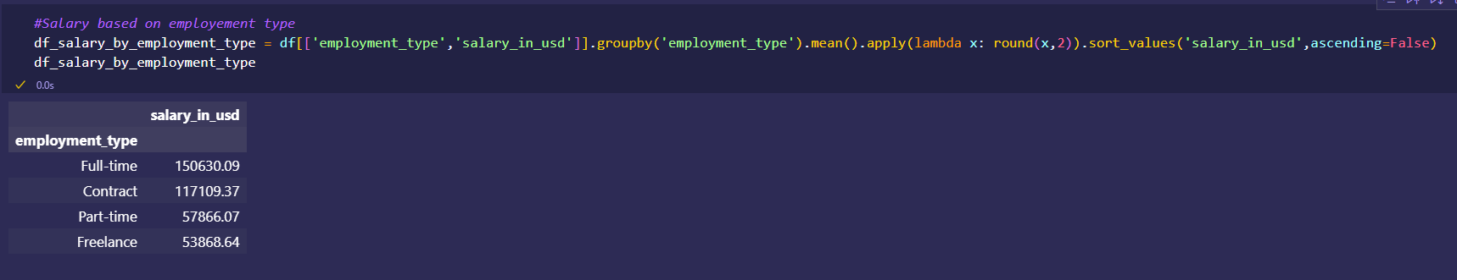
Average salary based on employment type

Slide 16
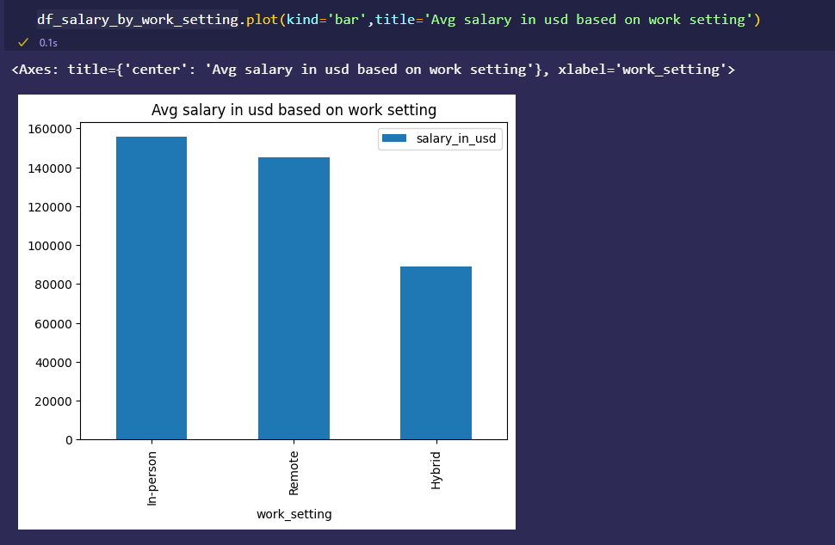
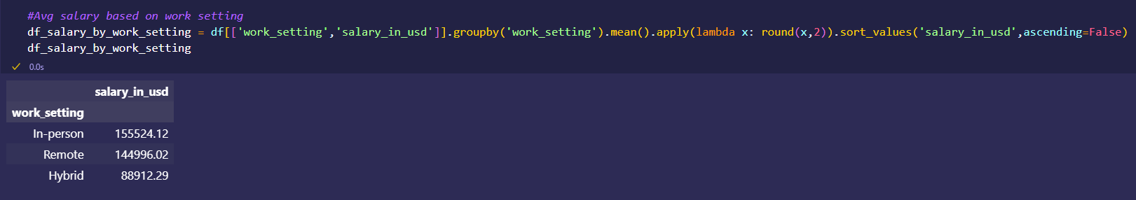
Average salary based on work setting

Slide 17
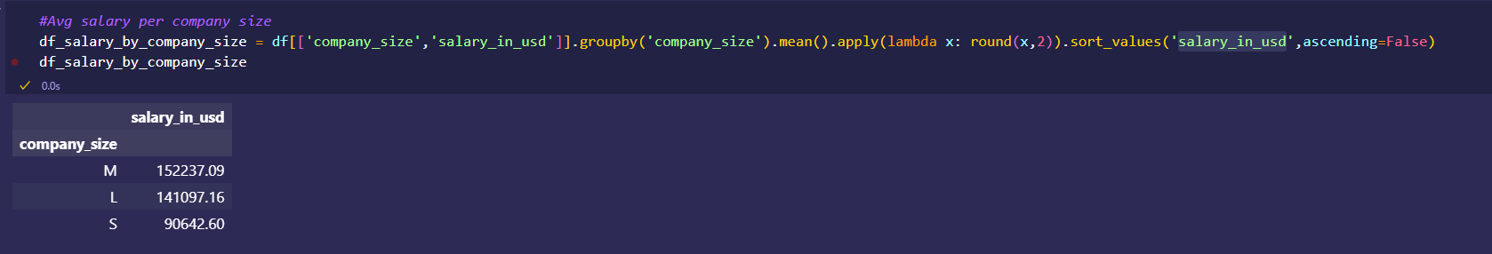
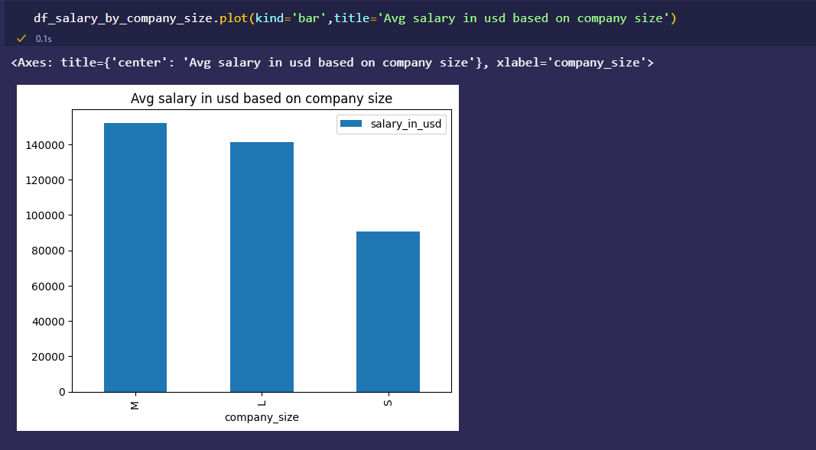
Average salary based on company size

Slide 18
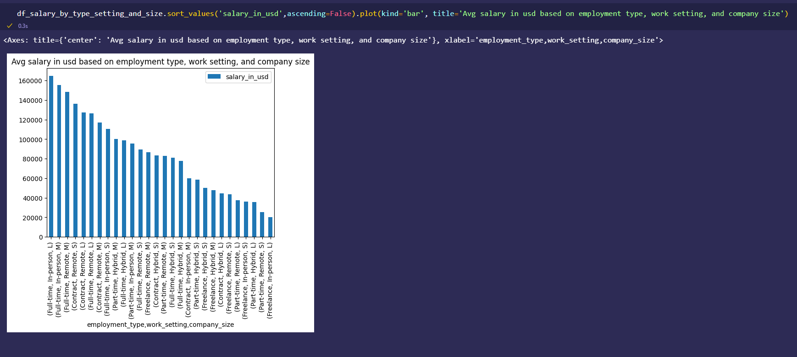
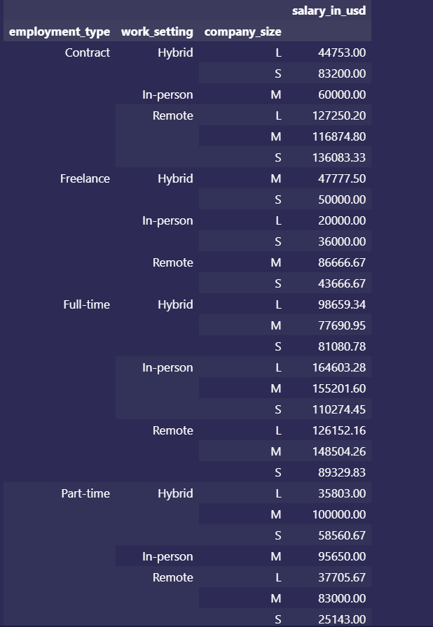
Average salary based on employment type, work setting, and company size

