Slide 1
PROJECT · FAKE NEWS DETECTION · IE MBDS-PT
Multi-Agent Fake News
Detection
A CrewAI multi-agent pipeline for automated news verification.
CrewAI · Qwen2.5:3b · WELFake Dataset · RoBERTa Classifier
TEAM MEMBERS
Luis Guareschi
Asier Ugarteche Perez
Alejandro Gutierrez Werner
Course · Generative AI & Intelligent Agents
Instructor · Dr. Manero
Deliverable · Group Practice III
FINAL
Gen AI & Agents · IE University · 2026
Notes:
ALE Opening. Good morning. We are Luis, Asier, and Alejandro. Our project is a multi-agent fake news detection system, built on CrewAI with a local Qwen2.5:3b model and evaluated against the WELFake dataset. The headline result is 90% accuracy, but the more interesting story is what that number does and doesn't mean. We will walk through the problem, the architecture, our results, and the engineering and methodological caveats we hit along the way.

Slide 2
SECTION 01
Problem & Objective
THE CHALLENGE
Fake news spreads six times faster than real news. Manual fact-checking cannot scale to millions of articles per day, and single-model classifiers miss the nuance, context, and bias that often reveal fabrications.
OUR APPROACH
DATASET
Four specialized CrewAI agents, each with a distinct role.
Claim extraction, fact-checking, bias detection, and a final verdict.
A RoBERTa classifier acts as a supporting signal for the Judge agent.
Deterministic Python scoring removes LLM arithmetic from the loop.
SOURCE
WELFake
SIZE
100 balanced articles
BALANCE
50 REAL · 50 FAKE
COVERAGE
US political news, 2015 to 2017
PURPOSE
Evaluation only
Gen AI & Agents · IE University · 2026 02 / 11
Notes:
ALE The problem. Fake news spreads roughly six times faster than real news online, and manual fact-checking simply does not scale. A single classifier model misses what humans pick up on instinctively: tone, framing, and how a piece of writing positions itself. Our approach uses four specialized CrewAI agents, each handling one part of that judgement. Claim extraction, fact-checking against external sources, bias detection, and a final judge that combines the signals. We also pulled all numerical scoring out of the LLM and into deterministic Python, which we will come back to. For evaluation we used WELFake, 100 balanced articles from US political news between 2015 and 2017.

Slide 3
SECTION 02
System Architecture
A sequential four-agent pipeline.
INPUT
→
AGENT 1
→
AGENT 2
→
AGENT 3
→
AGENT 4
Article Text
Claim Extractor
Fact Checker
Bias Detector
Judge
from dataset
3 to 5 factual claims
SUPPORTED / CONTRADICTED
bias_score + tone flags
REAL / FAKE + confidence
VERDICT FORMULA
combined = fact_signal × 0.60 + bias_signal × 0.35 + roberta_signal × 0.05
Why sequential rather than parallel. The bias detector is fast and has no tools, so running it in parallel with the fact-checker saves little wall-clock time. Concurrent logs would have made the tool-use and output_pydantic issues substantially harder to debug.
Gen AI & Agents · IE University · 2026 03 / 11
Notes:
ALE Architecture walkthrough. An article enters the pipeline and the Claim Extractor produces three to five factual claims worth verifying. The Fact Checker takes each claim and searches Wikipedia and DuckDuckGo, returning supported or contradicted. The Bias Detector reads the original text and produces a bias score and tone flags, no external tools. The Judge combines those signals and emits a real or fake verdict with a confidence score. The verdict formula weights fact-checking at 60%, bias at 35%, and the RoBERTa supporting signal at 5%. Crucially, the arithmetic happens in Python, not in the LLM, which guarantees reproducibility. On sequencing: we deliberately chose sequential over parallel. The bias detector is fast because it has no tools, so running it concurrently with fact-checking saves very little wall-clock time. Concurrent logs would have made debugging the tool-use issues substantially harder, which we can talk about next.

Slide 4
SECTION 03
Tech Stack & Tools
FRAMEWORK
LLM
SEARCH TOOLS
CrewAI
Qwen2.5:3b · Ollama
Wikipedia + DDG
Orchestration framework for multi-agent workflows, with a sequential pipeline and built-in task delegation.
Local inference via the Ollama chat endpoint. The smaller model overthinks less and gave the best accuracy and cost tradeoff.
Fact-checker retrieval stack. Provides real-time evidence against each factual claim the extractor surfaces.
CLASSIFIER
SCORING
DATASET
RoBERTa
Python · _compute_verdict()
WELFake
hamzab/roberta-fake-news-classification via the HuggingFace API. A supporting signal weighted at five percent in the final verdict.
All arithmetic is extracted from the LLM into a deterministic Python function, which guarantees reproducibility.
One hundred balanced articles, fifty REAL and fifty FAKE, sampled from US political news between 2015 and 2017.
Gen AI & Agents · IE University · 2026 04 / 11
Notes:
LUIS Tech stack. I'll keep this brief because the choices make sense. CrewAI handles orchestration, with sequential pipeline and built-in delegation between agents. For the LLM we used Qwen2.5:3b running locally through Ollama; the smaller model gave better results than 7b, which we will explain when we get to caveats. Wikipedia and DuckDuckGo provide fact-checker retrieval. RoBERTa, specifically the hamzab fake news classifier on HuggingFace, gives us a small supporting signal. All scoring lives in a Python function called _compute_verdict, which guarantees reproducibility. The dataset is WELFake, 100 balanced articles for evaluation only, no fine-tuning.

Slide 5
SECTION 04
Key Engineering Challenges
01
output_pydantic causes agents to skip tool calls
Setting output_pydantic makes the agent jump to JSON without searching.
Fix: split into a search-only task, then a verdict task that uses the result as context.
02
Local models are unreliable at tool calling
Qwen2.5:3b emits tool parameters as plain text, which CrewAI cannot execute.
Fix: use the OpenAI API for real-time search, or call tools directly from Python.
03
Non-deterministic scoring from the Judge agent
Letting the LLM compute final confidence produced different results on identical inputs.
Fix: extract all arithmetic to _compute_verdict in Python; the agent only narrates.
Gen AI & Agents · IE University · 2026 05 / 11
Notes:
LUIS Three engineering challenges, each with a structural fix. ONE. output_pydantic causes agents to skip tool calls. Setting output_pydantic makes the agent jump straight to JSON, skipping any Wikipedia or DuckDuckGo searches. The fix is to split into a search-only task without a schema, then a verdict task with a schema that uses the search result as context. One caveat worth flagging: this fixes the structural bug but not the epistemic one. Local models still invent plausible-looking sources when real evidence is thin, including fabricated URLs and snippets that quote the article back to itself. TWO. Local models are unreliable at tool calling. Qwen2.5:3b outputs tool parameters as plain text rather than structured function calls, which CrewAI cannot parse or execute. The framework requires OpenAI-style function calling. For pipelines that depend on real-time web searches, use the OpenAI API or call tools directly from Python. THREE. Non-deterministic scoring from the Judge agent. Letting the Judge LLM compute the final confidence score produced inconsistent results on identical inputs. The solution was to extract all arithmetic to a Python function called _compute_verdict. The agent now receives pre-computed values and only writes the human-readable explanation.

Slide 6
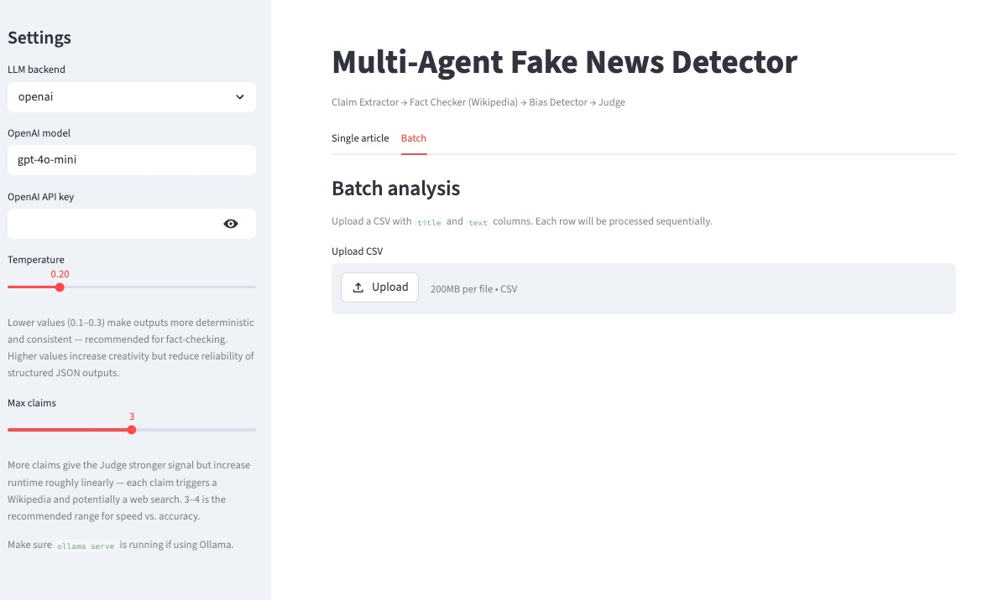
SECTION 05
Agent Interface
Gen AI & Agents · IE University · 2026 06 / 11
Notes:
LUIS Interface was built to handle both batch and single article analysis. We integrated backend LLM flexibility for both local and API models. A temperature level helps to give flexibility to the interpretations, and the Max claims help to set how deep you want to check the results.

Slide 7
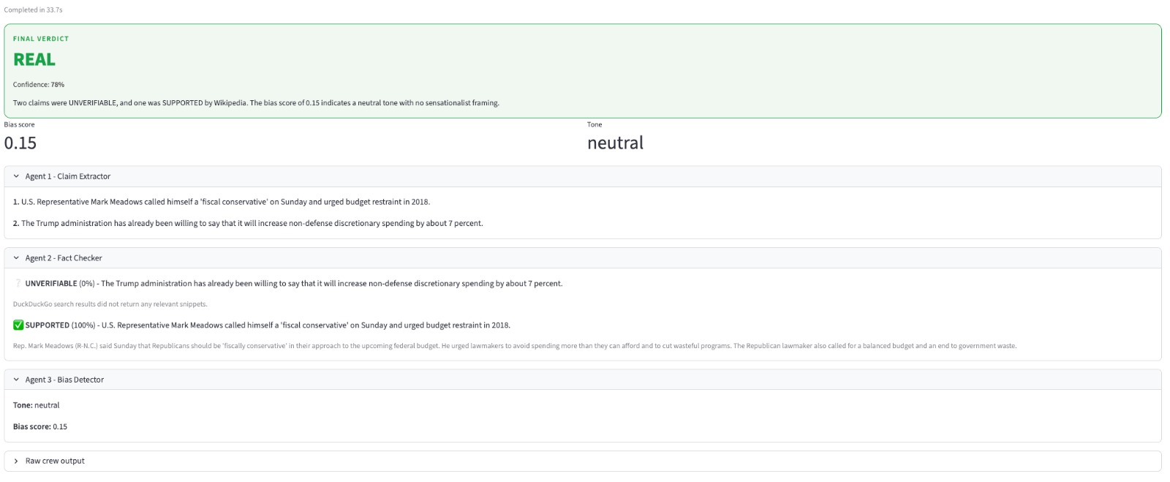
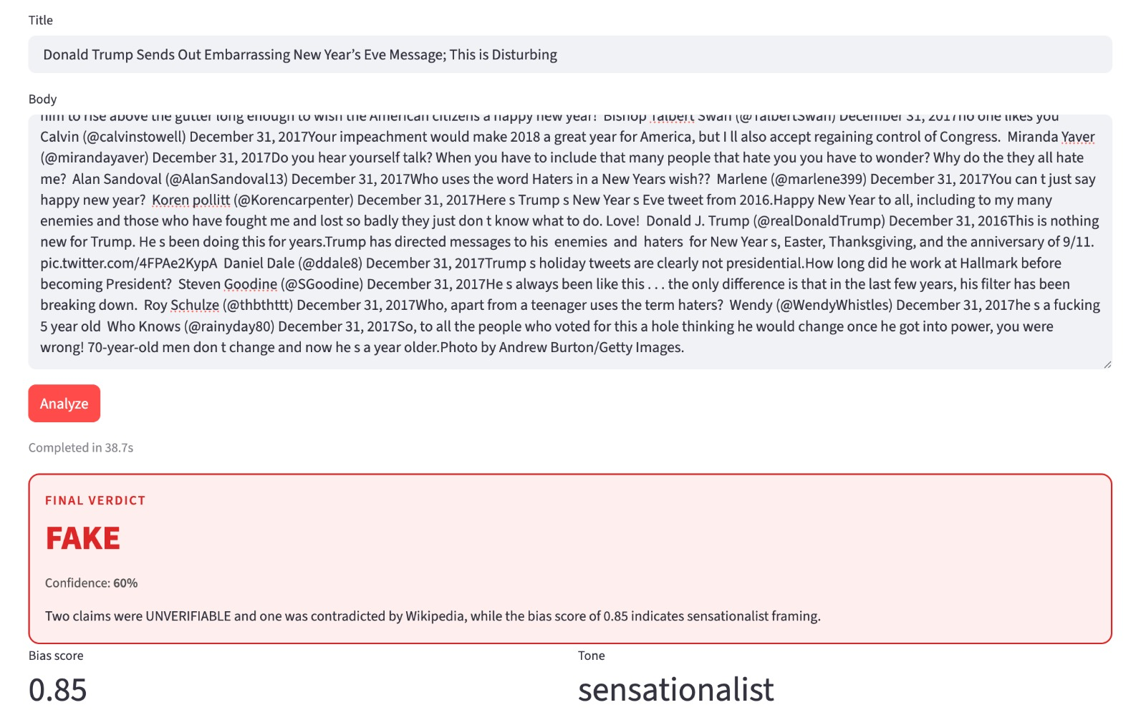
SECTION 05
Agent Outputs Real/Fake
Gen AI & Agents · IE University · 2026 07 / 11
Notes:
LUIS The agent outputs return each level of agent response, from the Claims Extractor Agent all the way to the judge, we can observe how the determinations are made. Fact verification, Bias, & Tone are all made available.

Slide 8
SECTION 05
Results Qwen2.5:3b on 100 articles
Temperature = 0.20 · Max Claims = 3
90%
0.90
0.86
~43s
ACCURACY
F1-SCORE
AVG. CONFIDENCE
PER-ARTICLE LATENCY
CONFUSION MATRIX
PER-CLASS PERFORMANCE
 | PRED REAL | PRED FAKE
TRUE REAL | 48 | 2
TRUE FAKE | 8 | 42
REAL
PRECISION
RECALL
F1
86%
96%
0.91
FAKE
PRECISION
RECALL
F1
96%
84%
0.89
TP = true positive · FP = false positive · FN = false negative · TN = true negative
Gen AI & Agents · IE University · 2026 08 / 11
Notes:
ASIER Results, on the headline numbers. On 100 articles we get 90% accuracy, 0.90 F1, average confidence of 0.86, and roughly 43 seconds per article. The confusion matrix is fairly balanced. On REAL articles we got 48 right and missed 2, recall of 96%, precision 86%. On FAKE we got 42 right and missed 8, so recall is 84% and precision 96%. The asymmetry is interesting: the system is good at identifying real news and conservative when it labels something as fake. Per-class F1 is 0.91 for REAL, 0.89 for FAKE. These are strong numbers, but I want to spend the next slide explaining why they don't tell the full story.

Slide 9
SECTION 06
Why 90% doesn't tell the full story
CAUTION
WELFake covers US political news from 2015 to 2017, which is data the model almost certainly memorized during pretraining. Treat the 90% as an upper bound on contaminated data, not real-world performance.
Training data leakage
Wikipedia search adds noise
WELFake's 2015 to 2017 articles were almost certainly in pretraining; the model is recognizing, not generalizing.
When the answer is already memorized, retrieved context conflicts with internal knowledge and sometimes makes verdicts worse.
Smaller model overthinks less
No clean post-2024 dataset
Qwen2.5:3b beat 7b not because it is smarter, but because it pattern-matches without hedging itself out of the right answer.
The obvious Kaggle alternative turned out to be synthetic, template-generated articles. A truly held-out test set is hard to build.
Gen AI & Agents · IE University · 2026 09 / 11
Notes:
ASIER The 90% accuracy is misleading and we want to flag four reasons before we move on. ONE. Training data leakage. The model pattern-matches to articles it already knows from pretraining. High accuracy on WELFake is not real generalization, it is memorization. A truly robust evaluation requires post-cutoff data the model has never seen. TWO. Wikipedia search adds noise. When the model already has the answer baked in from training, retrieved search results introduce conflicting or redundant context. The model tries to reconcile its internal knowledge with the retrieved text and sometimes produces worse verdicts. THREE. Smaller model overthinks less. Qwen2.5:3b outperformed Qwen2.5:7b on this dataset. Not because it is smarter, but because the 3b model pattern-matches quickly to salient features. The 7b model considers counterarguments, hedges, and talks itself out of the correct answer. FOUR. No clean post-2024 dataset exists. The algozee/fake-news Kaggle dataset turned out to contain synthetic template-generated articles rather than real news, making it useless for evaluation. Credible testing requires a held-out post-cutoff set, which is very hard to build. Bottom line, treat the 90% as an upper bound on contaminated data, not real-world performance.

Slide 10
SECTION 07
Key Lessons Learned
01
Use Python for arithmetic, not LLMs
02
Split search and synthesis into two tasks
Never let an agent decide a numerical score. Extract scoring to _compute_verdict() in Python for guaranteed reproducibility, and let the LLM produce only the human-readable explanation.
output_pydantic on a search task makes agents skip tool calls entirely. Use one task to search with plain text output, then a separate task to produce structured output from the search results.
03
Bias signal is the most reliable feature
04
Know when to break out of the framework
When tool calling fails on local models, the Bias Detector carries most of the weight. Fake news tends to use inflammatory language and one-sided framing that the model detects reliably without any web access.
CrewAI is a good abstraction when the model's judgement is the value being captured. Extract to Python when a step is just computation. The two-crew split here is a symptom of CrewAI lacking deterministic-step nodes; LangGraph or a hand-rolled orchestration loop fits this shape more naturally.
Gen AI & Agents · IE University · 2026 10 / 11
Notes:
ASIER Four lessons that generalize beyond this project. ONE. Use Python for arithmetic, not LLMs. Never let an agent decide a numerical score. Extract scoring to a Python function for guaranteed reproducibility, and let the LLM only produce the human-readable explanation. TWO. Split search and synthesis into two tasks. output_pydantic on a search task makes agents skip tool calls entirely. Use one task to search with plain text output, then a separate task to produce structured output from those results. THREE. Bias signal is the most reliable feature. When tool calling fails on local models, the Bias Detector carries most of the weight. Fake news tends to use inflammatory language and one-sided framing that the model detects reliably without any web access. FOUR. Know when to break out of the framework. CrewAI is a good abstraction when the model's judgement is the value being captured. Extract to Python when a step is just computation. The two-crew split here is a symptom of CrewAI lacking deterministic-step nodes; LangGraph or a hand-rolled orchestration loop fits this shape more naturally.

Slide 11
SECTION 08
Conclusions
WHAT WORKED
WHAT DIDN'T
FUTURE WORK
What Worked
What Didn't
Future Work
A four-agent pipeline with deterministic Python scoring. Bias detection as a reliable fallback. RoBERTa as a lightweight check.
90% accuracy on WELFake from a free, local 3b model.
Local model tool calling is fragile.
Dataset leakage inflates the metric.
The 3b model wins for the wrong reasons.
Confidence is uncalibrated: high-confidence wrong predictions appear in the test set.
Build a post-cutoff evaluation set.
Move to OpenAI for reliable tool use.
Parallelize agents 2 and 3 to cut latency.
Recalibrate confidence and revisit RoBERTa's 5% weight.
Gen AI & Agents · IE University · 2026 11 / 11
Notes:
ALE: To wrap up, three buckets: what worked, what didn't, and where this goes next. ALE: WHAT WORKED. A sequential four-agent pipeline with deterministic Python scoring via _compute_verdict. Bias detection turned out to be a reliable fallback when tool calling failed. RoBERTa contributed as a lightweight supporting signal. The system reaches 90% accuracy on WELFake using a free, local 3b model. LUIS: WHAT DIDN'T. Local model tool calling is fragile: Qwen outputs plain text instead of structured function calls. Dataset leakage inflates the headline metric. The 3b model wins for the wrong reasons, relying on fast pattern matching over memorized data rather than genuine reasoning. Confidence is poorly calibrated: several incorrect predictions were issued at 0.93 and above, for example articles 43702 and 34392. The reported confidence reflects internal signal agreement, not a calibrated probability of correctness. ASIER: FUTURE WORK. First, build a post-cutoff evaluation dataset for uncontaminated testing. Second, use an OpenAI backend for reliable tool use. Third, move to a parallel pipeline with agents two and three running concurrently to reduce latency. Fourth, recalibrate confidence against held-out accuracy, either via isotonic regression or coarse high, medium, and low buckets. Finally, revisit RoBERTa's five percent weight, given that it is the only component actually trained for this task. ASIER: We are happy to answer any questions.

