Slide 1
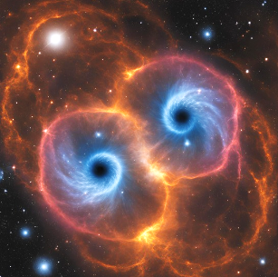
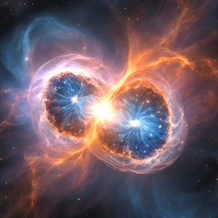
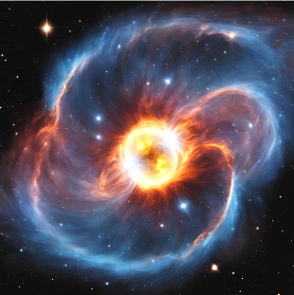
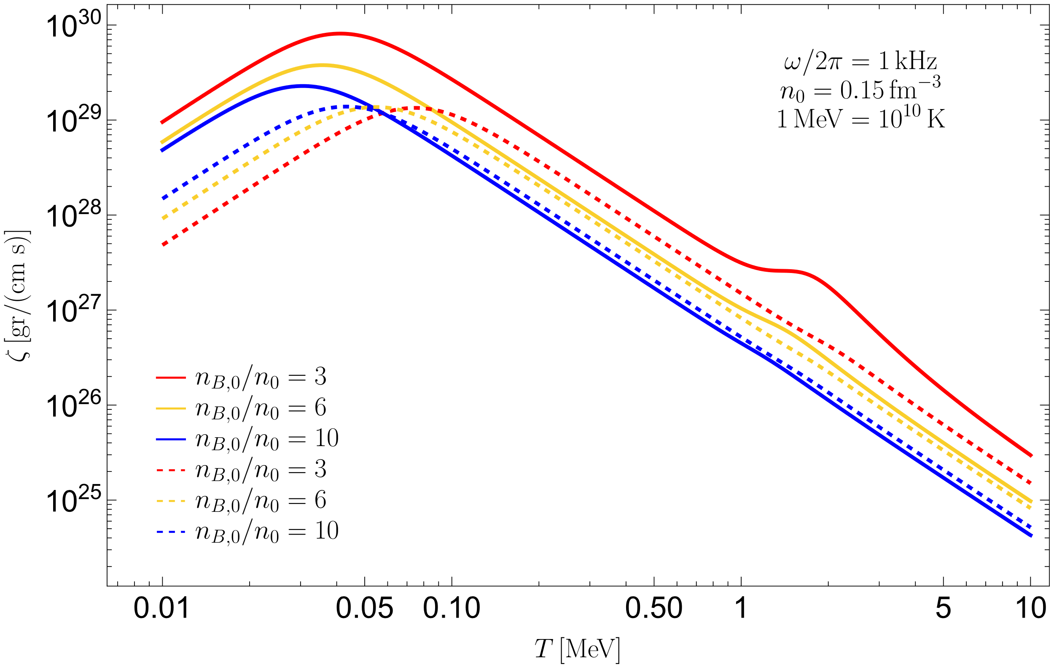
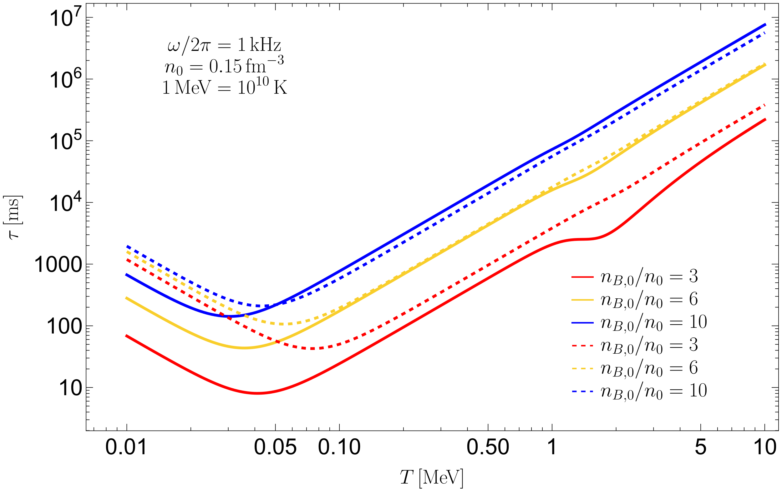




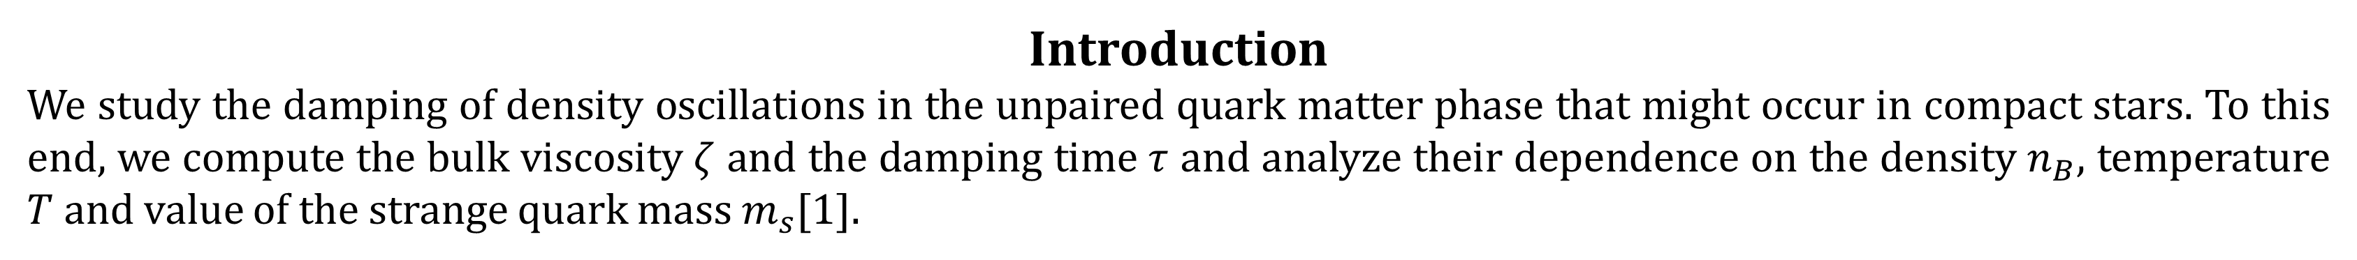


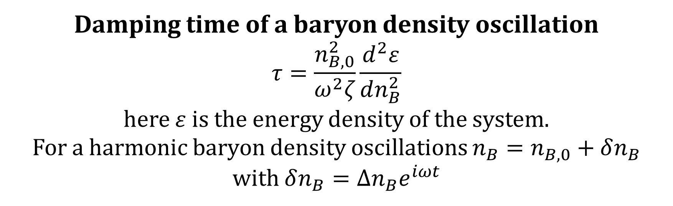

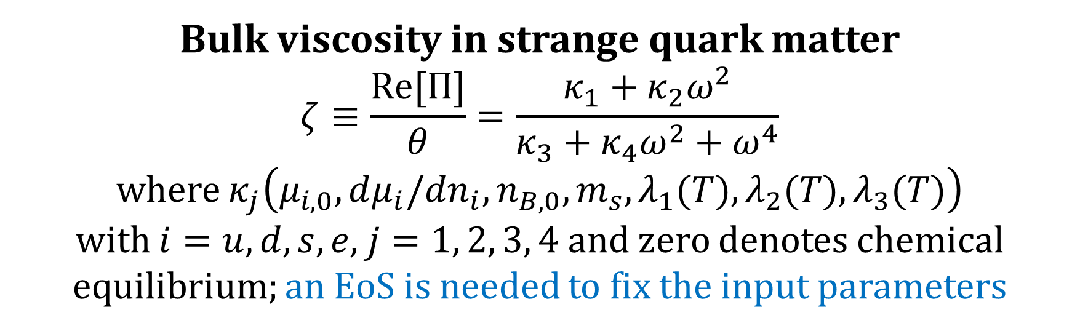

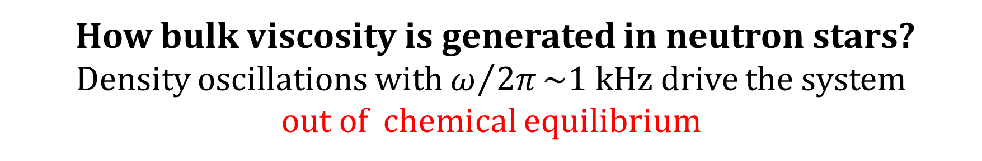


Damping of density oscillations in unpaired quark matter
J. L. Hernández^{1,2,3}, C. Manuel^{1,2} and L. Tolós^{1,2,4}
¹Institut de Ciències de L’Espai (ICE); ²Institut d’Estudis Espacials de Catalunya (IEEC); ³Universitat de Barcelona;
⁴Frankfurt Institute for Advanced Studies
Introduction
We study the damping of density oscillations in the unpaired quark matter phase that might occur in compact stars. To this end, we compute the bulk viscosity $ζ$ and the damping time $τ$ and analyze their dependence on the density $n_{B}$, temperature $T$ and value of the strange quark mass $m_{s}$[1].
$−20$ -10 0 10 20
$$t−t_{mrg}[ms]$$
Dissipation from bulk viscosity may be relevant for mergers [2]; dissipative effects could modify the GW signal generated from violent density oscillations a few milliseconds after the merger.
Neutron star mergers
Neutron star dynamics is studied using fluid elements locally neutral
$$n_{e}+\frac{1}{3}n_{s}+\frac{1}{3}n_{d}=\frac{2}{3}n_{u}$$
Weak-force processes are relevant because they occur at the timescale of mergers $($from $ms$ to $s)$
At low temperatures neutrinos escape of the star
How bulk viscosity is generated in neutron stars?
Density oscillations with $ω/{2π}\sim 1 kHz$ drive the system
out of chemical equilibrium
Detailed balance breaking induces deviations of chemical equilibrium
1. $u+s⟷u+d$
Chemical potential imbalances
$μ_{1}=μ_{s}−μ_{d}$,
$μ_{2}=μ_{s}−μ_{u}−μ_{e},$
$$μ_{3}=μ_{2}−μ_{1}$$
Source and sink terms
break the particle density conservation laws
$$∂_{μ}\left(n_{s}u^{μ}\right)=−λ_{1}μ_{1}−λ_{2}μ_{2}$$
$$∂_{μ}\left(n_{e}u^{μ}\right)=λ_{2}μ_{2}+λ_{3}μ_{3}$$
$$2. u+e^{−}⟶d+ν_{e}$$
$$3. d⟶u+e^{−}+{\overline{ν}}_{e}$$
$$4. u+e^{−}⟶s+ν_{e}$$
5. $s⟶u+e^{−}+{\overline{ν}}_{e}$
Nonequilibrium pressure $Π$
Results
Bulk viscosity in strange quark matter
$$ζ≡\frac{Re[Π]}{θ}=\frac{κ_{1}+κ_{2}ω^{2}}{κ_{3}+κ_{4}ω^{2}+ω^{4}}$$
where $κ_{j}\left(μ_{i,0},dμ_{i}/dn_{i},n_{B,0},m_{s}, λ_{1}(T),λ_{2}(T),λ_{3}(T)\right)$
with $i=u, d, s,e$, $j=1, 2, 3, 4$and zero denotes chemical equilibrium; an EoS is needed to fix the input parameters
Damping time of a baryon density oscillation
$$τ=\frac{n_{B,0}^{2}}{ω^{2}ζ}\frac{d^{2}ε}{dn_{B}^{2}}$$
here $ε$ is the energy density of the system.
For a harmonic baryon density oscillations $n_{B}=n_{B,0}+δn_{B}$
with $δn_{B}=∆n_{B}e^{iωt}$
Continuous lines: PQCD up to $𝒪(α_{s})$ with running $m_{s}$ and $α_{s}$; Dashed lines: MIT bag model with $m_{s}=150$ MeV.
Conclusions
The bulk viscosity and the damping time in quark matter strongly depend on $m_{s}$. Bulk-viscous damping might be relevant in the post-merger phase if deconfined matter is achieved in the process.
References
[1] J. L. Hernández, C. Manuel and L. Tolós, Phys. Rev. D 109, 123022, (2024)
[2] M. G. Alford, L. Bovard, M. Hanauske, L. Rezzolla, and K. Schwenzer, Phys. Rev. Lett. 120, 041101, (2018)
This work was supported by MCIN/AEI/10.13039/501100011033 and the FSE+
Contact: hernandez@ice.csic.es

