Slide 1



Microscopy Image Analysis
Hans-on Exercises
Load / Save
Dr. Luis Ibanez, Kitware
http://creativecommons.org/licenses/by/3.0/

Slide 2
© 2010 Insight Software Consortium
This presentation is Copyrighted by the ISC
This presentation is distributed under the Creative Commons Attribution License 3.0:
http://creativecommons.org/licenses/by/3.0/
You are free to Reuse
You are free to Remix
Provided that you give credit to the author

Slide 3

This presentation was created using
Open Source Software
Open Office copyright is jointly held by Sun Microsystems and Contributors.
The software is distributed under the
GNU Lesser General Public License Version 3.0.

Slide 4
Load / Save

Slide 5
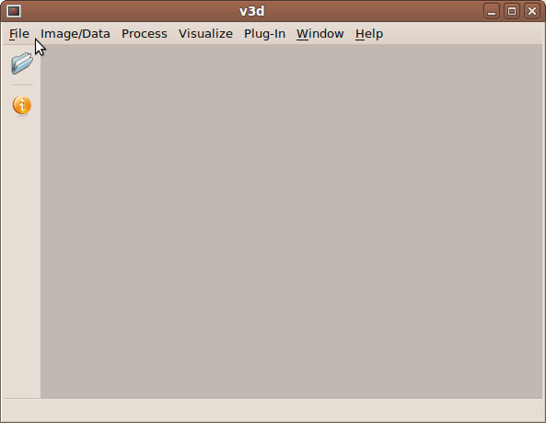
Start V3D
File Menu – Open Image Stack
or
ALT + F, O
or
CTRL+ O

Slide 7
Using V3D File Menu
TIFF
TIFF Stacks
LSM

Slide 8
Using ITK Plugins
DICOM
MetaImage
Nifti
Nrrd
VTK

Slide 9
End

