Slide 1



Microscopy Image Analysis
Hans-on Exercises
Thresholding
Dr. Luis Ibanez, Kitware
http://creativecommons.org/licenses/by/3.0/

Slide 2
© 2010 Insight Software Consortium
This presentation is Copyrighted by the ISC
This presentation is distributed under the Creative Commons Attribution License 3.0:
http://creativecommons.org/licenses/by/3.0/
You are free to Reuse
You are free to Remix
Provided that you give credit to the author

Slide 3

This presentation was created using
Open Source Software
Open Office copyright is jointly held by Sun Microsystems and Contributors.
The software is distributed under the
GNU Lesser General Public License Version 3.0.

Slide 4
Thresholding

Slide 5


V3D – ITK Plugins

Slide 6
Simple Thresholding
Output
Input

Slide 7
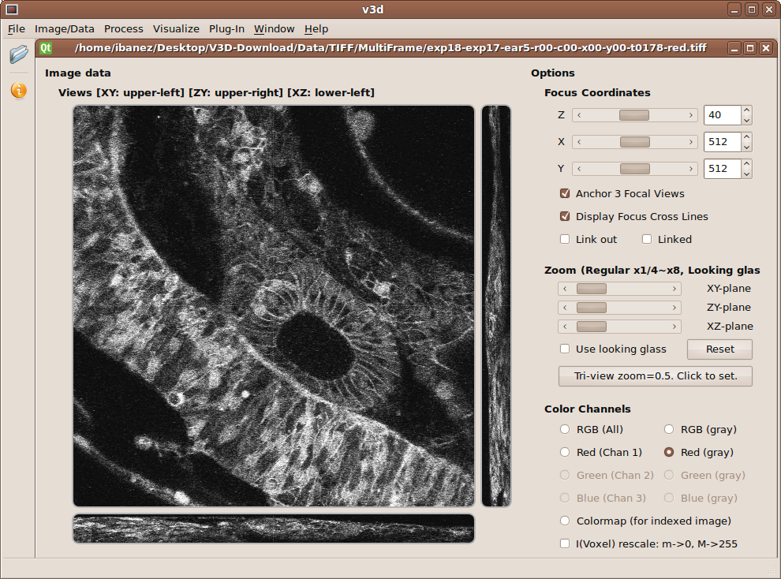

Slide 8
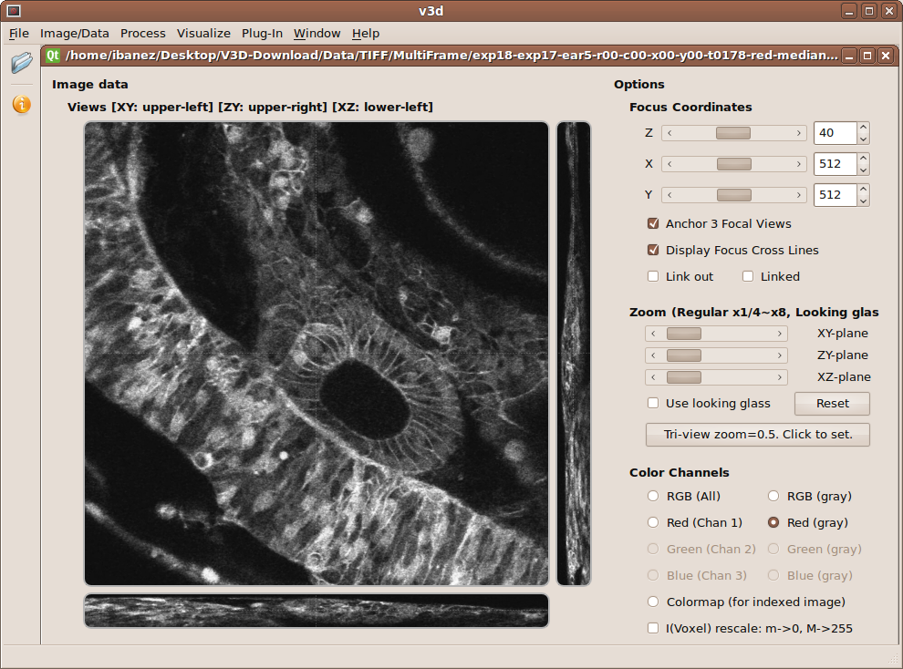

Slide 9
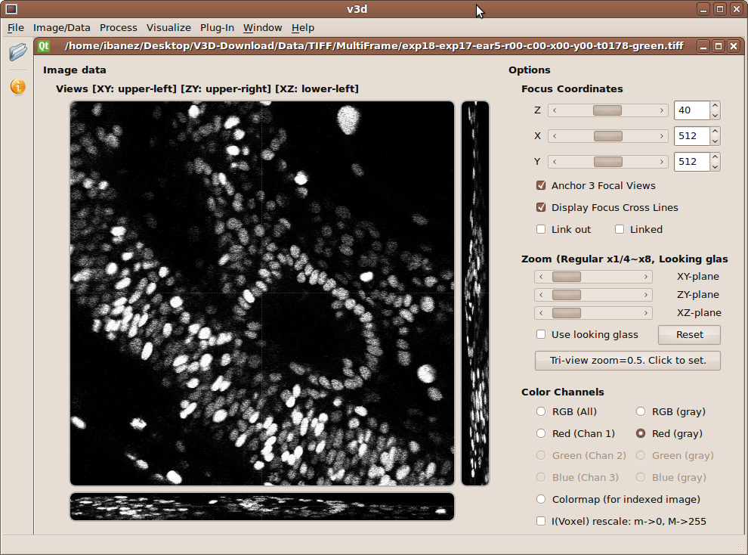

Slide 10


Slide 19
Double Thresholding
Similar to Hysteresis...

Slide 20
Double Thresholding
Output
Input

Slide 21
Double Thresholding
Output
Input

Slide 22
Double Thresholding
Output
Input

Slide 23
Double Thresholding
Mathematical Morphology
Geodesic Dilation
Output
Input

Slide 24
Double Thresholding
Mathematical Morphology
Geodesic Dilation
Output
T1
T2
T3
T4
Input

Slide 25
Double Thresholding

Slide 26
Double Thresholding

Slide 27
End

