Slide 1

Insight Toolkit
Introduction
Luis Ibáñez
William Schroeder
Insight Software Consortium

Slide 2
The best way
to learn to play the drums is…
to play the drums
Richard Feynman

Slide 3
ITK + VTK Pipeline
ITK Reader
ITK
VTK
ITK Segmentation
itk::VTKExport
vtkImport
vtkContour
vtkPolyDataMapper

Slide 4
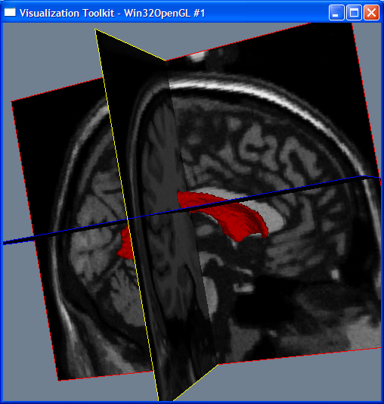
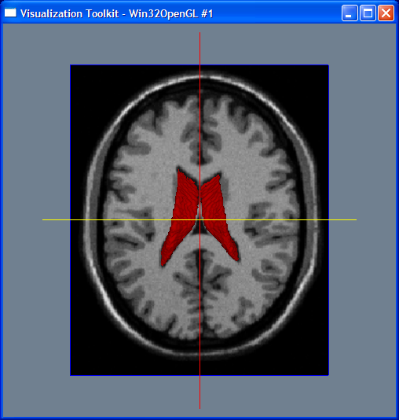
Visual Output
myProject34.exe brainweb165a10f17.mhd 80 110 95 ventricles.vtk

Slide 5
The Data Pipeline
Reader
Gaussian
Writer
Image
Image
File
File

Slide 6
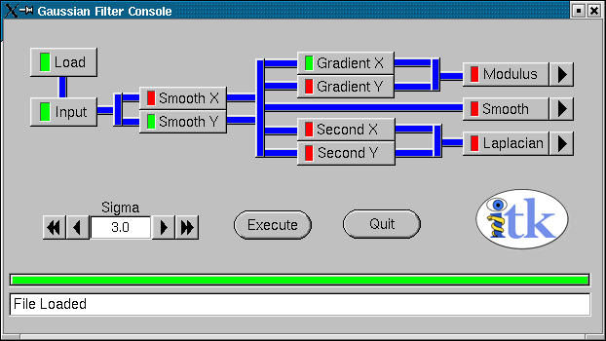
Filtering Images
Run the demo application GaussianFilter2D

Slide 7
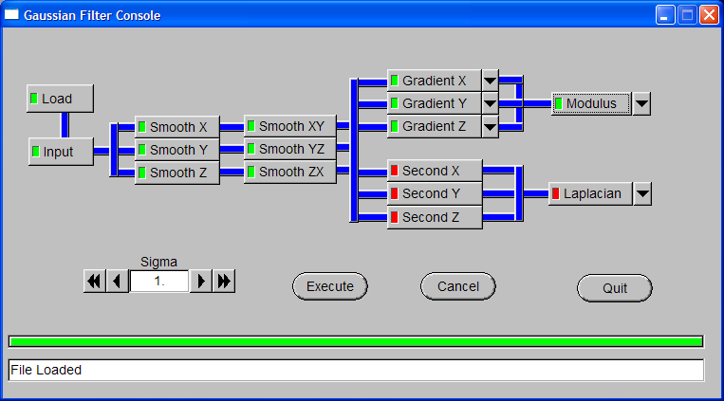
Filtering Images
Run the demo application GaussianFilter3D

Slide 8
What is ITK
Image Processing
Segmentation
Registration
No Graphical User Interface (GUI)
No Visualization

Slide 9









ITK Sponsors
The National
Institute for Dental and Craniofacial Research
The National
Science
Foundation
The National Institute of Neurological Disorders and Stroke

Slide 10














ITK Developers

Slide 11
ITK Developers
* indicates a subcontractor.

Slide 12
ITK by the Numbers
Public Investment
  $13 Million
March 2000
  First code check-in
2,040
  # of nightly builds
1,289
  tests run nightly
42
  # of platforms ( software + hardware )
1,647
  # of C++ classes
2,314
  # of files with code ( Insight / Code directory )
Numbers updated on September 29th 2007
Notes:
The number of classes was computed by taking the alphabetical page of Doxygen, exporting it to text, adding ends of line after every “html” and removing the lines containing itknamespace.
cat itkClassesList.txt | grep -v namespace > itkClassesList2.txt
grep html itkClassesList2.txt | wc
The number of files with Code was computed in the following way:
cd Insight
find Code -name "*.cxx" | wc
find Code -name "*.txx" | wc
find Code -name "*.h" | wc
and adding the three numbers

Slide 13
ITK by the Numbers
136K
  # of lines of code ( Insight / Code directory)
102K
  # of lines of test code ( Insight / Testing directory)
81.6%
  Code coverage (gcov)
27K
  # of lines of examples ( Insight / Examples directory)
114K
  # of lines of Applications (InsightApplications checkout)
328
  weekly t-cons
82
  unique developers
Numbers updated on September 29th 2007
Notes:
# of lines of Code (Insight / Code ) was computed as
sloccount Insight/Code
Total Physical Source Lines of Code (SLOC) = 141,895
# of lines of Testing (Insight / Testing ) was computed as
sloccount Insight/Testing
Total Physical Source Lines of Code (SLOC) = 102,579
# of lines of Examples (Insight/Examples) was computed as
sloccount Insight/Examples
Total Physical Source Lines of Code (SLOC) = 27,809
# of lines of Applications (Insight Applications)
sloccount InsightApplications
Total Physical Source Lines of Code (SLOC) = 114,922
Number of developers was taken from
http://www.ohloh.net/projects/3240/analyses/latest/contributors

Slide 14
ITK by the Numbers
1,380
  # of users subscribed to the mailing-list
345
  # of monthly emails in users-list (Oct’06 - Sep’07 average)
836
  # of pages in the Software Guide PDF document
15,040
  # of Software Guide PDF downloads (sourceforge)
3,393
  # of monthly hits to the URL of the ITK Software Guide
4,169
  # of Insight Applications downloads ITK 3.4 (sourceforge)
8,659
  # of source code downloads ITK 3.4 (sourceforge)
Numbers updated on September 29th 2007

Slide 15
How to Integrate ITK in you application
C++ Glue Code
GUI
{MFC,Qt,
wxWin
FLTK}
ITK
Image
Processing
Visualization
{OpenGL, VTK}

Slide 16
What do I need ?
C++ Compiler
GCC 2.95 – 4.1
Visual C++ 6.0
Visual C++ 7.0
Visual C++ 7.1
Visual C++ 8.0
Intel 7.1
Intel 8.0-9.0
IRIX CC
Borland 5.5
Mac - gcc
CMake
www.cmake.org

Slide 17
How to find what you need
http://www.itk.org/ItkSoftwareGuide.pdf
http://www.itk.org/Doxygen/html/index.html
Follow the link Alphabetical List
Follow the link Groups
Post to the insight-users mailing list

Slide 18


Slide 19
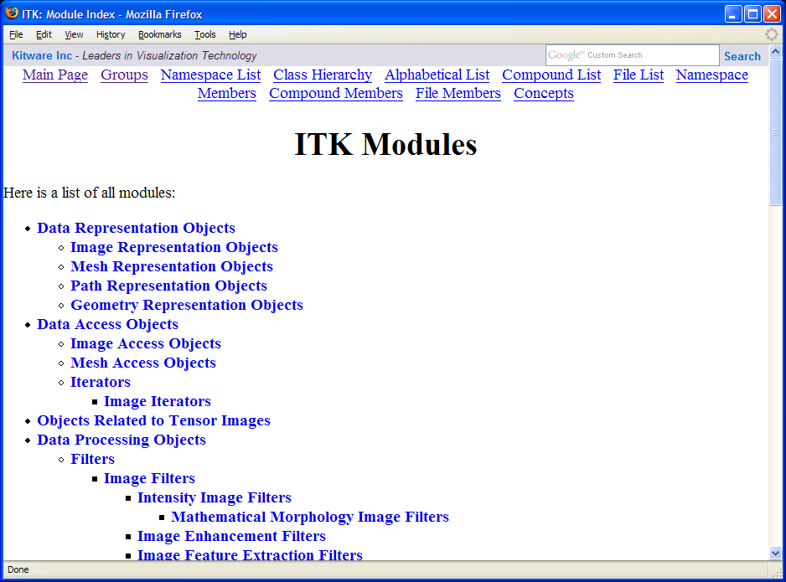

Slide 20
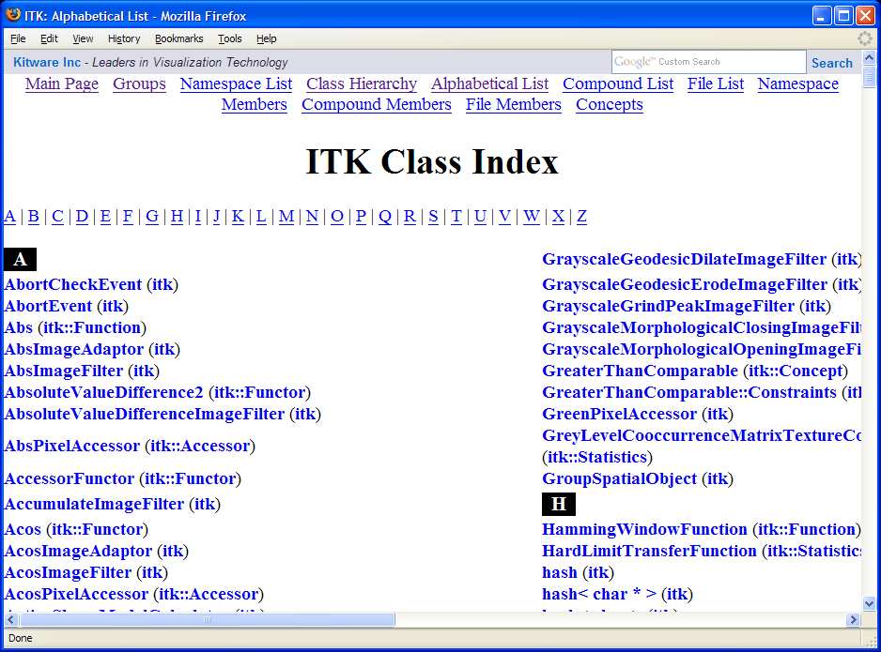

Slide 21

The ITK Software Guide is freely available as a PDF document at
www.itk.org/
ItkSoftwareGuide.pdf
Its paper version can be ordered from Amazon.com and from Kitware’s e-store.

Slide 22
ITK
Architecture

Slide 23
ITK Basics
C++ Generic Programming
Data Pipeline
Multi-threading
Streaming
Exceptions
Events / Observers
Tcl, Python and Java wrapping

Slide 24
Generic Programming
Example: STL Standard Template Library
Abstraction of Types and Behaviors
std::vector< T >
std::vector< int >
std::vector< double >
std::vector< char * >
std::vector< Point >
std::vector< Image >

Slide 25
itk::Image
itk::Image< PixelType , Dimension >
itk::Image< char , 2 >
itk::Image< char , 3 >
itk::Image< char , 4 >
itk::Image< float , 2 >
itk::Image< RGB , 3 >
itk::Image< unsigned short , 2 >
itk::Image< itk::Vector<float,2> , 2 >

Slide 26
namespaces
Avoid naming collisions
itk::
itk::Statistics::
itk::fem::
itk::fem::itpack
itk::bio

Slide 27
Your favorite keyword
typedef
typedef itk::Image< char , 2 > ImageType
typedef itk::ImageFilter< ImageType , ImageType > FilterType
otherwise...
itk::ImageFilter< Image< char , 2 > ,
Image< char , 2 > > FilterType

Slide 28
Smart Pointers
Smart
Pointer
Object
Smart
Pointer
Smart
Pointer
counter=0
counter=1
counter=2
counter=3
Self - Delete

Slide 29
SmartPointers
typedef itk::Image< char , 2 > ImageType
typedef itk::ImageFilter< ImageType , ImageType > FilterType
FilterType::Pointer filter = FilterType::New();
ImageType::Pointer image = filter->GetOutput();
Pointer notation
filter->Update();
NO NEED FOR
filter->Delete();

Slide 30
Const Correctness
Knowing constancy is Insight.
Not knowing constancy leads to disaster.
Tao Te Ching, XVI. Lao Tsu

Slide 31
Const Smart Pointers
typedef itk::Image< char , 2 > ImageType
typedef itk::ImageFilter< ImageType , ImageType > FilterType
FilterType::Pointer filter = FilterType::New();
ImageType::ConstPointer image = filter->GetOutput();
Can only invoke “const” methods
image->GetSpacing ();
Compiler error for “non-const” methods
image->SetSpacing ( spacing );

Slide 32
What is an Image ?
An Image is
a sampling of a
continuous field
using a discrete grid

Slide 33
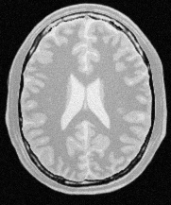
Image Origin & Spacing
Spacing (Sx)
y
x
Spacing (Sy)
Origin (Ox,Oy)

Slide 34
Image Sampling Grid
Spacing (Sx)
Spacing (Sy)
Origin (Ox,Oy)

Slide 35
Image Pixel
Spacing (Sx)
Pixel Value
Pixel Region
Spacing (Sy)
Origin (Ox,Oy)

Slide 36
Image Indices
Spacing (Sx)
[0,7]
[4,7]
Pixel Index
[0,6]
[0,5]
[0,4]
[0,3]
[0,2]
Spacing (Sy)
[0,1]
Origin (Ox,Oy)
[0,0]
[1,0]
[2,0]
[3,0]
[4,0]
[5,0]

Slide 37
Index to Physical Coordinates
Spacing (Sx)
[0,7]
[4,7]
Pixel Index
[0,6]
[0,5]
P[0] = Index[0] x Spacing[0] + Origin[0]
P[1] = Index[1] x Spacing[1] + Origin[1]
[0,4]
Index[0] = floor( ( P[0] - Origin[0] ) / Spacing[0] + 0.5 )
[0,3]
Index[1] = floor( ( P[1] - Origin[1] ) / Spacing[1] + 0.5 )
[0,2]
Spacing (Sy)
[0,1]
Origin (Ox,Oy)
[0,0]
[1,0]
[2,0]
[3,0]
[4,0]
[5,0]

Slide 38
Image Region
Spacing (Sx)
Pixel Value
Image Region
Pixel Region
Spacing (Sy)
Origin (Ox,Oy)

Slide 39
Image Region
Spacing (Sx)
Image Region
Region Size
[3,5]
Starting Index
[2,3]
Spacing (Sy)
Origin (Ox,Oy)

Slide 40
Creating an Image
typedef itk::Image< char , 3 > ImageType
ImageType::Pointer image = ImageType::New();
ImageType::SizeType size;
size[ 0 ] = 512; // x direction
size[ 1 ] = 512; // y direction
size[ 2 ] = 50; // z direction
ImageType::IndexType start;
start[ 0 ] = 0; // x direction
start[ 1 ] = 0; // y direction
start[ 2 ] = 0; // z direction

Slide 41
Creating an Image
ImageType::RegionType region;
region.SetSize( size );
region.SetIndex( start );
image->SetRegions( region );
image->Allocate();
image->FillBuffer( 0 );
ImageType::SpacingType spacing;
spacing[ 0 ] = 0.83; // x direction
spacing[ 1 ] = 0.83; // y direction
spacing[ 2 ] = 2.15; // z direction
image->SetSpacing( spacing );

Slide 42
Exercise 3

Slide 43
Streaming
Processing Large Images
Input
Image
Output
Image
Filter

Slide 44
Image Regions
LargestPossibleRegion
BufferedRegion
RequestedRegion

Slide 45
Data Pipeline
Image
Filter
Image
Filter
Image
Image
Filter
Image

Slide 46
Simple Image IO
Image
File
ImageFileReader
Image
Filter
Image
File
ImageFileWriter
Image

Slide 47
Simple Image IO
Image
File
ImageFileReader
Image
PNGImageIO
MetaImageIO
AnalyzeImageIO
GIPLImageIO
VTKImageIO
DICOMImageIO
CustomImageIO
Loadable Factories

Slide 48
Simple Image IO
#include “itkImage.h”
#include “itkImageFileReader.h”
#include “itkImageFileWriter.h”
typedef itk::Image< char , 2 > ImageType;
typedef itk::ImageFileReader< ImageType > ReaderType;
typedef itk::ImageFileWriter< ImageType > WriterType;
ReaderType::Pointer reader = ReaderType::New();
WriterType::Pointer writer = WriterType::New();
reader->SetFileName( “inputImage.dcm” ); // DICOM
writer->SetFileName( “outputImage.hdr” ); // Analyze
writer->SetInput( reader->GetOutput() );
writer->Update();

Slide 49
Exceptions
Error Management
Application Layer
ITK Layer

Slide 50
Exceptions
try
{
filter->Update();
}
catch( itk::ExceptionObject & exp )
{
std::cout << exp << std::endl;
}

Slide 51
Exercise 4
Image
File
ImageFileReader
Filter
Image
File
Caster
ImageFileWriter

Slide 52
Events and Observers
Itk::Command
Itk::Object
Event
itk::Command
Event
Event
itk::Command
Event
itk::Command
Event
itk::Command

Slide 53
Events and Observers
Common Events
AnyEvent()
StartEvent()
EndEvent()
ProgressEvent()
IterationEvent()

Slide 54
Events and Observers
Itk::Object
Itk::Command
Itk::ProcessObject
MyCommand
Execute()
Itk::FilterXY
AnyEvent
AddObserver( )
MyEvent

Slide 55
Events and Observers
Itk::Object
Itk::Command
Itk::SimpleMemberCommand
Itk::ProcessObject
AnyEvent
MyEvent
MyClass
Itk::FilterXY
MethodX()
AddObserver( )

Slide 56
Exercise 5
Image File
ImageFileReader
Filter
ProgressEvent()
StartEvent()
EndEvent()
ImageFileWriter
CommandObserver
Image File
Execute()

Slide 57
GUI Communication
GUI Layer
Widget
Widget
Observer
Command
Callback
ITK Layer
FilterX
FilterX

Slide 58
Enjoy ITK !

