Slide 1

ITK Segmentation Methods
Luis Ibáñez
William Schroeder
Insight Software Consortium

Slide 2
Overview
Obtaining Data from Medical Repositories
  Reading license
  Visualization
Segmentation Methods Overview
  Selecting a method
  Implementing an application
  Finding parameters
Submitting to the Insight Journal

Slide 3
Obtaining Data
MIDAS - Kitware
  http://insight-journal.org/dspace/
Brain Web
  http://www.bic.mni.mcgill.ca/brainweb/
IBSR Internet Brain Segmentation Repository
  http://www.cma.mgh.harvard.edu/ibsr/

Slide 4
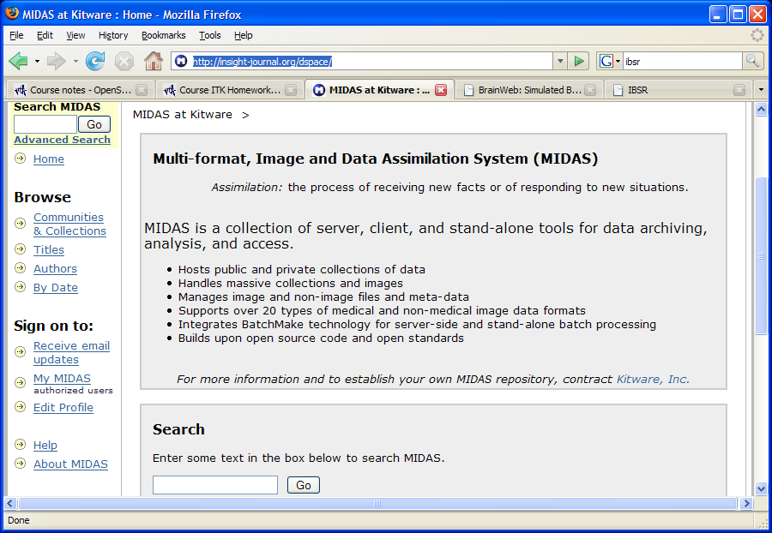
MIDAS Repository

Slide 5

MIDAS Repository

Slide 6
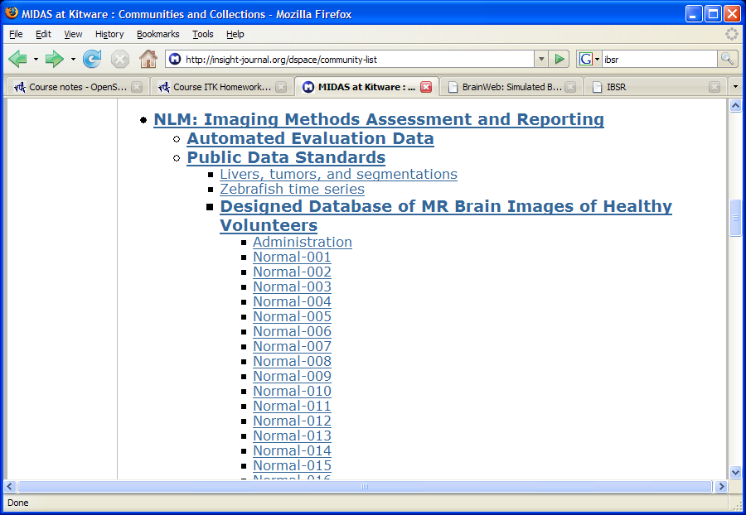
MIDAS Repository

Slide 7
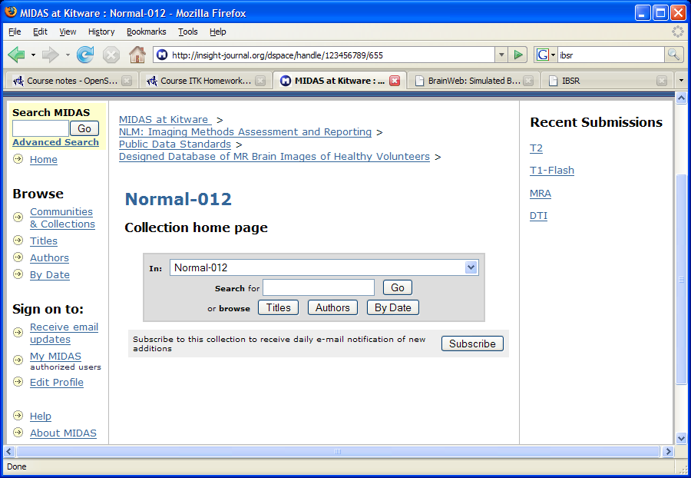
MIDAS Repository

Slide 8
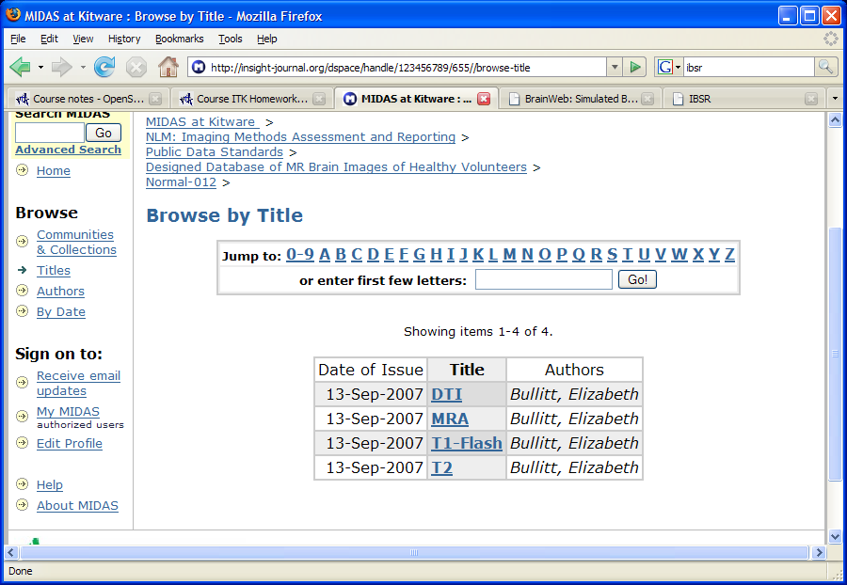
MIDAS Repository

Slide 9
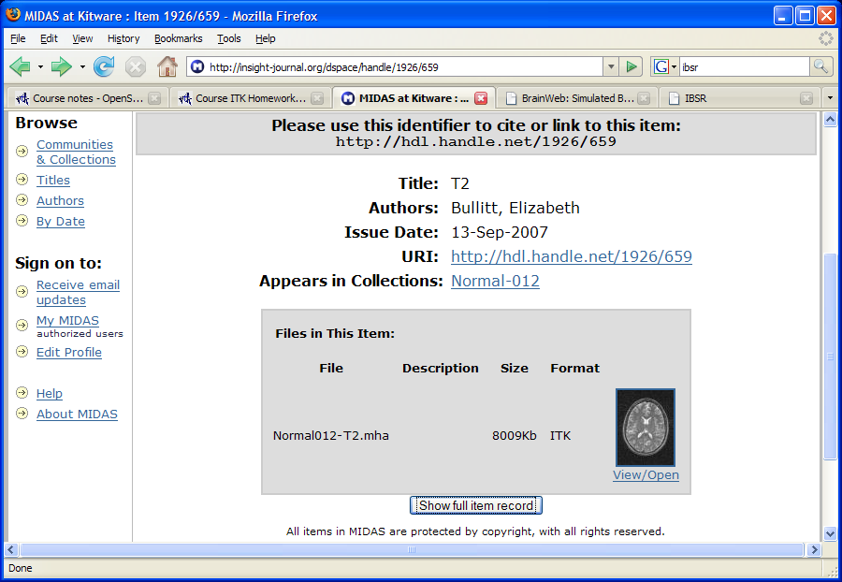
MIDAS Repository

Slide 10
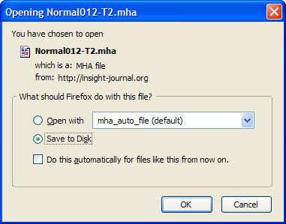
MIDAS Repository

Slide 11
Visualizing the Data

Slide 12
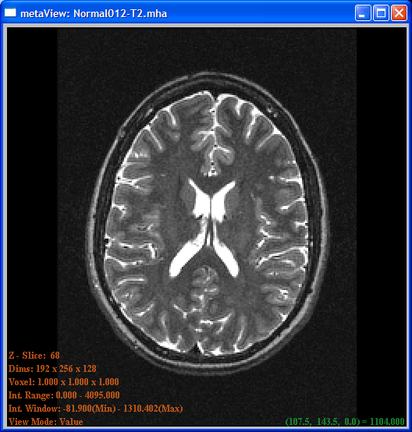
Visualizing the Data: ImageViewer
> Next Slice
< Previous Slice
h Help
0 View along X
1 View along Y
2 View along Z
+ Zoom in
- Zoom out
q,w Max Intensity
a,s Min Intensity
r Reset
ImageViewer.exe Normal012-T2.mha

Slide 13
Visualizing the Data: ParaView
Decompressing the Data
Reader
Writer
File
File
Insight / Examples / IO / ImageReadWrite.cxx
Change dimension from 2D to 3D
ImageReadWrite.exe Normal012-T2.mha Normal012-T2.mhd

Slide 14
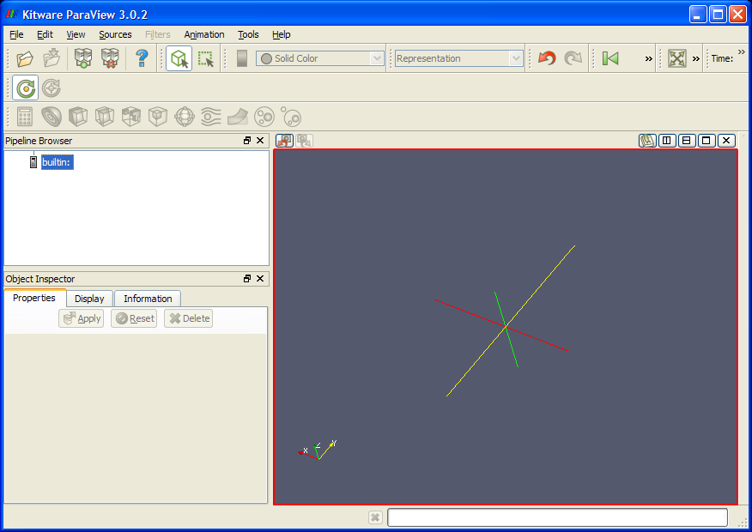
Visualizing the Data: ParaView

Slide 15
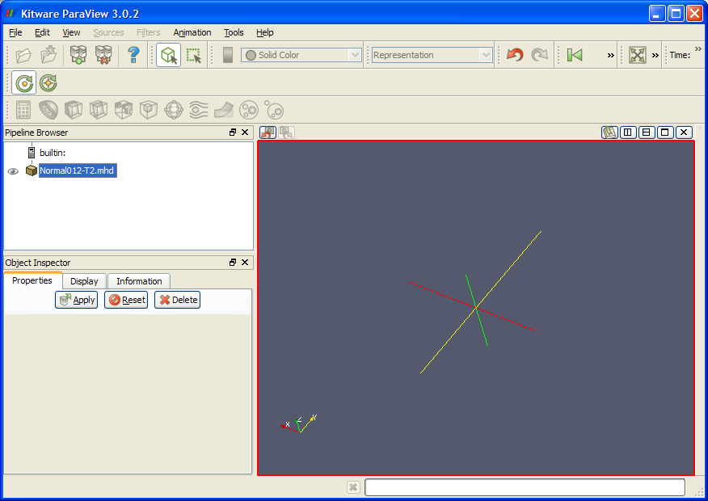
Visualizing the Data: ParaView

Slide 16
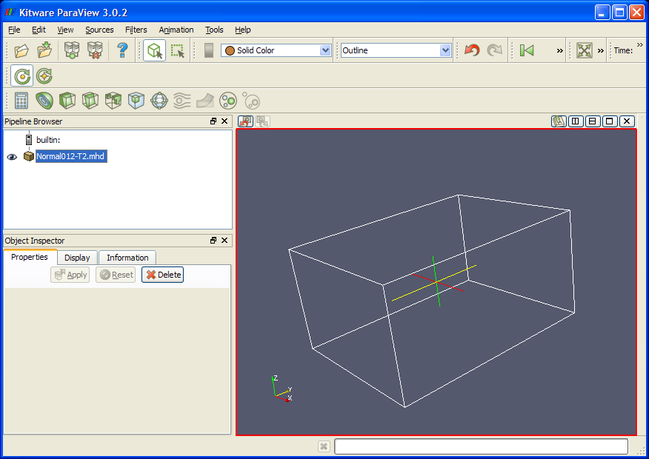
Visualizing the Data: ParaView

Slide 17
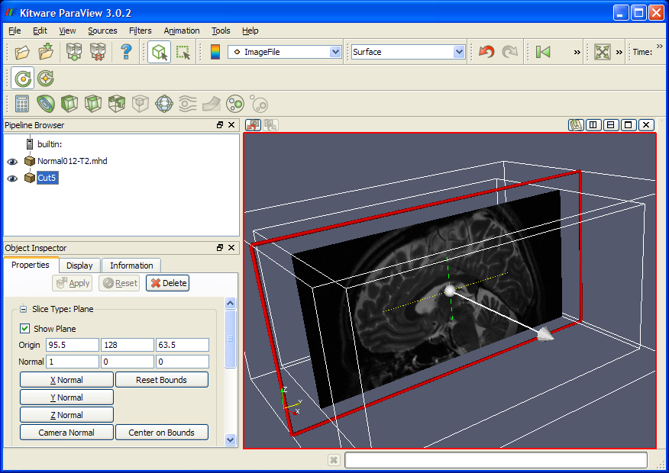
Visualizing the Data: ParaView

Slide 18
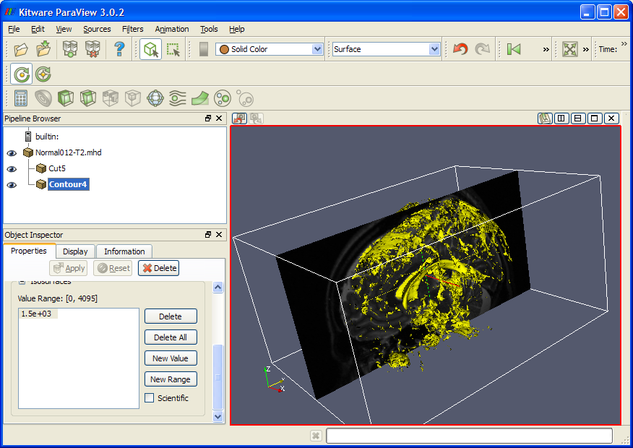
Visualizing the Data: ParaView

Slide 19
Segmenting the Data

Slide 20
Segmentation Methods Overview
Region Growing
  ConfidenceConnected
  ConnectedThreshold
  IsolatedConnected
Watersheds
Level Sets
  FastMarching
  ShapeDetection
  GeodesicActiveContours
  ThresholdSegmentation

Slide 21
Region Growing
Segmentation Methods

Slide 22
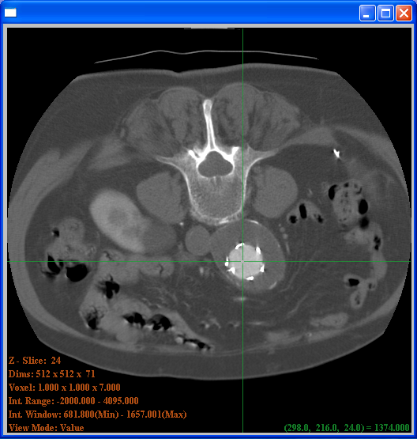
Confidence Connected
Intensity
Upper bound
X Multiplier
Standard
Deviation
Mean
Lower bound
Seed Point

Slide 23
Confidence Connected
typedef itk::Image< unsigned char , 2 > ImageType;
typedef itk::ConfidenceConnectedImageFilter<
ImageType, ImageType > FilterType;
FilterType::Pointer filter = FilterType::New();
filter->SetMultiplier( 1.5 );
filter->SetNumberOfIterations( 5 );
filter->SetInitialNeighborhoodRadius ( 2 );
filter->SetReplaceValue( 255 );
FilterType::IndexType index;
index[0] = 123; index[1] = 235;
filter->SetSeed( index );
filter->SetInput( reader->GetOutput() );
writer->SetInput( filter->GetOutput() );
writer->Update()

Slide 24
Exercise 12 a

Slide 25
Connected Threshold
Intensity
Upper bound
Seed
Lower bound
Seed Point

Slide 26
Connected Threshold
typedef itk::Image< unsigned char , 2 > ImageType;
typedef itk::ConnectedThresholdImageFilter<
ImageType, ImageType > FilterType;
FilterType::Pointer filter = FilterType::New();
filter->SetLower( 155 );
filter->SetUpper( 235 );
filter->SetReplaceValue( 255 );
FilterType::IndexType index;
index[0] = 123; index[1] = 235;
filter->SetSeed( index );
filter->SetInput( reader->GetOutput() );
writer->SetInput( filter->GetOutput() );
writer->Update()

Slide 27
Exercise 12 b

Slide 28
Isolated Connected
Intensity
Seed 2
UpperValueLimit
Isolated Value
Seed 1
Lower
2 Seed Points

Slide 29
Isolated Connected
typedef itk::Image< unsigned char , 2 > ImageType;
typedef itk::IsolatedConnectedImageFilter<
ImageType, ImageType > FilterType;
FilterType::Pointer filter = FilterType::New();
filter->SetLower( 155 );
filter->SetUpperValueLimit( 235 );
filter->SetReplaceValue( 255 );
filter->SetSeed1( index1 );
filter->SetSeed2( index2 );
filter->SetInput( reader->GetOutput() );
writer->SetInput( filter->GetOutput() );
writer->Update()

Slide 30
Exercise 12 c

Slide 31
Watershed
Segmentation

Slide 32
Watershed Concept
Intensity
Water
Level

Slide 33
Watershed Segmentation
typedef itk::Image< float , 2 > ImageType;
typedef itk::WatershedImageFilter<
ImageType
> WatershedFilterType;
WatershedFilterType::Pointer filter = WatershedFilterType::New();
filter->SetThreshold( 0.001 );
filter->SetLevel( 0.15 );
filter->SetInput( reader->GetOutput() );
filter->Update()

Slide 34
Color Encoding the Output
typedef itk::ScalarToRGBPixelFunctor< unsigned long > FunctorType;
typedef WatershedFilterType::OutputImageType LabeledImageType;
typedef itk::UnaryFunctorImageFilter< ImageType,
LabeledImageType,
FunctorType
> ColorFilterType;
ColorFilterType::Pointer colorFilter = ColorFilterType::New();
colorFilter->SetInput( filter->GetOutput() );
writer->SetInput( colorFilter->GetOutput() );
writer->Update()

Slide 35
Creating Edges
typedef itk::GradientMagnitudeRecursiveGaussianImageFilter<
ImageType, ImageType > EdgeFilterType;
EdgeFilterType::Pointer edgeFilter = EdgeFilterType::New();
edgeFilter->SetInput( reader->GetOutput() );
edgeFilter->SetSigma( 1.0 );
filter->SetInput( edgeFilter->GetOutput() );
writer->Update()

Slide 36
Exercise 13

Slide 37
Level Set
Segmentation Methods

Slide 38
Level Set Concept
F(x,y) < 0
F(x,y) > 0
Zero set: F(x,y)=0

Slide 39
Level Set Evolution
PDE = Restricted Cellular Automata
F(x,y,t)
F(x,y,t+1)

Slide 40

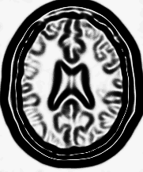
Fast Marching
Front propagation
Δx = V . Δt
Sigmoid
Gradient Magnitude
Speed Image

Slide 41
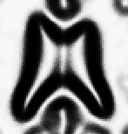
Fast Marching
Δx
Speed Image
Time-Crossing Map
Δx = V . Δt

Slide 42
Fast Marching
typedef itk::Image< float , 2 > ImageType;
typedef itk::FastMarchingImageFilter<
ImageType,
ImageType > FilterType;
FilterType::Pointer fastMarching = FilterType::New();
fastMarching->SetInput ( speedImage );
fastMarching->SetOutputSize(
speedImage->GetBufferedRegion().GetSize() );
fastMarching->SetStoppingValue( 100.0 );

Slide 43
Fast Marching
typedef FilterType::NodeContainer NodeContainer;
typedef FilterType::NodeType NodeType;
NodeContainer::Pointer seeds = NodeContainer::New();
seeds->Initialize();
NodeType seed;
seed.SetValue( 0.0 );
seed.SetIndex( index );
seeds->InsertElement( 0, seed );

Slide 44
Fast Marching
fastMarching->SetTrialPoints( seeds );
thresholder->SetInput( fastMarching->GetOutput() );
thresholder->SetLowerThreshold( 0.0 );
thresholder->SetUpperThreshold( timeThreshold );
thresholder->Update();

Slide 45
Exercise 14

Slide 46
Shape Detection
Zero set, time = t+1
Zero set, time = t
Speed
Curvature
PDE Includes a curvature term
Prevents leaking

Slide 47
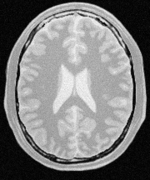


Shape Detection
Gradient
Sigmoid
Input
Image
Gradient
Magnitude
Feature
Image
Input
Feature
output
LevelSet
Shape
Detection
Input
LevelSet
Smooth
Rescale
Threshold
Binary
Mask
Positive
LevelSet
Balanced
[-0.5,0.5]

Slide 48
Shape Detection
typedef itk::Image< float , 2 > ImageType;
typedef itk::ShapeDetectionLevelSetImageFilter<
ImageType,
ImageType > FilterType;
FilterType::Pointer shapeDetection = FilterType::New();
shapeDetection->SetInput( inputLevelSet );
shapeDetection->SetFeatureImage( speedImage );
shapeDetection->SetPropagationScaling( 1.0 );
shapeDetection->SetCurvatureScaling( 0.05 );

Slide 49
Shape Detection
shapeDetection->SetMaximumRMSError( 0.001 );
shapeDetection->SetMaximumIterations( 400 );
shapeDetection->Update();
std::cout << shapeDetection->GetRMSChange() << std::endl;
std::cout << shapeDetection->GetElapsedIterations() << std::endl;
thresholder->SetInput( shapeDetection->GetOutput() );
thresholder->SetLowerThreshold( -1e7 );
thresholder->SetUpperThreshold( 0.0 );

Slide 50
Exercise 15

Slide 51
Geodesic Active Contour
Intensity Profile
ZeroSet
Displacement
X axis
Advection term added

Slide 52

Geodesic Active Contour
Vector
Field
Computed
Internally

Slide 53
Geodesic Active Contour
typedef itk::Image< float , 2 > ImageType;
typedef itk::GeodesicActiveContourLevelSetImageFilter<
ImageType,
ImageType > FilterType;
FilterType::Pointer geodesicActiveContour = FilterType::New();
geodesicActiveContour->SetInput( inputLevelSet );
geodesicActiveContour->SetFeatureImage( speedImage );
geodesicActiveContour->SetPropagationScaling( 1.0 );
geodesicActiveContour->SetCurvatureScaling( 0.05 );
geodesicActiveContour->SetAdvectionScaling( 8.0 );

Slide 54
Geodesic Active Contours
geodesicActiveContour->SetMaximumRMSError( 0.001 );
geodesicActiveContour->SetMaximumIterations( 400 );
geodesicActiveContour->Update();
std::cout << geodesicActiveContour->GetRMSChange() << std::endl;
std::cout << geodesicActiveContour->GetElapsedIterations() << std::endl;
thresholder->SetInput( geodesicActiveContour );
thresholder->SetLowerThreshold( -1e7 );
thresholder->SetUpperThreshold( 0.0 );

Slide 55
Exercise 16

Slide 56

Threshold Level Set
Advection term added controlled by a threshold
LevelSet equivalent
of a connected
components method
inside a threshold
but… with options
for preventing leaks

Slide 57
Threshold Segmentation
typedef itk::Image< float , 2 > ImageType;
typedef itk::ThresholdSegmentationLevelSetImageFilter<
ImageType,
ImageType > FilterType;
FilterType::Pointer thresholdSegmentation = FilterType::New();
thresholdSegmentation->SetInput( inputLevelSet );
thresholdSegmentation->SetFeatureImage( inputImage );
thresholdSegmentation->SetPropagationScaling( 1.0 );
thresholdSegmentation->SetCurvatureScaling( 5.0 );
thresholdSegmentation->SetAdvectionScaling( 2.0 );

Slide 58
Threshold Segmentation
thresholdSegmentation->SetMaximumRMSError( 0.001 );
thresholdSegmentation->SetMaximumIterations( 400 );
thresholdSegmentation->SetLowerThreshold( 210 );
thresholdSegmentation->SetUpperThreshold( 250 );
thresholdSegmentation->SetIsoSurface( 0.0 ); // zero set
thresholdSegmentation->SetUseNegativeFeaturesOn();
thresholdSegmentation->Update();

Slide 59
Exercise 17

Slide 60
Submitting to the
Insight Journal

Slide 61
Insight Journal Submission
PDF
Technical
Report
How to repeat
your experiment
Input
Data
Source
Code
Output
Data

Slide 62
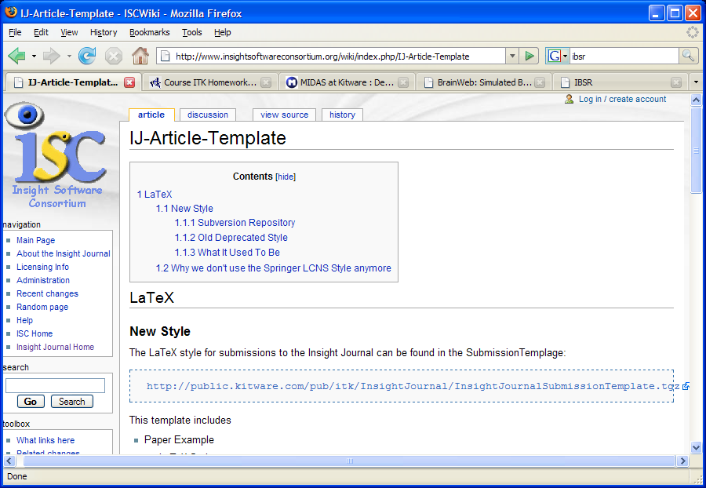
Insight Journal Template

Slide 63
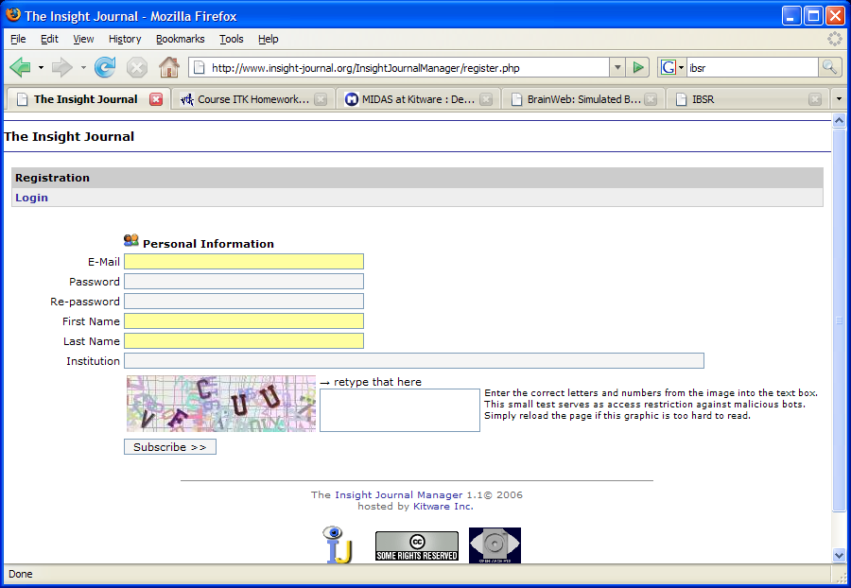
Insight Journal Subscription

Slide 64
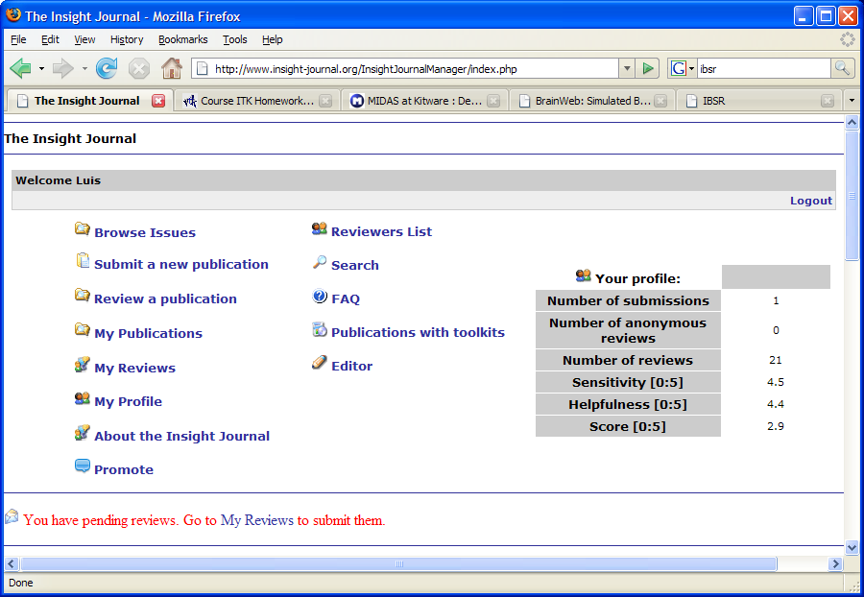
Insight Journal Submission

Slide 65
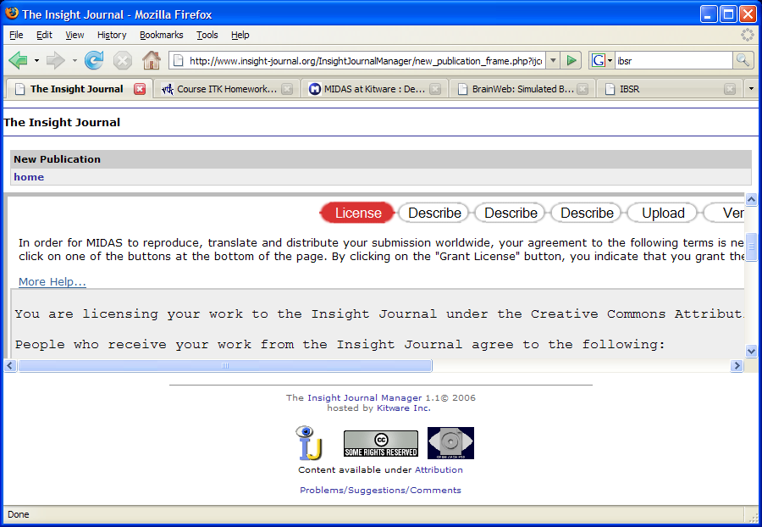
Insight Journal : Licensing

Slide 66
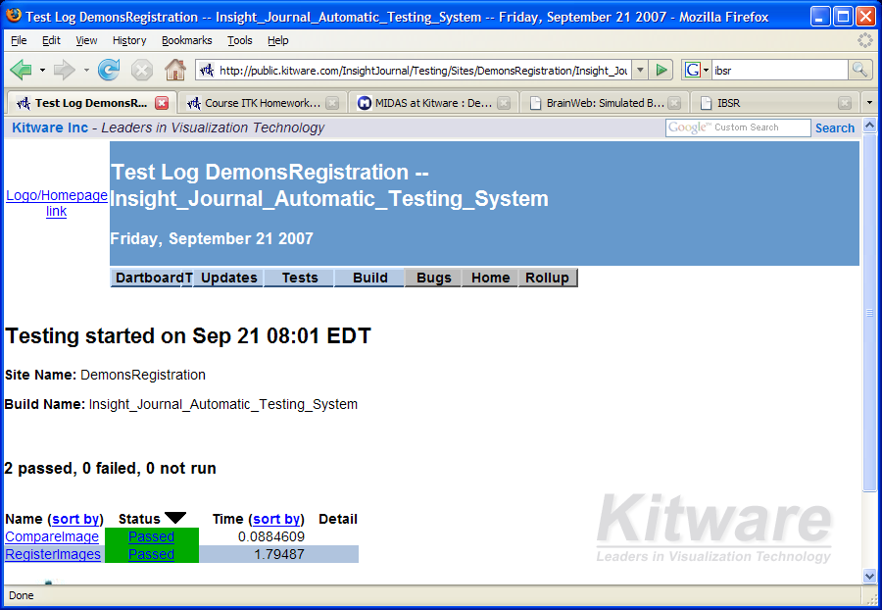
Insight Journal : Reproducibility

Slide 67
Enjoy ITK !

