Slide 1





Class Infrastructure
Dr. Luis Ibanez, Kitware
http://creativecommons.org/licenses/by/3.0/

Slide 2
© 2010 Luis Ibanez
This presentation is Copyrighted by Luis Ibanez
This presentation is distributed under the Creative Commons Attribution License 3.0:
http://creativecommons.org/licenses/by/3.0/
You are free to Reuse
You are free to Remix
Provided that you give credit to the author

Slide 3
This presentation was created using
Open Source Software
Open Office copyright is jointly held by
Sun Microsystems and Contributors.
The software is distributed under the
GNU Lesser General Public License Version 3.0.

Slide 4
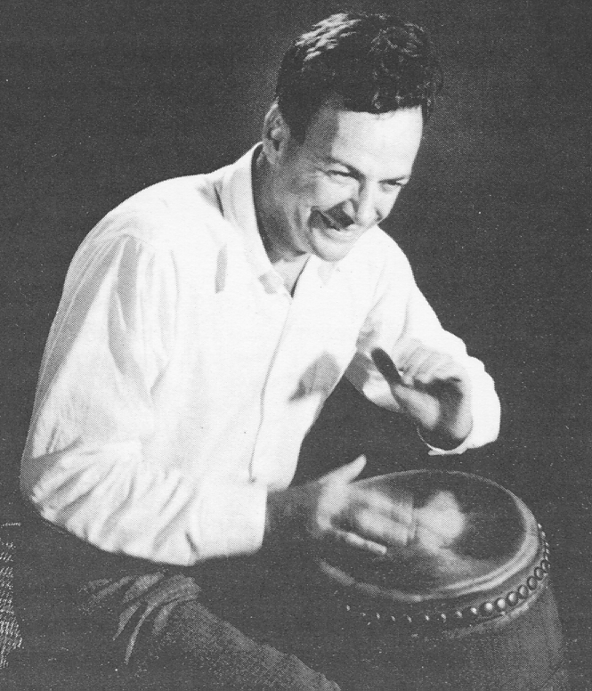
The best way to learn to play the drums
is
to play the drums.

Slide 5
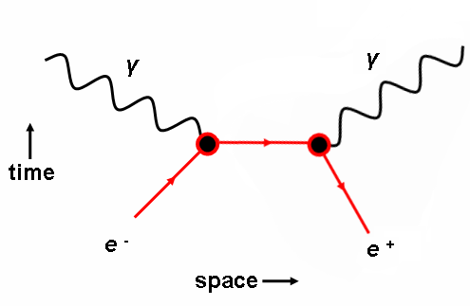

Feynman Diagrams
Graphical representation of a term in the Wick's expansion of the time product in the n-th order term S(n) of the S-matrix
S-matrix is represented within the interaction picture by the perturbation series in the powers of the interaction Lagrangian,

Slide 6
Tools
Brain
  with switch in the ON position.
Laptop
  With network connection enabled
iClicker
  Registered, and set to Frequency BC
Bootable USB stick
  4GB or larger
  with Ubuntu 10.04 installed

Slide 7
Class Motto
There is no Shame
in not knowing...
The shame lies
in not Finding Out !

Slide 8
Setup
Subscribe to the course mailing list
http://www.kitware.com/cgi-bin/mailman/listinfo/opensourcesoftwarepractice
Bookmark the Wiki of this course
http://public.kitware.com/OpenSourceSoftwarePractice/index.php/Main_Page
and Get your account in this Wiki.

Slide 9
Setup
Register your iClicker
http://www.iclicker.com/dnn/

Slide 10
Setup
In your USB bootable Ubuntu,
You will install:
  build-essentials
Setup your wireless

Slide 11
Setup
Sign up for your github account
https://github.com/

Slide 12
Class Project

Slide 13
End

