Slide 1





Economy 0x65
Dr. Luis Ibanez, Kitware
http://creativecommons.org/licenses/by/3.0/

Slide 2
© 2009 Luis Ibanez
This presentation is Copyrighted by Luis Ibanez
This presentation is distributed under the Creative Commons Attribution License 3.0:
http://creativecommons.org/licenses/by/3.0/
You are free to Reuse
You are free to Remix
Provided that you give credit to the author

Slide 3
This presentation was created using
Open Source Software
Open Office copyright is jointly held by
Sun Microsystems and Contributors.
The software is distributed under the
GNU Lesser General Public License Version 3.0.

Slide 4
Principles of Economics

Slide 5
Textbook
http://www.flatworldknowledge.com/node/39863
https://www.flatworldknowledge.com/
luisibanez/open-source-software-practice
Flatworldknowledge
Creative Commons Share-Alike License

Slide 6
video

Slide 7
Choice

Slide 8
Economics
The social science
that examines
how people choose
among the alternatives
available to them.

Slide 9
Scarcity
The condition of having to chose
among alternatives

Slide 10
Scarce Good
A good for which
the choice of one alternative
requires than another be given up

Slide 11
Opportunity Cost
The value
of the best alternative
forgone
in making any choice

Slide 12
Free Good
A good for which
the choice of one use
does not require
that another be given up

Slide 13
Rivalrous Good
A good whose consumption
by one consumer
prevents simultaneous consumption
by other consumers.
Most goods, both durable and nondurable,
are rival goods

Slide 14
Excludable Good
A good for which is possible
to prevent people
who have not paid for it
from enjoying its benefits

Slide 15
Private and Public Goods
 | Excludable | Non-Excludable
Rivalrous | Private Goods Food, Clothing, Cars | Common Goods Fish, Hunting, Water
Non-Rivalrous | Club Goods Satellite Television | Public Goods National Defense, Air

Slide 16
Economics Way of Thinking
Emphasis on
Opportunity Cost Analysis
Individuals try to maximize some objective,defined in terms of Self-Interest
Individuals focus on consequences
of Small Changes from current levels.

Slide 17
Scientific Method
A systematic set of procedures
through which
knowledge is created

Slide 18
Economic Models
All scientific though involves
simplification of reality
The real world is far too complex
for the human mind to consider

Slide 19
“Ceteris Paribus”
“All other things unchanged”

Slide 20
Fallacy of False Cause
The incorrect assumption
that one event causes another
because the two events
tend to occur together

Slide 21
Correlation does not mean
Causation

Slide 22
The Logic of Maximizing Behavior
Consumers
  Seek to maximize utility. (Assumption)
Firms
  Seek to maximize economic profit. (Assumption)

Slide 23
Economic Profit
Difference between
total revenue
And total cost
Cost in economic sense:
Opportunity cost =
value of the best opportunity forgone

Slide 24
Modeling Reality
Economist do not assume that people
actually go through the calculations...
Economist argue that people's behavior
is broadly consistent
with such a model.

Slide 25
Modeling Reality
A farmer is having problems with the chickens on his farm. he calls his friend who happens to be a physicist and tells him his problem. a few days later the physicists calls back and says:
"I think I've solved your problem but
it involves a vacuum and perfectly spherical chickens"

Slide 26
Net Benefit
The total benefit of an activity
minus its opportunity cost

Slide 27
Marginal Benefit
Amount by which
an additional unit of an activity
increases its total benefit

Slide 28
Marginal Cost
Amount by which
an additional unit of an activity
increases its total cost

Slide 29
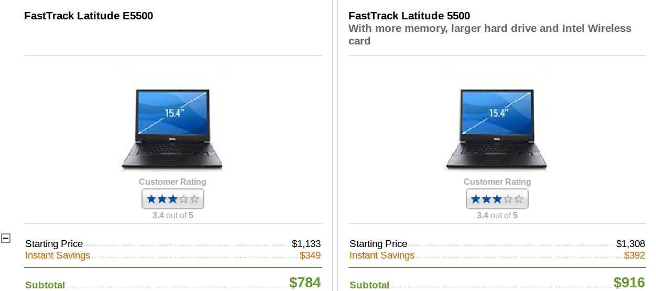
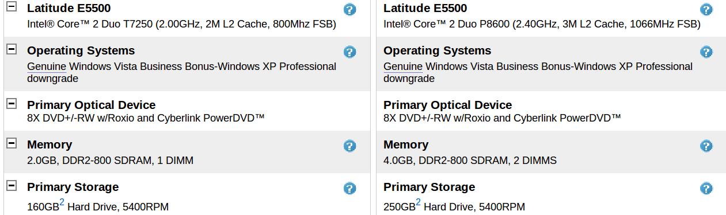

Slide 30
Marginal Decision Rule
if( marginal_benefit > marginal_cost )
{
activity_quantity += delta;
}
else
{
activity_quantity -= delta;
}

Slide 31
Net Benefit Maximization
bool IsNetBenefitMazimized()
{
if( marginal_benefit == marginal_cost )
{
return true;
}
return false;
}

Slide 32
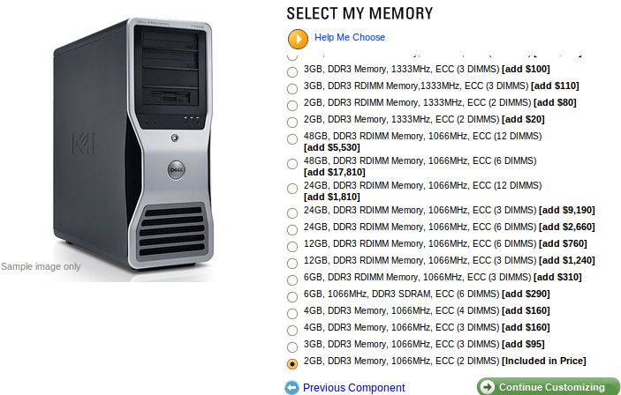

Slide 33
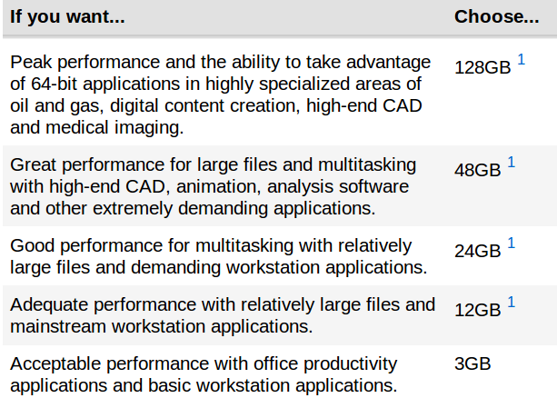
Help Me Choose...

Slide 34
Marginal Cost / Benefit Curves
Buying RAM for your Computer

Slide 35
Marginal Cost / Benefit Curves
Net Benefit
Buying RAM for your Computer

Slide 36
Marginal Cost / Benefit Curves
6 Gb
Net Benefit
Deadweight
Loss
Buying RAM for your Computer

Slide 37
Marginal Cost / Benefit Curves
30 Gb
Deadweight
Loss
Net Benefit
Buying RAM for your Computer

Slide 38
Deadweight loss
The loss in net benefits
resulting from a failure
to carry out an activity
at the most efficient level

Slide 39
Constraint
A boundary
that limits
the range of choices
that be be made

Slide 40
Efficient
The allocation of resources
when the net benefit of all
economic activities
are maximized

Slide 41
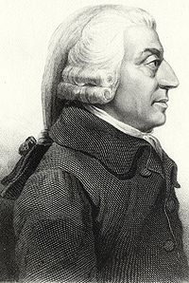
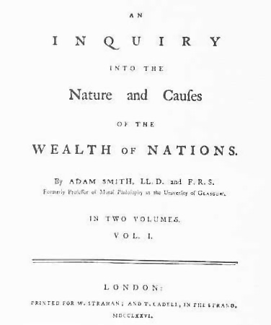
Adam Smith

Slide 42
An Inquiry into the Nature and Causes of the Wealth of Nations
The pursuit of self-interest
in a marketplace
would promote
the general interest.

Slide 43
An Inquiry into the Nature and Causes of the Wealth of Nations
Resources would be guided,
as if by an “invisible hand”,
to their best uses.

Slide 44
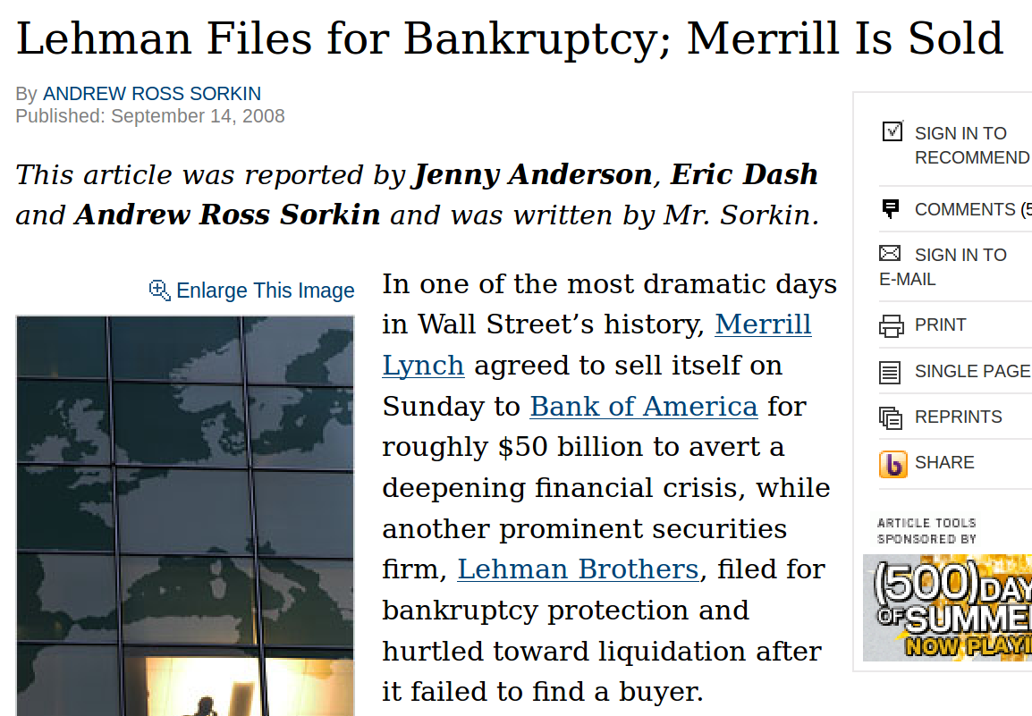
http://www.nytimes.com/2008/09/15/business/15lehman.html?_r=2&hp&oref=slogin

Slide 45

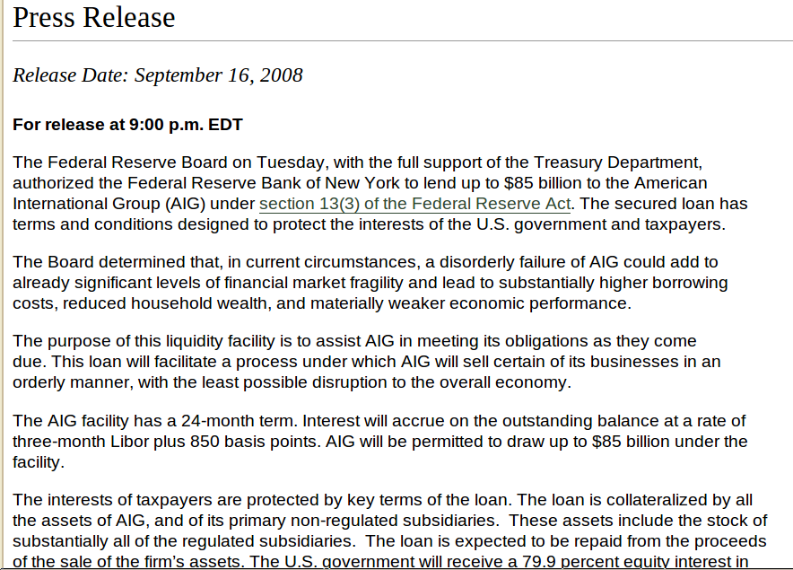

Slide 46
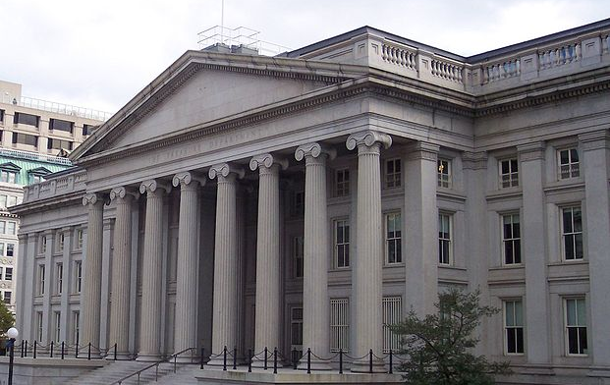
The Emergency Economic Stabilization Act of 2008, commonly referred to as a bailout
of the U.S. financial system
Sec. 6. Maximum Amount of Authorized Purchases.
The Secretary’s authority to purchase mortgage-related assets under this Act shall be limited to $700,000,000,000 outstanding at any one time
Sec. 10. Increase in Statutory Limit on the Public Debt.
Subsection (b) of section 3101 of title 31, United States Code, is amended by striking out the dollar limitation contained in such subsection and inserting in lieu thereof $11,315,000,000,000.

Slide 47
Public Good
A good for which
the cost of exclusion is prohibitive
and for which
the marginal cost
of an additional user is zero

Slide 48
Private Good
A good for which
exclusion is possible
and for which
the marginal cost
of an additional user is positive

Slide 49
Free Rider
People or firms
that consume a public good
without paying for it

Slide 50
The Free Rider
“Problem”

Slide 51
Government as Producer
Public goods
can be provided by
the government,
financed through taxation

Slide 52
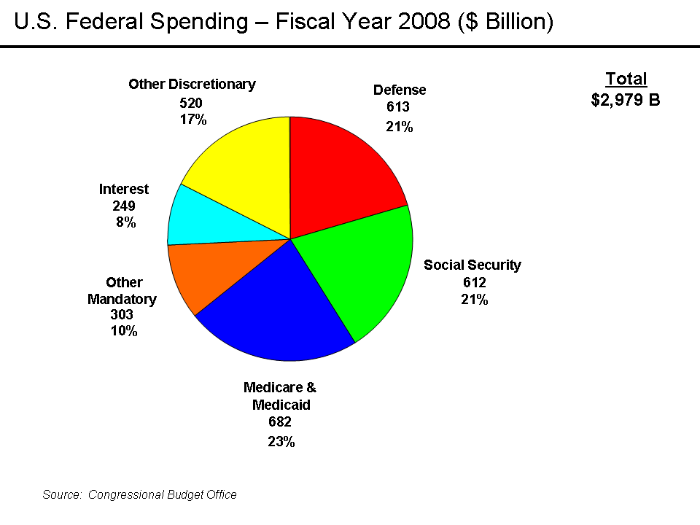

Slide 53
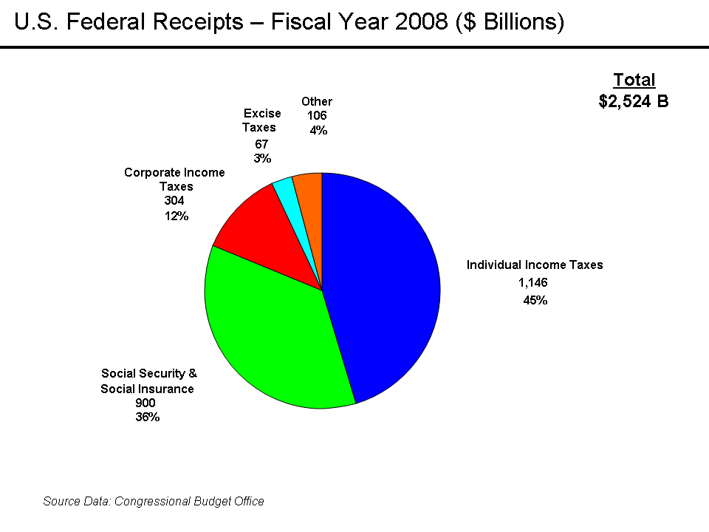

Slide 54
Budget Deficit
In Fiscal Year 2008
Collected $2.52 trillion
Spending $2.98 trillion
Total deficit of $455 billion

Slide 55
Government as Customer
Buys 20%
of the US production !

Slide 56
Economic System
The set of rules that define how
an economy's resources
are to be owned and
how decisions about their use
are to be made

Slide 57
Market Capitalist
Economy
Economy in which resources
are generally owned by
private individuals
who have the power to
make decisions
about their use

Slide 58
Command Socialist Economy
Economy in which government
is the primary owner of
capital and natural resources
and has broad power
to allocate the use
of factors of production.

Slide 59
Mixed Economy
Economy that combine elements of
market capitalist and
command socialist
economic systems

Slide 60
External Cost
A cost imposed on others
outside of
any market exchange

Slide 61
External Benefit
An action taken by a person or firm that creates benefits for others
in the absence
of any market agreement

Slide 62
Common Property Resources
Resources for which
no property rights
have been defined

Slide 63
Common Property Resources
...the “difficulty”
with common property resources is that individuals
may not have
adequate incentives
to engage in efforts
to preserve or protect them

Slide 64
Motivations
What motivates people
as they make choices ?
Individuals maximize
in pursuit of self-interest

Slide 65
Yochia Benkler
“Coase's Penguin”
http://www.ted.com/talks/yochai_benkler_on_the_new_open_source_economics.html
http://www.benkler.org/CoasesPenguin.html
http://www.yale.edu/yalelj/112/BenklerWEB.pdf

Slide 66
Steve Weber
“The Political Economy of Open Source”
http://brie.berkeley.edu/econ/publications/wp/wp140.pdf

Slide 67
People enjoy the interaction on the Internet,
and the feeling of belonging to a group
that does something interesting:
that's how some software projects are born
Linus Torvals

Slide 68
To be happy, humans crave:
Satisfying work to do
The experience of being good at something
Time spent with people we like
The chance to be part of something bigger
Jane McGonigal

Slide 69
Gamers Context
Blissful Productivity
Urgent Optimism
Social Fabric
Epic Meaning
T = 9:00
Jane McGonigal

Slide 70
Organization theory predicts that
increasing complexity in a division of labor
leads to formal organizational structures.
However, the “new economy” shows that formal organizational structures are undermined by technologies that reduce the cost of communications and transactions.
Steve Weber

Slide 72
End

