Slide 1





Economy 0x65
Dr. Luis Ibanez, Kitware
http://creativecommons.org/licenses/by/3.0/

Slide 2
© 2009 Luis Ibanez
This presentation is Copyrighted by Luis Ibanez
This presentation is distributed under the Creative Commons Attribution License 3.0:
http://creativecommons.org/licenses/by/3.0/
You are free to Reuse
You are free to Remix
Provided that you give credit to the author

Slide 3
This presentation was created using
Open Source Software
Open Office copyright is jointly held by
Sun Microsystems and Contributors.
The software is distributed under the
GNU Lesser General Public License Version 3.0.

Slide 4
Principles of Economics

Slide 5
Textbook
http://www.flatworldknowledge.com/node/39863
https://www.flatworldknowledge.com/
luisibanez/open-source-software-practice
Flatworldknowledge
Creative Commons Share-Alike License

Slide 6
Back to Mr. Adam Smith...

Slide 7


Adam Smith

Slide 8
Informationally Efficient
Traded assets already reflect
all known information
and instantly change
to reflect new information.

Slide 9

http://commons.wikimedia.org/wiki/File:Alanya_Market_50.jpg

Slide 10
Efficiency Requirement
In order to be efficient
the marketplace
must be competitive
or act as if it were.

Slide 11

http://commons.wikimedia.org/wiki/File:A-public-market-in-Paris_March%C3%A9-de-Grenelle_located-in-boulevard-Grenelle_sunday-first-juin-2008_from-Dupleix-subway-station_816x612.jpg

Slide 12
Efficiency Requirement
In order to be efficient
the market requires that
producers possess property rights
to the goods and services they produce,
and that
consumers possess property right
to the goods and services they buy

Slide 13
Property Right
A set of rules
that specify the ways
in which an owner
can use a resource

Slide 14
Property Rights
Must be:
Exclusive
Transferable

Slide 15

http://commons.wikimedia.org/wiki/File:Amzei_apples.jpg

Slide 16
Exclusive Property Right
A property right
that allows its owner
to prevent others
from
using the resource

Slide 17
Transferable Property Right
A property right
that allows the owner
of a resource to sell or lease
it to someone else

Slide 18
Marketplace Exchanges
Both buyers and sellers
expect
to emerge from the transaction
better off...

Slide 19
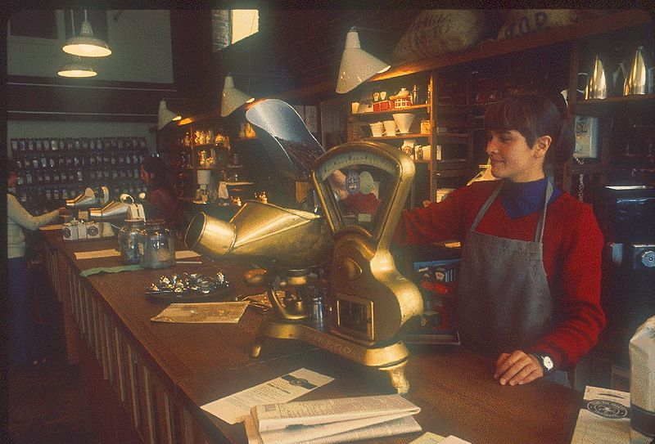
http://commons.wikimedia.org/wiki/File:Pike_Place_Market_-_Starbucks_circa_1977A.jpg

Slide 20
Consumer Surplus
The amount by which
the total benefit to consumers
from consuming a good
exceed
their total expenditures on the good.

Slide 21
Producer Surplus
The difference between
the total revenue
received by sellers
and their total cost.

Slide 22
Market Failure
The failure of private decisions
in the marketplace
to achieve an efficient allocation
of scare resources

Slide 23
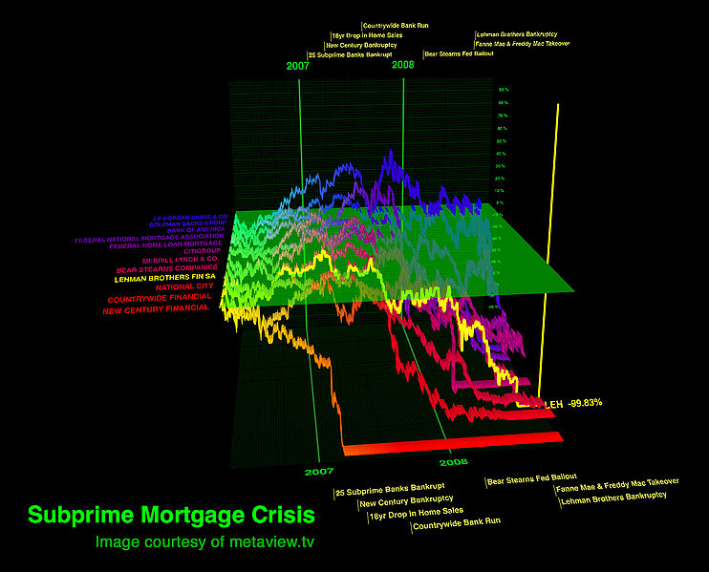
http://commons.wikimedia.org/wiki/File:Subprime_Crisis.jpg

Slide 24
Market Failure
Results from
Lack of competition
Not well defined or not fully transferable
Property rights
  Incomplete Information

Slide 25
Market Price
Determined by the intersection of
demand and supply

Slide 26
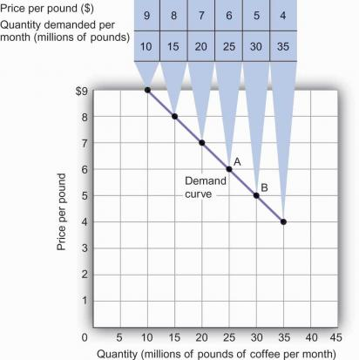
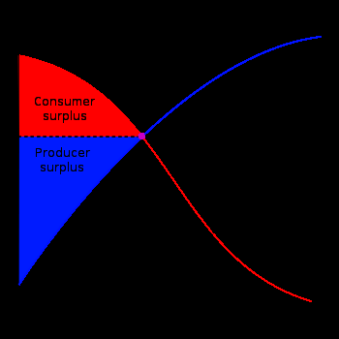
http://www.flatworldknowledge.com/pub/1.0/principles-economics/31935?course=47973#book-31826

Slide 27
It is All About:
Expectations
Uncertainty
Information

Slide 28
Law of Demand
For virtually all goods and services
A higher price leads to
a reduction in quantity demanded
A lower price leads to
an increase in quantity demanded

Slide 29
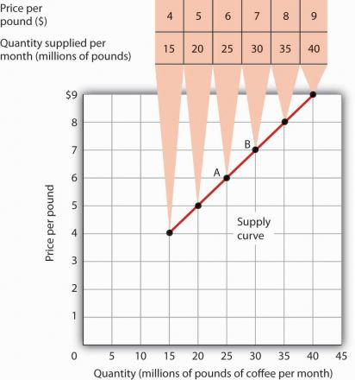
http://www.flatworldknowledge.com/pub/1.0/principles-economics/31935?course=47973#book-31827

Slide 30
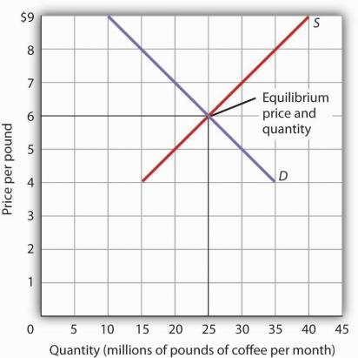
http://www.flatworldknowledge.com/pub/1.0/principles-economics/31935?course=47973#book-31828

Slide 31
Equilibrium Price
Price at which
quantity demanded
equals
quantity supplied

Slide 32
Personal
Computer
Market

Slide 33
“I think there is a world market for maybe five computers”
James Watson, 1943

Slide 34




1960s
IBM
http://www-03.ibm.com/ibm/history/history/decade_1960.html

Slide 35
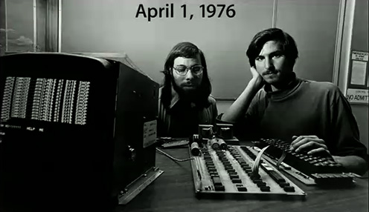
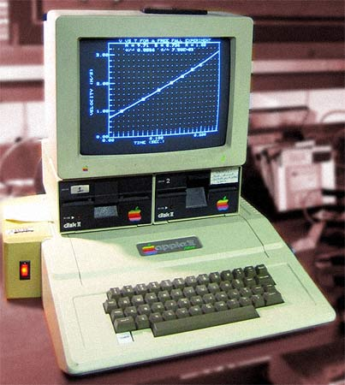
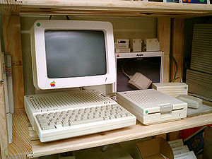


1976-
Apple
http://www.theapplemuseum.com/
http://en.wikipedia.org/wiki/Apple_II_series

Slide 36
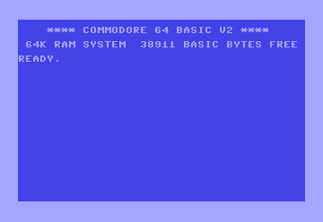

1982-
Commodore
http://en.wikipedia.org/wiki/Commodore_64

Slide 37
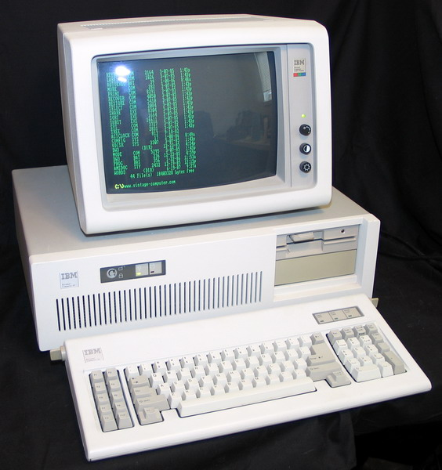

1984
IBM
http://en.wikipedia.org/wiki/IBM_Personal_Computer/AT

Slide 38
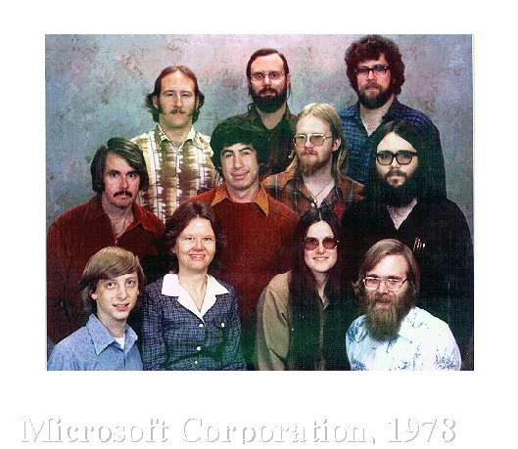




Slide 39





Slide 40
Price per Unit Halved:
Every 50 months 1976 - 1989
Every 28 months 1990 - 1995
Every 24 months 1995 - 2000

Slide 41
Bureau of Labor Statistics: between 1993-1998
CPU speed rose by 1,263%
Memory increased by 1,500%
Hard drive capacity by 3,700%
Monitor size by 13%

Slide 42
Personal Computers - 2005
Percentage of World Shipments
Dell 18.9 %
Hewlett-Packard 15.4 %
IBM 5.1 %
Fujitsu-Siemens 4.6 %
Acer 4.0 %
Others 52.0 %
http://www.flatworldknowledge.com/pub/1.0/principles-economics/31935?course=47973#book-31831

Slide 43
Personal Computers - 2005
Percentage of US Shipments
Dell 34.0 %
Hewlett-Packard 18.2 %
Gateway 5.7 %
IBM 4.3 %
Apple 3.9 %
Others 34.0 %
http://www.flatworldknowledge.com/pub/1.0/principles-economics/31935?course=47973#book-31831

Slide 44
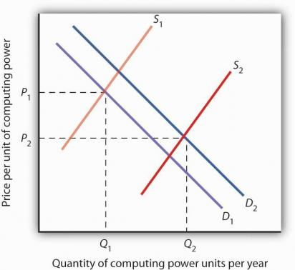
http://www.flatworldknowledge.com/pub/1.0/principles-economics/31935?course=47973#book-31831

Slide 45
Firms
Organizations that produce
goods and services

Slide 46








Slide 47
Short Run
A planning period over which
the managers of a firm
must consider
one or more
of their factors of production
as fixed in quantity

Slide 48
Long Run
The planning period over
which a firm
can consider all
factors of production
as variable

Slide 49
Fixed Factor of Production
A factor of production
whose quantity
cannot be changed
during a particular period

Slide 50
Variable Factor of Production
A factor of production
whose quantity
can be changed
during a particular period

Slide 51
Production Function
The relationship between
factors of production
and
the output of a firm

Slide 52
Total Production Curve
Graph that shows
the quantities of output
that can be obtained
from different amounts
of a variable factor of production,
assuming other factors of production
are fixed

Slide 53
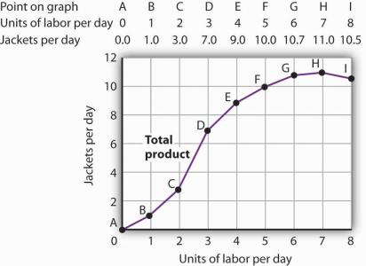
http://www.flatworldknowledge.com/pub/1.0/principles-economics/31851?course=47973#book-31851

Slide 54
Marginal Product
The amount by which
output raises
with an additional unit
of a variable factor

Slide 55
Marginal Product of Labor
The amount by which
output raises
with an
additional unit of labor

Slide 56
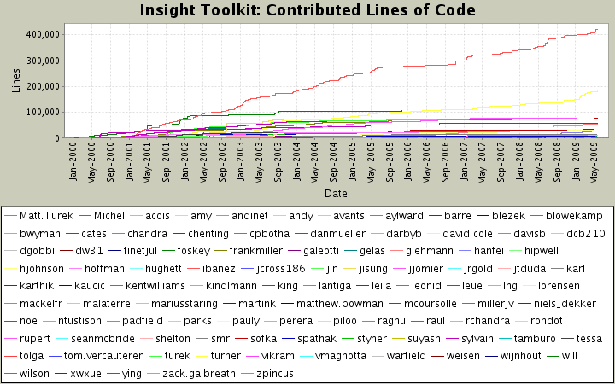

Slide 57
Average Product
The output
per unit
of variable factor

Slide 58
Average Product of Labor
The ratio of output
to the
number of units of labor

Slide 59
Increasing Marginal Returns
The range over which
each additional unit
of a variable factor
adds more
to total output
than the previous unit

Slide 60
Diminishing Marginal Returns
The range over which
each additional unit
of a variable factor
adds less
to total output
than the previous unit

Slide 61
Diminishing
Increasing
http://www.flatworldknowledge.com/pub/1.0/principles-economics/31851?course=47973#book-31851

Slide 62
Negative Marginal Returns
The range over which
additional units
of a variable factor
reduce
the total output
given constant quantities
of all other factors

Slide 63
"Adding manpower to a late software project makes it later".
The Mythical Man-Month,
Fred Brooks
http://en.wikipedia.org/wiki/The_Mythical_Man-Month

Slide 64
Law of Diminishing Marginal Returns
The marginal product
of any variable factor of production
will eventually decline,
assuming the quantities
of other factors of production
are unchanged

Slide 65
Variable Costs
The cost associated
with the use
of variable factors
of production

Slide 66
Fixed Costs
The cost associated
with the use
of fixed factors
of production

Slide 67
Total Variable Cost
Cost that varies
with the level of output

Slide 68
Total Fixed Cost
Cost that does not vary
with the level of output

Slide 69
Total Cost
Then sum of
total variable cost
and
total fixed cost

Slide 70
Average Total Cost
Total cost
divided by quantity
it is the firms total cost
per unit of output

Slide 71
Average Variable Cost
Total variable cost
divided by quantity
it is the firms total variable
cost per unit of output

Slide 72
Average Fixed Cost
Total fixed cost
divided by quantity

Slide 73
Capital Intensive
Situation in which a firm
has a high ratio
of capital to labor

Slide 74
Labor Intensive
Situation in which a firm
has a low ratio
of capital to labor

Slide 75
Economies of Scale
Situation in which
the long-run average cost
declines
as the firm expands its output

Slide 76
Diseconomies of Scale
Situation in which
the long-run average cost
increases
as the firm expands its output

Slide 77
Constant returns to Scale
Situation in which
the long-run average cost
stays the same
over an output range

Slide 78
End

