Slide 1





Economy 0x65
Dr. Luis Ibanez, Kitware
http://creativecommons.org/licenses/by/3.0/

Slide 2
© 2009 Luis Ibanez
This presentation is Copyrighted by Luis Ibanez
This presentation is distributed under the Creative Commons Attribution License 3.0:
http://creativecommons.org/licenses/by/3.0/
You are free to Reuse
You are free to Remix
Provided that you give credit to the author

Slide 3
This presentation was created using
Open Source Software
Open Office copyright is jointly held by
Sun Microsystems and Contributors.
The software is distributed under the
GNU Lesser General Public License Version 3.0.

Slide 4
Principles of Economics

Slide 5
Textbook
http://www.flatworldknowledge.com/node/39863
https://www.flatworldknowledge.com/
luisibanez/open-source-software-practice
Flatworldknowledge
Creative Commons Share-Alike License

Slide 6
Competitive Markets for
Goods and Services

Slide 7
Competitive Markets

Slide 8
More Competitive
Perfect
Competition
Monopoly
Less Competitive

Slide 9
Perfect Competition
Model of the market
based on the assumption
that a large number of firms
produce identical goods
consumed by
a large number of buyers

Slide 10
Price Takers
Individuals or firms
who must take
the market price
as given

Slide 11
Price Takers
The assumptions
of the perfectly competitive model
ensure that each
buyer or seller
is a price taker

Slide 12
Perfect Competition...
No individual
has enough power
in a perfectly competitive market
to have any impact
on that price.

Slide 13
Ease of Entry and Exit
Level of difficulty
for a firm
to enter and exit
a market

Slide 14
Complete Information
The model of perfect competition
assume that all sellers have
complete information
about prices, technology and all other factors about the operation of the market.

Slide 15
Complete Information
If one seller
had an advantage over other sellers,
perhaps special information about
a lower-cost production method,
then that seller could exert
some control over market price.
The seller will no longer be
a price taker

Slide 16
Complete Information
Buyers
know the prices
offered by every seller.
Information can be obtained
at low cost.

Slide 17
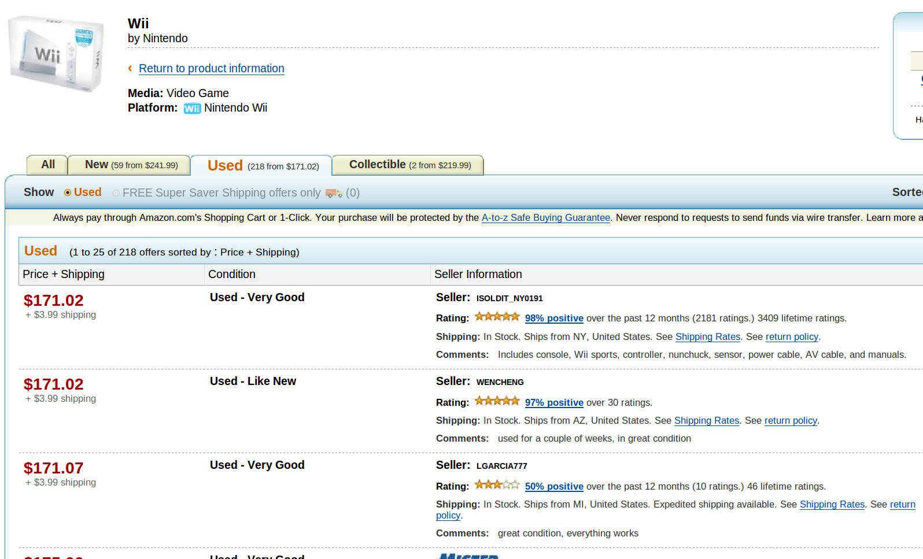

Slide 18
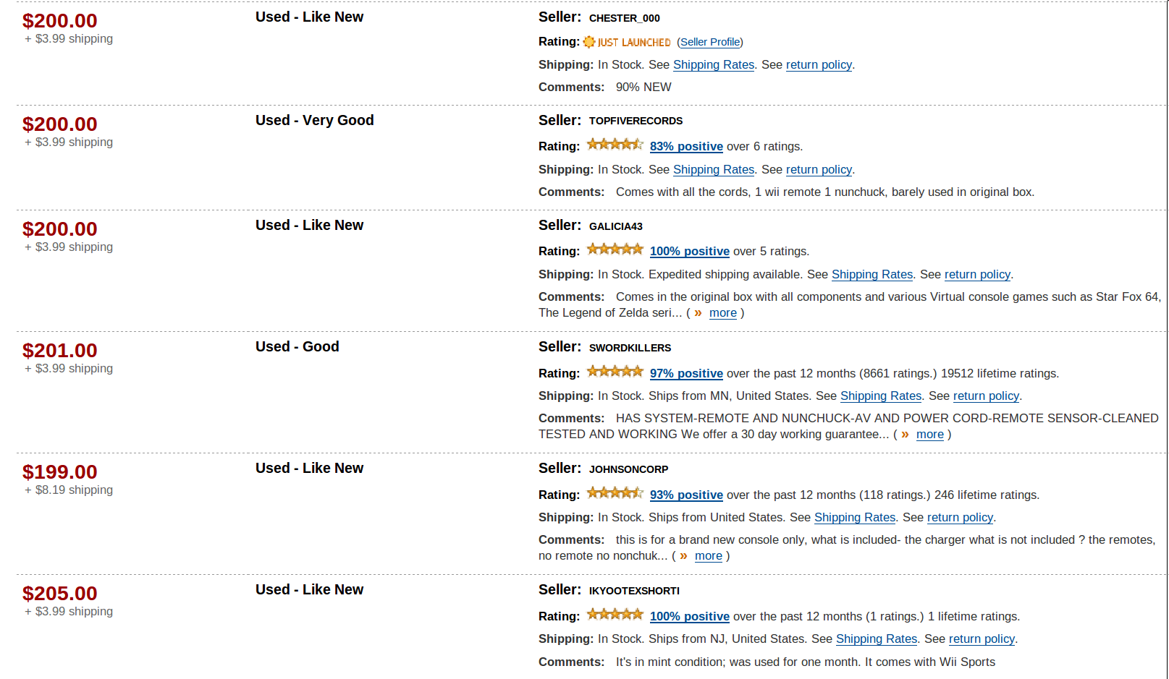

Slide 19
Supply and Demand Model
Assumes
that market forces
determine prices

Slide 20
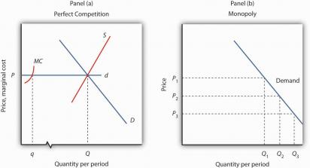
http://www.flatworldknowledge.com/pub/1.0/principles-economics/31879#book-31861

Slide 21
Government Intervention
Price Floors and Price Ceilings

Slide 22
Walrasian Auction
Equilibrium of supply and demand
for a given price and number of units
FSF: 1:37:42

Slide 23
Value and Information
How much
is your laptop worth ?

Slide 24
Market Signals
Using prices and demand
as an information carrier...

Slide 25
Decisions
Decisions about how to deploy society's productive resources is being made “automatically”, cybernetically even,
by rational individuals
responding to price signals.

Slide 26
What about Marketing ?
Marketing intend to “inform” consumers,
and at the same time “persuade” them
that the need the goods and services

Slide 27
Monopolies

Slide 28
Monopoly
A firm that is the only producer
of a good or service
for which there are no close substitutes
and for which entry
by potential rivals
is prohibitively difficult

Slide 29
Price Setter
A firm that
set or picks price
based on its
output decision

Slide 30
Monopoly Power
The ability
to act
as a price setter

Slide 31
Barriers to Entry
Characteristic of a particular market
that blocks
the entry of new firms
in a monopoly market

Slide 32
Natural Monopoly
A firm that confronts
economies of scale
over the entire range of outputs
demanded in its industry

Slide 33
Network Effects
Situations where products
become more useful
the larger the number
of users of the product

Slide 34
Price in Monopoly Market
Is driven by
the demand curve

Slide 35
Total Revenue
http://www.flatworldknowledge.com/pub/1.0/principles-economics/31879#book-31861

Slide 36
Total Revenue in a Monopoly Market
= Quantity x Price
Given by the demand curve
= Q x P
= Q x ( b – a.Q )

Slide 37
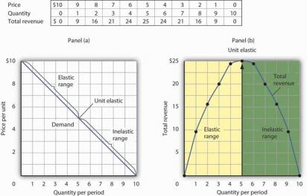
http://www.flatworldknowledge.com/pub/1.0/principles-economics/31879#book-31861

Slide 38
Marginal Revenue in a Monopoly Market
MR = d/dQ ( Q x P )
= d/dQ ( Q x ( b – a . Q ) )
= d/dQ( b.Q – a.Q.Q )
= b - 2.a.Q

Slide 39
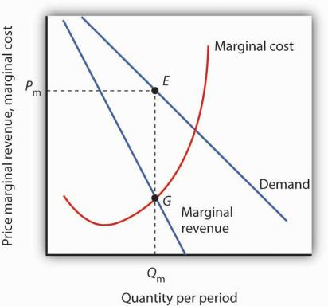
http://www.flatworldknowledge.com/pub/1.0/principles-economics/31879#book-31861

Slide 40
Marginal Decision Rule
Marginal Revenue == Marginal Cost
Value of Q at which MR==MC

Slide 41
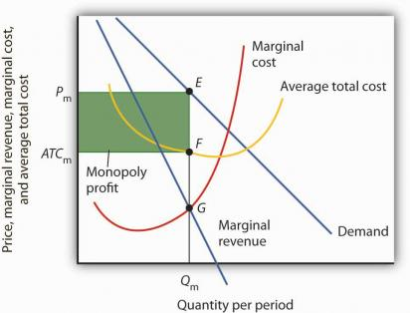
http://www.flatworldknowledge.com/pub/1.0/principles-economics/31879#book-31861

Slide 42
Monopoly and Efficiency
Since price exceeds
marginal cost
Monopolies
violate the basic condition
for economic efficiency

Slide 43
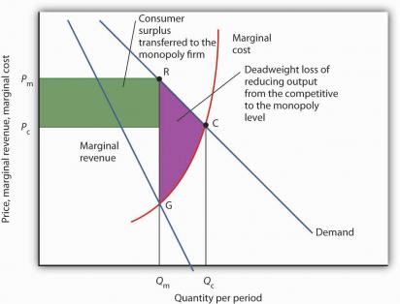
http://www.flatworldknowledge.com/pub/1.0/principles-economics/31879#book-31862

Slide 44
Monopolies and Society
Monopolies generate a
dead-weight loss to society
Higher prices transfer consumer surplus to the firm
Public policy consist of antitrust laws and regulations of natural monopolies
Monopolies are fragile over time

Slide 45
Imperfect Competition

Slide 46
Imperfect Competition
A market structure
with more than one firm
in an industry
in which at least one firm
is a price setter

Slide 47
Monopolistic Competition
A model characterized
by many firms
producing similar
but differentiated products
in a market with
easy entry and exit

Slide 48
Monopolistic Competition
Restaurants
Retail Stores
Barber and Beauty Shops
Auto-repair Shops
Service Stations
Banks
Law and Accounting Firms

Slide 49
Product Differentiation
Gives firms
producing a particular product
some degree of
price-setting
or monopoly power

Slide 50
Differentiated Markets
Imply that the notion of a single
“Market Price”
is meaningless

Slide 51
Oligopoly:
Competition among the Few

Slide 52
Concentration Ratio
percentage of the output
accounted for
by the largest firms
in an industry

Slide 53
Strategic Choice
A choice based on the recognition
that the actions of others
will affect the outcome of the choice
and that takes
these possible actions
into account

Slide 54
Game Theory
An analytical approach
through which
strategic choices
can be assessed

Slide 55
Overt Collusion
When firms openly agree
on price, output and other decisions
aimed at achieving
monopoly profits

Slide 56
Cartel
Firms that coordinate their activities
through overt collusion
and by forming
collusive coordinating
mechanisms

Slide 57
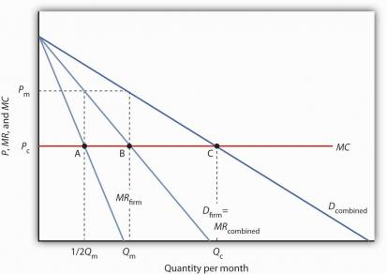
http://www.flatworldknowledge.com/pub/1.0/principles-economics/31879#book-31866

Slide 58
Tacit Collusion
An underwritten, unspoken
understanding
through which firms
agree to limit
their competition

Slide 59
Payoff
The outcome
of a strategic decision

Slide 60
Prisoner's Dilemma
Two prisoners face a dilemma.
They can chose to confess
or not confess.
Because they are separated,
they cannot plot a joint strategy.
Each must make a strategic choice
in isolation

Slide 61
Advertising
Firms in monopoly, monopolistic competition, and oligopoly
use advertising
when they expects it
to increase their profits

Slide 62
Anti-Trust Policy and
Business Regulations

Slide 63
Trust
business entity formed
with intent to
monopolize business,
to restrain trade, or
to fix prices

Slide 64
Antitrust Policy
Visa / Mastercard
Recover TRIPLE the damages
Discover/American Express
Fines for $1.8B and $2.1B:
The largest settlement in
antitrust history.
Discover $6B suit is pending...

Slide 65
Cartels and Trusts
Edmund Cartel and Georges Cartel
  Brothers in Rennes, France
J.P. Morgan (Steel)
Duke (Tobacco)
Rockefeller (Oil)
Carnegie (Steel)

Slide 66
Anti-Trust Legislation
Price Fixing
Bid Rigging
Customer Allocation

Slide 67
Price Fixing
GE – Westinghouse - 1950
  Multi-million Fines
  Jail sentences
LCD screens - 2008
  LG - $400M fine
  Sharp Corp. - $120M fine
  Chungwa - $65M fine
Hoffman-LaRoche - 1999
  $500M for price fixing in Vitamins

Slide 68
Federal Trade Commission - FTC
Sherman Act
Clayton Act
Celler-Kefauver
  Prevents Vertical Merges

Slide 69
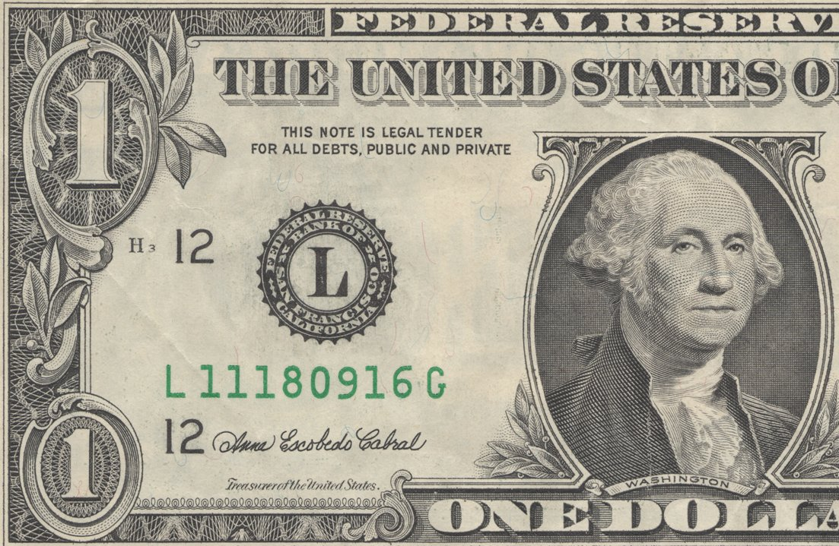

Slide 70
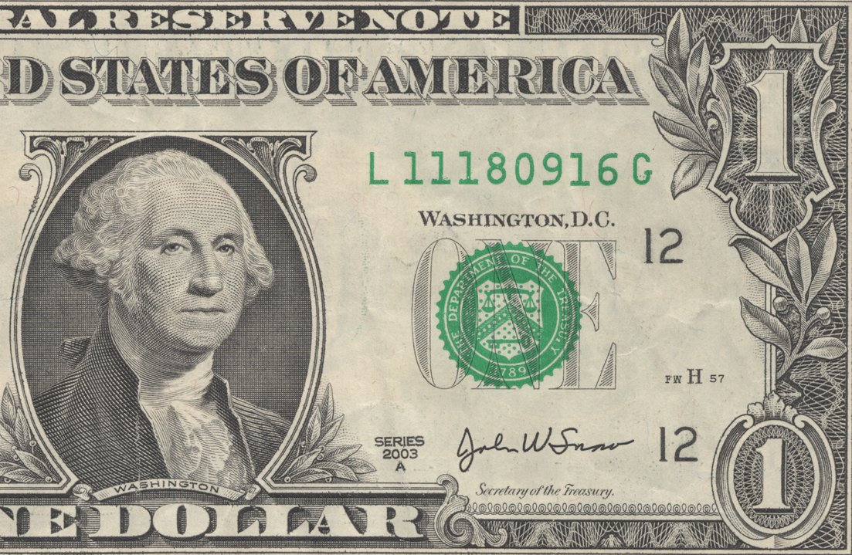

Slide 71
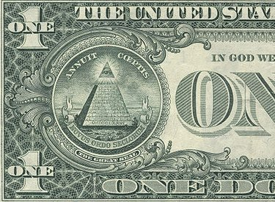

Slide 72
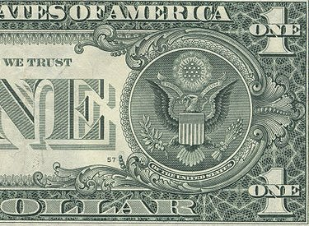

Slide 73
End

