Slide 1





Legal Aspects of Software Development
Yvette Fitzgerald, Kitware
http://creativecommons.org/licenses/by/3.0/

Slide 2
© 2010 Yvette Fitzgerald
Presentation Copyrighted by Yvette Fitzgerald
This presentation is distributed under the Creative Commons Attribution License 3.0:
http://creativecommons.org/licenses/by/3.0/
You are free to Reuse
You are free to Remix
Provided that you give credit to the author

Slide 3
This presentation was created using
Open Source Software
Open Office copyright is jointly held by
Sun Microsystems and Contributors.
The software is distributed under the
GNU Lesser General Public License Version 3.0.

Slide 4
Contracts

Slide 5
Why are Contracts
Important in Software
You are subject to contract terms when:
You are employed by a software company
You develop software for a customer
You get software from a provider
You install any off-the-shelf package
You use Web services (Terms of Use)
You provide Web services

Slide 6
Contract Law Principles
Did the parties make an agreement ?
How should the contract be interpreted ?
  What did each party promise?
Did one or both parties fail to keep a promise ?
If so, what compensation (remedies) should be given to the non-breaching party ?

Slide 7
Contracting Parties
Who has the right to enter in contracts ?
  Minimal age ?
    Can a 15 years old accept an EULA ?
Do parties have to be in the US ?

Slide 8
Making an Agreement
Offer
Acceptance
Mutual assent
Consideration
  Something of Value
Consideration for modifying a contract
Communication
  (can I accept a contract by email ?)
Oral versus written contracts

Slide 9
What is a Breach of Contract
Is that a Federal Crime ?
Will that lead to a civil litigation ?
Good Faith vs Bad Faith
  (knowingly delivering damaged goods)
What are Remedies ?
  How far can they get ?
What is the difference between
  “Damages” and
  “Specific Performance” ?

Slide 10
Employment

Slide 11
Employment Agreements
IP agreements
  Concept of Work for Hire
    Copyright
    Patents
  What happen with previous IP (before this job)
  What happen with future IP (done after this job)
Confidentiality agreement
  Trade secrets

Slide 12
End User
License Agreements
EULAs

Slide 13
Windows 7 - EULA

Slide 14
Windows 7 - EULA
Section 2: Installation and Use Rights
  Item c: Number of users per computer
Section 3:
  Item b: Font components: you may only...
  Item c: Icons, Images and Sound
Section 4: Mandatory Activation

Slide 15
Windows 7 - EULA
Section 8: Scope of License
  The Software is Licensed, not Sold.
  You may not
    work around any technical limitation of this software.
    reverse engineer, decompile or dis assemble the software

Slide 16
Windows 7 - EULA
Section 9: Benchmark Testing
  You may conduct internal benchmark testing of those components. You may disclose the results of any benchmark test of those components, provided that you comply with the conditions set forth at go.microsoft.com/fwlink/?LinkID=66406
  Does this waives rights to Free Speech ?

Slide 17
Windows 7 - EULA
Section 18: Notice about Video Patent Licenses
  THIS PRODUCT IS LICENSED UNDER THE AVC, THE VC-1, THE MPEG-4 PART 2 VISUAL, AND THE MPEG-2 VIDEO PATENT PORTFOLIO LICENSES FOR THE PERSONAL AND NON-COMMERCIAL USE OF A CONSUMER TO (i) ENCODE VIDEO IN COMPLIANCE WITH THE ABOVE STANDARDS..

Slide 18
Windows 7 - EULA
Section 23: Applicable Law
  If in the United States:
    Washington State Laws apply
  Outside of the United States
    The laws of the country where the software is used, apply

Slide 19
Windows 7 - EULA
Section 25: Limitation and Exclusion of Damages
  Except for any refund the manufacturer may provide...
  you can not recover any other damages...
  This limitation applies to
    Claims for breach of contract,
    Breach of warranty
    Strict liability
    Negligence
  It also applies even if
    Microsoft knew or should have known about the possibility of the damages.

Slide 20
Windows 7 - EULA
LIMITED WARRANTY
  Section D: Remedy for breach of warranty
  Section G: No other warranties
    Microsoft exclude implied warranties of merchantability, fitness for a particular purpose and non-infringement.

Slide 21
Adobe Acrobat Standard 9.0
EULA

Slide 22
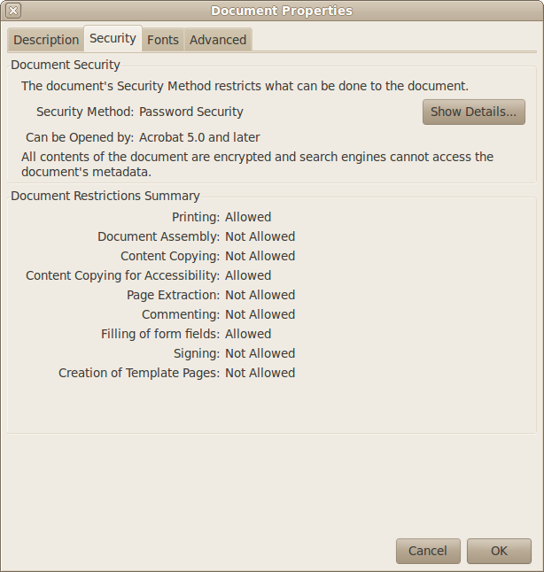
Adobe Acrobat Standard 9.0 - EULA
There are restrictions on what
you can do with the EULA itself.

Slide 23
Adobe Acrobat Standard 9.0 - EULA
YOU AGREE THAT THIS AGREEMENT IS LIKE ANY WRITTEN NEGOTIATED AGREEMENT SIGNED BY YOU AND ANY LEGAL ENTITY THAT OBTAINED THE SOFTWARE AND ON WHOSE BEHALF IT IS USED: FOR EXAMPLE, IF APPLICABLE, YOUR EMPLOYER.

Slide 24
Adobe Acrobat Standard 9.0 - EULA
THE SOFTWARE MAY INCLUDE PRODUCT ACTIVATION AND OTHER TECHNOLOGY DESIGNED TO PREVENT UNAUTHORIZED USE AND COPYING. THIS TECHONLOGY MAY CAUSE YOUR COMPUTER TO AUTOMATICALLY CONNECT TO THE INTERNET AND MAY PREVENT USES OF THE SOFTWARE THE ARE NOT PERMITTED.

Slide 25
Adobe Acrobat Standard 9.0 - EULA
“Permitted Number” means one (1) unless otherwise indicated under a valid license granted by Adobe

Slide 26
Adobe Acrobat Standard 9.0 - EULA
Section 2.8: Content Files.
  Content Files may not be used in the production of libelous, defamatory, fraudulent, lewd, obscene or pornographic material or any material that infringes upon any third party intellectual property rights or in any otherwise unlawful manner.

Slide 27
Adobe Acrobat Standard 9.0 - EULA
Section 3: Intellectual Property Ownership.
The Software and any authorized copies that you make are the intellectual property of and are owned by Adobe System Incorporated....
The structure, organization and code of the Software are the valuable trade secrets and confidential information of Adobe Systems Incorporated and its suppliers.

Slide 28
Adobe Acrobat Standard 9.0 - EULA
Section 4: Restrictions
  4.2: No Modifications: you may no modify, adapt or translate the Software.
  4.3: No Reverse Engineering. You will not reverse engineer, decompile, disassemble or otherwise attempt to discover the source code of the software...

Slide 29
Adobe Acrobat Standard 9.0 - EULA
Section 6: LIMITED WARRANTY
Adobe warrants … that the Software will perfom substantially in accordance wit the Documentation for the ninety (90) day period following receipt of the Software when used on the recommended operating system and hardware configuration.

Slide 30
Adobe Acrobat Standard 9.0 - EULA
Section 6: LIMITED WARRANTY
...if the Software does not perform substantially in accordance with the Documentation, the entire liability of Adobe and its affiliates and your exclusive remedy will be limited to either, at Adobe's option, replacement of the Software or refund of the license fee you paid for the Software.

Slide 31
Adobe Acrobat Standard 9.0 - EULA
Section 7: DISCLAIMER
THE FOREGOING LIMITED WARRANTY IS THE ONLY WARRANTY MADE BY ADOBE AND ITS AFFILIATES AND STATES THE SOLE AND EXCLUSIVE REMEDIES FOR ADOBE, ITS AFFILIATES OR SUPPLIER'S BREACH OF WARRANTY...

Slide 32
Adobe Acrobat Standard 9.0 - EULA
Section 8: LIMITATION OF LIABILITY
EXCEPT FOR THE EXCLUSIVE REMEDY SET FORTH ABOVE AND AS OTHERWISE PROVIDED IN SECTION 15, IN NO EVENT WILL ADOBE, ITS AFFILIATES, SUPPLIERS, OR CERTIFICATE AUTHORITIES BE LIABLE TO YOU FOR ANY LOSS, DAMAGES, CLAIMS OR COSTS WHATSOEVER,

Slide 33
Adobe Acrobat Standard 9.0 - EULA
Section 8: LIMITATION OF LIABILITY
...INCLUDING ANY CONSEQUENTIAL, INDIRECT OR INCIDENTAL DAMAGES, ANY LOST PROFITS OR LOST SAVINGS, ANY DAMAGES RESULTING FROM BUSINESS INTERRUPTION, PERSONAL INJURY OR FAILURE TO MEET ANY DUTY OF CARE,...

Slide 34
Adobe Acrobat Standard 9.0 - EULA
Section 8: LIMITATION OF LIABILITY
...EVEN IF AN ADOBE REPRESENTATIVE HAS BEEN ADVISED OF THE POSSIBILITY OF SUCH LOSS, DAMAGES, CLAIMS OR COSTS.

Slide 35
Adobe Acrobat Standard 9.0 - EULA
Section 9: Export Rules.
You agree that the Software will not be shipped, transferred or exported into any country or used in any manner prohibited by the United States Export Administration Act or any other export laws, restrictions or regulations (collectively the “Export Laws”).

Slide 36
Adobe Acrobat Standard 9.0 - EULA
Section 10: Governing Law
This agreement will be governed by and construed in accordance with the substantive laws in force in (a) the State of California, if a license to the Software is obtained when you are in the United States, Canada or Mexico. Or (b) Japan, if a license to the Software is obtained when you are in Japan, China, Korea or other Southeast Asian country...

Slide 37
Adobe Acrobat Standard 9.0 - EULA
Section 11: General Provisions
...This is the entire agreement between Adobe and you relating to the Software and it supersedes any prior representation, discussions, undertakings, communications or advertising relating to the Software.

Slide 38
Adobe Acrobat Standard 9.0 - EULA
Section 12: Compliance with Licenses.
If you are a business, company, or organization, you agree that, no more than once every 12 months, Adobe or its authorized representative shall, upon 10 days prior notice to you, have the right to inspect your records, systems and facilities to verify that your use of any and all Adobe software is in conformity with your valid licenses from Adobe.

Slide 39
Adobe Acrobat Standard 9.0 - EULA
Section 15.7: Font Software
If the Software includes font software –
15.7.2 If the Permitted Number of Computers is five or fewer, you may download the font software to the memory (hard disk or RAM) of one output device connected to at least on of such Computers for the purpose of having the font software remain resident in such output device, and of one more such output device for every multiple of five represented by the Permitted Number of Computers.

Slide 40
Adobe Acrobat Standard 9.0 - EULA
Section 15.21: MPEG Distribution
The following notice applies to Software containing MPEG-2 import and export functionality: USE OF THIS PRODUCT OTHER THAN CONSUMER PERSONAL USE IN ANY MANNER THAT COMPLIES WITH THE MPEG-2 STANDARD FOR ENCODING VIDEO INFORMATION FOR PACKAGED MEDIA IS EXPRESSLY PROHIBITED WITHOUT A LICENSE UNDER APPLICABLE PATENTS IN THE MPEG-2 PATENT PORTFOLIO, WHICH LICENSE IS AVAILABLE FROM MPEG LA, L.L.C.

Slide 41
End

