Slide 1





Linux Governance
Case Study
  Dr. Luis Ibanez, Kitware
http://creativecommons.org/licenses/by/3.0/

Slide 2
© 2008 Luis Ibanez
This presentation is Copyrighted by Luis Ibanez
This presentation is distributed under the Creative Commons Attribution License 3.0:
http://creativecommons.org/licenses/by/3.0/
You are free to Reuse
You are free to Remix
Provided that you give credit to the author

Slide 3

This presentation was created using
Open Source Software
  Open Office copyright is jointly held by Sun Microsystems and Contributors.
  The software is distributed under the
  GNU Lesser General Public License Version 2.1.

Slide 4
Governance Models
Roles of project participants
Process of
  Decision making
  Communicating
  Sharing
http://wiki.oss-watch.ac.uk/GovernanceModel

Slide 5
Need for a Governance Model
Clear path for contributors to engage in the project.
Important for sustainability.
Sets out expectations of community members.
States the rules for decision making
  Preventing
    Ambiguous situations, and
    Subsequent chaos and cosmic destruction
http://wiki.oss-watch.ac.uk/GovernanceModel

Slide 6
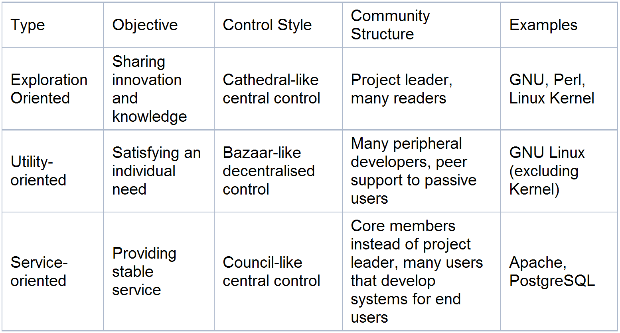
Governance Models

Slide 7
Governance Models
Meritocracies
Benevolent Dictatorships

Slide 8
Initial Barriers
Perception of “Red Tape”
Worry of losing project's flexibility and agility
Fear of losing project's strategic control
Too early for attracting new contributors,...
therefore, no need for rules yet.

Slide 9
Red Tape
But... the purpose is not to restrict contributions
Model must be simple but effective
No need of having rules for every situation
Lightweight way of guiding the project
  Clear and transparent.

Slide 10
Loss of Flexibility
Is actually an evidence of a poor / bad model
A good model should
  Increase agility
    Guiding contributors to take new directions
    But still aligned with the project goals
  Provide Alignment: clear goals
  Prevent random wandering
  Allow complementary work

Slide 11
Loss of Control
Fear of losing control to third parties
  Due to newcomers empowering
A good model should
  Provide power and restrict power
A level of leadership should always be maintained

Slide 12
The Project is too young...
Too young for attracting contributors
But not too young for lacking structure
Lack of governance model makes the project look (and be) disorganized and not very serious
Contributors don't knock twice.
  When they look at the project,
  the first impression
  may be the last one too.
Never too young

Slide 13
Project Roles
Project Lead
Committer
User
Release
Manager
Contributor
Bug
Manager

Slide 14
Linux Kernel

Slide 15
Benevolent Dictatorship Model
Dictator
Community building skills
Deep technical knowledge
Commitment and dedication
Last word in case of disagreements
Forking is always possible, so... the dictator must behave

Slide 16
Benevolent Dictatorship Model
Maintainer
High level of expertise
Dedication to quality
...that earned them respect
Bridge between the lead and the users
Executing decision of the project lead
Quality Assurance

Slide 17
Benevolent Dictatorship Model
Contributor
Open to anybody
No expectation of commitment
No specific skills
No selection process
(if maintainers have a process of code quality control)

Slide 18
Benevolent Dictatorship Model
User
The MOST important members of the community
Software with no users...
is pointless
Anyone who have a need for project X.
Moral support (developers appreciate a “thank you”)

Slide 19
Debian Governance

Slide 20
Meritocracy Model
Gives control away to community members in response to their contributions to the project
Flat structure: all members with decision making authority have the same authority

Slide 21
Meritocracy Model
Contributor
Deep technical knowledge
Commitment and dedication
Helping others

Slide 22
Meritocracy Model
Committers
Receive patches from contributors
Code review
Commit to project
Quality assurance

Slide 23
Decision Process
Lazy Consensus
Discussion
Proposal
Occasionally
Vote
Decision

Slide 24
Linux Kernel Summit
http://www.deviceguru.com/16-interviews-with-linux-kernel-hackers/

Slide 25
Linus Torvals
http://www.linuxfoundation.org/events/node/154

Slide 26
Ted Ts'o of (Linux Foundation/IBM)
http://www.linuxfoundation.org/events/node/155

Slide 27
Cris Mason (Oracle)
http://www.linuxfoundation.org/events/node/149

Slide 28
Greg Kroah-Hartman (Novell)
http://www.linuxfoundation.org/events/node/152

Slide 29
Paul Mackerras (IBM)
http://www.linuxfoundation.org/events/node/155

Slide 30
Dirk Hohndel (Intel)
http://www.linuxfoundation.org/events/node/159

Slide 31
Dave Jones (Red Hat)
http://www.linuxfoundation.org/events/node/160

Slide 32
End

