Slide 1





Open Access - I
  Dr. Luis Ibanez, Kitware
http://creativecommons.org/licenses/by/3.0/

Slide 2
© 2007 Luis Ibanez
This presentation is Copyrighted by Luis Ibanez
This presentation is distributed under the Creative Commons Attribution License 3.0:
http://creativecommons.org/licenses/by/3.0/
You are free to Reuse
You are free to Remix
Provided that you give credit to the author

Slide 3

This presentation was created using
Open Source Software
  Open Office copyright is jointly held by Sun Microsystems and Contributors.
  The software is distributed under the
  GNU Lesser General Public License Version 2.1.

Slide 4
Stealing from the Public Domain

Slide 5
The Mouse that Roared
In the March of 1998 Walt Disney Co. chairman Michael D. Eisner was involved in intense lobbying activities on Capitol Hill. At the top of Disney's agenda was a request for Congress to resolve one of Disney's most urgent problems: The copyright for Disney's crown jewel, Mickey Mouse, will expire after 2003, 75 years after the appearance in 1928 of the Disney cartoon that launched Mickey's golden career, "Steamboat Willie." In fast succession, copyrights will end for Pluto in 2006 and Goofy in 2008. Early in the next century, protections also will expire for Bambi, Dumbo, Donald Duck, Snow White and all the Seven Dwarfs. Without copyright, Disney would collect no fees for the showing of classic movies such as "Fantasia," and other companies could freely use its characters in their movies and videos.
http://www.kellogg.northwestern.edu/faculty/fedderse/ftp/other/Disney.htm

Slide 6
The Mouse that Roared
To prevent the loss of its most precious assets Disney pursued a nonmarket strategy designed and implemented by Preston Patten, Disney's head of lobbying operations. First, Disney increased its campaign contributions. Recipients of campaign money included members of key committees such as Sen. Patrick J. Leahy, D-Vt., a family friend of Eisner and ranking Democrat on the Judiciary Committee, and Rep. Howard Coble, R.-N.C., chairman of the Judiciary Subcommittee on Arts and Intellectual Property, which oversees copyright issues.
Disney contributed nearly $800,000 to political campaigns in the 1997-98 cycle.
http://www.kellogg.northwestern.edu/faculty/fedderse/ftp/other/Disney.htm

Slide 7
The Mouse that Roared
In 1998 this strategy bore fruit.
In the Spring of 1998, the U.S. House of Representatives debated
HR2589
(sponsored by Rep. Coble):
The Copyright Term Extension Bill.
The bill would extend the 75-year copyright by 20 years. It would thus grant Disney exclusive rights to the images for another generation and make it harder for them to be reproduced by other manufacturers when copyrights run out.
http://www.kellogg.northwestern.edu/faculty/fedderse/ftp/other/Disney.htm

Slide 8
Collateral Damage
Copyright laws apply
to more
than the Evil Mouse...
They also apply to
scientific publications

Slide 9
Scientific Research
US GDP $13 Trillion
Federal Budget $ 2.4 Trillion
Federal Research Budget $143 Billion
  Defense $ 80 Billion
  Health $ 30 Billion
  NASA $ 12 Billion
  Energy $ 9 Billion
  NSF $ 4.5 Billion
  EPA $ 0.5 Billion

Slide 10
NIH Institutes Budget
Cancer $ 4.8 Billion
Infectious Diseases $ 4.6 Billion
Heart Lung and Blood $ 2.9 Billion
Aging $ 1.0 Billion
National Library of Medicine $ 0.3 Billion
Biomedical Imaging $ 0.3 Billion

Slide 11
NIH Research
NIH Budget $ 29 Billion
Outcome $ 65,000~60,000 papers
Cost of 1 paper $ 550,000
Cost of publishing 1 paper $ 2,500
0.5 ~ 1%

Slide 12
Publish or Perish
Papers
Journals
Scholarly
Societies
(IEEE, ACM)
Papers
Journals
Commercial
Publishers
(Elsevier, Springer)
Papers
Journals
Author
Papers
Journals
Papers

Slide 13
Peer Review
Scholarly
Societies
(IEEE, ACM)
Journals
Paper
Editor
Author
Reviewer
Reviewer
Reviewer

Slide 14
Copyright Transfer
Scholarly
Societies
(IEEE, ACM)
Paper
Journals
Library
Author
Reader
Reader
Reader
Librarian

Slide 15
Scholarly Publishing Economics
Do Authors get paid ?
Do Reviewers get paid ?
Do Associate Editors get paid ?
Do Editors get paid ?
Who's rights do Copyright
cover in a scholarly publication ?
Do Authors pay for publishing ?
Do Readers pay for reading ?

Slide 16
Intellectual Production
No Researcher
Left behind

Slide 17
Lack of technological innovation is a symptom of monopolies

Slide 18
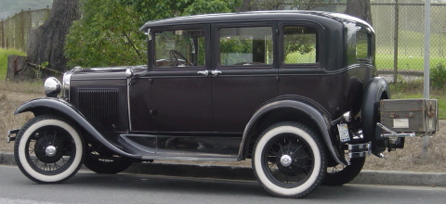
1927
Ford Model A

Slide 19
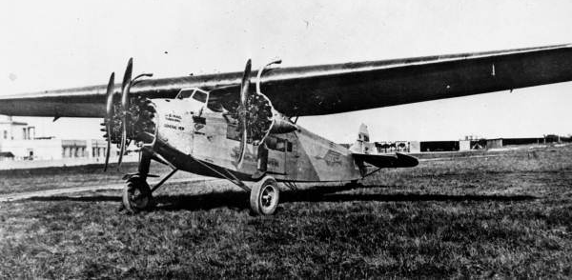
1927
Fokker F. VII
This photo comes from the Florida Photographic Collection

Slide 20
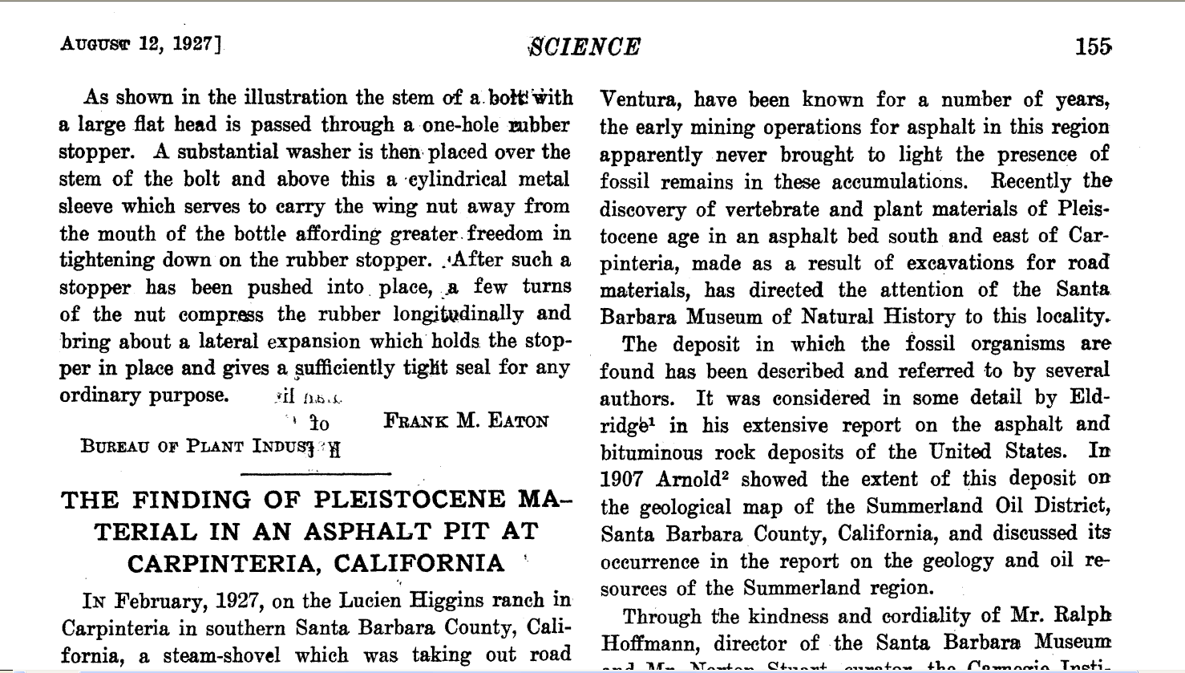
1927
Science Magazine Paper

Slide 21
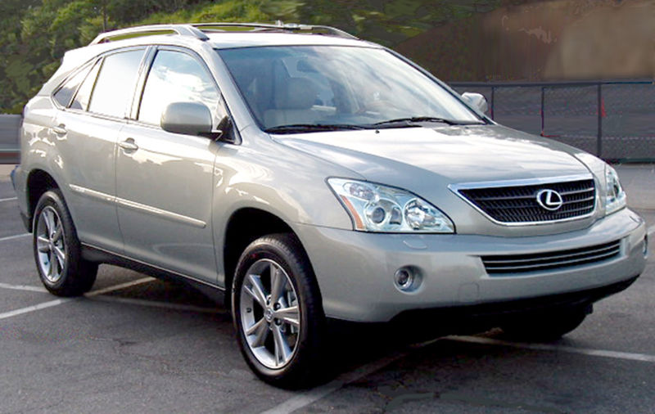
2007
Lexus RX

Slide 22
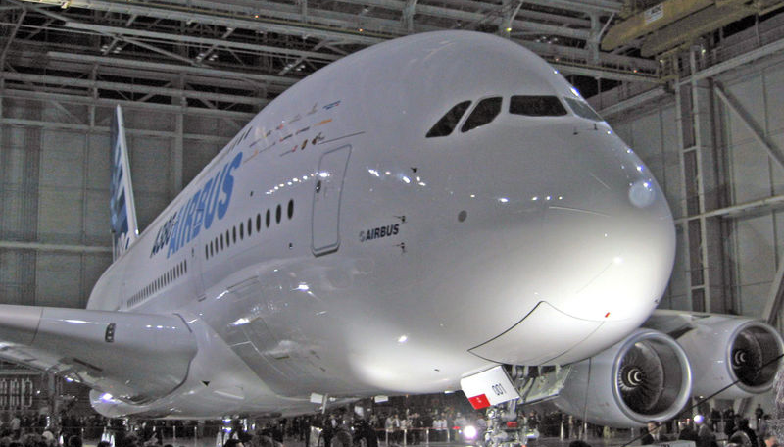
2007
Airbus 380

Slide 23
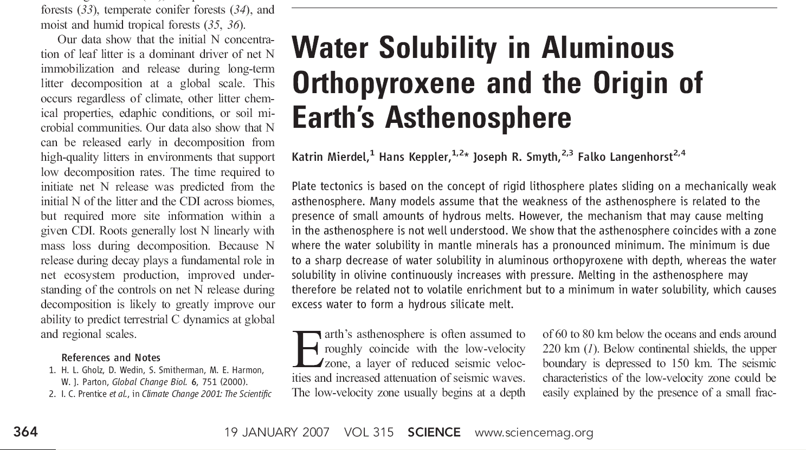
2007
Science Magazine Paper

Slide 24
The fundamental methods
of scientific publishing
have not changed
in the last 80 years.

Slide 25
However…
Many things
have changed

Slide 26






The Information Age

Slide 27
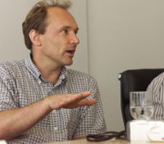
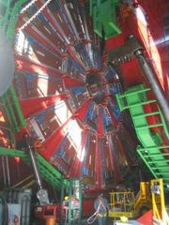
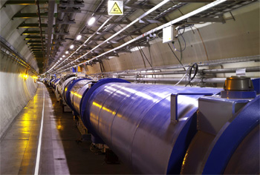
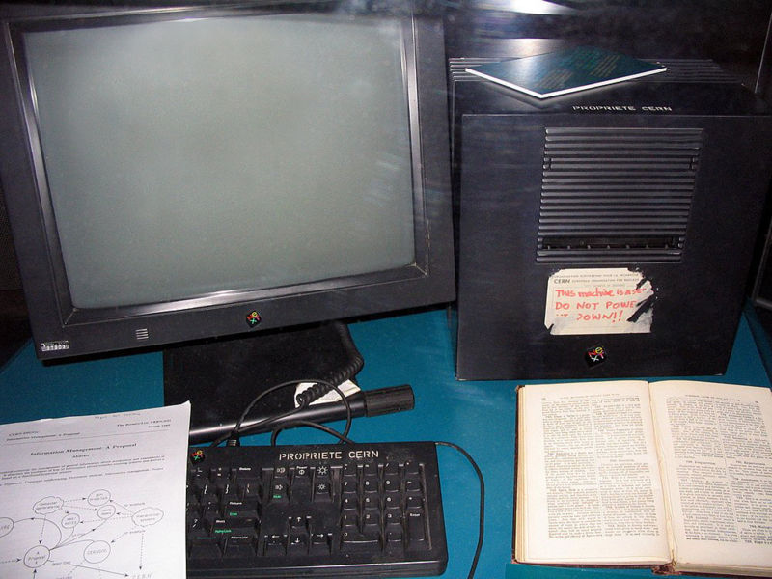
The Web-HTML Irony
Tim Berners Lee
First Web Server
CERN
HTML

Slide 28
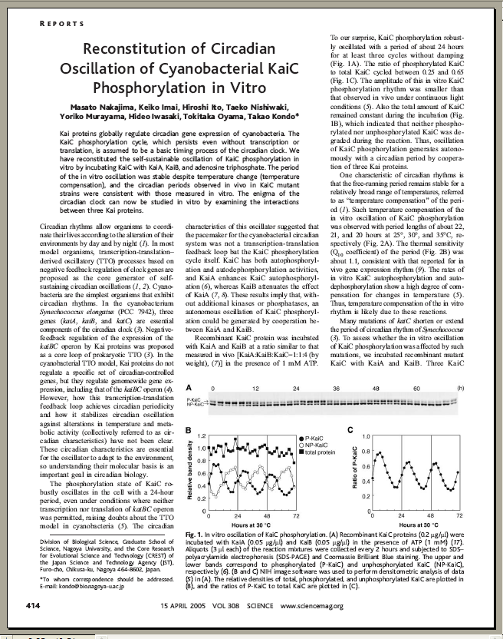
And still “Papers” are…
10 Pages
2D Representations
90% Text
5% Diagrams
5% Pictures
Color (optional)

Slide 29
In Traditional Journals…
What You See
is What You Get

Slide 30
In fact…
That is the ONLY
thing you get

Slide 31
The Insight Journal
The next generation
of publishing technology

Slide 32
The Insight Journal
Technical work must be reproducible
Papers should be publicly accessible
Fully Electronic publishing
Open peer-review

Slide 33
The Insight Journal
Reproducibility requires sharing
  Source code
  Images
  Parameters
Open source
  Existing algorithms provide services
  New algorithms should be made available to others

Slide 34
Submission for the IJ
PDF doc
Journal
Repository
Code
Input
Data
Author
Web
Site
Build
Machines
Results
Data

Slide 35
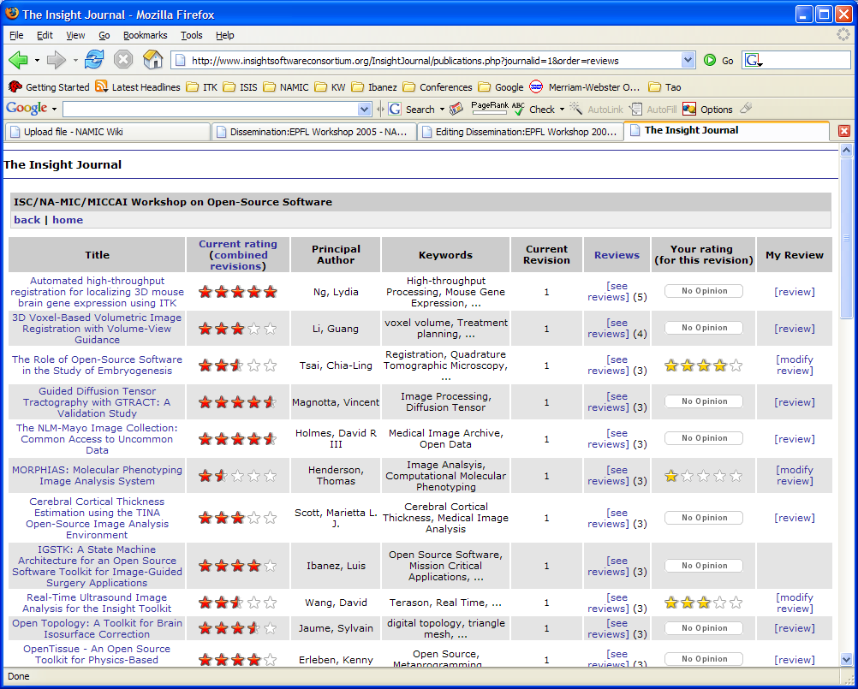

Slide 36
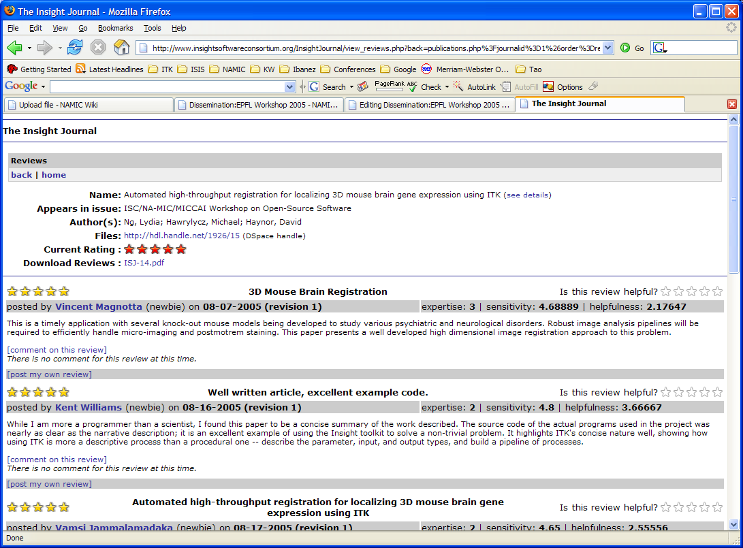

Slide 37
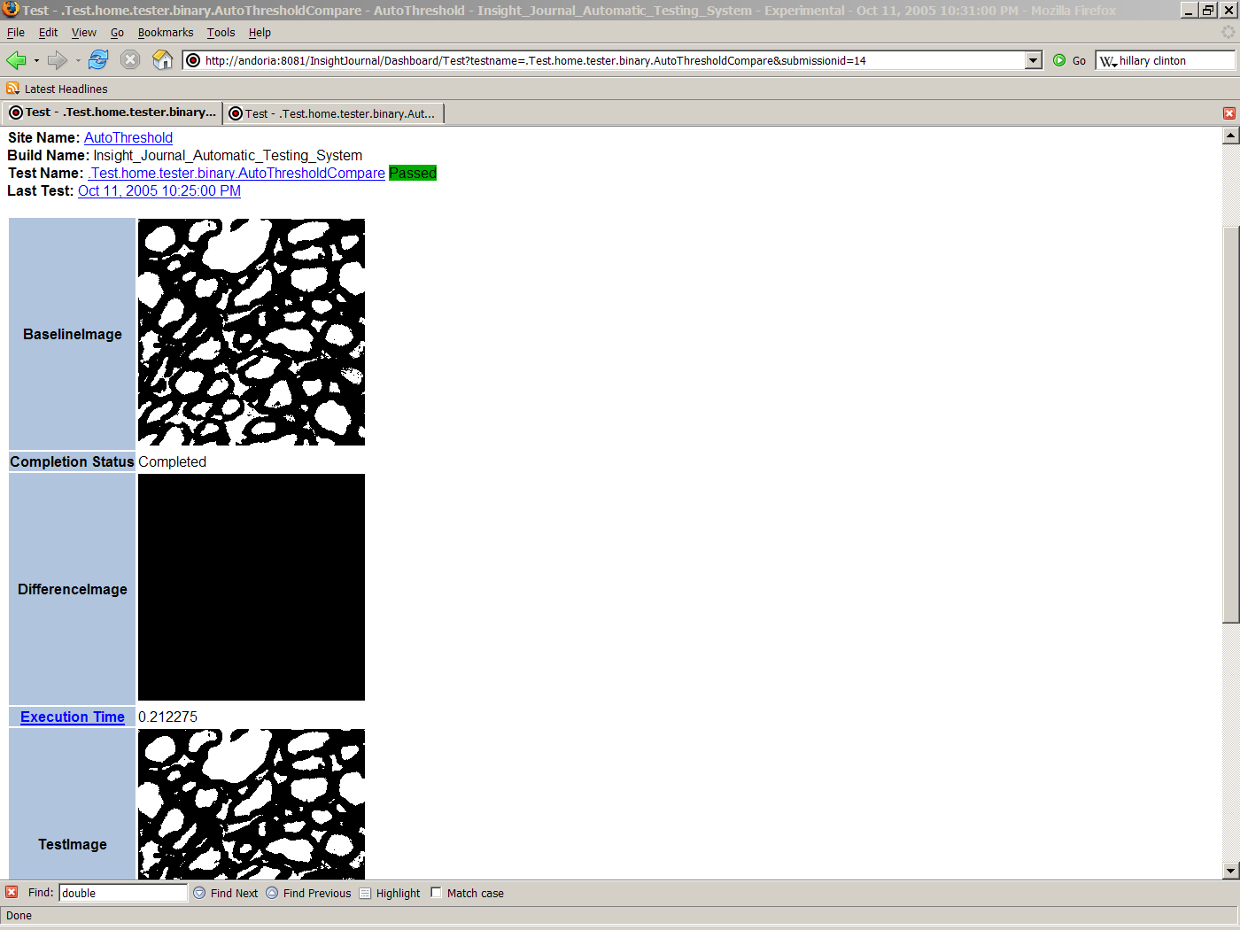
Comparison of output images
Publicly available
Tests for non-trivial images
Reviewers and readers
can use it as a first view
of the paper.
Results Verification

Slide 38
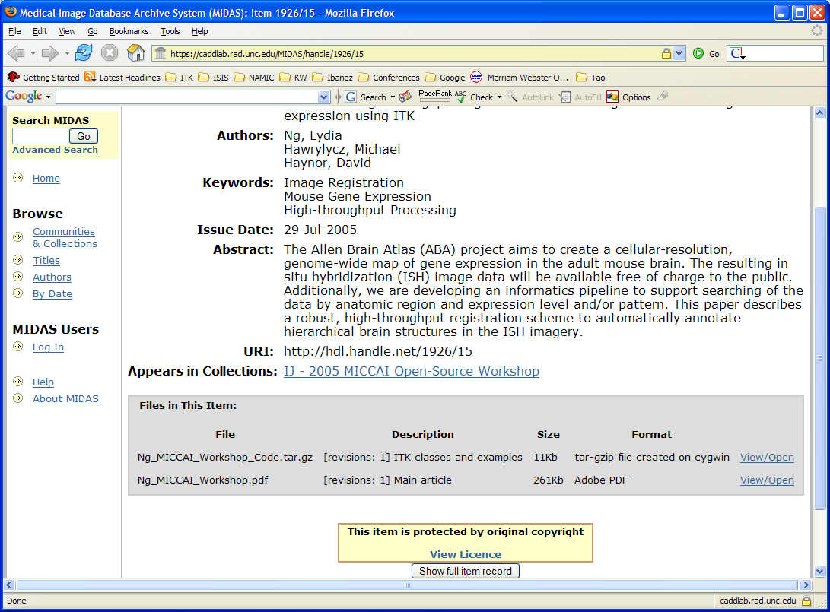

Slide 39
Benefits of the Insight Journal
Allows sharing your Source Code
  Faster and larger impact on the community
Immediate feedback from Readers and Reviewers
  Open Dialog / Forum
No Limitations
  No page limitations
  No limit or charges for color figures
  Accepting additional electronic material

Slide 40
Benefits of the Insight Journal
Indexed by Google
Post revisions of papers and code
Richer readers experience
  Source code available
  Original parameters and images available
  Reader can try on their own data
Accepts practical contributions
  complimentary to full Journal Papers

Slide 41
Benefits of the Insight Journal
No Time Constraints
  Continuous submission process
  Continuous peer-review
  Continuous submission of revision (paper/code)
  Thanks to not using Paper !

Slide 42
The Future

Slide 46
Other Open Access Journals
PLoS
BioMed Central
ArXiv

Slide 47
End

