Slide 1





Open Access - I
  Dr. Luis Ibanez, Kitware
http://creativecommons.org/licenses/by/3.0/

Slide 2
© 2007 Luis Ibanez
This presentation is Copyrighted by Luis Ibanez
This presentation is distributed under the Creative Commons Attribution License 3.0:
http://creativecommons.org/licenses/by/3.0/
You are free to Reuse
You are free to Remix
Provided that you give credit to the author

Slide 3

This presentation was created using
Open Source Software
  Open Office copyright is jointly held by Sun Microsystems and Contributors.
  The software is distributed under the
  GNU Lesser General Public License Version 2.1.

Slide 4
US CDC Mortality Statistics
College Age Range
Accident (car)
Suicide
Cancer
Heart disease
Homicide
HIV

Slide 5
US CDC Mortality Statistics
2,397,615 deaths in 2004
Diseases of Heart 652,486
Malignant Neoplasm (cancer) 553,888
Cerebro-vascular disease 150,074
Chronic respiratory disease 121,987
Accidents (unintentional) 112,012
Diabetes 73,138
Alzheimer's disease 65,965
Influenza and neumonia 59,664

Slide 6
US CDC Mortality Statistics
2,397,615 deaths in 2004
Nephritis (Kidney) 42,480
Septicemia 33,373
Suicide 32,439
Chronic Liver disease 27,013
Hypertension 23,076
Parkinson's 17,989
Homicide 17,357
Other 414,674

Slide 7
US CDC - Life Expectancy
Male 75 years
Female 80 years

Slide 8
Scientific Research
US GDP $13 Trillion
Federal Budget $ 2.4 Trillion
Federal Research Budget $143 Billion
  Defense $ 80 Billion
  Health $ 30 Billion
  NASA $ 12 Billion
  Energy $ 9 Billion
  NSF $ 4.5 Billion
  EPA $ 0.5 Billion

Slide 9
NIH Institutes Budget
Cancer $ 4.8 Billion
Infectious Diseases $ 4.6 Billion
Heart Lung and Blood $ 2.9 Billion
Aging $ 1.0 Billion
National Library of Medicine $ 0.3 Billion
Biomedical Imaging $ 0.3 Billion

Slide 10
HR2589
Longevity Agent
Can extend lifespan from 75 years to 95 years !!

Slide 11
Pierce the Illusion... to see the void.

Slide 12
The Mouse that Roared
In the March of 1998 Walt Disney Co. chairman Michael D. Eisner was involved in intense lobbying activities on Capitol Hill. At the top of Disney's agenda was a request for Congress to resolve one of Disney's most urgent problems: The copyright for Disney's crown jewel, Mickey Mouse, will expire after 2003, 75 years after the appearance in 1928 of the Disney cartoon that launched Mickey's golden career, "Steamboat Willie." In fast succession, copyrights will end for Pluto in 2006 and Goofy in 2008. Early in the next century, protections also will expire for Bambi, Dumbo, Donald Duck, Snow White and all the Seven Dwarfs. Without copyright, Disney would collect no fees for the showing of classic movies such as "Fantasia," and other companies could freely use its characters in their movies and videos.
http://www.kellogg.northwestern.edu/faculty/fedderse/ftp/other/Disney.htm

Slide 13
The Mouse that Roared
To prevent the loss of its most precious assets Disney pursued a nonmarket strategy designed and implemented by Preston Patten, Disney's head of lobbying operations. First, Disney increased its campaign contributions. Recipients of campaign money included members of key committees such as Sen. Patrick J. Leahy, D-Vt., a family friend of Eisner and ranking Democrat on the Judiciary Committee, and Rep. Howard Coble, R.-N.C., chairman of the Judiciary Subcommittee on Arts and Intellectual Property, which oversees copyright issues.
Disney contributed nearly $800,000 to political campaigns in the 1997-98 cycle.
http://www.kellogg.northwestern.edu/faculty/fedderse/ftp/other/Disney.htm

Slide 14
The Mouse that Roared
In 1998 this strategy bore fruit.
In the Spring of 1998, the U.S. House of Representatives debated
HR2589
(sponsored by Rep. Coble):
The Copyright Term Extension Bill.
The bill would extend the 75-year copyright by 20 years. It would thus grant Disney exclusive rights to the images for another generation and make it harder for them to be reproduced by other manufacturers when copyrights run out.
http://www.kellogg.northwestern.edu/faculty/fedderse/ftp/other/Disney.htm

Slide 15
Collateral Damage
Copyright laws apply
to more
than the Evil Mouse...
They also apply to
scientific publications

Slide 16
NIH Research
NIH Budget $ 29 Billion
Outcome $ 65,000~60,000 papers
Cost of 1 paper $ 550,000
Cost of publishing 1 paper $ 2,500
0.5 ~ 1%

Slide 17
Publish or Perish
Papers
Journals
Scholarly
Societies
(IEEE, ACM)
Papers
Journals
Commercial
Publishers
(Elsevier, Springer)
Papers
Journals
Author
Papers
Journals
Papers

Slide 18
Peer Review
Scholarly
Societies
(IEEE, ACM)
Journals
Paper
Editor
Author
Reviewer
Reviewer
Reviewer

Slide 19
Copyright Transfer
Scholarly
Societies
(IEEE, ACM)
Paper
Journals
Library
Author
Reader
Reader
Reader
Librarian

Slide 20
Scholarly Publishing Economics
Do Authors get paid ?
Do Reviewers get paid ?
Do Associate Editors get paid ?
Do Editors get paid ?
Who's rights do Copyright
cover in a scholarly publication ?
Do Authors pay for publishing ?
Do Readers pay for reading ?

Slide 21
Intellectual Production
“No Researcher
Left behind”

Slide 22
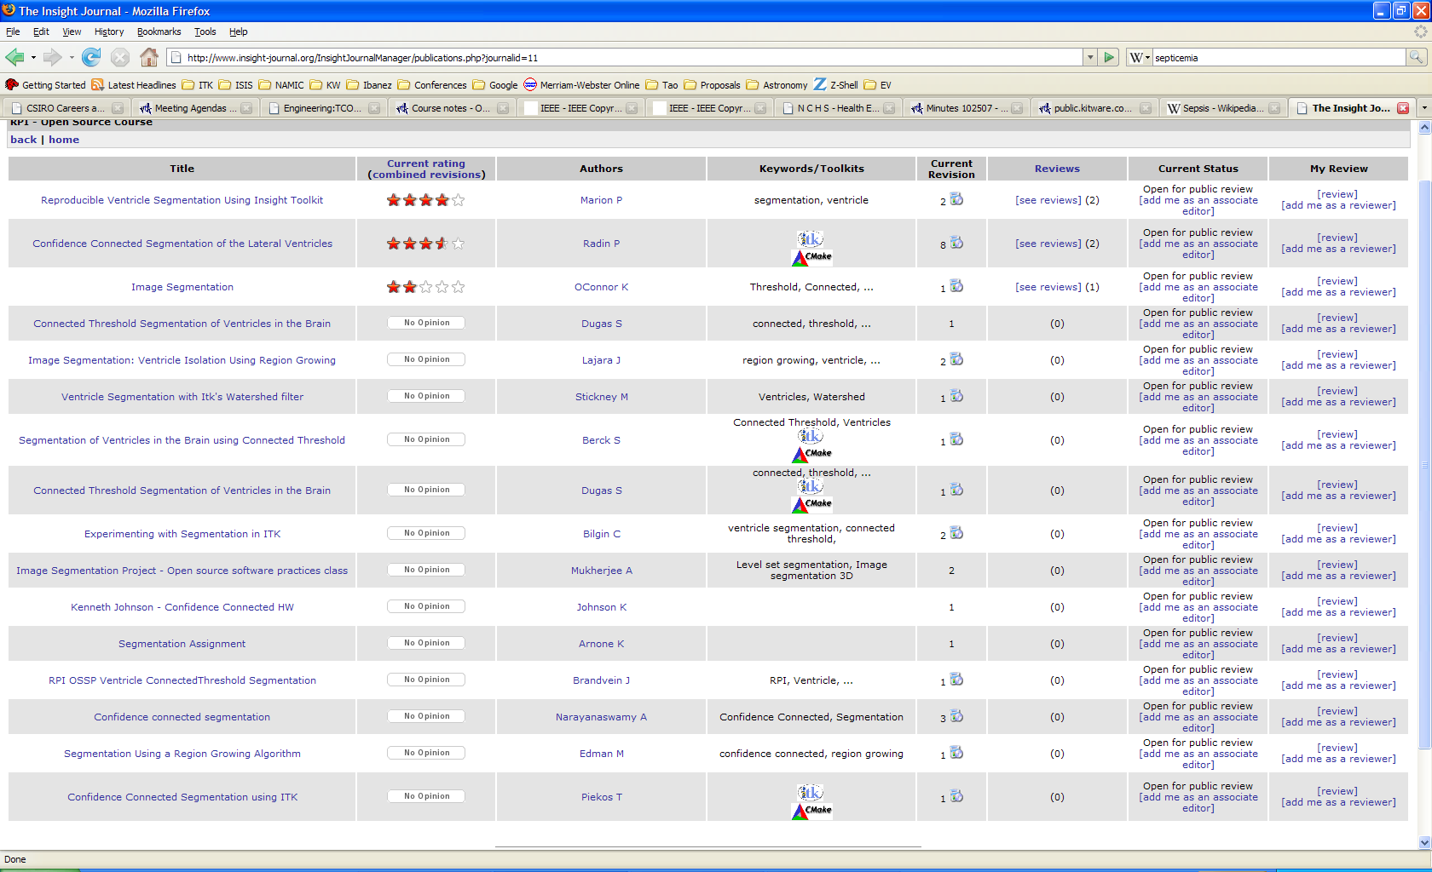
Scholarly Publishing

Slide 23
Exercise

Slide 24
End

