Slide 1





Open Access
Dr. Luis Ibanez, Kitware
http://creativecommons.org/licenses/by/3.0/

Slide 2
© 2007-2014 Luis Ibanez
This presentation is Copyrighted by Luis Ibanez
This presentation is distributed under the Creative Commons Attribution License 3.0:
http://creativecommons.org/licenses/by/3.0/
You are free to Reuse
You are free to Remix
Provided that you give credit to the author

Slide 3
This presentation was created using
Open Source Software
Open Office copyright is jointly held by
Sun Microsystems and Contributors.
The software is distributed under the
GNU Lesser General Public License Version 3.0.

Slide 4
Open Access

Slide 5

Open Access

Slide 6
Quiz
How many Books have been published ?
How many Articles and Essays ?
How many Songs ?
How many Images ?
How many Movies ?
How many Videos, TV Shows and Short Films ?
How many public Web Pages ?

Slide 7
Published Human Knowledge
32 Million Books
750 Million Articles and Essays
25 Million Songs
500 Million Images
500,000 Movies
3 Million Videos, TV Shows and Short Films
100 Billion public Web Pages
http://www.kk.org/writings/scan_this_book.php

Slide 8
Total Amount to Store ?
50 Peta Bytes !
http://en.wikipedia.org/wiki/Petabyte
http://www.nytimes.com/2006/05/14/magazine/14publishing.html

Slide 9
But... We keep writing...
Stock of
Human Knowledge
doubles
every
5 years
http://www.nytimes.com/2006/05/14/magazine/14publishing.html

Slide 10
Scientific Research

Slide 11
Scientific Research (Budget - 2010)
US GDP (2008) $14.2 Trillion
Federal Budget $ 3.6 Trillion
Federal Research Budget $147 Billion
  Defense $ 80 Billion
  Health $ 31 Billion
  NASA $ 11 Billion
  Energy $ 10 Billion
  NSF $ 5 Billion
  EPA $ 0.6 Billion
http://www.aaas.org/spp/rd/rdreport2010/tbli01.pdf

Slide 12
NIH Institutes Budget (2010)
Cancer $ 5.2 Billion
Infectious Diseases $ 4.7 Billion
Heart Lung and Blood $ 3.0 Billion
Aging $ 1.1 Billion
National Library of Medicine $ 0.3 Billion
Biomedical Imaging $ 0.3 Billion
http://officeofbudget.od.nih.gov/pdfs/FY10/Tabular%20Data.pdf

Slide 13
NIH Research
NIH Budget $ 30 Billion
Outcome $ 65,000~60,000 papers
Cost of 1 paper $ 550,000
Cost of publishing 1 paper $ 2,500
0.5 ~ 1%

Slide 14
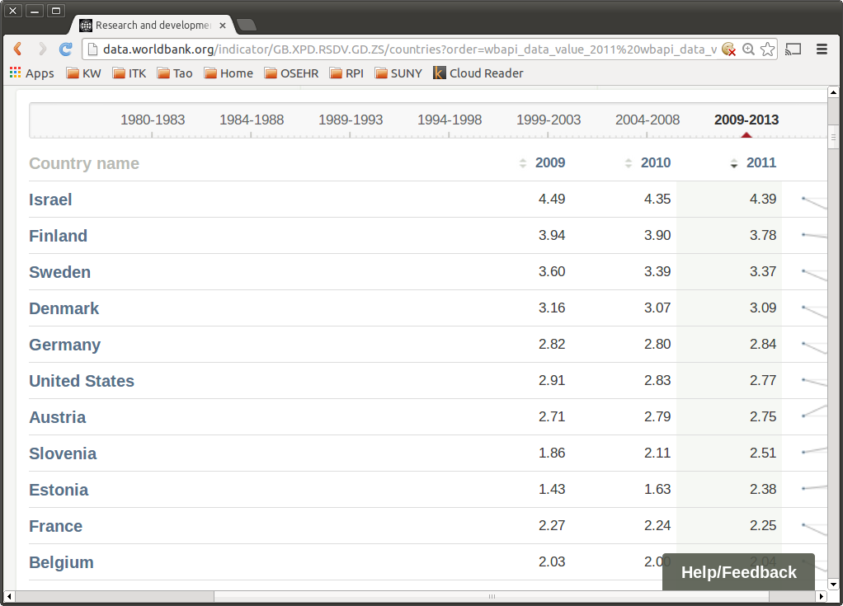
http://data.worldbank.org/indicator/GB.XPD.RSDV.GD.ZS/countries

Slide 15
Publish or Perish
Papers
Journals
Scholarly
Societies
(IEEE, ACM)
Papers
Journals
Commercial
Publishers
(Elsevier, Springer)
Papers
Journals
Author
Papers
Journals
Papers

Slide 16
Peer Review
Scholarly
Societies
(IEEE, ACM)
Journals
Paper
Editor
Author
Reviewer
Reviewer
Reviewer

Slide 17
Copyright Transfer
Scholarly
Societies
(IEEE, ACM)
Paper
Journals
Library
Author
Reader
Reader
Reader
Librarian

Slide 18
Scholarly Publishing Economics
Do Authors get paid ?
Do Reviewers get paid ?
Do Associate Editors get paid ?
Do Editors get paid ?
Who's rights do Copyright
cover in a scholarly publication ?
Do Authors pay for publishing ?
Do Readers pay for reading ?

Slide 19
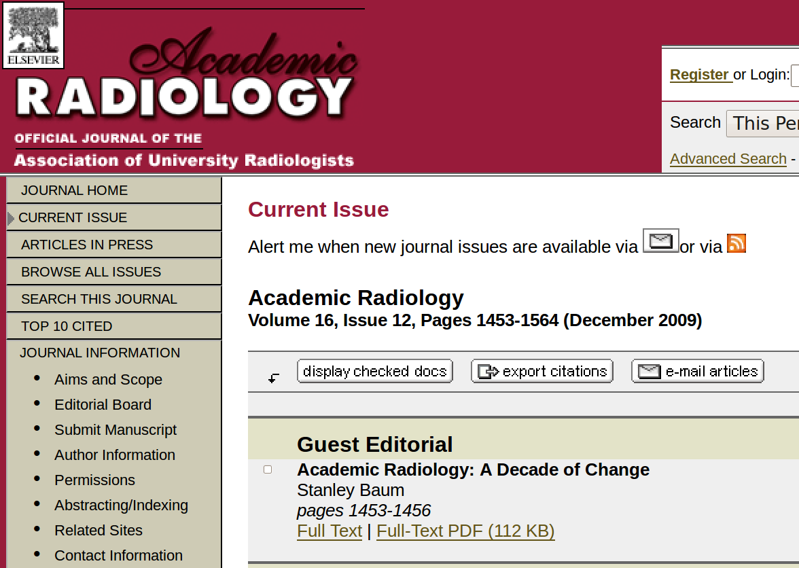
Traditional Publishing

Slide 20
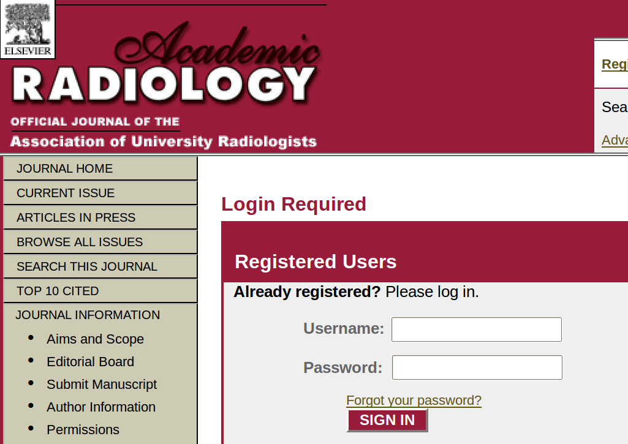
Traditional Publishing

Slide 21
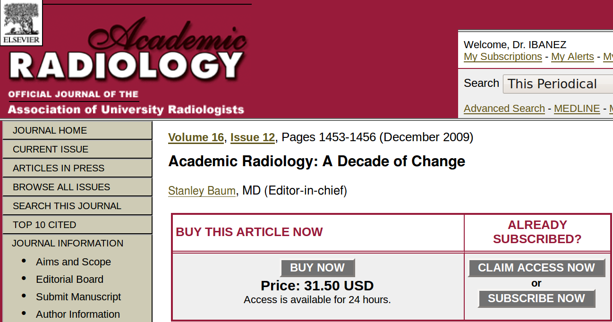
Traditional Publishing

Slide 22
Lack of technological innovation is a symptom of monopolies

Slide 23
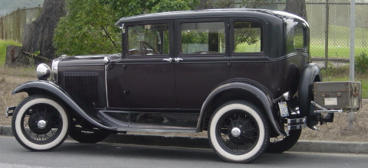
1927
Ford Model A

Slide 24
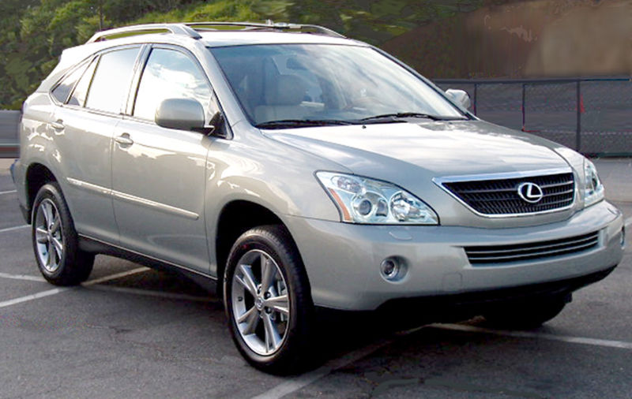
2007
Lexus RX

Slide 25
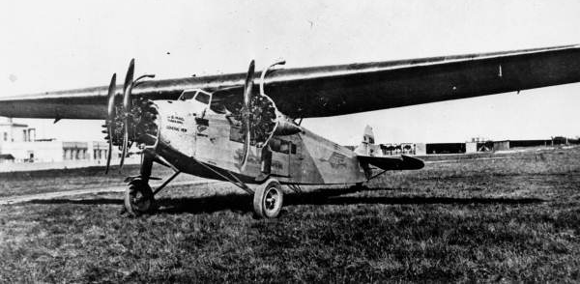
1927
Fokker F. VII
This photo comes from the Florida Photographic Collection

Slide 26
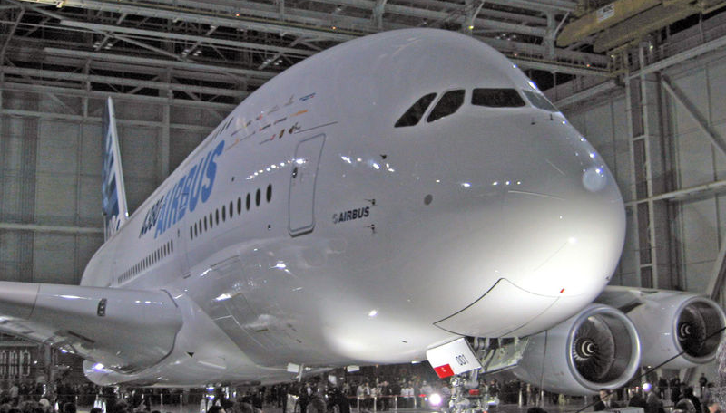
2007
Airbus 380

Slide 27
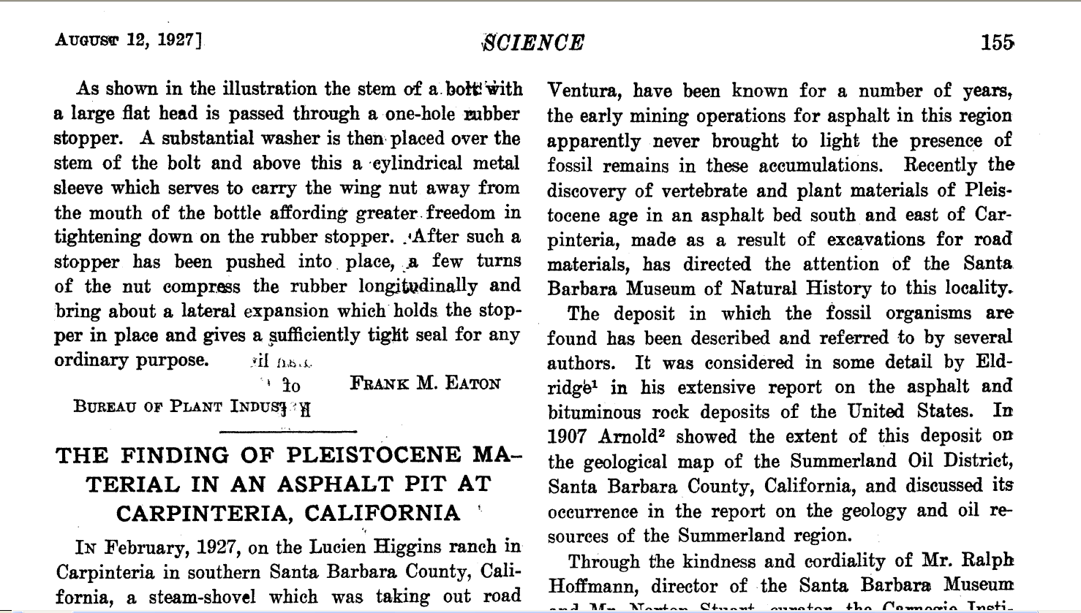
1927
Science Magazine Paper

Slide 28
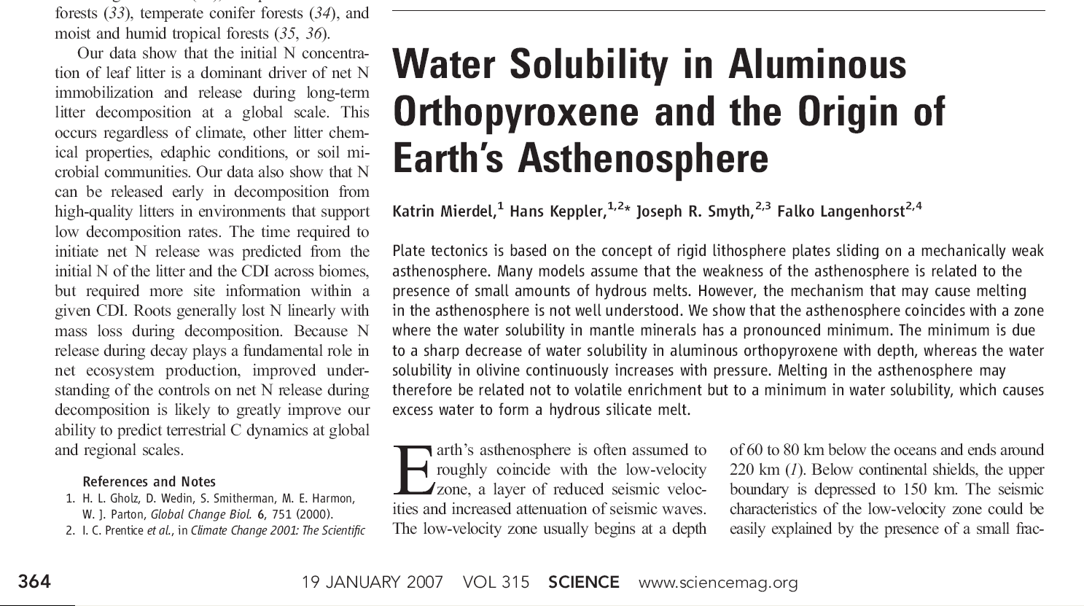
2007
Science Magazine Paper

Slide 29
The fundamental methods
of scientific publishing
have not changed
in the last 80 years.

Slide 30
However…
Many things
have changed

Slide 31






The Information Age

Slide 32

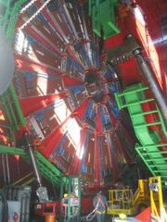
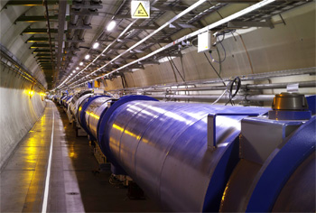
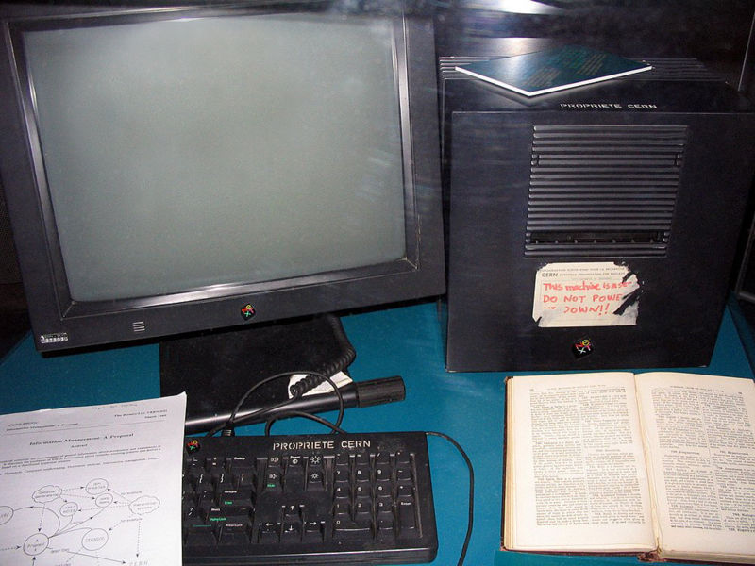
The Web-HTML Irony
Tim Berners Lee
First Web Server
CERN
HTML

Slide 33
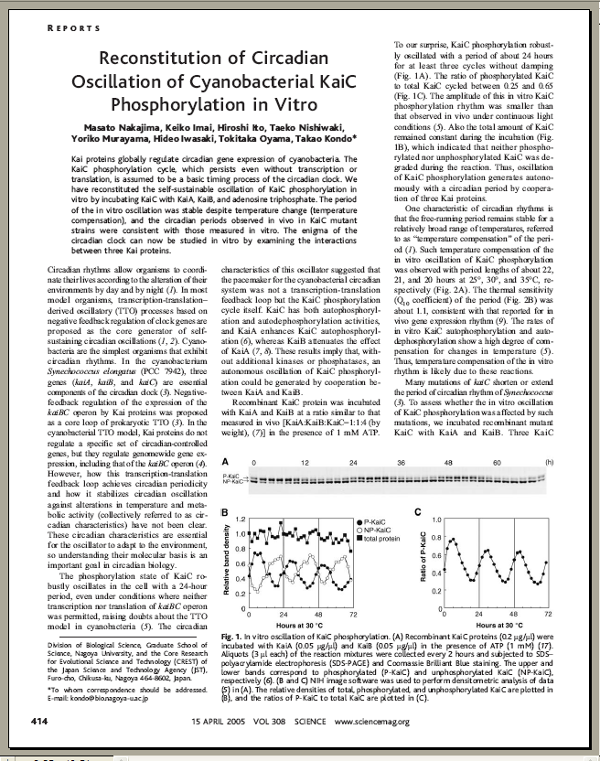
And still “Papers” are…
10 Pages
2D Representations
90% Text
5% Diagrams
5% Pictures
Color (optional)

Slide 34
In Traditional Journals…
What You See
is What You Get

Slide 35
In fact…
That is the ONLY
thing you get

Slide 36
Open Access

Slide 37
Open Access – Patient Advocate
http://vimeo.com/1899536

Slide 38
Open Access - Benefits
http://www.youtube.com/watch?v=g2JT23E1bRE

Slide 39
Open Access - Middle School
http://vimeo.com/1829969

Slide 40
Open Access – Funding Agencies
http://vimeo.com/1865535

Slide 41
Open Access – Peter Suber
http://www.youtube.com/watch?v=tStVPr0PSEQ&feature=related
Peter Suber of SPARC speaks at a Berkman Center for Internet and Society talk on the future of open access in scholarly publications and research.
(1:06:17)

Slide 42
Open Access
Journals

Slide 43
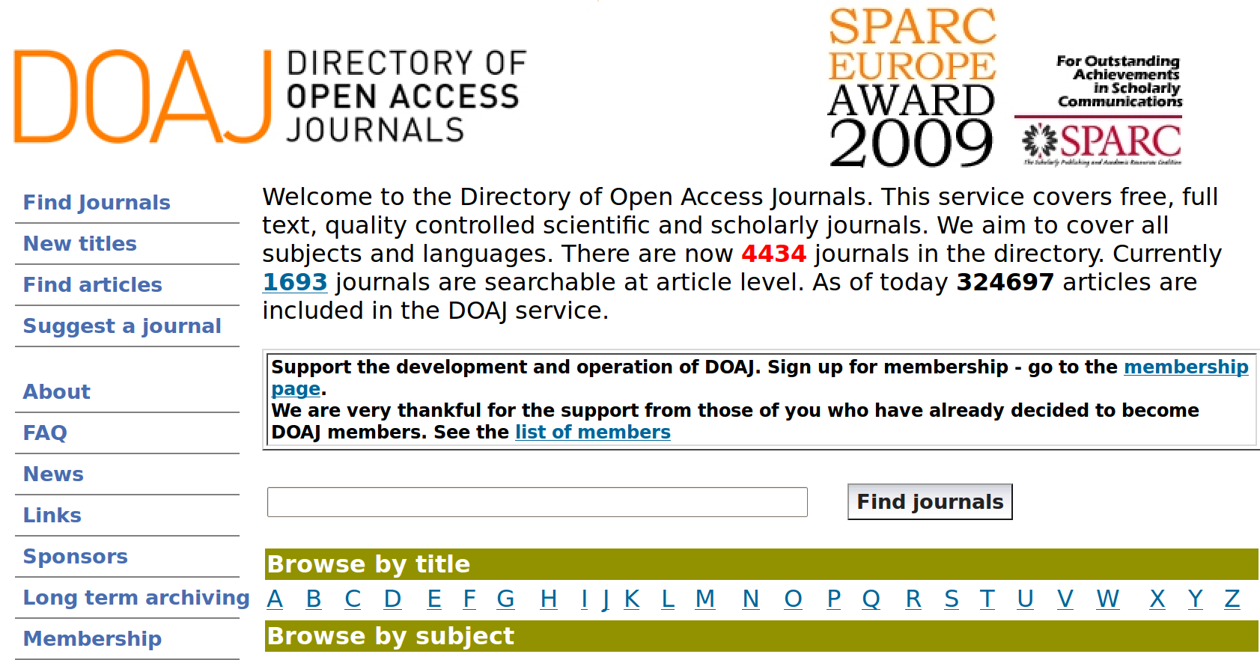
Directory of Open Access Journals
http://www.doaj.org/

Slide 44
Key Open Access Journals
BioMed Central
ArXiv
PLoS

Slide 45
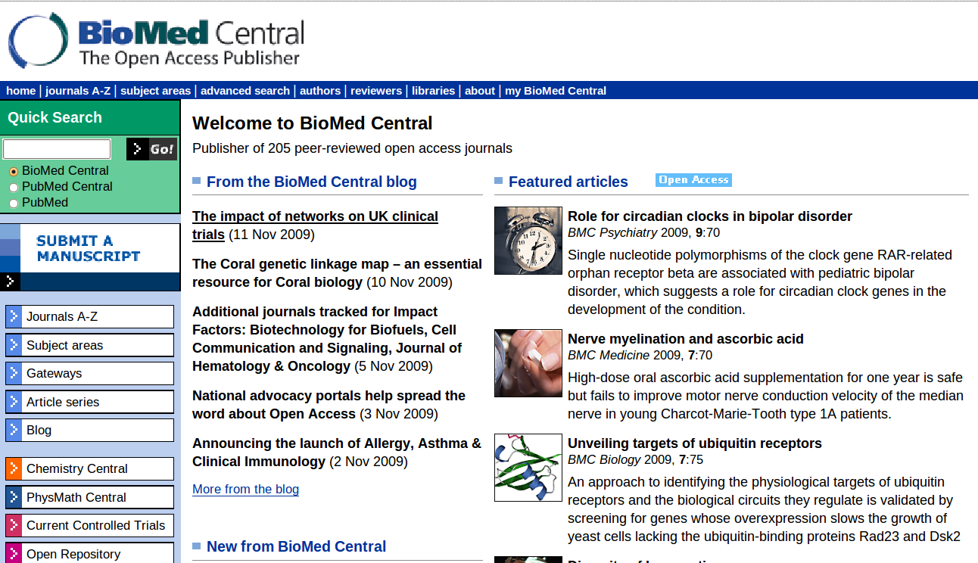
BioMed Central

Slide 46
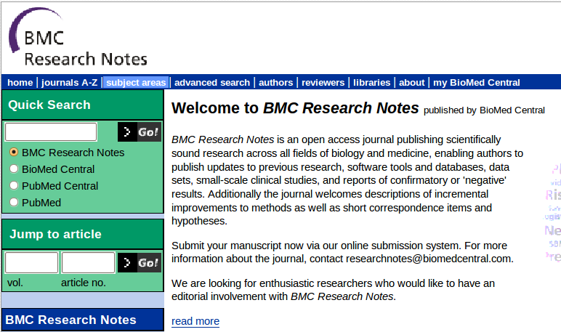
BioMedCentral – Research Notes

Slide 47
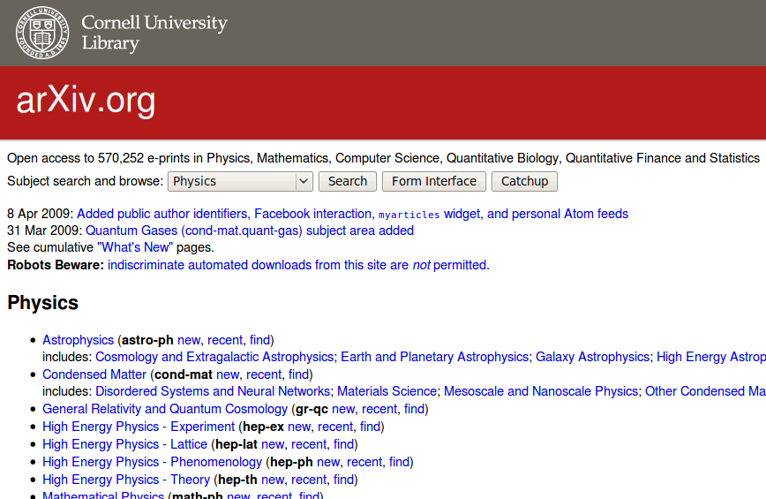
arXiv
http://arxiv.org/

Slide 48

PLoS
Committed to making the world’s
scientific and medical literature
a public resource

Slide 49
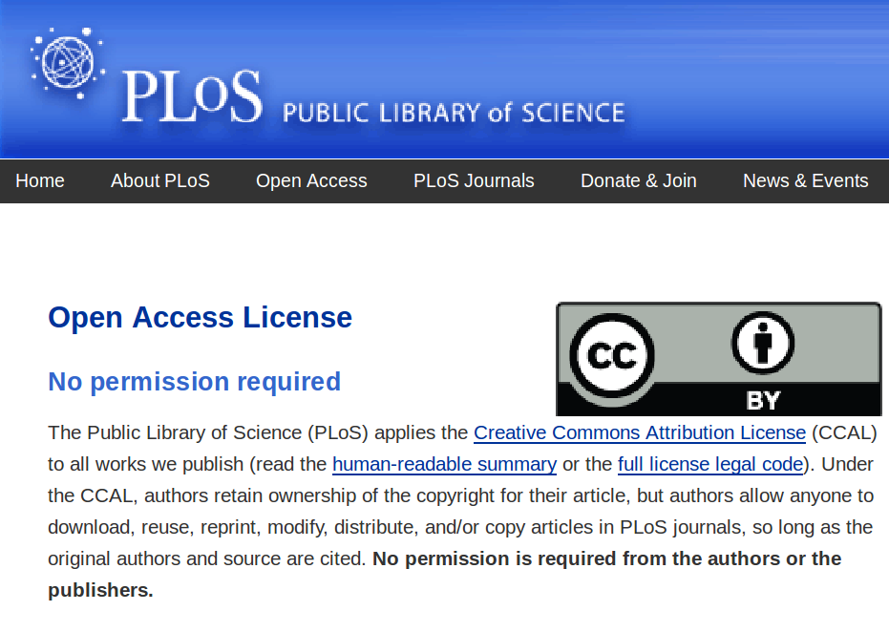

Slide 50
PloS ONE
Integration of text and
3D visualization
http://www.plosone.org/enhanced/pone.0006975/

Slide 51
Your Tax Dollars at Work !

Slide 52
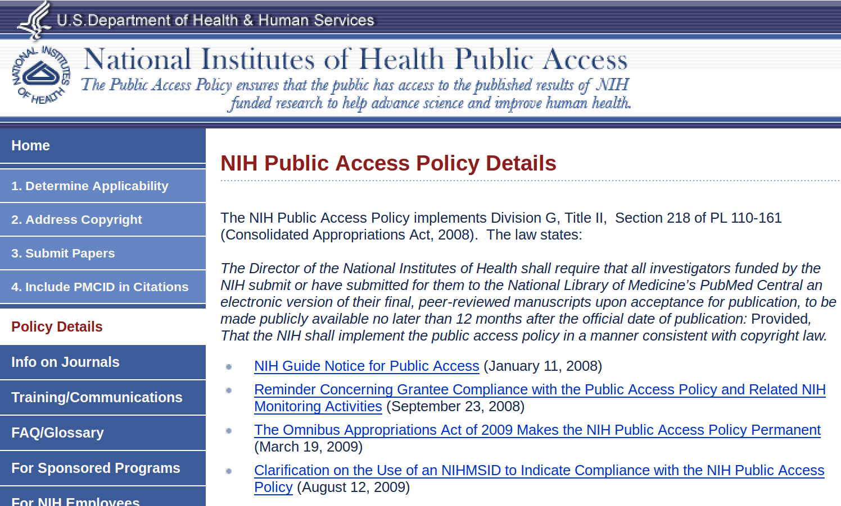
NIH – Public Access Policy

Slide 53
NIH – Public Access Policy
The NIH Public Access Policy implements Division G, Title II, Section 218 of PL 110-161 (Consolidated Appropriations Act, 2008). The law states:
The Director of the National Institutes of Health shall require that all investigators funded by the NIH submit or have submitted for them to the National Library of Medicine’s PubMed Central an electronic version of their final, peer-reviewed manuscripts upon acceptance for publication, to be made publicly available no later than 12 months after the official date of publication: Provided, That the NIH shall implement the public access policy in a manner consistent with copyright law.

Slide 54
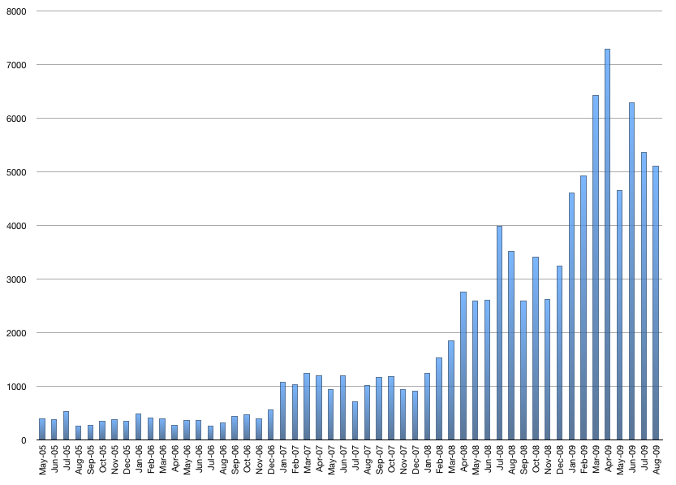
NIH -Manuscript Submission System
This chart represents the number of manuscripts received by NIHMS
and approved for processing by the author/PI for a given month.
http://www.nihms.nih.gov/stats/index.shtml

Slide 55
Open Data

Slide 56
Open Access - Genomes
Is the Human Genome Copyrighted ?
Is it Patented ?
  20% of Human Genes are Patented.

Slide 57
Challenging Gene Patents
Judge OKs Challenge to Human-Gene Patentshttp://www.wired.com/threatlevel/2009/11/genes/
Cancer Patients Challenge
the Patenting of a Gene http://www.nytimes.com/2009/05/13/health/13patent.html

Slide 58
Open Access the Human Genome
wget -m ftp://ftp.ncbi.nih.gov/genomes/H_sapiens/Assembled_chromosomes/

Slide 59
Open Access the Human Genome
sudo apt-get install ugene
Or
sudo yum install ugene

Slide 60
Open Access the Human Genome
ftp://ftp.ncbi.nih.gov/genomes/H_sapiens/
ftp://ftp.ncbi.nih.gov/genomes/H_sapiens/Assembled_chromosomes/
http://en.wikipedia.org/wiki/Genetic_code

Slide 61
Open Access – Other Genomes
ftp://ftp.ncbi.nih.gov/genomes/
ftp://ftp.ncbi.nih.gov/genomes/Viruses/Influenza_A_virus__A_Puerto_Rico_8_34_H1N1_ /

Slide 62
The Future

Slide 63
The Insight Journal
The next generation
of publishing technology

Slide 64
The Insight Journal
Technical work must be reproducible
Papers should be publicly accessible
Fully Electronic publishing
Open peer-review

Slide 65
The Insight Journal
Reproducibility requires sharing
  Source code
  Images
  Parameters
Open source
  Existing algorithms provide services
  New algorithms should be made available to others

Slide 66
Submission for the IJ
PDF doc
Journal
Repository
Code
Input
Data
Author
Web
Site
Build
Machines
Results
Data

Slide 67
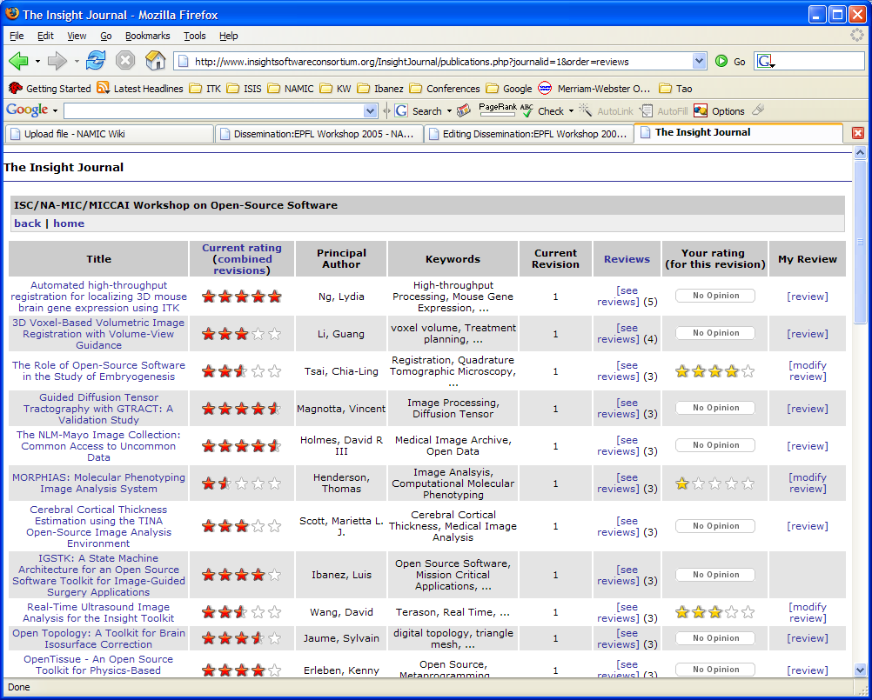

Slide 68
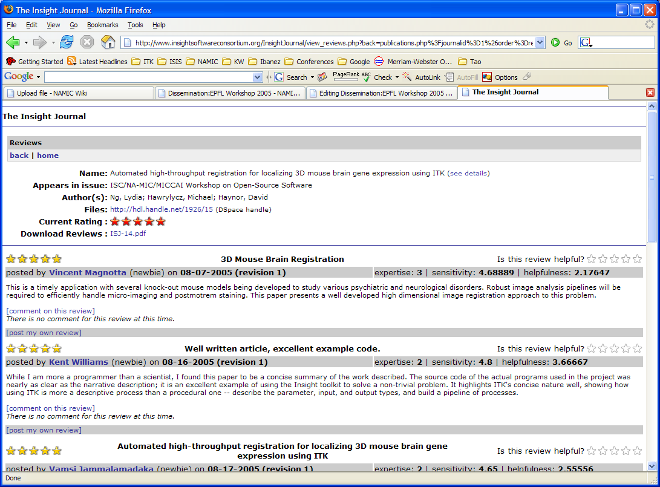

Slide 69
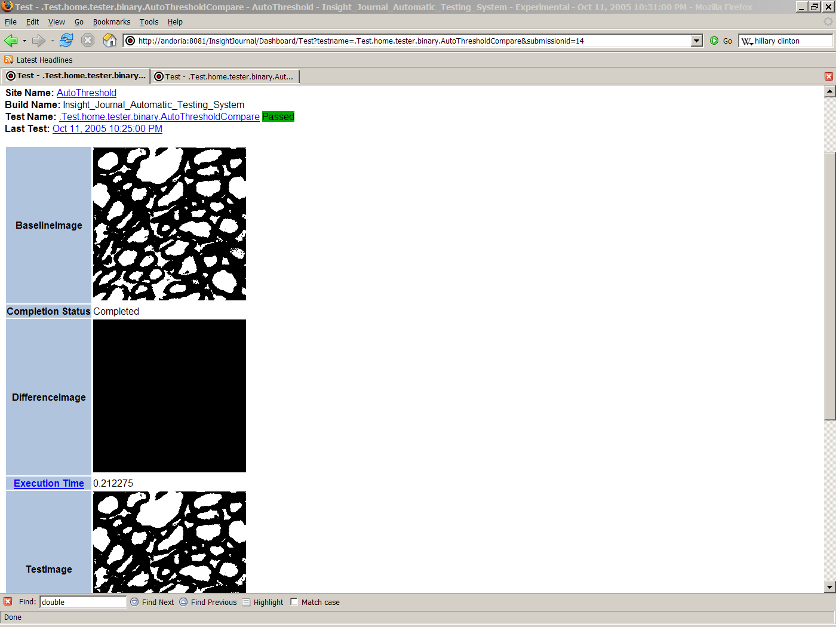
Comparison of output images
Publicly available
Tests for non-trivial images
Reviewers and readers
can use it as a first view
of the paper.
Results Verification

Slide 70
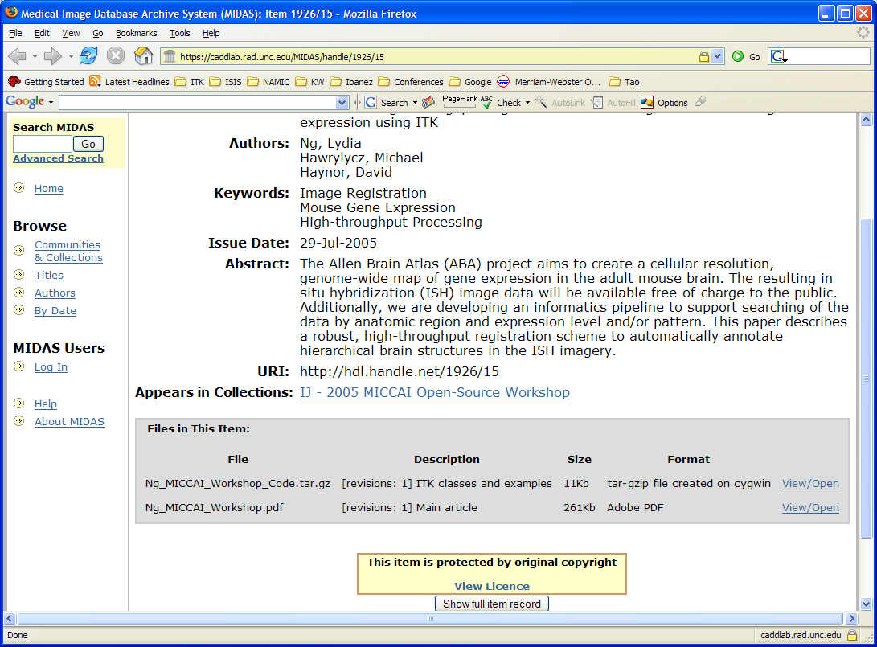

Slide 71
Benefits of the Insight Journal
Allows sharing your Source Code
  Faster and larger impact on the community
Immediate feedback from Readers and Reviewers
  Open Dialog / Forum
No Limitations
  No page limitations
  No limit or charges for color figures
  Accepting additional electronic material

Slide 72
Benefits of the Insight Journal
Indexed by Google
Post revisions of papers and code
Richer readers experience
  Source code available
  Original parameters and images available
  Reader can try on their own data
Accepts practical contributions
  complimentary to full Journal Papers

Slide 73
Benefits of the Insight Journal
No Time Constraints
  Continuous submission process
  Continuous peer-review
  Continuous submission of revision (paper/code)
Thanks to not using Paper !

Slide 74
End

