Slide 1




Open Science
Dr. Luis Ibanez, Kitware
http://creativecommons.org/licenses/by/3.0/

Slide 2
© 2007-2014 Luis Ibanez
This presentation is Copyrighted by Luis Ibanez
This presentation is distributed under the Creative Commons Attribution License 3.0:
http://creativecommons.org/licenses/by/3.0/
You are free to Reuse
You are free to Remix
Provided that you give credit to the author

Slide 3
This presentation was created using
Open Source Software
Open Office copyright is jointly held by
Sun Microsystems and Contributors.
The software is distributed under the
GNU Lesser General Public License Version 3.0.

Slide 4
Reproducible
Research

Slide 5
Non reproducible
Research

Slide 6
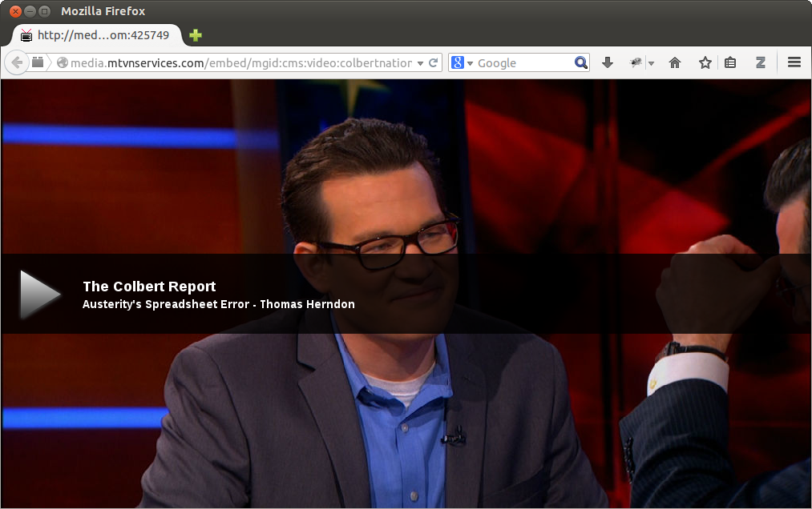
http://media.mtvnservices.com/embed/mgid:cms:video:colbertnation.com:425749
http://www.kitware.com/blog/home/post/479

Slide 7
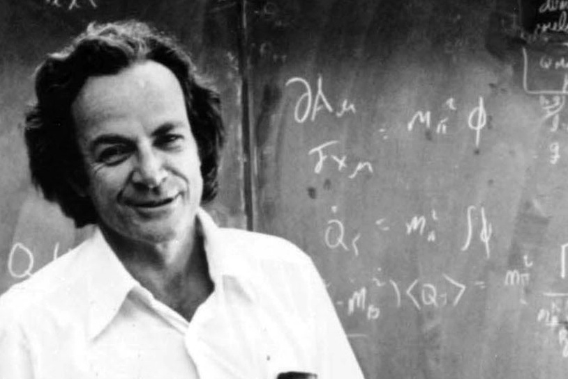
https://www.youtube.com/watch?v=OL6-x0modwY

Slide 8
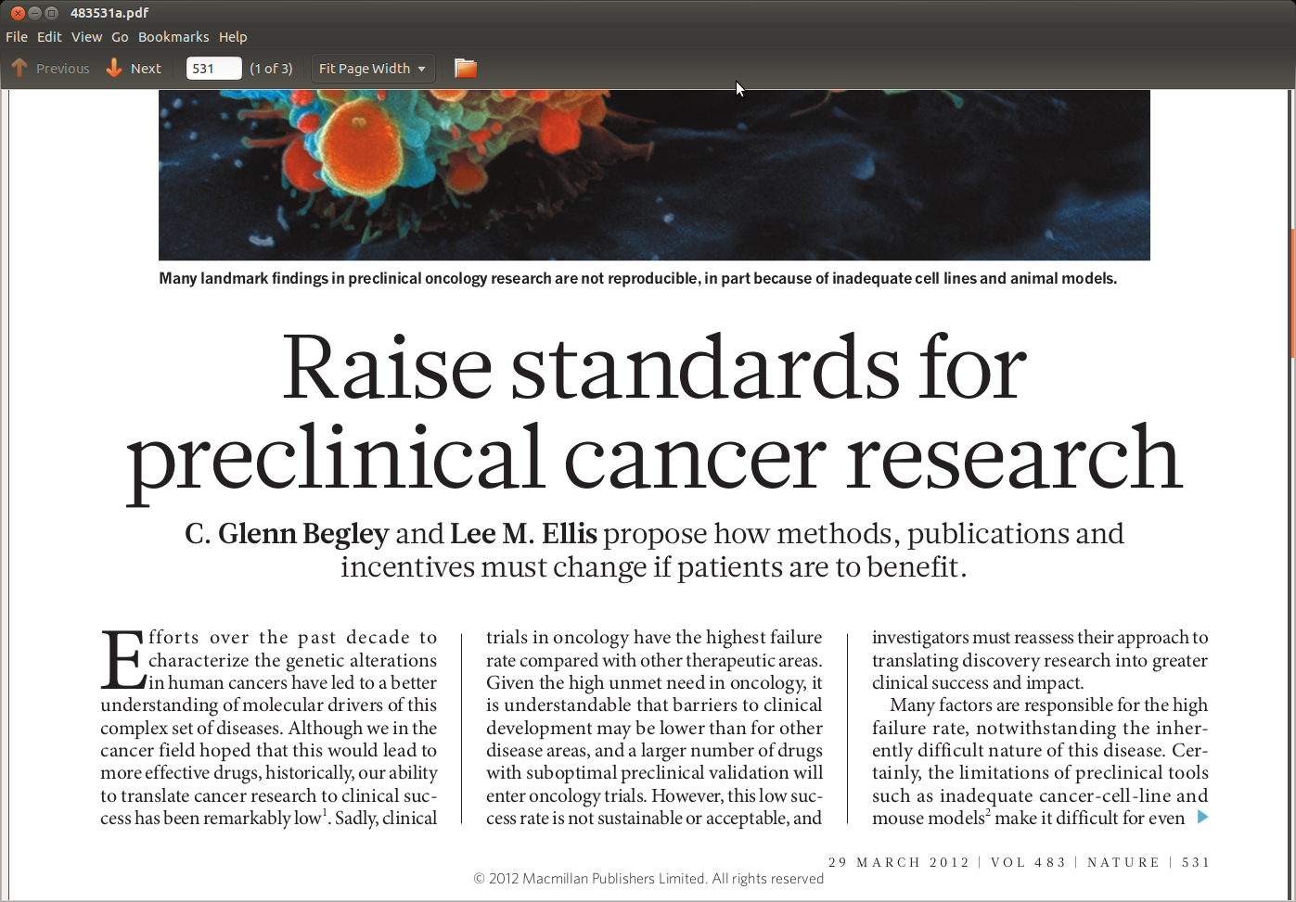
http://www.nature.com/nature/journal/v483/n7391/full/483531a.html

Slide 9
Publish or
Perish

Slide 10
Publish or Perish
Degrees
Jobs
Promotions
Tenures
Fame and Glory !

Slide 11
Replicate or
Perish

Slide 12
Be
Reproducible

Slide 13
Reproduce

Slide 14
Reproducible Research
Open
Data
Open
Source
Open
Access
Open Science

Slide 15
Research
Verifier
Reproducible
Papers
Open Source
Research
Producer
Open Data
Replication
Papers
Research
Enabler
Positive
Results
Negative
Results

Slide 16
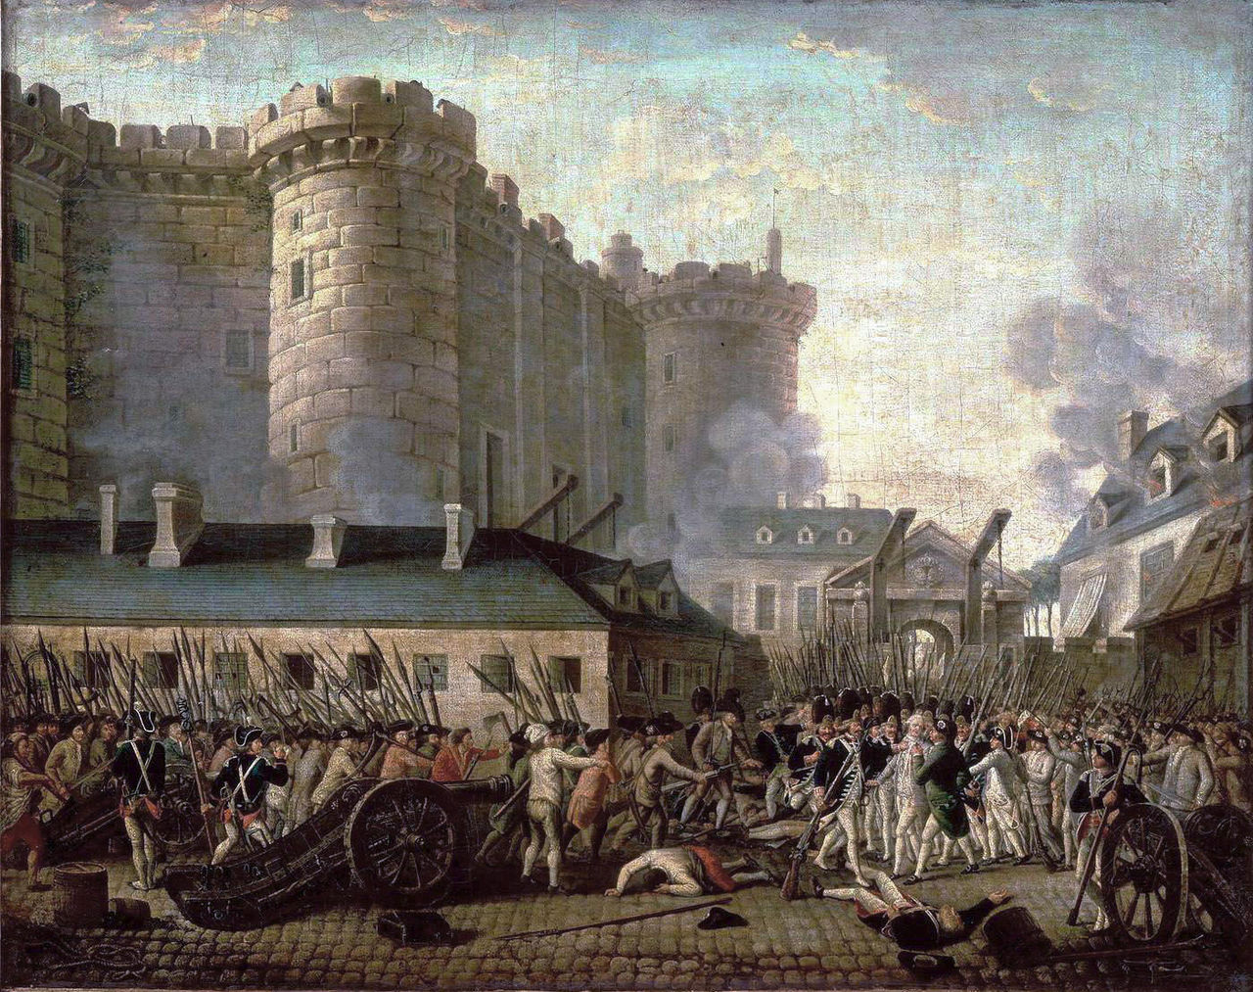

Slide 17


Slide 18
Open Access

Slide 19

Open Access

Slide 20
Quiz
How many Books have been published ?
How many Articles and Essays ?
How many Songs ?
How many Images ?
How many Movies ?
How many Videos, TV Shows and Short Films ?
How many public Web Pages ?

Slide 21
Published Human Knowledge
32 Million Books
750 Million Articles and Essays
25 Million Songs
500 Million Images
500,000 Movies
3 Million Videos, TV Shows and Short Films
100 Billion public Web Pages
http://www.kk.org/writings/scan_this_book.php

Slide 22
Total Amount to Store ?
50 Peta Bytes !
http://en.wikipedia.org/wiki/Petabyte
http://www.nytimes.com/2006/05/14/magazine/14publishing.html

Slide 23
But... We keep writing...
Stock of
Human Knowledge
doubles
every
5 years
http://www.nytimes.com/2006/05/14/magazine/14publishing.html

Slide 24
Scientific Research

Slide 25
Scientific Research (Budget - 2010)
US GDP (2008) $14.2 Trillion
Federal Budget $ 3.6 Trillion
Federal Research Budget $147 Billion
  Defense $ 80 Billion
  Health $ 31 Billion
  NASA $ 11 Billion
  Energy $ 10 Billion
  NSF $ 5 Billion
  EPA $ 0.6 Billion
http://www.aaas.org/spp/rd/rdreport2010/tbli01.pdf

Slide 26
NIH Institutes Budget (2010)
Cancer $ 5.2 Billion
Infectious Diseases $ 4.7 Billion
Heart Lung and Blood $ 3.0 Billion
Aging $ 1.1 Billion
National Library of Medicine $ 0.3 Billion
Biomedical Imaging $ 0.3 Billion
http://officeofbudget.od.nih.gov/pdfs/FY10/Tabular%20Data.pdf

Slide 27
NIH Research
NIH Budget $ 30 Billion
Outcome $ 65,000~60,000 papers
Cost of 1 paper $ 550,000
Cost of publishing 1 paper $ 2,500
0.5 ~ 1%

Slide 28
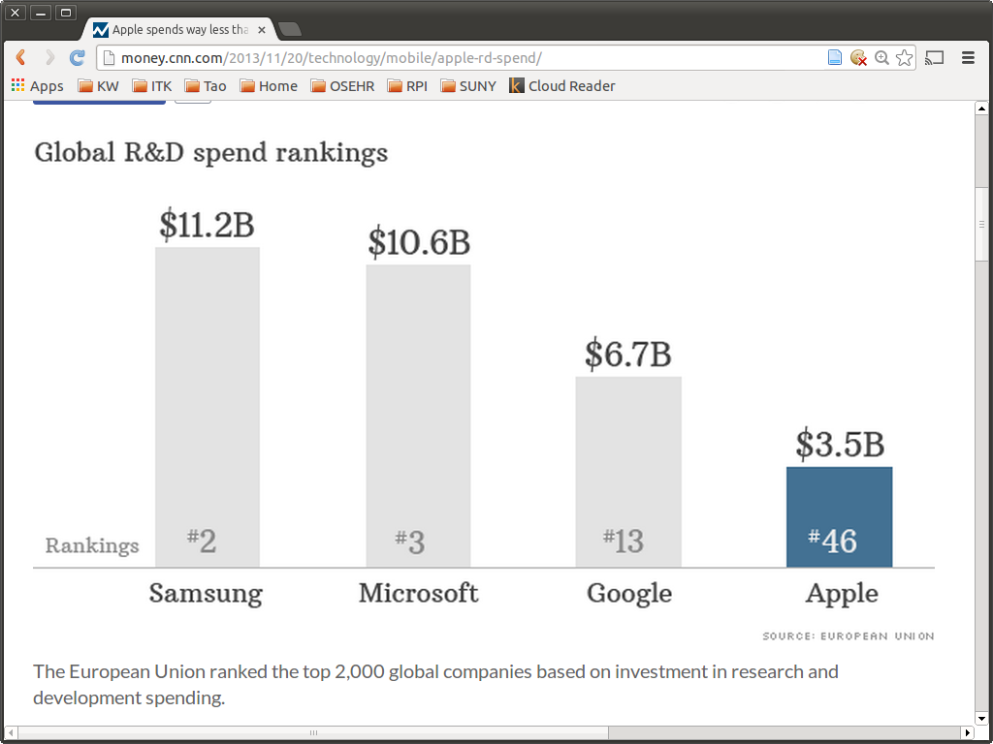

Slide 29
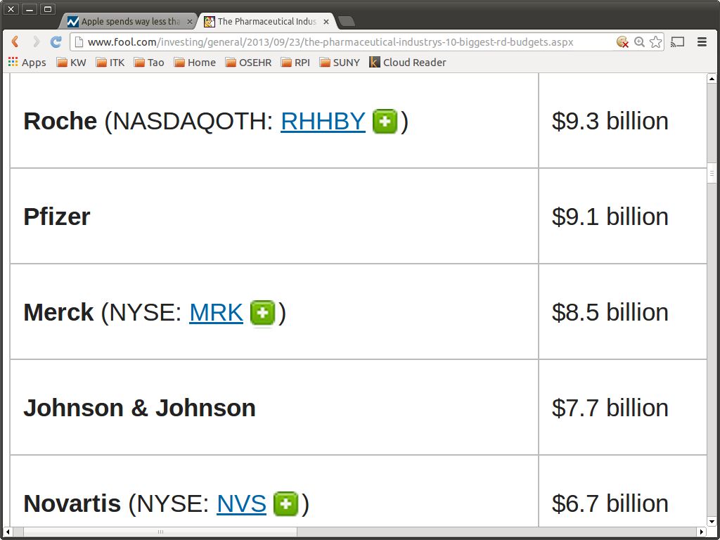

Slide 30
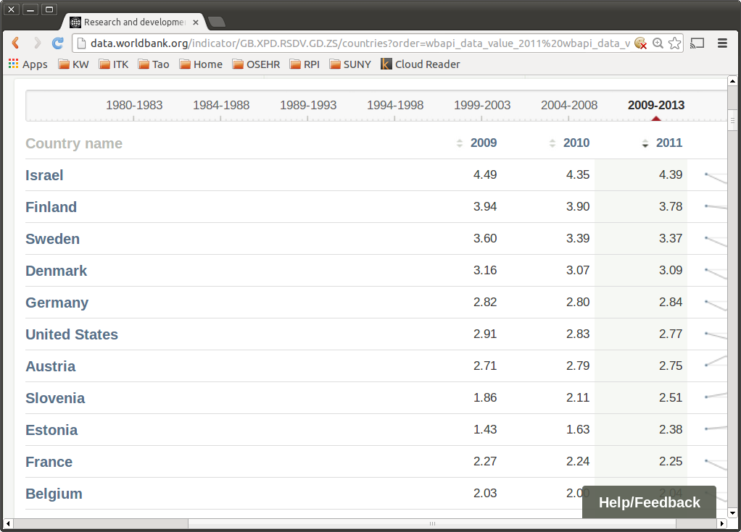
http://data.worldbank.org/indicator/GB.XPD.RSDV.GD.ZS/countries

Slide 31
Where does
The Money Go ?

Slide 32
Publish or Perish
Papers
Journals
Scholarly
Societies
(IEEE, ACM)
Papers
Journals
Commercial
Publishers
(Elsevier, Springer)
Papers
Journals
Author
Papers
Journals
Papers

Slide 33
Peer Review
Scholarly
Societies
(IEEE, ACM)
Journals
Paper
Editor
Author
Reviewer
Reviewer
Reviewer

Slide 34
Copyright Transfer
Scholarly
Societies
(IEEE, ACM)
Paper
Journals
Library
Author
Reader
Reader
Reader
Librarian

Slide 35
Scholarly Publishing Economics
Do Authors get paid ?
Do Reviewers get paid ?
Do Associate Editors get paid ?
Do Editors get paid ?
Who's rights do Copyright
cover in a scholarly publication ?
Do Authors pay for publishing ?
Do Readers pay for reading ?

Slide 36
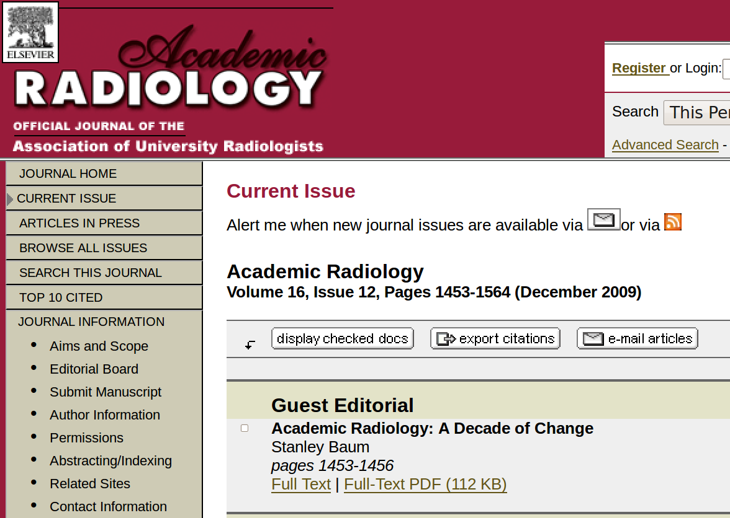
Traditional Publishing

Slide 37
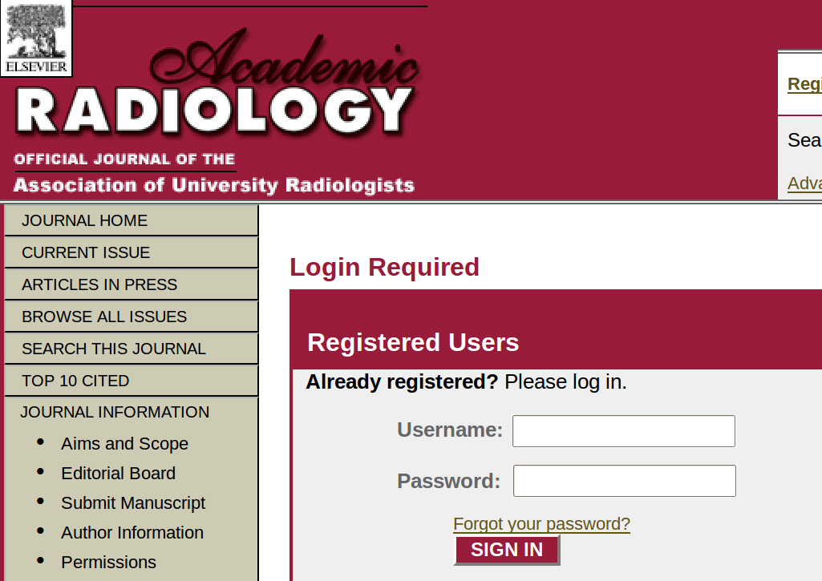
Traditional Publishing

Slide 38
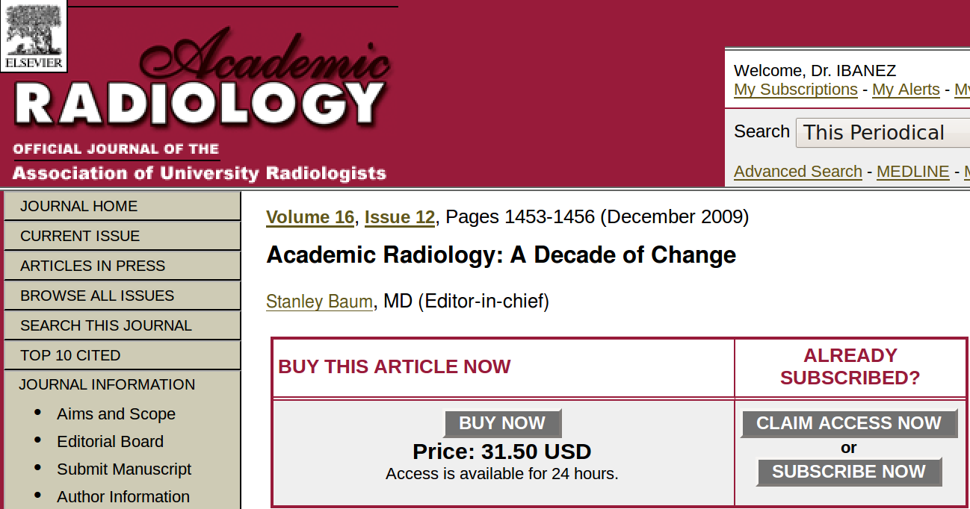
Traditional Publishing

Slide 39
Lack of technological innovation is a symptom of monopolies

Slide 40
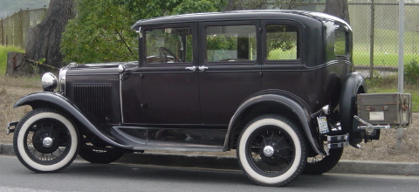
1927
Ford Model A

Slide 41
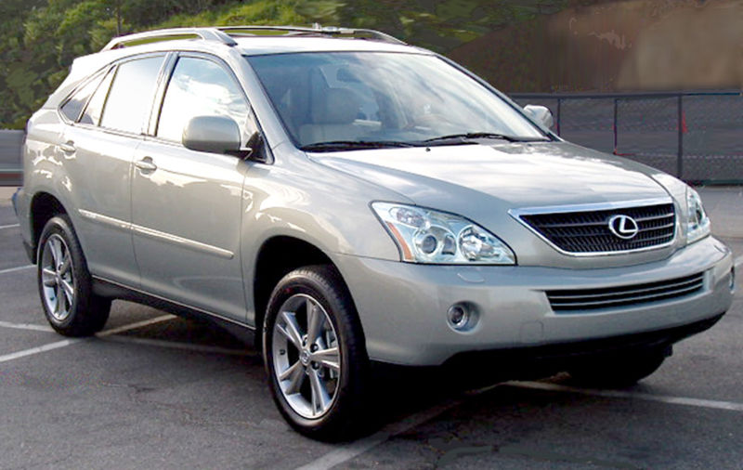
2007
Lexus RX

Slide 42

1927
Fokker F. VII
This photo comes from the Florida Photographic Collection

Slide 43
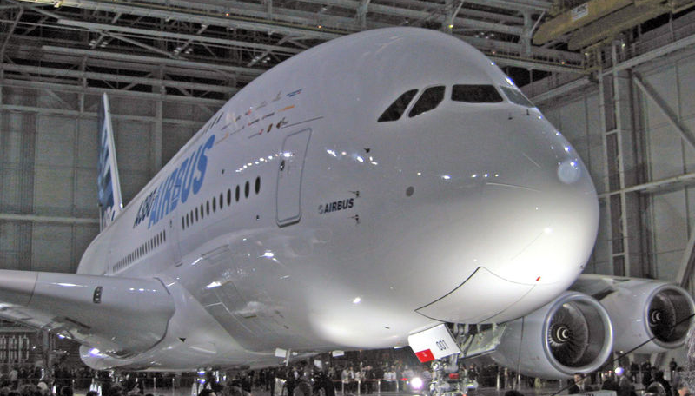
2007
Airbus 380

Slide 44
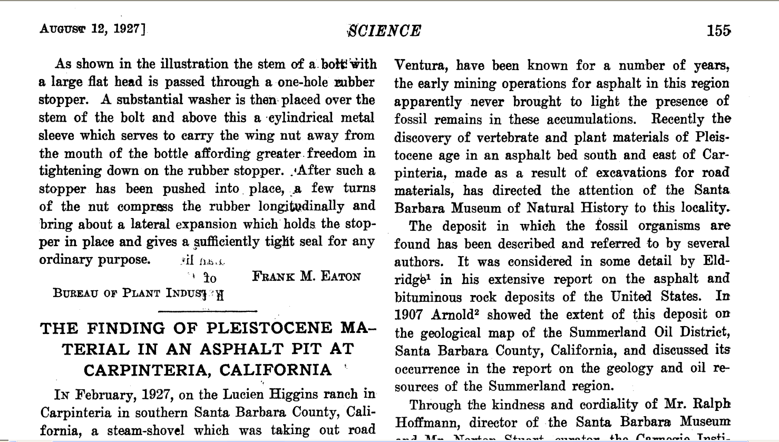
1927
Science Magazine Paper

Slide 45
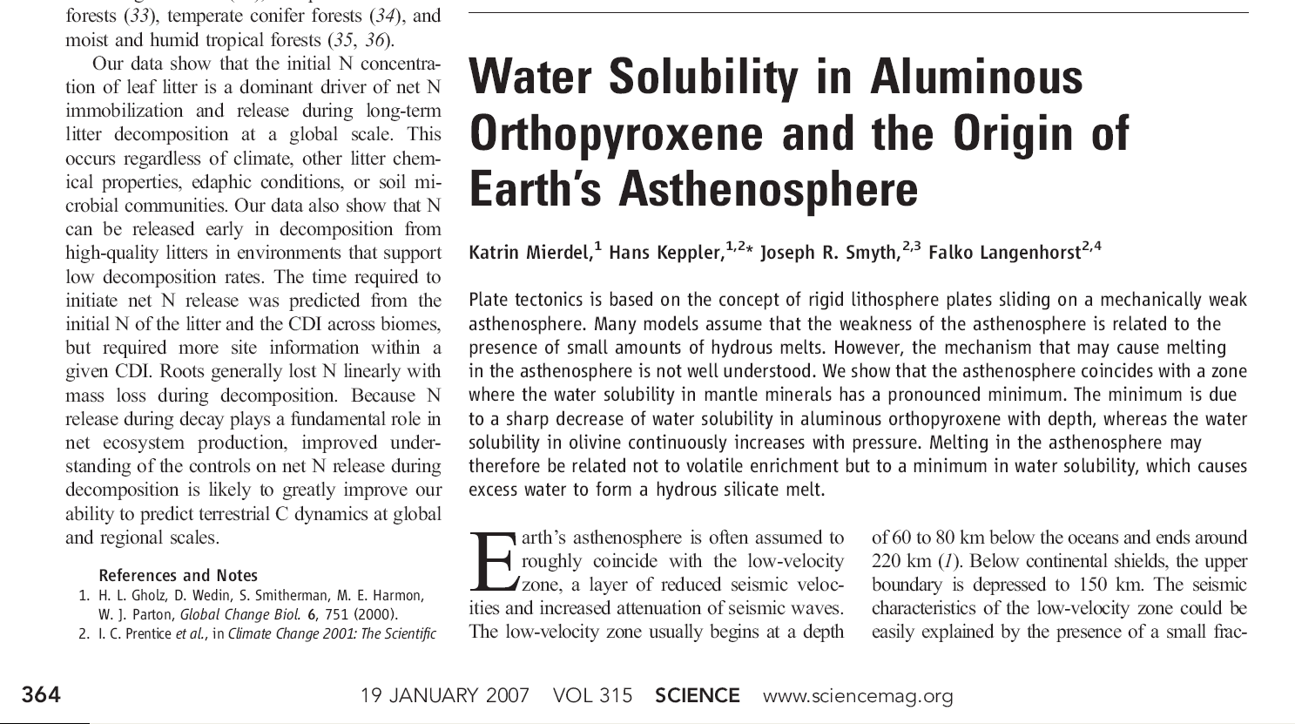
2007
Science Magazine Paper

Slide 46
The fundamental methods
of scientific publishing
have not changed
in the last 80 years.

Slide 47
However…
Many things
have changed

Slide 48






The Information Age

Slide 49

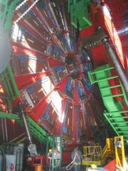
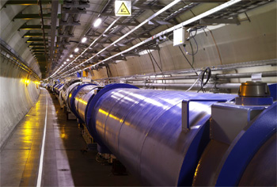
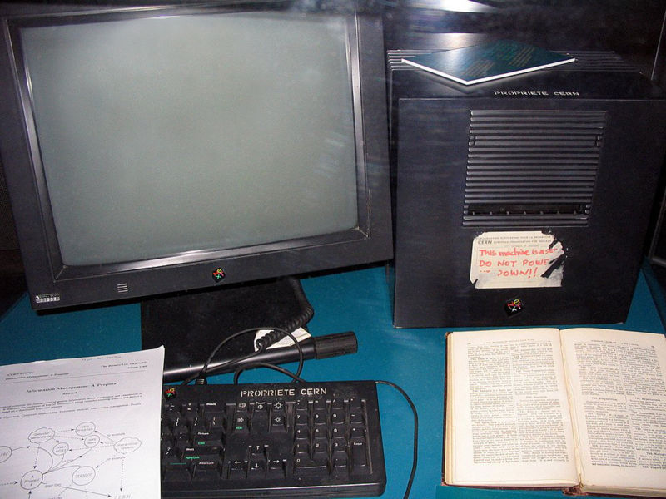
The Web-HTML Irony
Tim Berners Lee
First Web Server
CERN
HTML

Slide 50
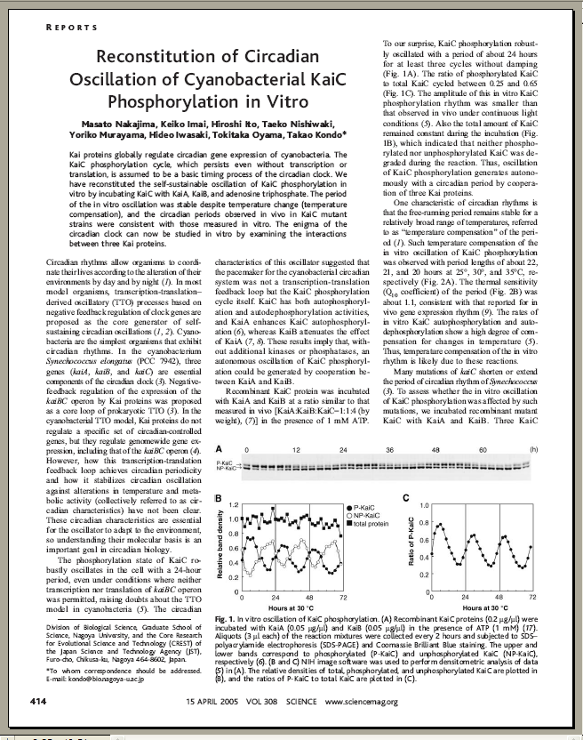
And still “Papers” are…
10 Pages
2D Representations
90% Text
5% Diagrams
5% Pictures
Color (optional)

Slide 51
In Traditional Journals…
What You See
is What You Get

Slide 52
In fact…
That is the ONLY
thing you get

Slide 53
Open Access

Slide 54
Open Access – Patient Advocate
http://vimeo.com/1899536

Slide 55
Open Access - Benefits
http://www.youtube.com/watch?v=g2JT23E1bRE

Slide 56
Open Access - Middle School
http://vimeo.com/1829969

Slide 57
Open Access – Funding Agencies
http://vimeo.com/1865535

Slide 58
Open Access – Peter Suber
http://www.youtube.com/watch?v=tStVPr0PSEQ&feature=related
Peter Suber of SPARC speaks at a Berkman Center for Internet and Society talk on the future of open access in scholarly publications and research.
(1:06:17)

Slide 59
Open Access
Journals

Slide 60
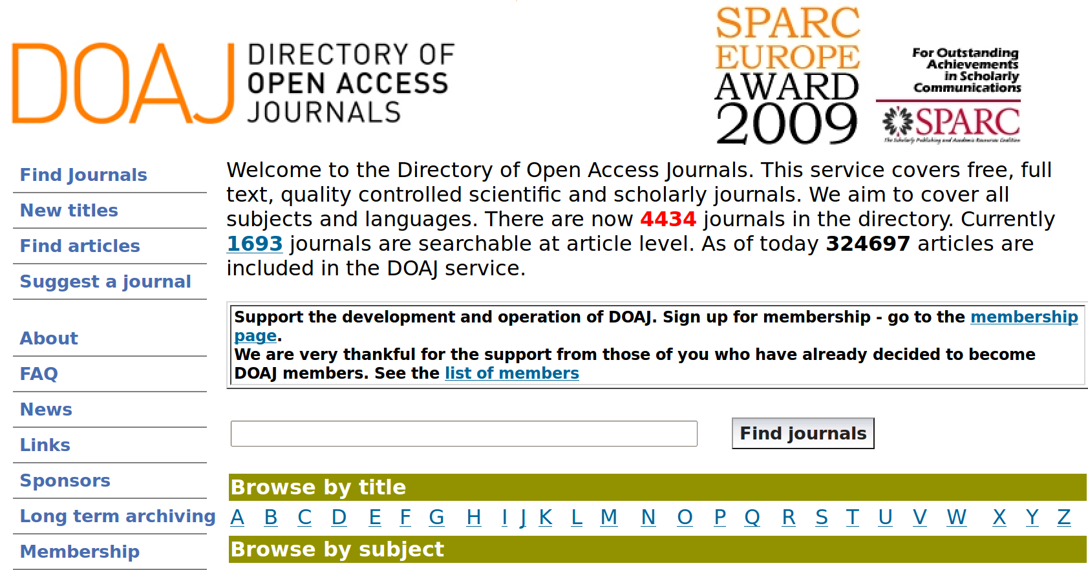
Directory of Open Access Journals
http://www.doaj.org/

Slide 61
Key Open Access Journals
BioMed Central
ArXiv
PLoS

Slide 62
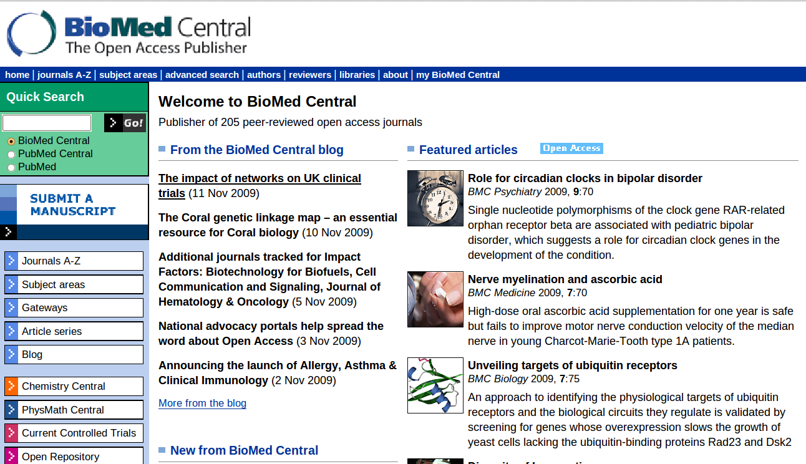
BioMed Central

Slide 63
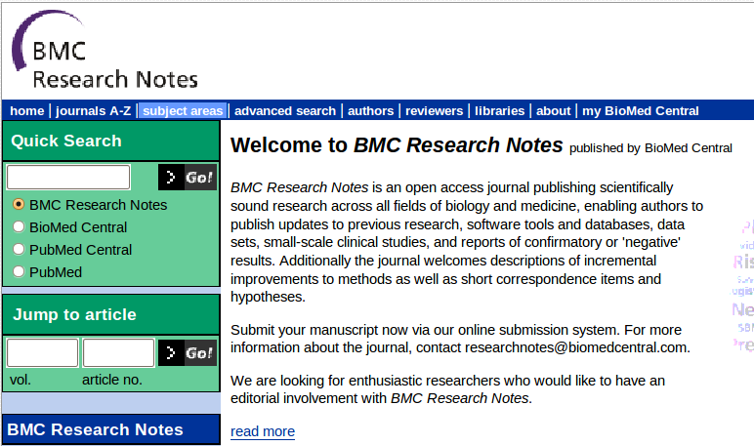
BioMedCentral – Research Notes

Slide 64
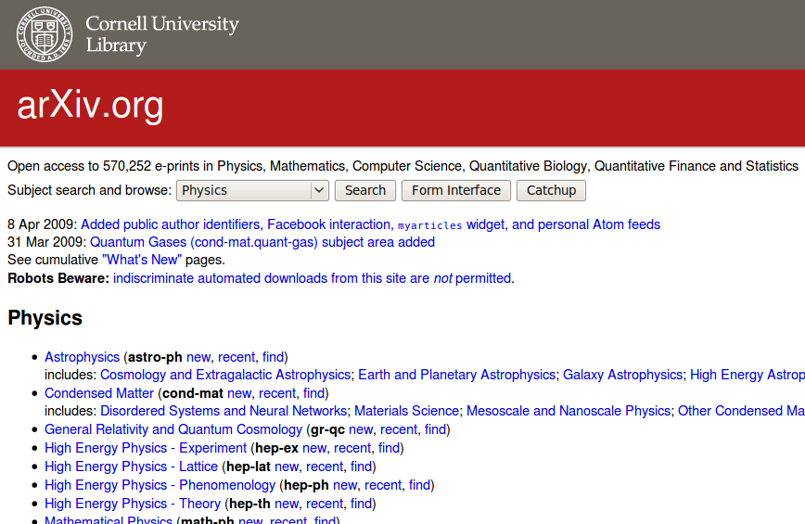
arXiv
http://arxiv.org/

Slide 65

PLoS
Committed to making the world’s
scientific and medical literature
a public resource

Slide 66
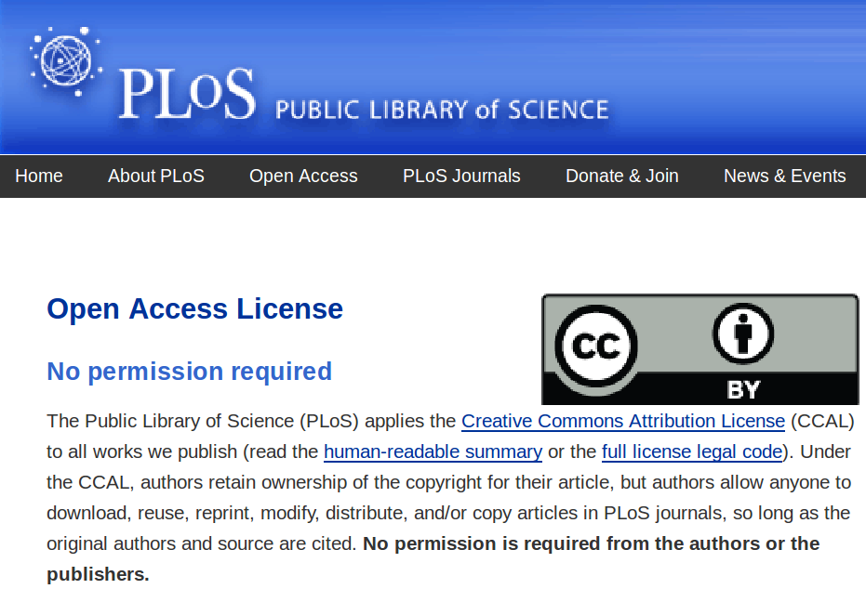

Slide 67
PloS ONE
Integration of text and
3D visualization
http://www.plosone.org/enhanced/pone.0006975/

Slide 68
Your Tax Dollars at Work !

Slide 69
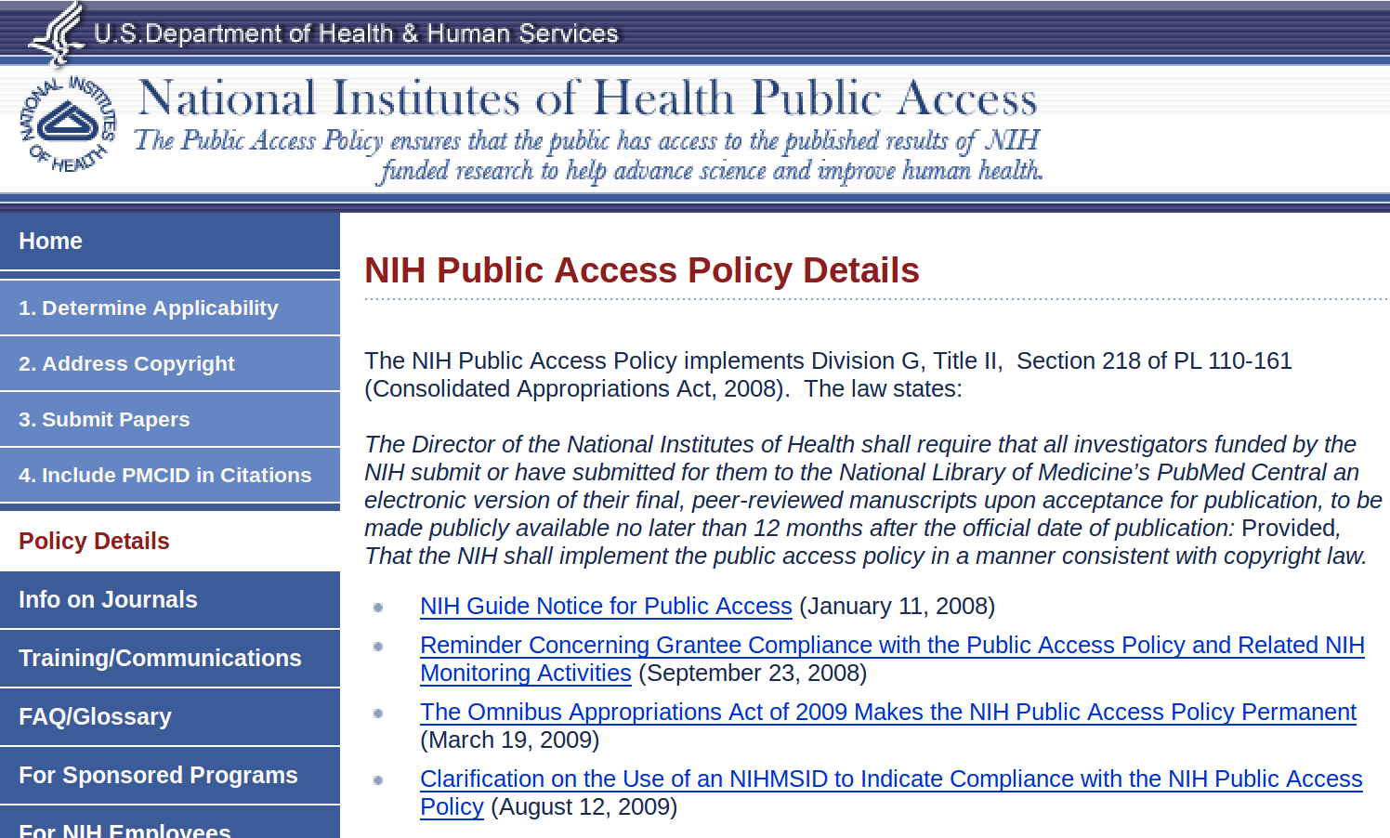
NIH – Public Access Policy

Slide 70
NIH – Public Access Policy
The NIH Public Access Policy implements Division G, Title II, Section 218 of PL 110-161 (Consolidated Appropriations Act, 2008). The law states:
The Director of the National Institutes of Health shall require that all investigators funded by the NIH submit or have submitted for them to the National Library of Medicine’s PubMed Central an electronic version of their final, peer-reviewed manuscripts upon acceptance for publication, to be made publicly available no later than 12 months after the official date of publication: Provided, That the NIH shall implement the public access policy in a manner consistent with copyright law.

Slide 71
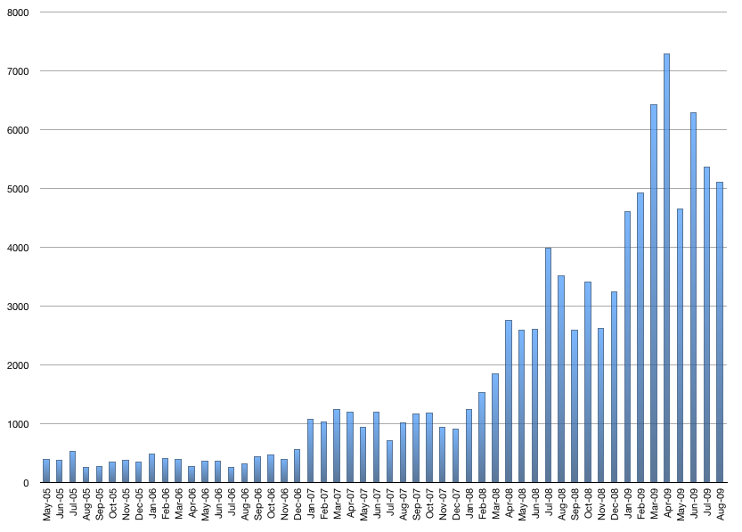
NIH -Manuscript Submission System
This chart represents the number of manuscripts received by NIHMS
and approved for processing by the author/PI for a given month.
http://www.nihms.nih.gov/stats/index.shtml

Slide 72
Open Data

Slide 73
Open Access - Genomes
Is the Human Genome Copyrighted ?
Is it Patented ?
  20% of Human Genes are Patented.

Slide 74
Challenging Gene Patents
Judge OKs Challenge to Human-Gene Patentshttp://www.wired.com/threatlevel/2009/11/genes/
Cancer Patients Challenge
the Patenting of a Gene http://www.nytimes.com/2009/05/13/health/13patent.html

Slide 75
Open Access the Human Genome
wget -m ftp://ftp.ncbi.nih.gov/genomes/H_sapiens/Assembled_chromosomes/

Slide 76
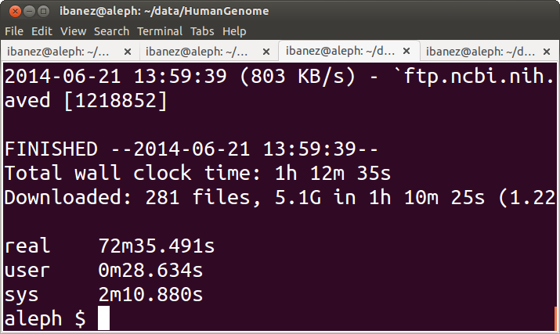
Open Access the Human Genome

Slide 77
Open Access the Human Genome
sudo apt-get install ugene
Or
sudo yum install ugene

Slide 78
Open Access the Human Genome
ftp://ftp.ncbi.nih.gov/genomes/H_sapiens/
ftp://ftp.ncbi.nih.gov/genomes/H_sapiens/Assembled_chromosomes/
http://en.wikipedia.org/wiki/Genetic_code

Slide 79
Open Access – Other Genomes
ftp://ftp.ncbi.nih.gov/genomes/
ftp://ftp.ncbi.nih.gov/genomes/Viruses/Influenza_A_virus__A_Puerto_Rico_8_34_H1N1_ /

Slide 80


Slide 81
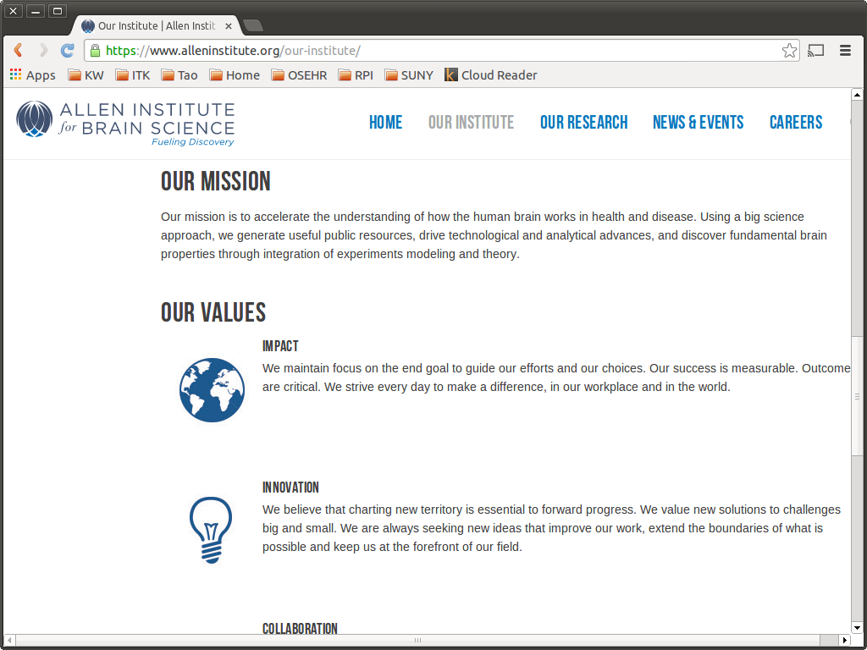

Slide 82
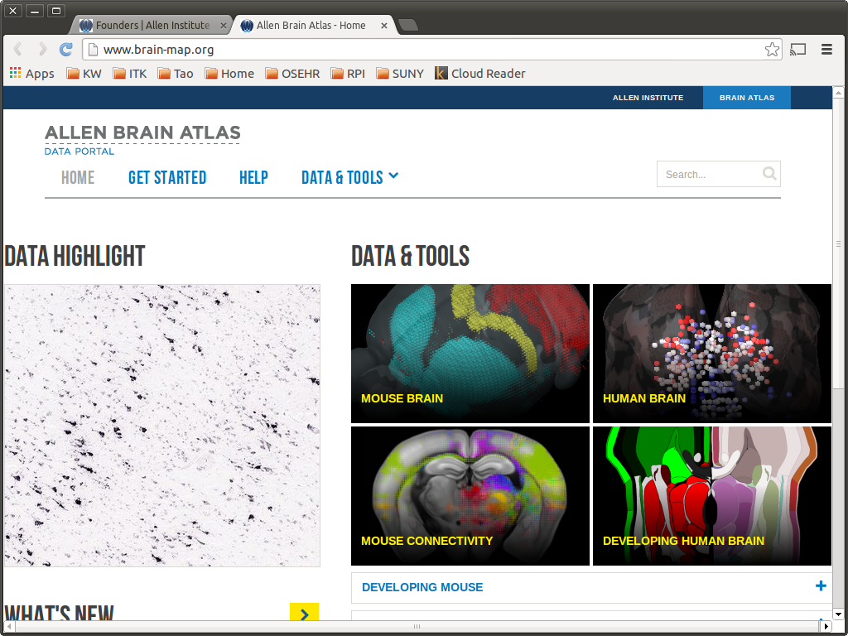

Slide 83
The Question...

Slide 84
Efficiency

