Slide 1





Open Access
Dr. Luis Ibanez, Kitware
http://creativecommons.org/licenses/by/3.0/

Slide 2
© 2007-2009 Luis Ibanez
This presentation is Copyrighted by Luis Ibanez
This presentation is distributed under the Creative Commons Attribution License 3.0:
http://creativecommons.org/licenses/by/3.0/
You are free to Reuse
You are free to Remix
Provided that you give credit to the author

Slide 3
This presentation was created using
Open Source Software
Open Office copyright is jointly held by
Sun Microsystems and Contributors.
The software is distributed under the
GNU Lesser General Public License Version 3.0.

Slide 4
Stealing from the Public Domain

Slide 5
Steamboat Willie (1928)
http://www.youtube.com/watch?v=AEEaT_UQnVM
Steamboat Bill, Jr. (1928)
http://www.youtube.com/watch?v=PwUwV-HX7x0

Slide 6
The Mouse that Roared
In the March of 1998 Walt Disney Co. chairman Michael D. Eisner was involved in intense lobbying activities on Capitol Hill. At the top of Disney's agenda was a request for Congress to resolve one of Disney's most urgent problems: The copyright for Disney's crown jewel, Mickey Mouse, will expire after 2003, 75 years after the appearance in 1928 of the Disney cartoon that launched Mickey's golden career, "Steamboat Willie." In fast succession, copyrights will end for Pluto in 2006 and Goofy in 2008. Early in the next century, protections also will expire for Bambi, Dumbo, Donald Duck, Snow White and all the Seven Dwarfs. Without copyright, Disney would collect no fees for the showing of classic movies such as "Fantasia," and other companies could freely use its characters in their movies and videos.
http://www.kellogg.northwestern.edu/faculty/fedderse/ftp/other/Disney.htm

Slide 7
The Mouse that Roared
To prevent the loss of its most precious assets Disney pursued a nonmarket strategy designed and implemented by Preston Patten, Disney's head of lobbying operations. First, Disney increased its campaign contributions. Recipients of campaign money included members of key committees such as Sen. Patrick J. Leahy, D-Vt., a family friend of Eisner and ranking Democrat on the Judiciary Committee, and Rep. Howard Coble, R.-N.C., chairman of the Judiciary Subcommittee on Arts and Intellectual Property, which oversees copyright issues.
Disney contributed nearly $800,000 to political campaigns in the 1997-98 cycle.
http://www.kellogg.northwestern.edu/faculty/fedderse/ftp/other/Disney.htm

Slide 8
The Mouse that Roared
In 1998 this strategy bore fruit.
In the Spring of 1998, the U.S. House of Representatives debated
HR2589
(sponsored by Rep. Coble):
The Copyright Term Extension Bill.
The bill would extend the 75-year copyright by 20 years. It would thus grant Disney exclusive rights to the images for another generation and make it harder for them to be reproduced by other manufacturers when copyrights run out.
http://www.kellogg.northwestern.edu/faculty/fedderse/ftp/other/Disney.htm

Slide 9
Became Public Law 105 - 298
The 20 Years extension
applied retroactively
to existing works
http://www.gpo.gov/fdsys/pkg/PLAW-105publ298/content-detail.html

Slide 10
How Much is a Mouse Worth ?
http://www.google.com/finance?q=NYSE:DIS&fstype=ii

Slide 11
Collateral Damage
Copyright laws apply
to more
than the Evil Mouse...
They apply to
Many, many things...

Slide 12
Quiz
How many Books have been published ?
How many Articles and Essays ?
How many Songs ?
How many Images ?
How many Movies ?
How many Videos, TV Shows and Short Films ?
How many public Web Pages ?

Slide 13
Published Human Knowledge
32 Million Books
750 Million Articles and Essays
25 Million Songs
500 Million Images
500,000 Movies
3 Million Videos, TV Shows and Short Films
100 Billion public Web Pages
http://www.kk.org/writings/scan_this_book.php

Slide 14
Total Amount to Store ?
50 Peta Bytes !
http://en.wikipedia.org/wiki/Petabyte
http://www.nytimes.com/2006/05/14/magazine/14publishing.html

Slide 15
But... We keep writing...
Stock of
Human Knowledge
doubles
every
5 years
http://www.nytimes.com/2006/05/14/magazine/14publishing.html

Slide 16
Scientific Research

Slide 17
Scientific Research (Budget - 2007)
US GDP $13 Trillion
Federal Budget $ 2.4 Trillion
Federal Research Budget $143 Billion
  Defense $ 80 Billion
  Health $ 30 Billion
  NASA $ 12 Billion
  Energy $ 9 Billion
  NSF $ 4.5 Billion
  EPA $ 0.5 Billion

Slide 18
Scientific Research (Budget - 2010)
US GDP (2008) $14.2 Trillion
Federal Budget $ 3.6 Trillion
Federal Research Budget $147 Billion
  Defense $ 80 Billion
  Health $ 31 Billion
  NASA $ 11 Billion
  Energy $ 10 Billion
  NSF $ 5 Billion
  EPA $ 0.6 Billion
http://www.aaas.org/spp/rd/rdreport2010/tbli01.pdf

Slide 19
NIH Institutes Budget (2007)
Cancer $ 4.8 Billion
Infectious Diseases $ 4.6 Billion
Heart Lung and Blood $ 2.9 Billion
Aging $ 1.0 Billion
National Library of Medicine $ 0.3 Billion
Biomedical Imaging $ 0.3 Billion

Slide 20
NIH Institutes Budget (2010)
Cancer $ 5.2 Billion
Infectious Diseases $ 4.7 Billion
Heart Lung and Blood $ 3.0 Billion
Aging $ 1.1 Billion
National Library of Medicine $ 0.3 Billion
Biomedical Imaging $ 0.3 Billion
http://officeofbudget.od.nih.gov/pdfs/FY10/Tabular%20Data.pdf

Slide 21
NIH Research
NIH Budget $ 30 Billion
Outcome $ 65,000~60,000 papers
Cost of 1 paper $ 550,000
Cost of publishing 1 paper $ 2,500
0.5 ~ 1%

Slide 22
Publish or Perish
Papers
Journals
Scholarly
Societies
(IEEE, ACM)
Papers
Journals
Commercial
Publishers
(Elsevier, Springer)
Papers
Journals
Author
Papers
Journals
Papers

Slide 23
Peer Review
Scholarly
Societies
(IEEE, ACM)
Journals
Paper
Editor
Author
Reviewer
Reviewer
Reviewer

Slide 24
Copyright Transfer
Scholarly
Societies
(IEEE, ACM)
Paper
Journals
Library
Author
Reader
Reader
Reader
Librarian

Slide 25
Copyright Transfer
1. The undersigned hereby assigns to The Institute of Electrical and Electronics Engineers, Incorporated (the “IEEE”) all rights under copyright that may exist in and to:
(a) the above Work, including any revised or expanded derivative works submitted to the IEEE by the undersigned based on the Work; and (b) any associated written or
multimedia components or other enhancements accompanying the Work.
http://www.ieee.org/portal/cms_docs_iportals/iportals/publications/rights/IEEECopyrightForm.pdf

Slide 26
Copyright Transfer
3. In connection with the permission granted in Section 2, the undersigned hereby grants IEEE the unlimited, worldwide, irrevocable right to use his/her name, picture, likeness, voice and biographical information as part of the advertisement, distribution and sale of products incorporating the Work or Presentation, and releases IEEE from any claim based on right of privacy or publicity.
http://www.ieee.org/portal/cms_docs_iportals/iportals/publications/rights/IEEECopyrightForm.pdf

Slide 27
Copyright Transfer
The undersigned agrees to indemnify and hold harmless the IEEE from any damage or expense that may arise in the event of a breach of any of the warranties set forth above.
http://www.ieee.org/portal/cms_docs_iportals/iportals/publications/rights/IEEECopyrightForm.pdf

Slide 28
Scholarly Publishing Economics
Do Authors get paid ?
Do Reviewers get paid ?
Do Associate Editors get paid ?
Do Editors get paid ?
Who's rights do Copyright
cover in a scholarly publication ?
Do Authors pay for publishing ?
Do Readers pay for reading ?

Slide 29
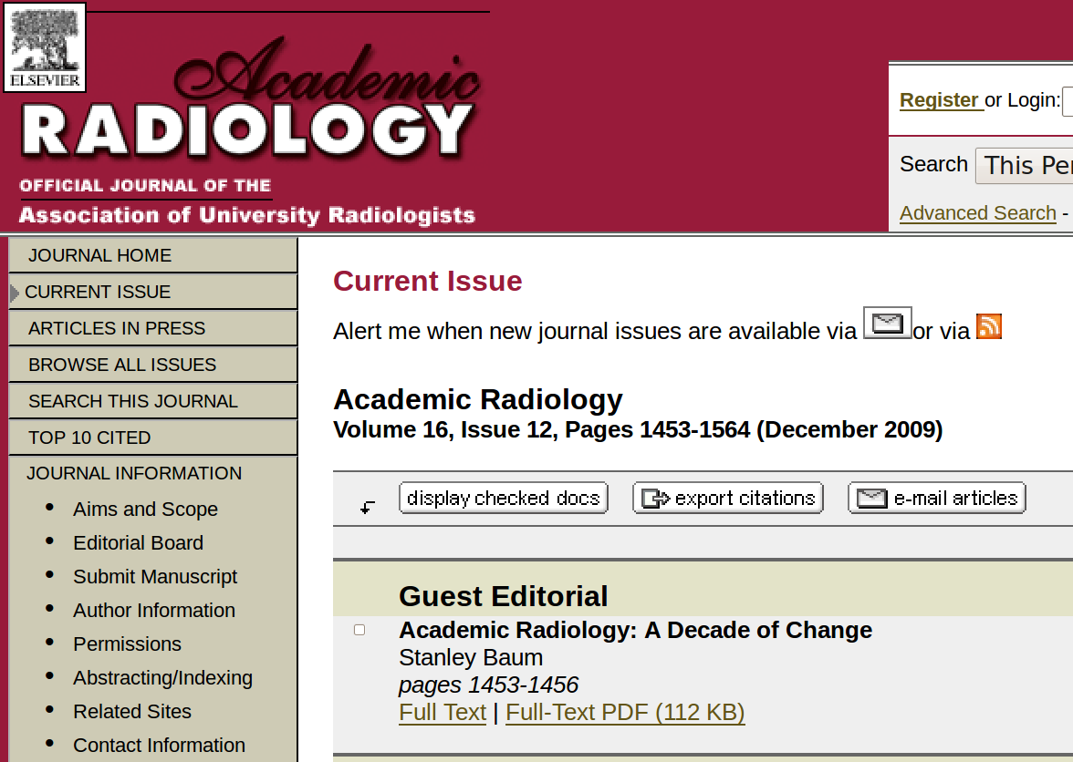
Traditional Publishing

Slide 30
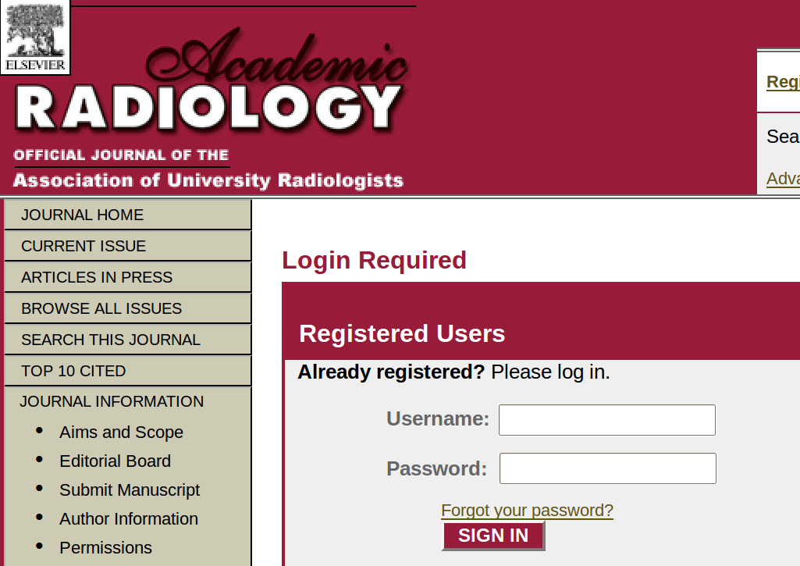
Traditional Publishing

Slide 31

Traditional Publishing

Slide 32
Traditional Publishing - IEEE
Page Charges and Reprints: ...the author will be requested to pay a page charge of $110.00 per printed page to cover the cost of publication. If this charge, which is not a prerequisite for publication, is honored, the author will receive 100 free reprints. Additional reprints may be ordered upon return of proofs. A mandatory page charge ($250 per page after the first eight) is imposed on all papers of length exceeding eight published TRANSACTIONS pages
http://www.ieee-tmi.org/EditorialPolicy.html

Slide 33
Traditional Publishing - IEEE
The following are the basic charges for color:
$1,045.00 US for printing charges
(four or fewer color pages)
$2,090.00 US (four to eight pages)
$3,135.00 US (nine to twelve pages)
+ $62.50 US per color image (i.e., if you have two color figures the charge would be $125 US, + $1,045)
http://www.ieee.org/web/publications/authors/transjnl/faq.html

Slide 34
Lack of technological innovation is a symptom of monopolies

Slide 35
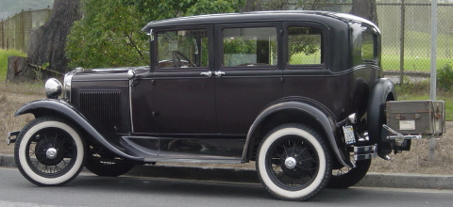
1927
Ford Model A

Slide 36
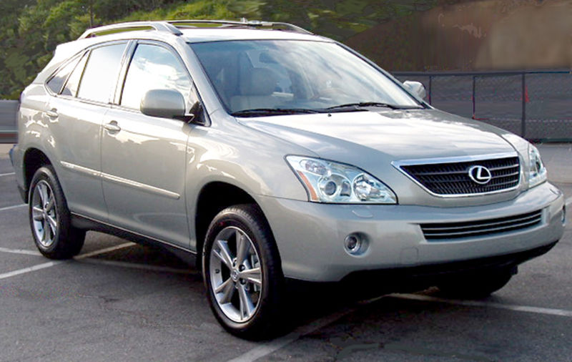
2007
Lexus RX

Slide 37
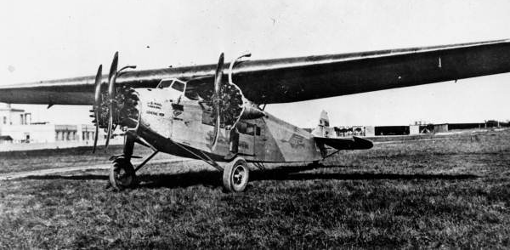
1927
Fokker F. VII
This photo comes from the Florida Photographic Collection

Slide 38
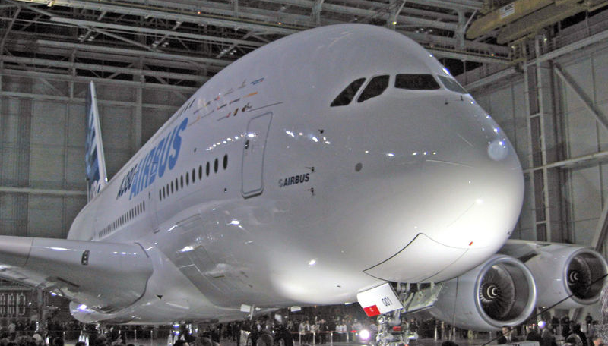
2007
Airbus 380

Slide 39
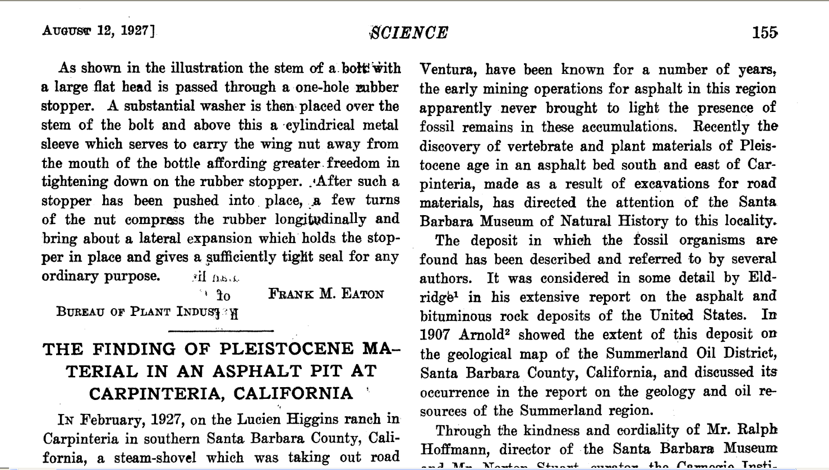
1927
Science Magazine Paper

Slide 40
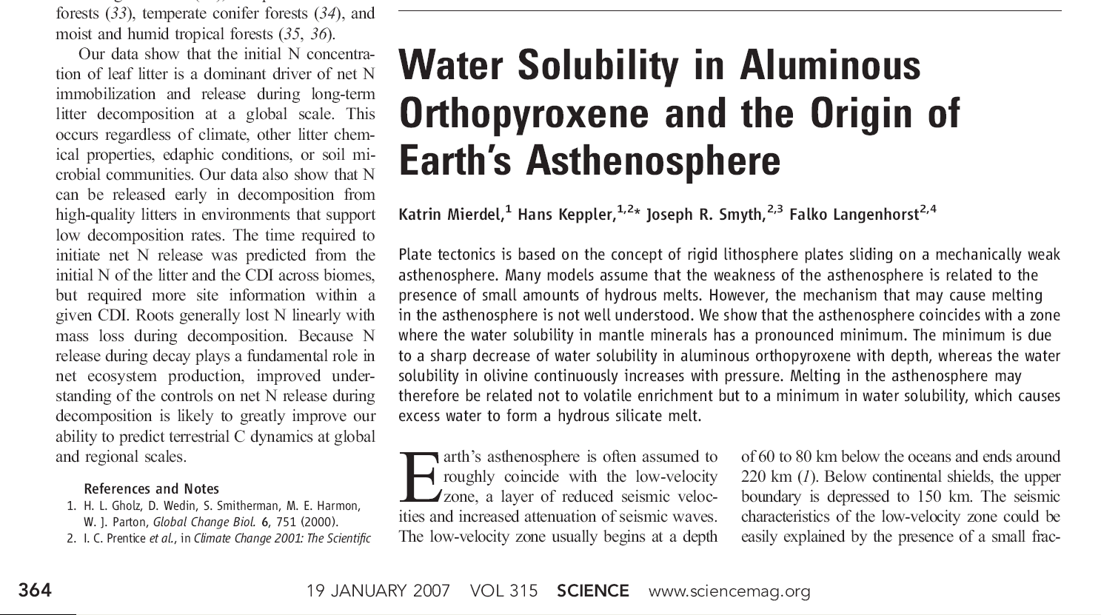
2007
Science Magazine Paper

Slide 41
The fundamental methods
of scientific publishing
have not changed
in the last 80 years.

Slide 42
However…
Many things
have changed

Slide 43






The Information Age

Slide 44
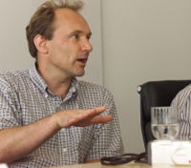
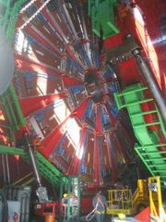
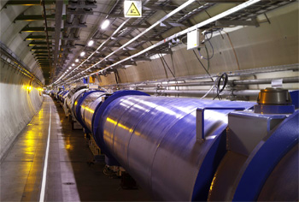
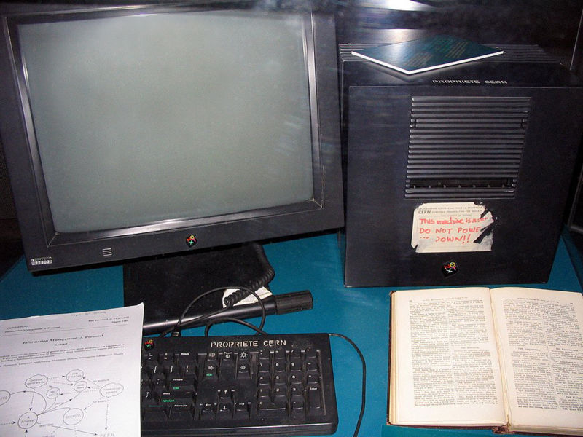
The Web-HTML Irony
Tim Berners Lee
First Web Server
CERN
HTML

Slide 45
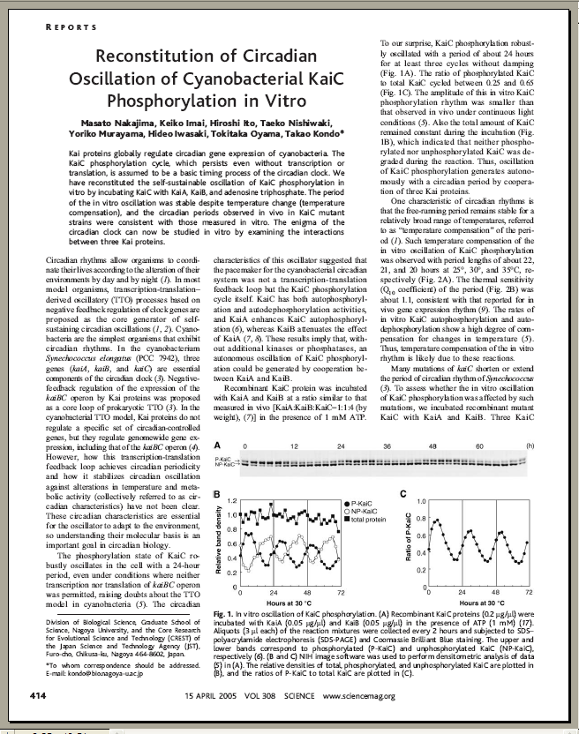
And still “Papers” are…
10 Pages
2D Representations
90% Text
5% Diagrams
5% Pictures
Color (optional)

Slide 46
In Traditional Journals…
What You See
is What You Get

Slide 47
In fact…
That is the ONLY
thing you get

Slide 48

Open Access

Slide 49
Open Access – Patient Advocate
http://vimeo.com/1899536

Slide 50
Open Access - Benefits
http://www.youtube.com/watch?v=g2JT23E1bRE

Slide 51
Open Access - Middle School
http://vimeo.com/1829969

Slide 52
Open Access – Funding Agencies
http://vimeo.com/1865535

Slide 53
Open Access – Peter Suber
http://www.youtube.com/watch?v=tStVPr0PSEQ&feature=related
Peter Suber of SPARC speaks at a Berkman Center for Internet and Society talk on the future of open access in scholarly publications and research.
(1:06:17)

Slide 54
Open Access
Journals

Slide 55
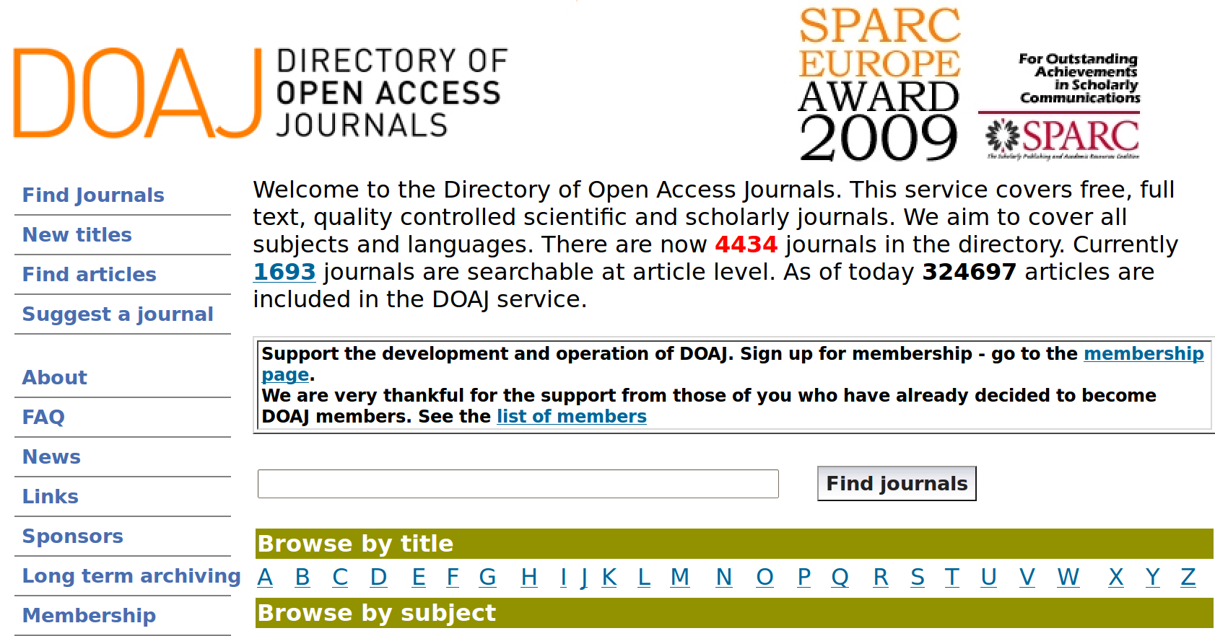
Directory of Open Access Journals
http://www.doaj.org/

Slide 56
Key Open Access Journals
BioMed Central
ArXiv
PLoS

Slide 57
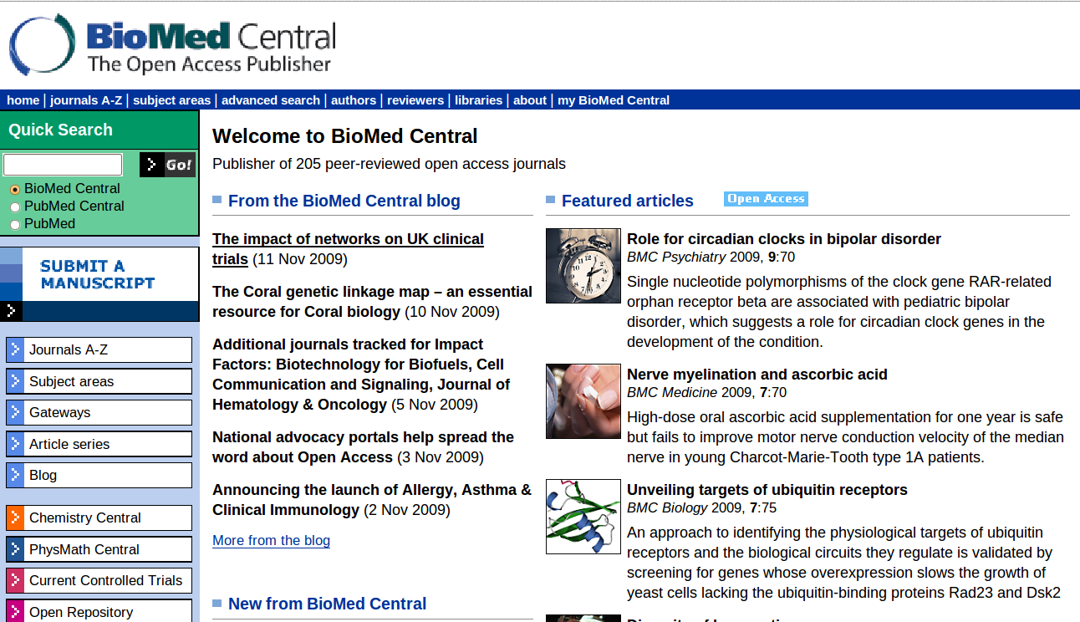
BioMed Central

Slide 58
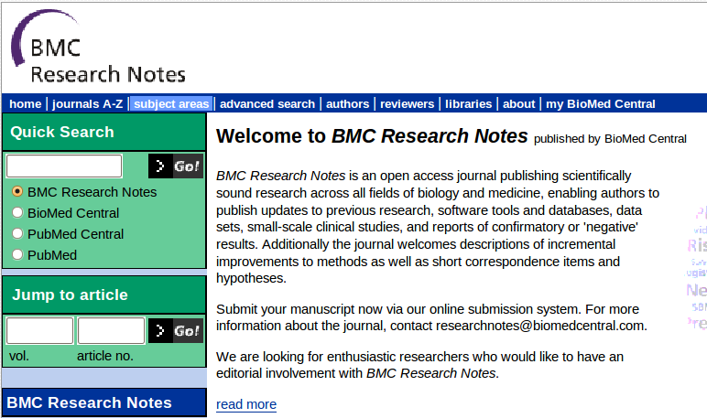
BioMedCentral – Research Notes

Slide 59
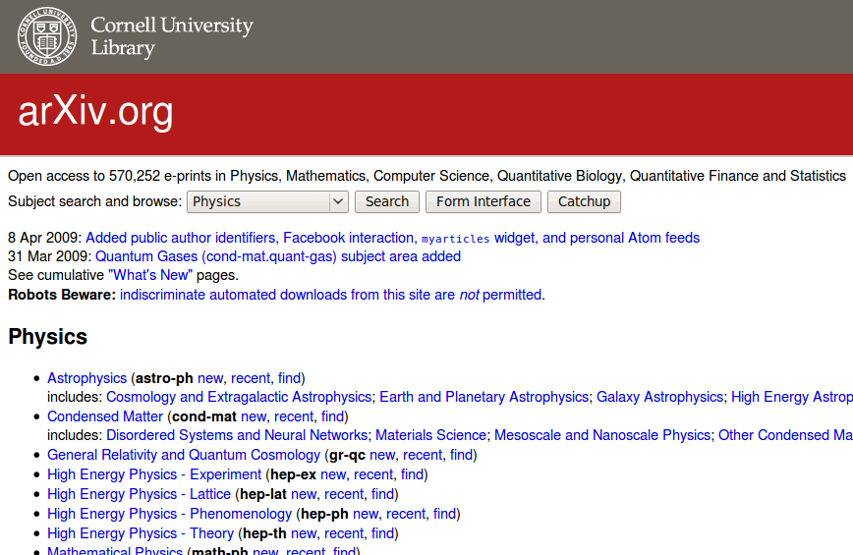
arXiv
http://arxiv.org/

Slide 60

PLoS
Committed to making the world’s
scientific and medical literature
a public resource

Slide 61
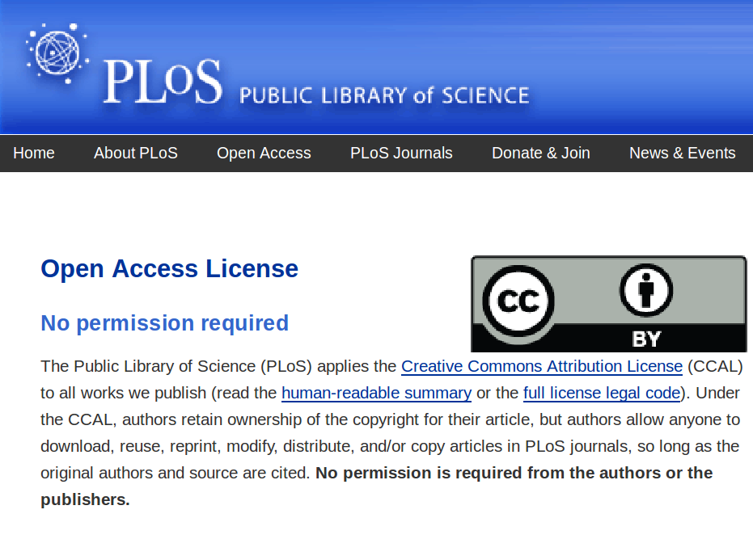

Slide 62
PloS ONE
Integration of text and
3D visualization
http://www.plosone.org/enhanced/pone.0006975/

Slide 63
Your Tax Dollars at Work !

Slide 64
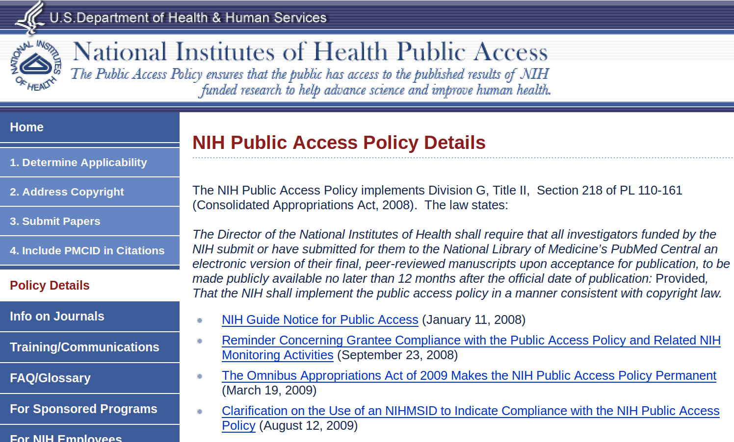
NIH – Public Access Policy

Slide 65
NIH – Public Access Policy
The NIH Public Access Policy implements Division G, Title II, Section 218 of PL 110-161 (Consolidated Appropriations Act, 2008). The law states:
The Director of the National Institutes of Health shall require that all investigators funded by the NIH submit or have submitted for them to the National Library of Medicine’s PubMed Central an electronic version of their final, peer-reviewed manuscripts upon acceptance for publication, to be made publicly available no later than 12 months after the official date of publication: Provided, That the NIH shall implement the public access policy in a manner consistent with copyright law.

Slide 66
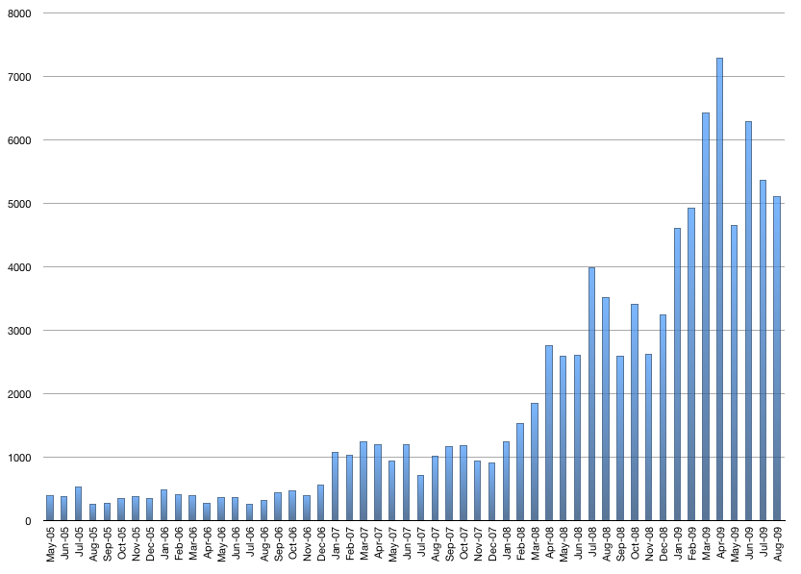
NIH -Manuscript Submission System
This chart represents the number of manuscripts received by NIHMS
and approved for processing by the author/PI for a given month.
http://www.nihms.nih.gov/stats/index.shtml

Slide 67
Open Data

Slide 68
Open Access - Genomes
Is the Human Genome Copyrighted ?
Is it Patented ?
  20% of Human Genes are Patented.

Slide 69
Challenging Gene Patents
Judge OKs Challenge to Human-Gene Patentshttp://www.wired.com/threatlevel/2009/11/genes/
Cancer Patients Challenge
the Patenting of a Gene http://www.nytimes.com/2009/05/13/health/13patent.html

Slide 70
Open Access the Human Genome
sudo apt-get install ugene
or
sudo yum install ugene
ftp://ftp.ncbi.nih.gov/genomes/H_sapiens/
ftp://ftp.ncbi.nih.gov/genomes/H_sapiens/Assembled_chromosomes/
http://en.wikipedia.org/wiki/Genetic_code

Slide 71
Open Access – Other Genomes
ftp://ftp.ncbi.nih.gov/genomes/
ftp://ftp.ncbi.nih.gov/genomes/Viruses/Influenza_A_virus__A_Puerto_Rico_8_34_H1N1_ /

Slide 72
Exercise

Slide 73
Compiling the Compiler
GCC
GCC
GCC Soure Code

Slide 74
Compiling the Compiler
Cell
Cell
DNA

Slide 75
Human Genome
http://www.youtube.com/watch?v=XuUpnAz5y1g

Slide 76
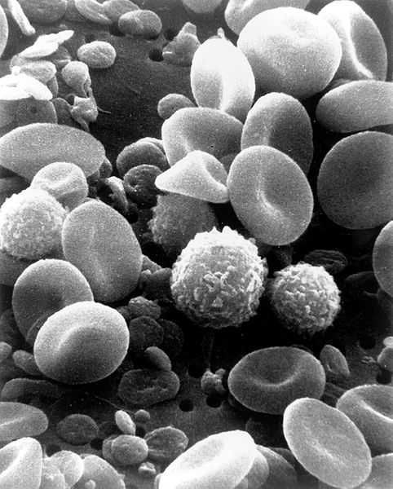
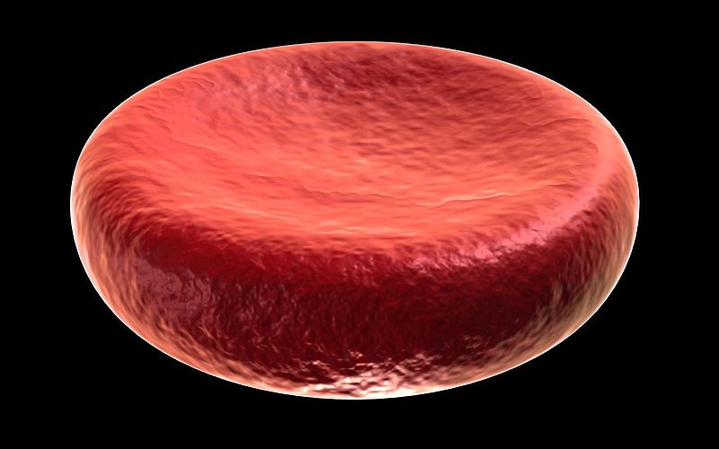
Red Blood Cells
http://commons.wikimedia.org/wiki/Category:Blood_cells

Slide 77
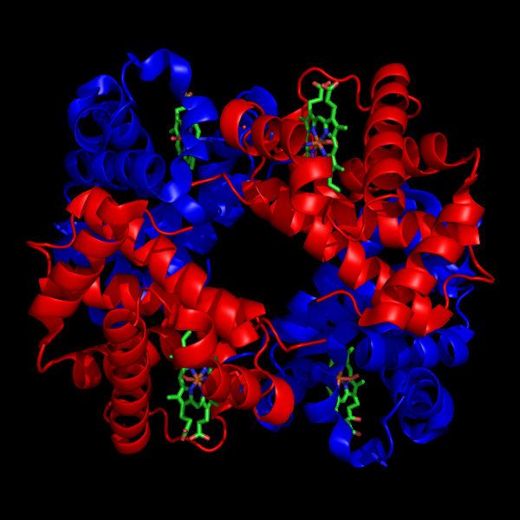
Hemoglobin
http://en.wikipedia.org/wiki/File:1GZX_Haemoglobin.png

Slide 78
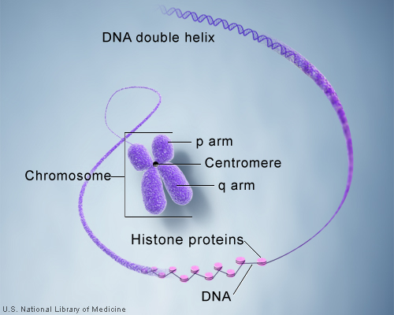
DNA - Chromosomes
http://ghr.nlm.nih.gov/handbook/basics/chromosome

Slide 81
The Future

Slide 82
The Insight Journal
The next generation
of publishing technology

Slide 83
The Insight Journal
Technical work must be reproducible
Papers should be publicly accessible
Fully Electronic publishing
Open peer-review

Slide 84
The Insight Journal
Reproducibility requires sharing
  Source code
  Images
  Parameters
Open source
  Existing algorithms provide services
  New algorithms should be made available to others

Slide 85
Submission for the IJ
PDF doc
Journal
Repository
Code
Input
Data
Author
Web
Site
Build
Machines
Results
Data

Slide 86
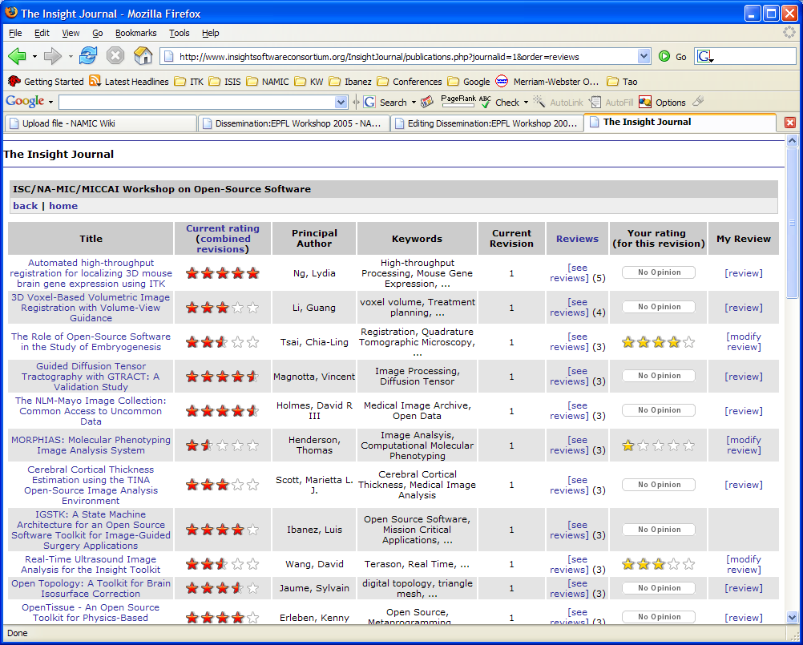

Slide 87
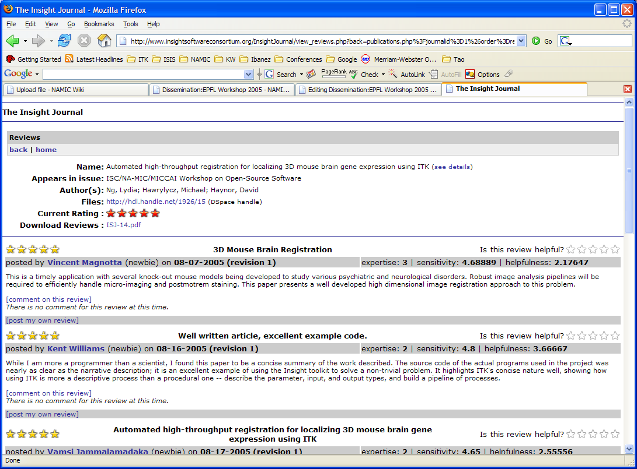

Slide 88
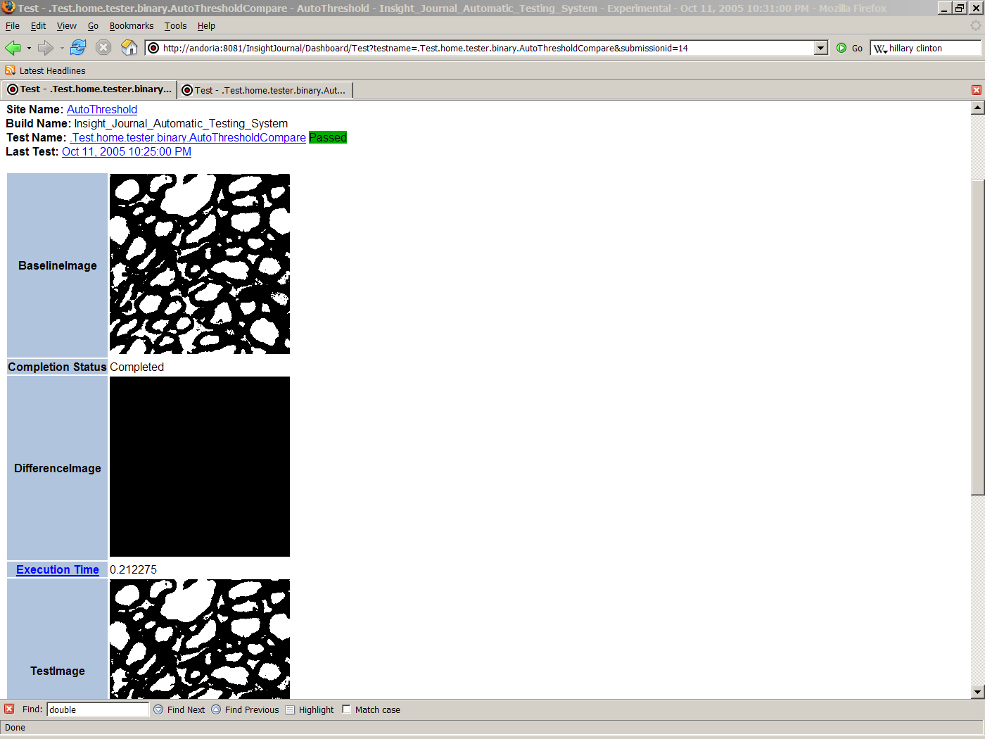
Comparison of output images
Publicly available
Tests for non-trivial images
Reviewers and readers
can use it as a first view
of the paper.
Results Verification

Slide 89
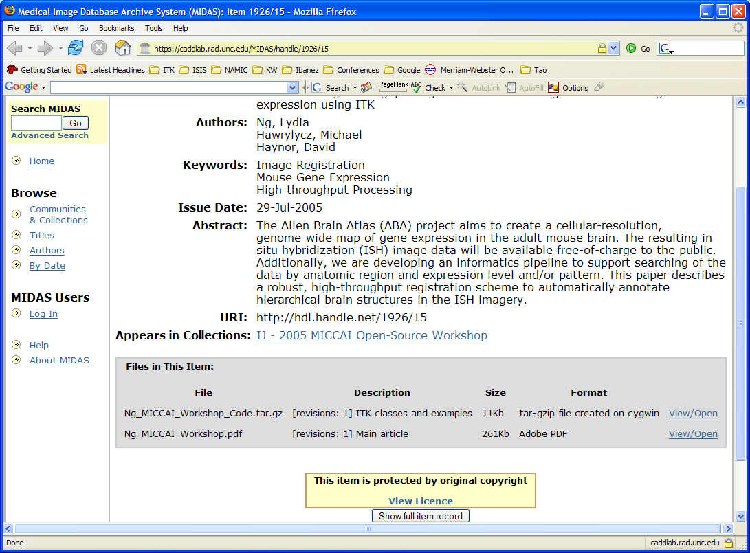

Slide 90
Benefits of the Insight Journal
Allows sharing your Source Code
  Faster and larger impact on the community
Immediate feedback from Readers and Reviewers
  Open Dialog / Forum
No Limitations
  No page limitations
  No limit or charges for color figures
  Accepting additional electronic material

Slide 91
Benefits of the Insight Journal
Indexed by Google
Post revisions of papers and code
Richer readers experience
  Source code available
  Original parameters and images available
  Reader can try on their own data
Accepts practical contributions
  complimentary to full Journal Papers

Slide 92
Benefits of the Insight Journal
No Time Constraints
  Continuous submission process
  Continuous peer-review
  Continuous submission of revision (paper/code)
Thanks to not using Paper !

Slide 96
End

