Slide 1





Open Culture
  Dr. Luis Ibanez, Kitware
http://creativecommons.org/licenses/by/3.0/

Slide 2
© 2008 Luis Ibanez
This presentation is Copyrighted by Luis Ibanez
This presentation is distributed under the Creative Commons Attribution License 3.0:
http://creativecommons.org/licenses/by/3.0/
You are free to Reuse
You are free to Remix
Provided that you give credit to the author

Slide 3

This presentation was created using
Open Source Software
  Open Office copyright is jointly held by Sun Microsystems and Contributors.
  The software is distributed under the
  GNU Lesser General Public License Version 2.1.

Slide 4
Open-Sourceness

Slide 5
Open-Sourceness
No controlling content (Let go!)
  Allowing redistribution
Collaboration platform
  Improvement scheme
  Sharing improvements
Building a shared resource

Slide 6
Open Source
Hardware

Slide 7
Open Source Hardware
http://www.openhardwarefoundation.org
Non-profit corporation
Whose charter is to promote the design and production of
  open source and
  open documentation hardware.

Slide 8
Open Source
Graphics Card

Slide 9
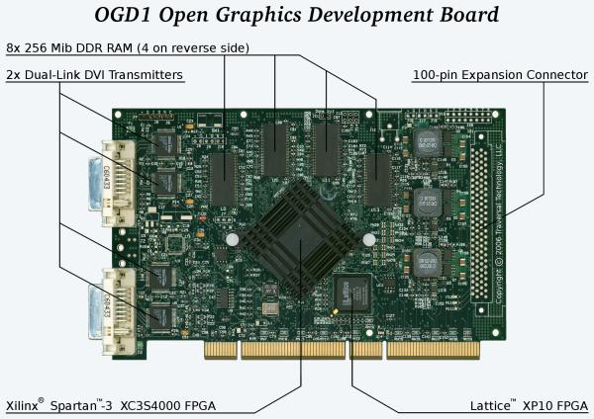
Open Source Graphics Card

Slide 10
Open Source Graphics Card
http://wiki.opengraphics.org/tiki-index.php
The Open Graphics Project (OGP)
is developing
  Graphics cards with
  Fully published specs and
  Open source drivers.

Slide 11
Open Source Graphics Card
List of Materials
http://spreadsheets.google.com/pub?key=ps980ejSIf3DeoBkURvDZQ
Development Tools
http://wiki.opengraphics.org/tiki-index.php?page=Development_Tools
Hardware Development Tools
http://wiki.opengraphics.org/tiki-index.php?page=Hardware+Development_Tools

Slide 12
Open Source Phone
Freerunner

Slide 13
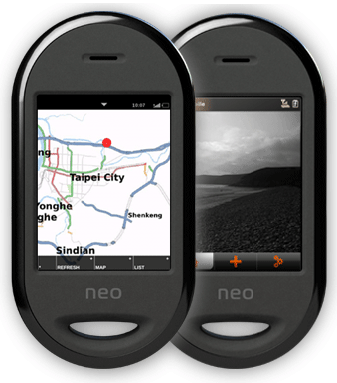
Open Source Phone
Freerunner
Linux-based
Touch screen
Smart phone
Aimed at general consumer use
as well as Linux desktop users and software developers.

Slide 14
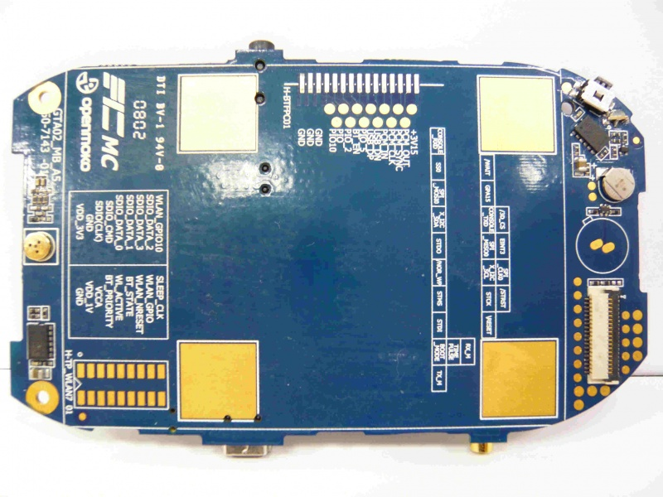
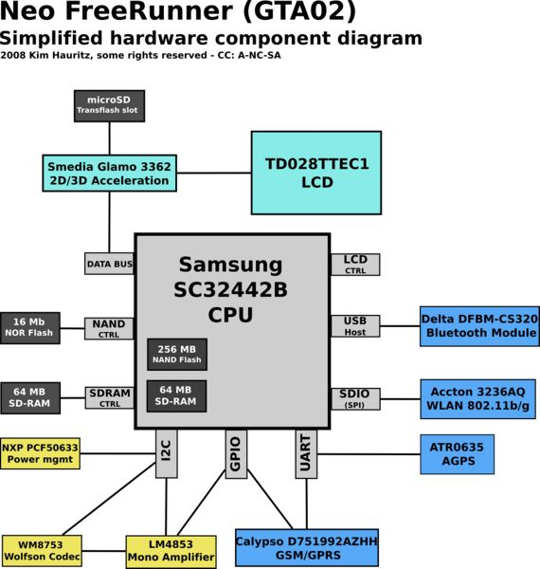
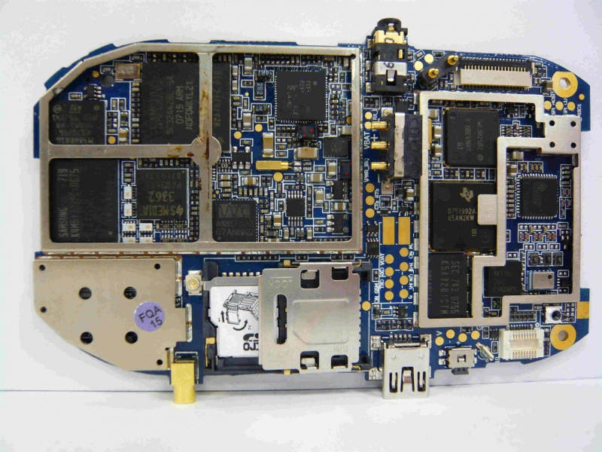
Open Source Phone
Freerunner
http://wiki.openmoko.org/wiki/Neo_FreeRunner_GTA02_Hardware

Slide 15
Open Source Phone
Freerunner
Openmoko
Qt Extended (Qtopia)
  Nokia-Trolltech
Gentoo
Debian
Android (Google)
http://wiki.openmoko.org/wiki/Distributions

Slide 16
Open Source Beer

Slide 17
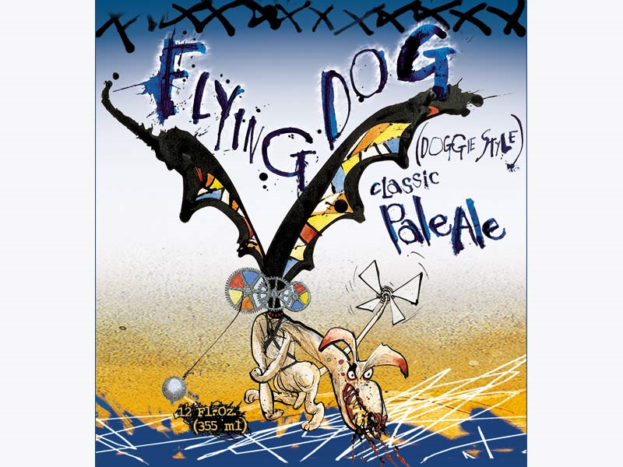
Open Source Beer Project

Slide 18
Open Source Beer Project
http://www.opensourcebeerproject.com/
“Flying Dog Brewery”
Denver’s largest brewery and the second largest craft brewery in the state of Colorado.
Sharing Beer recipes
Collaborating on improving them.

Slide 19
Free Beer Project
http://freebeer.org/blog/about/
FREE BEER
is a beer which is free in the sense of freedom, not in the sense of free beer.
Conceived by
  Copenhagen-based artist collective Superflex and
  Students at the Copenhagen IT University,
Applies modern free software / open source methods to a traditional real-world product: Beer

Slide 20

Free Beer Project
http://freebeer.org/blog/recipe/
VERSION 4.0, SEPTEMBER 2008
Codename: SKANDS
INGREDIENTS
  MALT:
    3,8 kg Maris Otter (3,0 SRM)
    800 g Munich Malt (7,1 SRM)
    200 g Crystal Malt (66,0 SRM)
    100 g Brown Malt (95,4 SRM)
    80 g Carafa Special Type III (710,7 SRM)
  HOPS:
    7.48 AAU Northern Brewer hop pellets (FWH.)
    (25 g of 8.5% alpha acid)
    2.92 AAU Williamette hop pellets (7 min.)
    (15 g of 5.5% alpha acid)

Slide 21
Open Source Games

Slide 22
Fantastic Contraptions

Slide 23
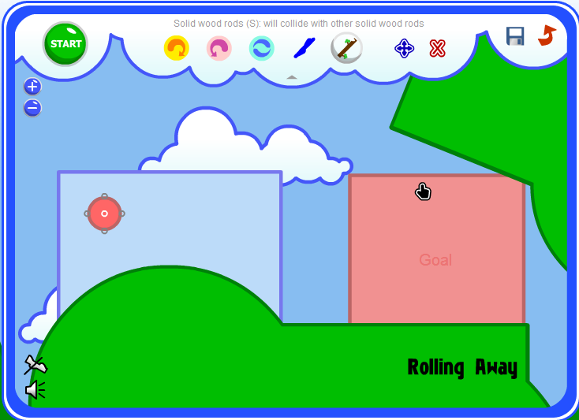
Fantastic Contraptions
http://fantasticcontraption.com/

Slide 24
Fantastic Contraptions
Roaming user
  21 First levels
  See other people's solutions
Subscriber ($10 one-time fee)
  Save your solutions
  See all existing levels (over 1000)
  Create you own challenges (levels)

Slide 25
Fantastic Contraptions
Quiz
  “Rolling Away”
  “Mind the Gap”
  “Back and Forth” (Bonus, 2nd page)

Slide 26
Open Source Architecture

Slide 27
Open Source Architecture
What global housing crisis?
One billion people live in abject poverty.
Four billion live in fragile but growing economies.
One in seven live in slum settlements.
By 2030 it will be one in three.
http://www.architectureforhumanity.org/

Slide 28
Open Source Architecture
Architecture for Humanity created the
Open Architecture Network
The first site on the Web to provide access to open source architectural plans.
  embracing open-source technology
  removing barriers to the improvement,
  distribution, and
  implementation of well-designed solutions,
Ensure that communities receive innovative, sustainable and, dignified shelter.
http://www.architectureforhumanity.org/

Slide 29
Open Source Architecture
Architectural Designs under
Creative Commons Licenses
Cameron Sinclair (TED Video) (min 15 & 19)
Lack of
  Repositories
  Standard file formats
  Design applications
http://www.openarchitecturenetwork.org/

Slide 30
Open Source Music

Slide 31
ccMixter

Slide 32
ccMixter
Post sound tracks
  Under Creative Commons licenses
Remix them with other tracks
Share the remixes
Review / Rate
Download and Redistribute Music
All Legal !
http://ccmixter.org/

Slide 33
ccMixter
Drums
  http://ccmixter.org/files/Fireproof_Babies/11757
Synthetizer (think nuclear powered pipe organ)
  http://ccmixter.org/files/bmccosar/14737
Remix with Guitar
  http://ccmixter.org/files/Pitx/17154
Remix with vocals (Wired but disconnected)
  http://ccmixter.org/files/duckett/17456
http://ccmixter.org/

Slide 34
ccMixter
A Capellas
  http://ccmixter.org/files/silviao/9063
Smooth remix
  http://ccmixter.org/files/_ghost/12254
Cinematix Mix
  http://ccmixter.org/files/DJDecay/9122
Soft Jazz (Good bye Mr. Rogers)
  http://ccmixter.org/files/cdk/12043
http://ccmixter.org/

Slide 35
Kompoz

Slide 36


Kompoz
Kompoz is a social workspace for musicians and songwriters.
Record with GarageBand, Pro Tools, etc.
Upload your tracks
Invite others to collaborate on your song idea

Slide 37

Kompoz
Music CD created by 45 musicians,
Who have never met,
Brought together in Kompoz.com.
Working from their homes all over the map
These artists are defining the future of music.

Slide 38
Kompoz
“The Fall”
http://cdbaby.com/mp3lofi/kompoz-04.m3u
  Guillaume Muhlmann (Metz, France): Guitar
  Karl Knutson (Naperville, IL, USA): Vocals, Lyrics
  Pacal Lopez (France): Keyboards
  Matt Relstab (Portland, OR): Guitar
Creative Commons License

Slide 39
Kompoz
“Down to the River”
http://cdbaby.com/mp3lofi/kompoz-11.m3u
  Raf Fiol (Miami, FL, USA): Lyrics, Rhythm Guitars
  Tommy Hall (Miami, FL, USA): Lead Guitar
  Karl Knutson (Naperville, IL, USA): Vocals
  Bjorn Pehrson (Stockholm, Sweden): Bass
  Jay Schankman (Kingston, OH, USA): Keyboards
  John Wooten (Kansas, USA): Drums

Slide 40
Slice the Pie

Slide 41

Slice the Pie
Artists can raise money directly from their fans to professionally record albums
Fans can become emotionally and financially involved at all levels of the music industry
  Scouting
  Breaking
  Investing in and
  Influencing real artists
http://www.slicethepie.com/

Slide 42
Slice the Pie
Investors can
  Gamble on
  Trade in and
  Profit from the success of these artists
Artists who secure finance
  Pay Slicethepie a small royalty on album sales but
  Keep all their copyright and publishing rights.
http://www.slicethepie.com/

Slide 43
Open Source Movies

Slide 44
Elephants Dream

Slide 45
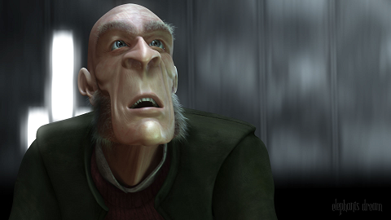
Elephants Dream

Slide 46
Elephants Dream
The world’s first open movie
Made entirely with open source graphics software such as Blender, and
With all production files freely available to use however you please, under a
Creative Commons license.

Slide 47
Elephants Dream
Created by the Orange Open Movie Project studio in Amsterdam during 2005/2006
Bringing together a diverse team of artists and developers from all over the world

Slide 48
Big Buck Bunny

Slide 49
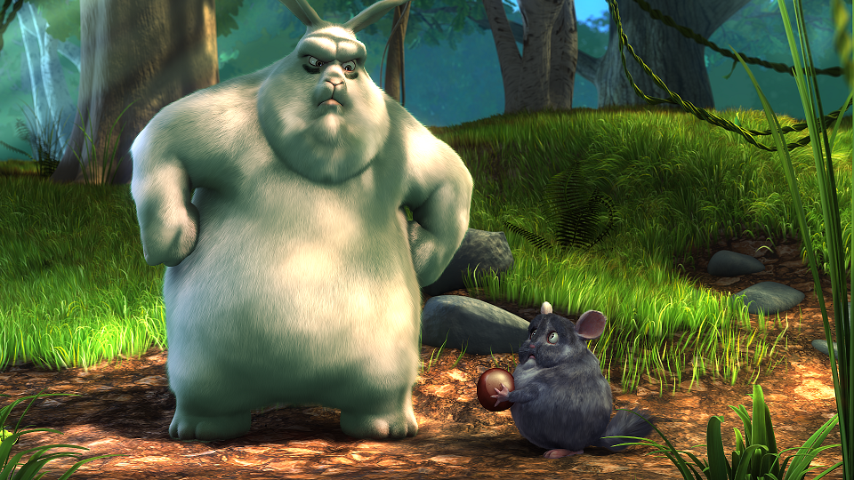
Big Buck Bunny

Slide 50
Big Buck Bunny
License information
The results of the Peach open movie project has been licensed under the Creative Commons Attribution 3.0 license.
This includes all the data published online and on the DVDs, and all of the contents on their website.
If any content on this site is not licensed as such, it will be clearly indicated.

Slide 51
Big Buck Bunny
You can freely reuse and distribute this content, also commercially, for as long you provide a proper attribution.
The attribution is:
  a) If you redistribute or screen or broadcast the movie itself: include the entire credits scroll.
  b) In all other cases, attribute it as:
  (c) copyright Blender Foundation
  www.bigbuckbunny.org

Slide 52
Big Buck Bunny – Production Files
scenes
sets
chars
props
envs
mattes

Slide 53
Big Buck Bunny – Production Files
Create a new Blender scene AND save the file
Delete the default cube object ( select and X)
View -> Front
Append the scene file from
  production/chars/
  FlyingSquirrel.blend/Group/FlyingSquirrel
  Select: Relative Paths & Link, then click on
  Load Library

Slide 54
Big Buck Bunny – Production Files
The character will not be visible yet.
Shift + a
  Add -> Group -> FlyingSquirrel
Correct Orientation
  View -> Side
  Hit “r”
  Hold CTRL and move mouse until it is up-right
  Left click to let it go.

Slide 55
Big Buck Bunny – Production Files
Select Wireframe Visualization
Make it local (or Proxy)
  Ctrl+ Alt + p
  Select FlyingSquirrelRig
Select “Pose” mode
  Select any bone (right click on it)
  Move it around (mouse)
    “r” rotate in one axis
    “r r” rotate in two axes

Slide 56
Big Buck Bunny – Production Files
More instructions on the Tutorials in the DVD
Additional Tutorials in the “Help” menu.
Remember to give credits to
the Blender Foundation
in order to comply with the License.

Slide 57
End

