Slide 1





Open Culture
Dr. Luis Ibanez, Kitware
http://creativecommons.org/licenses/by/3.0/

Slide 2
© 2008-2011 Luis Ibanez
This presentation is Copyrighted by Luis Ibanez
This presentation is distributed under the Creative Commons Attribution License 3.0:
http://creativecommons.org/licenses/by/3.0/
You are free to Reuse
You are free to Remix
Provided that you give credit to the author

Slide 3
This presentation was created using
Open Source Software
Open Office copyright is jointly held by
Sun Microsystems and Contributors.
The software is distributed under the
GNU Lesser General Public License Version 3.0.

Slide 4
Open-Sourceness

Slide 5
Open-Sourceness
No controlling content
  Allowing redistribution
  Letting Go
Collaboration platform
  Improvement scheme
  Sharing improvements
Building a shared resource

Slide 6
Open Source
Hardware

Slide 7
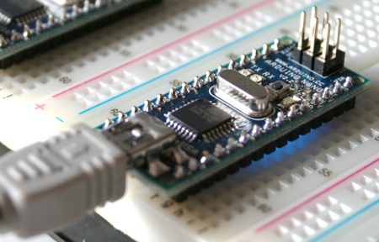
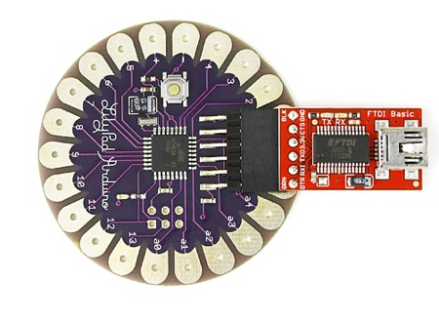
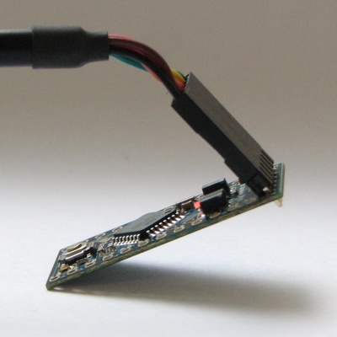
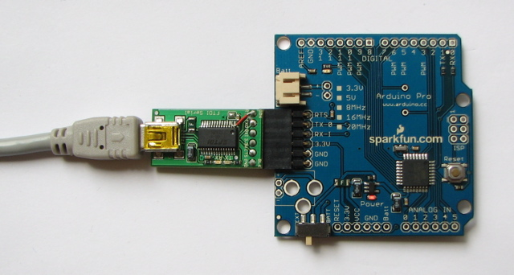
Arduino
http://www.arduino.cc/

Slide 8
Arduino
It's an open-source physical computing platform
based on a simple microcontroller board, and
a development environment for writing software
for the board
Programming language based on Wiring,
which is based on Processing.
Designs published under CC licenses
http://www.arduino.cc/

Slide 9
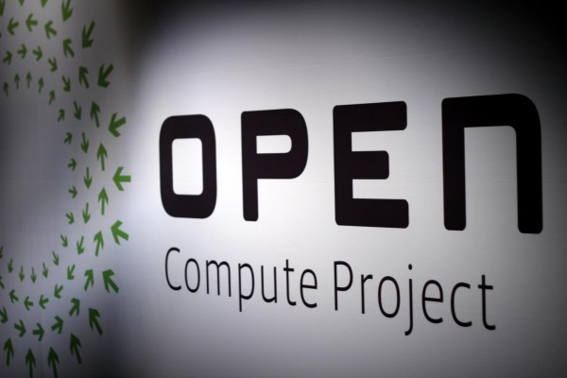

Slide 10
Open Compute Project
Released by Facebook in 2011
Big goal: to build one of the
  most efficient computing infrastructures
  at the lowest possible cost
Develop servers and data centers following the model traditionally associated with open source software projects
http://opencompute.org/

Slide 11
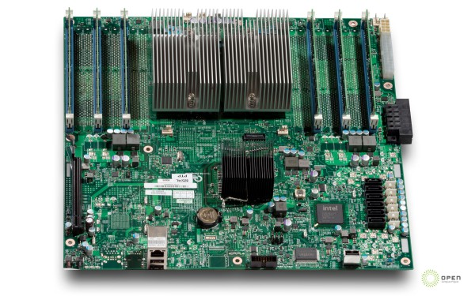
Open Compute Project
http://opencompute.org/projects/intel-motherboard/

Slide 12
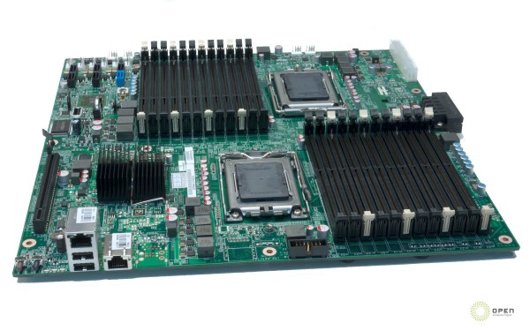
Open Compute Project
http://opencompute.org/projects/amd-motherboard/

Slide 13
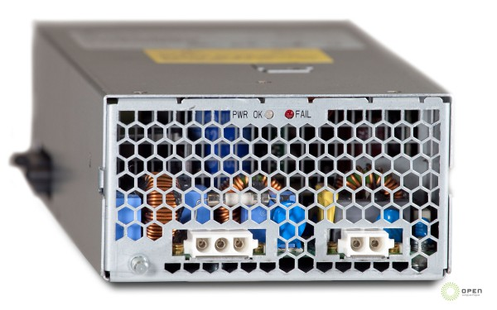
Open Compute Project
http://opencompute.org/projects/power-supply/

Slide 14
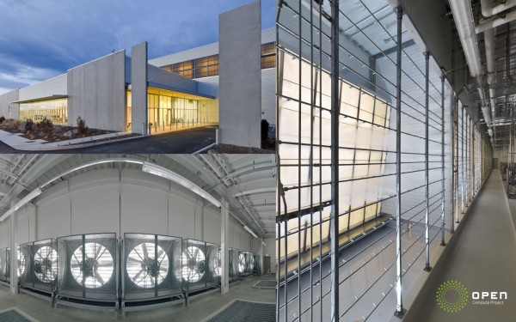
Open Compute Project
http://opencompute.org/projects/mechanical/

Slide 15
Open Source
Graphics Card

Slide 16
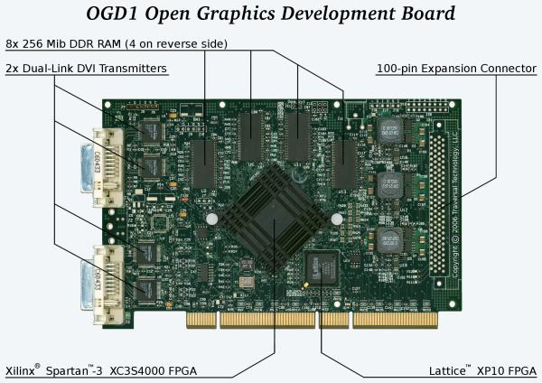
Open Source Graphics Card

Slide 17
Open Source Graphics Card
http://wiki.opengraphics.org/tiki-index.php
The Open Graphics Project (OGP)
is developing
  Graphics cards with
  Fully published specs and
  Open source drivers.

Slide 18
Open Source Graphics Card
Development Tools
http://wiki.opengraphics.org/tiki-index.php?page=Development_Tools
Hardware Development Tools
http://wiki.opengraphics.org/tiki-index.php?page=Hardware+Development_Tools

Slide 19
Open Source Resources
Hardware Development Tools
  GEDA : Schematic Design
  PCB : Printed Circuit Board

Slide 20
Open Source
Robotics

Slide 21
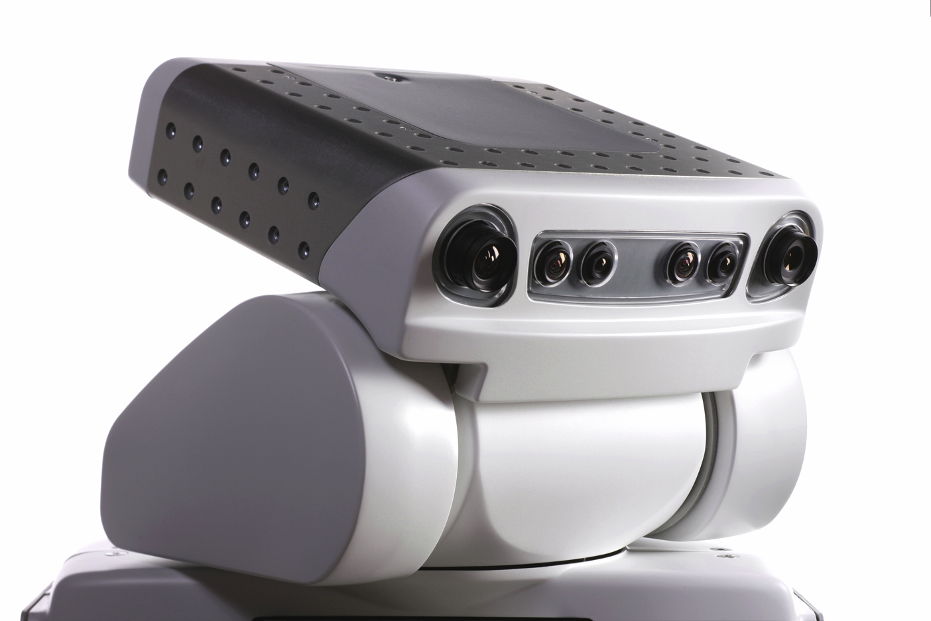
The Willow Garage
http://www.willowgarage.com/

Slide 22
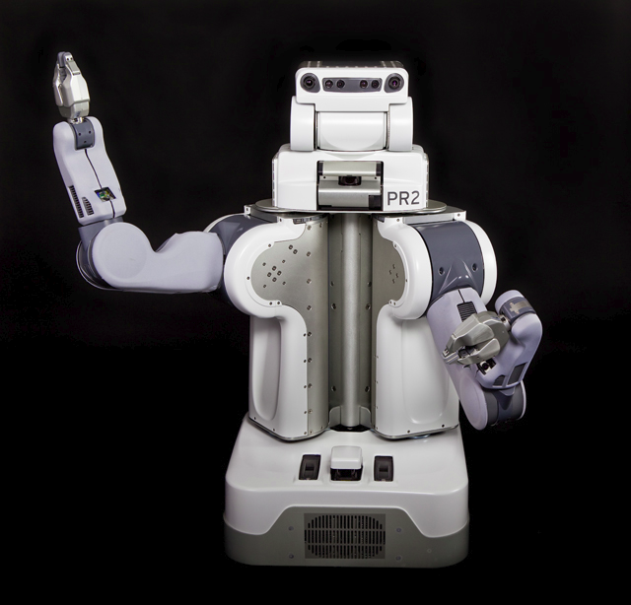
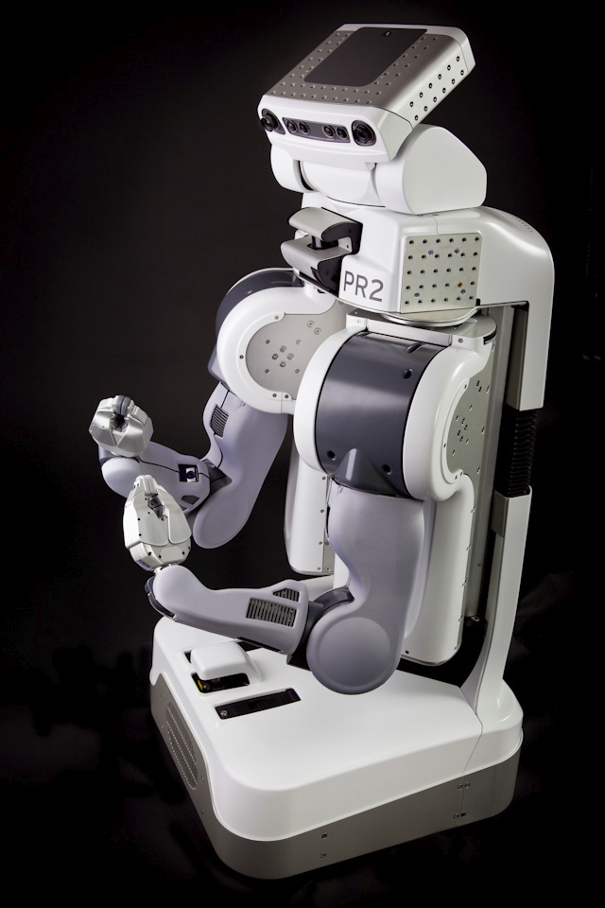
The Willow Garage
http://www.willowgarage.com/
http://www.willowgarage.com/pages/about-us/press-room

Slide 23
The Willow Garage
OpenCV
ROS (Robot Operating System)
PCL (Point Cloud Library)
Gazebo (Multi-Robot Simulator)
Player (Robot Device Network Interface)
http://www.willowgarage.com/

Slide 24
The Willow Garage
"At the center of the open source ideal is the concept that we can get more done if we work together than if we work separately.
You can go to the Moon on that attitude."
– ZDNet
"Willow Garage shows how open source is supposed to work"
http://www.willowgarage.com/

Slide 25
Open Source Beer

Slide 26


Slide 27
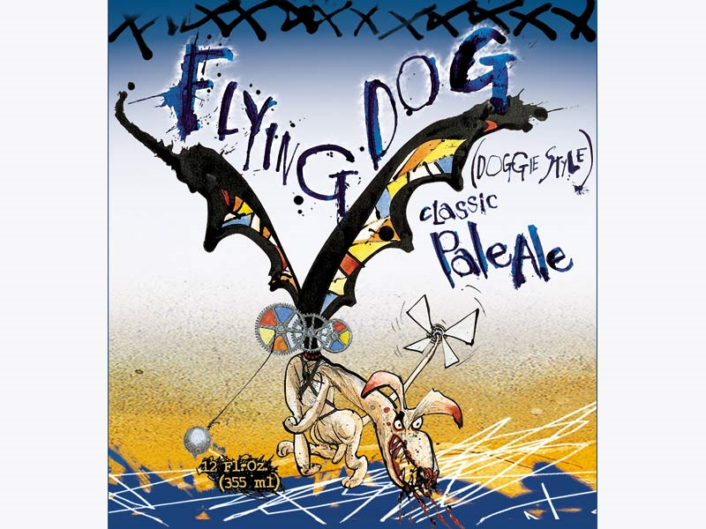
Open Source Beer Project

Slide 28
Open Source Beer Project
“Flying Dog Brewery”
Denver’s largest brewery and the second largest craft brewery in the state of Colorado.
Sharing Beer recipes
Collaborating on improving them.
http://flyingdogales.com/flying-dog-brewery-to-launch-an-open-source-beer/

Slide 29
Free Beer Project
http://freebeer.org/blog/about/
FREE BEER
is a beer which is free in the sense of freedom, not in the sense of free beer.
Conceived by
  Copenhagen-based artist collective Superflex and
  Students at the Copenhagen IT University,
Applies modern free software / open source methods to a traditional real-world product: Beer

Slide 30
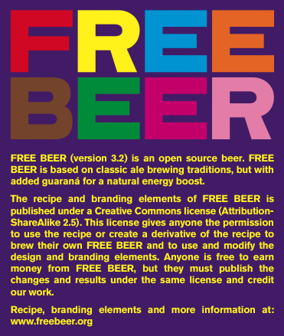
Free Beer Project
http://freebeer.org/blog/recipe/
VERSION 4.0, SEPTEMBER 2008
Codename: SKANDS
INGREDIENTS
  MALT:
    3,8 kg Maris Otter (3,0 SRM)
    800 g Munich Malt (7,1 SRM)
    200 g Crystal Malt (66,0 SRM)
    100 g Brown Malt (95,4 SRM)
    80 g Carafa Special Type III (710,7 SRM)
  HOPS:
    7.48 AAU Northern Brewer hop pellets (FWH.)
    (25 g of 8.5% alpha acid)
    2.92 AAU Williamette hop pellets (7 min.)
    (15 g of 5.5% alpha acid)

Slide 31
Open Source Music

Slide 32
Magnatune

Slide 33

Magnatune
http://magnatune.com/

Slide 34
Why Magnatune is not Evil
No DRM : no copy protection
Listen to Everything: no partial samples
Download Everything: for members
Musicians get paid 50%
Give songs to friends: up to 3 friends
Podcast: non-commercial podcasters (free)
Financially support Open Source:
  Amrok and Rhythmbox
http://magnatune.com/

Slide 35
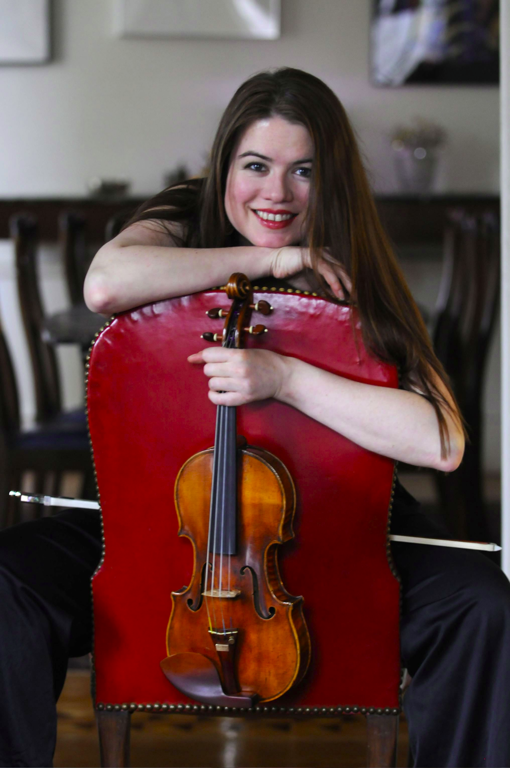
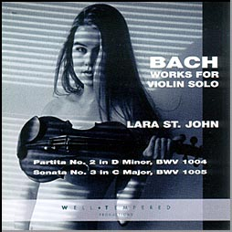
http://magnatune.com/artists/lara_st_john
http://magnatune.com/artists/albums/lara-bach/

Slide 36
Lara St. John's
"Bach: The Six Sonatas and
Partitas for Violin Solo"
iTunes’ best-selling
double album of 2007.

Slide 37
Her previous recording,
"Bach: The Concerto Album,"
number one in the iTunes’ classical category in 2005,
“strongly recommended” by Gramophone.

Slide 38
ccMixter

Slide 39
ccMixter
Post sound tracks
  Under Creative Commons licenses
Remix them with other tracks
Share the remixes
Review / Rate
Download and Redistribute Music
All Legal !
http://ccmixter.org/

Slide 40
ccMixter
Drums
  http://ccmixter.org/files/Fireproof_Babies/11757
Synthetizer (think nuclear powered pipe organ)
  http://ccmixter.org/files/bmccosar/14737
Remix with Guitar
  http://ccmixter.org/files/Pitx/17154
Remix with vocals (Wired but disconnected)
  http://ccmixter.org/files/duckett/17456
http://ccmixter.org/

Slide 41
ccMixter
A Capellas
  http://ccmixter.org/files/silviao/9063
Smooth remix
  http://ccmixter.org/files/_ghost/12254
Cinematix Mix
  http://ccmixter.org/files/DJDecay/9122
Soft Jazz (Good bye Mr. Rogers)
  http://ccmixter.org/files/cdk/12043
http://ccmixter.org/

Slide 42
Kompoz

Slide 43


Kompoz
Kompoz is a social workspace for musicians and songwriters.
Record with GarageBand, Pro Tools, etc.
Upload your tracks
Invite others to collaborate on your song idea

Slide 44

Kompoz
Music CD created by 45 musicians,
Who have never met,
Brought together in Kompoz.com.
Working from their homes all over the map
These artists are defining the future of music.

Slide 45
Kompoz
“The Fall”
http://www.kompoz.com/compose-collaborate/home.project?projectId=2754
  Guillaume Muhlmann (Metz, France): Guitar
  Karl Knutson (Naperville, IL, USA): Vocals, Lyrics
  Pacal Lopez (France): Keyboards
  Matt Relstab (Portland, OR, USA): Guitar
Creative Commons
Attribution Non-Commercial License

Slide 46
Kompoz
“Down to the River”
http://www.kompoz.com/compose-collaborate/home.project?projectId=3612
  Raf Fiol (Miami, FL, USA): Lyrics, Rhythm Guitars
  Tommy Hall (Miami, FL, USA): Lead Guitar
  Karl Knutson (Naperville, IL, USA): Vocals
  Bjorn Pehrson (Stockholm, Sweden): Bass
  Jay Schankman (Kingston, OH, USA): Keyboards
  John Wooten (Kansas, USA): Drums

Slide 47
Slice the Pie

Slide 48

Slice the Pie
Artists can raise money directly from their fans to professionally record albums
Fans can become emotionally and financially involved at all levels of the music industry
  Scouting
  Breaking
  Investing in and
  Influencing real artists
http://www.slicethepie.com/

Slide 49
Slice the Pie
Investors can
  Gamble on
  Trade in and
  Profit from the success of these artists
Artists who secure finance
  Pay Slicethepie a small royalty on album sales but
  Keep all their copyright and publishing rights.
http://www.slicethepie.com/

Slide 50
Indaba-Music

Slide 51
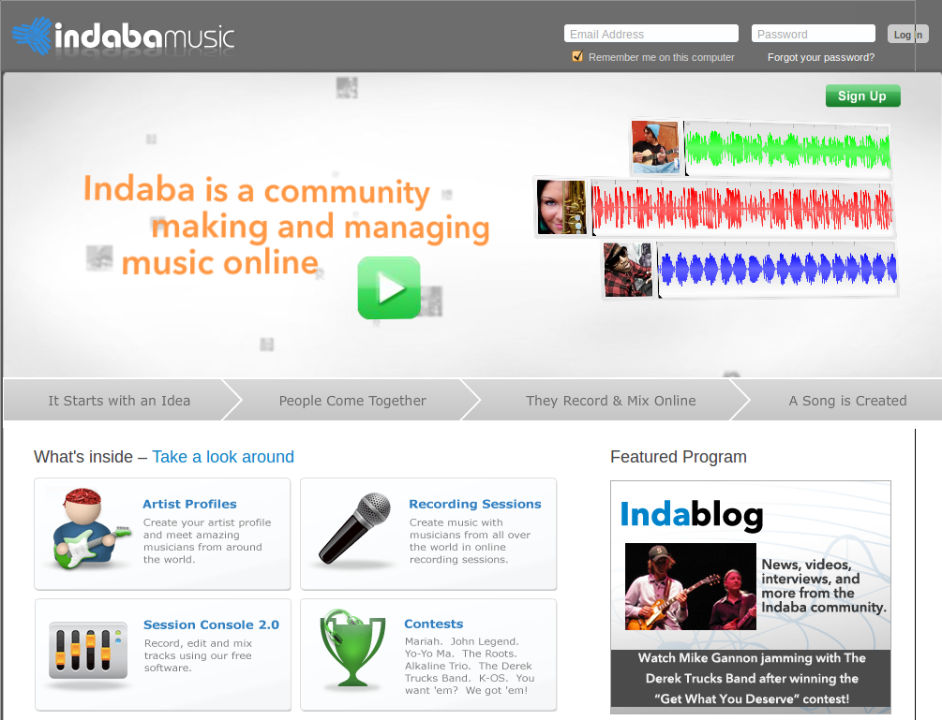

Slide 52
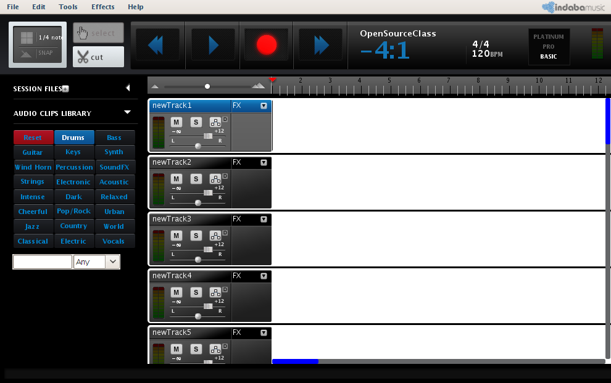
Indaba-Music Session Console
http://www.indabamusic.com/opportunities/colbert

Slide 53

http://www.nin.com/

Slide 54
“as a thank you to our fans
for your continued support,
we are giving away the new
nine inch nails album one hundred percent free, exclusively via nin.com”
http://dl.nin.com/theslip/signup

Slide 55
“the slip is licensed under a creative commons
attribution
non-commercial
share alike license.”
http://dl.nin.com/theslip/signup

Slide 56
“we encourage you to remix it
share it with your friends,
post it on your blog,
play it on your podcast,
give it to strangers,
etc.”
http://dl.nin.com/theslip/signup

Slide 57

The Grateful Dead

Slide 58


Slide 59
“We're on a mission to
make a miracle every day.
As a token of our appreciation for making 2011 an epic year, we're giving away a high-quality 320Kbps MP3 download
every day this month..”
http://www.dead.net/

Slide 60
“Of the approximately 2,350 shows the Grateful Dead played, almost 2,200 were taped,
and most of these are
available online.”
http://www.archive.org/details/GratefulDead
http://en.wikipedia.org/wiki/Grateful_Dead#Concert_sound_systems

Slide 61
Open Source Movies

Slide 62
Elephants Dream

Slide 63
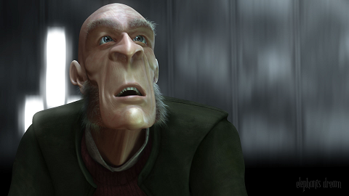
Elephants Dream

Slide 64
Elephants Dream
The world’s first open movie
Made entirely with open source graphics software such as Blender, and
With all production files freely available to use however you please, under a
Creative Commons license.

Slide 65
Elephants Dream
Created by the Orange Open Movie Project studio in Amsterdam during 2005/2006
Bringing together a diverse team of artists and developers from all over the world

Slide 66
Big Buck Bunny

Slide 67
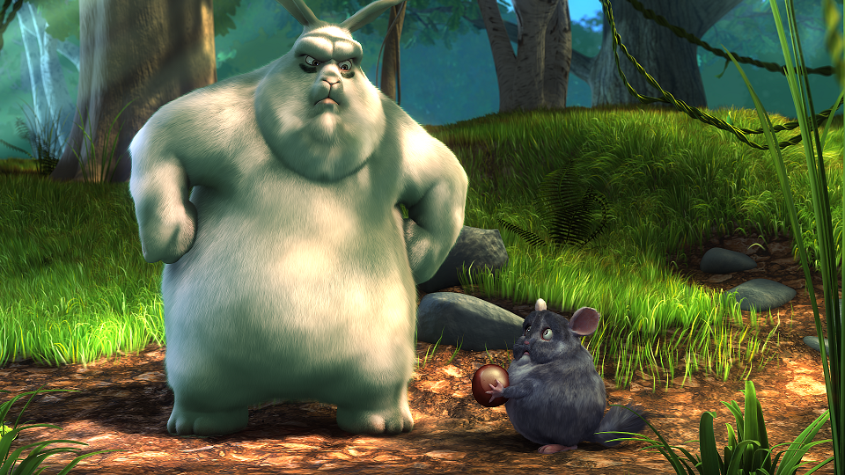
Big Buck Bunny

Slide 68
Big Buck Bunny
License information
The results of the Peach open movie project has been licensed under the Creative Commons Attribution 3.0 license.
This includes all the data published online and on the DVDs, and all of the contents on their website.
If any content on this site is not licensed as such, it will be clearly indicated.
http://www.bigbuckbunny.org/

Slide 69
Big Buck Bunny
You can freely reuse and distribute this content, also commercially, for as long you provide a proper attribution.
The attribution is:
  a) If you redistribute or screen or broadcast the movie itself: include the entire credits scroll.
  b) In all other cases, attribute it as:
  (c) copyright Blender Foundation
  www.bigbuckbunny.org

Slide 70
Big Buck Bunny – Production Files
scenes
sets
chars
props
envs
mattes

Slide 71
Big Buck Bunny – Production Files
Create a new Blender scene AND save the file
Delete the default cube object ( select and X)
View -> Front
Append the scene file from
  production/chars/
  FlyingSquirrel.blend/Group/FlyingSquirrel
  Select: Relative Paths & Link, then click on
  Load Library

Slide 72
Big Buck Bunny – Production Files
The character will not be visible yet.
Shift + a
  Add -> Group -> FlyingSquirrel
Correct Orientation
  View -> Side
  Hit “r”
  Hold CTRL and move mouse until it is up-right
  Left click to let it go.

Slide 73
Big Buck Bunny – Production Files
Select Wireframe Visualization
Make it local (or Proxy)
  Ctrl+ Alt + p
  Select FlyingSquirrelRig
Select “Pose” mode
  Select any bone (right click on it)
  Move it around (mouse)
    “r” rotate in one axis
    “r r” rotate in two axes

Slide 74
Big Buck Bunny – Production Files
More instructions on the Tutorials in the DVD
Additional Tutorials in the “Help” menu.
Remember to give credits to
the Blender Foundation
in order to comply with the License.

Slide 75
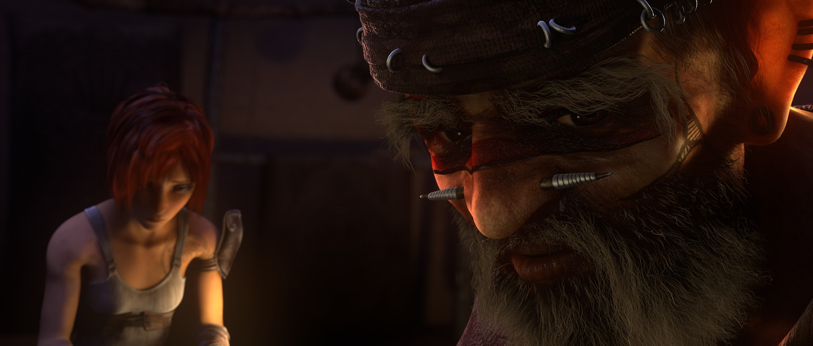
Sintel
http://www.sintel.org/

Slide 76
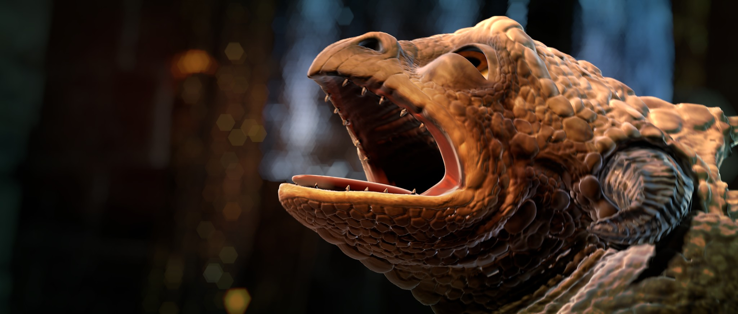
Sintel
http://www.sintel.org/

Slide 77
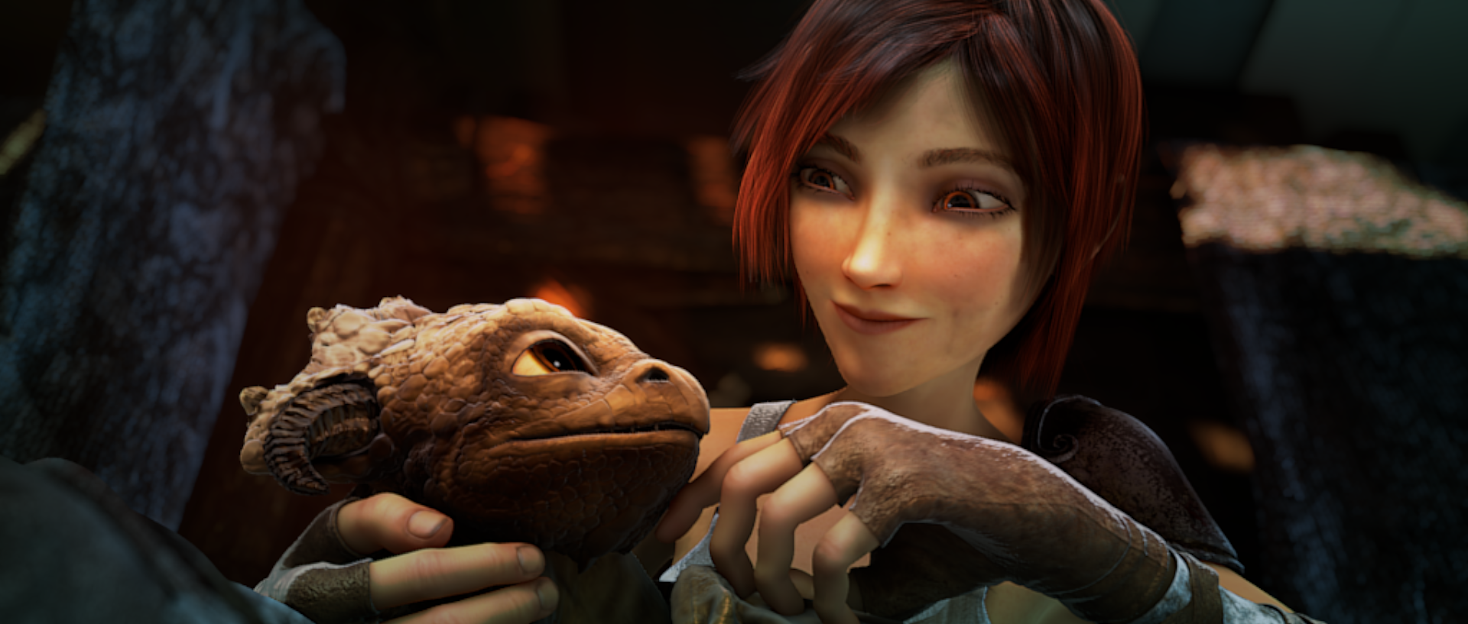
Sintel
http://www.sintel.org/

Slide 78
Open Source Architecture

Slide 79
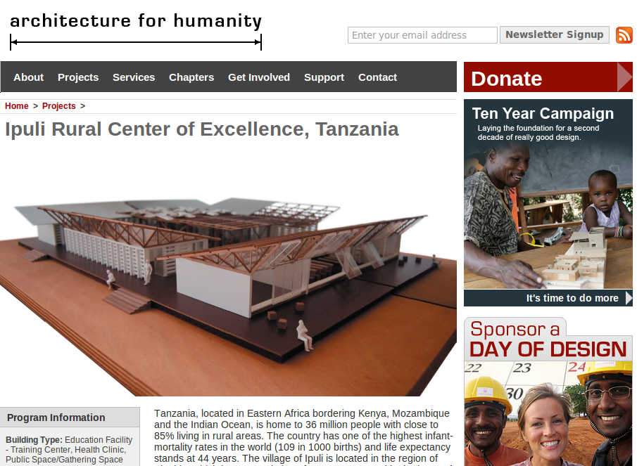
Open Source Architecture

Slide 80
Open Source Architecture
What global housing crisis?
One billion people live in abject poverty.
Four billion live in fragile but growing economies.
One in seven live in slum settlements.
By 2030 it will be one in three.
http://www.architectureforhumanity.org/

Slide 81
Open Source Architecture
Architecture for Humanity created the
Open Architecture Network
The first site on the Web to provide access to open source architectural plans.
  embracing open-source technology
  removing barriers to the improvement,
  distribution, and
  implementation of well-designed solutions,
Ensure that communities receive innovative, sustainable and, dignified shelter.
http://www.architectureforhumanity.org/

Slide 82
Open Source Architecture
Architectural Designs under
Creative Commons Licenses
Cameron Sinclair (TED) (min 15 & 19-23)
Difference with Open Source: Lack of
  Repositories
  Standard file formats
  Design applications
http://www.openarchitecturenetwork.org/

Slide 83
End

