Slide 1





Software Patents
Dr. Luis Ibanez, Kitware
Dr. William Schroeder, Kitware
http://creativecommons.org/licenses/by/3.0/

Slide 2
© 2009 Luis Ibanez, William Schroeder
This presentation is Copyrighted by Luis Ibanez
This presentation is distributed under the Creative Commons Attribution License 3.0:
http://creativecommons.org/licenses/by/3.0/
You are free to Reuse
You are free to Remix
Provided that you give credit to the author

Slide 3
This presentation was created using
Open Source Software
Open Office copyright is jointly held by
Sun Microsystems and Contributors.
The software is distributed under the
GNU Lesser General Public License Version 3.0.

Slide 4
Recommended Books

Slide 5

The Public Domain
Enclosing the Commons
of the Mind
by James Boyle
Yale University Press
http://www.thepublicdomain.org/

Slide 6
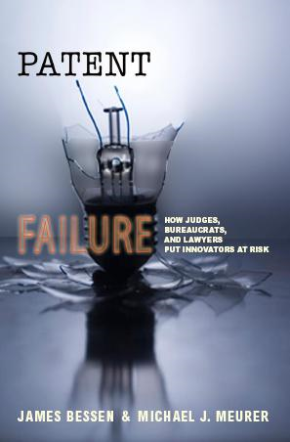
Patent Failure
How Judges, Bureaucrats,
and Lawyers
Put Innovators at Risk
by James Bessen and
Michael J. Meurer
Princeton University Press
http://www.researchoninnovation.org/dopatentswork/

Slide 7
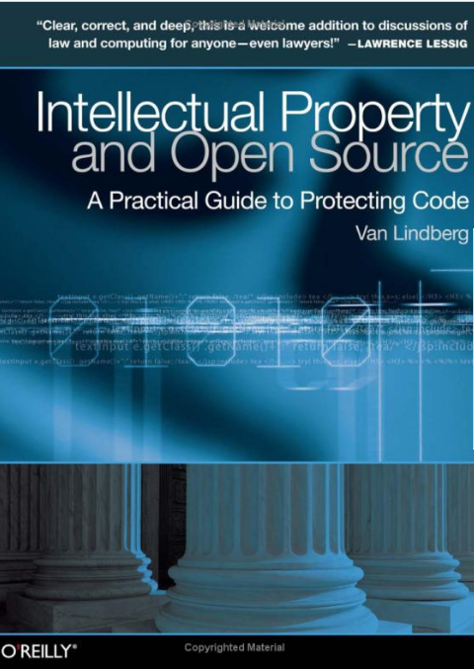
Intellectual Property and
Open Source
A Practical Guide
to Protecting Code
by Van Lindberg
O'Reilly Press
http://oreilly.com/catalog/9780596517960

Slide 8
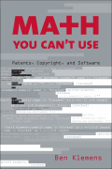
Math You Can't Use
Patents, Copyright
and Software
by Ben Klemens
Brookings Institution Press
http://www.brookings.edu/press/Books/2005/mathyoucantuse.aspx

Slide 9
Why should you care ?

Slide 10
US Patent 6,004,596
Sealed Crustless Sandwich
...The sandwich includes a lower bread portion, an upper bread portion, an upper filling and a lower filling between the lower and upper bread portions, a center filling sealed between the upper and lower fillings, and a crimped edge along an outer perimeter of the bread portion for sealing the fillings there between.
The upper and lower fillings are preferably comprised of peanut butter and
the center filling is comprised of at least jelly.

Slide 11
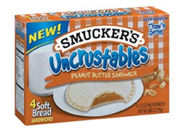
Initial Assignee:
MenuSaver
Assigned to:
Smucker's on Dec 22 2000
Lawsuit:
Smucker's v. Albeit Foods

Slide 12
US Patent 2,463,439
Prior Art ?
Sandwich Grill
Issue Date: March 1949
...a device for making sealed crustless sandwiches....

Slide 13
US Patent 6,368,227
Method for Swinging on a Swing
...A method of swing on a swing is disclosed, in which a user positioned on a standard swing suspended by two chains from a substantially horizontal tree branch induces side to side motion by pulling alternately on one chain and then the other...
Inventor: Steven Olson
Primary Examiner: Kien T. Nguyen
Issued: April 9, 2002
http://www.google.com/patents/about?id=T2QKAAAAEBAJ

Slide 14
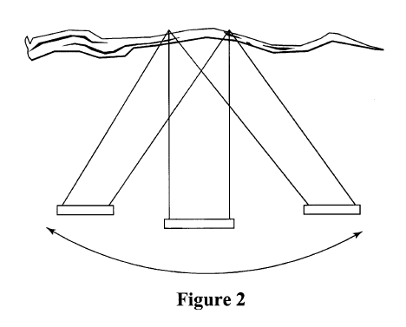
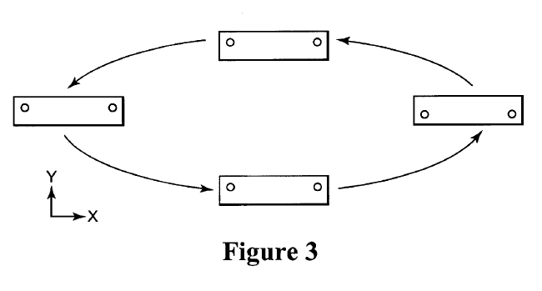
US Patent 6,368,227
“… The user may even choose to produce a Tarzan-type yell while swinging in a manner described, which more accurately replicates swinging on vines in a dense jungle forest.”
“Actual jungle forest is not required...”
http://www.google.com/patents/about?id=T2QKAAAAEBAJ

Slide 15
US Patent 6,368,227
Method for Swinging on a Swing
Reexamination Certificate
Issued under 35 U.S.C 307
The Patent is hereby amended
as indicated below:
  As a result of reexamination, it has been determined that:
  Claims 1,2,3 and 4 are canceled
July 1, 2003
http://www.google.com/patents/about?id=T2QKAAAAEBAJ

Slide 16
US Patent 6,360,693
Animal Toy
An apparatus for use as a toy by an animal, for example a dog, to either fetch carry or chew includes a main section with at least one protrusion extending therefrom that resembles a branch in appearance. The toy is formed of any of a number of materials including rubber, plastic, or wood...
Inventors: Ross Eugene Long, III
Primary Examiner: Thomas Price
Issue Date: March 26, 2002
http://www.google.com/patents?id=hhYJAAAAEBAJ

Slide 17
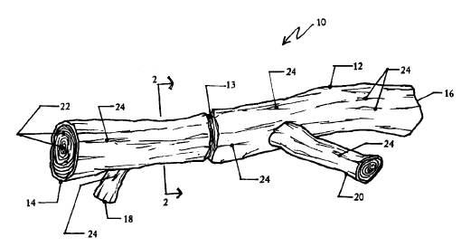
US Patent 6,360,693
http://www.google.com/patents?id=hhYJAAAAEBAJ

Slide 18
US Patent 6,360,693
Animal Toy
Reexamination Certificate
Issued under 35 U.S.C 307
The Patent is hereby amended
as indicated below:
  As a result of reexamination, it has been determined that:
  Claims 1-20 are canceled
July 4, 2006
http://www.google.com/patents?id=hhYJAAAAEBAJ

Slide 19
Patents

Slide 20
Material taken from:
Intellectual Property and Open Source
A Practical Guide to Protecting Code
by Van Lindberg
O'Reilly Press
http://oreilly.com/catalog/9780596517960

Slide 21
The Patent System
“The Bargain Principle”
Contract between society (represented by the government) and an inventor
In return for the development (and disclosure) of new technology and its eventual dedication to the public domain,
the government agrees to grant a
20-year exclusive right
to make, use, sell or import the invention.

Slide 22
Patentable Subject Matter
Defined in four sections of the U.S. Code.
Section 101: Subject matter and utility
Section 102: Novelty
Section 103: Obviousness
Section 112: Enablement

Slide 23
Subject Matter and Utility
101. Inventions patentable
Whoever invents or discovers any new and useful process, machine, manufacture, or composition of matter, or any new and useful improvement thereof, may obtain a patent therefor, subject to the conditions and requirements of this title.
http://www.uspto.gov/web/offices/pac/mpep/documents/appxl_35_U_S_C_101.htm

Slide 24
Subject Matter and Utility
Process, Act or Method
Machine (including non-tangible systems)
Items of Manufacture
Composition of Matter
The inventors of a sandwich could patent:
  The “method” for making the sandwich
  The “machine” that makes the sandwich
  The “sandwich” itself

Slide 25
Subject Matter and Utility
What you can not patent
Things that you did not invent:
Discoveries, natural laws and algorithms.
Things that have no real-world effect or real-world embodiments: Theories, algorithms, information and purely mental acts.
Basic things that did not require inventive work: basic information and discoveries
Things that are purely aesthetic.

Slide 26
Subject Matter and Utility
Utility:
Not as in
“Serviceable for an end or purpose,
valuable or productive”
But as in:
“Has an intended use”
Or as in:
“It does work”

Slide 27
Novelty
It must be “New”:
It has not been disclosed withing the prior art.
A person shall be entitled to a patent unless -
  (a) the invention was known or used by others in this country, or patented or described in a printed publication in this or a foreign country, before the invention thereof by the applicant for patent, or
http://www.uspto.gov/web/offices/pac/mpep/documents/appxl_35_U_S_C_102.htm

Slide 28
Novelty
A person shall be entitled to a patent unless -
  (b) the invention was patented or described in a printed publication in this or a foreign country or in public use or on sale in this country, more than one year prior to the date of the application for patent in the United States, or....
http://www.uspto.gov/web/offices/pac/mpep/documents/appxl_35_U_S_C_102.htm

Slide 29
Prior Art
One Year grace period
Date of
Invention
Date of
Filing
Known, used, published, or patented by others
Patented or published
Patented or published
PRIOR ART
NOT PRIOR ART
PRIOR ART

Slide 30
Prior Art – Element by Element
Patents are checked against Prior Art
on a claim by claim basis.
First each claim is considered alone
Then each clause of the claim is considered
as a necessary feature.

Slide 31
Obviousness
A patent may not be obtained....
if the differences between the subject matter sought to be patented and the prior art are such that the subject matter as a whole
would have been obvious at the time the invention was made to
a person having ordinary skill in the art
to which said subject matter pertains.
http://www.uspto.gov/web/offices/pac/mpep/documents/appxl_35_U_S_C_103.htm

Slide 32
“PHOSITA”
Person
Having
Ordinary
Skill
In
The
Art

Slide 33
Enablement
112 Specification
“The specification shall contain a written description of the invention, and of the manner and process of making and using it, in such full, clear, concise, and exact terms as to enable any person skilled in the art to which it pertains, or with which it is most nearly connected, to make and use the same, and shall set forth the best mode contemplated by the inventor of carrying out his invention”
http://www.uspto.gov/web/offices/pac/mpep/documents/appxl_35_U_S_C_112.htm

Slide 34
Right to Injunctive Relief
A person who is entitled to injunctive relief has the power to ask a court to enjoin another person's conduct. (an Injunction).
To force the second person to STOP doing whatever it is that trespasses on the right's of the first person's property right.
A Court can order you to STOP:
making, selling, importing, or offering for sale...

Slide 35
I4i vs Microsoft
PERMANENT INJUNCTION
In accordance with the Court’s contemporaneously issued memorandum opinion and order in this case, Microsoft Corporation is hereby permanently enjoined from performing the following actions with Microsoft Word 2003, Microsoft Word 2007, and Microsoft Word products not more than colorably different from Microsoft Word 2003 or Microsoft Word 2007 (collectively “Infringing and Future Word Products”)
during the term of U.S. Patent No. 5,787,449:
1. selling, offering to sell, and/or importing in or into the United States any Infringing and Future Word Products that have the capability of opening a .XML,.DOCX, or .DOCM file (“an XML file”) containing custom XML;
http://blog.seattlepi.com/microsoft/library/20090811i4iinjunction.pdf
http://www.pcworld.com/businesscenter/article/170083/injunction_blocks_microsoft_from_selling_word.html

Slide 36
I4i vs Microsoft
PERMANENT INJUNCTION
2. using any Infringing and Future Word Products to open an XML file containing custom XML;
3. instructing or encouraging anyone to use any Infringing and Future Word Products to open an XML file containing custom XML;
4. providing support or assistance to anyone that describes how to use any infringing and Future Word Products to open an XML file containing custom XML; and
5. testing, demonstrating, or marketing the ability of the Infringing and Future Word Products to open an XML file containing custom XML.
http://blog.seattlepi.com/microsoft/library/20090811i4iinjunction.pdf
http://www.pcworld.com/businesscenter/article/170083/injunction_blocks_microsoft_from_selling_word.html

Slide 37
The Patent Document

Slide 38
The Patent Document
Face of the Patent
Figures and Short Descriptions
Description of Figure 1.
Description of Figure 2.
…
Claims

Slide 39
The Patent Number
USPTO Established on July 4, 1836
Before then,
patents were approved by
the Secretary of State !
There were about 10,000 patents between the first patent act in 1790 and 1836
There is no direct correspondence between
Patent number and application date.
Numbers are issued in order of approval.
Source: “Intellectual Property and Open Source” by Van Lindberg, page 24.

Slide 40
Specialized Patent Categories
The common type of patents are “Utility” patents.
In addition to them, there are specialized categories of patents:
Example Patent Numbers | Specialized Category
RE38,325,RE36,424,RE41,027 | Reexamined Patents
PP17,133,PP15,888,PP18,011 | Plant Patents
D552,191, D485,981, D506,743 | Design Patents
H2,204, H1,986, H2,034 | Statutory Invention Registrations
T1,012,T2,875,T1,843 | Defensive Publications
Source: “Intellectual Property and Open Source” by Van Lindberg, page 25.

Slide 41
Statutory Invention Registrations (SIR)
Have Defensive Value
Affirmatively places some advance
in the Public Domain
It is not required to be
  New
  Useful
  Non-Obvious
They don't make an invention excludable
Source: “Intellectual Property and Open Source” by Van Lindberg, page 25.

Slide 42
List of Inventors
One or multiple
Each inventor has separate rights to the patent;
to “own” a patent a company must get an agreement from every inventor
The patent document has
  A short list of inventors
  A full list of inventors
  A Patent assignee (typically their employer)
Source: “Intellectual Property and Open Source” by Van Lindberg, page 26.

Slide 43
Becoming an Inventor
Conception
  Come up with a “working” idea
  And recognize it as such
  (to be aware of its utility)
  Demonstrated by an “Enabling Disclosure”
Reduction to practice
  Filling up technical details necessary to make the invention work.
  It can be: Actual (build) or
  Constructive (describing it in a disclosure).
Source: “Intellectual Property and Open Source” by Van Lindberg, page 27.

Slide 44
Who gets in the Inventors List ?
Inventorship is considered on a
claim by claim basis
Anyone who comes up with an idea or implementation detail that is important enough to be included in the claims should be listed as an inventor
Source: “Intellectual Property and Open Source” by Van Lindberg, page 27-28.

Slide 45
“Owning” a Patent
Patents are “Assigned”
Typically, employees are required to “assign” all their inventions to their employer (check your contract).
An inventor can “assign” the patent to someone else in exchange for a payment
Assignees are tracked by a USPTO database
BUT: the Patent documents are not updated.
To check for ownership you should look at the USPTO PAIR database
Source: “Intellectual Property and Open Source” by Van Lindberg, page 28.

Slide 46
“Destroying” a Patent
Dedication to the Public Domain
Example:
RSA patent 4,405,829
“Cryptography, communications systems and Method”
covering public-key cryptography
The Patent was to expire on September 20, 2000
Dedicated to the Public Domain on Sep 6, 2000
Source: “Intellectual Property and Open Source” by Van Lindberg, page 29.

Slide 47
“Destroying” a Patent
If found that some claims are anticipated.
(if someone else created them first)
Or for inequitable conduct:
  Deceiving
  Misleading, or
  Concealing information from the PTO
A Court can declare a Patent to be “Unenforceable”.
Source: “Intellectual Property and Open Source” by Van Lindberg, page 30.

Slide 48
Invention vs. Embodiment
A Patent covers ALL implementations of an invention
Implementations are called “Embodiments”
The embodiment is NOT the invention
Inventors have rights to embodiments that they didn't list in the patent application, as long as the patent claims cover those embodiments.
Source: “Intellectual Property and Open Source” by Van Lindberg, page 41.

Slide 49
The Claims
The claims “are” the invention
Each separate claim is a separate invention and represents a separate grant of rights from the government
Each claim must be a single sentence
Source: “Intellectual Property and Open Source” by Van Lindberg, page 44.

Slide 50
Claim Structure
Claim Sections
  Preamble
  Transitional phrase
  One or more limitations, and
  Optional effects clauses
Separation between sections is shown by indentation
Source: “Intellectual Property and Open Source” by Van Lindberg, page 44.

Slide 51
Claim Structure
Preamble
  Must specify the type of invention: A system, An apparatus, a method, a composition of matter...
Transitional Phrase
  “comprising” : open-ended transition: “having at least one of the following”.
Limitations
  Describe a single component of the invention.
  Useful to differentiate from Prior Art.
Optional Effect Clause
  Assert that certain result is caused by the system. Tend to use: “wherein”, “whereby”
Source: “Intellectual Property and Open Source” by Van Lindberg, page 45.

Slide 52
Claim Structure
Example from Amazon's US Patent 5,960,411
or ”411” for short:
The “One-Click” Patent
“Method and System for placing a purchase
order via a communications network”
http://www.google.com/patents?vid=USPAT5960411
Source: “Intellectual Property and Open Source” by Van Lindberg, page 44.

Slide 53
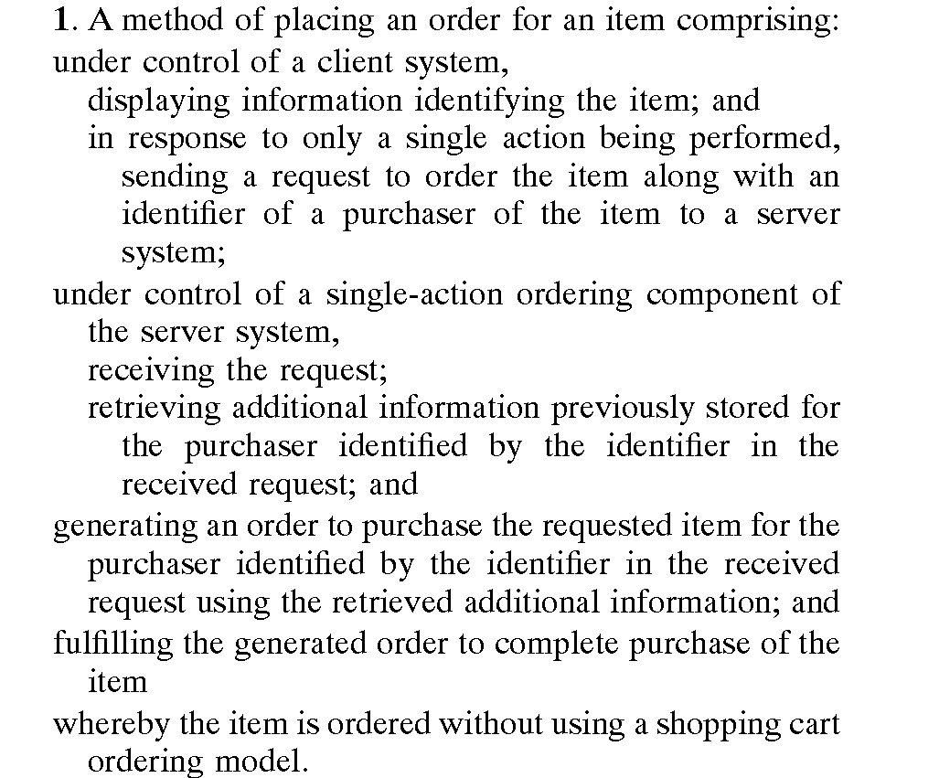
Preamble
Transitional Phrase
Limitations
Effect Clause
Source: “Intellectual Property and Open Source” by Van Lindberg, page 45.

Slide 54
Claims Dependency
Independent Claims
  Have enough limitations to meet requirements:
    Completely describe the working invention
    They are unique
Dependent Claims
  Modified preamble: “The system of claim 1...”
  Add to an independent claim and further limit it
Source: “Intellectual Property and Open Source” by Van Lindberg, page 47.

Slide 55
The Slippery Slope...

Slide 56
Process Patents

Slide 57
Process Patents
In 1953 the requirement for producing a working physical prototype was (mostly) dropped
Working prototypes were only required for inventions that claimed to violate the
Second Law of Thermodynamics:
for example: “Perpetual Movement Machines”
For all other inventions:
“The claims and drawings were sufficient”

Slide 58
Software Patents

Slide 59
Step 1. Subject Matter
35 U.S.C. 101. - Inventions patentable
“Whoever invents or discovers any new and useful process, machine, manufacture, or composition of matter, or any new and useful improvement thereof, may obtain a patent therefor, subject to the conditions and requirements of this title”

Slide 60
What is Patentable ?
Abstract
Ideas
Realm
Physical
World
Realm
Inventions that have an effect in the physical world

Slide 61
US Supreme Court
“Patent Eligibility Trilogy”

Slide 62
Gottschalk v. Benson
“Method to convert from one method of writing binary numbers to another”.
The Supreme Court, in 1972 ruled:
“It is conceded that one may not patent an idea. But in practical effect that would be the result if the formula for converting BCD [binary coded decimal] numerals to pure binary numerals were patented in this case. The mathematical formula involved here has no substantial practical application except in connection with a digital computer”
Source: “Math you can't use” by Ben Klemens, page 53.

Slide 63
Parker v. Flook
"Method for Updating Alarm Limits"
The Supreme Court, in 1978 used the criteria that for inventions containing an algorithm:
“Patent-eligibility must be analyzed on the basis of it being as if the principle, algorithm, or mathematical formula were already well known (was in the prior art).”
http://en.wikipedia.org/wiki/Parker_v._Flook

Slide 64
Parker v. Flook
The Supreme Court, in 1978 stated:
“A competent draftsman could attach some form of post-solution activity to almost any mathematical formula; the Pythagorean theorem would not have been patentable, or partially patentable, because a patent application contained a final step indicating that the formula, when solved, could be usefully applied to existing surveying techniques.”
Source: “Math you can't use” by Ben Klemens, page 54.

Slide 65
Parker v. Flook
INVENTION
INVENTION
Algorithm
(abstract idea)
Real World
Application
(machine)
Real World
Application
(machine)

Slide 66
Diamond v. Diehr
“A process for molding raw, uncured synthetic rubber into cured precision products”
The US Supreme Court in 1981
“The broad question whether computer programs should be given patent protection involves policy considerations that this
Court is not authorized to address.”
http://caselaw.lp.findlaw.com/scripts/getcase.pl?court=US&vol=450&invol=175

Slide 67
Diamond v. Diehr
The US Supreme Court in 1981
“...We defined "algorithm" as a "procedure for solving a given type of mathematical problem," and we concluded that such an algorithm, or mathematical formula, is like a law of nature, which cannot be the subject of a patent.”
http://caselaw.lp.findlaw.com/scripts/getcase.pl?court=US&vol=450&invol=175

Slide 68
Diamond v. Diehr
The Court respected the concept of mathematics as a law of nature.
The Court concluded that some machinery
is necessary for patentability.
It didn't stated: How much machinery?
Source: “Math you can't use” by Ben Klemens, page 56.

Slide 69
The Freeman-Walter-Abele Test
Ask for a patent application that recites an algorithm:
“Does the overall invention includes more
than just the algorithm ?”
Many took this test to mean that any physical manifestation of the algorithm was patentable
if the machine as a whole was inventive.
Source: “Math you can't use” by Ben Klemens, page 56.

Slide 70
The Freeman-Walter-Abele Test
Thus, instead of claiming a patent on:
“An algorithm to...”
Inventors could claim a patent on:
“A general-purpose computer
on which is loaded an algorithm to...”
Source: “Math you can't use” by Ben Klemens, page 56.

Slide 71
CAFC & In re Alappat
“We have held that such programming
creates a new machine,
because a general purpose computer in effect becomes a special purpose computer once it is programmed to perform particular functions pursuant instructions from program software”
The computer running the software is a physical machine, so it is patentable subject matter.
Source: “Math you can't use” by Ben Klemens, page 57.

Slide 72
CAFC – Open the Floodgates
Non-Patentable
Algorithm
Software
Special
Purpose
Computer
General
Purpose
Computer
Patentable
Non-Patentable
Source: “Math you can't use” by Ben Klemens, page 57.

Slide 73
CAFC – Open the Floodgates
Also applied 35 U.S.C. 112 paragraph 6:
(that more or less states that:)
Patent examiners should “fill-in” the
details of materials used for a claim.
Therefore, if a patent application says
“an algorithm to...”
the patent examiner should read it as
“a general purpose computer
on which is loaded an algorithm to...”
http://www.uspto.gov/web/offices/pac/mpep/documents/appxl_35_U_S_C_112.htm
Source: “Math you can't use” by Ben Klemens, page 57.

Slide 74
CAFC – In re Lowry
Established that:
“A data structure to store information
is not patentable”
But
“A hard disk or computer memory on which
is encoded a data structure to store information
is patentable”
http://digital-law-online.info/cases/32PQ2D1031.htm
Source: “Math you can't use” by Ben Klemens, page 57.

Slide 75
Software Patents
Problem with the Patent Bargain Principle
  Protection of rights is given in exchange
  for public disclosure of the invention
  Most software projects do not disclose their source code, only the verbal description of what the code does
  Software patents on basic technologies bring the
  field to a gridlock, since it becomes too expensive
  to acquire all the licenses needed for developing applications.

Slide 76
US Patent 6,389,458
Granted May 14 2002
Pop-up browser windows
Javascript version
  Function onExit() {
  popup = window.open(“pop.html”, “Don't go”);
  popup.focus(); }
Will enter the public domain in the year 2018

Slide 77
US Patent 5,835,392
Method for performing complex fast Fourier transforms
Nov 10, 1998
Inventors:
Carole Dulong, Larry M. Mennemeier, Eiichi Kowashi, Alexander D. Peleg, Stephen A. Fischer
Assignee: Intel Corporation
http://www.google.com/patents?vid=USPAT5835392

Slide 78
Software == Algorithm == Math
Turing Maching
Church-Turing Thesis
Any algorithm can be mapped to a Turing machine

Slide 79
US Patent 5,886,908
Method of efficient Gradient computation
Inventors:
Andrew Roger Conn, Rudolf Adriaan Haring, Chandramouli Visweswariah
Assignee:
International Business Machines Corporation
Primary Examiner: Russell W. Frejd
http://www.google.com/patents?vid=USPAT5886908

Slide 80
US Patent 6,807,536
Methods for Singular Value Decomposition Analysis
Inventors:
Dimitris Achlioptas, Frank D. McSherry
Assignee: Microsoft Corporation
Primary Examiner: George B. Davis
Attorneys: Lee & Hayes, PLLC
http://www.google.com/patents?vid=USPAT6807536

Slide 81
US Patent 6,078,938
Method and System for solving linear systems
Inventors:
ShaoWei Pan, Srinivas L. Panchumarthi, Ramamoorthy Srinath, Shay-Ping T. Wang
Assignees: Motorola, Inc.
Primary Examiner: Tim Vo
http://www.google.com/patents?vid=USPAT6078938

Slide 82
US Patent 6,735,658
“Method and system for identifying people who are likely to have a successful relationship”
  Ask candidate to fill up a survey
  Enter data into a Matrix
  Run a Singular Value Decomposition (SVD)
  Match candidates who are closer in the parametric space

Slide 83
Patents and The Courts

Slide 84
CAFC History
Established in 1982
Combined two previous courts
  US Court of Customs and Patent Appeals
  US Court of Claims

Slide 85
CAFC
Court of Appeals for the Federal Circuit
http://www.cafc.uscourts.gov/
Stocked with pro-patent Judges
http://www.cafc.uscourts.gov/judgbios.html
Consists of twelve judges
who are appointed by the President
It is the only court that has its jurisdiction based wholly upon subject matter rather than geographic location

Slide 86
CAFC
The Federal Circuit is unique among the thirteen Circuit Courts of Appeals.
It has nationwide jurisdiction in a variety of subject areas, including
  international trade,
  government contracts,
  patents,
  trademarks,
  certain money claims against the United States government,
  federal personnel, and veterans' benefits

Slide 87
CAFC
The decisions of the Federal Circuit, particularly in regard to patent cases, are unique in that they are binding precedent throughout the U.S. within the bounds of the court's subject-matter jurisdiction.
Its decisions are only superseded by decisions of the Supreme Court

Slide 88
PAUL R. MICHEL, Chief Circuit Judge
In March 2007, Chief Judge Michel
was awarded the
New York Intellectual Property Law Association's
Fifth Annual Outstanding Public Service Award for
"Unwavering commitment to
the administration of justice."
http://www.cafc.uscourts.gov/judgbios.html

Slide 89
PAUL R. MICHEL, Chief Circuit Judge
He was made a Member of Honor of the
Fédération Internationale des Conseils
en Propriété Industrielle (FICPI),
the worldwide organization of patent attorneys in private practice.
He has addressed FICPI World Congresses and Forums annually for over a decade.
http://www.cafc.uscourts.gov/judgbios.html

Slide 90
ALAN D. LOURIE, Circuit Judge
President of the Philadelphia Patent Law Association
Member of the Board of Directors of the
American Intellectual Property Law Association
(formerly American Patent Law Association),
Treasurer of the Association of Corporate Patent Counsel
Member of the board of directors of the
Intellectual Property Owners Association.
Chairman of the Patent Committee of the Law Section of the Pharmaceutical Manufacturers Association
from 1980 to 1985.
http://www.cafc.uscourts.gov/judgbios.html

Slide 91
ALAN D. LOURIE, Circuit Judge
Recipient of the Jefferson Medal of the
New Jersey Intellectual Property Law Association
for extraordinary contributions to the field of intellectual property law and a recipient of the
Intellectual Property Owners Education Foundation
Distinguished Intellectual Property Professional Award
for extraordinary leadership in the intellectual property community and a lifetime commitment to invention and innovation.
http://www.cafc.uscourts.gov/judgbios.html

Slide 92
CAFC Record
The CAFC is interested in expanding the scope of its jurisdiction
In 1978 (before CAFC)
About 40% of patent cases found the patent valid or infringed
In 1982 (after CAFC)
About 80% of cases were ruled as infringement

Slide 93
CAFC Concentration of Power
“The purpose of a bureaucracy
is to maximize its budget”
CAFC assigns a large proportion of the patent cases to a few judges
Natural judge candidates are:
current patent lawyers
With interest in keeping the patent law business healthy
Source: “Math you can't use” by Ben Klemens, page 70.

Slide 94
Fixing the CAFC
The US National Academy of Sciences recommended:
“Changing the method of selecting judges to bring some fresh economic thinking into patent rulings”...
“appointments... should not be confined to intellectual property practitioners and academics....it should broadened... with backgrounds in antitrust... finance...economics”
Source: “Math you can't use” by Ben Klemens, page 70.

Slide 95
Nearsighted CAFC
Arti Kaur Rai: Duke School of Law:
“...at least some members of the CAFC
view patent rights as comparable to
rights in tangible property.”
“while conventional economic analysis of patents is concerned with the deadweight loss and impediments to future innovations that patents may create”
Source: “Math you can't use” by Ben Klemens, page 72.

Slide 96
Patent Boundaries

Slide 97
Material taken from:
Patent Failure
How Judges,
Bureaucrats,
and Lawyers
Put Innovators at Risk
by James Bessen and Michael J. Meurer
Princeton University Press
March 2008
http://www.researchoninnovation.org/dopatentswork/

Slide 98
Are Patents Property?
The term “Intellectual Property” has become popular in the last ~20 years
Comparison to “Tangible Property” is faulty
Intellectual property scholars are not comfortable applying the property label to patents

Slide 99
Property Concepts
Use and exclusion
Division and transfer
Scope and duration of rights
Acquisition and ownership
Remedies

Slide 100
Use and Exclusion
The right to use and exclude use by others
Liability does not depend on intent
Patents law differs:
  Grants only the negative right to exclude use
  Does not grant affirmative right to use an invention (e.g., if party A patents an improvement to a patented invention B, A does not have the right to use B)

Slide 101
Division and Transfer
Property owners can divide, rent and transfer their rights
In patent law
  Sale is an assignment
  Rental is called a license
Patent law differs
  Inexhaustible quality of information
  Anti-trust behavior is generally ignored

Slide 102
Scope and Duration of Rights
Significant differences exist:
  Property rights are perpetual
  20 year limitation on patents
  The scope (“boundary”) of tangible property is readily fixed
  The boundary of an idea (patent) is hard to ascertain

Slide 103
Acquisition and Ownership
Tangible property and patents can be acquired through sale or assignment
Property and patents can be newly acquired from “the state of nature”
  Homesteading land
  Inventing
First harvester receives all rights
Patent differences
  Not all ideas are patentable

Slide 104
Remedies
Injunctive relief
  Tangible property: profits may be disgorged
Patents are different
  Treated more like contract law
  Is not as generous with damages

Slide 105
Summary of Differences
Patents are weaker
  Limited in term (20 years)
  No affirmative right to use an invention
  Only some inventions can be patented
  Patent damages do not include profit
Patents are stronger
  More freedom in design of their contracts due to limited anti-trust immunity
  Liability: suit can be brought against parties above and below the direct infringer

Slide 106
What's The Problem?
Patents are arguably similar to laws governing tangible property
The most significant problem boils down to the issue of notice (an implementation detail):
“If you can't tell the boundaries,
then it ain't property”

Slide 107
Bad Fences Make Bad Patents
A successful property system establishes clear, easily determined rights
Clarity promotes efficiency so that “strangers” can avoid trespass, or negotiate usage
An ideal patent system defines rights as clearly as a fence around a piece of land
Patents fail to provide clear notice of rights

Slide 108
Inadvertent Infringement
Independent development of a technology that was previously (or subsequently) patented
  Prior art is often ignored or misunderstood
  Trade secrets are ignored
Purposeful development of technology to skirt (a) patents
  The claims are vague
  The set of claims is large (and ever changing)

Slide 109
Issue of Clear Notice
Fuzzy and unpredictable boundaries
  Land can be surveyed
Public access to boundary information
  Patent boundaries can be hidden for many years
Possession
  Tangible property rights are linked to possession
  Patents are too, but this is generally ignored (i.e., patent owners may have rights over future inventions)
The Patent Flood

Slide 110
Notice Failure
Increases costs of patents
Injects uncertainty into patent valuation

Slide 111
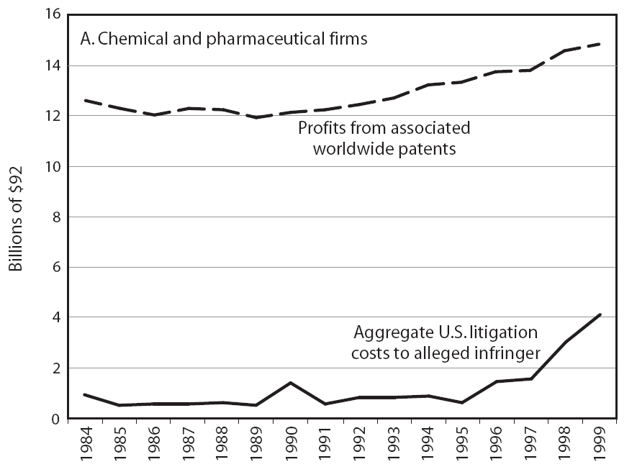
Profit vs. Cost: Chemical & Pharma

Slide 112
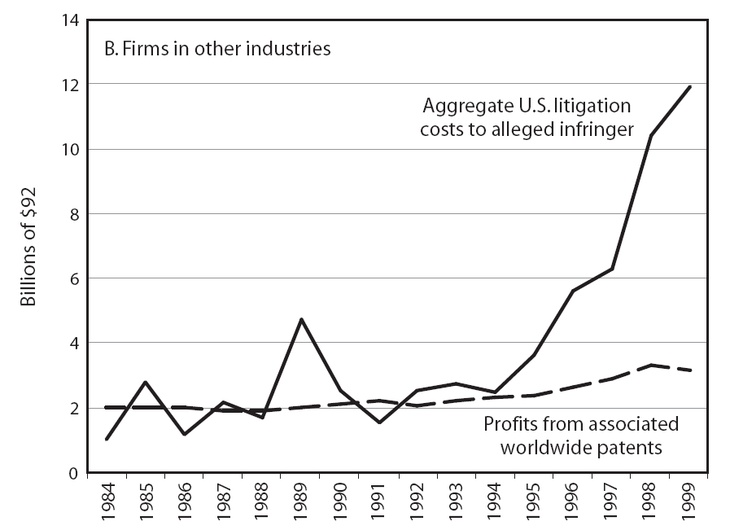
Profit vs. Cost: Other Technologies

Slide 113
The Problem With Software Patents
Software patents are abstract
  As are business methods
Abstract claims
  Lead to fuzzy boundaries
  Give rise to opportunistic litigation, including inventions they did not envision or invent
  Many claims are made as vague and broad
  as possible
Well-defined boundaries (e.g., chemical and pharmaceutical) have fewer problems

Slide 114
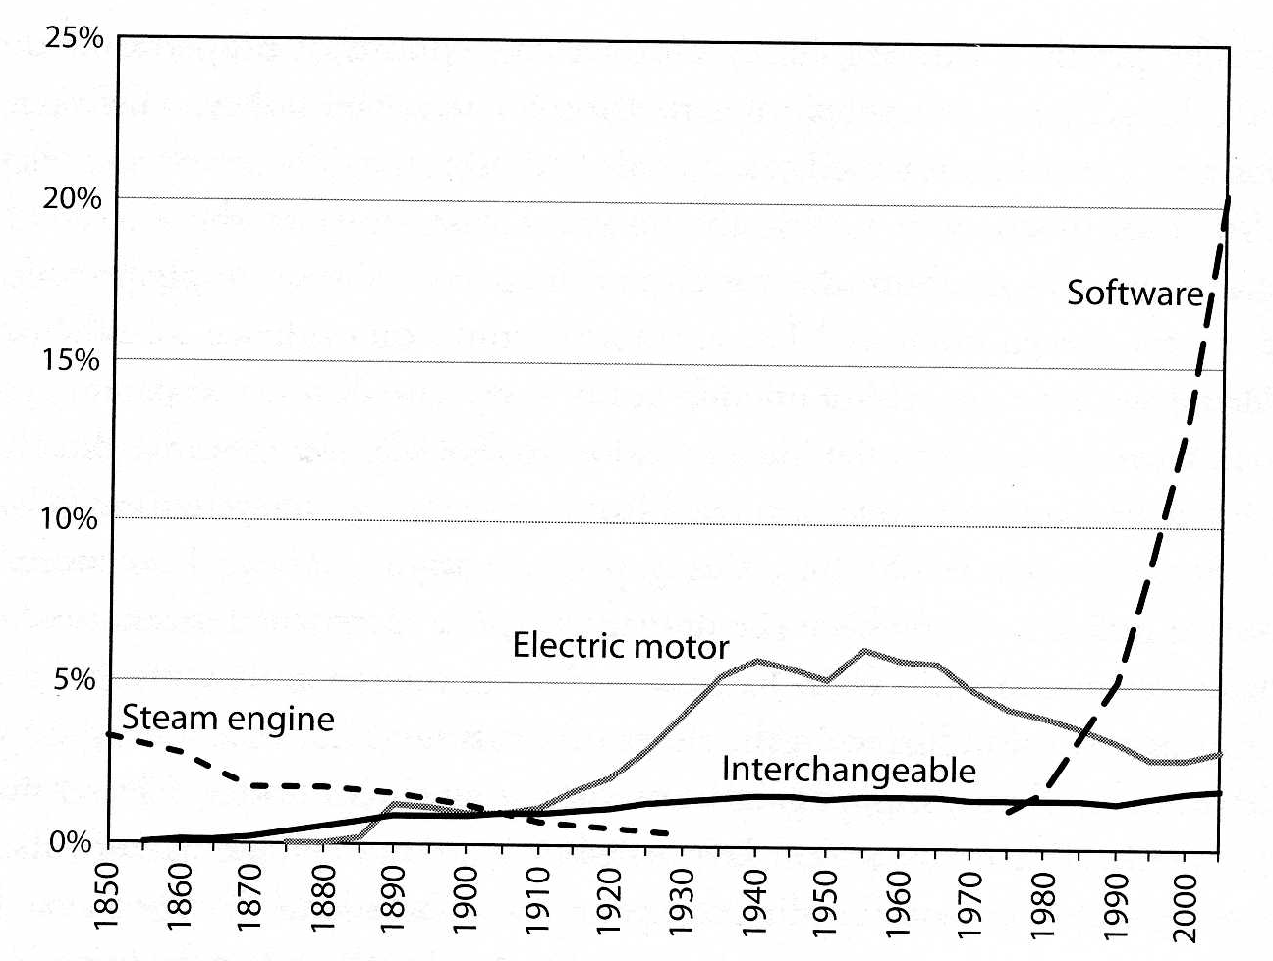
Shares of Patents Using
General Purpose Technologies

Slide 115
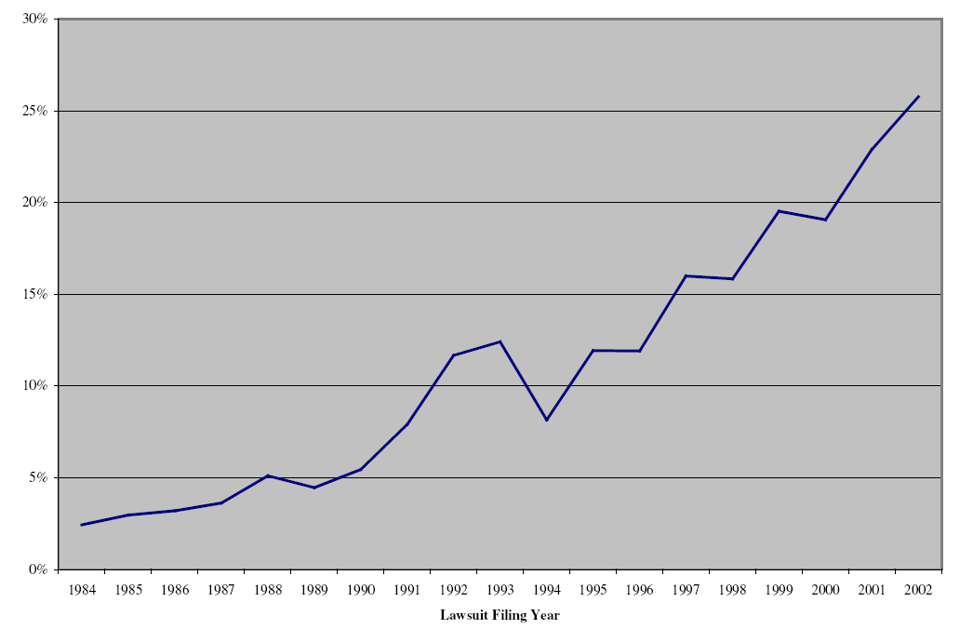
Percent of Software Patent Lawsuits

Slide 116
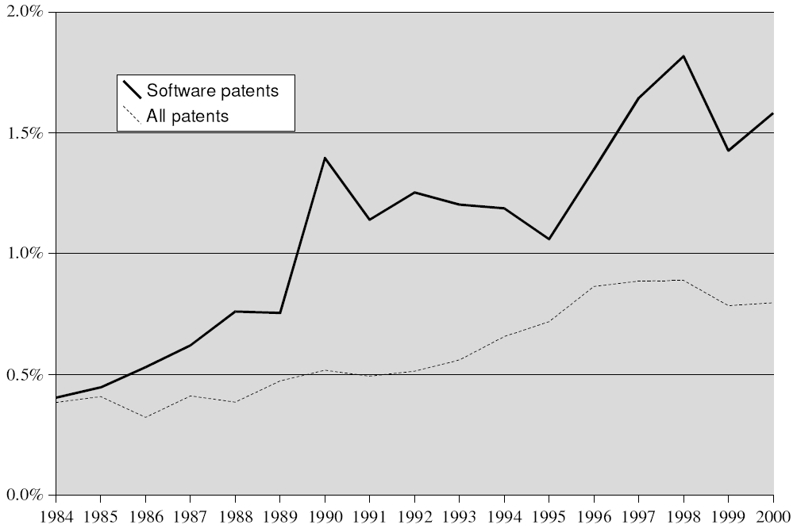
Probability of Lawsuit
(within Four Years of Issue)

Slide 117
The First Amendment

Slide 118
Freedom
of Speech
Patent
Rights

Slide 119
Patent Document == Disclosure
The Patent Bargain included
FULL DISCLOSURE
as an essential element
It was a way of preventing methods to remain as trade secrets
Allowing others to “know” and “talk” about the patented invention is part of the Bargain.

Slide 120
The First Amendment
Freedom of Speech
Talking about Patents is a right
Communicating about Patents is a right
Source code is an expression of ideas
Writing source code about patented methods should not be considered Patent Infringement because it will be a restriction on Free Speech
Compiling (making) and running (using) the code however infringes on Patent Rights.

Slide 121
Research Exemption

Slide 122
Research Exemption
In the context of Patented drugs
It is not considered infringement to use the drug, when dealing with research and tests required for FDA approval
http://www.uspto.gov/web/offices/pac/mpep/documents/appxl_35_U_S_C_271.htm

Slide 123
No Other Research is Exempted
JOHN M.J. MADEY v. DUKE UNIVERSITY
Research Exemption is only:
"...for amusement, to satisfy idle curiosity,
or for strictly philosophical inquiry..."
Experimental use is disqualified from the patent infringement defense if it has the
"slightest commercial implication."
http://cyber.law.harvard.edu/people/tfisher/2002Madeyedit.html

Slide 124
Your cells or mine ?

Slide 125
US Patent 4,438,032
Human T-lymphoblast cell line,
Proteinaceous products produced therefrom, messenger RNA and DNA expressing the proteinaceous products.
Inventors: David W. Golde, Shirley G. Quan
Assignee:
The Regents of the University of California

Slide 126
Who owns your body ?
John Moore first visited
UCLA Medical Center on October 5, 1976,
after learning he had leukemia.
On October 8, 1976, Dr. David W. Golde recommended that Moore's spleen be removed
Moore returned to the UCLA Medical Center several times between November 1976 and September 1983.
On each of these visits Golde withdrew additional samples of blood, blood serum,....

Slide 127
Who owns your body ?
Throughout the period of time that Moore was under Golde's care and treatment, the defendants were actively involved in a number of activities which they concealed from Moore
Defendants were conducting research on Moore's cells and planned to benefit financially by exploiting the cells and their exclusive access to the cells by virtue of Golde's ongoing physician-patient relationship.

Slide 128
Who owns your body ?
On January 6, 1983, the Regents applied for a patent on the cell line, listing Golde and Quan as inventors.
U.S. Patent 4,438,032 issued on March 20, 1984, naming Golde and Quan as the inventors of the cell line and the Regents
as the assignee of the patent.
Moore brought suit against defendants Dr. David W. Golde (Golde), and others...

Slide 129
Who owns your body ?
The court found that Moore had no property rights to his discarded cells or any profits made from them.
The court feared that extending property rights to include organs would have a chilling effect on medical research.
...It was however, ok, for Golde and UCLA to acquire property rights on the Cell line by obtaining a 20-year Monopoly at the USPTO

Slide 130
Submarine Patents

Slide 131
The Evil Plan...
File Lawsuits
Against users with
large budgets
Publish
Important: Do NOT
Mention the
patent application
Public
Space
Private
Space
File
Patent
Application
Wait for
the Method to
become widely
used
Come up
with
Invention
Evil optimization problem: Ideal number of years ?

Slide 132
Patent 4,558,302
Data Compression
T. Welch, “A Technique for High-Performance Data Compression,” Computer, vol. 17, 1984, pp. 8-19.
Jacob Ziv and Abraham Lempel; “Compression of Individual Sequences Via Variable-Rate Coding”, IEEE Transactions on Information Theory, September 1978
http://www.google.com/patents?vid=USPAT5835392

Slide 133
LZW: Data Compression
LZ78: U.S. Patent 4,464,650
  Lempel, Ziv, Cohn, and Eastman
  Assigned to Sperry Corporation,
  (later) Unisys Corporation,
Filed on August 10, 1981.

Slide 134
Patent 4,558,302
Data Compression
LZW: Abraham Lempel, Jacob Ziv, Terry Welch
Journal Article: June 1983
Assignee: Unisys
Designers of GIF, used LZW compression
Unisys asserted ownership of the patent and charged:
  0.45% unit sale price (and 10cents < P < $10)
http://www.google.com/patents?vid=USPAT5835392

Slide 135
LZW: Data Compression
U.S. Patent 4,814,746
  by Victor S. Miller and Mark N. Wegman
  assigned to IBM,
  originally filed on June 1, 1983, and
U.S. Patent 4,558,302
  Welch,
  assigned to Sperry Corporation, later Unisys Corporation,
  filed on June 20, 1983.
  On June 20, 2003, this patent on the LZW algorithm expired

Slide 136
Working around the
Broken Patent System

Slide 137
Microsoft
Open Specification Promise
Microsoft irrevocably promises not to assert
any Microsoft Necessary Claims against you
for
  making, using, selling, offering for sale, importing or distributing
any implementation to the extent it conforms to a Covered Specification
http://www.microsoft.com/Interop/osp/default.mspx

Slide 138
Open Invention Network
An intellectual property company that was formed to promote the Linux system by using patents to create a collaborative ecosystem.
Important patents are openly shared in a collaborative environment
Patents owned by Open Invention Network
are available royalty-free to any company, institution or individual that agrees not to
assert its patents against the Linux System.
http://www.openinventionnetwork.com/

Slide 139
Allied Security Trust
Seeks to minimize patent assertion risks for major high tech industry operating companies.
Its purpose is purely defensive.
Model:
to buy patents of potential interest to their members, license interested members, and
sell the patents subject to licenses previously granted
Its purpose is:
freedom of operation and cost reduction
http://www.alliedsecuritytrust.com/

Slide 140
Linux Defenders
Architected to eliminate poor quality patents and ensure that only high quality patents issue
Enables individuals and organizations to efficiently contribute to:
  “Defensive Publications” that codify ‘known’ inventions that have not previously been patented so that they can be brought to the attention of the patent office to ensure that later developed patent applications claiming such inventions do not issue.
http://linuxdefenders.org/

Slide 141
Linux Defenders
Enables individuals and organizations to efficiently contribute to:
  “Peer to Patent” which solicits prior art contributions from the Linux and broader open source community
  “Post-Issue Peer to Patent” which solicits prior art contribution from Linux and the broader open source community to permit the invalidation of previously issued patents
http://linuxdefenders.org/

Slide 142
Patent Review Process
Patent reviewer gets 1 point when start reviewing
Get another point when patent is issued
The system is biased towards approval

Slide 143
USPTO Funding
The USPTO is funded mostly from the fees paid by Patent Applicants
Congress took about 70% of the USPTO income and spend it in discretionary projects unrelated to the USPTO's role

Slide 144
Benjamin Franklin
“Governor Thomas was so pleased with the construction of this stove...
that he offered to give me a patent for the sole vending of them for a term of years;
but I declined it from a principle which has ever weighted with me on such occasions, viz.:
That as we enjoy great advantages from the inventions of others, we should be glad of an opportunity to serve others by any invention of
ours; and this we should do freely and generously.”
Benjamin Franklin, Autobiography,
The works of Benjamin Franklin, John Bigelow, G. P. Putman Sons, 1904, 237-238

Slide 145
End

