Slide 1





The Wikipedia
  Dr. Luis Ibanez, Kitware
http://creativecommons.org/licenses/by/3.0/

Slide 2
© 2007 Luis Ibanez
This presentation is Copyrighted by Luis Ibanez
This presentation is distributed under the Creative Commons Attribution License 3.0:
http://creativecommons.org/licenses/by/3.0/
You are free to Reuse
You are free to Remix
Provided that you give credit to the author

Slide 3

This presentation was created using
Open Source Software
  Open Office copyright is jointly held by Sun Microsystems and Contributors.
  The software is distributed under the
  GNU Lesser General Public License Version 2.1.

Slide 4
There is Hope...

Slide 5

Wikipedia

Slide 6
Wikipedia
Wiki
Encyclopedia
Wikipedia

Slide 7
Wikipedia
Yahoo
Google
YouTube
Windows Live
Facebook
Microsoft Network (MSN)
Myspace
Wikipedia
Blogger
Yahoo
http://www.alexa.com/site/ds/top_500
The 8th
most visited
web site
Web 2.0
http://meta.wikimedia.org/wiki/Wikipedia.org_is_more_popular_than...

Slide 8
Wikipedias
English
2,585,000
Articles
Dutch
814,000
Articles
French
715,000
Articles
Polish
544,000
Articles
Japanese
527,000
Articles
8.29 Million Articles
253 Languages
Netherlands
374,000
Articles
Italian
505,000
Articles
Portuguese
434,000
Articles
Spanish
407,000
Articles
Swedish
294,000
Articles
http://meta.wikimedia.org/wiki/List_of_articles_every_Wikipedia_should_have

Slide 9
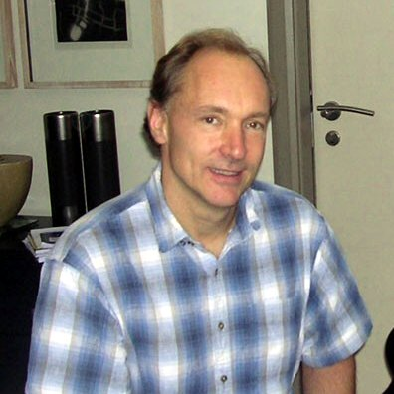
The Future of the WWW
...and non-commercial sites such
as the Wikipedia have pioneered
new collaborate styles of information sharing.
Tim Berners-Lee
innovation will happen
provided it has a platform of open technical standards,
a flexible, scalable architecture, and access to these standards on royalty-free ($0 fee patent licenses) terms.
http://dig.csail.mit.edu/2007/03/01-ushouse-future-of-the-web.html

Slide 10
Wikipedia – Free Content
full-time staff
2006 = 5
2007 = 10
2008 = 19
non-for-profit
Wikimedia Foundation
Volunteers Collaborating
Some Language Versions
carry full
Free Content
English Version
carries some
non Free Content
http://en.wikipedia.org/wiki/Wikipedia_Foundation

Slide 11
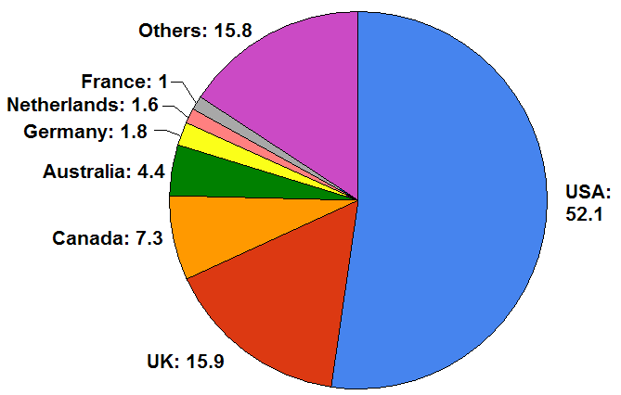
Number of Contributors by Country
http://en.wikipedia.org/wiki/Image:English_Wikipedia_contributors_by_country.png
Permission is granted to copy, distribute and/or modify this document under the terms of the
GNU Free Documentation License, Version 1.2 or any later version published by the Free Software Foundation

Slide 12
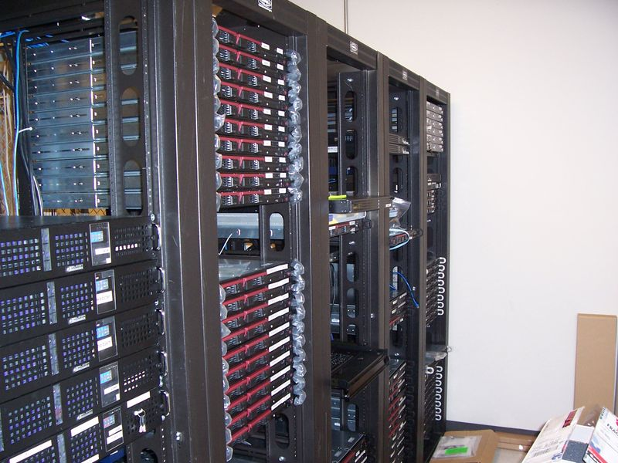
Infrastructure
Tampa, Florida
Seul
Amsterdam
San Francisco
Dedicated clusters
of Linux Servers

Slide 13
Infrastructure
More than 400 servers
10 Billion pages per month (Average)
50,000 HTTP request per Second (Peak)
Hardware budget: $ 1.5 M
Bandwidth budget: $ 35 K
IT Staff: 4 paid employees + 3 volunteers
Migrated to Ubuntu (from mix Fedora + RedHat)
http://arstechnica.com/news.ars/post/20081009-wikipedia-adopts-ubuntu-for-its-server-infrastructure.html

Slide 14
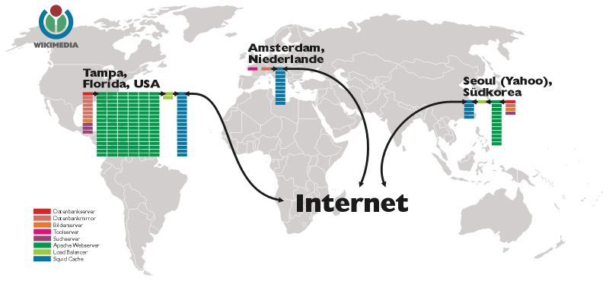
Infrastructure
http://meta.wikimedia.org/wiki/Wikimedia_servers

Slide 15

MediaWiki
http://www.mediawiki.org/wiki/MediaWiki

Slide 16
MediaWiki
Written in PHP
Built upon MySQL
Licensed as GPL
Page modifications are added to the database
Easy page recovery in case of vandalism
Manage image and media files
Supports caching
Coupled with Squid proxy server
http://www.mediawiki.org/wiki/MediaWiki

Slide 17
Founders
Nupedia
Larry Sanger
Jimmy Wales
Wiki as a
feeder
January 2001
GNU Free Documentation
License
January 2003
Richard Stallman
Wikipedia
Wikipedia ® Trademark 2006

Slide 18
Wikipedia Size
2 Million Articles in 2006
Yongle Encyclopedia (1407)
Record for 600 Years !!

Slide 19
Wikipedia Size Comparison
Articles (K) Words (M) Characters (M) Words/art.
Wikipedia 2,000 1,000 3,500 435
Siku Quanshu - 800 -
Yongle Encyclopedia - 370 / 770 -
Enciclopedia Universal 1,000 200 1,000 -
Gujin Tushu Jicheng - 100 -
Encyclopedia of China 80 126 1,580
Enciclopedia Italiana 60 50 247 833
Nationalencyklopedin 183 - - -
Encyclopaedia Britannica 120 55 300 370
Great Soviet Encyclopedia 100 21 200 570
Encyclopedie 72 20 - 278
Microsoft Encarta 70 40 200 200
Encyclopedia Americana 45 25 - 556
http://en.wikipedia.org/wiki/Wikipedia:Size_comparisons

Slide 20
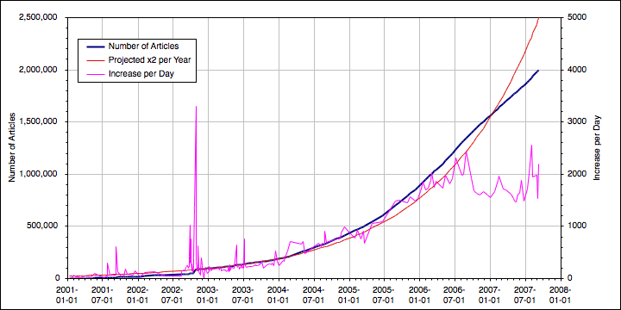
Number of Articles
http://en.wikipedia.org/wiki/Image:EnglishWikipediaArticleCountGraph_linear.png
This file is licensed under the Creative Commons Attribution ShareAlike license versions 2.5, 2.0, and 1.0

Slide 21
Wikipedia Statistics (English Edition)
2 Million Articles
175 Million edits by users
  Average of 16 per page
5.7 Million registered users
1,390 Users have administrative tools

Slide 22
Wikipedia Self-Healing
Type Number Mean Median
All content 618,502 22.3 days 90.5 min
Mass delete 3,574 7.7 days 2.8 min
MD Obscene 47 1.8 days 1.7 min
http://alumni.media.mit.edu/~fviegas/papers/history_flow.pdf

Slide 23
Wikipedia - Essentials
Wikipedia is not for sale.
Non-for-profit.
Free for everyone (learned from Free Software) GFDL
250 Languages (local chapters, volunteer translators)
You can't change anything, only add to it. (MySQL)
Quality Control: Editors
Not an authoritative reference: (use critical thinking)
Is a collection: contributions by unpaid volunteers
For the long haul: at least 100 years from now.

Slide 24
Wikipedia - Open Nature
Collaboration of volunteers
Consensus over Credentials
Susceptibility to Vandalism
Capability for Self-correction
As accurate as other Encyclopedias
Peer-reviewed
Attention to Copyright and proper Licensing

Slide 25
Wikipedia Accuracy
“Internet encyclopaedias go head to head”
Jim Giles, Nature 438, 900 - 901 (2005).
Entries on Science Topics were taken from Wikipedia and Britannica.
Sent to domain experts (on blind study)
42 Entries tested
  4 Average errors in Wikipedia, 3 in Britannica
  4 Serious errors in both Wikipedia and Britannica
  162 factual errors in Wikipedia, 123 in Britannica
    (but Wikipedia articles are 2.6 longer than Britannica)

Slide 26
Wikipedia - Images
Image self-pages (author, copyright, license)
Over 2.5 million images
Anybody can upload more images
Serious copyright management (GPL, CC licenses)
Vector images and Audio recordings
Most image are stored in Wikimedia Commons
Avoid repeated uploads
You can use (free) images in your own work

Slide 27
Cultural Freedom
The freedom
  To use the work and enjoy the benefits of using it
  To study the work and to apply knowledge acquired from it
  To make and redistribute copies, in whole or in part, of the information or expression
  To make changes and improvements, and to distribute derivative works
These freedoms should be available
to anyone, anywhere, anytime.
  http://freedomdefined.org/Definition

Slide 28
Users Access Levels
Stewards
  Allow users to change rights of others
Bureaucrats
  Create admins bots, move pages, rename users
Admins
  Block users, delete pages and history, protect pages
  rollback changes...
Registered
  create articles, upload files, move articles
All Users
  Create accounts, edit, read
http://en.wikipedia.org/w/index.php?title=Wikipedia:User_access_levels&oldid=100160162

Slide 29
Wikipedia Fauna
WikiElf
  Works behind the scenes, infrastructure maintenance
WikiFairy
  Wiki editor who beautifies and standardize articles
WikiGnome
  User who makes small incremental improvements
WikiOgre
  Users who makes huge changes in articles.
http://en.wikipedia.org/wiki/Category:Wikipedia_fauna

Slide 30
Wikipedia Fauna
WikiGremlin
  Creature that runs a Wikipedia website
WikiTroll
  Deliberate and intentional attempts to disrupt the usability of Wikipedia
WikiDragon
  Vast contributions. Creating entire articles.
  Bold edits
http://en.wikipedia.org/wiki/Category:Wikipedia_fauna

Slide 31
Wikipedia Special Forces
Counter-Vandalism Unit
New Pages Patrol
Recent Changes Patrol
Random Page Patrol

Slide 32
Wikipedia Sister Projects

Slide 33
Wikimedia Commons
Media Repository
Maintained by volunteers
Material reusable across Wikipedias
Freely licensed material
  Photographs, diagrams, animations, music, spoken text, video clips...
Mayflower (image search engine)
2.6 Million pages, 2 Million media files
http://commons.wikimedia.org/wiki/Main_Page
http://en.wikipedia.org/wiki/Wikimedia_Commons

Slide 34
Wikisource
Online Library of free content publications
  Public domain, or
  Freely available licenses
Historical Documents
Translations
Examples
  Bible, Tao Te Ching, Britannica 1911, Jules Verne, Grimm's Brothers Fairy Tales, Allan Poe.
http://en.wikisource.org/wiki/Main_Page

Slide 35
Wikiquotes
Free online compendium of Quotations
16,271 pages so far
Categories
  People
  Proverbs
  Films
  TV shows
  Literary works
http://en.wikiquote.org/wiki/Main_Page

Slide 36
Wikinews
Free content news source Wiki
Every story is written as a News reports
(as opposed to an Article in the Wikipedia)
Neutral Point of View Policy
Started on December 2004
By September 2007 it has 10,000 news articles
Beyond Texts: Audio, Video
Credibility Question
  (but you can trust cable news... isn't it ?)
http://en.wikipedia.org/wiki/Wikinews

Slide 37
Wiktionary
Free content Dictionary
Available in 150 Languages
Written collaboratively by Volunteers
Wikisaurus (synonyms)
Started on December 2002
November 2006
  1.7 Million entries in 171 languges
Many of the entries are created by “bots”
http://en.wikipedia.org/wiki/Wiktionary

Slide 38
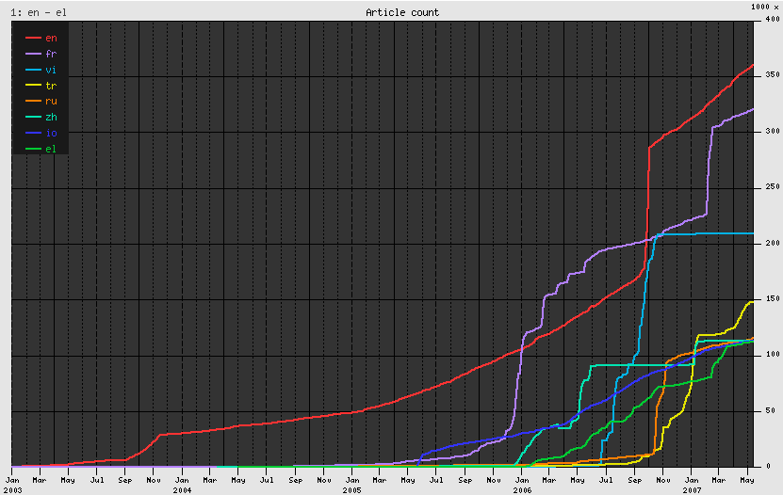
Wiktionary – Growth per Language
http://en.wikipedia.org/wiki/Image:Wiktionary_growth.png

Slide 39
Wikiversity
Free Learning Materials
Five Languages
  English, French, German, Italian, Spanish
Host scholarly projects and communities
Concept of “University of the World”
Doesn't confer Titles (Degrees)
Learning, Teaching and Researching
http://en.wikipedia.org/wiki/Wikiversity
http://en.wikiversity.org/wiki/Wikiversity:What_is_Wikiversity%3F

Slide 40
Wikispecies
Free content catalog of all species
Aimed at scientists
Started in August 2004
Growth
  by Oct 2006 it reached 75,000 articles
  by May 2007 it reached 100,000 articles
  by Sep 2008 it reached 150,000 articles
Support for Taxonomy relationships
Avoids duplication with Wikipedia
http://en.wikipedia.org/wiki/Wikispecies
http://species.wikimedia.org/wiki/Main_Page

Slide 41
Wikimedia - Meta-Wiki
Coordination of all the
Wikimedia Foundation Projects
Administration
Discussion about new and ongoing projects
http://meta.wikimedia.org/wiki/Main_Page

Slide 42
Wikibooks
Collection of Free Textbooks
Books directly written by contributors
Self-publishing
Started on July 2003
Content available for continuous peer-review
Anybody can edit them an improve them
English version has 27,342 Modules
http://en.wikipedia.org/wiki/Wikibooks

Slide 43
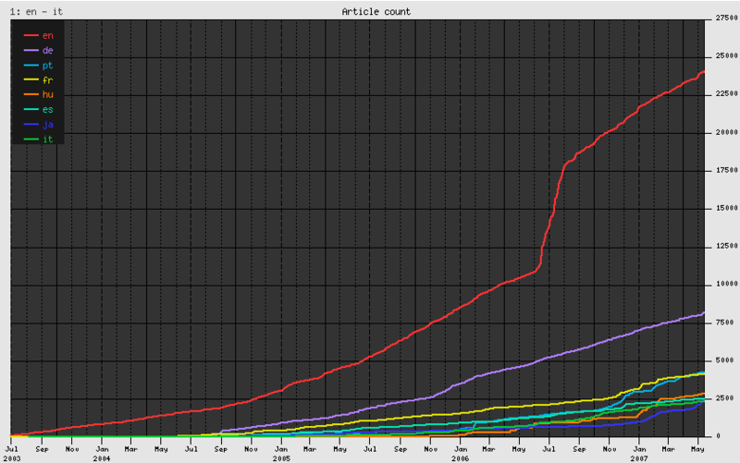
Wikibooks - Growth
http://en.wikipedia.org/wiki/Image:Wikibooks_growth.png

Slide 44
End

