Slide 1





The Wikipedia
Dr. Luis Ibanez, Kitware
http://creativecommons.org/licenses/by/3.0/

Slide 2
© 2007-2012 Luis Ibanez
This presentation is Copyrighted by Luis Ibanez
This presentation is distributed under the Creative Commons Attribution License 3.0:
http://creativecommons.org/licenses/by/3.0/
You are free to Reuse
You are free to Remix
Provided that you give credit to the author

Slide 3
This presentation was created using
Open Source Software
Open Office copyright is jointly held by
Sun Microsystems and Contributors.
The software is distributed under the
GNU Lesser General Public License Version 3.0.

Slide 4
There is Hope...

Slide 5

Wikipedia

Slide 6
“Imagine a world in which every single person on the planet is given free access to the sum of all human knowledge.
That's what we are doing.”
Jimmy Wales

Slide 7

http://en.wikipedia.org/wiki/File:JimmyWalesJI5.jpg

Slide 8
Wikipedia
Wiki
Encyclopedia
Wikipedia

Slide 9
Wikipedia (2008)
Yahoo
Google
YouTube
Windows Live
Facebook
Microsoft Network (MSN)
Myspace
Wikipedia
Blogger
Yahoo
http://www.alexa.com/site/ds/top_500
The 8th
most visited
web site
Web 2.0
http://meta.wikimedia.org/wiki/Wikipedia.org_is_more_popular_than...

Slide 10
Wikipedia (2009)
Google
Facebook
Yahoo
YouTube
Windows Live
Wikipedia
Blogger
Microsoft Network (MSN)
Baidu
Yahoo.jp
http://www.alexa.com/topsites
The 6th
most visited
web site
Web 2.0
http://meta.wikimedia.org/wiki/Wikipedia.org_is_more_popular_than...

Slide 11
Wikipedia (2010)
Google
Facebook
YouTube
Yahoo!
Windows Live
Baidu
Wikipedia
Blogger
QQ
Twitter
http://www.alexa.com/topsites
The 7th
most visited
web site
Web 2.0
http://meta.wikimedia.org/wiki/Wikipedia.org_is_more_popular_than...

Slide 12
Wikipedia (2011)
Google
Facebook
YouTube
Yahoo!
Wikipedia
Baidu
Blogger
Windows Live
Twitter
QQ
http://www.alexa.com/topsites
The 5th
most visited
web site
Web 2.0
http://meta.wikimedia.org/wiki/Wikipedia.org_is_more_popular_than...

Slide 13
Wikipedia (2012)
Google
Facebook
YouTube
Yahoo!
Baidu
Wikipedia
Windows Live
Twitter
QQ
Amazon
http://www.alexa.com/topsites
The 6th
most visited
web site
Web 2.0
http://meta.wikimedia.org/wiki/Wikipedia.org_is_more_popular_than...

Slide 14
Wikipedia (2013)
Google
Facebook
YouTube
Yahoo!
Baidu
Wikipedia
QQ
LinkedIn
Live
Twitter
http://www.alexa.com/topsites
The 6th
most visited
web site
Web 2.0
http://meta.wikimedia.org/wiki/Wikipedia.org_is_more_popular_than...

Slide 15
Wikipedia is more Popular Than
All News and Media Sites
BBC, CNN, New York Times...
All Universities
Harvard, MIT, Cornell, Cambridge...
All Corporate Sites
Including Windows Live
http://meta.wikimedia.org/wiki/Wikipedia.org_is_more_popular_than...

Slide 16
Wikipedias - 2008
English
2,585,000
Articles
German
814,000
Articles
French
715,000
Articles
Polish
544,000
Articles
Japanese
527,000
Articles
8.29 Million Articles
253 Languages
Netherlands
374,000
Articles
Italian
505,000
Articles
Portuguese
434,000
Articles
Spanish
407,000
Articles
Swedish
294,000
Articles
http://en.wikipedia.org/wiki/Wikipedia:Multilingual_statistics

Slide 17
Wikipedias - 2011
English
3,801,000
Articles
German
1,316,000
Articles
French
1,174,000
Articles
Polish
844,000
Articles
Japanese
778,000
Articles
20.6 Million Articles
269 Languages
Netherlands
869,000
Articles
Italian
861,000
Articles
Portuguese
704,000
Articles
Spanish
844,000
Articles
Swedish
416,000
Articles
http://stats.wikimedia.org/EN/TablesArticlesTotal.htm
http://stats.wikimedia.org/EN/Sitemap.htm

Slide 18
Wikipedias - 2013
English
4,379,049
Articles
German
1,650,000
Articles
French
1,443,000
Articles
Polish
1,008,000
Articles
Japanese
881,000
Articles
29.6 Million Articles
269 Languages
Netherlands
1,706,000
Articles
Italian
1,076,000
Articles
Portuguese
803,067
Articles
Spanish
1,056,000
Articles
Swedish
1,597,920
Articles
http://stats.wikimedia.org/EN/TablesArticlesTotal.htm
http://stats.wikimedia.org/EN/Sitemap.htm

Slide 19
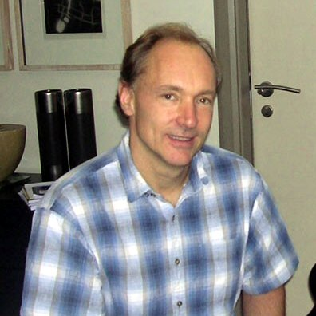
The Future of the WWW
...and non-commercial sites such
as the Wikipedia have pioneered
new collaborate styles of information sharing.
Tim Berners-Lee
innovation will happen
provided it has a platform of open technical standards,
a flexible, scalable architecture, and access to these standards on royalty-free ($0 fee patent licenses) terms.
http://dig.csail.mit.edu/2007/03/01-ushouse-future-of-the-web.html

Slide 20
Wikipedia – Free Content
full-time staff
2006 = 5
2007 = 10
2008 = 19
2010 = 40
2011 = 100
non-for-profit
Wikimedia Foundation
Volunteers Collaborating
Some Language Versions
carry full
Free Content
English Version
carries some
non Free Content
http://en.wikipedia.org/wiki/Wikipedia_Foundation

Slide 21
Wikimedia Foundation
Employees: 23 (in 2008)
Employees: 43 (in 2010)
Employees: 95 (in 2011)
Employees: 175 (in 2013)
Volunteers: 350,000 (in 2005)
http://en.wikipedia.org/wiki/Wikipedia_Foundation

Slide 22
Financial Statements (2013)
Unrestricted net assets:
Support and revenue:
  Donations and contributions $ 44,666,470
  In-kind service revenue $ 260,909
  Other income, net $ 414,297
  Investment income, net $ 17,422
  Release of restrictions $ 3,276,310
Total support and revenue $ 48,635,408
http://upload.wikimedia.org/wikipedia/foundation/6/6e/FINAL_12_13From_KPMG.pdf

Slide 23
Financial Statements (2013)
Expenses:
  Salaries and wages $ 15,983,542
  Awards and grants $ 2,791,378
  Internet hosting $ 2,549,992
  In-kind service expenses $ 260,909
  Other operating expenses $ 10,017,121
  Travel and conferences $ 1,395,013
  Depreciation $ 2,706,841
  Total expenses $ 35,704,796
http://upload.wikimedia.org/wikipedia/foundation/6/6e/FINAL_12_13From_KPMG.pdf

Slide 24
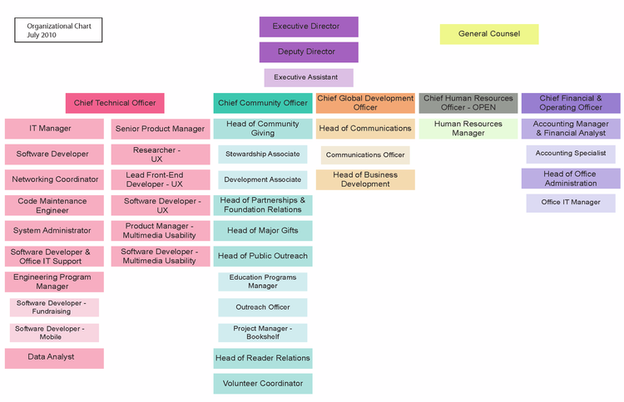
http://wikimediafoundation.org/wiki/Staff#Community

Slide 25
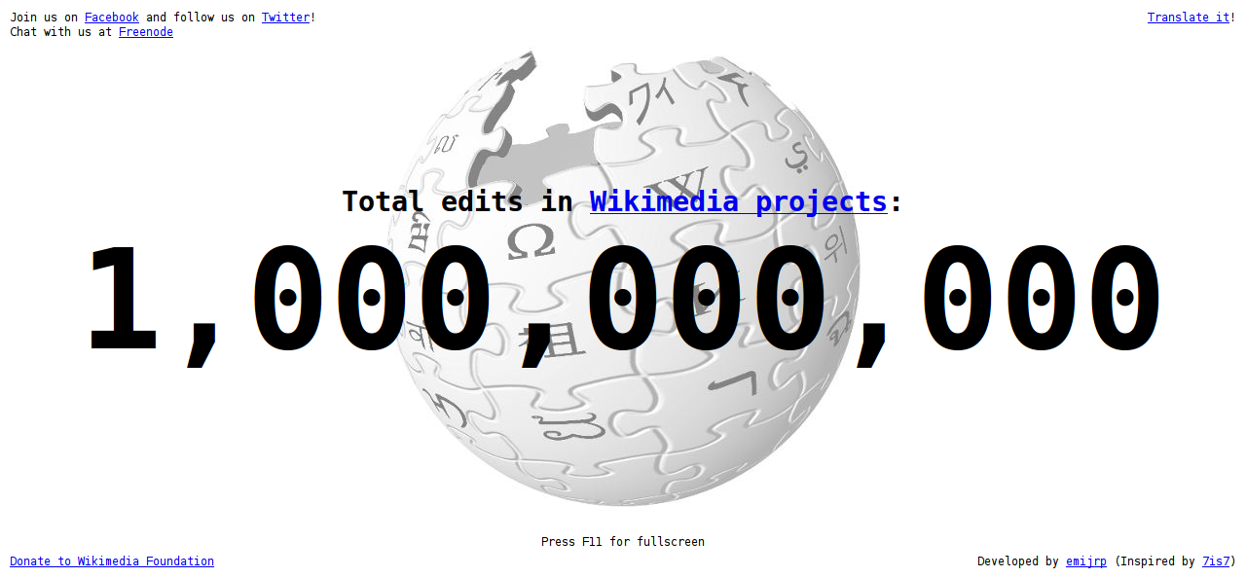
1 Billionth Edit: April 16 2010
http://toolserver.org/~emijrp/wikimediacounter/

Slide 26
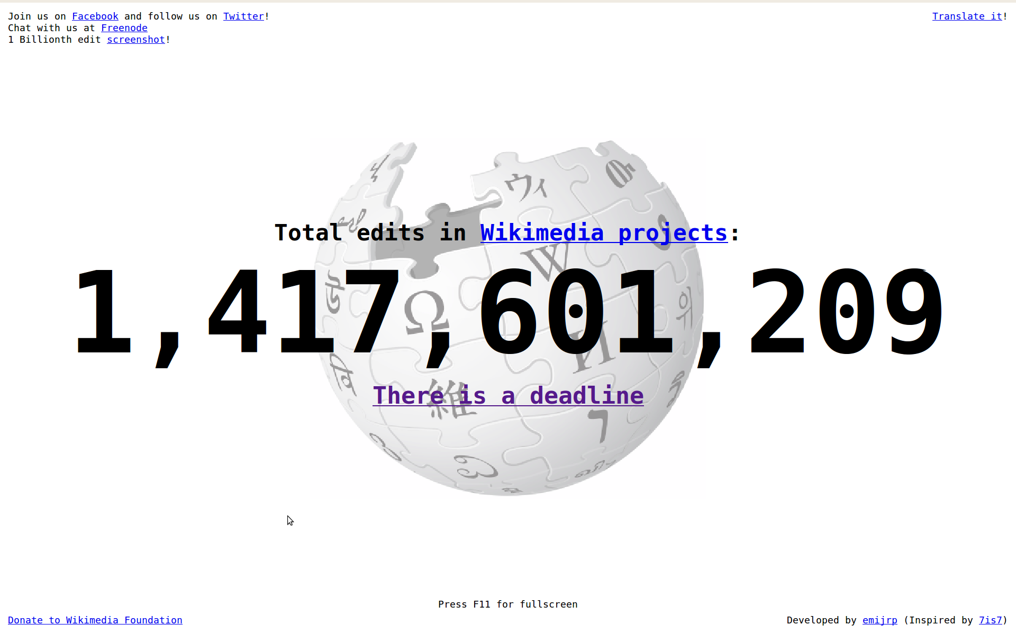
1.4 Billionth Edit: Nov 2011
http://toolserver.org/~emijrp/wikimediacounter/

Slide 27
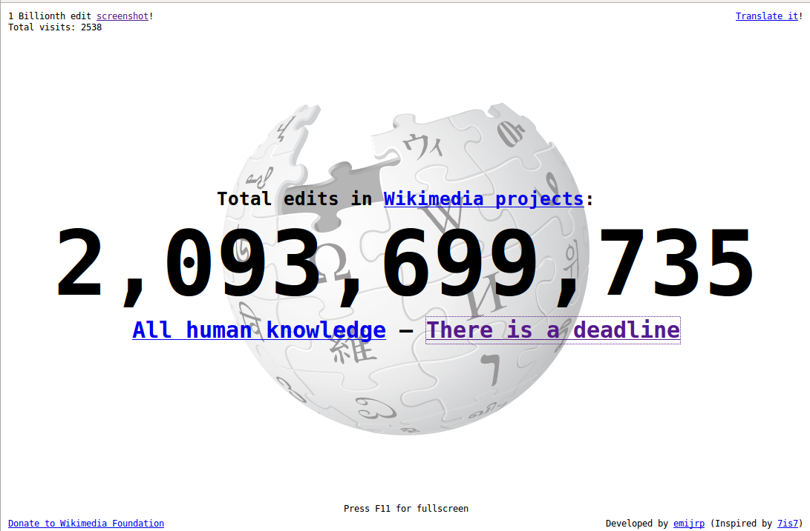
2.0 Billionth Edit: Nov 2013
http://toolserver.org/~emijrp/wikimediacounter/

Slide 28
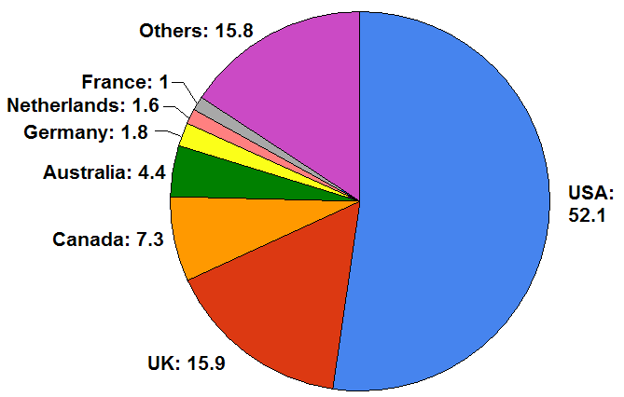
Number of Contributors by Country
http://en.wikipedia.org/wiki/Image:English_Wikipedia_contributors_by_country.png
Permission is granted to copy, distribute and/or modify this document under the terms of the
GNU Free Documentation License, Version 1.2 or any later version published by the Free Software Foundation

Slide 29
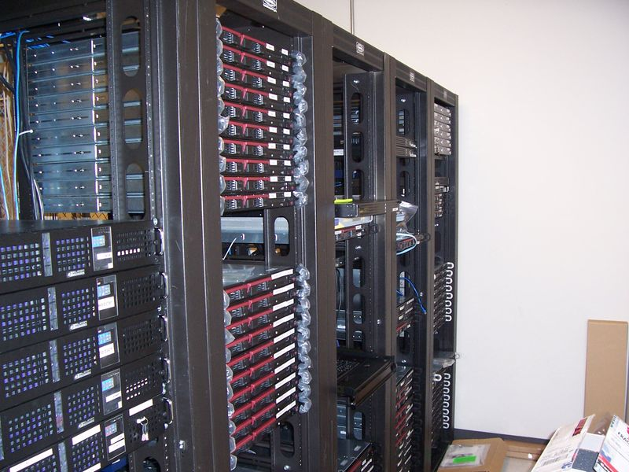
Infrastructure
Tampa, Florida
Seul
Amsterdam
San Francisco
Dedicated clusters
of Linux Servers

Slide 30
Infrastructure (2008)
More than 400 servers
10 Billion pages per month (Average)
50,000 HTTP request per Second (Peak)
Hardware budget: $ 1.5 M
Bandwidth budget: $ 35 K
IT Staff: 4 paid employees + 3 volunteers
Migrated to Ubuntu
(from mix Fedora + RedHat)
http://arstechnica.com/news.ars/post/20081009-wikipedia-adopts-ubuntu-for-its-server-infrastructure.html

Slide 31
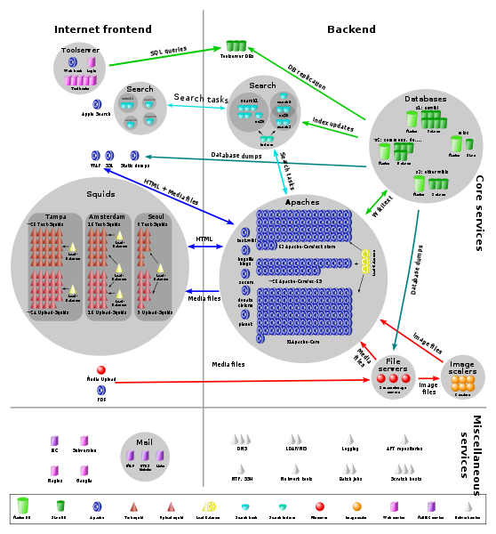
Infrastructure (2009)
http://meta.wikimedia.org/wiki/Server_layout_diagrams

Slide 32
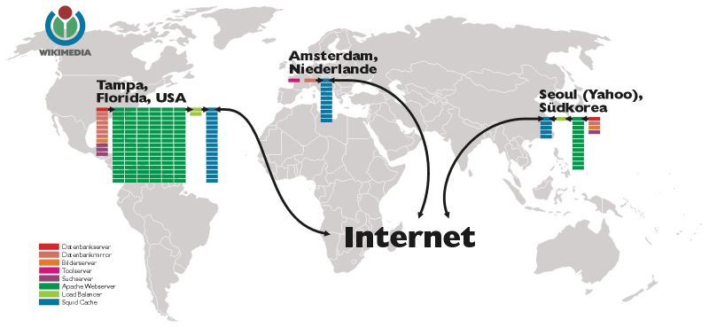
Infrastructure (2006)
http://meta.wikimedia.org/wiki/Wikimedia_servers

Slide 33
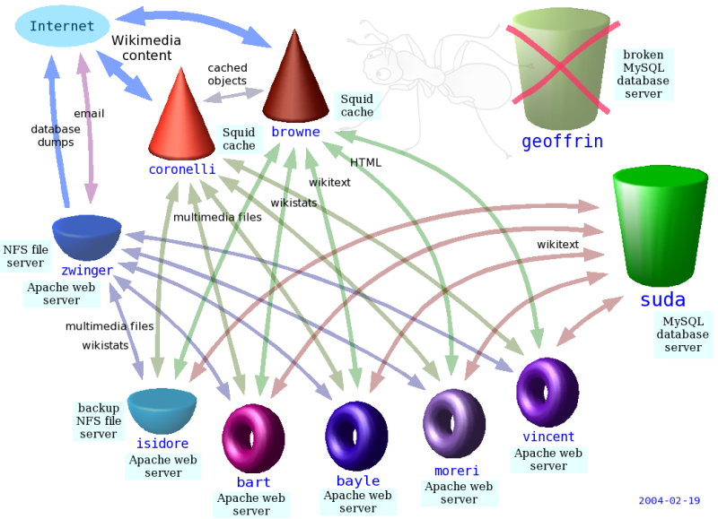
Infrastructure (2004)
http://meta.wikimedia.org/wiki/Server_layout_diagrams

Slide 34

MediaWiki
http://www.mediawiki.org/wiki/MediaWiki

Slide 35
MediaWiki
Written in PHP
Built upon MySQL
Licensed as GPL
Page modifications are added to the database
Easy page recovery in case of vandalism
Manage image and media files
Supports caching
Coupled with Squid proxy server
http://www.mediawiki.org/wiki/MediaWiki

Slide 36
Founders
Nupedia
Larry Sanger
Jimmy Wales
Wiki as a
feeder
January 2001
GNU Free Documentation
License
January 2003
Richard Stallman
Wikipedia
Wikipedia ® Trademark 2006

Slide 37
Beginnings - Nupedia
1998 – Jimmy Wales, Larry Sanger
Paid academics and topic experts
Seven-steps review process
One year and $120,000 later:
24 Articles published

Slide 38
Beginnings - Wiki
Wiki:
invented by Ward Cunningham in 1995
Wales started again 1999: Wikipedia
First month: 200 Articles
First year: 18,000 Articles
Ten years: 3,079,000 Articles
14 years: 29,600,000 Articles

Slide 39
Licensing
GNU Free Documentation License (GFDL)
In 2009 adopted the CC-by-SA
Creative Commons Share-Alike License
  Votation: 17,000 votes
  88% in favor
Creative Commons did not existed when Wikipedia started
GFDL requires the work to include the license
http://meta.wikimedia.org/wiki/Licensing_update/Result
http://wikimediafoundation.org/wiki/Press_releases/Dual_license_vote_May_2009

Slide 40
Download the Wikipedia ?
http://en.wikipedia.org/wiki/Wikipedia:Database_download
All text content is multi-licensed under the
Creative Commons
Attribution-ShareAlike 3.0 License (CC-BY-SA)
and
GNU Free Documentation License (GFDL).

Slide 41
Download the Wikipedia ?
http://en.wikipedia.org/wiki/Wikipedia:Database_download
All versions:
  In bz2 = ~280 Gb
  In 7z = ~31 Gb
  Decompressed = ~ 5 Tb !

Slide 42
Download the Wikipedia ? (2008)
http://en.wikipedia.org/wiki/Wikipedia:Database_download
Current version:
  In bz2 = ~6 Gb
  Decompressed = ~ 27 Gb !

Slide 43
Download the Wikipedia ? - 2011
http://en.wikipedia.org/wiki/Wikipedia:Database_download
Current version:
  In bz2 = ~7.3 Gb
  Decompressed = ~ 31 Gb !

Slide 44
Download the Wikipedia ? - 2013
http://en.wikipedia.org/wiki/Wikipedia:Database_download
Current version:
  In bz2 = ~9.5 Gb
  Decompressed = ~ 44 Gb !

Slide 45
Wikipedia Size (English)
2.0 Million Articles in 2006
3.0 Million Articles in 2009
3.5 Million Articles in 2010
3.8 Million Articles in 2011
4.3 Million Articles in 2013
Yongle Encyclopedia (1407)
Record for 600 Years !!

Slide 46
Wikipedia Size Comparison (2008)
Articles (K) Words (M) Characters (M) Words/art.
Wikipedia 2,000 1,000 3,500 435
Siku Quanshu - 800 -
Yongle Encyclopedia - 370 / 770 -
Enciclopedia Universal 1,000 200 1,000 -
Gujin Tushu Jicheng - 100 -
Encyclopedia of China 80 126 1,580
Enciclopedia Italiana 60 50 247 833
Nationalencyklopedin 183 - - -
Encyclopaedia Britannica 120 55 300 370
Great Soviet Encyclopedia 100 21 200 570
Encyclopedie 72 20 - 278
Microsoft Encarta 70 40 200 200
Encyclopedia Americana 45 25 - 556
http://en.wikipedia.org/wiki/Wikipedia:Size_comparisons

Slide 47
Wikipedia Size Comparison (2009)
Articles (K) Words (M) Characters (M) Words/art.
Wikipedia 3,079 1,000 3,500 435
Hudong 3,200 3,700
Siku Quanshu - 800 -
Yongle Encyclopedia - 370 / 770 -
Enciclopedia Universal 1,000 200 1,000 -
Gujin Tushu Jicheng - 100 -
Encyclopedia of China 80 126 1,580
Enciclopedia Italiana 60 50 247 833
Nationalencyklopedin 183 - - -
Encyclopaedia Britannica 120 55 300 370
Great Soviet Encyclopedia 100 21 200 570
Encyclopedie 72 20 - 278
Microsoft Encarta 70 40 200 200
http://en.wikipedia.org/wiki/Wikipedia:Size_comparisons

Slide 48
Wikipedia Size Comparison (2010)
Articles (K) Words (M) Characters (M) Words/art.
Wikipedia 3,400 1,000 3,500 435
Hudong 3,920 4,340
Siku Quanshu - 800 -
Yongle Encyclopedia - 370 / 770 -
Enciclopedia Universal 1,000 200 1,000 -
Gujin Tushu Jicheng - 100 -
Encyclopedia of China 80 126 1,580
Enciclopedia Italiana 60 50 247 833
Nationalencyklopedin 183 - - -
Encyclopaedia Britannica 120 55 300 370
Great Soviet Encyclopedia 100 21 200 570
Encyclopedie 72 20 - 278
Microsoft Encarta 70 40 200 200
http://en.wikipedia.org/wiki/Wikipedia:Size_comparisons

Slide 49
Wikipedia Size Comparison (2013)
Articles (K) Words (M) Characters (M) Words/art.
Wikipedia 4,300 2,500 20,737 590
Hudong 7,000 4,340
Siku Quanshu - 800 -
Yongle Encyclopedia - 370 / 770 -
Enciclopedia Universal 1,000 200 1,000 -
Gujin Tushu Jicheng - 100 -
Encyclopedia of China 80 126 1,580
Enciclopedia Italiana 60 50 247 833
Nationalencyklopedin 183 - - -
Encyclopaedia Britannica 120 55 300 370
Great Soviet Encyclopedia 100 21 200 570
Encyclopedie 72 20 - 278
Microsoft Encarta 70 40 200 200
http://en.wikipedia.org/wiki/Wikipedia:Size_comparisons

Slide 50
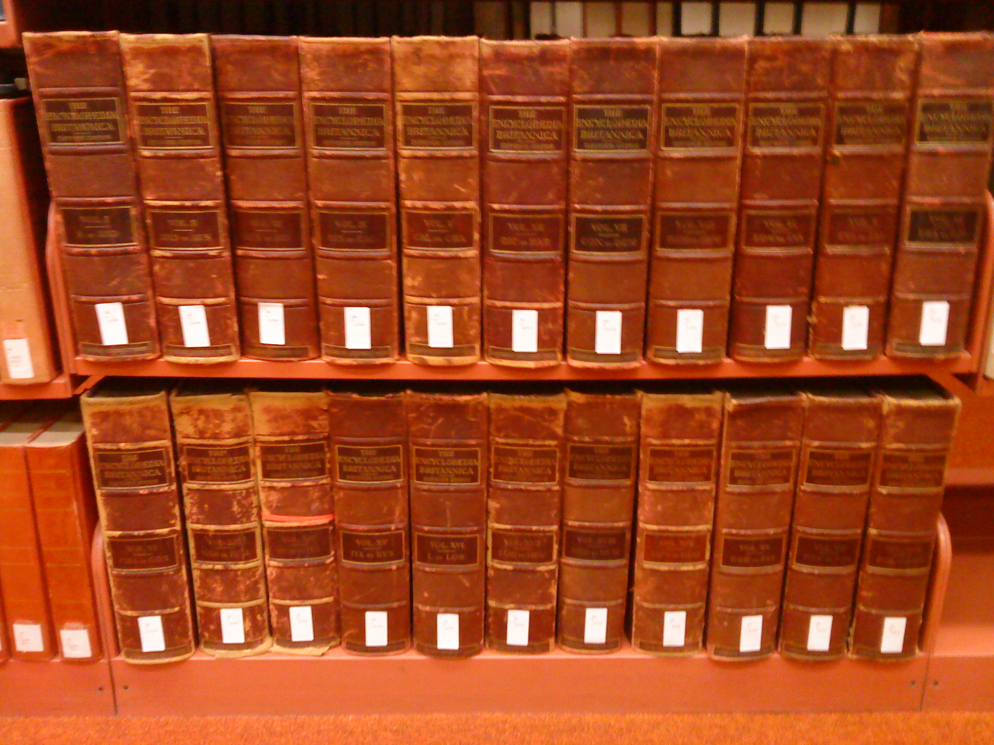
Encyclopedia Brittanica
Britannica Volumes at the Rensselaer Polytechnic Institute Library

Slide 51
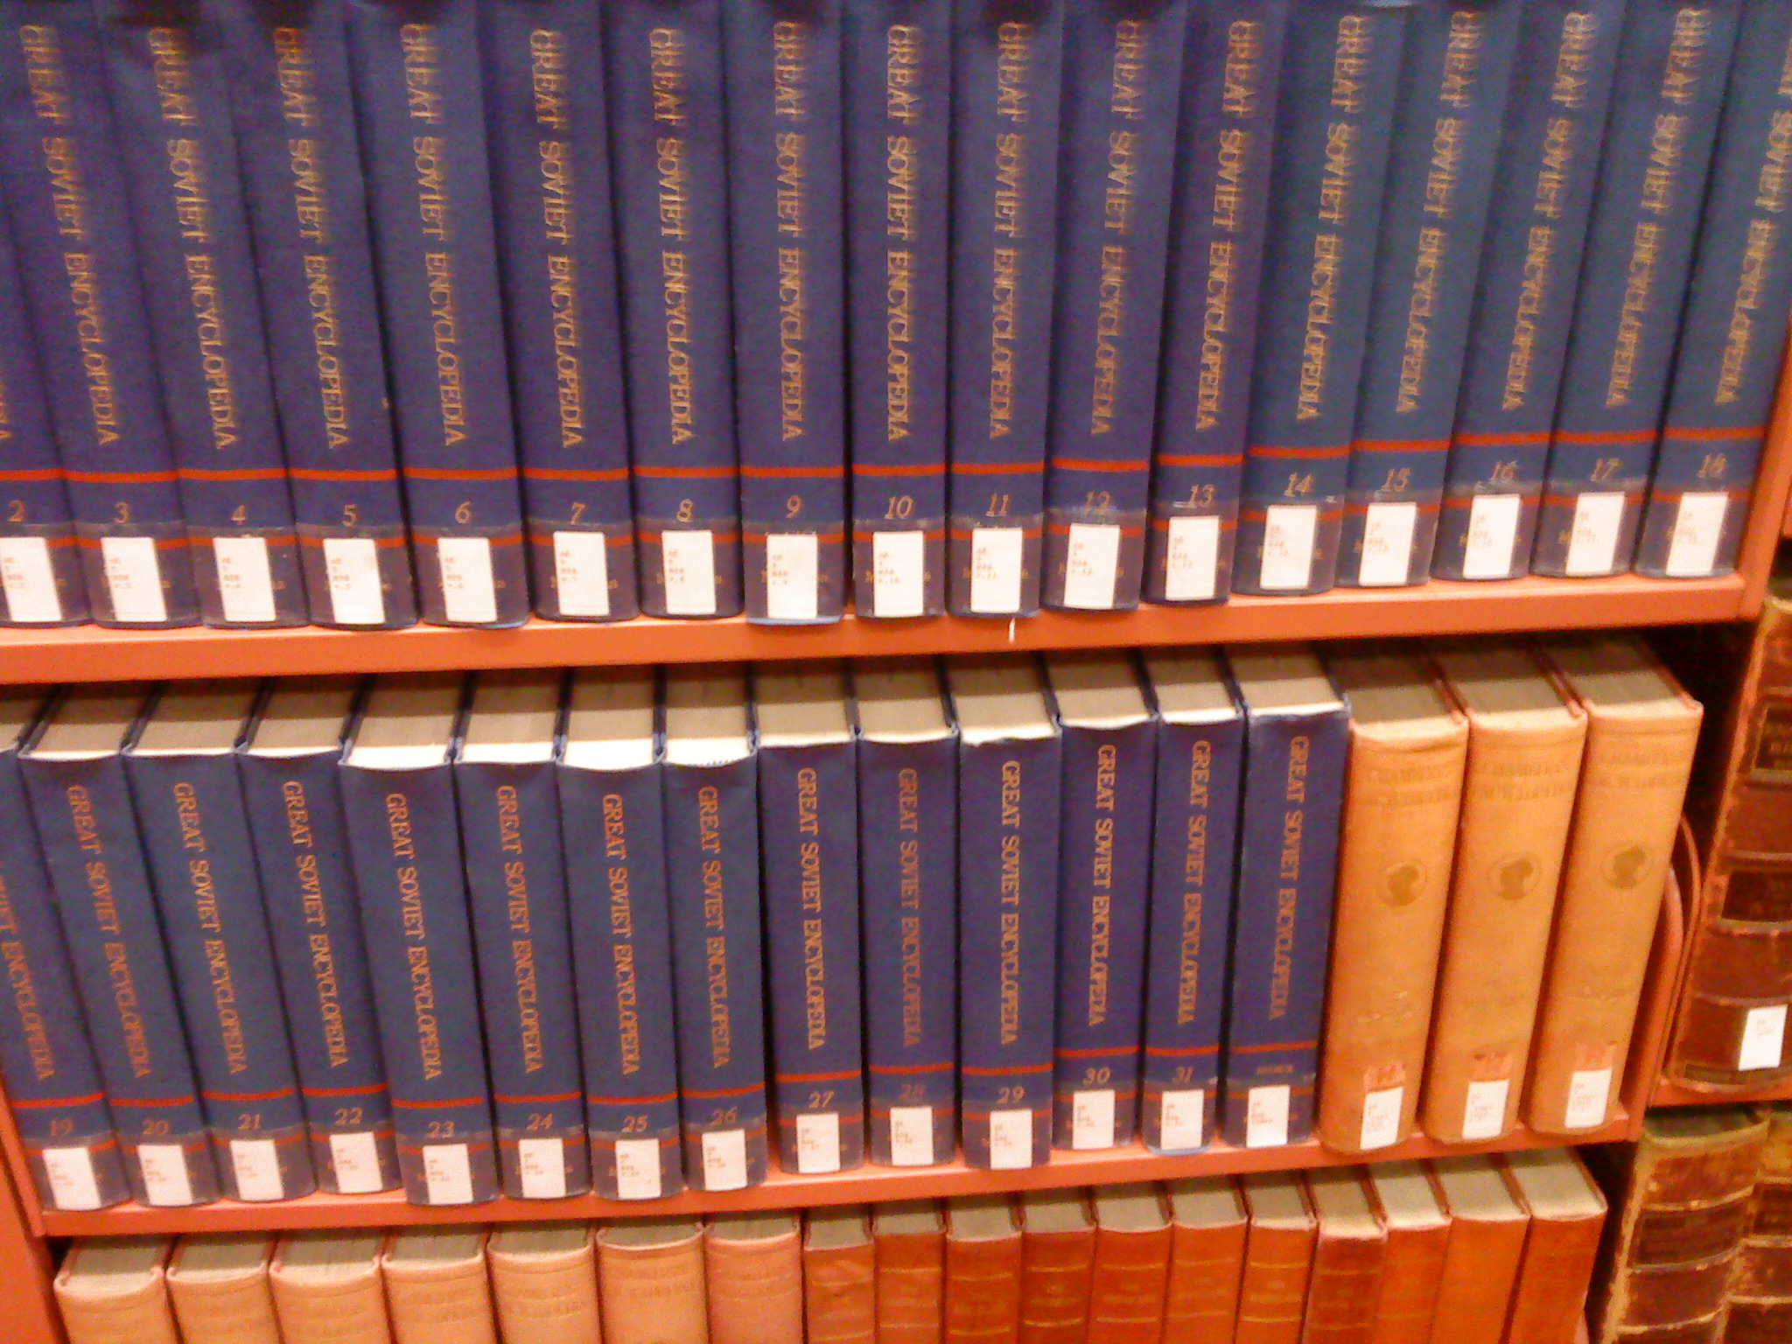
Soviet Encyclopedia
Soviet Encyclopedia Volumes at the Rensselaer Polytechnic Institute Library

Slide 52
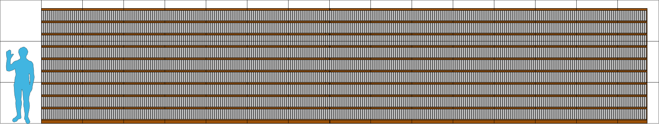
Wikipedia Size
http://en.wikipedia.org/wiki/Wikipedia:Size_of_Wikipedia

Slide 53
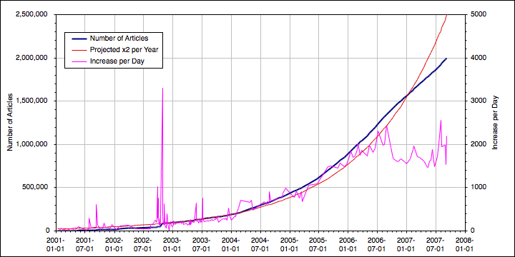
Number of Articles
http://en.wikipedia.org/wiki/Image:EnglishWikipediaArticleCountGraph_linear.png
This file is licensed under the Creative Commons Attribution ShareAlike license versions 2.5, 2.0, and 1.0

Slide 54
Wikipedia Statistics (English Edition)(2008)
2 Million Articles
175 Million edits by users
  Average of 16 per page
5.7 Million registered users
1,390 Users have administrative tools

Slide 55
Wikipedia Statistics (English Edition)(2009)
3.0 Million Articles
344 Million edits by users
  Average of 18.6 per page
10.9 Million registered users
1,694 Users have administrative tools
http://en.wikipedia.org/wiki/Special:Statistics

Slide 56
Wikipedia Statistics (English Edition)(2010)
3.5 Million Articles
428 Million edits by users
  Average of 19.2 per page
13.5 Million registered users
1,766 Users have administrative tools
http://en.wikipedia.org/wiki/Special:Statistics

Slide 57
Wikipedia Statistics (English Edition)(2011)
3.8 Million Articles
500 Million edits by users
  Average of 19.55 per page
15.8 Million registered users
1,514 Users have administrative tools
http://en.wikipedia.org/wiki/Special:Statistics

Slide 58
Wikipedia Statistics (English Edition)(2013)
4.3 Million Articles
665 Million edits by users
  Average of 21.07 per page
20.1 Million registered users
2,156 Users have administrative tools
http://en.wikipedia.org/wiki/Special:Statistics

Slide 59
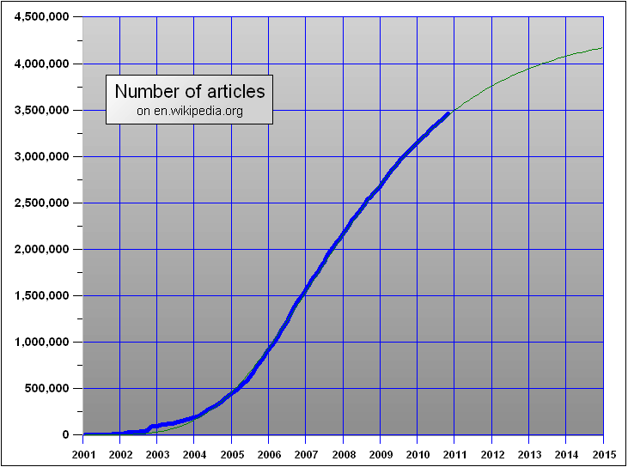
Wikipedia Size
http://en.wikipedia.org/wiki/Wikipedia:Size_of_Wikipedia

Slide 60
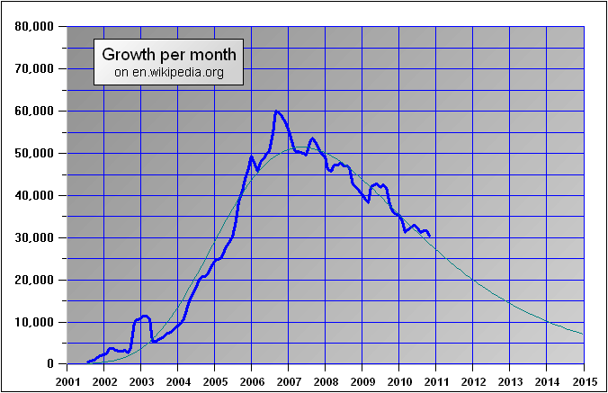
Wikipedia Size
http://en.wikipedia.org/wiki/Wikipedia:Size_of_Wikipedia

Slide 61
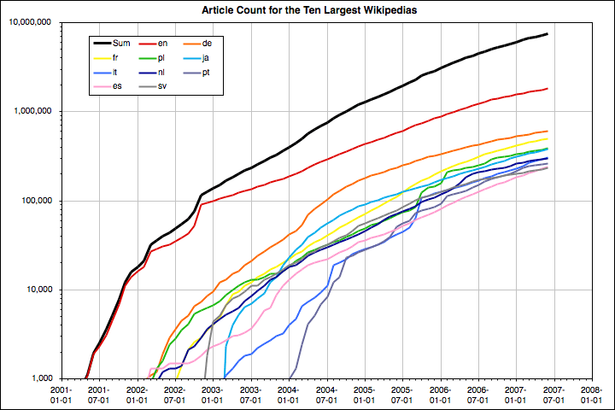
Wikipedia Size
http://stats.wikimedia.org/EN/TablesArticlesTotal.htm
http://en.wikipedia.org/wiki/Wikipedia:Size_of_Wikipedia

Slide 62
Wikipedia Self-Healing
Type Number Mean Median
All content 618,502 22.3 days 90.5 min
Mass delete 3,574 7.7 days 2.8 min
MD Obscene 47 1.8 days 1.7 min
http://alumni.media.mit.edu/~fviegas/papers/history_flow.pdf

Slide 63
Wikipedia - Essentials
Wikipedia is not for sale.
Non-for-profit.
Free for everyone (learned from Free Software) GFDL
250 Languages (local chapters, volunteer translators)
You can't change anything, only add to it. (MySQL)
Quality Control: Editors
Not an authoritative reference: (use critical thinking)
Is a collection: contributions by unpaid volunteers
For the long haul: at least 100 years from now.

Slide 64
Wikipedia - Essentials
Wikipedia is not for sale.
Non-for-profit.
Free for everyone (learned from Free Software) GFDL
250 Languages (local chapters, volunteer translators)
You can't change anything, only add to it. (MySQL)
Quality Control: Editors
Not an authoritative reference: (use critical thinking)
Is a collection: contributions by unpaid volunteers
For the long haul: at least 100 years from now.

Slide 65
Wikipedia - Open Nature
Collaboration of volunteers
Consensus over Credentials
Susceptibility to Vandalism
Capability for Self-correction
As accurate as other Encyclopedias
Peer-reviewed
Attention to Copyright and proper Licensing

Slide 66
Wikipedia Accuracy
“Internet encyclopaedias go head to head”
Jim Giles, Nature 438, 900 - 901 (2005).
Entries on Science Topics were taken from Wikipedia and Britannica.
Sent to domain experts (on blind study)
42 Entries tested
  4 Average errors in Wikipedia, 3 in Britannica
  4 Serious errors in both Wikipedia and Britannica
  162 factual errors in Wikipedia, 123 in Britannica
    (but Wikipedia articles are 2.6 longer than Britannica)

Slide 67
Wikipedia - Images
Image self-pages (author, copyright, license)
Over 2.5 million images
Anybody can upload more images
Serious copyright management (GPL, CC licenses)
Vector images and Audio recordings
Most image are stored in Wikimedia Commons
Avoid repeated uploads
You can use (free) images in your own work

Slide 68
Wikipedia – Real Time Map
http://rcmap.hatnote.com/#en

Slide 69
Cultural Freedom
The freedom
  To use the work and enjoy the benefits of using it
  To study the work and to apply knowledge acquired from it
  To make and redistribute copies, in whole or in part, of the information or expression
  To make changes and improvements, and to distribute derivative works
These freedoms should be available
to anyone, anywhere, anytime.
http://freedomdefined.org/Definition

Slide 70
Users Access Levels
Stewards
  Allow users to change rights of others
Bureaucrats
  Create admins bots, move pages, rename users
Admins
  Block users, delete pages and history, protect pages
  rollback changes...
Registered
  create articles, upload files, move articles
All Users
  Create accounts, edit, read
http://en.wikipedia.org/w/index.php?title=Wikipedia:User_access_levels&oldid=100160162

Slide 71
Prolific Contributors - Examples
http://stats.wikimedia.org/EN/TablesWikipediaEN.htm#wikipedians
http://en.wikipedia.org/wiki/User:Rich_Farmbrough
http://en.wikipedia.org/wiki/User:Rjwilmsi

Slide 72
Wikipedia Fauna
WikiElf
  Works behind the scenes, infrastructure maintenance
WikiFairy
  Wiki editor who beautifies and standardize articles
WikiGnome
  User who makes small incremental improvements
WikiOgre
  Users who makes huge changes in articles.
http://en.wikipedia.org/wiki/Category:Wikipedia_fauna

Slide 73
Wikipedia Fauna
WikiGremlin
  Creature that runs a Wikipedia website
WikiTroll
  Deliberate and intentional attempts to disrupt the usability of Wikipedia
WikiDragon
  Vast contributions. Creating entire articles.
  Bold edits
http://en.wikipedia.org/wiki/Category:Wikipedia_fauna

Slide 74
Wikipedia Special Forces
Counter-Vandalism Unit
New Pages Patrol
Recent Changes Patrol
Random Page Patrol

Slide 75




Counter-Vandalism Unit
The RickK
Anti-Vandalism
Barnstar
Award
Vandalism
Level
{{user CVU4-en}} : This user fights in open resistance against the forces of the Vandals
{{user CVU2-en}} : This user is a member of the Counter-Vandalism Unit.
{{user CVU5-en}} : This user fights in the ground forces of
Operation Enduring Encyclopedia.
http://en.wikipedia.org/wiki/Wikipedia:Counter-Vandalism_Unit

Slide 76
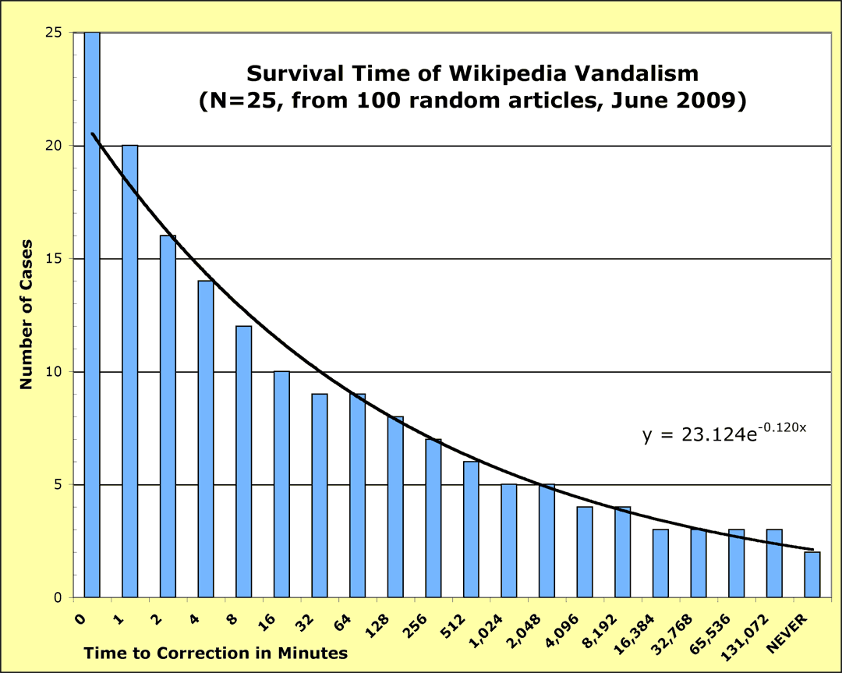
Counter-Vandalism Unit
http://en.wikipedia.org/wiki/Wikipedia:Counter-Vandalism_Unit

Slide 77


New Pages Patrol
This user is a newpage patroller.
Do not bite the newbies !
http://en.wikipedia.org/wiki/Wikipedia:Please_do_not_bite_the_newcomers
http://en.wikipedia.org/wiki/New_pages_patrol

Slide 78

Recent Change Patrol
The patrol is entirely voluntary
and carries no obligation.
Identify "bad" or "needy" edits
Remove or improve the edit
Warn the editor
Check the user's other contributions
http://en.wikipedia.org/wiki/Recent_changes_patrol

Slide 79
Random Page Patrol
The guidelines for the Recent changes and
New pages patrols apply,
merely the search method is different.
Selected pages through: Special:Random
http://en.wikipedia.org/wiki/Random_page_patrol

Slide 80
Jimmy Wales at TED
http://www.ted.com/talks/lang/eng/jimmy_wales_on_the_birth_of_wikipedia.html
July 2005

Slide 81
Jimmy Wales - Wikipedia
http://www.youtube.com/watch?v=QF7MgFVbubs
Infrastructure and Open Source Software

Slide 82
Vibber Brion - WikiMedia
http://www.youtube.com/watch?v=DWef69ItVrU

Slide 83
Yochai Benkler - WikiMedia
http://www.youtube.com/watch?v=jMxz7rzwee8

Slide 84
Steven Colbert - WikiMedia
http://www.colbertnation.com/the-colbert-report-videos/72347/july-31-2006/the-word---wikiality
http://www.colbertnation.com/the-colbert-report-videos/422660/january-07-2013/jimmy-wales

Slide 85
Wikipedia Sister Projects

Slide 86
Wikimedia Commons
Media Repository
Maintained by volunteers
Material reusable across Wikipedias
Freely licensed material
  Photographs, diagrams, animations, music, spoken text, video clips...
Mayflower (image search engine)
2.6 Million pages, 2 Million media files
http://commons.wikimedia.org/wiki/Main_Page
http://en.wikipedia.org/wiki/Wikimedia_Commons

Slide 87
Wikisource
Online Library of free content publications
  Public domain, or
  Freely available licenses
Historical Documents
Translations
Examples
  Bible, Tao Te Ching, Britannica 1911, Jules Verne, Grimm's Brothers Fairy Tales, Allan Poe.
http://en.wikisource.org/wiki/Main_Page

Slide 88
Wikiquotes
Free online compendium of Quotations
16,271 pages so far
Categories
  People
  Proverbs
  Films
  TV shows
  Literary works
http://en.wikiquote.org/wiki/Main_Page

Slide 89
Wikinews
Free content news source Wiki
Every story is written as a News reports
(as opposed to an Article in the Wikipedia)
Neutral Point of View Policy
Started on December 2004
By September 2007 it has 10,000 news articles
Beyond Texts: Audio, Video
Credibility Question
  (but you can trust cable news... isn't it ?)
http://en.wikipedia.org/wiki/Wikinews

Slide 90
Wiktionary
Free content Dictionary
Available in 150 Languages
Written collaboratively by Volunteers
Wikisaurus (synonyms)
Started on December 2002
November 2006
  1.7 Million entries in 171 languges
Many of the entries are created by “bots”
http://en.wikipedia.org/wiki/Wiktionary

Slide 91
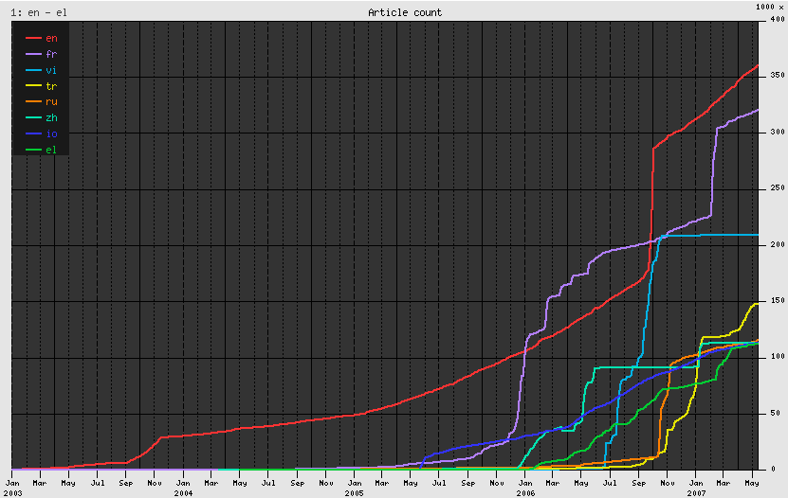
Wiktionary – Growth per Language
http://en.wikipedia.org/wiki/Image:Wiktionary_growth.png

Slide 92
Wikiversity
Free Learning Materials
Five Languages
  English, French, German, Italian, Spanish
Host scholarly projects and communities
Concept of “University of the World”
Doesn't confer Titles (Degrees)
Learning, Teaching and Researching
http://en.wikipedia.org/wiki/Wikiversity
http://en.wikiversity.org/wiki/Wikiversity:What_is_Wikiversity%3F

Slide 93
Wikispecies
Free content catalog of all species
Aimed at scientists
Started in August 2004
Growth
  by Oct 2006 it reached 75,000 articles
  by May 2007 it reached 100,000 articles
  by Sep 2008 it reached 150,000 articles
Support for Taxonomy relationships
Avoids duplication with Wikipedia
http://en.wikipedia.org/wiki/Wikispecies
http://species.wikimedia.org/wiki/Main_Page

Slide 94
Wikimedia - Meta-Wiki
Coordination of all the
Wikimedia Foundation Projects
Administration
Discussion about new and ongoing projects
http://meta.wikimedia.org/wiki/Main_Page

Slide 95
Wikibooks
Collection of Free Textbooks
Books directly written by contributors
Self-publishing
Started on July 2003
Content available for continuous peer-review
Anybody can edit them an improve them
English version has 27,342 Modules
http://en.wikipedia.org/wiki/Wikibooks

Slide 96
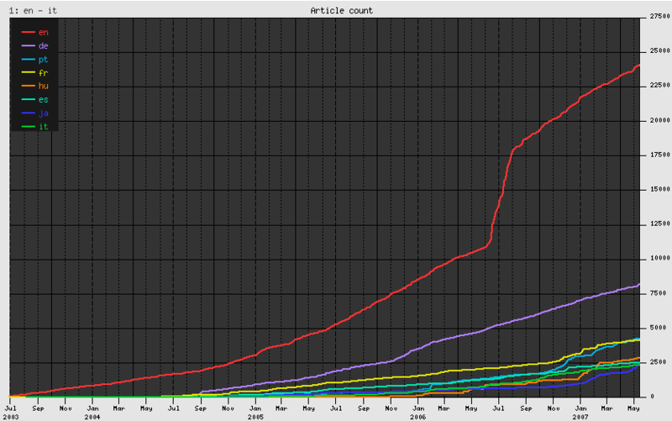
Wikibooks - Growth
http://en.wikipedia.org/wiki/Image:Wikibooks_growth.png

Slide 97
End

