Slide 1
Hospital Dietary Database
By Luis Jaco

Slide 2
What is a dietary database?
Employee information (name, username, admin status)
Patient information (name, username, date of birth)
Patient diets (regular, clear liquid, diabetic)
Patient meal orders (breakfast, lunch, dinner)

Slide 3
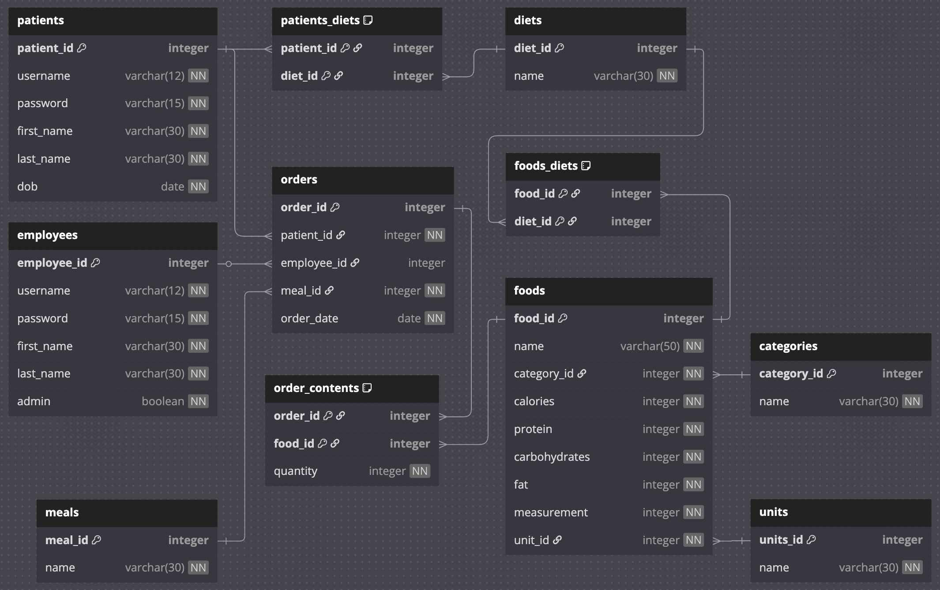
Database schema

Slide 4
Project goals
Patient:
View previous orders
Check order content
Create new orders
Employee:
Select Patient
View previous orders
Check order content
Create new orders
Edit orders
Edit patient diets
Admin:
Select Patient
View previous orders
Check order content
Create new orders
Edit orders
Edit patient diets
Change password
Select Employee
Change password
Add Employee
Add Patient

Slide 5
Result
Patient:
View previous orders
Check order content
Create new orders
Employee:
Select Patient
View previous orders
Check order content
Create new orders
Edit orders
Edit patient diets
Admin:
Select Patient
View previous orders
Check order content
Create new orders
Edit orders
Edit patient diets
Change password
Select Employee
Change password
Add Employee
Add Patient

Slide 6
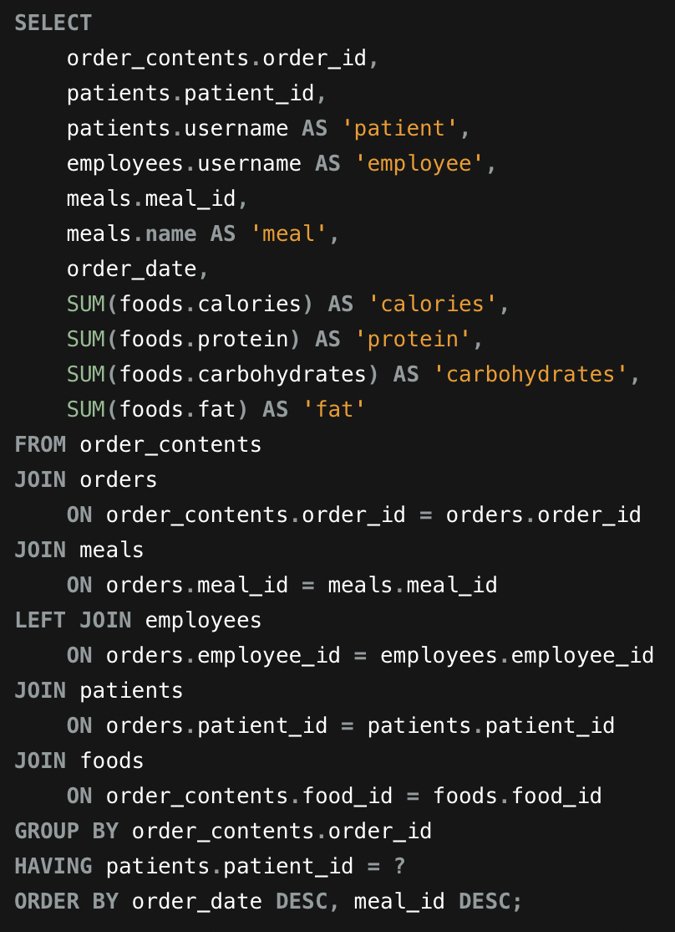
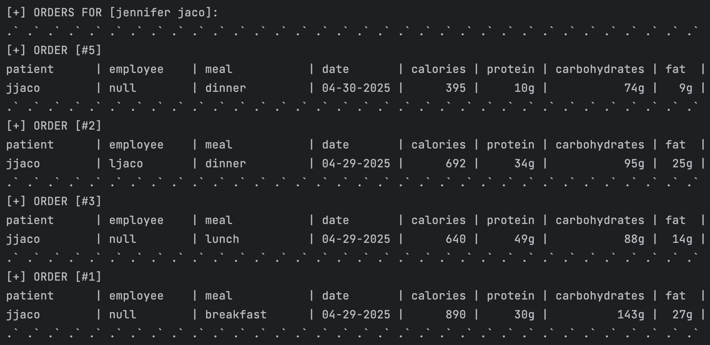
View previous orders

Slide 7
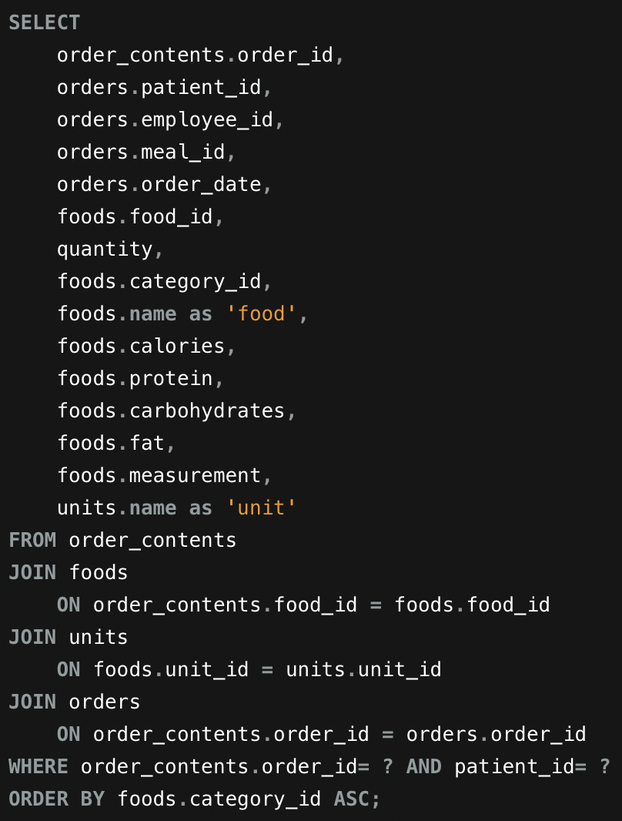
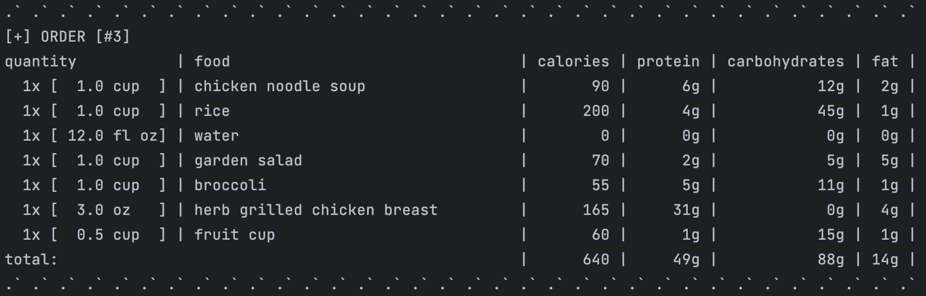
Check order content

Slide 8
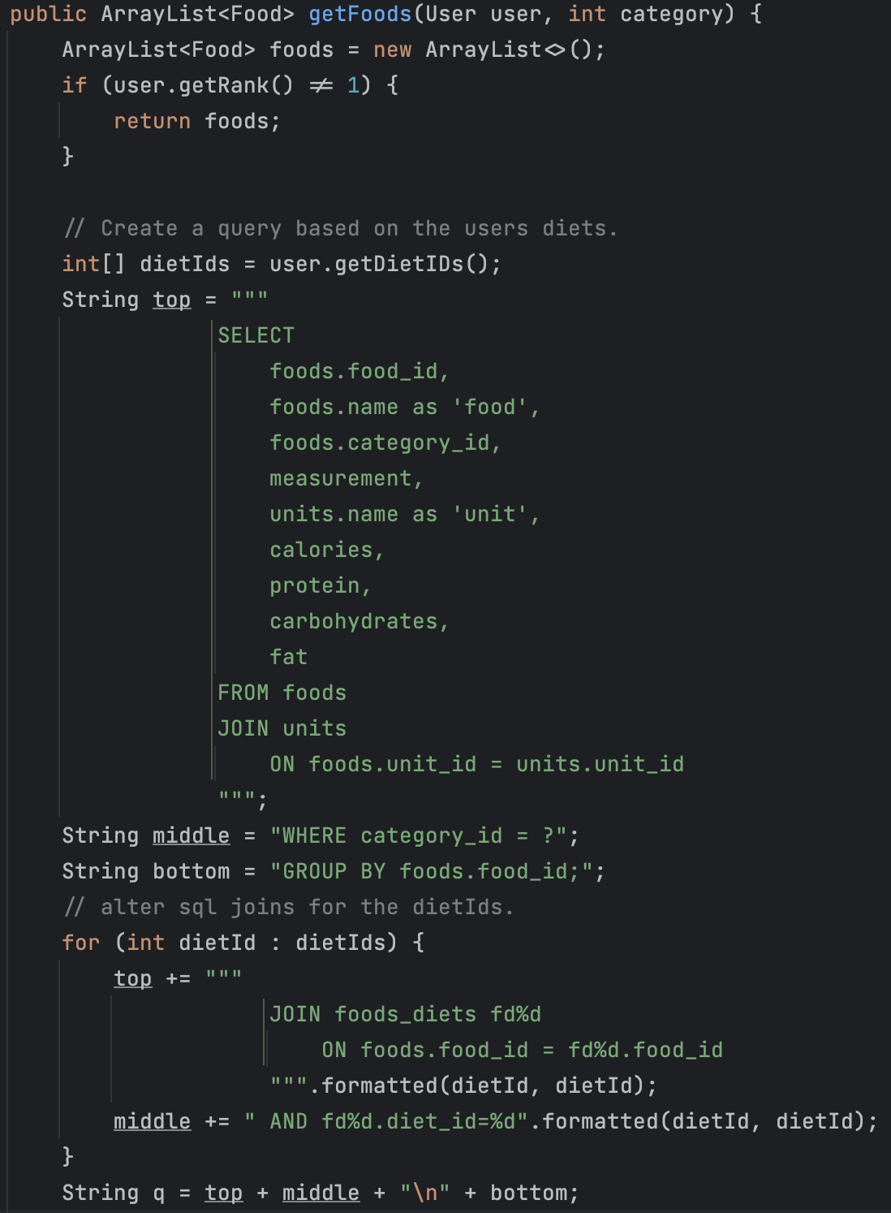
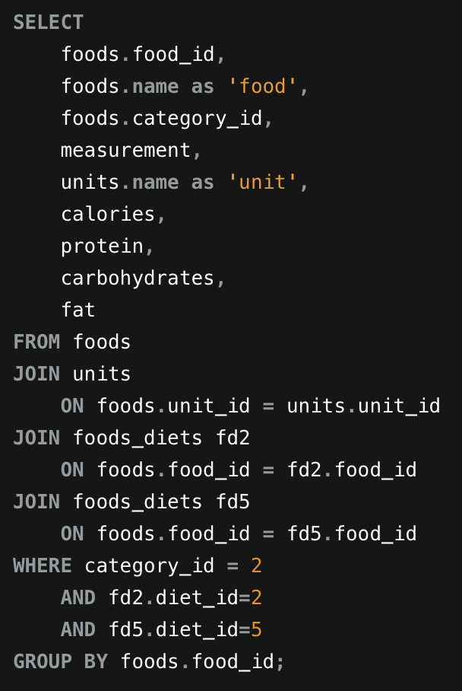
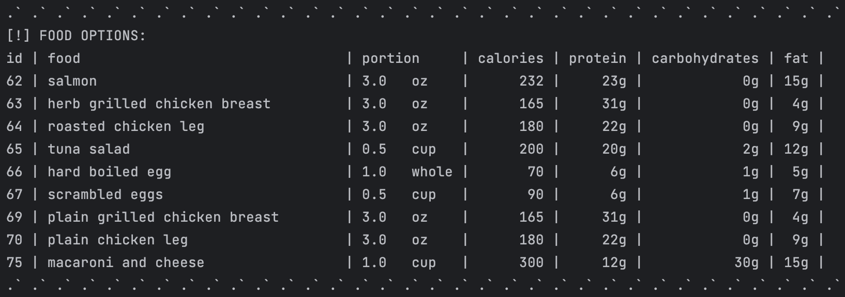
Create new order (get options)

Slide 9
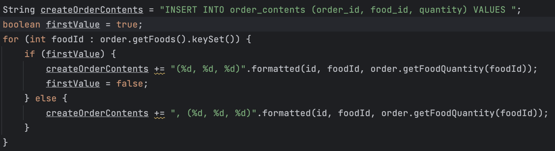
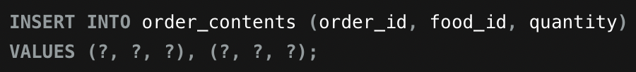
Create new order (complete order)

Slide 10
LIVE DEMO

