Slide 1
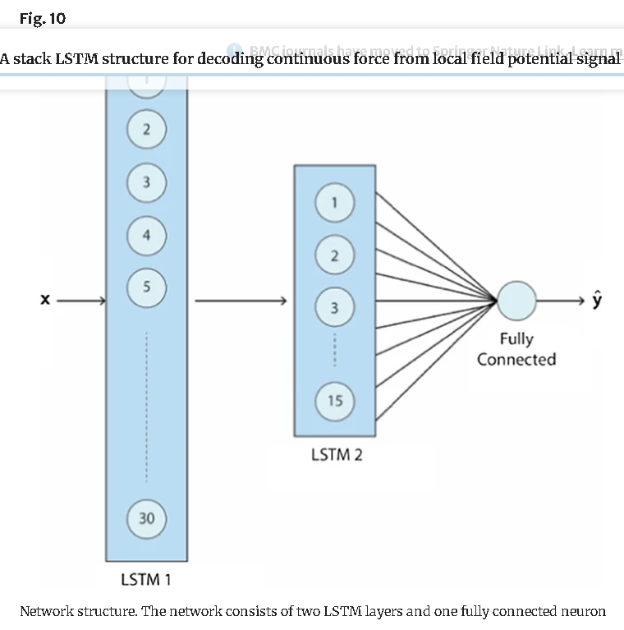
Sequence of video features
LSTM Layer-1
LSTM Layer-2
1
1
2
2
Predicted Engagement Score (1-5)
64
64
Fully Connected

Slide 2
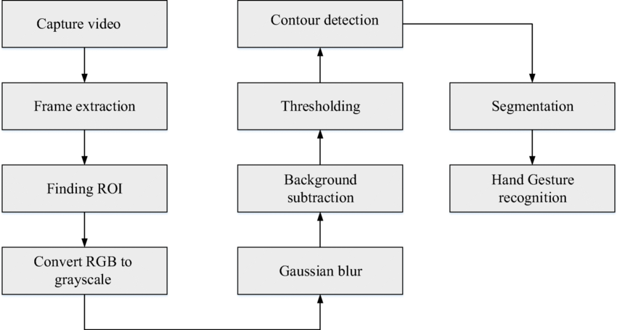

Slide 3
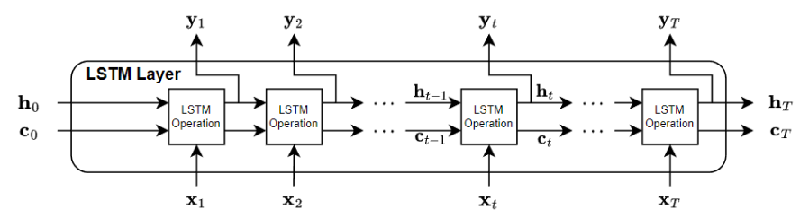






$$c_{t−1}$$
LSTM Cell
$$c_{0}$$
LSTM Cell
Cell state
$$h_{t−1}$$
Hidden state
$$h_{0}$$
$$x_{1}$$
$$x_{2}$$

Slide 4
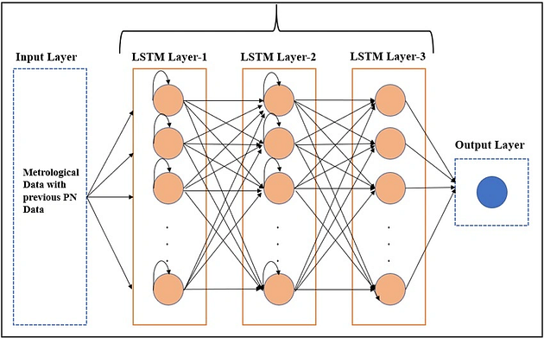
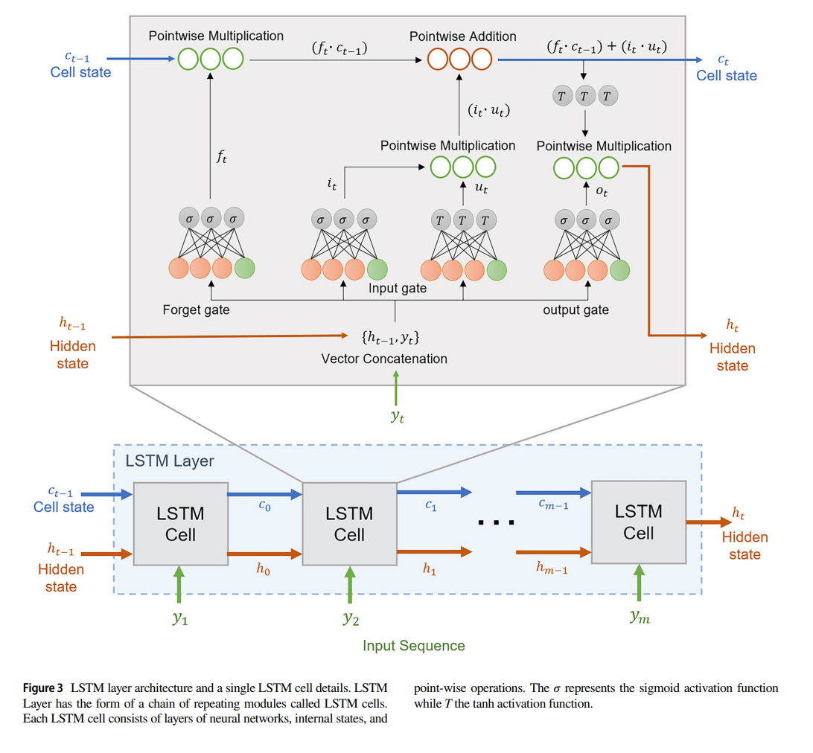
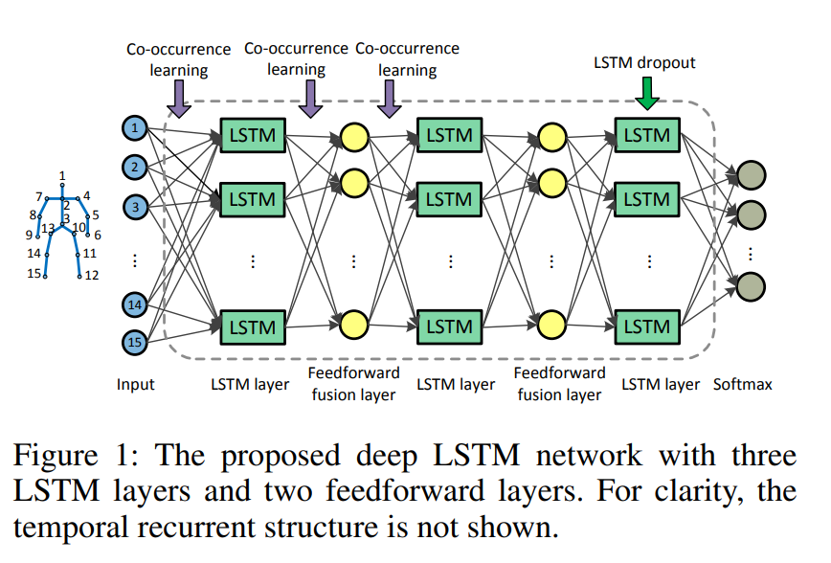

Slide 5
