Slide 1
Foundations

Slide 2
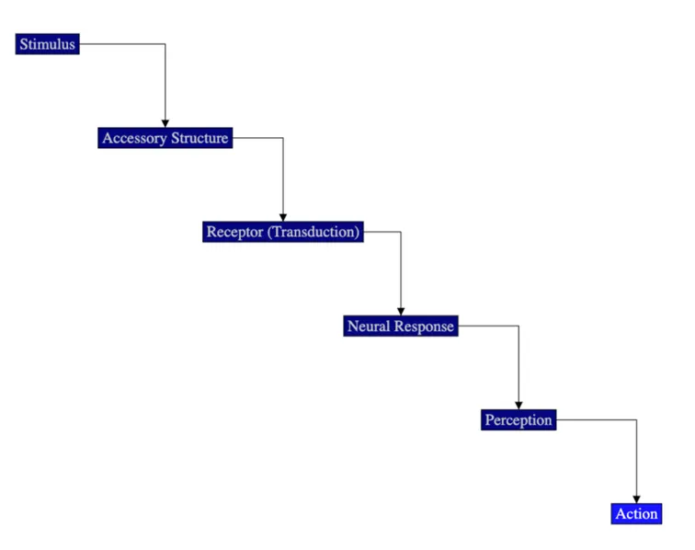
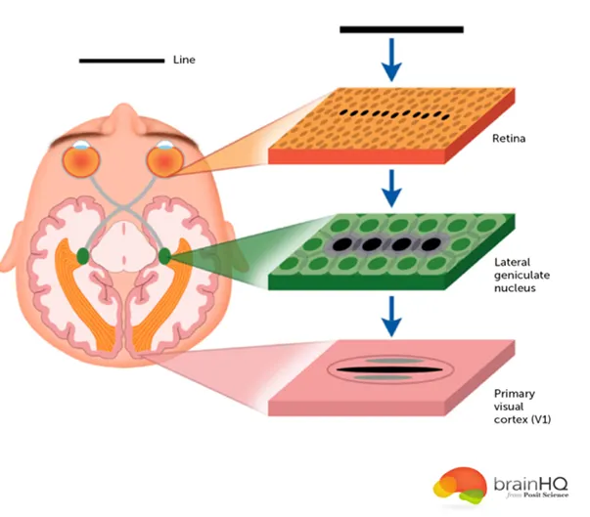
Steps of sensory processing

Slide 3
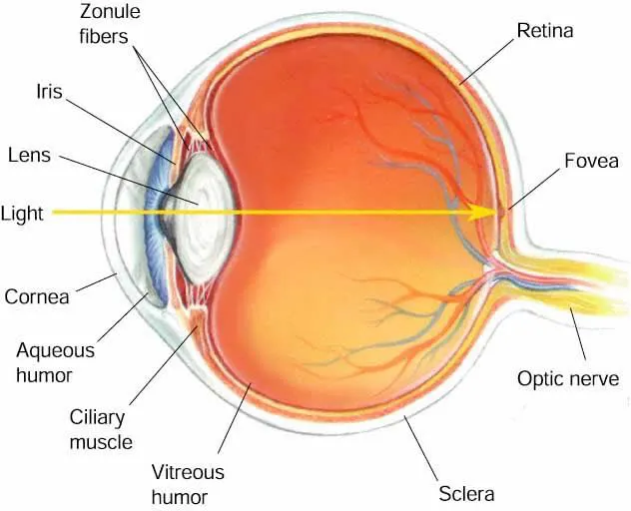
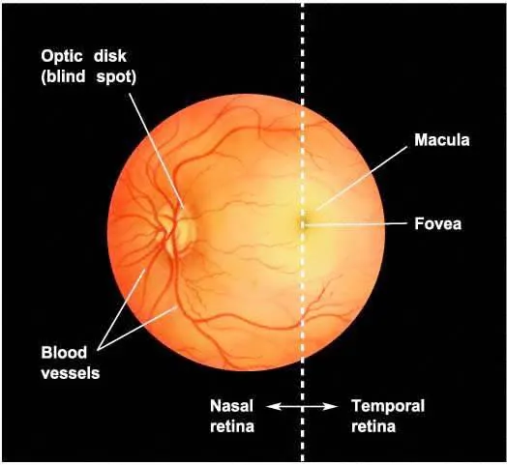
The Eye:
In a “simple” or “camera eye”,
The iris adjusts to let in more or less light through the pupil.
the image is inverted on the retina.
The blood vessels that supply the intraretinal circulation enter and leave the eye at the optic disk. The optic disk is also the place where optic axons leave the eye and become the optic nerve. The optic disk has no receptors and is thus a blind spot.

Slide 4
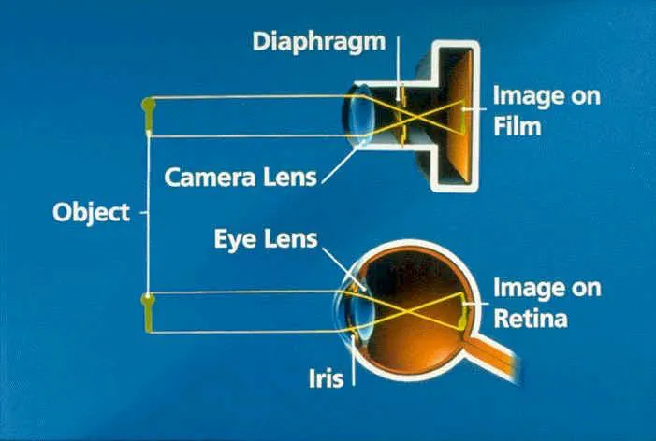
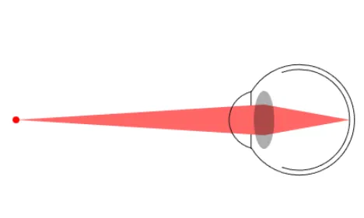
The Lens: Accommodation
The Lens is the adjustable focusing element of the eye.
It is located just behind the iris.
This process of adjusting the focus for different distances by changing the shape of the lens is called accommodation.
This process is very rapid although changing accommodation from a near object to a far object is faster than going from a far object to a near object
Accommodation is controlled by muscles connected to the lens, called ciliary muscles.
The ciliary muscles work automatically without conscious control.
They can contract and increase the curvature of the lens so that the lens thickens.
The increased curvature of the lens allows the eye to focus on a close object.
When the person then has to look at a faraway object, the muscles relax and the focus of the lens changes to an object further away.
https://isle.hanover.edu/Ch03Eye/Ch03Accommodation.html

Slide 5
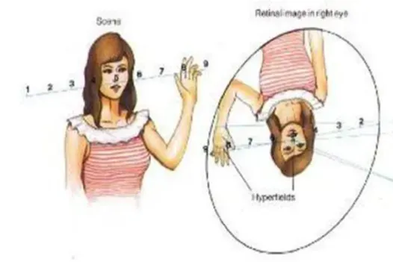
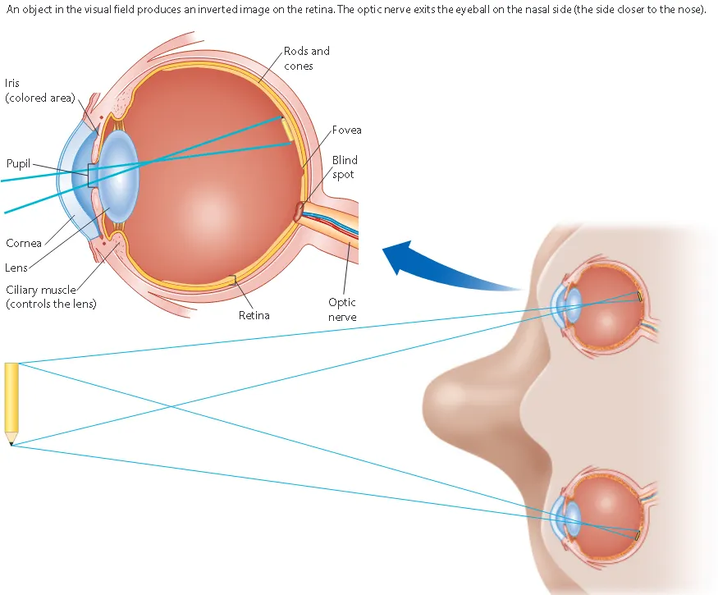
The Lens: Image inversion
Everything gets reversed when it passes through the lens
An object in the visual field produces an inverted image on the retina

Slide 6
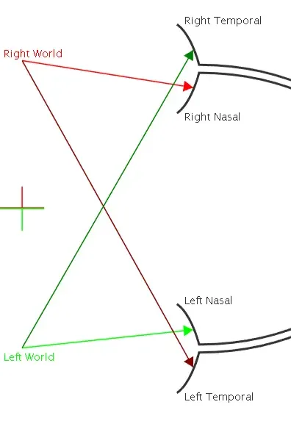
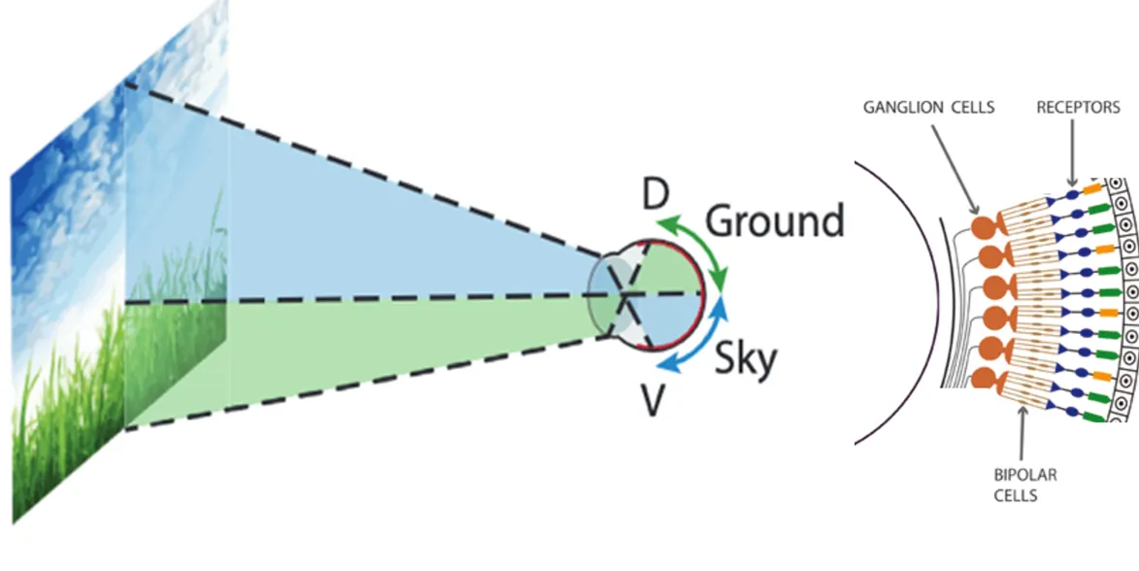
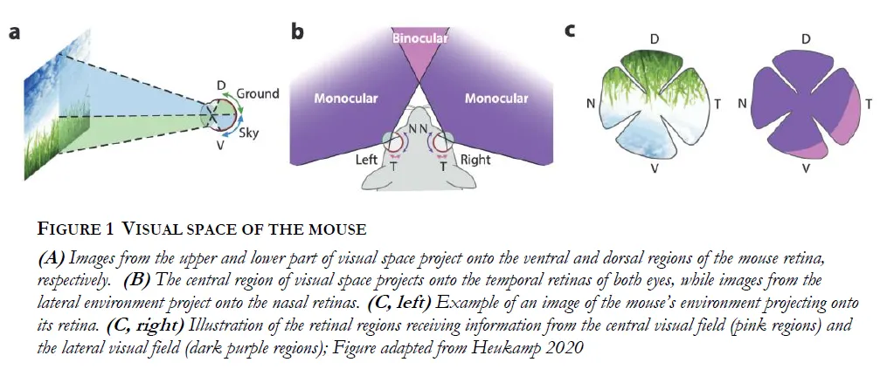
Image Projection onto the Retina
Transformation of the image by the lens has consequences for the retina…

Slide 7
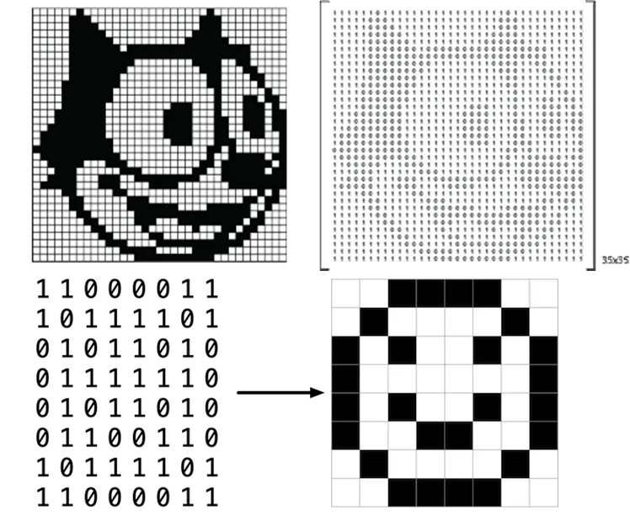
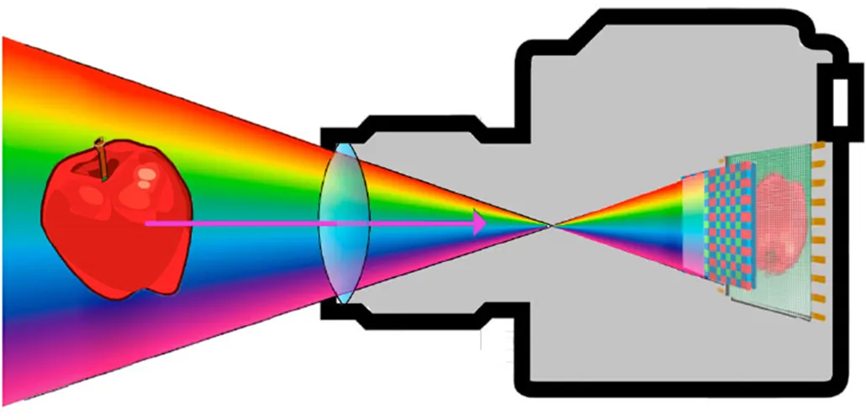
Images can be described as a set of pixels

Slide 8
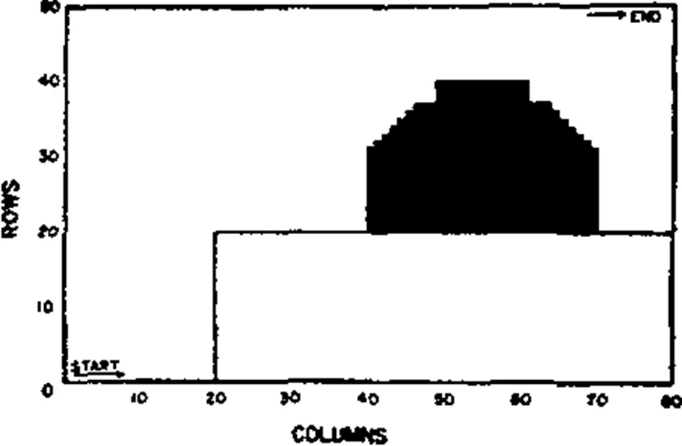
A note on Information content

Slide 9
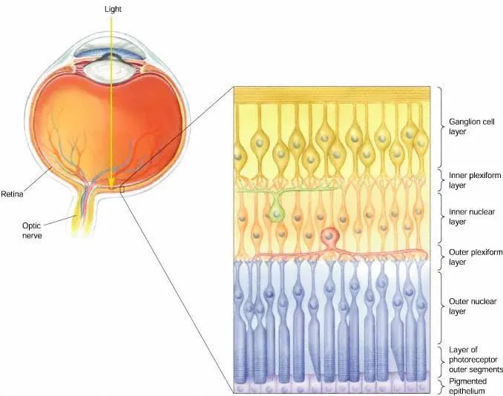
THE RETINA
Three layers of cells and two layers of synapses.
Optic nerve fibers
Ganglion cell layer
Inner plexiform layer (IPL)
Bipolar cell layer: horizontal cells + bipolar cells + amacrine cells
Outer plexiform layer (OPL)
Photoreceptor cells: rods & cones
Pigmented epithelium

Slide 10
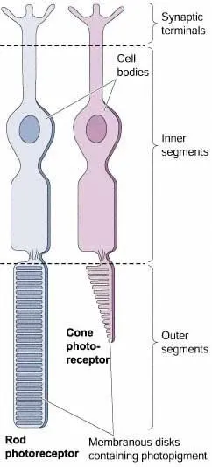
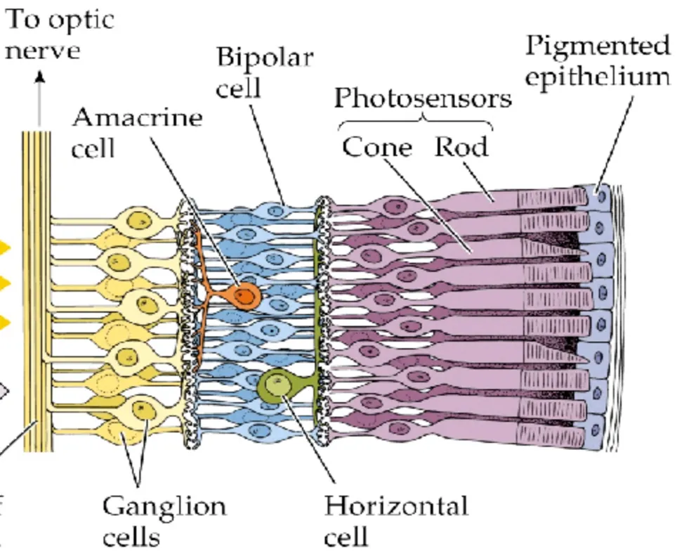
THE RETINA
Photoreceptors
Rods work at low (scotopic) light levels.
Cones work at high (photopic) levels and are responsible for both sharp acuity and color vision.
Both work at intermediate (mesopic) light levels.
The direct pathway is from cones → bipolar cells → ganglion cells.
Horizontal cells and amacrine cells provide lateral connections. H cells do NOT contact bipolar cells.
Cones and bipolar cells give graded responses.
Ganglion cells fire spikes.

Slide 11
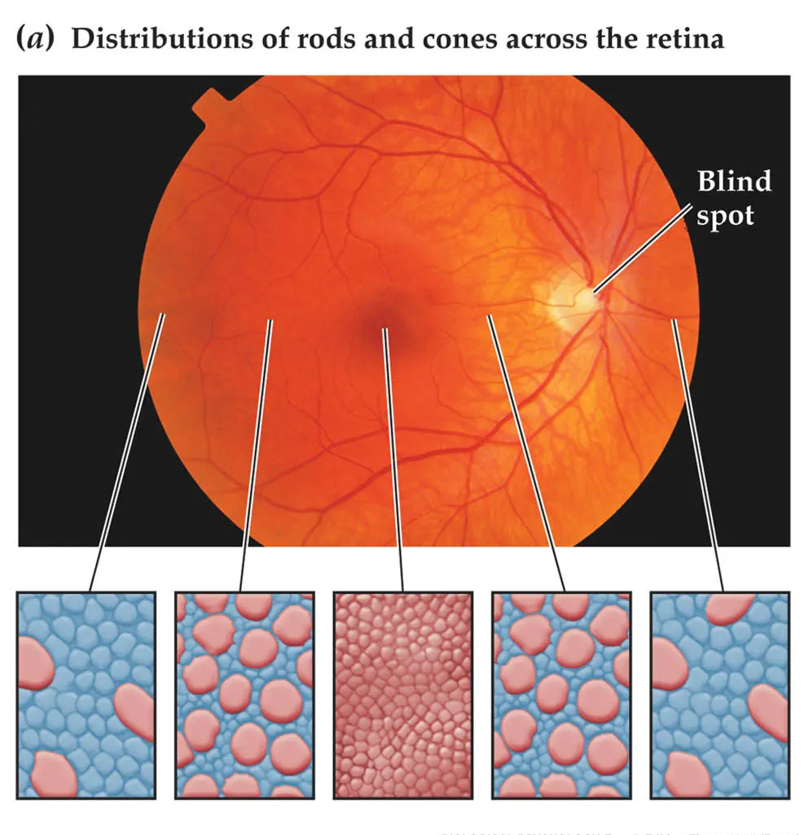
Photoreceptor Layout
Layout (Humans):
the center (fovea) has only cones
Visual acuity is best in the fovea–it has a high density of cones.
Optic disc–where blood vessels enter and leave the eye and where “optic axons” from ganglion cells leave the eye.
Blind spot due to lack of photoreceptors in the optic disc

Slide 12
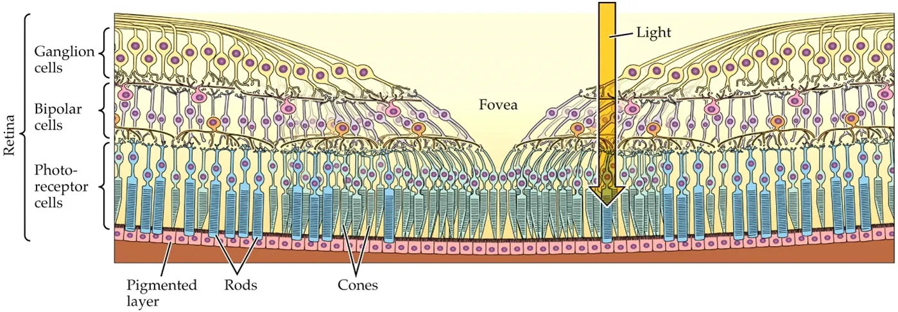
The Fovea
The fovea
The fovea (‘pit’), at the center of the retina, has no rods, only densely packed cones.
The cone terminals, bipolar cells and ganglion cells, along with their intraretinal blood supply, are swept to the side, so the path of light to foveal cones is unimpeded by blood.
Clinically, the center of the retina is called the macula. Macular degeneration is the most common cause of blindness in the elderly.

Slide 13
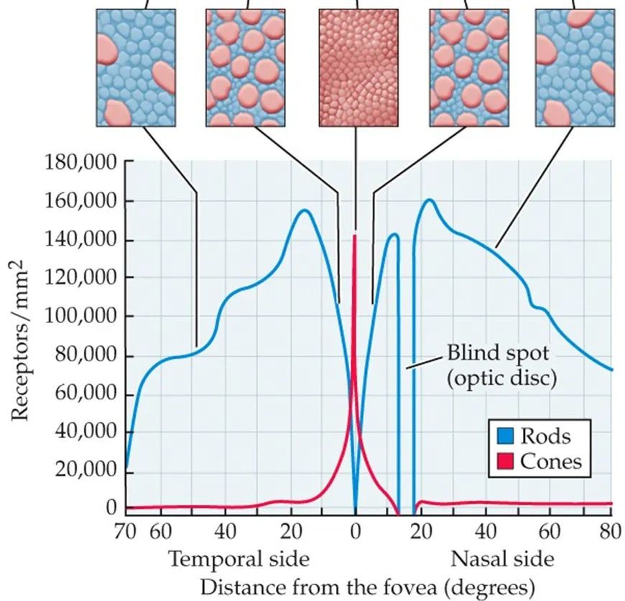
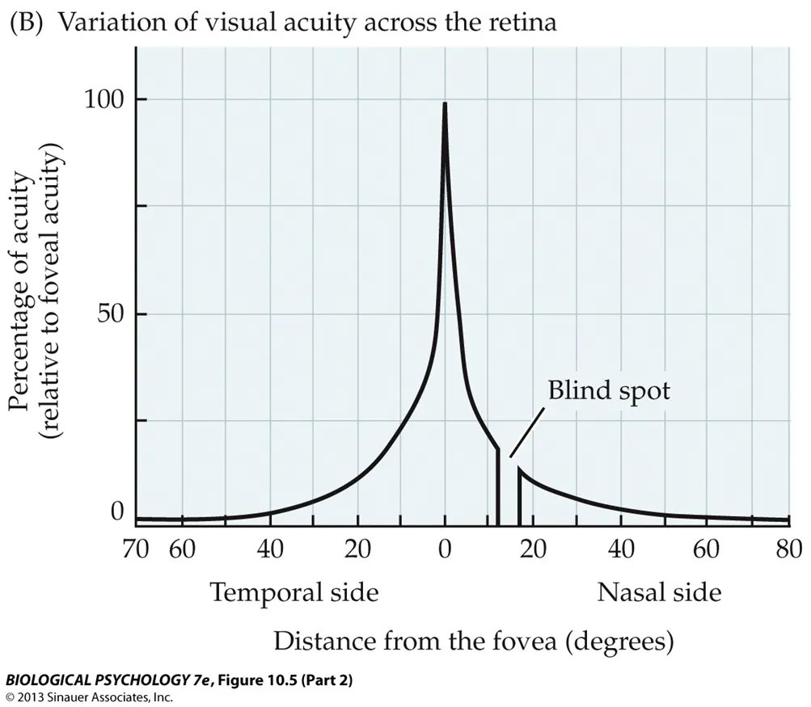
The Fovea
Visual resolution in the fovea
Foveal cones are very densely packed, giving just ~2.5 mm spacing. With 300 mm/deg of visual angle in human, this is ~1/120th deg.
With 120 samples/deg, our theoretical best resolution 60 cycles/deg. Remarkably, our resolution limit is this good!
Therefore, the circuits driven by foveal cones must be able to preserve the sampling density of the cones. The midget bipolar/midget ganglion cell pathway does this.
Resolution follows ganglion cell spacing, which increases away from the fovea because
a) the density of cones falls away from the fovea,
b) more and more cones converge on each midget bipolar cell, and
c) more and more midget bipolar cells converge on each midget ganglion cell.
The Blind Spot:
https://michaelbach.de/ot/cog-blindSpot/

Slide 14
Readings + Assignment
Readings/Assignments (MUST DO)
Submit your research question on friday
Read and Send me a paper on visual prosthetics. Once I confirm we’ll both read
Read Chapter 12 The Nervous System and Nervous Tissue (MUST READ)
https://openstax.org/books/anatomy-and-physiology/pages/12-introduction 12.1 Basic Structure and Function of the Nervous System 12.2 Nervous Tissue 12.3 The Function of Nervous Tissue 12.4 The Action Potential 12.5 Communication Between Neurons
From : J. Gordon Betts, Kelly A. Young, James A. Wise, Eddie Johnson, Brandon Poe, Dean H. Kruse, Oksana Korol, Jody E. Johnson, Mark Womble, Peter DeSaix (Book URL: https://openstax.org/books/anatomy-and-physiology/pages/1-introduction)
Kalat JW (2024) Biological psychology, 14th edition. Boston, MA: Cengage. (MUST READ)
Module 5.1: Visual coding (stop reading at color vision)
Module 5.2: Visual Processing in the Brain
Module 5,3: Specialized Visual Processes
Sensation and Perception Cengage Free chapter 1 (MAYBE READ)
Chapter 1. Introduction to Perception
1.3. The Perceptual Proces
1.4. Studying the Perceptual Process
1.5. Measuring Perception
1.6. Something to Consider: Why Is the Difference Between Physical and Perceptual Important?
Next Meeting
retinal cell signaling
must have read up on action potentials
central processing
discuss paper you sent

Slide 15
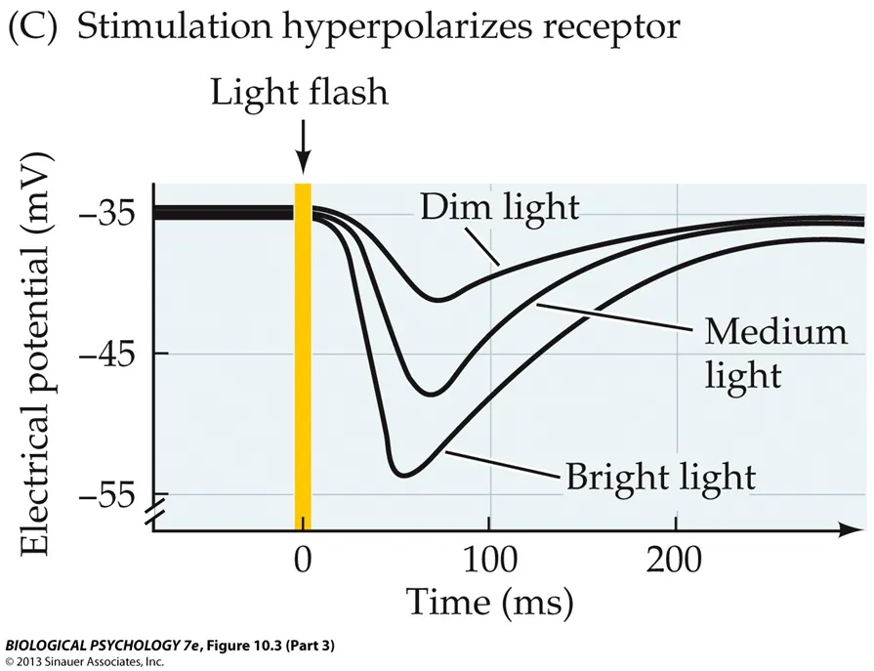
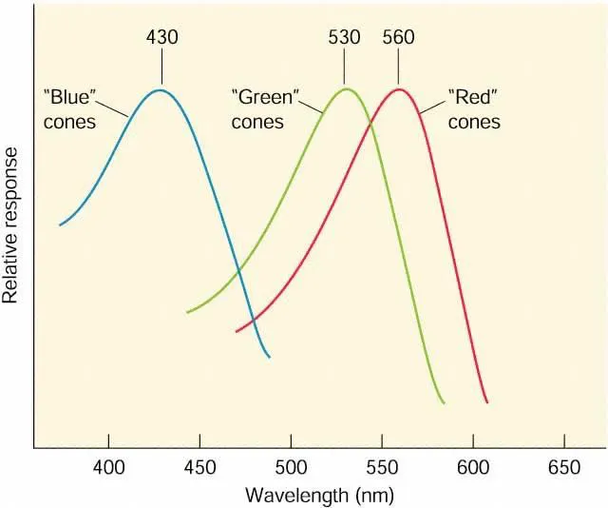
Next Week

