Slide 1
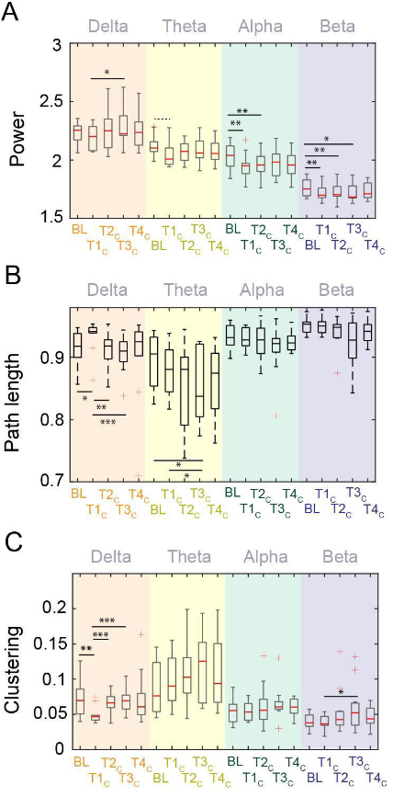
Delta
no significant differences between baseline and post-awakening test bouts within the delta band
(all p > .05)”
In the theta band, compared to baseline, the power was marginally lower only at
T1C (t(10) = 2.2, p = .053).
Alpha Band:
compared to baseline, global alpha power was significantly reduced in the first two test bouts in the control (dim red light) condition
T1C: t(10) = 3.84, p = .003;
T2C: t(10) = 3.56, p = .005
BETA
T1C (t(10) = 3.47, p = .006),
T2C (t(10) = 3.54, p = .005),
and T3C (t(10) = 2.98, p = .014

Slide 2
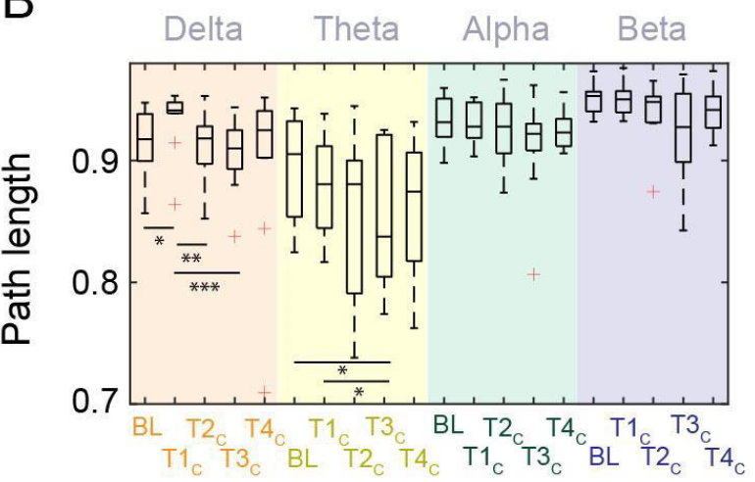
Delta Band:
control at t1 increased from baseline
- t(10) = -2.52, p = .03
Control at t1 to T2 reduced to baseline”
Control at T1 to T3 reduced even more?
Theta
Baseline vs Run 2??? a single effect of path length in the theta band significantly decreasing more than 30 minutes after awakening
t(10) = 2.65, p = .02),
Alpha + Beta
there were no significant differences in these metrics compared to baseline in other frequency bands.

Slide 3
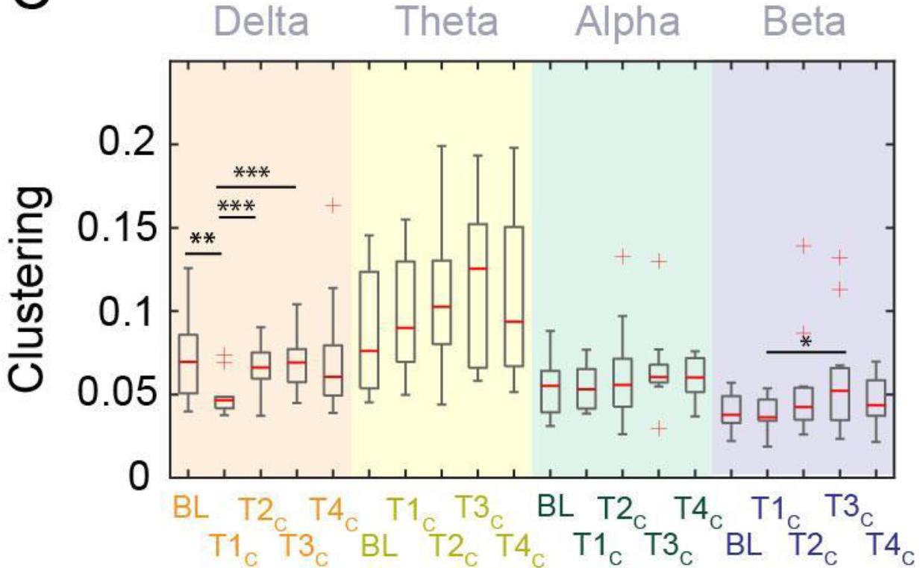
Delta Band
- Baseline vs run 1: (t(10) = 4.0, p = .002; Figure 2C).
- Baseline vs run 2?

Slide 4
