Slide 1
機器學習作業
第五組
408402066 吳柏緯
408402212 黃品綺
408402327 盛慧欣
408402432 吳承翰

Slide 2
目錄
01
Variable (feature) definition
資料描述說明
02
Descriptive statistics
資料敘述統計
03
Data preprocessing
資料前處理過程
04
Model building and results
模式建立與結果
05
CART vs KNN vs ANN

Slide 3
01
Variable (feature) definition

Slide 4
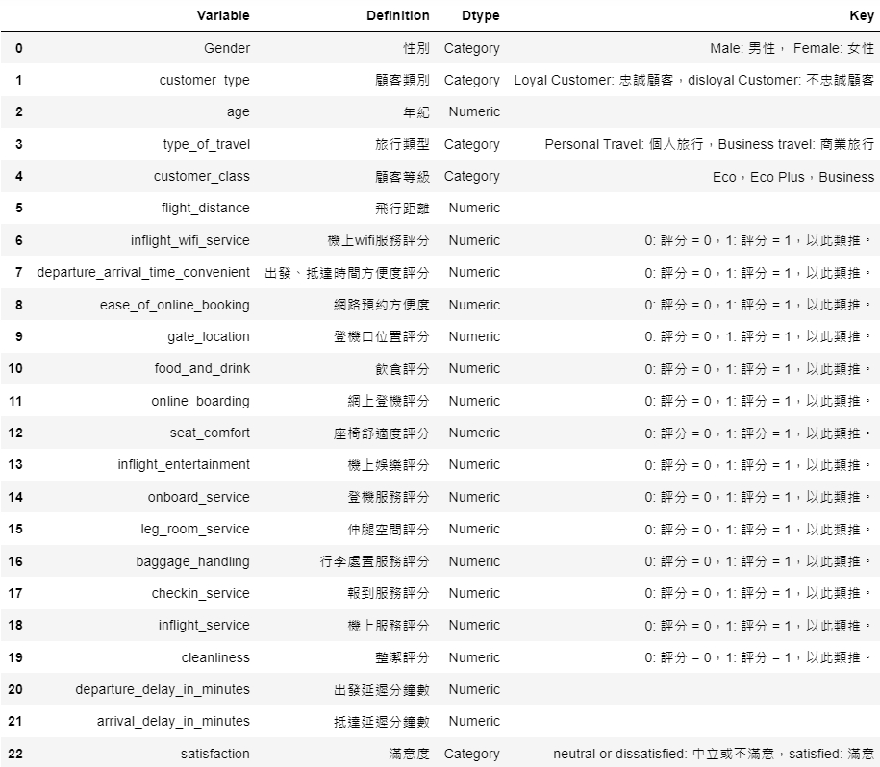
Variable (feature) definition
預測變數
目標變數
Notes:
哈哈哈哈阿

Slide 5
02
Descriptive statistics

Slide 6
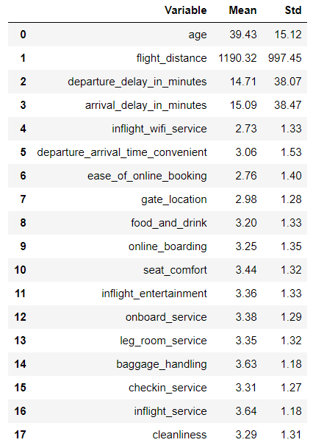
Descriptive Statistics

Slide 7
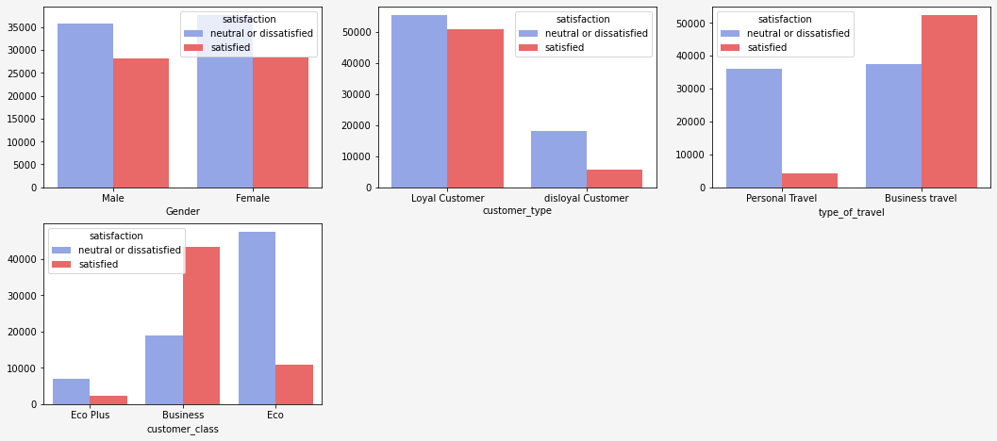
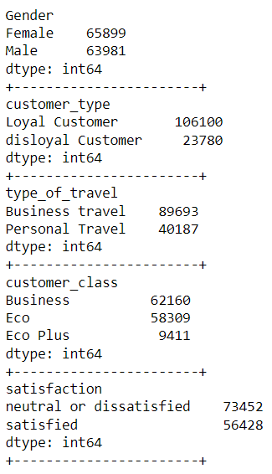
Descriptive Statistics

Slide 8
03
Data preprocessing

Slide 9
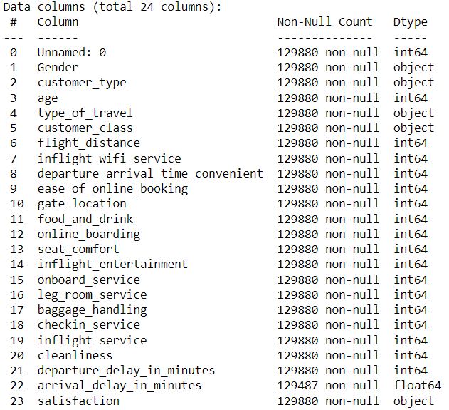
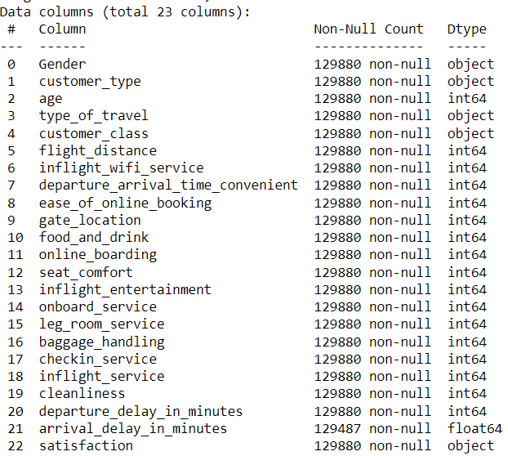
Data Preprocessing
Step1. 刪除冗餘資料

Slide 10
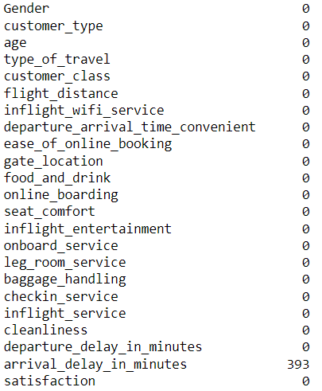
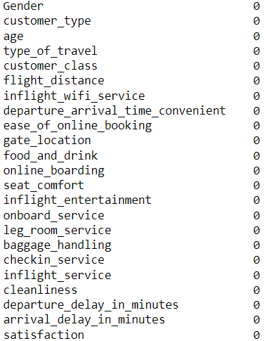
Data Preprocessing
Step2. 檢查有無空值，並刪除空值

Slide 11
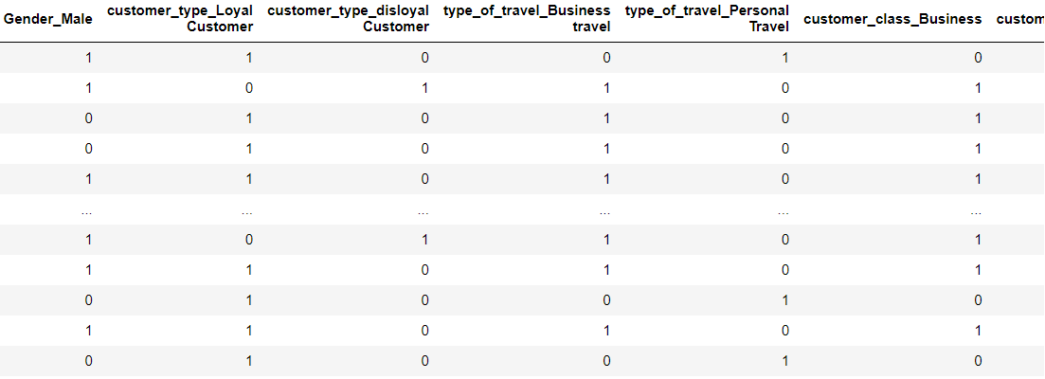
Data Preprocessing
Step3. 使用 one-hot encoding 替類別變數編碼(show部分資料)

Slide 12
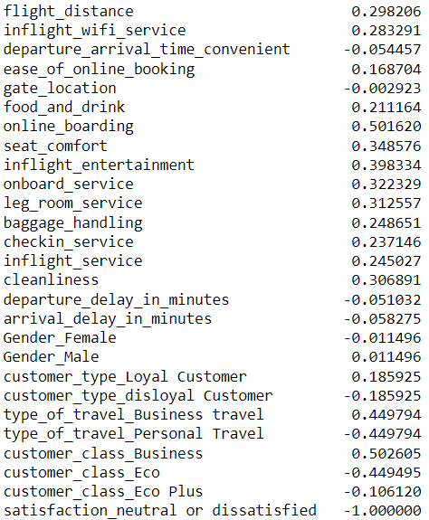
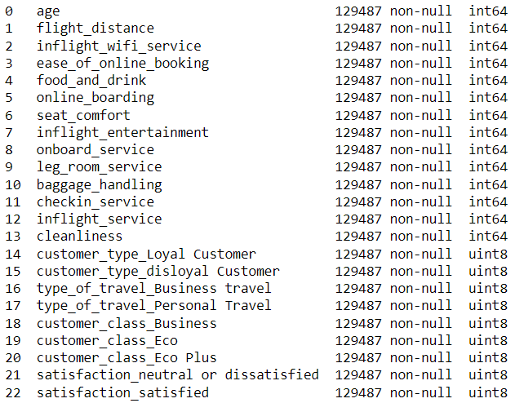
Data Preprocessing
Step4. 透過相關係數分析，刪除相關係數接近0的變數

Slide 13
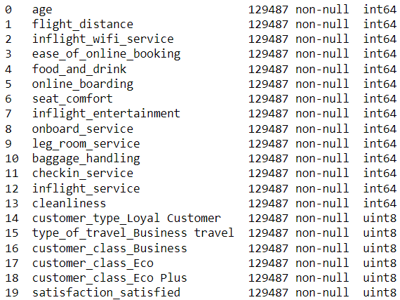
Data Preprocessing
Step5. 刪除冗餘資料

Slide 14
Data Preprocessing
Step6. 前處理完成
預測變數
目標變數

Slide 15
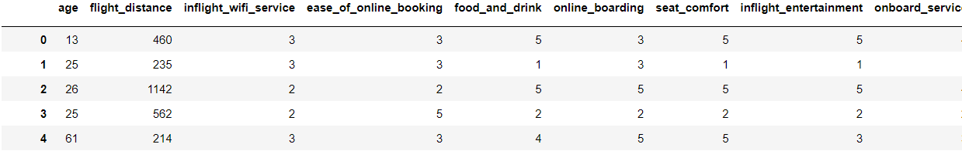
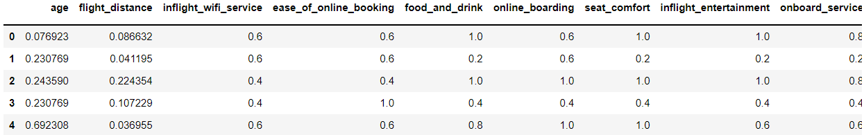
Data Preprocessing
Step7. 資料標準化

Slide 16
04
Model building and results

Slide 17
CART

Slide 18
Hyper parameter tuning result
 | min_samples_leaf=20 | min_samples_leaf=50 | min_samples_leaf=80
max_leaf_nodes=90 | 94.57(0.1) | 94.04(0.05) | 93.64(0.03)
max_leaf_nodes=100 | 94.69(0.07) | 94.07(0.06) | 93.66(0.03)
max_leaf_nodes=110 | 94.78(0.06) | 94.1(0.05) | 93.67(0.05)
max_depth=13
Data splited into 67% training & 33% testing.
Hyper parameter：
max_depth = 13
max_leaf_nodes = [90,100,110]
min_sample_leaf = [20,50,80]
random_state = [4,100,2000]
cv = 3

Slide 19
Hyper parameter tuning result
 | min_samples_leaf=20 | min_samples_leaf=50 | min_samples_leaf=80
max_leaf_nodes=90 | 94.56(0.09) | 94.07(0.05) | 93.66(0.03)
max_leaf_nodes=100 | 94.68(0.09) | 94.1(0.05) | 93.68(0.04)
max_leaf_nodes=110 | 94.78(0.06) | 94.12(0.06) | 93.69(0.05)
max_depth=14
Data splited into 67% training & 33% testing.
Hyper parameter：
max_depth = 14
max_leaf_nodes = [90,100,110]
min_sample_leaf = [20,50,80]
random_state = [4,100,2000]
cv = 3

Slide 20
Hyper parameter tuning result
 | min_samples_leaf=20 | min_samples_leaf=50 | min_samples_leaf=80
max_leaf_nodes=90 | 94.57(0.09) | 94.09(0.03) | 93.66(0.03)
max_leaf_nodes=100 | 94.67(0.07) | 94.12(0.03) | 93.68(0.04)
max_leaf_nodes=110 | 94.77(0.07) | 94.14(0.04) | 93.69(0.05)
max_depth=15
Data splited into 67% training & 33% testing.
Hyper parameter：
max_depth = 15
max_leaf_nodes = [90,100,110]
min_sample_leaf = [20,50,80]
random_state = [4,100,2000]
cv = 3

Slide 21
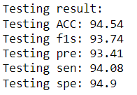
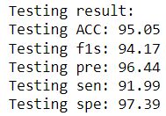
Best set
Parameter set: default
Round | 1 | 2 | 3
Accuracy | 93.89 | 94.19 | 93.88
Average | 93.99 +/- 0.15
Parameter set: max_depth=13,max_leaf_nodes=110,min_samples_leaf=20
Round | 1 | 2 | 3
Accuracy | 94.83 | 94.8 | 94.71
Average | 94.78 +/- 0.06

Slide 22
K-Nearest neighbors

Slide 23
Hyper parameter tuning result
Data splited into 67% training & 33% testing.
random_state= [4,100,2000]
n_neighbor = [9,27,43,75,99]
n_neighbors | Accuracy | Sensitivity | Specificity | Precision | F1-score
9 | 93.16(0.03) | 88.23(0.02) | 3.03(0.06) | 95.74(0.09) | 91.83(0.05)
27 | 92.75(0.06) | 87.23(0.17) | 2.99(0.05) | 95.75(0.04) | 91.29(0.09)
43 | 92.46(0.03) | 86.59(0.22) | 3.09(0.05) | 95.58(0.05) | 90.93(0.06)
75 | 92.07(0.05) | 85.94(0.2) | 3.21(0.06) | 95.39(0.06) | 90.42(0.09)
99 | 91.84(0.05) | 85.45(0.22) | 3.23(0.09) | 95.34(0.09) | 90.13(0.09)

Slide 24
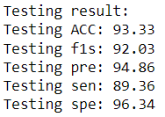
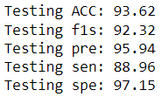
Best set
Parameter set：n_neighbor = 3
Round | 1 | 2 | 3
Accuracy | 92.97 | 92.94 | 92.91
Average | 92.94 +/- 0.03
Parameter set：n_neighbor = 9
Round | 1 | 2 | 3
Accuracy | 93.19 | 93.15 | 93.13
Average | 93.16 +/- 0.03

Slide 25
ANN

Slide 26
Hyper parameter tuning result
hidden_layer_1 | hidden_layer_2 | learning_rate | Accuracy
19 | 38 | 0.001 | 94.65(0.19)
 |  | 0.002 | 94.81(0.04)
 |  | 0.003 | 94.94(0.06)
Data splited into 67% training & 33% testing.
Hyper parameter：
hidden_layer_1=19
hidden_layer_2=38
learning rate = [0.001,0.002,0.003]
random_state = [4,100,2000]

Slide 27
Hyper parameter tuning result
hidden_layer_1 | hidden_layer_2 | learning_rate | Accuracy
38 | 76 | 0.001 | 95.14(0.12)
 |  | 0.002 | 95.32(0.04)
 |  | 0.003 | 95.44(0.14)
Data splited into 67% training & 33% testing.
Hyper parameter：
hidden_layer_1=38
hidden_layer_2=76
learning rate = [0.001,0.002,0.003]
random_state = [4,100,2000]

Slide 28
Hyper parameter tuning result
hidden_layer_1 | hidden_layer_2 | learning_rate | Accuracy
76 | 152 | 0.001 | 95.41(0.13)
 |  | 0.002 | 95.46(0.08)
 |  | 0.003 | 95.51(0.09)
Data splited into 67% training & 33% testing.
Hyper parameter：
hidden_layer_1=76
hidden_layer_2=152
learning rate = [0.001,0.002,0.003]
random_state = [4,100,2000]

Slide 29
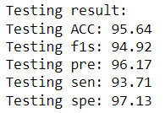
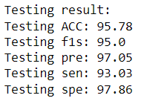
Best set
Parameter set：hidden_layer_1=19, hidden_layer_2=38, learning_rate=0.001
Round | 1 | 2 | 3
Accuracy | 94.72 | 94.77 | 94.83
Average | 94.77 +/- 0.06
Parameter set：hidden_layer_1=76, hidden_layer_2=152, learning_rate=0.003
Round | 1 | 2 | 3
Accuracy | 95.5 | 95.6 | 95.43
Average | 95.51 +/- 0.09

Slide 30
05
CART vs KNN vs ANN

Slide 31
CART vs KNN vs ANN
Methods | Metrics
 | ACC | SEN | SPC | Precision | F1-score
CART | 95.05 | 94.17 | 96.44 | 91.99 | 97.39
KNN | 93.62 | 92.32 | 95.94 | 88.96 | 97.15
ANN | 95.78 | 95.0 | 97.05 | 93.03 | 97.86

Slide 32
THANK YOU

