Slide 1
Sample PPTX Presentation
Generated on 2025-06-13

Slide 2
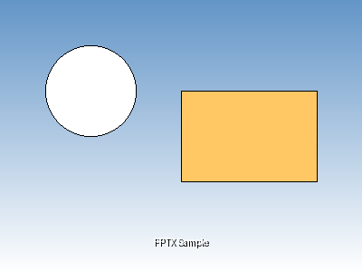
Sample Content with Image
This slide demonstrates image embedding in presentations:
  • High-quality image integration
  • Flexible positioning and sizing

Slide 3
Structured Table Example
Product | Category | Price | Stock
Laptop | Electronics | $999.99 | 25
Smartphone | Electronics | $699.99 | 50
Desk Chair | Furniture | $199.99 | 15
Coffee Mug | Kitchen | $12.99 | 100

Slide 4
Unstructured Table (Merged Cells)
Department | Q1 | Q2 | Q3
Sales | $10,000 | $12,000 | $15,000
Marketing | $5,000 | $6,000 | $7,000
Total | $15,000 | $18,000 | $22,000
Grand Total |  |  | $55,000

Slide 5
Vertical Merging Example
Category | Subcategory | Value
Technology | Hardware | $1,000
 | Software | $500
Services | Consulting | $2,000

