Slide 1

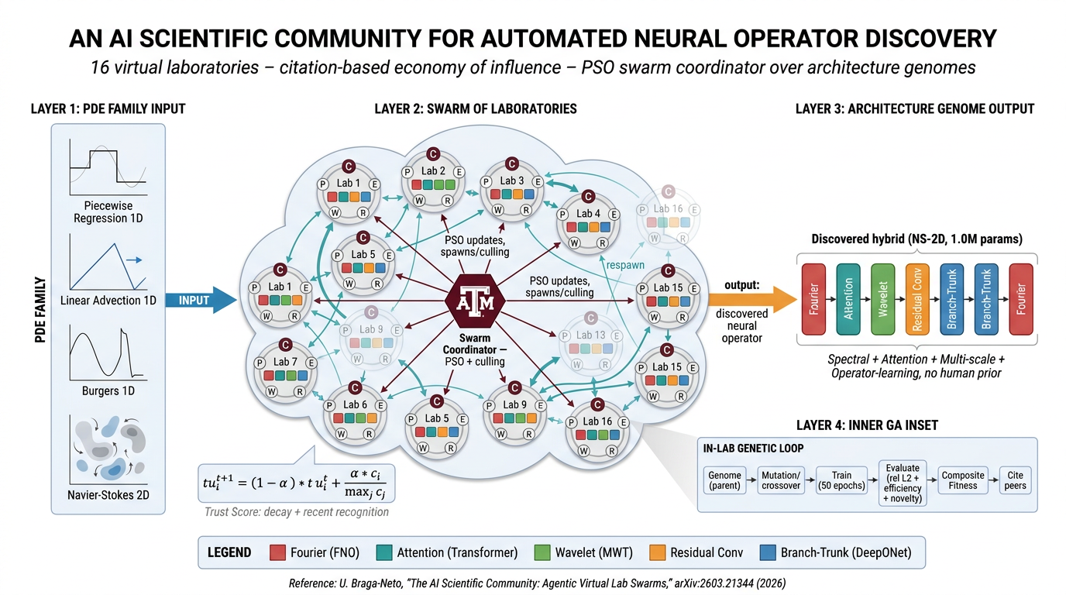
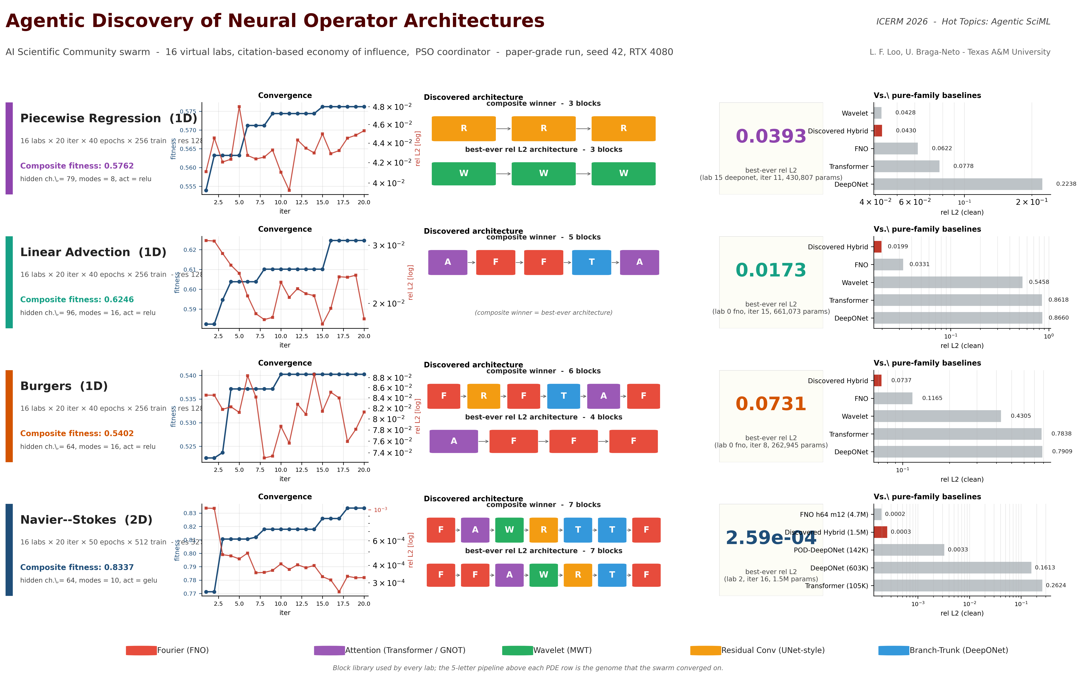
[ TAMU LOGO ]
An Agentic AI Science Community for
Automated Neural Operator Discovery
Luis Loo | Advisor: Ulisses Braga-Neto | Department of Electrical & Computer Engineering, Texas A&M University
Hot Topics Workshop on Agentic Scientific Computing and Scientific Machine Learning | ICERM, Brown University | May 9-10, 2026
github.com/luislootx/AI-SC
Key Takeaway
Framework Overview
A swarm of virtual labs, exchanging CITATIONS like a research community, discovers HYBRID neural operator architectures with no human prior - and converges on a DIFFERENT architecture for each PDE family.
Motivation
- Neural operators (FNO, DeepONet, GNOT, MWT, ...) ship with fixed inductive biases. Picking the right family is still done by hand.
- QUESTION: can a swarm of virtual labs discover the right architecture per PDE, with no human prior?
- FRAMEWORK: Braga-Neto's AI Scientific Community (arXiv:2603.21344, 2026). 16 labs, citation-based influence, PSO coordinator over architecture genomes.
Methods - Five Role Agents per Lab
- PLANNER: proposes the architecture genome.
- WORKER: inner GA over hyperparameters.
- EVALUATOR: multi-objective fitness
f = w_a acc + w_g gen + w_e eff + w_n nov + w_p peer.
- REVIEWER: votes for top-2 peer labs.
- COORDINATOR (shared): PSO + culling.
TRUST SCORE
tau_i = (1-a) tau_i + a c_i / max c.
Drives GA budget, PSO weight, lab survival.
BLOCK LIBRARY: Fourier (FNO) - Branch-Trunk (DeepONet)
- Wavelet (MWT) - Attention (GNOT) - Residual Conv.
Results - All Four Experiments
Discussion & Caveats
- Regime-aware hybrid: 4-family recombination, no human prior.
- For NS-2D the hybrid matches FNO h64 m12 with ~3x fewer params.
- Block usage shifts measurably iter 1 -> 20 in every benchmark - this is not random search.
- CAVEAT: absolute rel L2 is NOT comparable across PDEs (signal energies, noise floors, spectral structure differ).
- We do NOT claim to beat DeepONet. Darcy-2D test pending.
Next Steps & References
NEXT: Darcy-2D (DeepONet regime); LLM-backed Planner / Reviewer (Athena, Toscano et al., 2025); graph operator + neural Galerkin blocks.
- Braga-Neto. AI Scientific Community. arXiv:2603.21344 (2026).
- Lu et al. The AI Scientist. Nature 651, 914-919 (2026).
- Toscano, Chen, Karniadakis. Athena. arXiv:2512.03476 (2025).
- Li et al. FNO. ICLR 2021. Lu et al. DeepONet. NMI 3 (2021).
ACKNOWLEDGMENTS - Prof. Ulisses Braga-Neto; ICERM organisers; TAMU ECEN travel grant; ICERM lodging support.
Discovered Architectures
Honest Comparison - 1D Baselines
PIECEWISE REG. 1D R + R + R
LIN. ADVECTION 1D A + F + F + T + A
BURGERS 1D F + R + F + T + A + F
NS-2D (winner) F + A + W + R + T + T + F
NS-2D (best rel L2) F + F + A + W + R + T + F
rel L2 = 2.6e-4 (1.5M params)
Different PDEs => different architectures.
Legend: F=Fourier A=Attention W=Wavelet
R=ResConv T=Branch-Trunk.
Same data, same training budget per architecture
(40 epochs, 256 train, res 128).
PDE | Hybrid | FNO | DeepO | Wave | Trans
Piecewise | 0.043 | 0.062 | 0.224 | 0.043*| 0.078
Lin. Advec. | 0.020* | 0.033 | 0.866 | 0.546 | 0.862
Burgers | 0.074* | 0.117 | 0.791 | 0.430 | 0.784
* = best per row. Hybrid WINS Advection + Burgers,
TIES the regime-optimal pure family on regression.

