Slide 1
A generalized decision-making mechanism for physical and abstract spaces Luis Luarte
Notes:
Use real-life screenshots
Use clear instructions
Redo with grayscale
Be super clear with the lab instructions
Add type of pilots to add and confirm the validity of the task key parameters

Slide 2
Conceptual model
Exploitation
Leverage current knowledge.
Maximize immediate returns.
Balance determines
Exploration
Gather new info.
Improve future returns.
Postulate I:
general algorithm
Adaptive behavior under uncertainty
Shared structure, parameters
Postulate II: isomorphism
Physical foraging
Abstract foraging

Slide 3




Proposed mechanism
Evaluation
Model
Agent
$$Q=\left(State×Action\right)$$
Environment
Evaluation
Prediction
Environmental cues
$$δ=R_{actual} −Q_{predicted}$$
Prediction
$$Q=Q+α⋅δ$$
Action
Action
$$P\left(Action_{i}\right)∝e^{Q\left(\frac{Action_{i}}{τ}\right)}$$
Exploration/Exploitation
Sutton & Barto, 2020

Slide 4






Proposed mechanism
Evaluation
Specific to physical or abstract foraging.
$$Q=\left(State×Action\right)$$
Prediction
$$δ∝Uncertainty$$
$$Q_{predicted}∝Uncertainty$$
$$δ=R_{actual} −Q_{predicted}$$
$$Q=Q+α⋅δ$$
Action
$$Action=f\left(prediction\right) \\ Action∝τ \\ τ=g(δ)$$
$$P\left(Action_{i}\right)∝e^{Q\left(\frac{Action_{i}}{τ}\right)}$$
Sutton & Barto, 2020

Slide 5

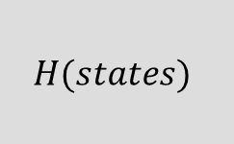


Proposed mechanism
Exploration/Exploitation
balance
Environment
Reward prediction error (RPE)
$$E$$
Increases
$$δ$$
Increases
$$τ$$
Here is the experimental hypothesis
$$H(states)$$
Phasic DA activity
Variability controller
Behavior
Evaluation process is left as specific to task domain
Task parameters
ERP FRN
Spontaneous behavior
RL model

Slide 6


Proposed mechanism
RPE
Encodes environment uncertainty
$$δ$$
Variability controller
Bias behavior towards exploration
$$τ$$
Exploration/Exploitation
balance

Slide 7
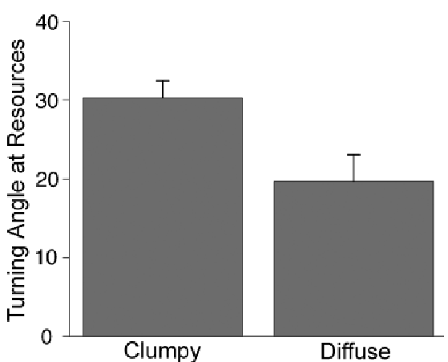
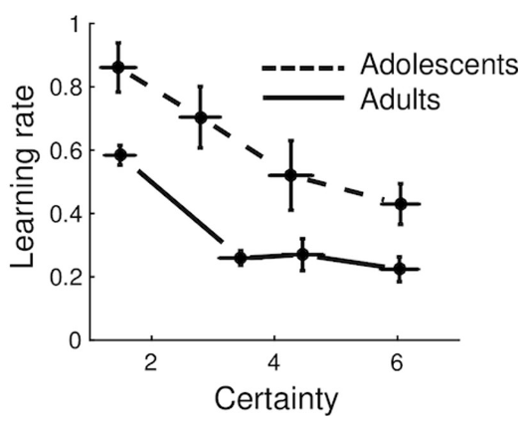
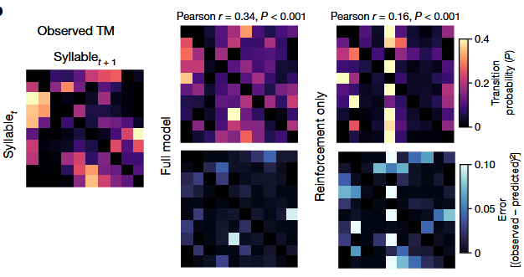
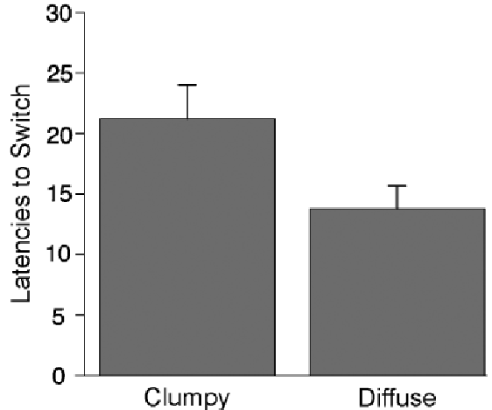
Empirical support
A.
B.
C.
Physical
Abstract
(Jepma et al., 2020)
(Markowitz et al., 2023)
(Hills et al., 2008)

Slide 8
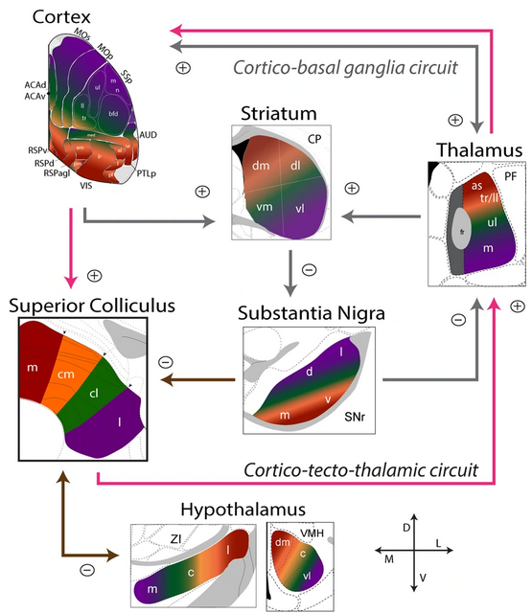
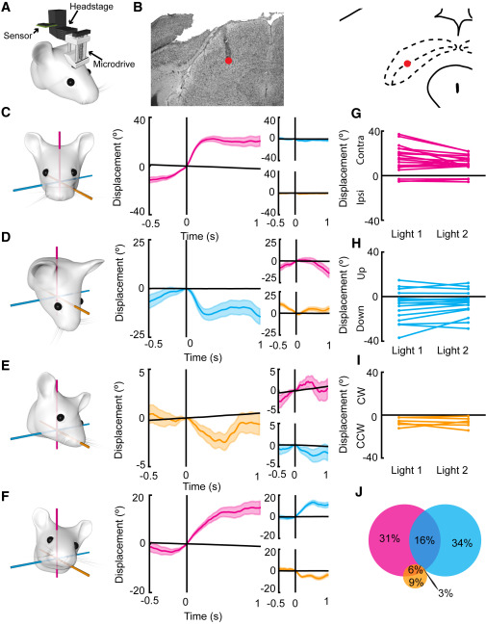
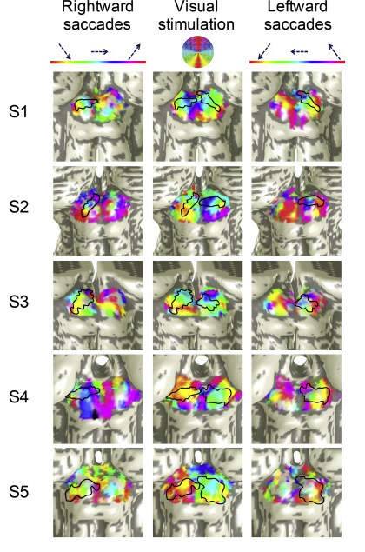
Empirical support
A.
B.
C.
(Benavidez et al., 2021)
(Wilson et al., 2018)
(Savjani et al., 2018)

Slide 9
Objective
Determine if the computational architecture that governs the exploration-exploitation balance in abstract foraging is isomorphic to the architecture governing foraging.

Slide 10
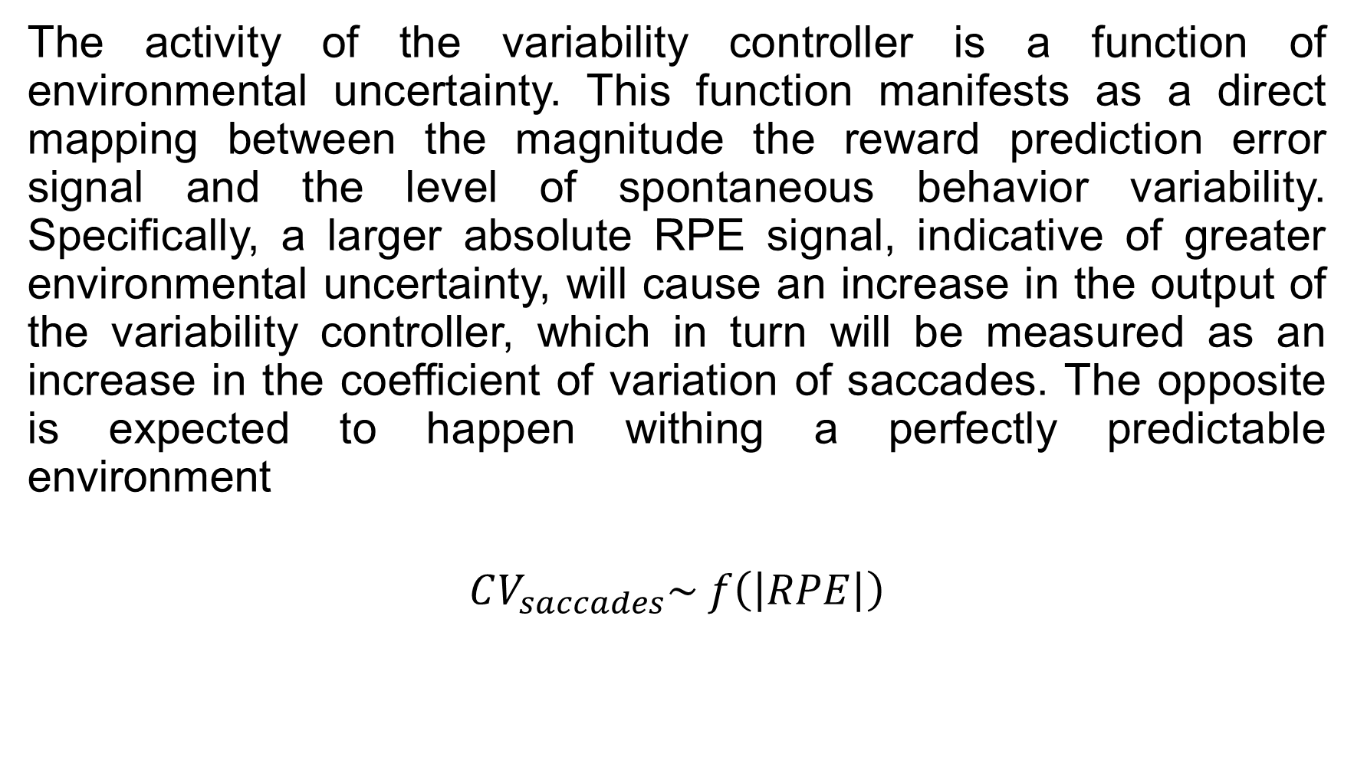
Hypothesis I
The activity of the variability controller is a function of environmental uncertainty. This function manifests as a direct mapping between the magnitude the reward prediction error signal and the level of spontaneous behavior variability. Specifically, a larger absolute RPE signal, indicative of greater environmental uncertainty, will cause an increase in the output of the variability controller, which in turn will be measured as an increase in the coefficient of variation of saccades. The opposite is expected to happen withing a perfectly predictable environment
$$CV_{saccades}\sim f\left(\left|RPE\right|\right)$$

Slide 11
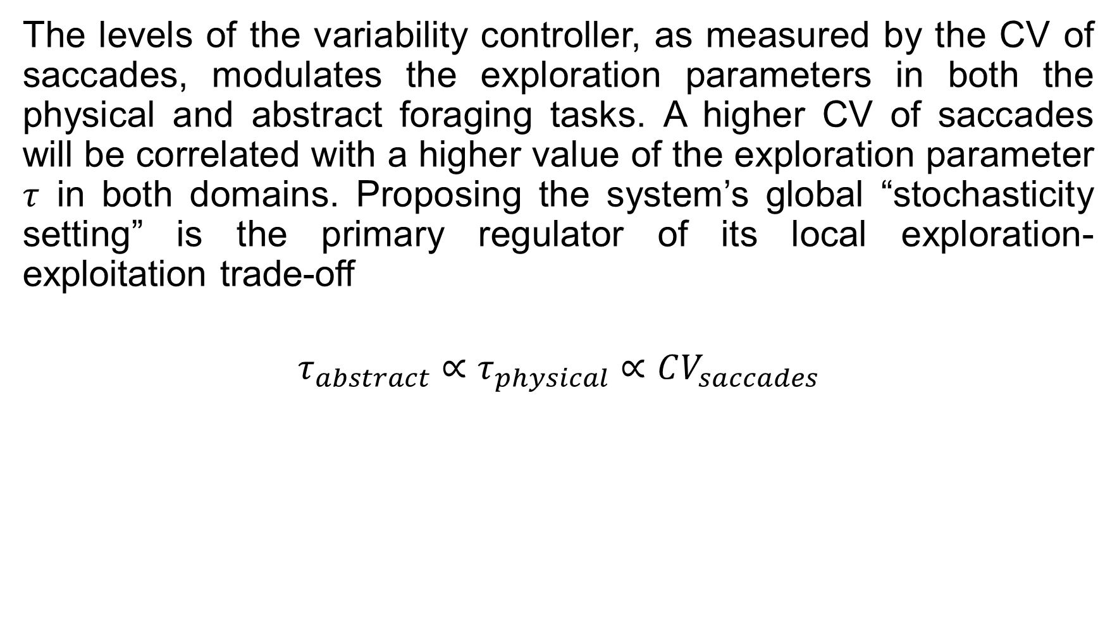
Hypothesis II
The levels of the variability controller, as measured by the CV of saccades, modulates the exploration parameters in both the physical and abstract foraging tasks. A higher CV of saccades will be correlated with a higher value of the exploration parameter $τ$ in both domains. Proposing the system’s global “stochasticity setting” is the primary regulator of its local exploration-exploitation trade-off
$$τ_{abstract}∝τ_{physical}∝CV_{saccades}$$

Slide 12
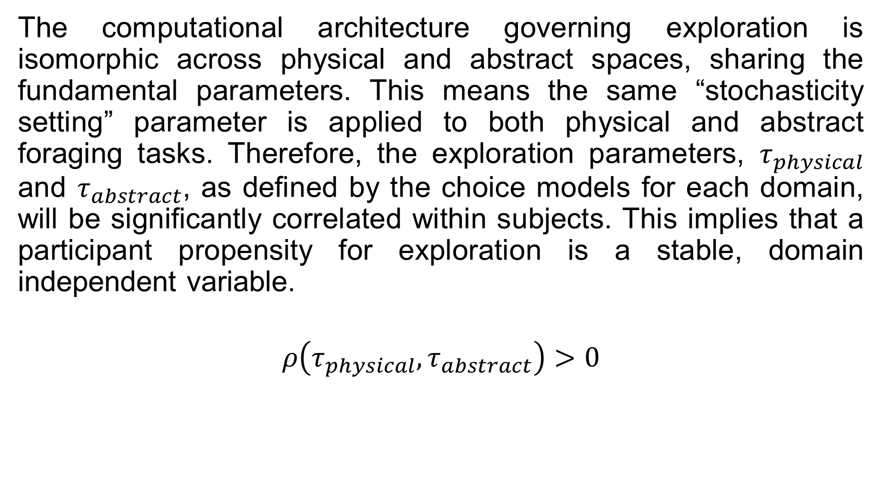
Hypothesis III
The computational architecture governing exploration is isomorphic across physical and abstract spaces, sharing the fundamental parameters. This means the same “stochasticity setting” parameter is applied to both physical and abstract foraging tasks. Therefore, the exploration parameters, $τ_{physical}$ and $τ_{abstract}$, as defined by the choice models for each domain, will be significantly correlated within subjects. This implies that a participant propensity for exploration is a stable, domain independent variable.
$$ρ\left(τ_{physical}, τ_{abstract}\right)>0$$

Slide 13



Hypothesis over mechanism
$$ρ\left(τ_{physical}, τ_{abstract}\right)>0$$
Exploration/Exploitation
balance
Environment
Reward prediction error (RPE)
$$E$$
Increases
$$δ$$
Increases
$$τ$$
$$τ_{abstract}∝τ_{physical}∝CV_{saccades}$$
$$CV_{saccades}\sim f\left(\left|RPE\right|\right)$$
$$H(states)$$
Phasic DA activity
Variability controller
Behavior
Task parameters
ERP FRN
Spontaneous behavior
RL model

Slide 14
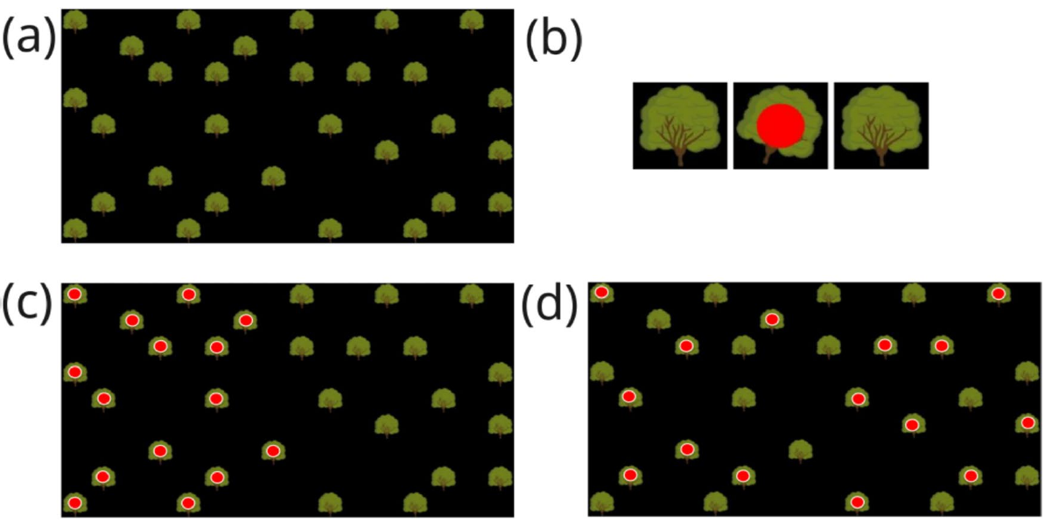
Experimental design (physical)
+
1s animation
ITI 5-5.5s
Saccades/ERP measurement
~15s
- After visit, a visual cue (fade) is integrated to aid memory
50 ms. of gaze sample within a tree hit box, shakes the tree
Reward is binary, red dot or no red dot
(Hills et al., 2008)
Notes:
Add cognitive interview to determine task parameters (5-8 participants for pilot)
Add break between two RPE levels
Think: abstract stimuli
Think instruction

Slide 15
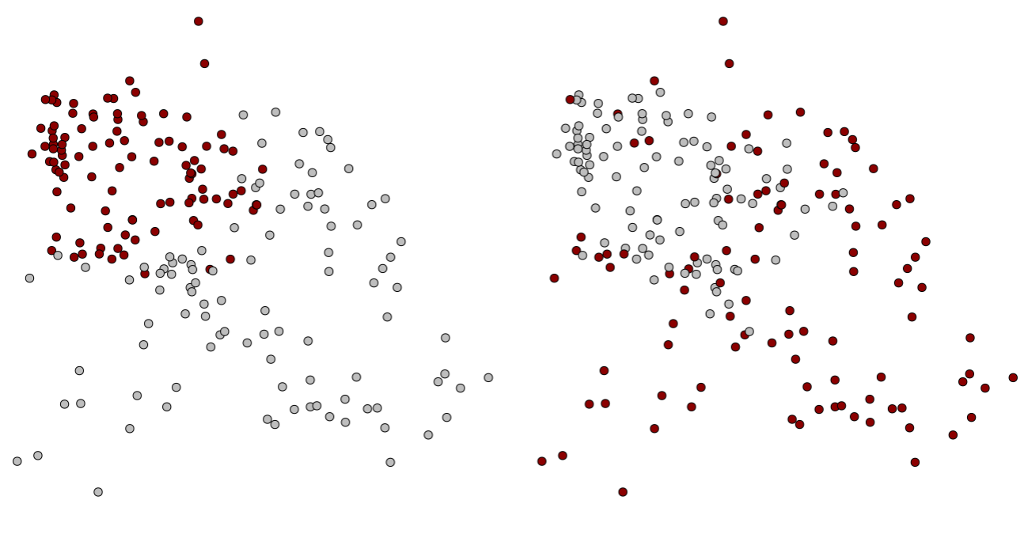

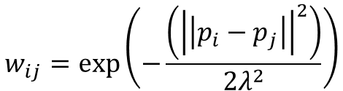




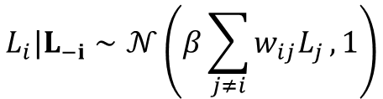

Task parameters determination
$$β=100$$
$$β=0.1$$
Reward
Position
$$L_{i}|L_{−i}∼𝒩\left(β\sum_{j≠i}{w_{ij}L_{j}},1\right)$$
$$p_{i}=p_{i−1}+δ_{i}$$
$$δ_{i}=Φ⋅δ_{i−1}+ε_{i}$$
$$w_{ij}=\exp\left(−\frac{\left({\left|\left|p_{i}−p_{j}\right|\right|}^{2}\right)}{2λ^{2}}\right)$$
$$ε_{i}∼𝒩\left(0,Σ_{ε}\right)$$
$$Φ=\left(\begin{matrix}φ & 0 \\ 0 & φ\end{matrix}\right)$$
Truncate for n highest ranked rewards
Low RPE
High RPE
Notes:
Add cognitive interview to determine task parameters (5-8 participants for pilot)
Add break between two RPE levels
Think: abstract stimuli
Think instruction

Slide 16
Task parameters fit
Hit box size
Time to trigger reward
Difficulty to predict
Post-task interview
How hard was to trigger a reward? (easy-difficult)
How difficult was to focus your gaze within the tree? (easy-difficult)
How likely was to trigger a tree reward by accident? (likely-unlikely)
How did you feel the reward animation? (long-short)
In scenario A how hard was to predict where the rewards were (easy-difficult)
In scenario B how hard was to predict where the reward were (easy-difficult)
Notes:
Add cognitive interview to determine task parameters (5-8 participants for pilot)
Add break between two RPE levels
Think: abstract stimuli
Think instruction
Gatillastes un arbol sin tener intencion de hacerlo?
Why was hard to trigger?
Did you manage to trigger rewards?

Slide 17
Task instructions
In this part of the experiment, you will play a simple game where your goal is to search for rewards in a virtual forest.
The entire task is controlled by your eyes, so please try to remain still and comfortable.
Your objective is to find as many rewards as possible in each round. The rewards will look like red dots that appear on the trees.
Look to choose you will se a forest of trees on the screen. To check a tree simply look directly at it.
Shake the tree, if you hold your gaze on a tree for a moment, you will see the tree shake. This means you’ve successfully checked it.
Find the reward, after the tree shakes, it will either reveal a red dot (a reward) or nothing
Memory help, once you have checked a tree, it will fade slightly. This is a visual cue to help you remember where you’ve already looked.
Notes:
Add cognitive interview to determine task parameters (5-8 participants for pilot)
Add break between two RPE levels
Think: abstract stimuli
Think instruction

Slide 18

Example task
Notes:
Add cognitive interview to determine task parameters (5-8 participants for pilot)
Add break between two RPE levels
Think: abstract stimuli
Think instruction

Slide 19


Experimental design (abstract)
+
Baseline recording, during calibration
+
+
Late!
0/1
ITI 5-5.5s
5s
1-1.5s
>5s
2-3s
3-3.5s
Saccades/ERP measurement
Joystick input
Modified from (Stojić et al., 2020)
Notes:
Add cognitive interview to determine task parameters (5-8 participants for pilot)
Add break between two RPE levels
Think: abstract stimuli
Think instruction

Slide 20
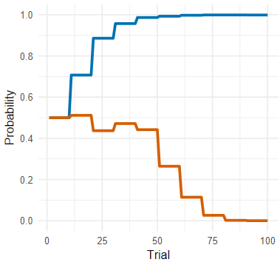
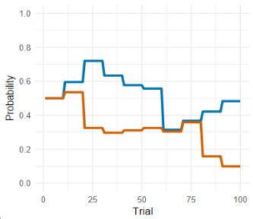

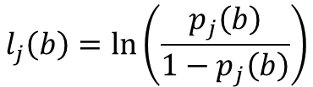





Task parameter determination
Low RPE
Reward
Position
$$l_{j}\left(b\right)=\ln\left(\frac{p_{j}\left(b\right)}{1−p_{j}\left(b\right)}\right)$$
$$∅$$
$$φ= 1$$
$$δ_{j}\left(b+1\right)=φ⋅δ_{j}\left(b\right)+ε_{j}, \text{where} ε_{j}∼𝒩\left(0,σ_{p}^{2}\right)$$
High RPE
$$l_{j}\left(b+1\right)=l_{j}\left(b\right)+δ_{j}\left(b+1\right)$$
$$p_{j}\left(b+1\right)=\frac{1}{1+e^{−l_{j}\left(b+1\right)}}$$
$$φ=0.1$$
$$R_{j}\left(t\right)∼\text{Bernoulli}\left(p_{j}\left(t\right)\right)$$
Notes:
Add cognitive interview to determine task parameters (5-8 participants for pilot)
Add break between two RPE levels
Think: abstract stimuli
Think instruction

Slide 21
Task parameters fit
Trial length
Difficulty to predict
Post-task interview
How long did you find each trial? (long-short)
In scenario A how hard was to predict where the rewards were (easy-difficult)
In scenario B how hard was to predict where the reward were (easy-difficult)
Notes:
Add cognitive interview to determine task parameters (5-8 participants for pilot)
Add break between two RPE levels
Think: abstract stimuli
Think instruction

Slide 22
Behavioral variable definition
Trial length
Difficulty to predict
Post-task interview
How long did you find each trial? (long-short)
In scenario A how hard was to predict where the rewards were (easy-difficult)
In scenario B how hard was to predict where the reward were (easy-difficult)
Notes:
Add cognitive interview to determine task parameters (5-8 participants for pilot)
Add break between two RPE levels
Think: abstract stimuli
Think instruction

Slide 23
Task instructions
In this part of the experiment, you will play a choice game. Your goal is to figure out which of two symbols is the most rewarding. This task is controlled with a joystick
Your objective is to win as many points as you can. You win a point by choosing the symbol that is currently the “best” option.
See the choices, at the start of each round, you will see two different symbols appear on the screen.
Make your choice, use the joystick to move left or right to select the symbol you believe will give you a point. Please make your decision as quickly and accurately as you can while the symbols are visible.
Get feedback, after your choice, you will see feedback where the symbol previously was. A +1 symbol means you won a point, 0 means you did not win a point for that round.
Notes:
Add cognitive interview to determine task parameters (5-8 participants for pilot)
Add break between two RPE levels
Think: abstract stimuli
Think instruction

Slide 24
General instructions
In this session, you will be playing two different short games. The goal in both is to use the information you’re given to make choice and earn as many rewards or points as possible
We’ll give you detailed instruction for each game right before it starts, but here is a brief overview of what to expect.
Game 1: (RANDOM), in this game, you will explore a virtual forest using just your eyes. Your goal will be to find hidden rewards by looking at different trees.
Game 2: (RANDOM), in this game, you’ll use a joystick to choose between two abstract symbols. Your goals is to lean which symbols is currently the best choice to win points.
In both games, for each point earned you’ll win 1 Zenny. Based on the Zenny you win at the end; you’ll be rewarded with a certain amount of CLP and $5000 for transportation terms.
Notes:
Add cognitive interview to determine task parameters (5-8 participants for pilot)
Add break between two RPE levels
Think: abstract stimuli
Think instruction

Slide 25
Example task
Late!
+1
Notes:
Add cognitive interview to determine task parameters (5-8 participants for pilot)
Add break between two RPE levels
Think: abstract stimuli
Think instruction

Slide 26











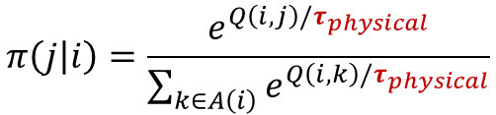






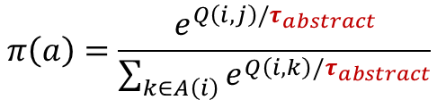

Behavioral variables definition
Decision variability (physical)
Decision variability (abstract)
$$π\left(j | i\right)=\frac{e^{Q\left(i,j\right)/τ_{physical}}}{\sum_{k∈A\left(i\right)}{e^{Q\left(i,k\right)/τ_{physical}}}}$$
$$π\left(a\right)=\frac{e^{Q\left(i,j\right)/τ_{abstract}}}{\sum_{k∈A\left(i\right)}{e^{Q\left(i,k\right)/τ_{abstract}}}}$$
$$C\left(i, j\right)=\left|\left|p_{i}−p_{j}\right|\right|$$
$$Cost_{t} =\max_{Q}{K} − Q\left(A_{t}\right)$$
$$i$$
$$j$$
$$i$$
$$j$$
$$A\left(i\right)←\{k∣k∈\{1,…,N\} \text{and} k∉Visited\}$$
$$A\left(i\right)←\{k∣k∈\{i, j\}\}$$
U$\left(i,j\right)=\exp\left(−\frac{|p_{i}−p_{j}|^{2}}{2σ^{2}}\right)$
$$δ_{t}←R_{t}−Q\left(A_{t}\right)$$
$$Q\left(i, j\right)=U\left(j\right)−C\left(i, j\right)$$
$$Q\left(A_{t}\right)←Q\left(A_{t}\right)+α⋅δ_{t}$$
Notes:
How to determine subject priors
Offer the empirical reward, based on the spatial location this may change

Slide 27
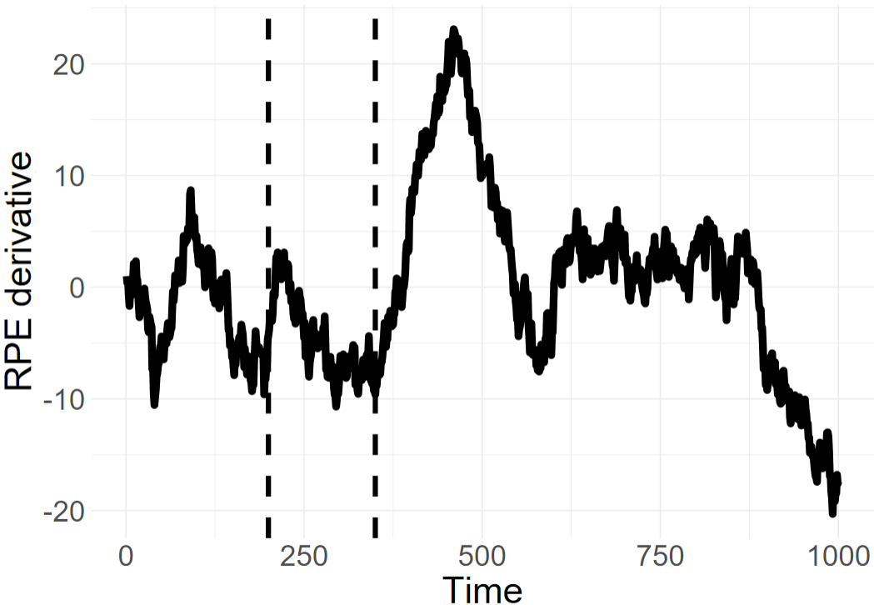
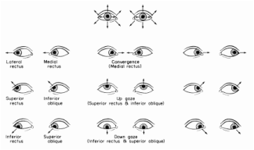

Biological variables definition
RPE signal
$$μV\sim \left(Time, RPE, by=Domain\right)+\left(Time, by=Domain\right)+\left(\left(Time\right)\right|Participant)+(RPE|Participant)$$
"Does the computational RPE effectively modulate the ERP waveform, and can we specifically see this effect within the canonical 200–350 ms time window of the FRN?"
Spontaneous behavior variability
$$CV_{saccades}=\frac{σ_{saccades}}{μ_{saccades}}$$

Slide 28
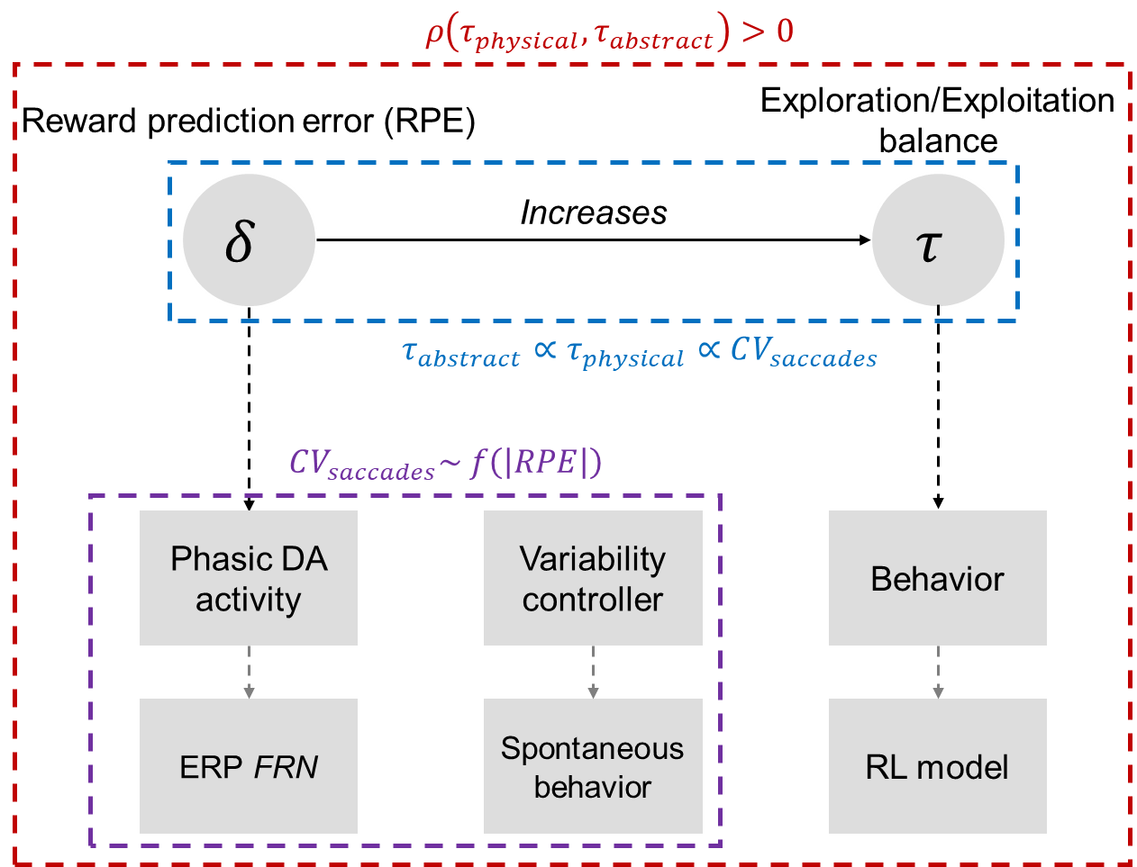


Analysis definition
$$\left(1\right) CV_{saccades}\sim \left(RPE, by=Domain\right)+(1|RPE)$$
$$\left(2\right) FRN_{mean amplitude}\sim RPE⋅Domain+\left(1+RPE \right| Participant)$$
$$\left(3\right) CV_{saccades} \sim \left(FRN_{amplitude}, by=Domain\right)+\left(RPE, by=Domain\right)$$
$$Θ \sim {CV}_{saccades}⋅θ_{type}⋅Domain+\left(1+CV_{saccades} \right|Participant)+(1| Domain:Participant)$$
$$Θ=\{τ_{abstract}, τ_{physical}\}$$
$${ρ(\hat{θ}}_{abstract}, {\hat{θ}}_{physical})$$

Slide 29
Analysis definition
Analysis
I
RL model or FRN derived RPE as independent variable
Per domain (physical, abstract)
Per controls
Analysis II
RPE taken a categorial variable with two level (low, high)
Per domain (physical, abstract)
RL model or FRN derived RPE as dependent ~ RPE categorical (positive control)
Per controls
Analysis III
RL model or FRN derived RPE as independent within RPE categorial two-levels (low, high)
Per domain (physical, abstract)
Per controls

Slide 30
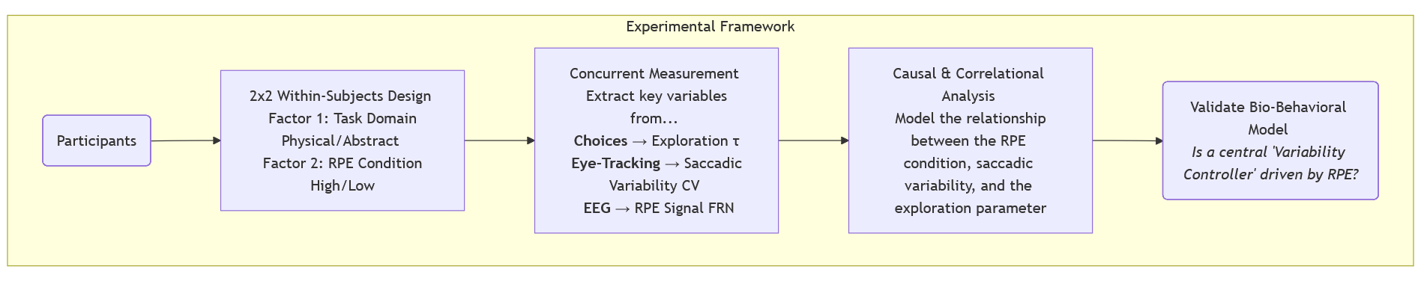
Overall experimental setup
Participants: 30 (15 male), university participant pool with normal or normal-corrected vision, no pharmacological intervention
Task order is randomized
5 min. Break within tasks (masked as recalibration)

Slide 31
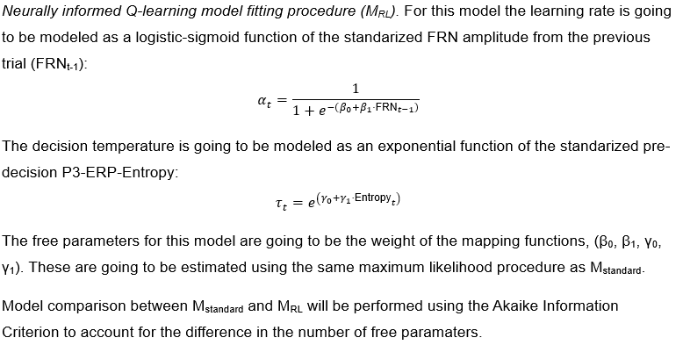
Extras

Slide 32
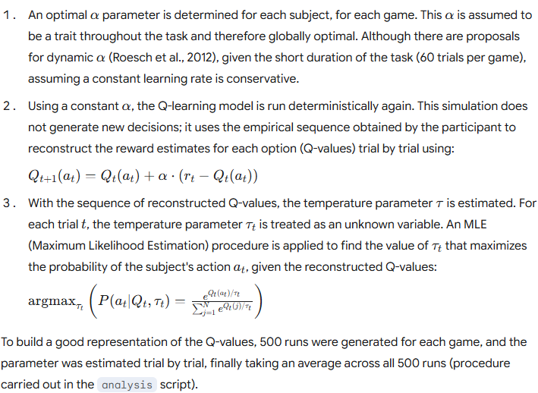
Extras

