Slide 1
An exaptive framework for decision-making: linking spontaneous saccadic variability to exploratory choice stochasticity Luis Luarte

Slide 2
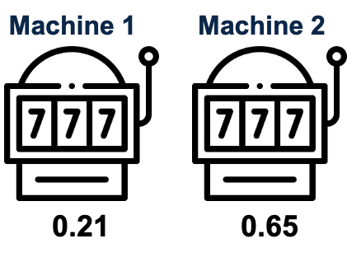
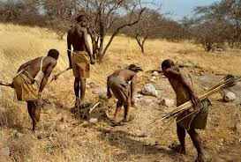


Motivation: explore/exploit dilemma
Explore/Exploit
Physical foraging
$$P\left(l\right)\sim l^{σ}$$
Generalized optimal strategy
Exploit
Explore

Slide 3







Motivation: the role of spontaneous behavior
Generalized optimal strategy
Evolutionary exaptation
Adaptive behavior
Spontaneous behavior
$$τ=g\left(f^{−1}\left(Ω\right)\right)$$
$$P\left(l\right)\sim l^{σ}$$
$$σ=f\left(Ω\right)$$
$$Ω$$
$$τ=g\left(Ω\right)$$
$$Ω↓$$
$$Ω↑$$
(Hills et al., 2015)
Exploit
Explore

Slide 4
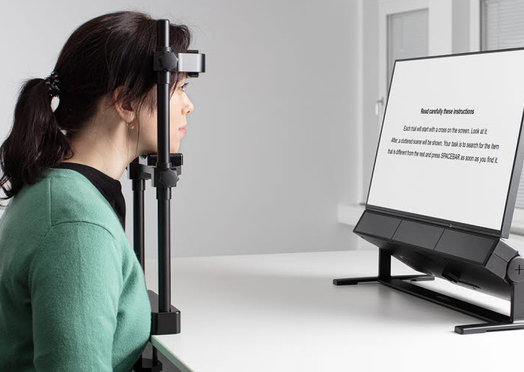
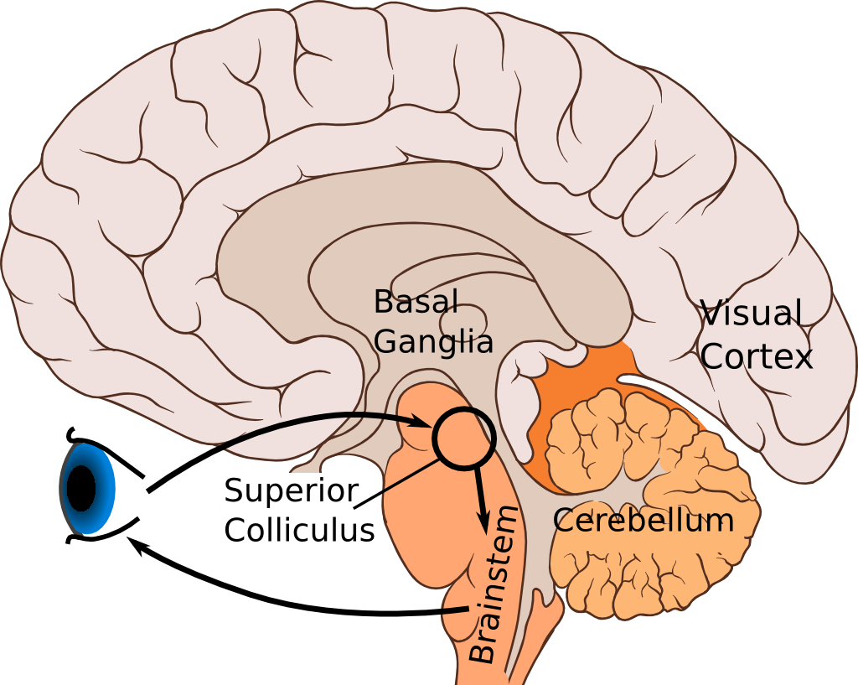
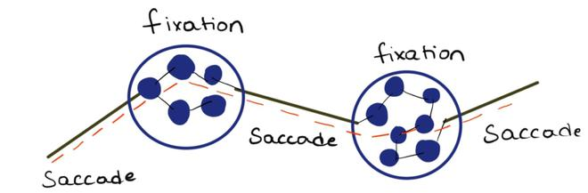

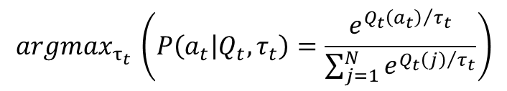
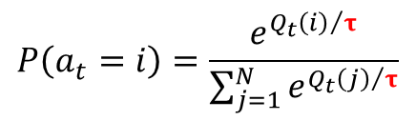

Motivation: biological mechanism
Spontaneous behavior
Superior Colliculus
Decision making parameters
$$τ=g\left(f^{−1}\left(Ω\right)\right)$$
$$Q_{t+1}\left(a_{t}\right)=Q_{t}\left(a_{t}\right)+α⋅\left(r_{t}−Q_{t}\left(a_{t}\right)\right)$$
$$P\left(a_{t}=i\right)=\frac{e^{Q_{t}{\left(i\right)}/τ}}{\sum_{j=1}^{N}{e^{Q_{t}{\left(j\right)}/τ}}}$$
(Markowitz et al., 2023)
$$argmax_{τ_{t} }\left(P\left(a_{t} | Q_{t},τ_{t}\right)=\frac{e^{Q_{t}{\left(a_{t}\right)}/{τ_{t}}}}{\sum_{j=1}^{N}{e^{Q_{t}{\left(j\right)}/{τ_{t}}}}}\right)$$
(Romano et al., 2015)
(Sutton & Barto, 2020)

Slide 5
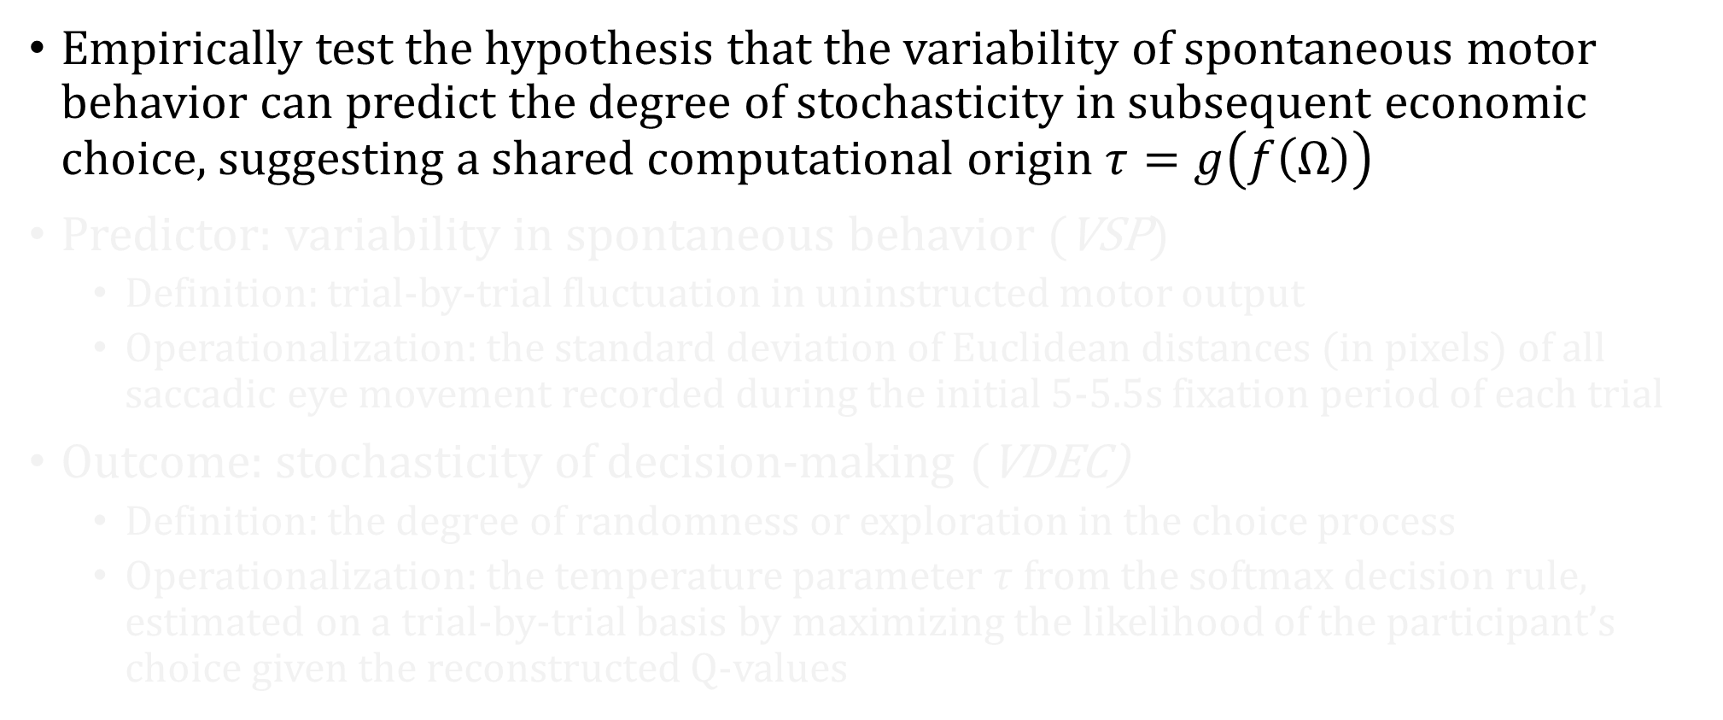
Objectives and variables
Empirically test the hypothesis that the variability of spontaneous motor behavior can predict the degree of stochasticity in subsequent economic choice, suggesting a shared computational origin $τ=g\left(f\left(Ω\right)\right)$
Predictor: variability in spontaneous behavior (VSP)
Definition: trial-by-trial fluctuation in uninstructed motor output
Operationalization: the standard deviation of Euclidean distances (in pixels) of all saccadic eye movement recorded during the initial 5-5.5s fixation period of each trial
Outcome: stochasticity of decision-making (VDEC)
Definition: the degree of randomness or exploration in the choice process
Operationalization: the temperature parameter $τ$ from the softmax decision rule, estimated on a trial-by-trial basis by maximizing the likelihood of the participant’s choice given the reconstructed Q-values

Slide 6
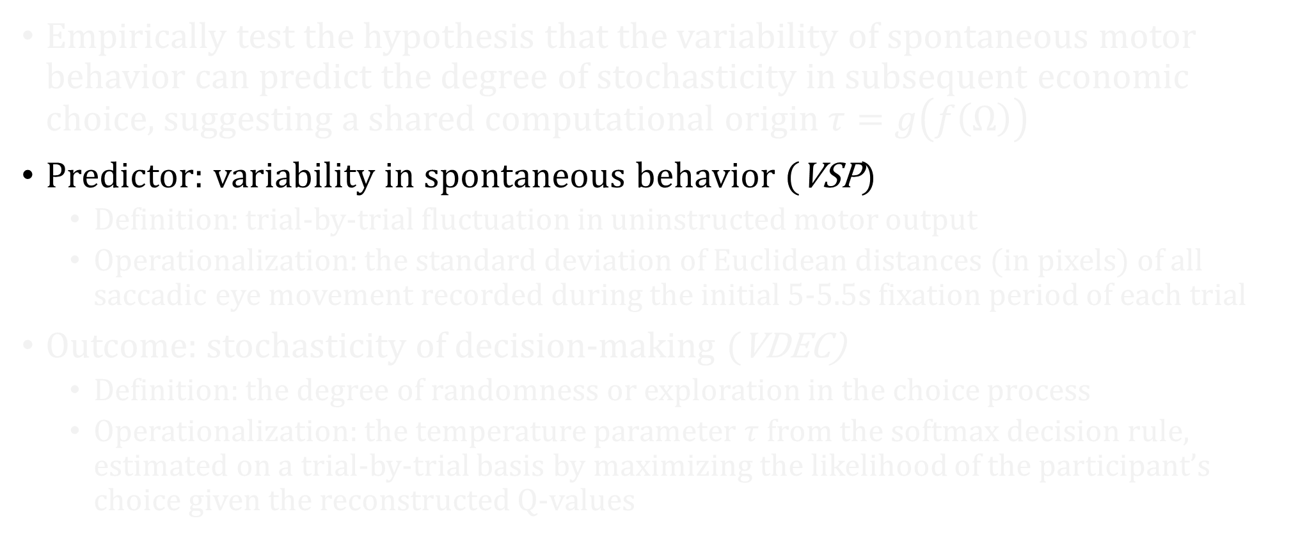
Objectives and variables
Empirically test the hypothesis that the variability of spontaneous motor behavior can predict the degree of stochasticity in subsequent economic choice, suggesting a shared computational origin $τ=g\left(f\left(Ω\right)\right)$
Predictor: variability in spontaneous behavior (VSP)
Definition: trial-by-trial fluctuation in uninstructed motor output
Operationalization: the standard deviation of Euclidean distances (in pixels) of all saccadic eye movement recorded during the initial 5-5.5s fixation period of each trial
Outcome: stochasticity of decision-making (VDEC)
Definition: the degree of randomness or exploration in the choice process
Operationalization: the temperature parameter $τ$ from the softmax decision rule, estimated on a trial-by-trial basis by maximizing the likelihood of the participant’s choice given the reconstructed Q-values

Slide 7
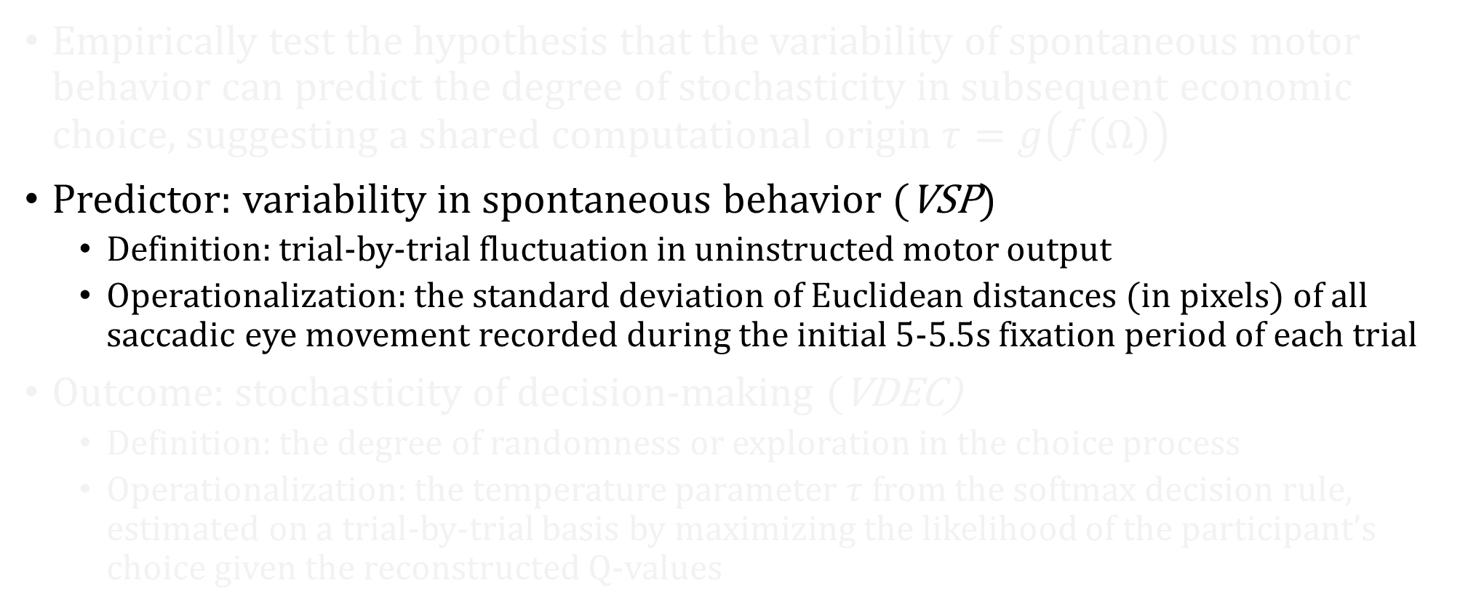
Objectives and variables
Empirically test the hypothesis that the variability of spontaneous motor behavior can predict the degree of stochasticity in subsequent economic choice, suggesting a shared computational origin $τ=g\left(f\left(Ω\right)\right)$
Predictor: variability in spontaneous behavior (VSP)
Definition: trial-by-trial fluctuation in uninstructed motor output
Operationalization: the standard deviation of Euclidean distances (in pixels) of all saccadic eye movement recorded during the initial 5-5.5s fixation period of each trial
Outcome: stochasticity of decision-making (VDEC)
Definition: the degree of randomness or exploration in the choice process
Operationalization: the temperature parameter $τ$ from the softmax decision rule, estimated on a trial-by-trial basis by maximizing the likelihood of the participant’s choice given the reconstructed Q-values

Slide 8
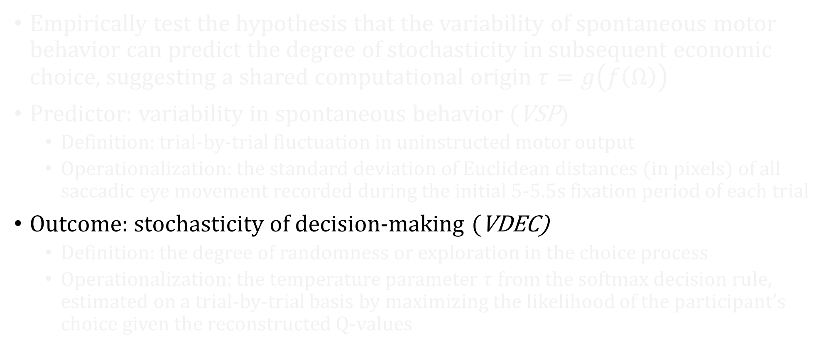
Objectives and variables
Empirically test the hypothesis that the variability of spontaneous motor behavior can predict the degree of stochasticity in subsequent economic choice, suggesting a shared computational origin $τ=g\left(f\left(Ω\right)\right)$
Predictor: variability in spontaneous behavior (VSP)
Definition: trial-by-trial fluctuation in uninstructed motor output
Operationalization: the standard deviation of Euclidean distances (in pixels) of all saccadic eye movement recorded during the initial 5-5.5s fixation period of each trial
Outcome: stochasticity of decision-making (VDEC)
Definition: the degree of randomness or exploration in the choice process
Operationalization: the temperature parameter $τ$ from the softmax decision rule, estimated on a trial-by-trial basis by maximizing the likelihood of the participant’s choice given the reconstructed Q-values

Slide 9
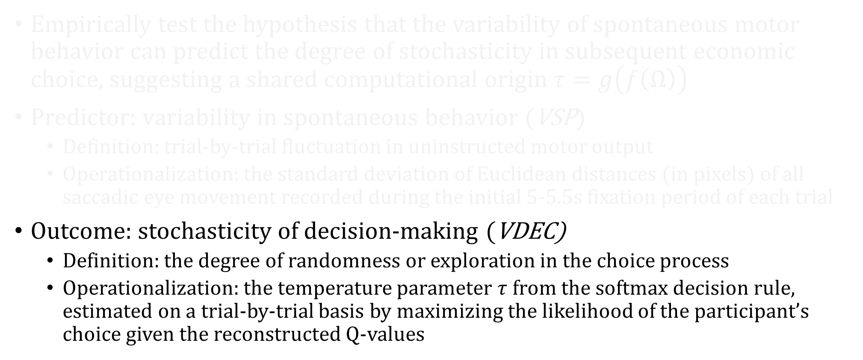
Objectives and variables
Empirically test the hypothesis that the variability of spontaneous motor behavior can predict the degree of stochasticity in subsequent economic choice, suggesting a shared computational origin $τ=g\left(f\left(Ω\right)\right)$
Predictor: variability in spontaneous behavior (VSP)
Definition: trial-by-trial fluctuation in uninstructed motor output
Operationalization: the standard deviation of Euclidean distances (in pixels) of all saccadic eye movement recorded during the initial 5-5.5s fixation period of each trial
Outcome: stochasticity of decision-making (VDEC)
Definition: the degree of randomness or exploration in the choice process
Operationalization: the temperature parameter $τ$ from the softmax decision rule, estimated on a trial-by-trial basis by maximizing the likelihood of the participant’s choice given the reconstructed Q-values

Slide 10


Experimental design
+
Baseline recording, during calibration
+
+
Late!
50
ITI 5-5.5s
5s
1-1.5s
>5s
2-3s
3-3.5s
VSP measurement
Joystick input
Random gaussian walk
Modified from (Stojić et al., 2020)

Slide 11
Experimental design
Participants: 30 (15 male), university participant pool with normal or normal-corrected vision, no pharmacological intervention.
Structure: 100 trials, preceded by an instruction screen + 10 guided tutorial-trials
Apparatus: Desk-mounted eye-tracker (EyeLink 1000) records gaze data at 500 Hz. Responses captured with a two-button joystick
Stimuli: Two visually distinct symbols (letters from the Glagolitic alphabet) will be presented on the left and right sides of the screen

Slide 12
Reward structure
Rewards are given in Zenny (fictional currency)
Independent Gaussian random walks for each option
Walks are bounded from 0 to 100 Zenny
Starting values are μ = 50, δ = 5
“Based on Zenny won, you’ll be rewarded with CLP. The more Zenny you win, the more CLP you earn.”
For your participation: $5000

Slide 13
Experimental design
Calibration
Training
Measurements
Compensation
Participant is assigned to a computer
Informed consent approval
Eye tracker calibration
Task verbal explanation
Task written explanation
Task active tutorial
Q&A
Isolated chamber measurements
Give monetary reward to participant

Slide 14
Hypothesis
The variability of spontaneous saccadic movements (VESP), measured during the initial fixation period of a trial, will positively and significantly predict the stochasticity of the subsequent economic choice (VDEC), as quantified by the SoftMax temperature parameter τ.

