Slide 1
A generalized problem-solving algorithm for physical and abstract spaces Luis Luarte
Notes:
Use real-life screenshots
Use clear instructions
Redo with grayscale
Be super clear with the lab instructions
Add type of pilots to add and confirm the validity of the task key parameters

Slide 2
Conceptual model
Postulate I: universal algorithm
Exploitation
Leverage current knowledge.
Maximize immediate returns.
Exploration
Gather new info.
Improve future returns.
Adaptive behavior under uncertainty
Postulate II: isomorphism
Physical foraging
Abstract foraging
Shared structure, parameters

Slide 3
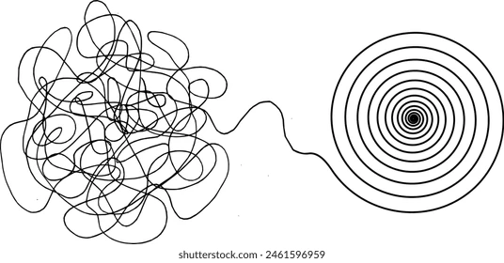
Bio-behavioral model
Step I
Reward prediction error
Variability controller
Spontaneous behavior
Functional process/module
Noise in motor and cognitive systems
Step II
Reward prediction error
Physical
Variability controller
Spontaneous behavior
Abstract
Explore/Exploit

Slide 4
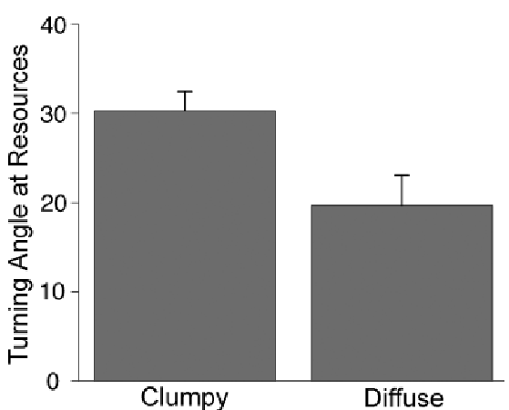
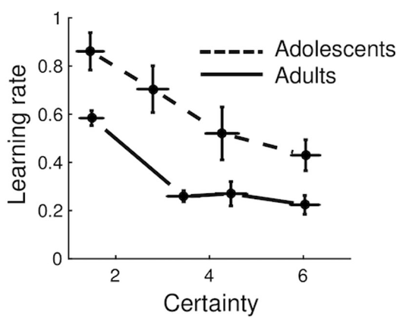
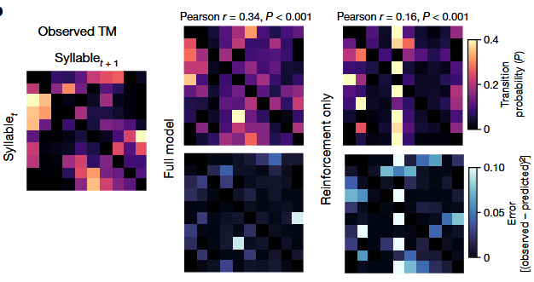
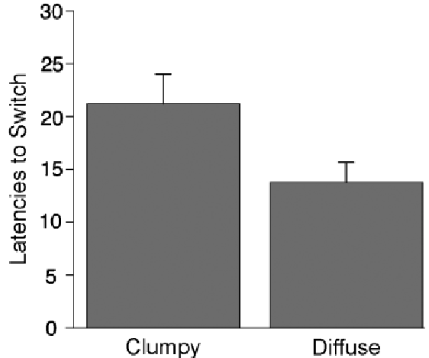
Bio-behavioral model empirical evidence
A.
B.
C.
Physical
Abstract
(Jepma et al., 2020)
(Markowitz et al., 2023)
(Hills et al., 2008)

Slide 5
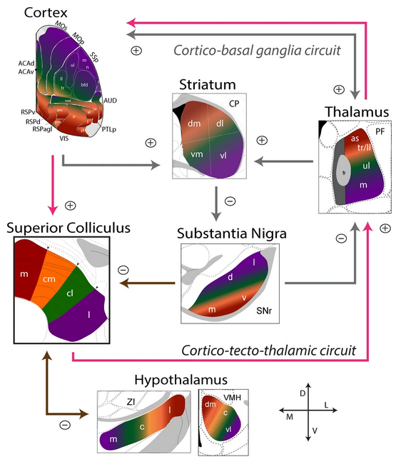
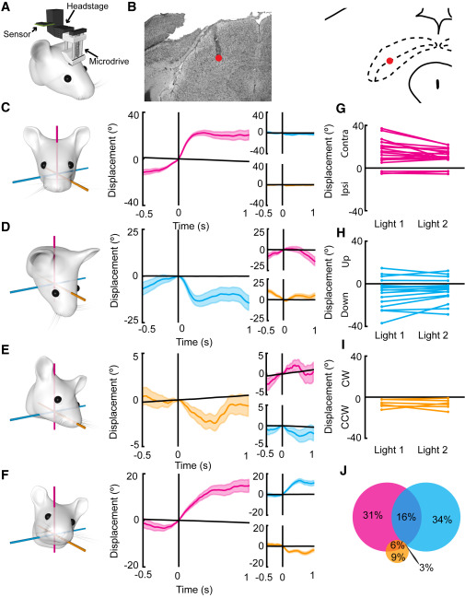
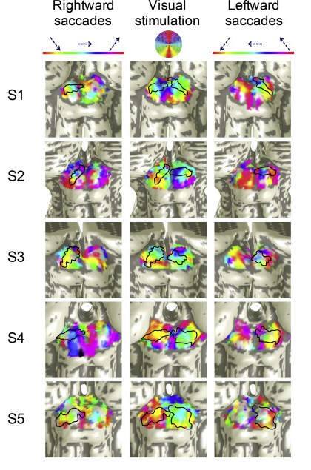
Bio-behavioral model empirical evidence
A.
B.
C.
(Benavidez et al., 2021)
(Wilson et al., 2018)
(Savjani et al., 2018)

Slide 6
Objective
Determine if the computational architecture that governs the exploration-exploitation balance in abstract foraging is isomorphic to the architecture governing foraging. This is tested by analyzing whether the key behavioral and biological variables are correlated across the two domains.

Slide 7
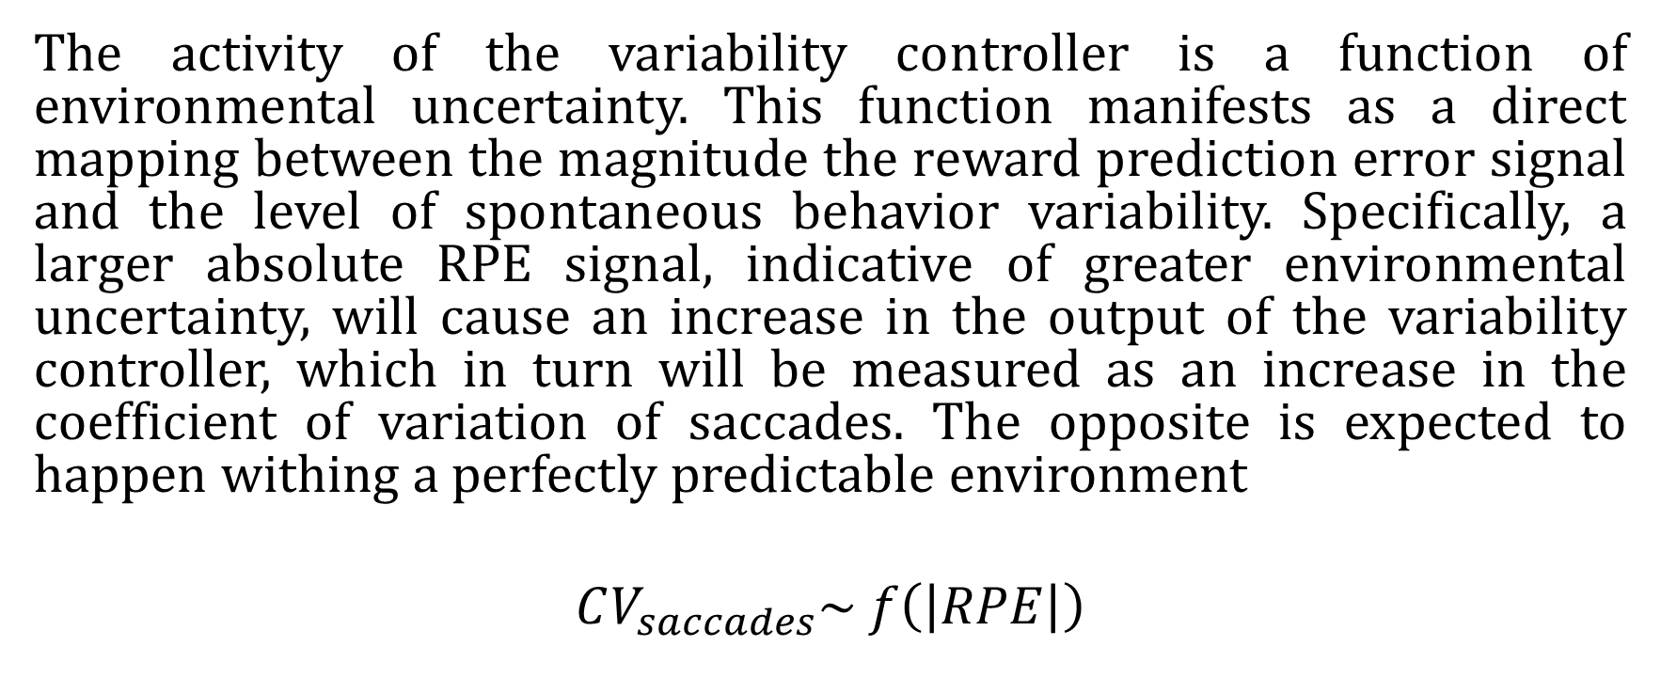
Hypothesis
The activity of the variability controller is a function of environmental uncertainty. This function manifests as a direct mapping between the magnitude the reward prediction error signal and the level of spontaneous behavior variability. Specifically, a larger absolute RPE signal, indicative of greater environmental uncertainty, will cause an increase in the output of the variability controller, which in turn will be measured as an increase in the coefficient of variation of saccades. The opposite is expected to happen withing a perfectly predictable environment
$$CV_{saccades}\sim f\left(\left|RPE\right|\right)$$

Slide 8
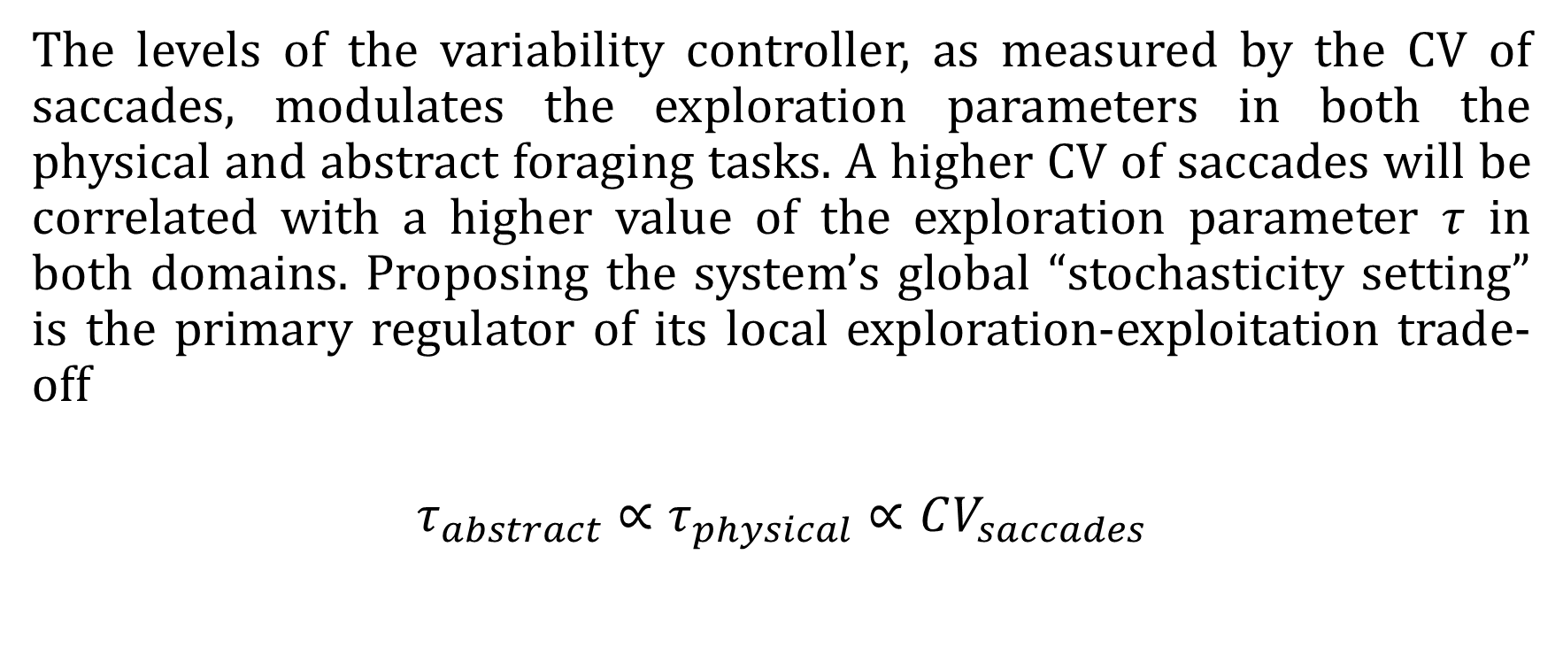
Hypothesis
The levels of the variability controller, as measured by the CV of saccades, modulates the exploration parameters in both the physical and abstract foraging tasks. A higher CV of saccades will be correlated with a higher value of the exploration parameter $τ$ in both domains. Proposing the system’s global “stochasticity setting” is the primary regulator of its local exploration-exploitation trade-off
$$τ_{abstract}∝τ_{physical}∝CV_{saccades}$$

Slide 9
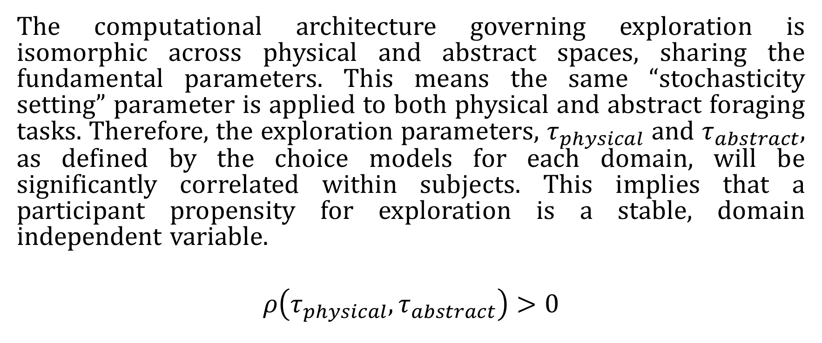
Hypothesis
The computational architecture governing exploration is isomorphic across physical and abstract spaces, sharing the fundamental parameters. This means the same “stochasticity setting” parameter is applied to both physical and abstract foraging tasks. Therefore, the exploration parameters, $τ_{physical}$ and $τ_{abstract}$, as defined by the choice models for each domain, will be significantly correlated within subjects. This implies that a participant propensity for exploration is a stable, domain independent variable.
$$ρ\left(τ_{physical}, τ_{abstract}\right)>0$$

Slide 10



Hypothesis
$$ρ\left(τ_{physical}, τ_{abstract}\right)>0$$
Reward prediction error
Variability controller
Physical
Spontaneous behavior
Abstract
$$CV_{saccades}\sim f\left(\left|RPE\right|\right)$$
$$τ_{abstract}∝τ_{physical}∝CV_{saccades}$$

Slide 11
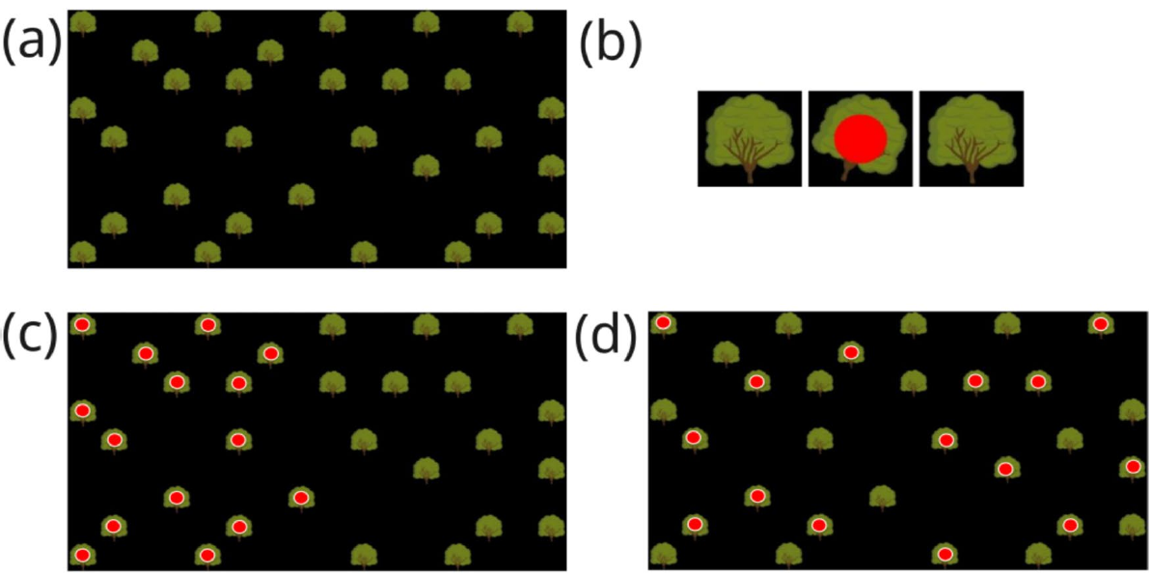
Experimental design (physical)
+
ITI 5-5.5s
Saccades/ERP measurement
~15s
- After visit, a visual cue (fade) is integrated to aid memory
10 ms. of gaze sample within a tree hit box, shakes the tree
Reward is binary, red dot or no red dot
(Hills et al., 2008)
Notes:
Add cognitive interview to determine task parameters (5-8 participants for pilot)
Add break between two RPE levels
Think: abstract stimuli
Think instruction

Slide 12
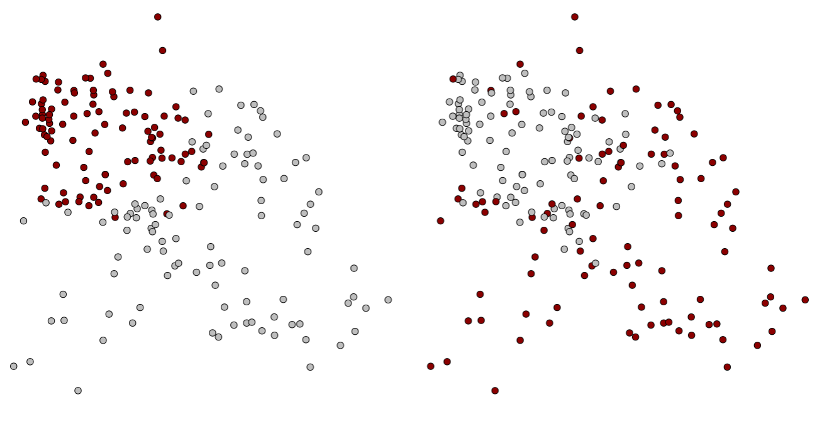

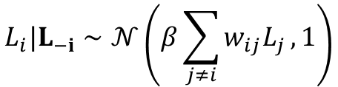

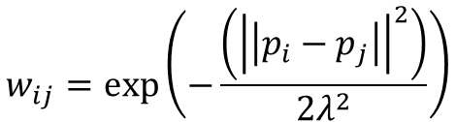




Task parametrization (physical)
Reward
Position
$$L_{i}|L_{−i}∼𝒩\left(β\sum_{j≠i}{w_{ij}L_{j}},1\right)$$
$$p_{i}=p_{i−1}+δ_{i}$$
$$β=100$$
$$β=0.1$$
$$δ_{i}=Φ⋅δ_{i−1}+ε_{i}$$
$$w_{ij}=\exp\left(−\frac{\left({\left|\left|p_{i}−p_{j}\right|\right|}^{2}\right)}{2λ^{2}}\right)$$
$$ε_{i}∼𝒩\left(0,Σ_{ε}\right)$$
$$Φ=\left(\begin{matrix}φ & 0 \\ 0 & φ\end{matrix}\right)$$
Truncate for n highest ranked rewards
Low RPE
High RPE

Slide 13


Experimental design (abstract)
+
Baseline recording, during calibration
+
+
Late!
0/1
ITI 5-5.5s
5s
1-1.5s
>5s
2-3s
3-3.5s
Saccades/ERP measurement
Joystick input
Modified from (Stojić et al., 2020)

Slide 14
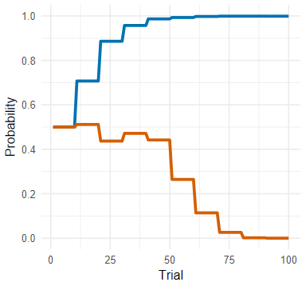
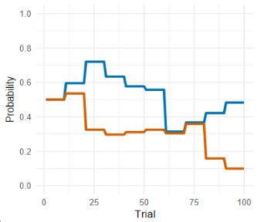

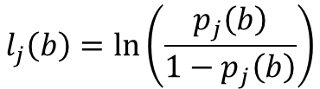





Task parametrization (abstract)
Low RPE
Reward
Position
$$l_{j}\left(b\right)=\ln\left(\frac{p_{j}\left(b\right)}{1−p_{j}\left(b\right)}\right)$$
$$∅$$
$$φ= 1$$
$$δ_{j}\left(b+1\right)=φ⋅δ_{j}\left(b\right)+ε_{j}, \text{where} ε_{j}∼𝒩\left(0,σ_{p}^{2}\right)$$
High RPE
$$l_{j}\left(b+1\right)=l_{j}\left(b\right)+δ_{j}\left(b+1\right)$$
$$p_{j}\left(b+1\right)=\frac{1}{1+e^{−l_{j}\left(b+1\right)}}$$
$$φ=0.1$$
$$R_{j}\left(t\right)∼\text{Bernoulli}\left(p_{j}\left(t\right)\right)$$
Notes:
Add cognitive interview for this parametrization again

Slide 15











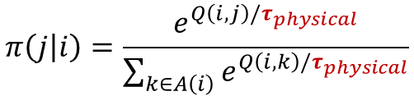






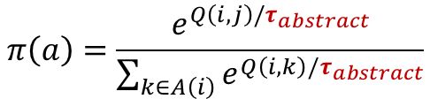

Behavioral variables definition
Decision variability (physical)
Decision variability (abstract)
$$π\left(j | i\right)=\frac{e^{Q\left(i,j\right)/τ_{physical}}}{\sum_{k∈A\left(i\right)}{e^{Q\left(i,k\right)/τ_{physical}}}}$$
$$π\left(a\right)=\frac{e^{Q\left(i,j\right)/τ_{abstract}}}{\sum_{k∈A\left(i\right)}{e^{Q\left(i,k\right)/τ_{abstract}}}}$$
$$C\left(i, j\right)=\left|\left|p_{i}−p_{j}\right|\right|$$
$$Cost_{t} =\max_{Q}{K} − Q\left(A_{t}\right)$$
$$i$$
$$j$$
$$i$$
$$j$$
$$A\left(i\right)←\{k∣k∈\{1,…,N\} \text{and} k∉Visited\}$$
$$A\left(i\right)←\{k∣k∈\{i, j\}\}$$
$$δ_{t}←R_{t}−Q\left(A_{t}\right)$$
$$Q\left(i, j\right)=U\left(j\right)−C\left(i, j\right)$$
$$Q\left(A_{t}\right)←Q\left(A_{t}\right)+α⋅δ_{t}$$

Slide 16
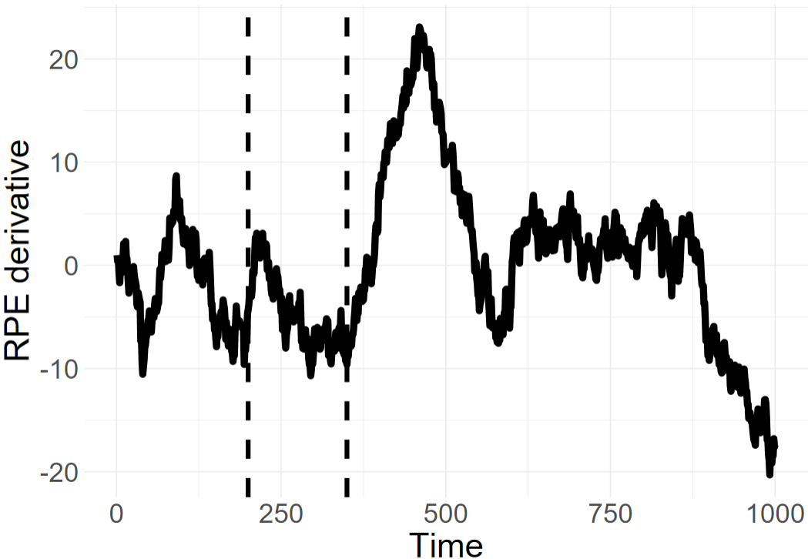
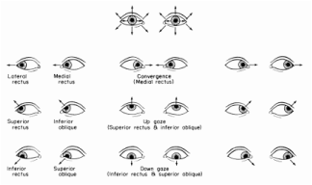

Biological variables definition
RPE signal
$$μV\sim \left(Time, RPE, by=Domain\right)+\left(Time, by=Domain\right)+\left(\left(Time\right)\right|Participant)+(RPE|Participant)$$
"Does the computational RPE effectively modulate the ERP waveform, and can we specifically see this effect within the canonical 200–350 ms time window of the FRN?"
Spontaneous behavior variability
$$CV_{saccades}=\frac{σ_{saccades}}{μ_{saccades}}$$

Slide 17

Model definition
Step I
Reward prediction error
Variability controller
Spontaneous behavior
$$\left(1\right) CV_{saccades}\sim \left(RPE, by=Domain\right)+(1|RPE)$$
$$\left(2\right) FRN_{mean amplitude}\sim RPE⋅Domain+\left(1+RPE \right| Participant)$$
Positive control
$$\left(3\right) CV_{saccades} \sim \left(FRN_{amplitude}, by=Domain\right)+\left(RPE, by=Domain\right)$$
Step II
Physical
Variability controller
Spontaneous behavior
Abstract
$$Θ \sim {CV}_{saccades}⋅θ_{type}⋅Domain+\left(1+CV_{saccades} \right|Participant)+(1| Domain:Participant)$$
$$Θ=\{τ_{abstract}, τ_{physical}\}$$

Slide 18
Analysis definition
Analysis I
RL model or FRN derived RPE as independent variable
Per domain (physical, abstract)
Per controls
Analysis II
RPE taken a categorial variable with two level (low, high)
Per domain (physical, abstract)
RL model or FRN derived RPE as dependent ~ RPE categorical (positive control)
Per controls
Analysis III
RL model or FRN derived RPE as independent within RPE categorial two-levels (low, high)
Per domain (physical, abstract)
Per controls

Slide 19
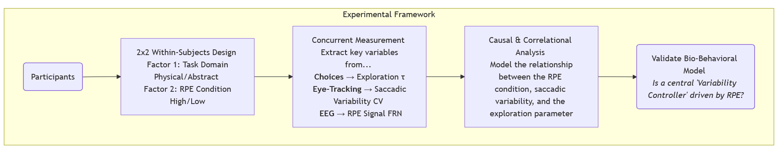
Experimental setup

Slide 20
Hypothesis
$$ρ\left(τ_{physical}, τ_{abstract}\right)>0$$
Reward prediction error
Variability controller
Physical
Spontaneous behavior
Abstract
$$CV_{saccades}\sim f\left(\left|RPE\right|\right)$$
$$τ_{abstract}∝τ_{physical}∝CV_{saccades}$$

Slide 21
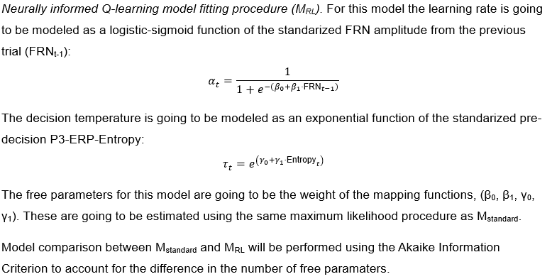
Extras

Slide 22
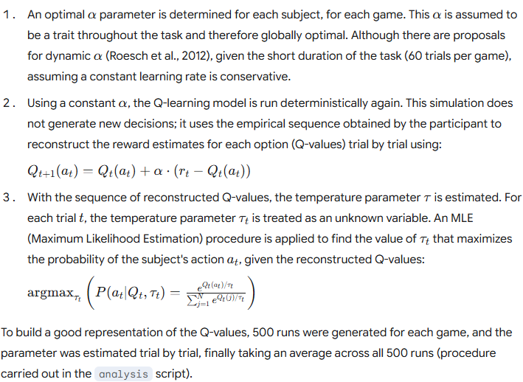
Extras

