Slide 1



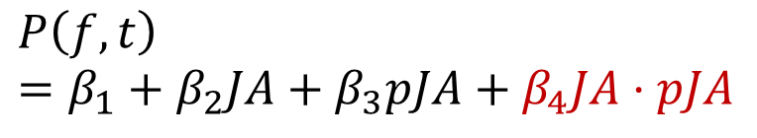


Building a hypothesis
Cognitive analysis
Hypothesis testing
Functional decomposition
Temporal dependance
$$A=\{f_{attn}, f_{ment}, …, f\{⋅\}\}$$
$$P\left(f, t\right)=β_{1}+β_{2}JA+β_{3}pJA+β_{4}JA⋅pJA$$
$$P_{JA}≔{\{f}_{attn},f_{ment}\}⊂A$$
Biological signature
Dedicated regressor
$$f_{ment}↦P_{β}\left(TPJ\right)$$
$$P\left(f, t\right)=β_{1}+β_{2}JA_{first}+β_{3}JA$$
$$f_{attn}↦Nc_{ERP}$$

Slide 2
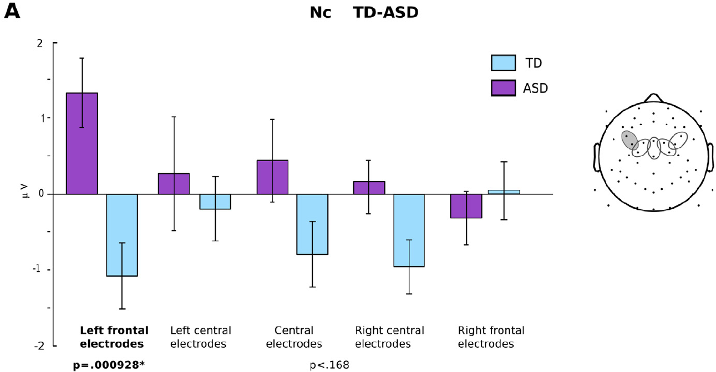


Positive controls, and first differences
Biological signature
$$f_{ment}↦P_{β}\left(TPJ\right)$$
$$f_{attn}↦Nc_{ERP}↑ASD↓TD$$
Behavior was similar between TD and ASD

Slide 3
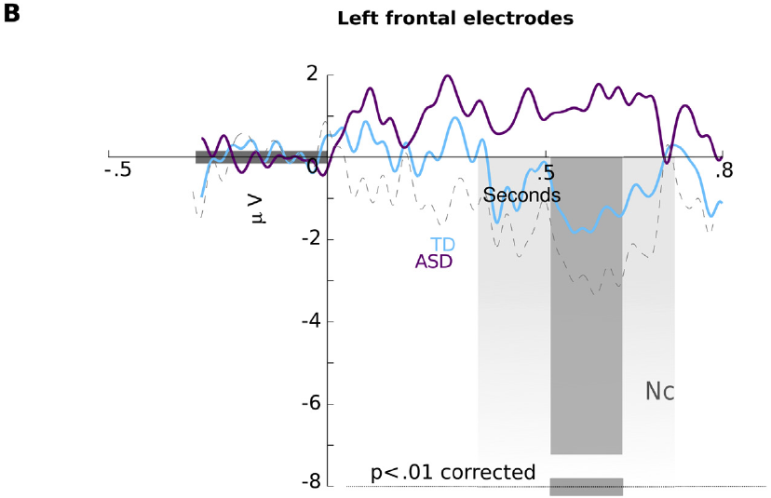
ERP signal differs precisely at Nc component
Biological signature
$$f_{ment}↦P_{β}\left(TPJ\right)$$
$$f_{attn}↦Nc_{ERP}↑ASD↓TD$$

Slide 4
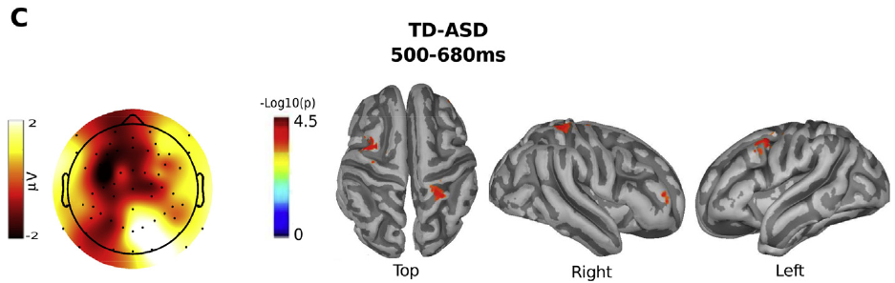

Source localization of Nc component differences
Biological signature
$$f_{ment}↦P_{β}\left(TPJ\right)$$
$$f_{attn}↦Nc_{ERP}↦Source$$

Slide 5
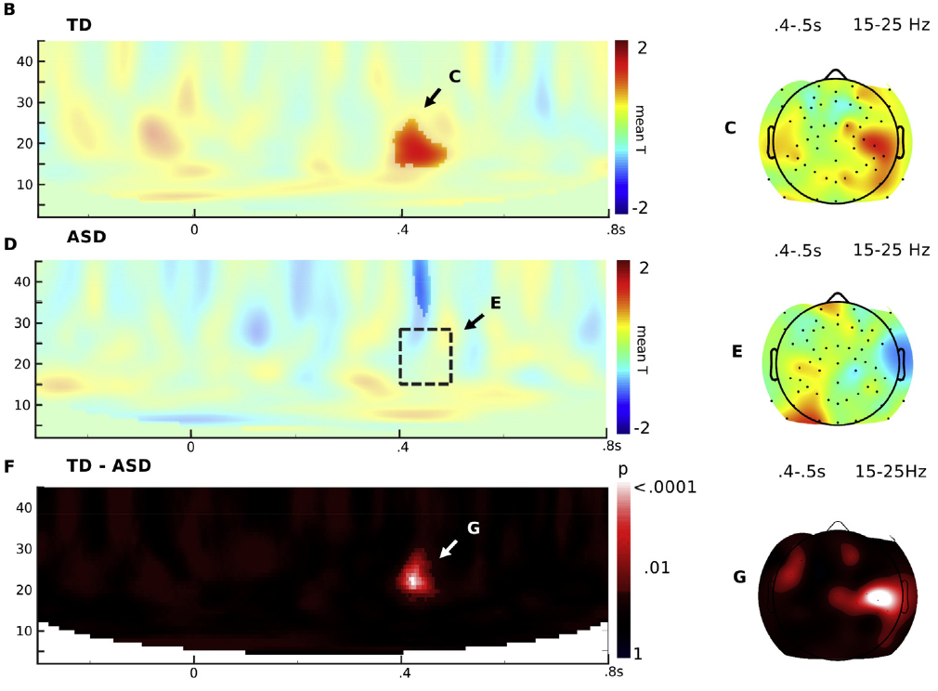
Beta power modulation in JA
Biological signature
$$f_{ment}↦P_{β}\left(TPJ\right)$$
$$f_{attn}↦Nc_{ERP}↦Source$$

Slide 6
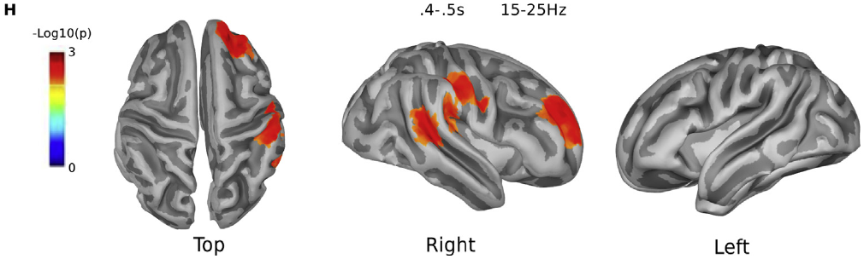

Source localization of beta power modulation differences
Biological signature
$$f_{ment}↦P_{β}\left(TPJ\right)↦Source$$
$$f_{attn}↦Nc_{ERP}↦Source$$

