Slide 1

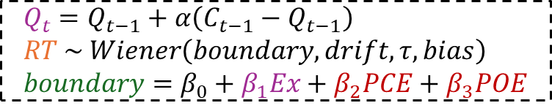

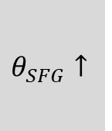

Model recap
Cognitive control model
Neurobiological implementation
Conflict expectation
Behavioral adaptation
fMRI
SFG
IFJ
Speed/Accuracy
Representation
Error
Computational model
TMS-EEG
SFG stimulation
$$θ_{SFG}↑$$
$$Q_{t}=Q_{t−1}+α\left(C_{t−1}−Q_{t−1}\right) \\ RT \sim Wiener\left(boundary, drift,τ, bias\right) \\ boundary=β_{0}+β_{1}Ex+β_{2}PCE+β_{3}POE$$
Gain-of-function (sufficiency)
$$θ_{SFG}↑$$
$$β_{1}Ex_{SFG}↑$$
Conflict expectation
Behavioral proxy
Speed/accuracy proxy
Actual conflict
$$β_{1}Ex_{IFJ}\sim$$
Specificity (necessity)

Slide 2
Behavioral models (Amaru)
Why model reaction times?
Controls
Sequence dependance
Inherent to cognitive CONTROL
Nested process
What does M2 and M3 mean?
Why RT can be homologable to decisión boundary?
Cognitive control
What is expectation
What does adaptation mean here?

Slide 3
Experimental setup (Juan)
Description of the experimental setup
Logical sequence (Behavior -> fmri -> tms+eeg)

Slide 4
FMRI derived neurobiological mechanism (Caro)
Explain fig 1 a
How were models specified (DIC, LOOIC)
Bayesian model coefficient interpretation
Why fMRI now?
How TF did they found PFC as relevant?
The circuit of conflict adaptation

Slide 5
Causal derivation (gain-of-function, specificity) (Mariana)
Logic flow of causality

Slide 6
Proposed mechanisms (Jorge)
Read A, B, C (and what does this mean)
TMS promotes theta oscillation in SFG

