Slide 1
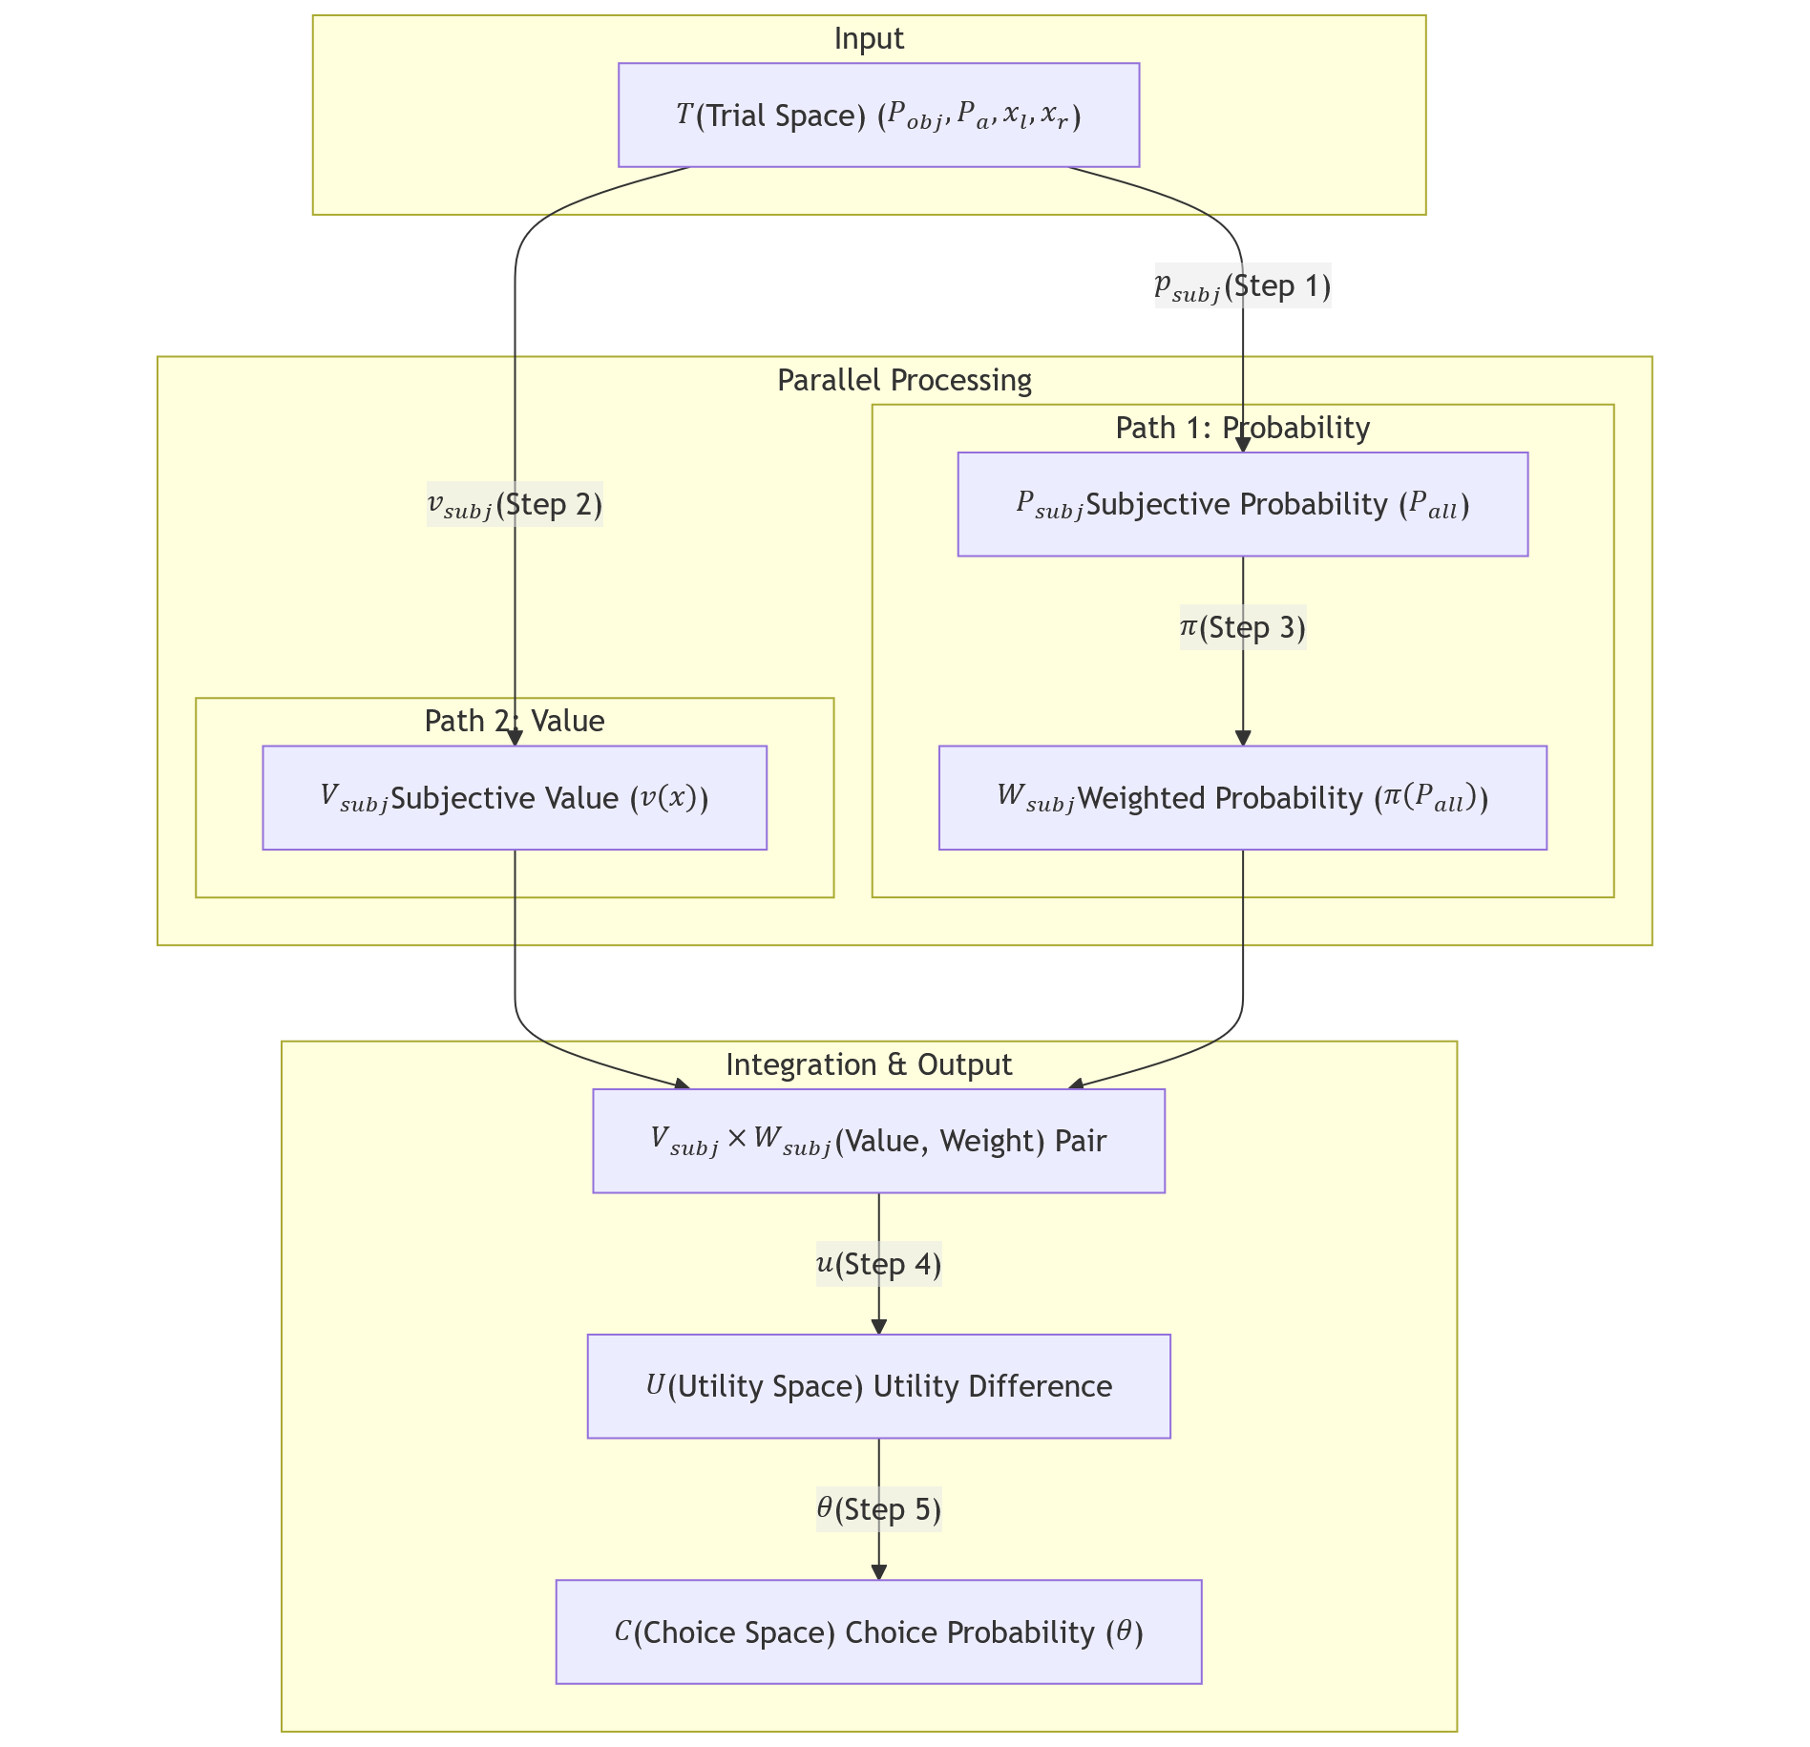

Slide 2
Amaru: intro

Slide 3
Juan: prospect theory + connect the problem

Slide 4
Amaru: model fits

Slide 5
LL: recap

Slide 6
Mariana: methods

Slide 7
Caro: figure 2, 3

Slide 8
LL: recap

Slide 9
Jorge: figure 4, 5A

Slide 10
LL: recap

Slide 11
Caro: figure 5B, 5C

Slide 12
LL: recap

Slide 13
Jorge: figure 6A, 6B

Slide 14
Caro: figure 6C

Slide 15
LL: recap

