Slide 1



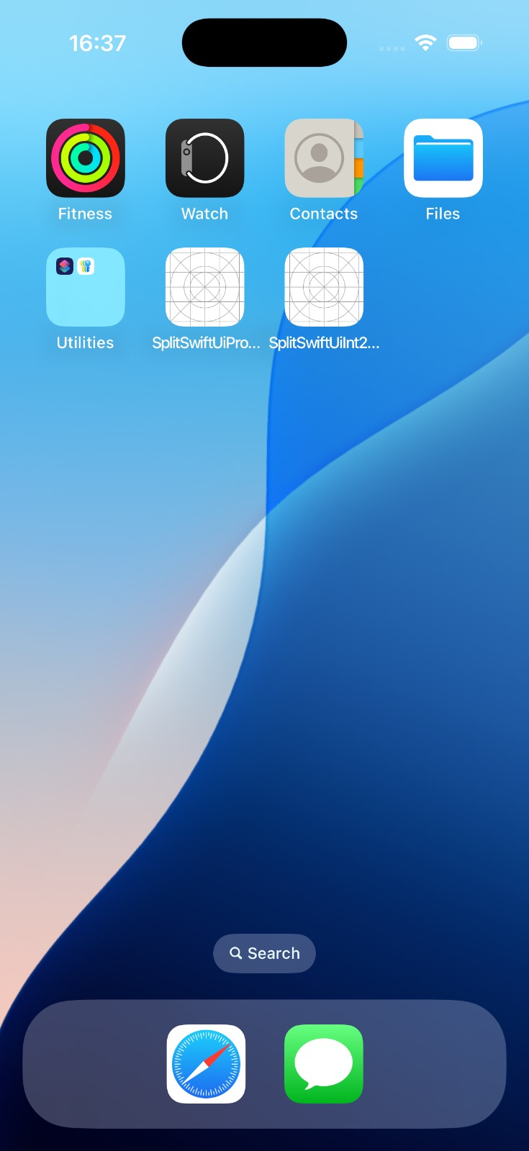
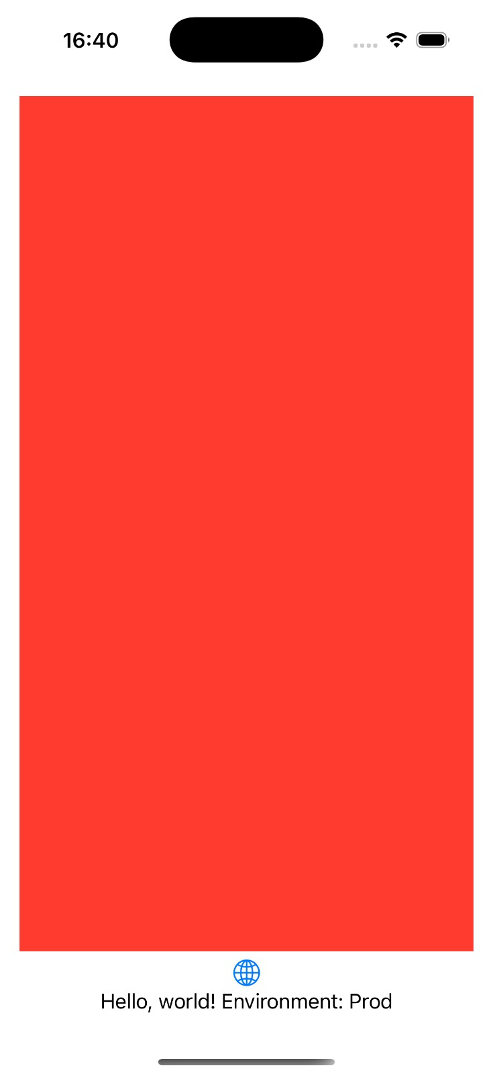
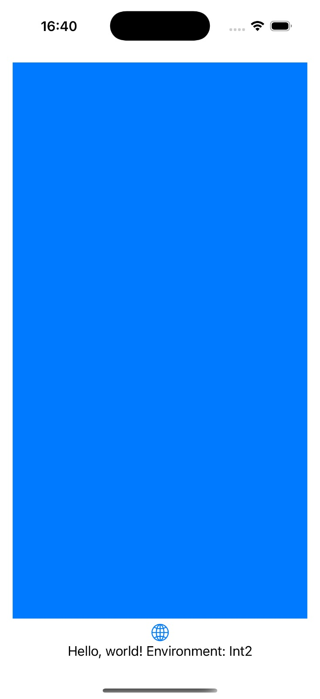

Split Build Settings – SwiftUI – Xcode 16.2

Slide 2



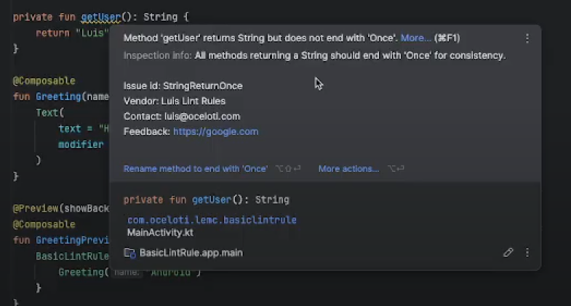
Create a custom method level Lint rule - Android

Slide 3




Create a custom method level Lint rule - Android

