Slide 1

Penetration Testing Methodology

Slide 2
WARNING You will be learning potentially dangerous techniques in this course. By continuing the beyond this point you agree that all the knowledge gained will be used in an ethical and safe manner. The point of this course is to learn about computer and network security, not to harm people or systems. If you do cause harm, either accidental or intentional, you will be responsible for your actions.

Slide 3
Penetration Testers
Mindset and Motivation

Slide 4
An Ethical Hacker Is…
As an ethical hacker there are two opposite ways of solving problems:
Follow a defined strategy, be thorough, methodical, recording all data, maintaining organization, and improving your process to maximize efficiency
Experimenting, thinking outside the box, being pragmatic, flexible, break habits and don’t think like a traditional IT administrator or developer
You will need to utilize both simultaneously to be a successful penetration tester
Learning to think like an attacker so we can help protect our systems from the threats to our security!

Slide 5
Motivation
Penetration testing is intended to:
Help a system owner get vulnerabilities patched before bad guys exploit them
Manage and reduce risk to a customer, system, or organization
Help make the case for a higher security budget!
Do this all by finding vulnerabilities, validating them through exploitation, and demonstrating the impact
Presenting discoveries in a report
A penetration test ends with a report to the system owner
Report details the risk of all findings and may provide mitigation recommendations
Risk may be explained in business or mission impact, accounting for the value of the assets
May be protecting financial data to physical safety and lives

Slide 6
Case Study
Free Pizza

Slide 7
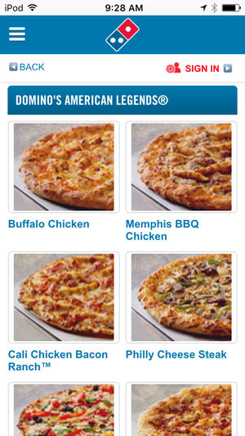
Case Study
Less serious case of Netsec failing
Security researcher darkp0rt found a vuln in the Dominos app
Motivation:
Sometimes Dominos gives the user a $10 coupon. Why?
Impact:
Free pizza, yum
Methodology:
Look at application source code
Use a web proxy (Burp) to monitor traffic
Notice that payment processing is done client side, on the app
MitM https request from app with a bogus CC#, but change
(payment == 'DECLINED') --into--> (payment == 'ACCEPTED')

Slide 8

More Information
Result
Dominos server thought the payment was successful
Dominos delivered the pizza
Full Writeup:
https://darkport.co.uk/blog/dominos-pizza-and-payments/

Slide 9
Vocabulary

Slide 10
Vocabulary
Vulnerability
A weakness in a business process, configuration, operating system, or application that can be used to create unintended and undesired scenarios
These can be considered opportunities for threat events (exploits)
Exploit
A threat event that weaponizes code or an application, to take advantage of a weakness for the purpose of having an intended effect to a target that would otherwise be impossible, unintended by the target owner, or unauthorized
Asset
Something that holds value, whether it’s a system or data, that a threat may be trying to access or compromise
Example: R&D data, Personnel data, credit cards, trade secrets,

Slide 11
Vocabulary
Threat
The thing that can cause our system harm, either adversarial, environmental, or accidental
Threat source
The actor (adversarial) or agent (environmental or accidental) that can trigger certain events which we try to protect against. Threats sources have certain properties such as posture, skill level, resources, intention, and motivation.
Adversarial threat postures:
Insider Threat - Threat posture which is internal to an organization (ex. Employees)
Nearsider Threat - Threat posture which is physically located with your system but has no system access (ex. visitors, maintenance, janitorial)
Outsider Threat - Threat posture which has no physical access. They may try to attack over the internet, wireless, or physical attacks.
Threat Event
The event that is doing some harm against a target. Adversarial could take the form of recon, creating weapons (exploits), attacking, exfiltrating data, or other malicious actions against a target. Non-adversarial examples might be disk failure, employee negligence, or natural disaster.

Slide 12
Vocabulary
Hacking
Using something in a deliberate way to create effects that is against the original intention or design
Ethical Hacking
Authorized behavior and actions to identify vulnerabilities of a system to help improve its security posture
Security Audit
Regulatory requirements for finance, corporate, government, or military systems
A thorough checklist of security controls are measured against both technical implementations, policies, and procedures

Slide 13
Vocabulary -
Penetration Testing vs Vulnerability Analysis
Almost identical terms
Targets an application, a system or server, or an entire network
Required a clearly defined scope - Permission and authorization to attack
Steps of ethical hacking, modeled after adversarial threats, performed against a system to discover vulnerabilities
Same Goal:
Help secure a targeted environment, system, network, or application, by recommending fixes and mitigations

Slide 14
Vocabulary -
Penetration Testing vs Vulnerability Analysis
Penetration Testing
Goes beyond identifying vulnerabilities
Validates findings through exploitation, and provide risk ratings for security findings according to assets and impacts
Vulnerability Analysis and Assessment
Like penetration testing but not as thorough, only part of the pen testing process
Same steps of Pen Testing, taken from Ethical Hacking, but stops at scanning
Typically doesn’t exploit vulnerabilities but still helps secure a target by providing mitigation recommendations

Slide 15
Vocabulary
White Box / Crystal Box Testing
Provided full access to networks and systems, configurations, admin/root access, source code
Usually results in more details and findings, but not as in-depth as Black Box Testing
Black Box Testing
Not provided any details on the target, system, network, application, or asset
May rely on open-source intelligence, social engineering
May target all exposures but will only go in-depth in certain vulns that can be exploited
Most accurate to mimicking outsider real-world attacks

Slide 16
Vocabulary
Blue Team
Team that is working almost entirely on the defensive side but may perform some tests to better secure system
e.g. Automated vulnerability scanning
Team works cooperatively with an organization to defend and protect their systems
Any kind of testing performed would be a White Box Test
Red Team / Teaming
Penetration testing team used to exercise the Blue Team and assess the security and response of an organization
Black Box Testing, acts as an outsider, mirroring real world Tactics, Techniques, and Procedures based off intelligence reports Still authorized but only known to a few people in an organization
May get details for white box testing for intentional planned exercises if the focus is to test the Blue Team in specific controlled situations
May also assess physical security and utilize social engineering
May not assess the entire system or network, only what is exposed to an outsider or nearsider
Provides an incomplete risk assessment of all systems but does a great job of mirroring real-world risk and prioritizing what mitigations and organizational improvements are needed

Slide 17
Comparison
Vulnerability Assessment
White Box
Depth
Black Box
Penetration Testing
Red Team
Breadth

Slide 18
Goal of Penetration Testing
The purpose of a Penetration Test is not for you to get root
This can be your personal goal, your heading, your target
When described in a report, do not write
The purpose of this penetration test was for me to get root...
As a system owner, I wouldn't hire you to just hack me and call it a day. I hire you to help me secure my system by hacking me.
Getting Root, Domain Admin, SYSTEM, etc. is just your objective
It steers your methodology and workflow
Your goal is to help secure the system
By describing and prioritizing flaws and how to fix them
Your findings and analysis become more actionable and meaningful by
demonstrating their impact and validation,
accomplished through exploitation

Slide 19
Methodology
Types of Penetration Tests
Testing Methodologies

Slide 20
Types of Tests
Most tests have:
Type - what does the test target
Category or posture - insider/Blue team/white box or outsider/Red Team/black box
Network tests
The most common and primary focus of this class
Scans the network, protocols, hosts, and services available for vulnerabilities and weaknesses
Typically a look at perimeter security (outsider threat) and/or internal network resources (nearsider and insider threat)
Client-Side tests
Testing the client software – apps, browser, configuration, OS
Web and web application
Testing the perimeter and functionality of internet-facing web resources
Notes:
Client-Side tests
As insiders have access to the internet, run applications, and have other capabilities, we test

Slide 21
Types of Tests, continued
Wireless testing
Assessing the use of wireless networks, encryption, authentication, DoS
Application Security Test
Testing software applications
Static Code Analysis Test
Having the source code available to identify code flaws, errors, looking for Common Weakness Enumeration (CWE - https://cwe.mitre.org/index.html)
Dynamic Analysis Test
Black box approach to application security testing
Debugging the binary, fuzzing memory, exposing sensitive data, looking for flaws and errors to exploit
Complete Red Team tests
Black box, outsider threat-style test
Different because this may include physical security, social engineering, stolen equipment, dumpster diving

Slide 22
Penetration Testing Methodologies
Testing methodologies cover the process of performing different types of pen tests
First - Understanding the attacker
Cyber Kill Chain
Model penetration testing frameworks
Penetration Testing Framework
Penetration Testing Execution Standard
Open Source Security Testing Methodology Manual
National Institute of Standards and Technology 800-115
OWASP Web App Testing Guide
These are not meant to be step-by-step or tool how-to guides
Theory which are then applies to many different situations

Slide 23
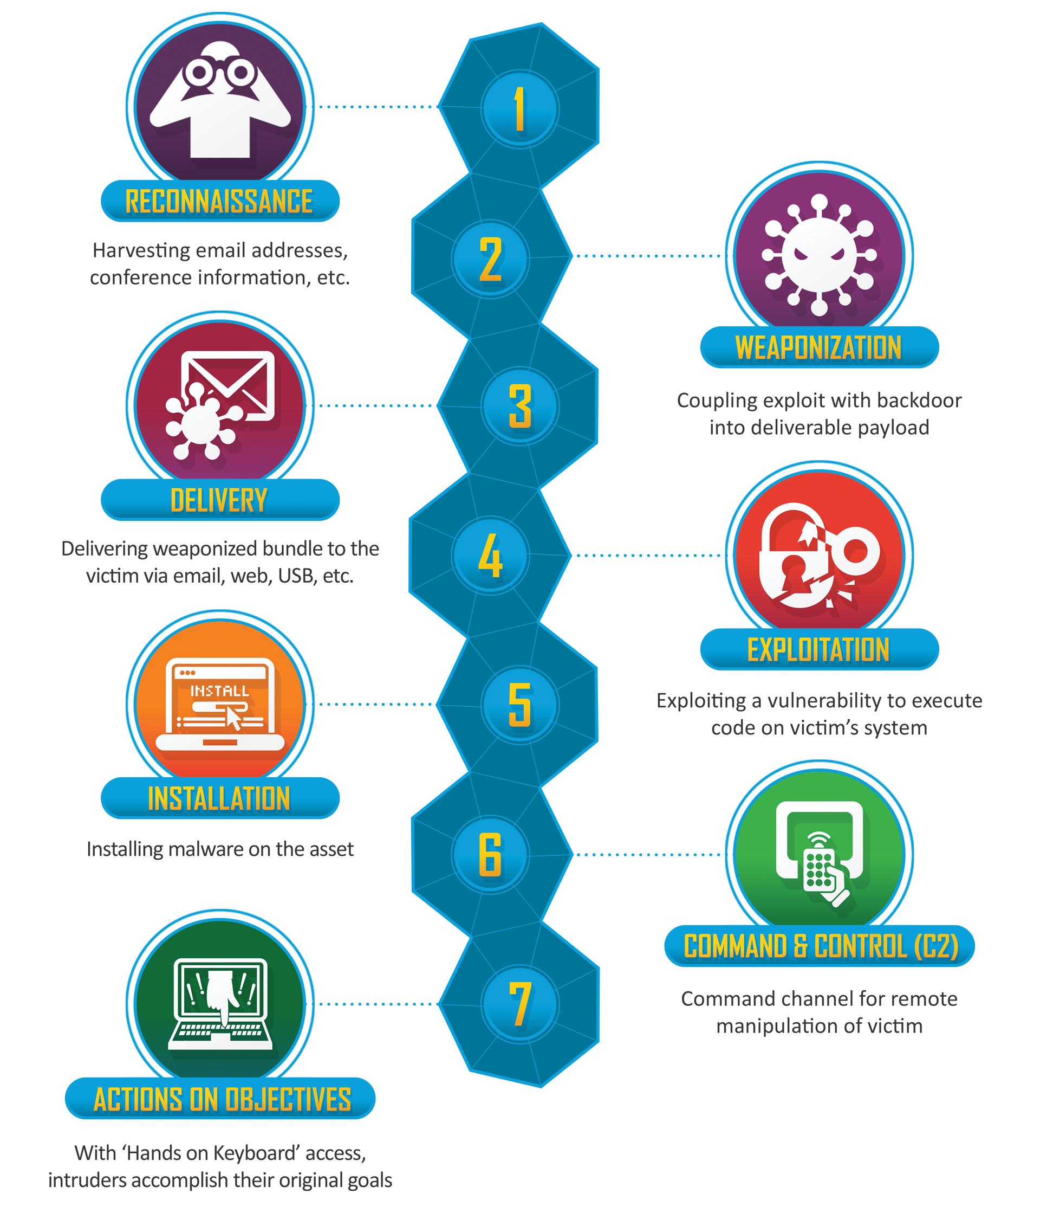
Cyber Kill Chain
https://www.lockheedmartin.com/en-us/capabilities/cyber/cyber-kill-chain.html
Developed by Lockheed Martin
The major steps to adversary compromise
Not exactly the methodology a pen tester wants to follow, but a useful guide
We'll see very similar steps

Slide 24
Penetration Testing Methodologies
Penetration testing is to help secure against real-world threats
By understanding the kill chain an adversary would use, the tester can think more like the attacker
Steps to compromise, such as a kill chain, allow testers to suggest mitigations that stop the kill chain at different steps
Consider this example:
A network has a predisposing condition. It must use a legacy operating system, Windows 2000, since this is the only OS that supports the legacy software applications that it must run.
By knowing that these OS vulnerabilities cannot be patched, we look to other steps in the kill chain to prevent adversary success
Limiting access and uptime, network boundary protection, traffic monitoring
Using the Kill-Chain to think about defense, vulnerabilities may remain, but there will be other mitigations in other steps

