Slide 1
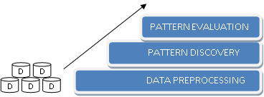
K
K
K
K
K
K
K
DATA MINING
KNOWLEDGE
 |  | PATTERN EVALUATION
 | PATTERN DISCOVERY
DATA PREPROCESSING
3
2
1
D
D
D
D
D
D
DATA

