Slide 1

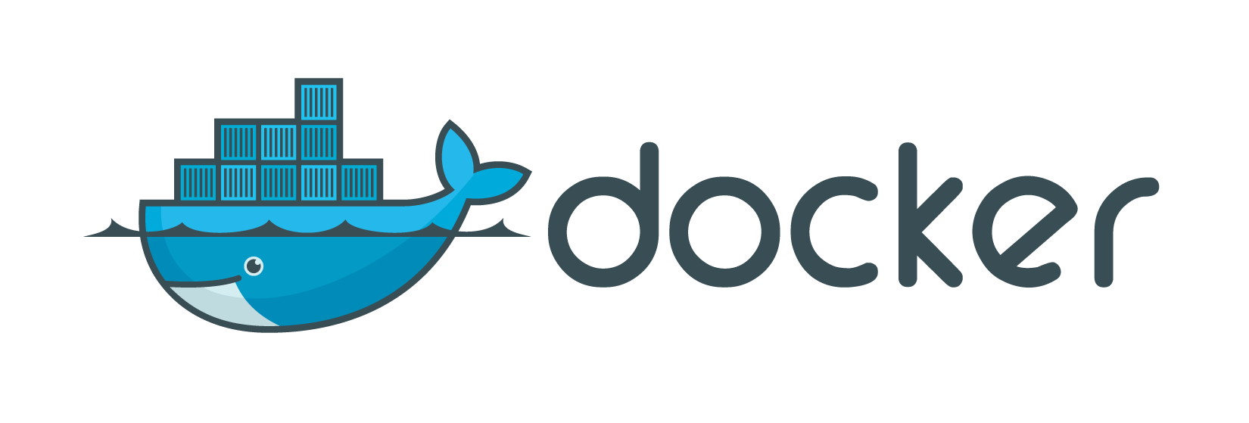
Intermediate
2019-02, by Luís Nabais - https://www.luisnabais.com

Slide 2

Introduction
Who am I?
Hello! My name is Luís Nabais (https://www.luisnabais.com), I’m a Findmore Consulting employee.
I’m currently working on a Findmore’s client company, called Indra, where I work as a DevOps Engineer.
My specialties are Linux, Docker, Jenkins, DevOps and OpenSource.
I’m a Red Hat Certified Engineer and an ITIL Foundations certified professional.
Agenda
All the content is publicly available (slides, code samples, scripts)
Notes
Feel free to interrupt for questions at any time
Please correct me if you think the pace is too fast or too slow.
Welcome to this Findmore Consulting Workshop! Enjoy!

Slide 3
What will we talk about?
Presentation Agenda
Microservices
Images & Dockerfiles
Docker Registry (Hub/Store, custom registry)
Networking
Volumes
Logging
Healthcheck
Interact with Containers
Docker Compose
NOTE: All resources are available at https://github.com/luisnabais-courses/course_docker

Slide 4
Pre-requisites
Nothing! Seriously, you can just listen, understand and try everything later, following the resources on the GitHub address above.
Optional (if you want to follow along, trying the examples live):
A computer with Docker and Docker Compose installed (any operating system works)
An Internet connection
IMPORTANT
Instead of a personal VM or Local Docker installation, you can (and should!) use Play With Docker: https://labs.play-with-docker.com (requires a free Docker Account)

Slide 5
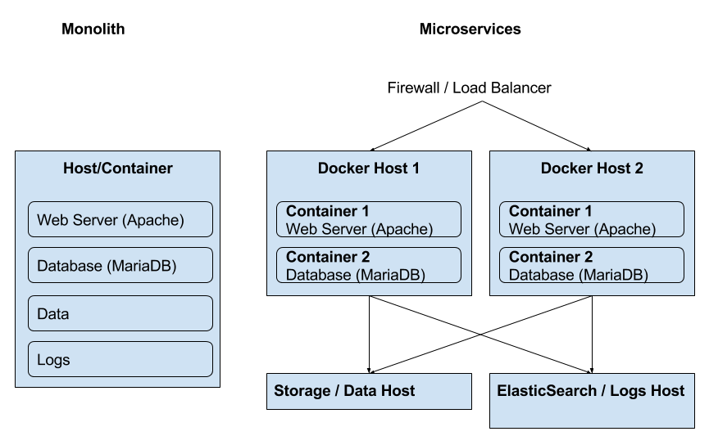
Monoliths vs Microservices

Slide 6
Monoliths vs Microservices
 | Monoliths | Microservices
Pros | Faster initial development Easier integration Easier local deployment | Easier to develop, understand, upgrade and maintain Starts faster Scales individually Easier fault isolation (ex: cpu/memory leaks) Not stuck with any stack
Cons | Stuck with same technology stack Difficult to share with other developers Difficult to scale Difficult to deploy to other environments | Slower initial development

Slide 7
Docker Images & Dockerfile
A Docker Image is a template, whether of a basic operating system, of a microservice, or even of a full service (monolith).
Containers are always created from Docker Images.
Docker Images can be downloaded from a Docker Registry, such as Docker Hub, with pre-built microservices.
Docker allows us to create customized Docker Images, using a definition file, called Dockerfile.
Every Docker Image starts with a Dockerfile. So we can say that a Dockerfile is where everything begins, in Docker.
FROM debian:stretch
LABEL maintainer="Luis Nabais <luis.nabais@findmore.pt>"
RUN apt update && \
apt -y install nginx && \
apt clean
#ADD index.html /var/www/html/
EXPOSE 80
VOLUME /var/html/www
CMD ["nginx", "-g", "daemon off;"]
To create an image with any of these Dockerfiles, run this command on the same folder as the Dockerfile:
$ docker build -t my-nginx-image .
And then, to run the container:
$ docker run -tdi --name my-nginx -p 80:80 my-nginx-image
FROM nginx:1.15.8
LABEL maintainer="Luis Nabais <luis.nabais@findmore.pt>"
RUN apt update && \
apt -y install iputils-ping && \
apt clean

Slide 8
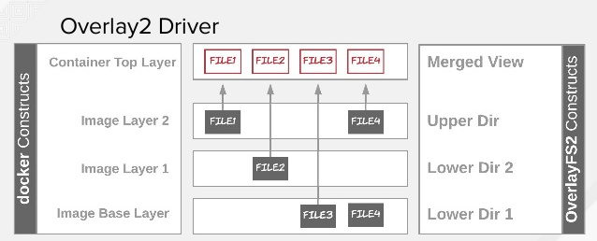
Docker Images & Layers
FROM debian:stretch
LABEL maintainer="Luis Nabais <luis.nabais@findmore.pt>"
RUN apt update && \
apt -y install nginx && \
apt clean
#ADD index.html /var/www/html/
EXPOSE 80
VOLUME /var/html/www
CMD ["nginx", "-g", "daemon off;"]
A Docker image consists of read-only layers each of which represents a Dockerfile instruction. The layers are stacked and each one is a delta of the changes from the previous layer.
$ docker image history my-nginx-image
When we create a new container, we add a new and thin writable layer on top of the underlying stack of layers present in the base docker image. All changes made to the running container, such as creating new files, modifying existing files or deleting files, are written to this thin writable container layer.

Slide 9
Docker Images & Layers
FROM debian:stretch
LABEL maintainer="Luis Nabais <luis.nabais@findmore.pt>"
RUN apt update && \
apt -y install nginx && \
apt clean
#ADD index.html /var/www/html/
EXPOSE 80
VOLUME /var/html/www
CMD ["nginx", "-g", "daemon off;"]
OverlayFS Filesystem
To allow layers on the filesystem, Docker uses a storage driver, called OverlayFS (also known as overlay or overlay2), which is integrated into Linux Kernel. Older driver was AUFS.
OverlayFS is a modern union filesystem, which allow one, usually read-write, directory tree to be overlaid onto another, read-only directory tree. All modifications go to the upper, writable layer. All of them are them read as one.
You can check the default storage driver, with the command:
$ docker info

Slide 10
Docker Images - Dockerfile examples
FROM node:carbon
WORKDIR /usr/src/app
COPY package*.json ./
RUN npm install
COPY . .
EXPOSE 8080
CMD [ "npm", "start" ]
Multi-Stage Builds
Docker also supports multi-stage builds, where the first stage creates a temporary image, which is used to build/compile and the second to integrate what was built, onto a final Docker Image.
FROM maven:3.5.2-jdk-9 AS build
COPY src /usr/src/app/src
COPY pom.xml /usr/src/app
RUN mvn -f /usr/src/app/pom.xml clean package
FROM openjdk:9
COPY --from=build /usr/src/app/target/flighttracker-1.0.0-SNAPSHOT.jar /usr/app/flighttracker-1.0.0-SNAPSHOT.jar
EXPOSE 8080
ENTRYPOINT ["java","-jar","/usr/app/flighttracker-1.0.0-SNAPSHOT.jar"]
FROM openjdk:8-jdk
VOLUME /tmp
COPY build/libs /app
ENTRYPOINT ["java", "-jar", "/app/java-example.jar"]

Slide 11
Docker Registry
What is a Docker Registry? A Docker registry is a centralized storage and distribution system for named Docker images.
Is organized into Docker repositories, where a repository holds all the versions of a specific image. The same image might have multiple different versions, identified by their tags.
Docker Hub
By default, the Docker engine interacts with Docker Hub (https://hub.docker.com), Docker's public registry.
However, it is possible to run on-premise the open-source Docker registry/distribution, as well as a commercially supported version called Docker Trusted Registry. There are other public registries available online.
Docker Hub allows 1 free private image per user, but doesn’t have any limit on pulled (downloaded) images.
There are other pricing plans, as usual.
Pull Image from Docker Hub
$ docker image pull mariadb:10.3.13
Push image to Docker Hub *
$ docker image push repository-name/image-name:tag
Login user to Docker Hub *
$ docker login
* After making sure user is registered on the Docker Hub website

Slide 12
Docker Registry
Custom Docker Registry
A custom Docker Registry allows unlimited private Docker Images, usually on a custom managed infrastructure.
The easiest way to create a Registry is to use the official Docker Registry container, like this:
$ docker image pull registry:2.7.1
$ docker container run -d --name registry -p 5000:5000 registry:2.7.1
There are more external applications which can be downloaded, integrated into existing infrastructures and used as Custom Registries.
List repositories on custom registry
$ curl localhost:5000/v2/_catalog
Pull image from custom registry
$ docker image pull localhost:5000/mariadb:10.3.13
Push image to custom registry *
$ docker image tag mariadb:10.1.13 localhost:5000/mariadb:10.3.13
$ docker image push localhost:5000/mariadb:10.3.13
Login user to custom registry *
$ docker login server-host:server-port
* After making sure user is registered on the Docker Hub website, if it is a private Docker Registry with user registration.

Slide 13
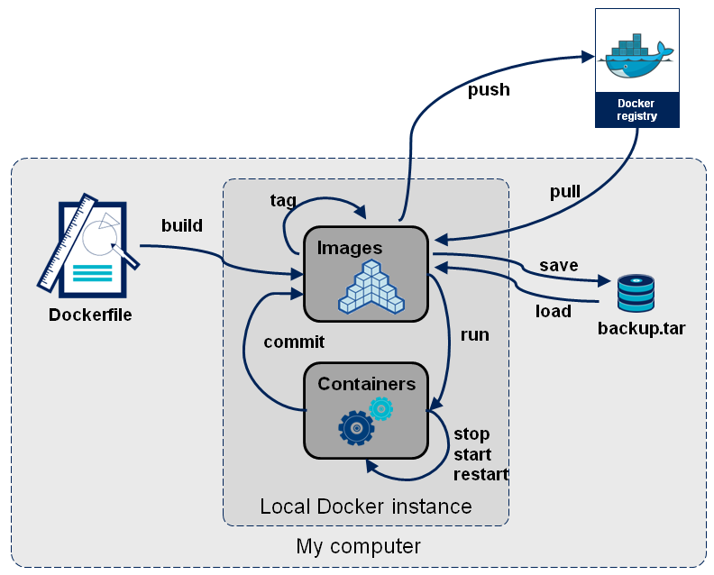
Docker Images Workflow

Slide 14
Docker Networks
Containers need networking to:
communicate with the outside
communicate among themselves
Be isolated from other containers
Be completely isolated
Port exposure
Port Binding
Docker takes care of networks out of the box, as it creates three networks automatically:
$ docker network ls
NETWORK ID NAME DRIVER SCOPE
e22d0e10deb3 bridge bridge local
276b6fb8ee09 host host local
55946e2e5ced none null local
bridge: the default network for all containers
host: this network exactly matches the host network
none: containers connected to this network will only have a loopback interface

Slide 15
Docker Networks - Drivers
Bridge
The default network driver. If no driver is specified, this is the type of network created.
The default bridge network also called “system bridge network” is also the default network for every container if you don’t specify a network.
IMPORTANT: This is not a bridged connection!
The bridge network is a standalone network with its own router (the Docker Engine).
Each container attached to this type of network is assigned its own private IP address which is not reachable from the outside by default. When the container needs to request outer resources it sends packets through the default gateway (the Docker Engine).
Communication from outside to container
To access a container from the outside of the Docker Engine, we need to expose a port on the Docker Host:
$ docker run -tdi --name my-nginx -p 80:80 nginx
Communication between containers on the same default bridge connection
Containers attached to the default bridge connection can communicate by default using IP addresses, but they can’t communicate using DNS.
This handy behavior can be obtained using user-defined bridge networks, which have a feature called automatic service discovery. This feature allows containers to resolve names into IPs of other containers connected to the same network, much like a local DNS server.

Slide 16
Docker Networks - Drivers
Host
This is basically a bridged network, as we usually know it.
It removes network isolation between the container and the Docker host, and use the host’s networking directly, sharing the networking stack with the host.
This means a container exposing port 80 will automatically bind to hostIP:80 (without the need of -p). If the container has no port exposed using the host network is meaningless.
The host network does not connect the container directly to the physical network of the host. The container doesn’t appear as a physical device in the network. The host network is still a classical bridge, it bridges the container to the host rather than the host physical interface.
Macvlan
Macvlan networks are also bridged networks, which allow us to assign a MAC address to a container, making it appear as a physical device on your network.
The Docker daemon routes traffic to containers by their MAC addresses. Using the macvlan driver is sometimes the best choice when dealing with legacy applications that expect to be directly connected to the physical network, rather than routed through the Docker host’s network stack.
None
Disable all networking, except loopback (127.0.0.1).
Usually used in conjunction with a custom network driver, or for some background tasks, like generate a report, or to integrate in CI/CD workflows.

Slide 17
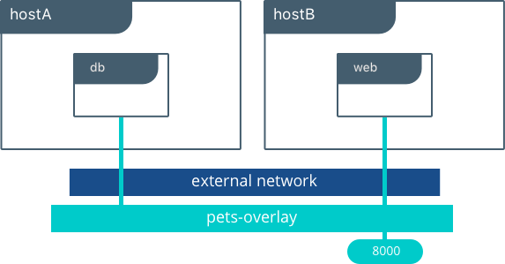
Docker Networks - Drivers
Overlay
Overlay networks connect multiple Docker daemons together and enable swarm services to communicate with each other.
We can also use overlay networks to facilitate communication between a swarm service and a standalone container, or between two standalone containers on different Docker daemons. This strategy removes the need to do OS-level routing between these containers.
Network plugins: You can install and use third-party network plugins with Docker. These plugins are available from Docker Hub or from third-party vendors. See the vendor’s documentation for installing and using a given network plugin.

Slide 18
Docker Networks - User-defined Networks
Creating a User-defined Network
$ docker network create --driver bridge --subnet 172.49.0.0/16 frontend
As bridge is the default driver, the option is not needed in the command.
The subnet is automatically configured, so it’s not mandatory as well.
So the command could just be only:
$ docker network create frontend
Starting a container on a specific network
When containers are created, can be associated with the networks, using the --network flag in the run command.
$ docker run -tdi --name my-nginx --network frontend nginx bash
Assign a network to a running container
$ docker network connect frontend my-nginx
Removing a User-defined Network
$ docker network rm frontend
Inspect a Network
$ docker network inspect frontend
Notes:
TASKS:
Create 2 containers with ping and try to ping between them by name
Talk about conflicts with (mainly automatically generated) subnets - relembrar problema na Indra

Slide 19
Persistent Data
By default, Docker containers do not store persistent data.
Any data written to a container's writable layer will no longer be available once the container stops running. Also, getting data written to a container back out of it for another process can be difficult. To solve the issue of persisting data from a container, Docker has two options.
Bind mounts
A bind mount is a file or folder stored anywhere on the Docker Host filesystem, mounted into a running container.
As the file or folder can exist anywhere on the host filesystem, processes outside of Docker can also modify it. A disadvantage is that it prevents an easy way of integrate with other processes, like backups, as it can be very disorganized, spread among the Host filesystem.
Volumes
Volumes are the preferred way to store persistent data Docker containers create or use. The Docker Host filesystem also stores volumes, similar to bind mounts. However, Docker completely manages them and stores them under a Docker internal directory (/var/lib/docker/volumes, in case of Linux).

Slide 20
Persistent Data
Both provide several useful features for persistent or shared data:
Can be shared and reused among containers.
Changes will not be included when and image is updated.
Persist even if the container itself is deleted.
Allows for troubleshooting (ex: view logs or edit configuration files which prevent service from starting)
Docker never automatically deletes volumes when you remove a container, nor will it “garbage collect” volumes that are no longer referenced by a container.

Slide 21
Persistent Data
Listing volumes
$ docker volume ls
Creating volumes
$ docker volume create nginx-conf
Assign to containers
This option is only available during container creation, using -v or --mount flags: $ docker run -tdi --name my-nginx -v nginx-conf:/etc/nginx/conf.d -p 80:80 nginx
$ docker run -tdi --name my-nginx --mount type=volume,source=nginx-conf,target=/etc/nginx/conf.d -p 80:80 nginx
Bind mounts can also be assigned to containers during creation, using the same -v or --mount flags:
$ docker run -tdi --name my-nginx -v /home/user/docker-data/nginx-conf:/etc/nginx/conf.d -p 80:80 nginx
$ docker run -tdi --name my-nginx --mount type=bind,source=/home/user/docker-data/nginx-conf:,target=/etc/nginx/conf.d -p 80:80 nginx
-v or --mount?
Using -v or --mount is a personal choice option, none is deprecated. The --mount flag is more explicit and easier to read and required for specific volume drivers, but using -v for local volumes is easier to manage.
Third Party Drivers
There are many external drivers which can be integrated with Binds/Volumes, such as AWS S3, GlusterFS, DigitalOcean Block Storage, among many others. Research Volume Plugins.
Notes:
TASK: Example troubleshooting with bad nginx Conf

Slide 22
Docker Logs
Docker incorporates a basic logging system.
If app is running as a true microservice, in foreground, logs will be available in a JSON file, on Docker file structure, in:
/var/lib/docker/containers/<container id>/<container id>-json.log
which can be seen using the command, which shows all logs for the container, since it was created:
$ docker logs nginx
or can be seen only the last 100 lines using the command:
$ docker logs nginx --tail=100
or even can be seen live using the command:
$ docker logs nginx -f
All options can combined, as this example shows:
$ docker logs nginx --tail=100 -f

Slide 23
Docker Logs
Logging Drivers
As usual, Docker allows third-party drivers to redirect logs to external logging management systems.
Logging drivers can be configured for all containers, using the Docker Host configuration:
{ "log-driver": "syslog" } - (in /etc/docker/daemon.json)
or for a specific container:
$ docker run -it --log-driver none alpine ash
Common third-party logging drivers:
none No logs are available for the container and docker logs does not return any output.
json-file The logs are formatted as JSON. The default logging driver for Docker. All logs are lost when container is removed.
local Writes logs messages to local filesystem in binary files using Protobuf.
syslog Writes logging messages to the syslog facility.
journald Writes log messages to journald.
gelf Writes log messages to a Graylog Extended Log Format (GELF) endpoint such as Graylog or Logstash.
fluentd Writes log messages to fluentd (forward input).
awslogs Writes log messages to Amazon CloudWatch Logs.
splunk Writes log messages to splunk using the HTTP Event Collector.
etwlogs Writes log messages as Event Tracing for Windows (ETW) events. (Windows only)
gcplogs Writes log messages to Google Cloud Platform (GCP) Logging.
Notes:
Fazer uma demonstração dum log com journald

Slide 24
Docker Logs
Logging examples
Starting a container with log rotation:
$ docker run -tdi --name nginx -p 80:80 --log-opt max-size=100m --log-opt max-file=3 nginx:1.15.8
Starting a container with log being sent to JournalD, the modern Linux OS’s logging system:
$ docker run -tdi --name nginx -p 80:80 --log-driver journald nginx:1.15.8
(to view these logs, use journalctl -xe --all or journalctl -f --all)
IMPORTANT
not all logs show correctly with docker logs commands, it depends on the service & container logging configurations
The ideal option is to keep the logs in an external system, like Elastic Stack (ELK or EFK).
For logs to work on a container, logs must be sent to stdout or stderr
Notes:
Explicar porque os logs podem não aparecer com docker logs
Falar de logstash/fluentd, Elastic Search e Kibana

Slide 25
Docker Healthcheck
Healthcheck is an instruction configured on Dockerfile, which reports the service status on the containers to Docker Engine.
The command’s exit status indicates the health status of the container. The possible values are:
0: success - the container is healthy and ready for use
1: unhealthy - the container is not working correctly
2: reserved - do not use this exit code
When a container has a health check specified, it has a health status in addition to its normal status. This status is initially starting. Whenever a health check passes, it becomes healthy (whatever state it was previously in). After a certain number of consecutive failures, it becomes unhealthy.
We can check the container health status by using the simple command
$ docker ps
And notice the extra column with the health status.
This can be integrated with monitoring systems to automatically restart or rebuild containers in case of failure.
HEALTHCHECK --interval=5m --timeout=3s --retries=3 CMD curl -f http://localhost/ || exit 1

Slide 26
Interact with Docker Containers
Copy
$ docker cp index.html nginx:/var/www/html/
$ docker cp nginx:/var/www/html/index.html .
If we copy the files to a folder which is associated to a volume, the files will be added to the volume, therefore, will be persistent.
We can also copy the files manually to the volume folder, and they will automatically show up on the container.
Exec
$ docker exec -ti nginx bash (use sh instead of bash if container doesn’t contain bash)
Attach
$ docker attach nginx
Use CTRL+c to stop container (SIGKILL)
Use CTRL+p & CTRL+q to detach and leave container running
Update
$ docker container update --restart always my-nginx
$ docker container update --cpus 1 my-nginx
$ docker container update -m 512m my-nginx
Stats
$ docker stats
$ docker container stats container_name
Notes:
Falar sobre attach?

Slide 27
Docker Compose
In the words of Docker Inc.:
“Compose is a tool for defining and running multi-container Docker applications. With Compose, you use a YAML file to configure your application’s services. Then, with a single command, you create and start all the services from your configuration.”
Docker Compose uses a Compose File, which allows the automation of the most common operations:
Container creation
Network creation
Port exposing/binding
Container linking
Volume/bind linking
Microservice scaling
But also some more advanced operations:
Add environment variables
Customize DNS Servers
Add entries to hosts
Add labels
Add service dependencies (on the same file)
version: '3'
services:
web:
build: .
ports:
- "80:80"
volumes:
- "nginx-conf:/etc/nginx/conf.d"
postgres:
image: "postgres:10.7"
Notes:
https://docs.docker.com/compose/wordpress/
https://docs.microsoft.com/en-us/dotnet/standard/microservices-architecture/multi-container-microservice-net-applications/multi-container-applications-docker-compose
https://devhints.io/docker-compose

Slide 28
Docker Compose
Some Docker Compose common commands
$ docker-compose build
$ docker-compose pull
$ docker-compose push
$ docker-compose up
$ docker-compose ps
$ docker-compose exec
$ docker-compose logs
$ docker-compose start
$ docker-compose stop
$ docker-compose restart
Some specific commands
$ docker-compose up -d
$ docker-compose logs -t
$ docker-compose logs --tail=10
$ docker-compose logs -f
$ docker-compose logs -t --tail=100 -f
$ docker-compose scale web=2 worker=3
$ docker-compose kill
$ docker-compose events
$ docker-compose down --volumes
version: '3'
services:
web:
build: .
image: my-nginx:1.0
ports:
- "80:80"
volumes:
- "nginx-conf:/etc/nginx/conf.d"
postgres:
image: "postgres:10.7"

Slide 29
Docker Compose
Some Notes & Best Practices
Docker Compose can interact with Dockerfiles for the services, if contains the build parameter
Automatically uses the image parameter for the build for naming and tagging the image
We can (and should) use a file with variables, called .env, for better organization
IMAGE_NAME=my-nginx
IMAGE_VERSION=1.0
CONTAINER_NAME=my-nginx
version: '3'
services:
web:
build: .
image: ${IMAGE_NAME}:${IMAGE_VERSION}
restart: always
container_name: ${CONTAINER_NAME}
hostname: ${CONTAINER_NAME}
ports:
- "80:80"
volumes:
- "nginx-conf:/etc/nginx/conf.d"
postgres:
image: "postgres:10.7"

Slide 30
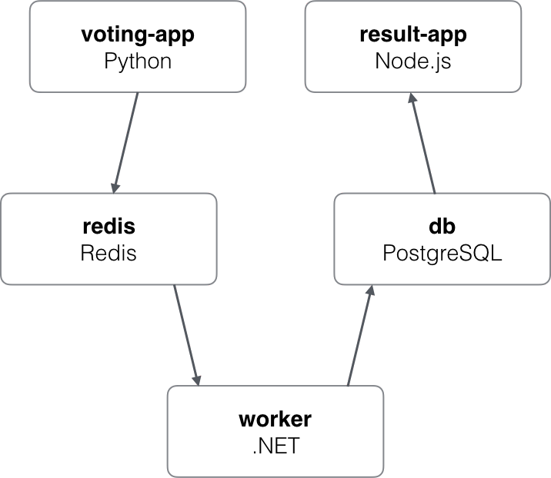
Project - The Voting App
This is an application based on micro-services architecture,
consisting of 5 simple services:
Voting-App: Frontend of the application written in Python, used by users to cast their votes.
Redis: In-memory database, used as intermediate storage.
Worker: .NET service, used to fetch votes from Redis and store in PostgreSQL database.
DB: PostgreSQL database, used as database.
Result-App: Frontend of the application written in Node.js, displays the voting results.

Slide 31
Project - Voting App - Requirements
Requirements
Docker
Docker Compose
Git
Internet Connection needed to get tools
Voting App Git repository
$ git clone https://github.com/dockersamples/example-voting-app.git
IMPORTANT
Instead of a personal VM or Local Docker installation, you can (and should!) use Play With Docker: https://labs.play-with-docker.com/
What will we do exactly?
Deploy a simple distributed application running across multiple Docker containers.
Inspect and investigate the definition files
Connect containers among themselves with multiple Docker Networks
Database data will be kept in volumes
Scale microservices
Upgrade microservices
If possible, hide Web UI Services and load them with a Load Balancer / Reverse Proxy

Slide 32
Where can I get more information?
Docker Documentation: https://docs.docker.com
Docker Overview: https://docs.docker.com/engine/docker-overview/
Networks: https://docs.docker.com/network/ Storage (Binds/Mounts): https://docs.docker.com/storage/
Dockerfile: https://docs.docker.com/engine/reference/builder/
Docker Compose: https://docs.docker.com/compose/
GitHub
https://github.com/luisnabais-courses/course_docker
My contacts
https://www.luisnabais.com
https://github.com/luisnabais
E-mail: luis.nabais@findmore.pt
Notes:
Demonstrar como abrir as organizations no GitHub

Slide 33
Q&A

Slide 34

Thank you
PS:
Feel free to give feedback on this Workshop (or on possible future ones) or ask questions on luis.nabais@findmore.pt
Don’t be shy!

