Slide 1


Fundamentals

Slide 2

What will we talk about?
Short docker introduction
- What is docker?
- How it compares to virtual machines
- Docker advantages
Practical class/tutorial
- Docker Installation
- Docker Hub
- Creating/downloading an image
- Creating a container
- Updating application in container
- Some useful commands for containers
- Dockerfile – Custom Image

Slide 3
What is Docker?
Docker is an open platform to build, ship and run distributed applications anywhere.
Docker containers wrap a piece of software in a complete filesystem that contains everything needed to run: code, runtime, system tools, system libraries – anything that can be installed on a server. This guarantees that the software will always run the same, regardless of its environment.

Slide 4
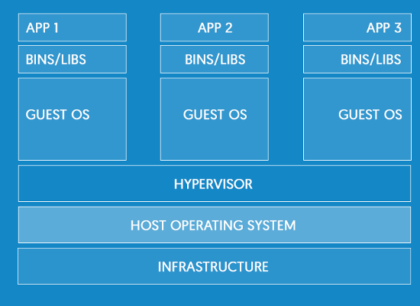
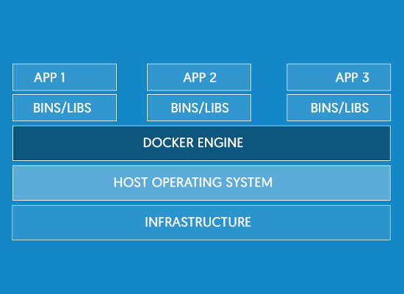
Containers vs Virtual Machines
Virtual Machine Architecture
Docker Architecture

Slide 5
Docker Advantages
Technical advantages
Lightweight
Containers running on a single machine share the same operating system kernel; they start instantly and use less RAM.
Images are constructed from layered filesystems and share common files, making disk usage and image downloads much more efficient.
Open
Docker containers are based on open standards, enabling containers to run on all major Linux distributions, Microsoft Windows, Apple macOS -- and on top of any infrastructure.
Secure
Containers isolate applications from one another and the underlying infrastructure, while providing an added layer of protection for the application.

Slide 6
Docker Advantages
Advantages for developers
No more “It works on my machine”
Accelerated Development
Stop wasting hours setting up developer environments, spinning up new instances, and making copies of production code to run locally.
With Docker, you simply take copies of your live environment and run them on any new endpoint running a Docker engine.
Eliminate environment inconsistencies
Packaging an application in a container with its configs and dependencies guarantees that the application will always work as designed in any environment: locally, on another machine, in test or production.
No more worries about having to install the same configurations into different environments.

Slide 7
Docker Advantages
Advantages for Operations Team
Less effort for maintaining environments
The creation of an environment is automated. Hence, less manual actions are necessary. This reduces the risks and increases the reliability.
Manually maintaining a consistent environment on multiple servers is error-prone and can be a nightmare. With Docker it’s easy to create several instances of an environment, because we just have to execute the image on the servers. This way it is easy to add further nodes to a cluster and to scale horizontally.
Easy updating
Using traditional approaches for setting up an environment (like install scripts) run into trouble when there is already an existing environment. Considering the update path in the script can be a very complex task (e.g. checking the existence of files and cleanup unused files). With Docker we don’t have to take an existing environment into account (except for the database). We just stop the running container and start the new updated one. This simplifies the setup because we always start with an empty environment.

Slide 8
Docker Installation
Docker Engine is supported on Linux, Cloud, Windows, and OS X.
Installation instructions are available at https://docs.docker.com/engine/installation/
CentOS Linux
- Create repository as indicated in website above
# yum update & yum install docker-engine
# systemctl start docker && systemctl enable docker
General Linux installation (should work in most Linux distributions)
# curl -fsSL https://get.docker.com/ | sh
# systemctl start docker && systemctl enable docker
Test installation
# docker images
# docker ps
Give access to other user than root
# usermod -a -G docker <user>
(login with user – if user is already login, must logout first)

Slide 9
Docker Hub
What is Docker Hub?
Docker Hub is a cloud-based registry service which allows you to link to code repositories, build your images and test them, stores manually pushed images, so you can deploy images to your hosts.
Docker Hub provides the following major features:
Image Repositories: Find, manage, and push and pull images from community, official, and private image libraries.
Automated Builds: Automatically create new images when you make changes to a source code repository.
Webhooks: A feature of Automated Builds, Webhooks let you trigger actions after a successful push to a repository.
Organizations: Create work groups to manage access to image repositories.
GitHub and Bitbucket Integration: Add the Hub and your Docker Images to your current workflows.

Slide 10
Creating/downloading an image
Downloading an image
# docker pull <image_name_like_ind_docker_registry>
# docker images
Multiple images
# docker pull <other_image_name>
# docker images
Multiple versions of the same image
# docker pull <image_name>:<version>
# docker images

Slide 11
Creating a container
Running a container
# docker images
# docker run <image_name> (it will be in the foreground)
# docker ps
Running a container in background
# docker run -ti -d --name my_webserver httpd
# docker ps
- try to open http://container_ip
Expose ports for access
# docker run -ti -d -p 80:80 --name my_webserver httpd
Mount an external mount point inside container
docker run -ti --name servidorweb -v /opt/external_mount/code/:/var/www/html:ro -d httpd
List all containers
# docker ps -a

Slide 12
Updating container
Saving changed container to a new image
(Change website content)
# docker commit findmore_apache findmore_apache:v2
# docker images
Export image to a file
# docker save -o image_save.tar <image_name>
Export container to a file
# docker export -o /home/container_save.tar <container_name>
(loses history, flattens image)
Run container with new version
# docker stop <container>
# docker rm <container>
# # docker run -ti -d -p 80:80 --name my_webserver findmore_apache:v2
Load a saved image
# docker load -i <container_file>

Slide 13
Commands for containers
Inspect
# docker inspect
Events
# docker events
Logs
# docker logs findmore_web:v2

Slide 14
Dockerfile
FROM centos:7
MAINTAINER Luís Nabais <luis.nabais@findmore.pt>
RUN yum -y update && yum clean all
RUN yum install -y curl vim net-tools httpd git && yum clean all
RUN yum clean all
RUN git clone https://github.com/luisnabais/findmore_course_docker.git /var/www/html/
EXPOSE 80 443
COPY run-httpd.sh /run-httpd.sh
RUN chmod -v +x /run-httpd.sh
CMD ["/run-httpd.sh"]
Creating image from Dockerfile
# docker build -t findmore_apache:v1 .
Running container
# docker run -ti -d --name findmore_apache findmore_apache:v1

Slide 15
Where can I get more information?

Slide 16

Thank you

