Slide 1
Agent TNE19
PowerTAC Broker

Slide 2
PowerTAC - What is it
Competing Brokers
build portfolios, buy & sell power
Power TAC
Simulation environment
Wholesale Market
Balancing Market
Tariff Market
Large Energy Suppliers
Distribution Utility
owns/operates local grid
Retail Customers
producers, consumers

Slide 3
Main Strategy (Only Wholesale)
Predict quantity and price per timeslot
Buy when it’s cheaper
To sell when it’s more expensive (for the next 24 timeslots)
Win money!

Slide 4
Previous Data to Predict
Pick historic demand to predict the future demand
Current Weather
Temperature
Wind speed
Time
Slot
Week of the day
To the current timeslot
24h ago
today
24h from now
For each of the previous 24 timeslots
Cleared Trade: energy that was bought through 24 hours to be used in that timeslot
Cleared amount: quantity of energy that was cleared (bought) for that timeslot
Cleared price: average price/Mwh of the energy that was cleared for that timeslot
Weather Report
Temperature
Wind speed
For each of the next 24 timeslots
Cleared Trades observed until now for the timeslot
Total quantity
Average price of all the cleared trades
Weather Forecast
Temperature
Weather

Slide 5

Prediction Model & API
When our agent requires a prediction, it sends a request to our REST Flask API in an asynchronous way, allowing the agent to keep trading in the market.
At the moment our API uses a linear regression model to predict both amounts and prices. This is highly modular and one model can be swapped at any time by another one. In fact, we tested several models, such as neural nets, with different parameters and train/test dataset sizes. At any given moment this can be swapped without affecting the current agent architecture.

Slide 6
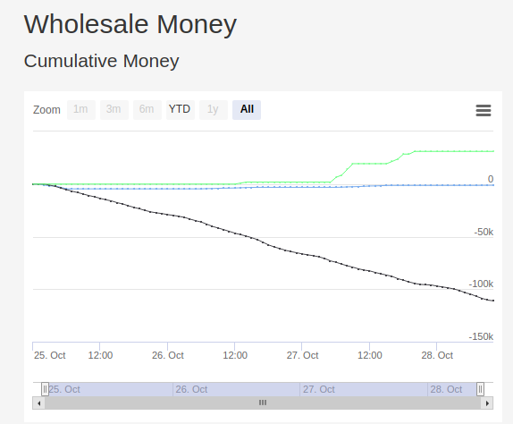

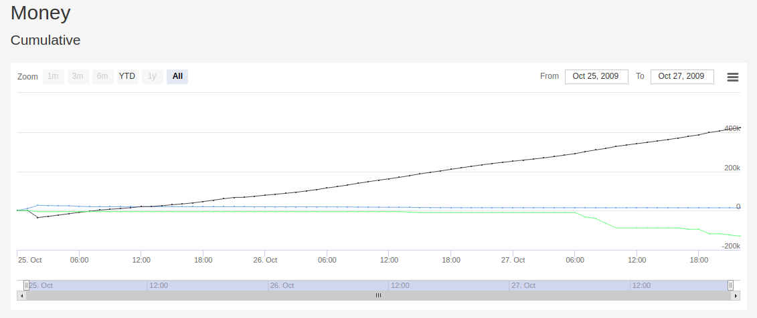
Current strategy

Slide 7
Current strategy
By only using an wholesale strategy as previously explained, we managed to win in the wholesale market. However, we overall lost money. We conclude that the wholesale strategy by itself is not enough.
This is a good indicator that PowerTAC is well designed and prevents people (like us) from trying to “cheat the system” and make money without providing customers good services.

Slide 8
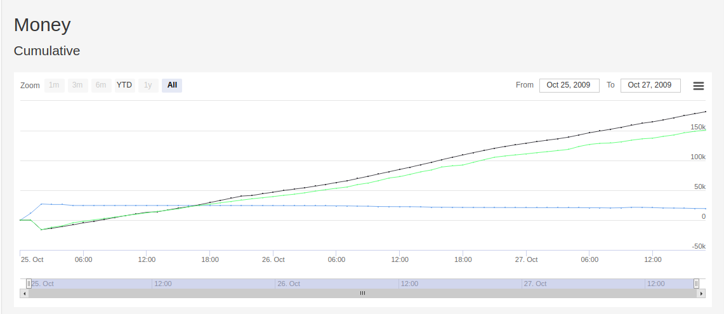
Current strategy
1. Initially we set up tariffs at mean market price
Thus we found the need to complement with a retail strategy.
Our current retail strategy relies on two stages
2. Tit-For-Tat: After we identify several better tariffs from competitors, we choose the one to us that is the best and offer a similar one but with one or two parameters improved.
Usually this translates into a huge sign-up payment bonus to attract customers, along with a heavy withdrawal penalty and a more expensive periodic pay.
Initially, this cost us money but pays off in the long term.

Slide 9
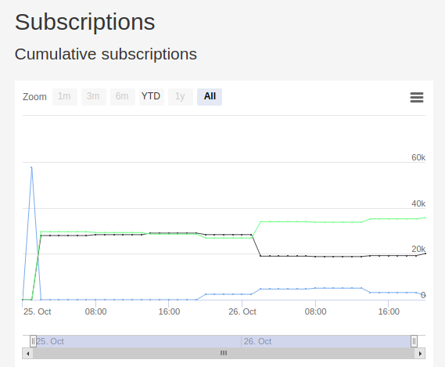
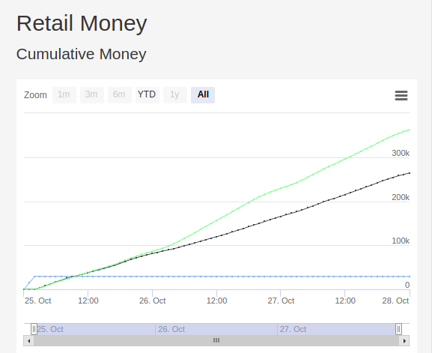
Current strategy
It is clear that after a certain point the clients belong to us and we make money.
In fact, way more money than the sample-broker agent.

Slide 10
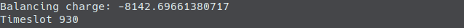
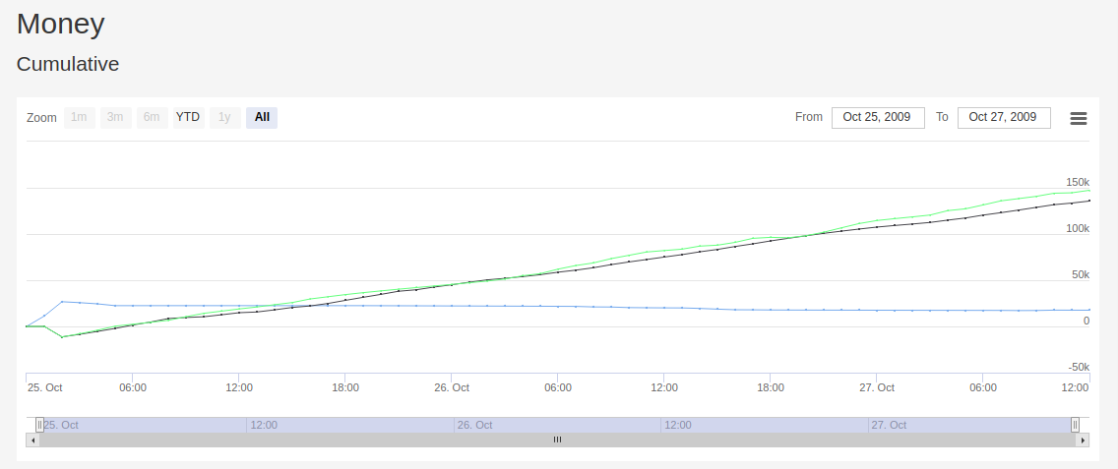
Current strategy
However, despite now making money and winning versus the sample-broker 7/10 test runs, we lose a lot of money due to DU (Distribution Utility) charges.
This translates into a small win, for such a big difference in the retail market.

Slide 11
Future improvements
1.
Clearly the DU charges are the condition holding us back.
As means to counter-attack this, as we’ve seen in our research, a future plan would be to implement Time-of-Use (TOU) tariffs in the retail market, that encourage customers to use energy when the DU will charge us less.
2.
Also, to avoid being so “unbalanced” relative to the market, in the future we would like to take into account our energy amount prediction plus the expected customer from our portfolio’s consumption
n. Customers * customer average usage

Slide 12
thank you!

