Slide 1
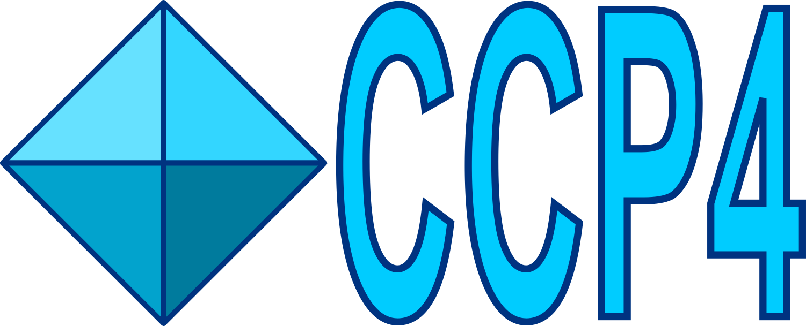

DUI2 - Dials User Interface
Dr. Luis Fuentes-Montero (Luiso)

Slide 2
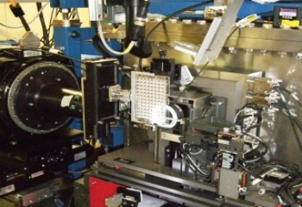
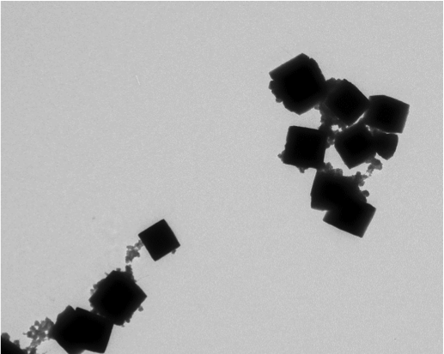
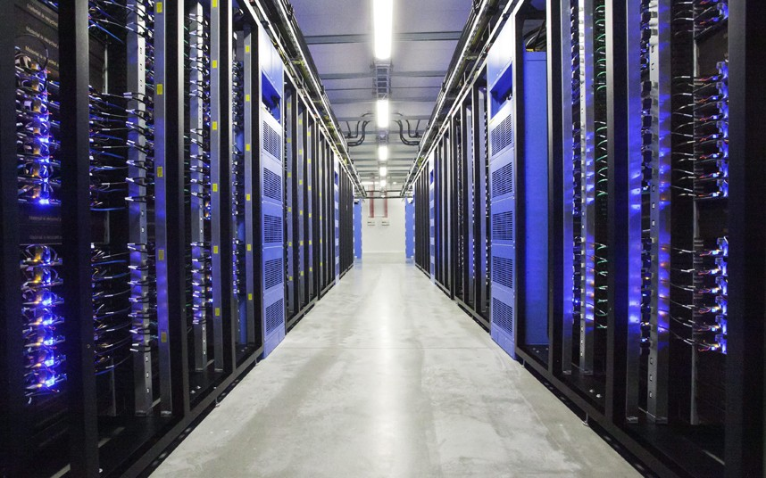
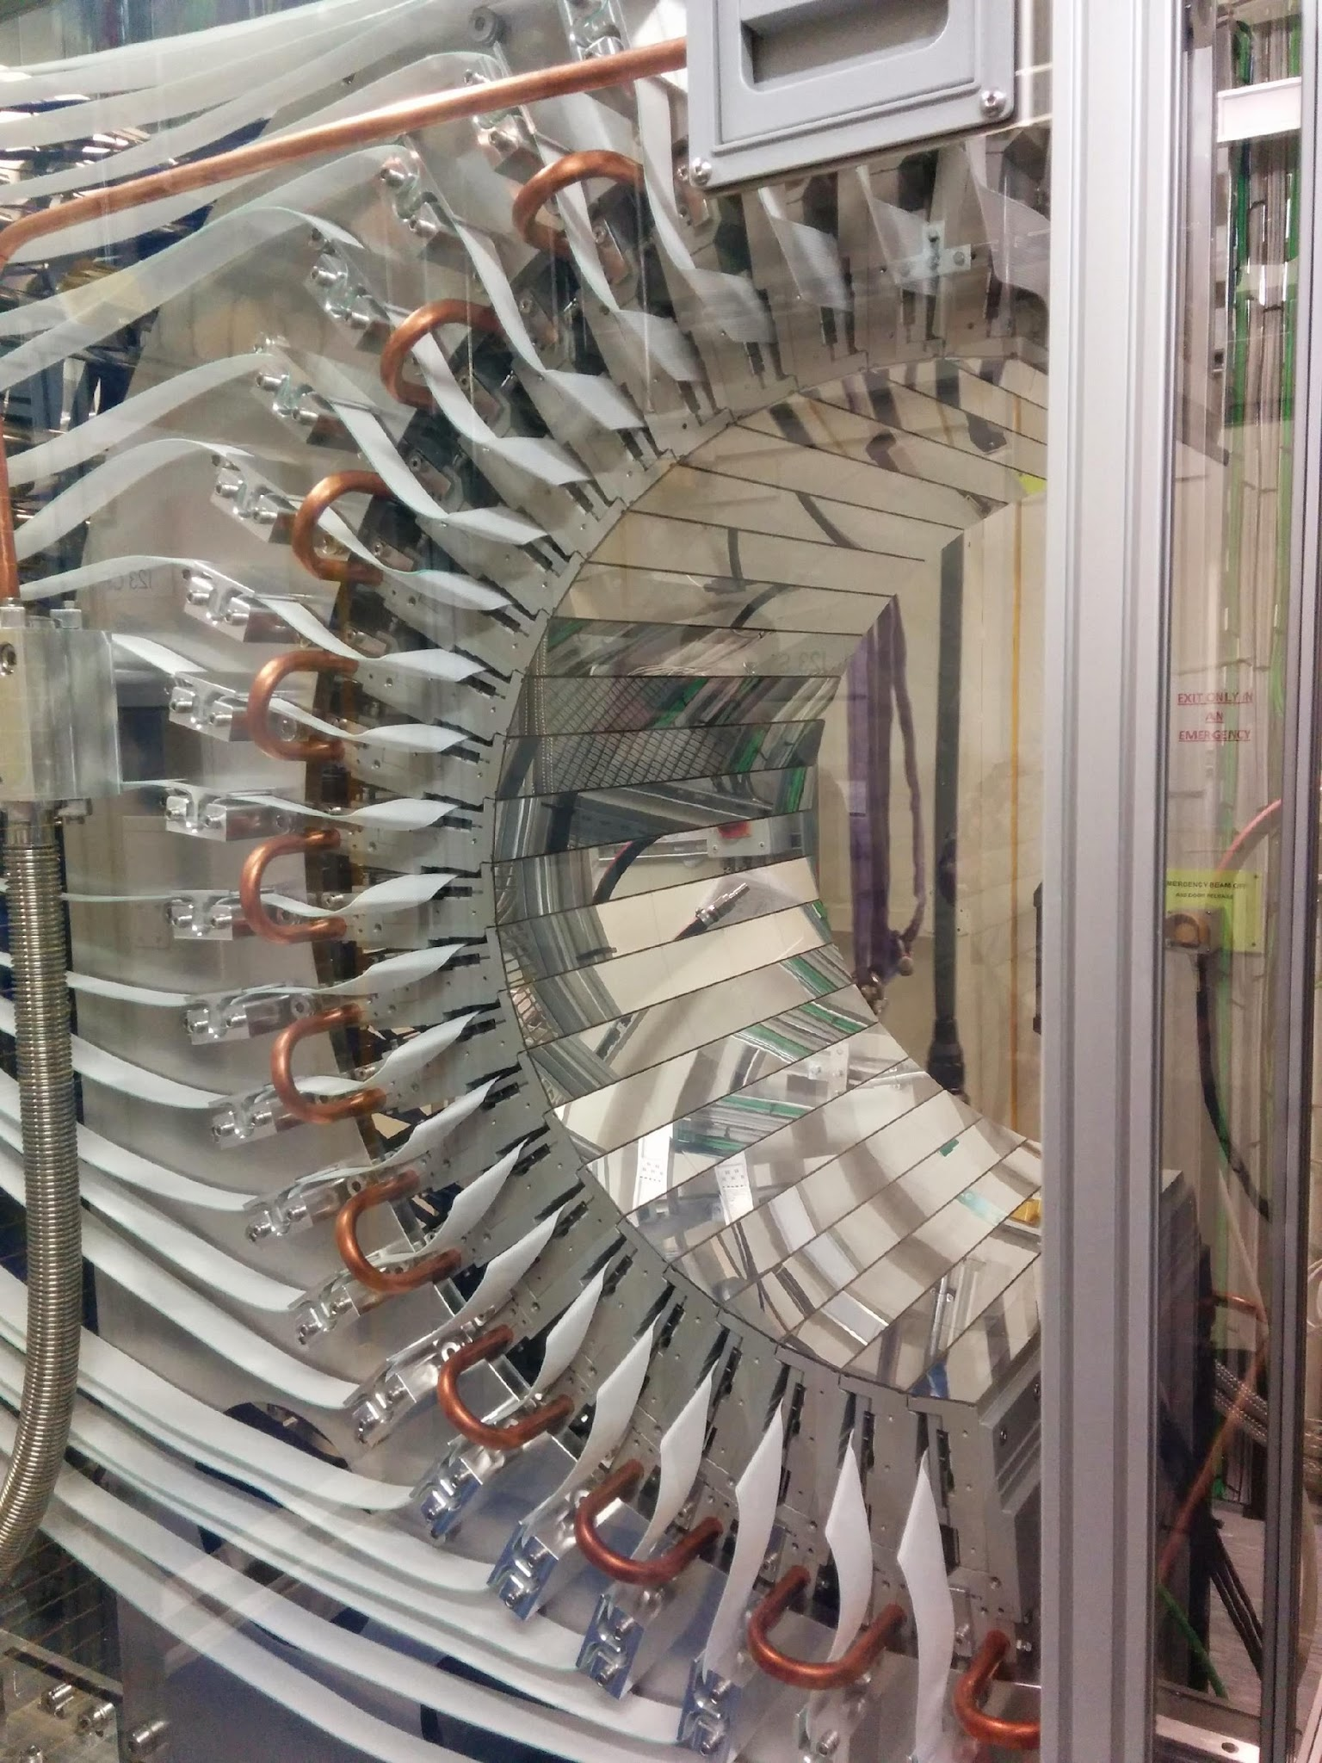
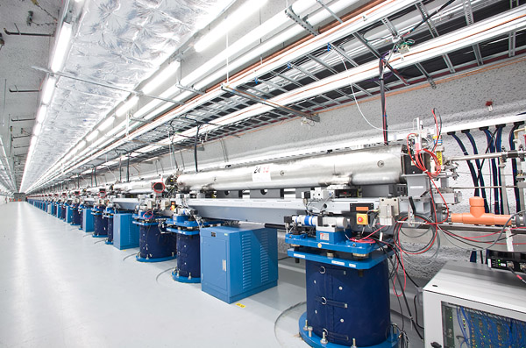
What is DIALS?
Diffraction Integration for Advanced Light Sources
Project began in late 2011 at Diamond Light Source and CCP4
Additional funding by BioStruct-X and now Wellcome Trust
Aim to develop new data processing software to meet modern challenges
Now an international collaborative development

Slide 3
DIALS commands
dials.import
dials.find_spots
dials.index
dials.refine_bravais_settings
dials.reindex
dials.refine
dials.integrate
dials.symmetry
dials.scale
dials.export
More than 90 dials.* commands

Slide 4
Levels of interaction with Dials
xia2
DUI2
Ease of use
Command line tools
Programmer's API
Degree of control

Slide 5
Levels of interaction with Dials
xia2
DUI2
Ease of use
Command line tools
Programmer's API
Degree of control

Slide 6
What is DUI?

Slide 7
What is DUI?
Drive Under Influence

Slide 8

What is DUI?
Drive Under Influence

Slide 9
What is DUI?
Drive Under Influence

Slide 10
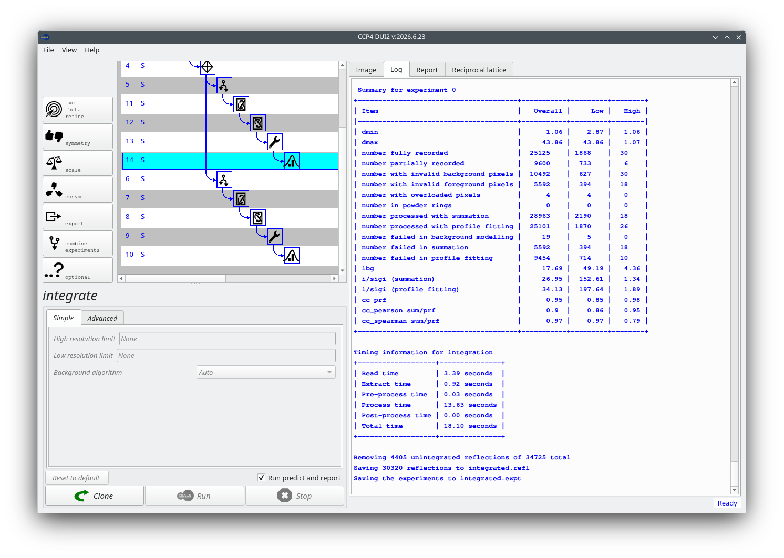
What is DUI?
Dials User Interface

Slide 11
What is DUI?
Dials User Interface

Slide 12
What is DUI?
Dials User Interface
Version 2

Slide 13



Why reach for Dui2?
Dui2 processes a single data set through DIALS with a graphical interface — an alternative to Xia2 for when you want direct, hands-on control over every DIALS command, rather than running from the command line.
Full command control
When Xia2 struggles
A gentle on-ramp
Step through import, find spots, index, refine, integrate and more — each one a DIALS command you configure and run yourself.
Users often turn to Dui2 when Xia2 hits problems or fails to complete — it lets you diagnose and steer processing directly.
This walkthrough introduces the basic steps using a simple example, before tackling more complex scenarios.

Slide 14
GETTING STARTED
Importing the dataset
Every Dui2 session begins the same way — bring your images in, then let DIALS build the geometry model.
1
Open images
2
Select a file
3
Run
Click “Open images” on the left panel.
Choose any single image from your dataset.
Click “Run” — the button with the DIALS logo.
This triggers the first DIALS command in the “import” node. Dui2 then walks you through the same four-step pattern for every subsequent command in the processing graph.

Slide 15
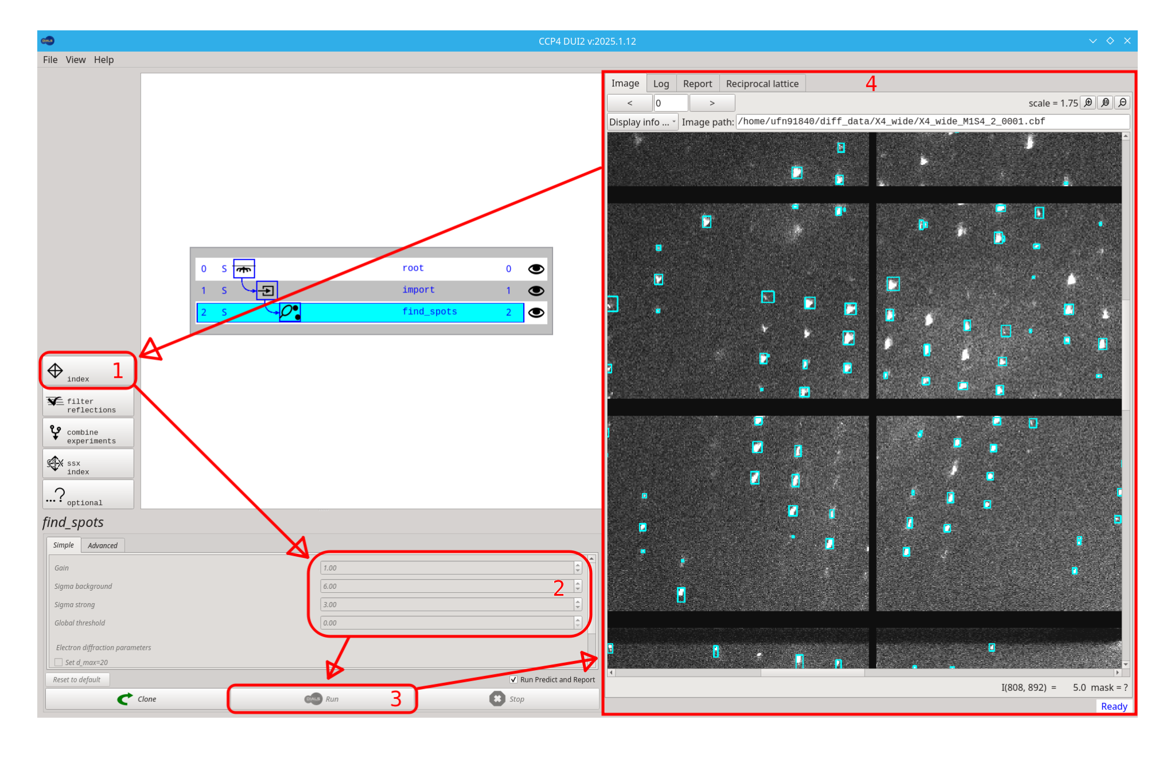
THE CORE PATTERN
The four-step processing loop
Once importing is done, every subsequent DIALS command in Dui2 follows the same repeating pattern — shown here for the “find spots” node.
1
Select a command
Pick a button in the command column (top left).
2
Adjust parameters
Edit values in the Simple or Advanced tabs.
3
Execute the command
Click “Run” and wait for it to finish.
4
Review the output
Check the Log/Report/Image tabs, then repeat.
The Dui2 interface, annotated with the four-step pattern.
↻ loops back to step 1 until you're happy with the result

Slide 16
EXPLORING ALTERNATIVES
Branching with Clone
Not happy with a result? Fork the workflow instead of overwriting it — Dui2 keeps every branch and node accessible for review or further editing at any time.
Sibling A
new parameters
Original node
(unsatisfying result)
Click “Clone”
Sibling B
new parameters
Modify the parameters and click “Run” again — Dui2 creates a sibling node so you can explore an alternative processing path without losing the original.

Slide 17
THE CORE IDEA
A tree of processing steps
Every DIALS command you run in Dui2 creates a new node in a tree. Click any node to jump back to that point and continue — or fork the tree to try a different path without losing what you already have.
root
import
find_spots
index
index (retry)
Clicking “Clone” on an earlier node forks a sibling — a second attempt with different parameters, sitting right alongside the first.
The rest of this deck walks through a typical session, node by node.

Slide 18
DUI2 WIKI · HOME
Usage Workflow (ideal case)
A typical DUI2 session, node by node — from launching the app to a scaled, merged MTZ.
Import → Find spots
Index → Refine
Integrate → Scale
Bring in images, locate reflections
Model the lattice and geometry
Measure and merge intensities

Slide 19
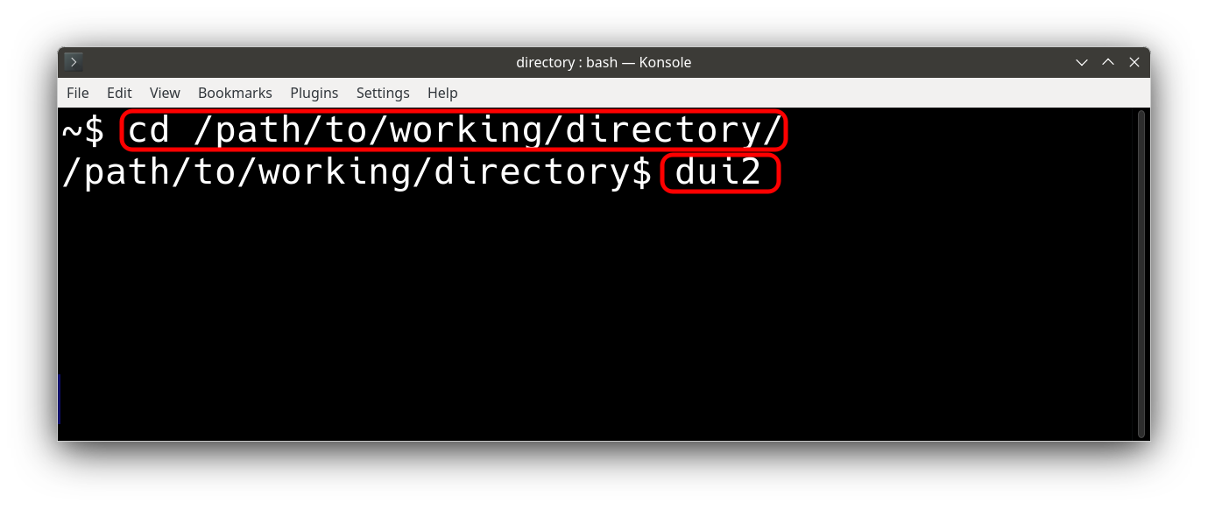
Launch Dui2
1
step 1 of 10
Start Dui2 from inside a working directory. Dui2 writes its files (logs, .expt/.refl files, etc.) to the directory it was launched from, so cd into a dedicated processing directory first.

Slide 20
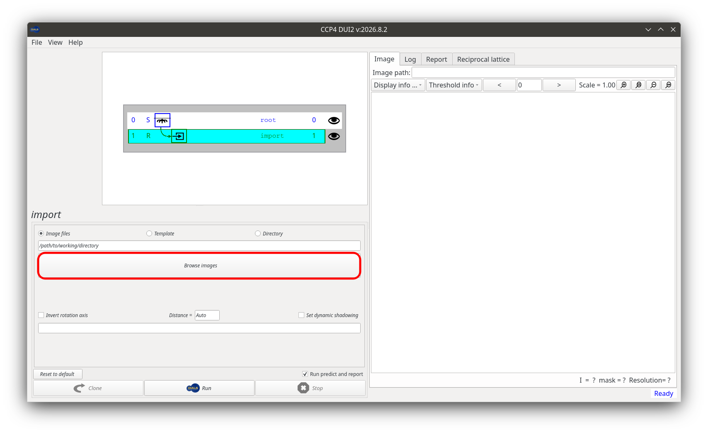
Import
2
step 2 of 10
Click “Open images”, navigate to your data, and select one image (or the master/.nxs file for HDF5/Eiger data). Dui2 builds a template matching the full data set, then “Run” reads the experiment metadata.
dials.import
Output: imported.expt

Slide 21
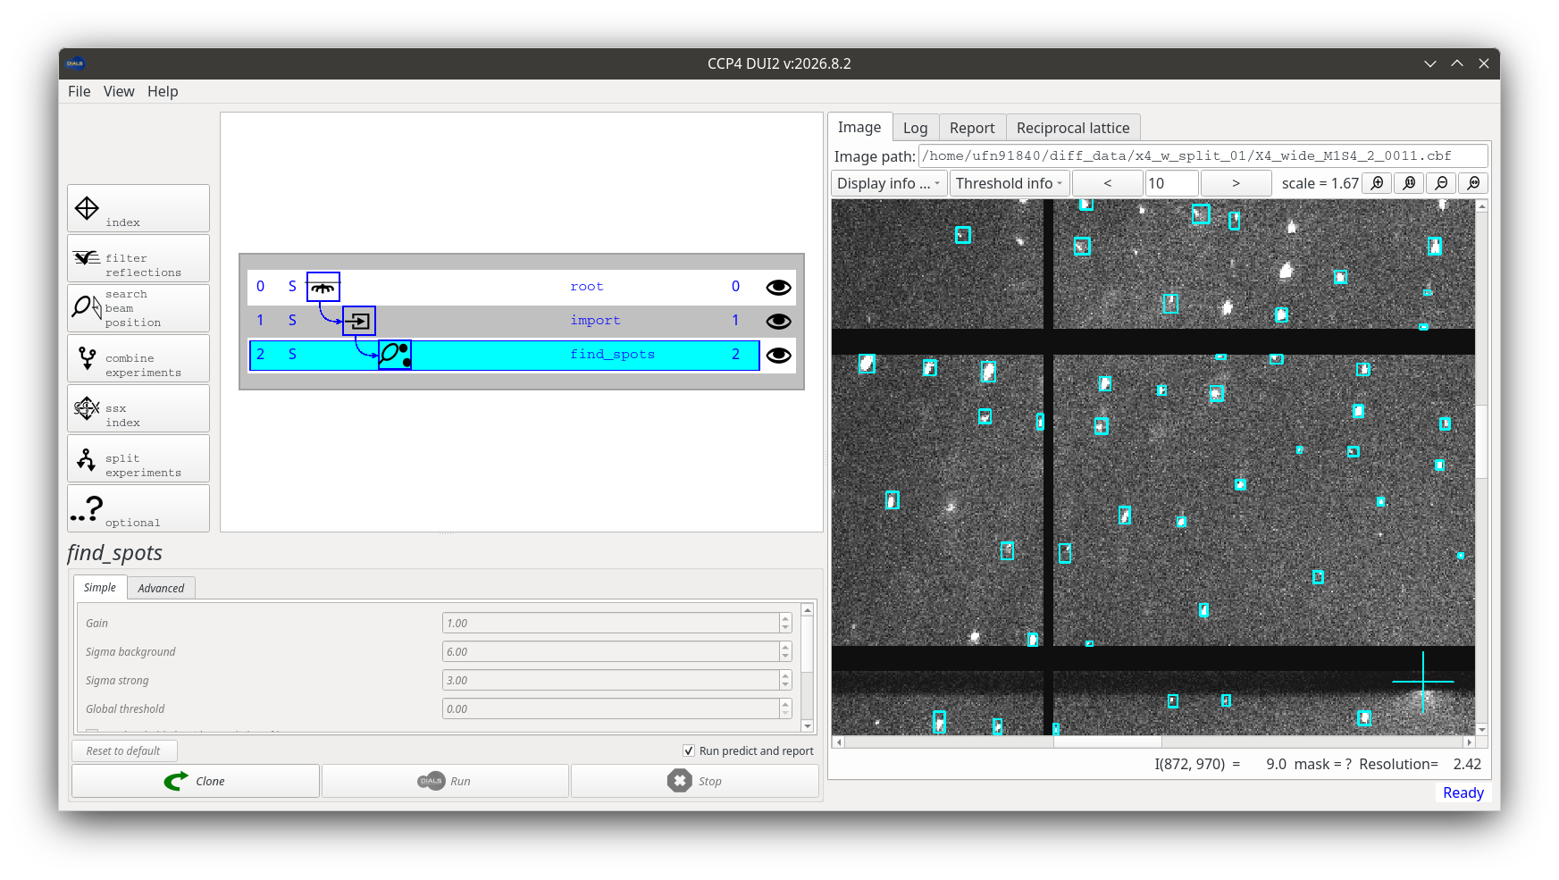
Find spots
3
step 3 of 10
Click the “find spots” button to create a new node, then “Run”. This searches every image for diffraction spots — one of the more time-consuming steps, since it reads the whole data set.
dials.find_spots
Output: strong.refl

Slide 22
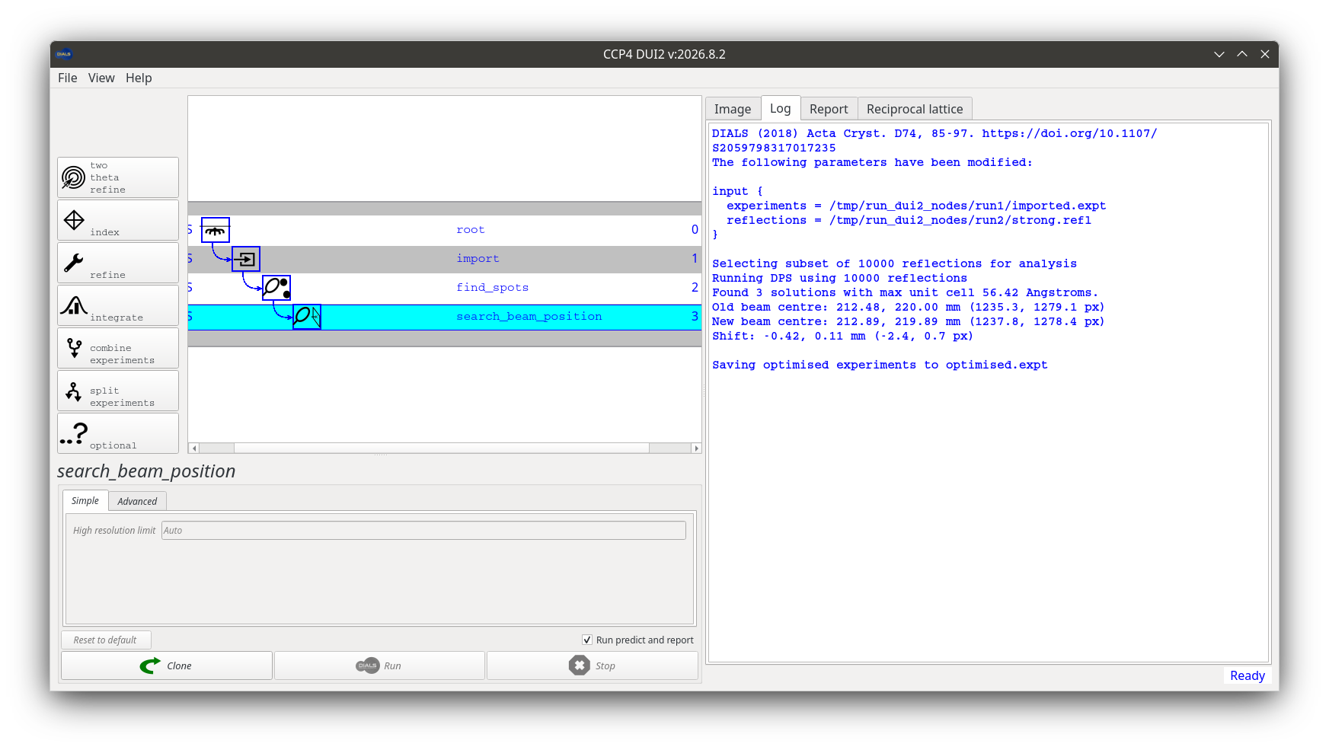
OPTIONAL
Search beam position
4
step 4 of 10
If the beam centre looks off in the Reciprocal Lattice viewer, this optional step refines it before indexing — worth a look if indexing struggles later on.
dials.search_beam_position

Slide 23
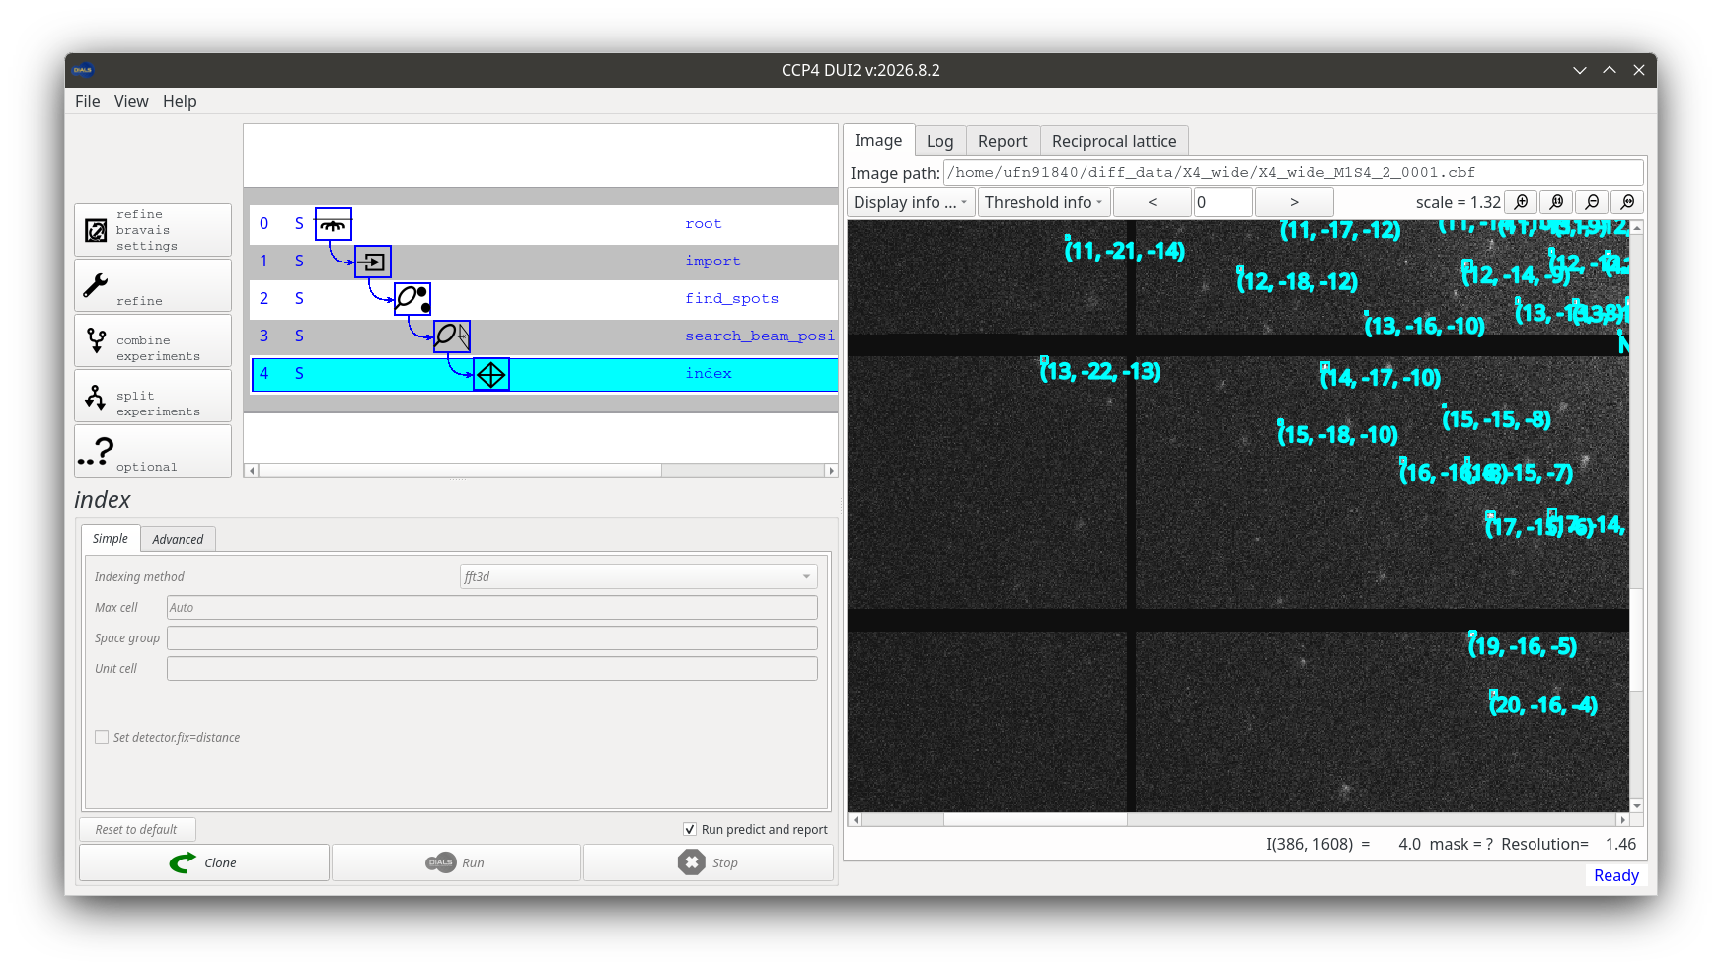
Index
5
step 5 of 10
Click “index” and “Run”. This finds the crystal lattice from the spot positions — the geometric heart of the whole processing pipeline.
dials.index
Output: indexed.expt / indexed.refl

Slide 24
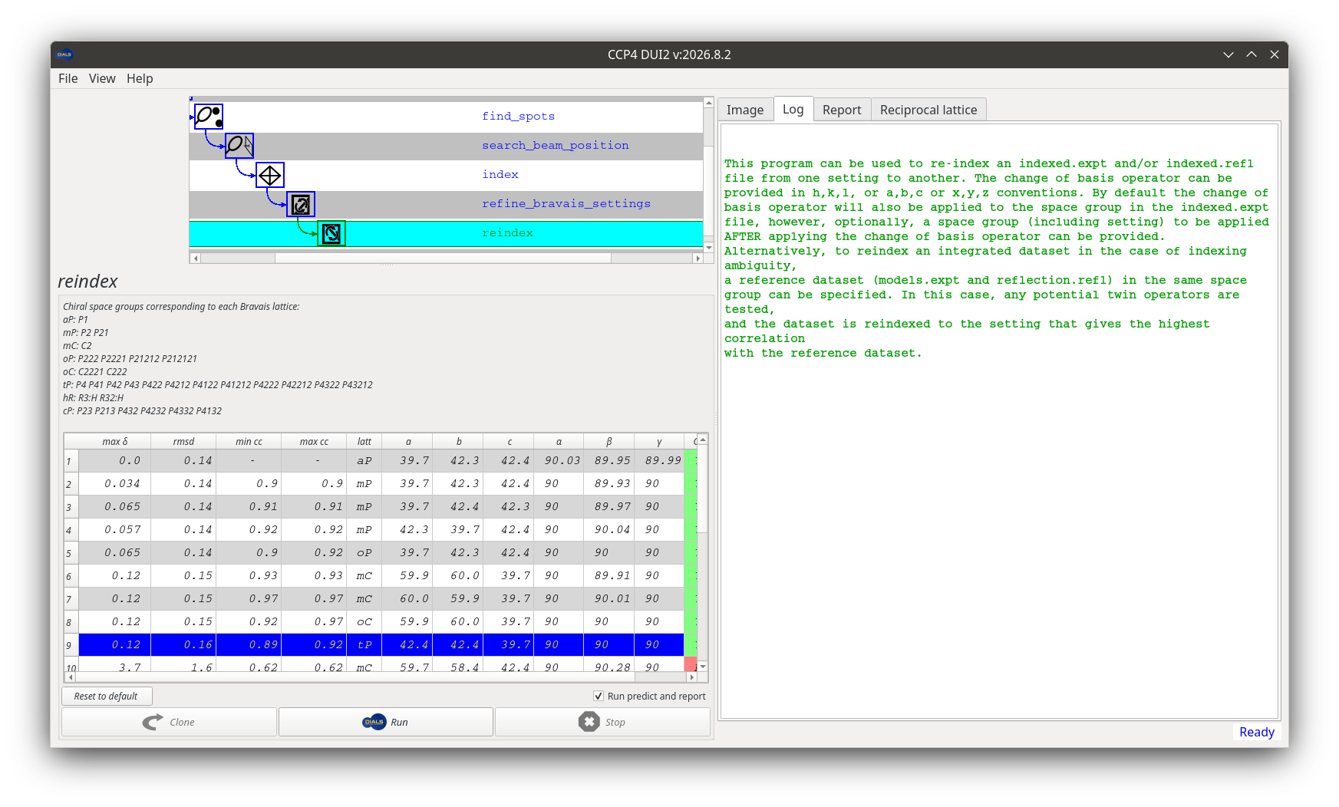
OPTIONAL
Determine the Bravais lattice
6
step 6 of 10
Proposes possible higher-symmetry lattices consistent with the indexed cell. If you pick one, a “Reindex” step applies it to the model.
dials.refine_bravais_settings

Slide 25
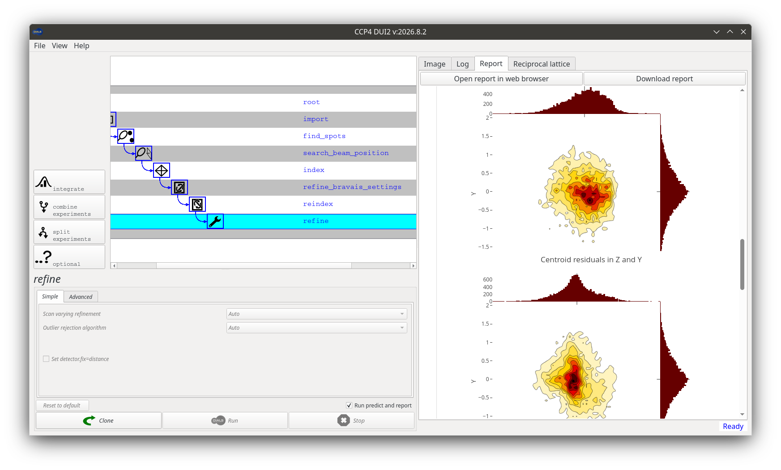
Refine
7
step 7 of 10
Click “Refine” to improve the crystal and experimental geometry model, including scan-varying refinement across the rotation range.
dials.refine

Slide 26
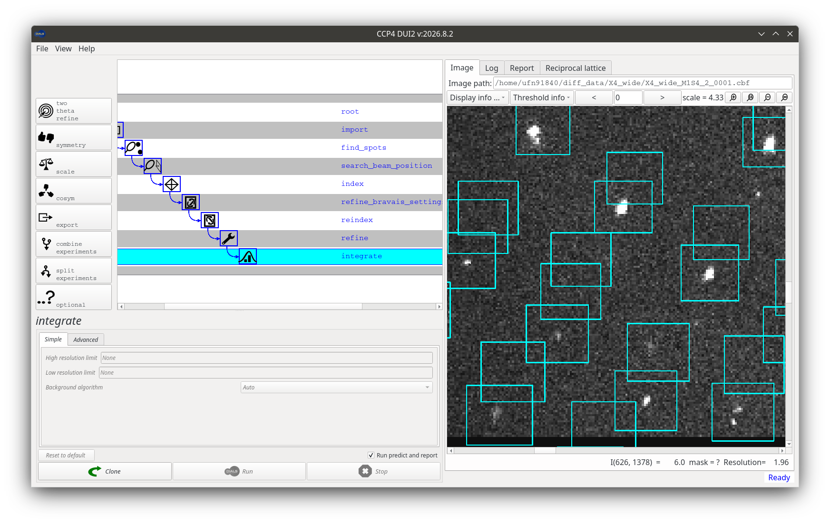
Integrate
8
step 8 of 10
Click “Integrate” and “Run” to measure the intensity of every predicted reflection. This is normally the most computationally expensive step in the whole workflow.
dials.integrate

Slide 27
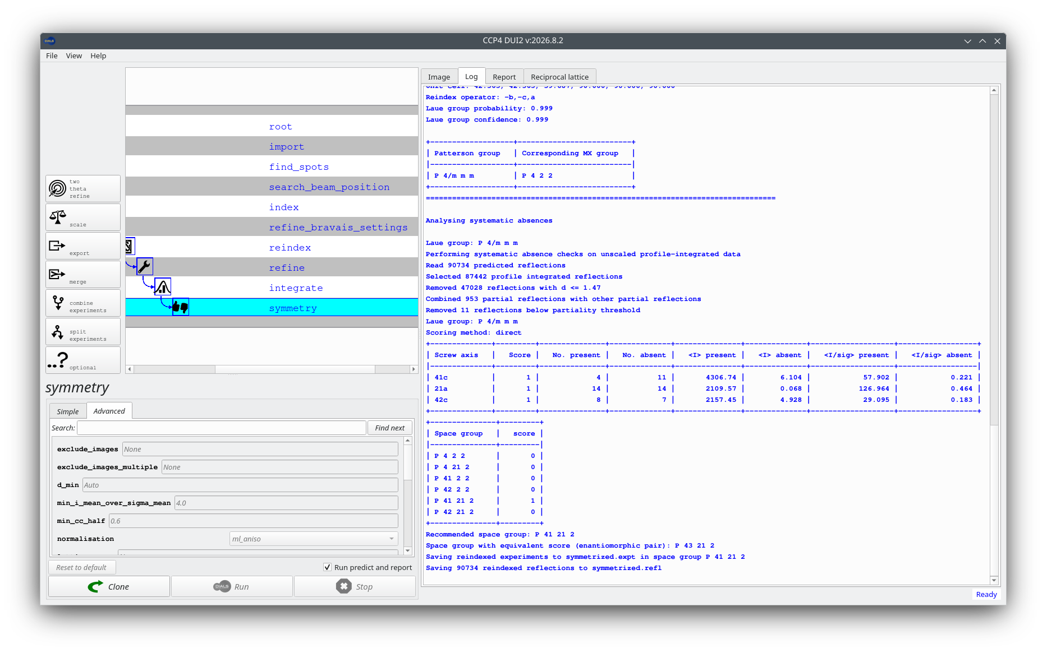
Symmetry
9
step 9 of 10
Click “symmetry” to determine the crystal's true symmetry, including a search for systematic absences that pin down screw axes.
dials.symmetry
Output: symmetrized.expt / symmetrized.refl

Slide 28
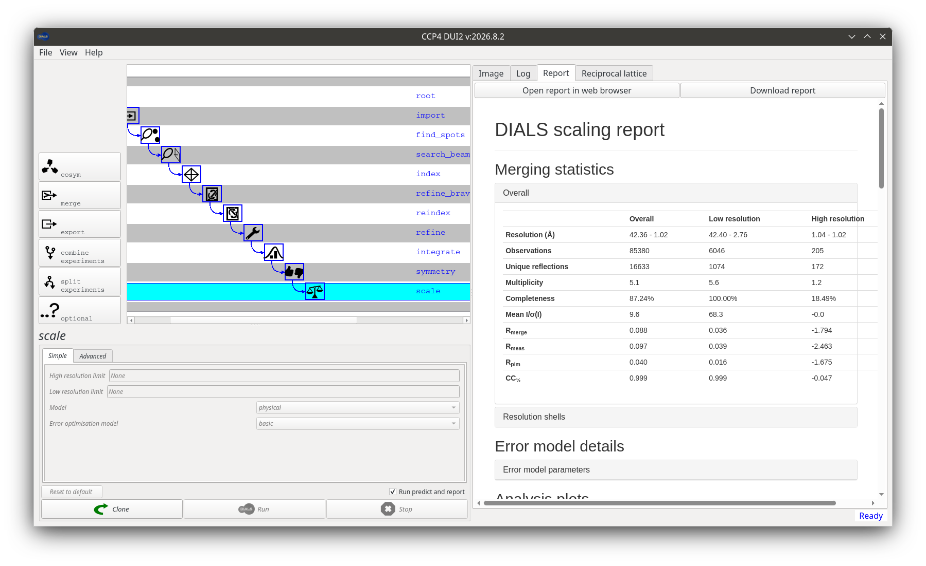
Scale (and merge)
10
step 10 of 10
Click “scale” to correct for radiation damage, beam intensity variation, and absorption. From here, merge for a merged MTZ, and/or export for a scaled, unmerged MTZ — both downloadable from their node.
dials.scale → dials.merge / dials.export

Slide 29
THROUGHOUT THE WORKFLOW
Inspect, and iterate if needed
Log
Report
Image
Reciprocal lattice
The command's raw text output.
An HTML dials.report summary.
Diffraction images with overlays.
The reciprocal-space view of spots.
If a step doesn't go the way you want, click back on an earlier node, fork a new path with “Clone”, and try again with different parameters — without losing your earlier work.
For more detail
Legacy tutorial (full step-by-step walkthrough) • Multi-lattice • THAS1 (anomalous SAD phasing) • Beta lactamase

Slide 30
How to treat a Multiple Lattices case:
Full tutorial: https://github.com/ccp4/DUI2/wiki/Multiple-lattices
This tutorial covers processing a dataset containing two overlapping crystal lattices using DIALS via DUI2. If you have not yet worked through a single-lattice dataset in DUI2, it is worth doing that first — this tutorial focuses on where the workflow diverges and why.
Dataset: semi-synthetic two-lattice trypsin dataset collected at beamline I04, Diamond Light Source (Zenodo record 10820).

Slide 31
Chapters:
Discover
Process
Post integration
Process as a single-lattice dataset first, use DUI2's visualisation tools to diagnose the second lattice, then re-index with max_lattices=5 and split the history tree into two independent branches.
Follow each branch through Bravais settings, refinement, and integration independently.
Scale and export each lattice independently.

Slide 32
CHAPTER 1
Discover
Run single-lattice processing first, use DUI2's visualisation tools to confirm a second lattice, then re-index and split the tree.
Import images · Find spots · Index (single lattice) · Clone & re-index · Split experiments

Slide 33
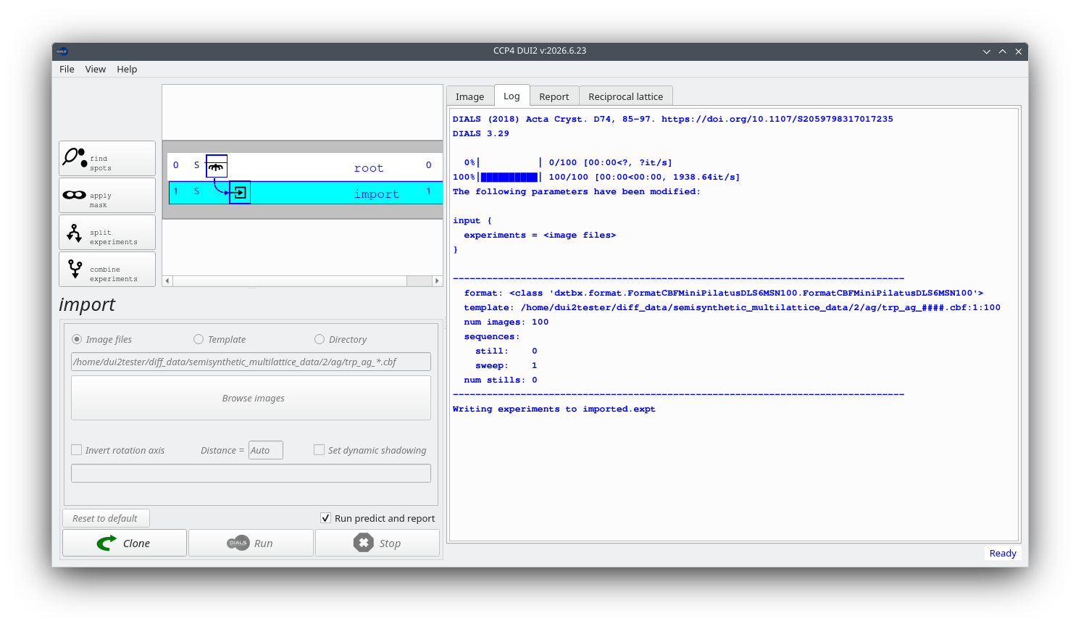
CHAPTER 1 · DISCOVER
Step 1
Import images
When DUI2 starts, an incomplete dials.import node is already highlighted in the history tree.
Click "Open images", navigate to the image directory, and select one CBF file, then click Run.
The log confirms 100 images interpreted as a single sweep, written to imported.expt.
The DUI window at start up

Slide 34
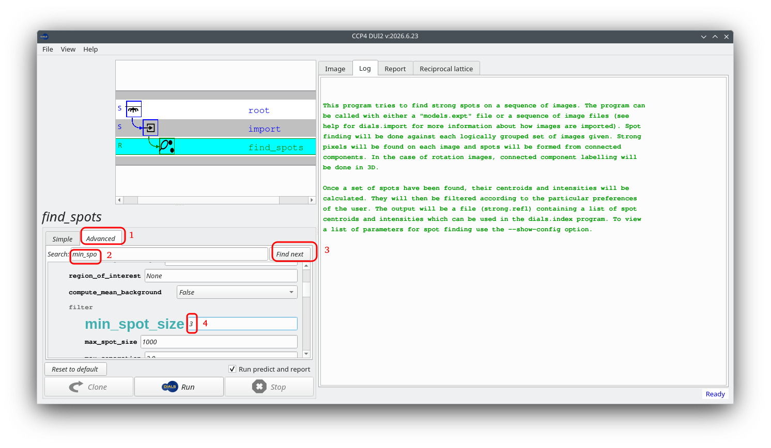
CHAPTER 1 · DISCOVER
Step 2
Find spots
Select "find spots" from the left-hand panel.
Under the Advanced tab, use the search box to find and set min_spot_size → 3.
This removes very small pixel islands that are not genuine Bragg spots. Click Run — the log reports a large number of spots found across 100 images.
Setting min_spot_size in the Advanced tab

Slide 35
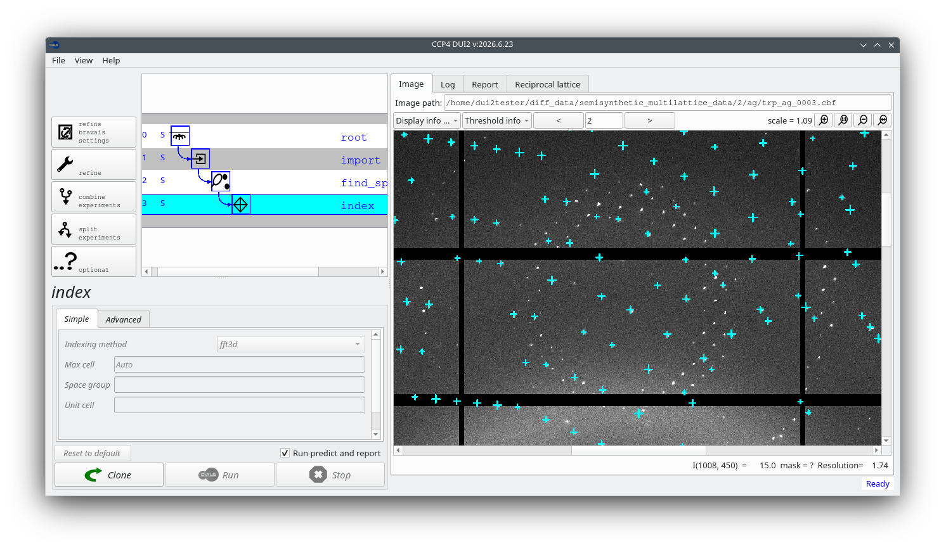
CHAPTER 1 · DISCOVER
Step 3
Index — single lattice first
Select "index" and click Run with default parameters. Evidence for a second lattice shows up across the visualisation tabs — starting with the Image tab:
"Image" tab — predictions match one orientation; a systematic set of strong spots remains unpredicted.

Slide 36
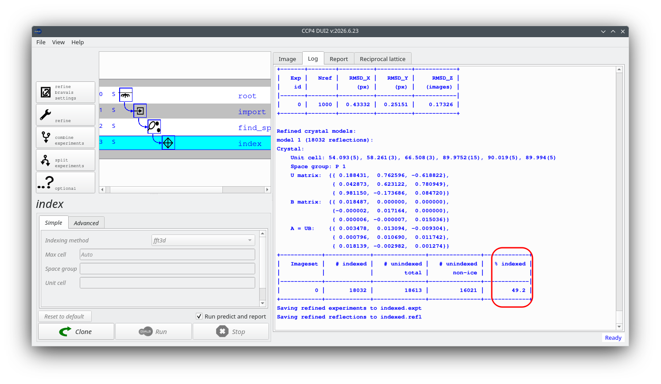
CHAPTER 1 · DISCOVER
Step 3 (continued)
Index — single lattice first
The Log tab tells the same story:
"Log" tab — the fraction of indexed spots is noticeably lower than the 80–95% expected for a clean dataset.

Slide 37
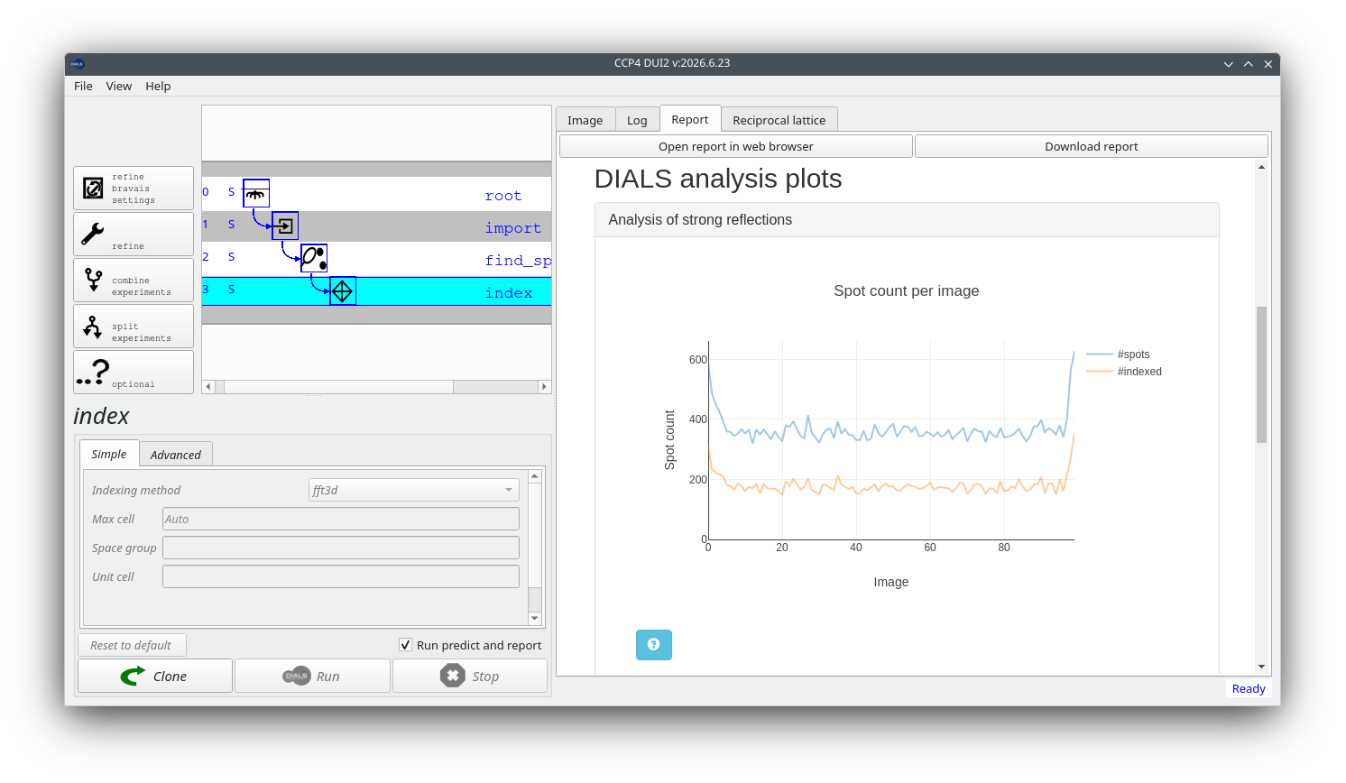
CHAPTER 1 · DISCOVER
Step 3 (continued)
Index — single lattice first
The remaining two tabs make the second lattice unmistakable — starting with the Report tab:
"Report" tab — Spot count per image: only around half the found spots appear as indexed.

Slide 38
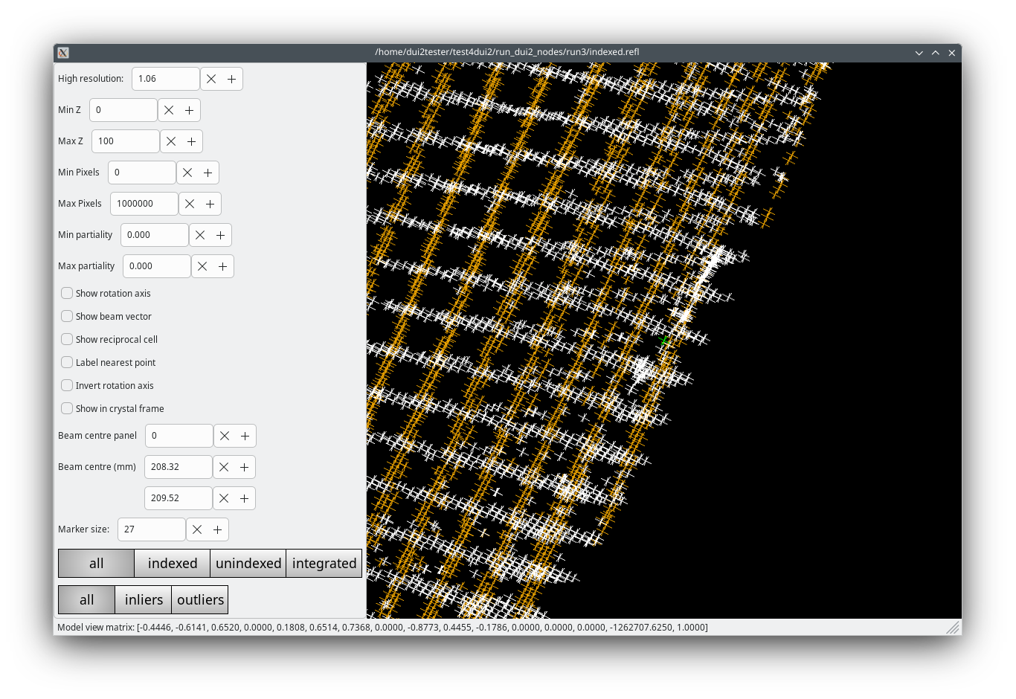
CHAPTER 1 · DISCOVER
Step 3 (continued)
Index — single lattice first
The Reciprocal lattice tab confirms it:
"Reciprocal lattice" tab — unindexed spots form their own ordered rows: the signature of a second lattice.

Slide 39
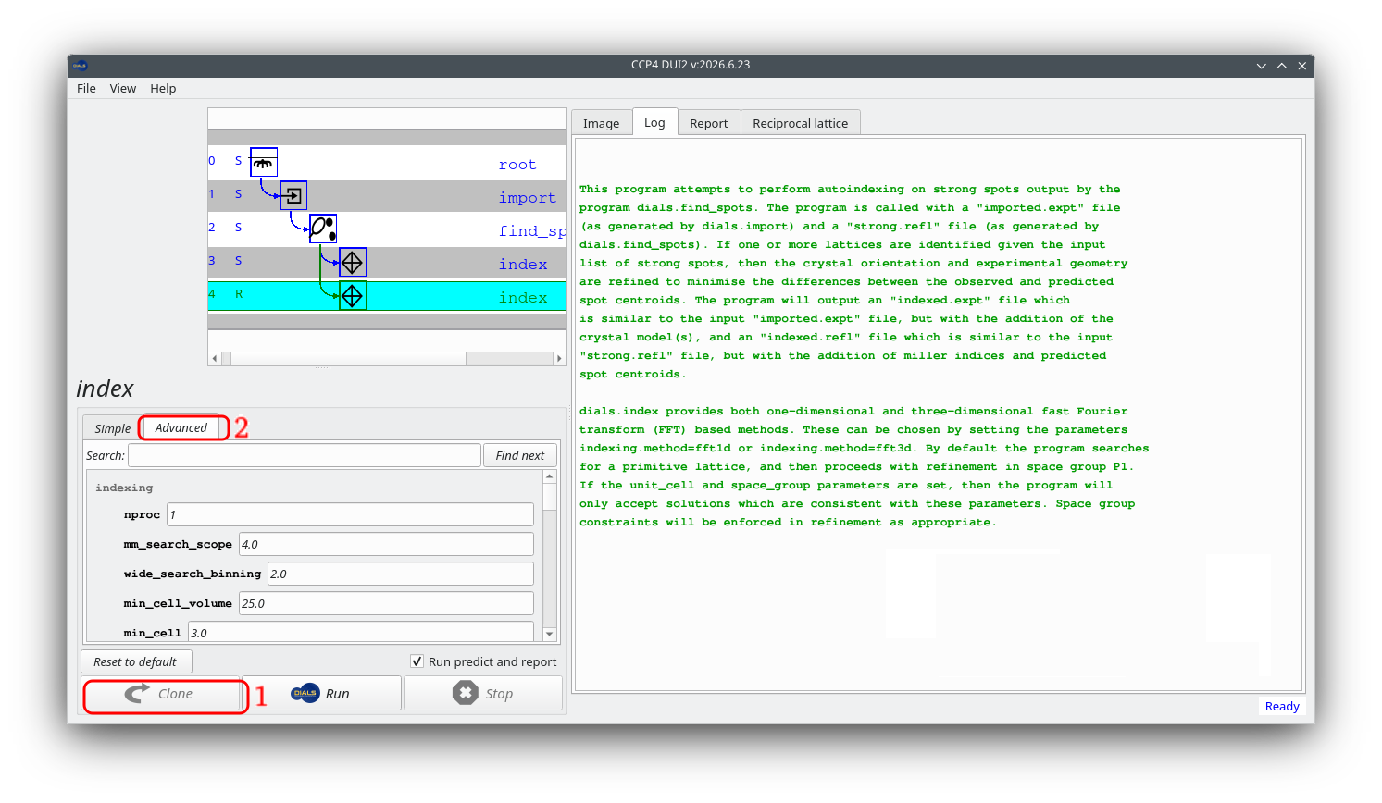
CHAPTER 1 · DISCOVER
Step 4
Clone and Index again, but with two lattices
With the index node selected, click "Clone" — this creates an independent copy branching from the same find-spots input; the original single-lattice node is preserved as a reference.
Cloning the index node

Slide 40
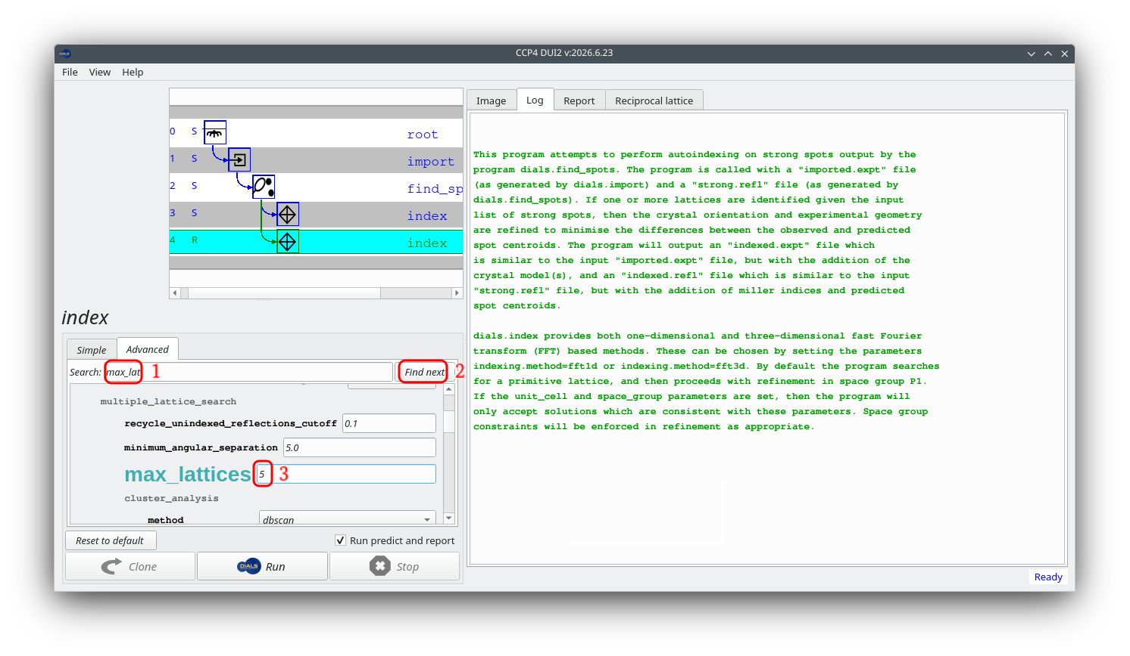
CHAPTER 1 · DISCOVER
Step 4 (continued)
Clone and Index again, but with two lattices
In the cloned node's Advanced tab, set max_lattices → 5, then click Run. DIALS searches for up to five lattices but stops once no more can be justified — here it finds exactly two, accounting for ~95% of all strong spots.
Setting max_lattices in the Advanced tab

Slide 41
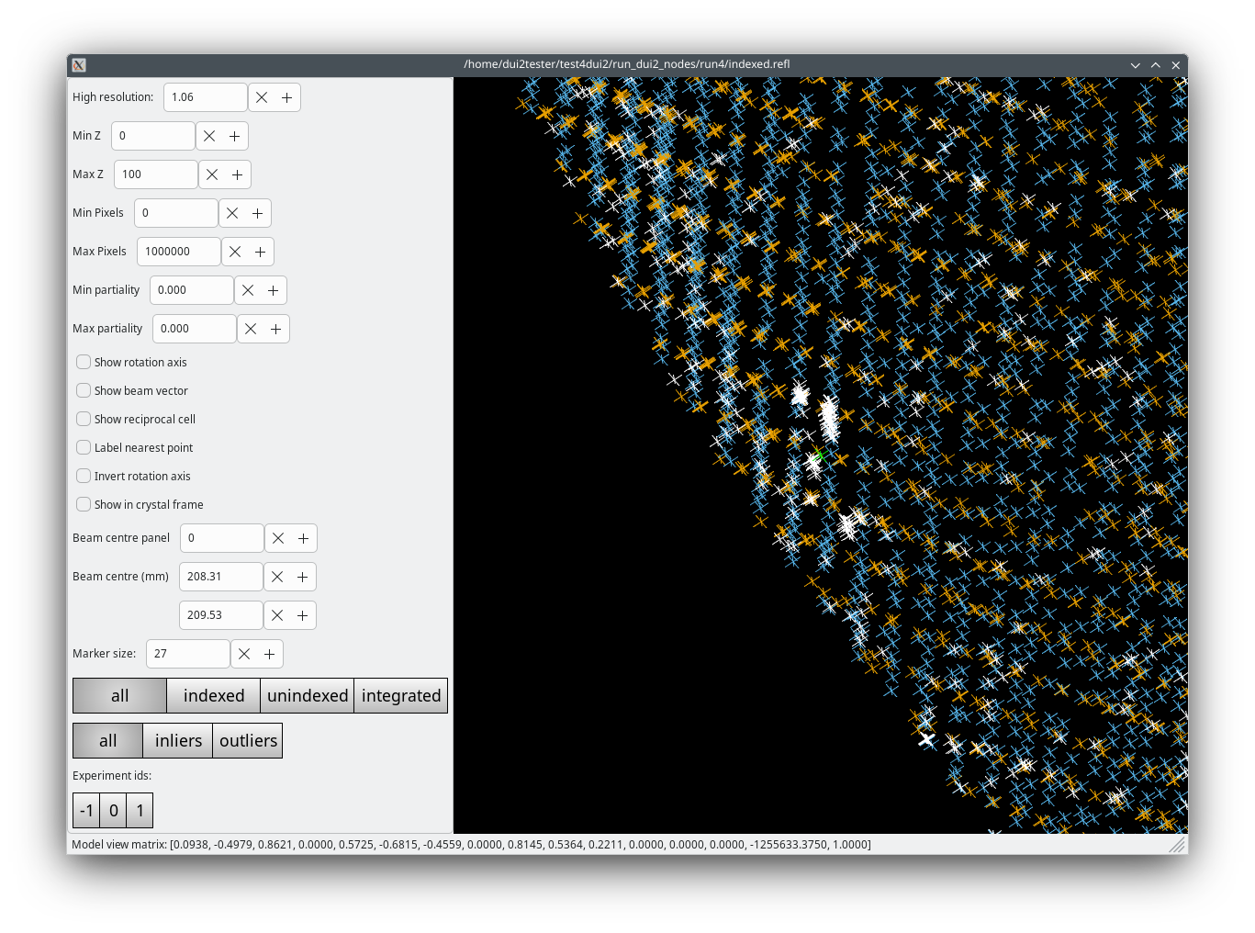
CHAPTER 1 · DISCOVER
Step 4
Result of new index step
After re-indexing with max_lattices=5, the log reports two refined crystal models.
Together they account for roughly 95% of all strong spots.
Two clearly distinct orientation families, each forming clean rows, with very few unindexed spots remaining.
Reciprocal lattice viewer after indexing with two lattices

Slide 42
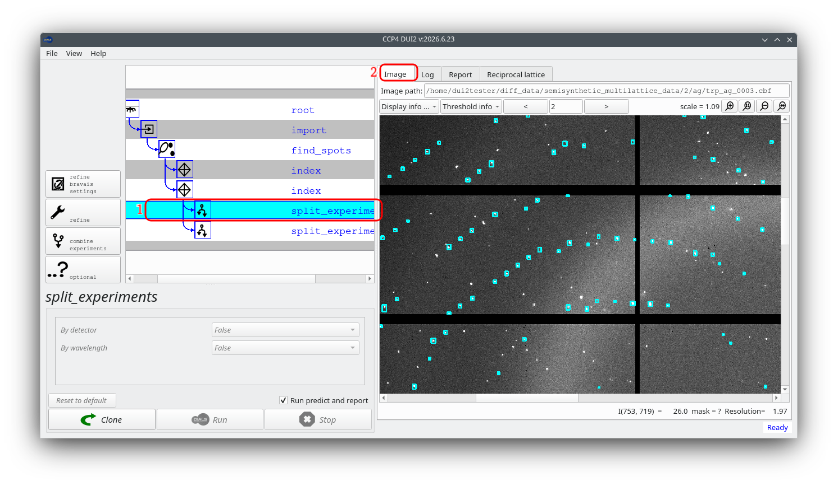
CHAPTER 1 · DISCOVER
Step 5
Split experiments
Select "split experiments" and click Run DUI2 creates one independent child node per lattice, each showing only its own reflections when you open its Image tab.
Decision point: if a lattice fits poorly throughout the scan, there is no obligation to process it further. For this dataset, both branches look good.
Image view — branch 0 (lattice 0)

Slide 43
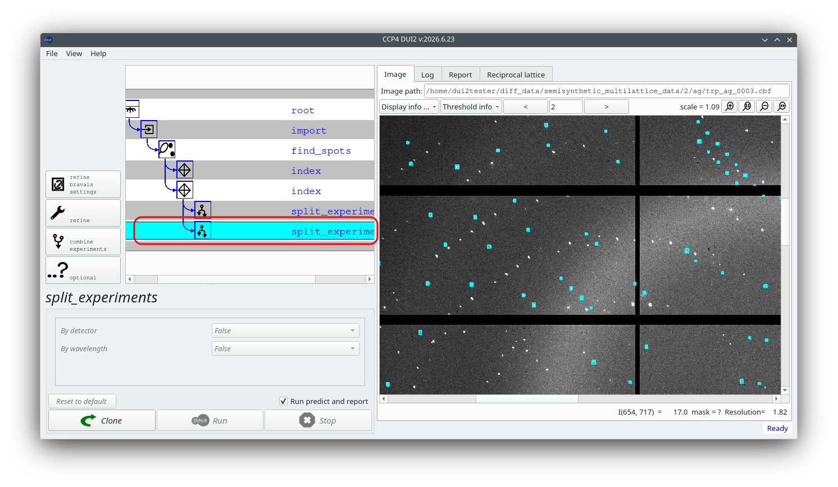
CHAPTER 1 · DISCOVER
Step 5 (continued)
Split experiments
Select "split experiments" and click Run DUI2 creates one independent child node per lattice, each showing only its own reflections when you open its Image tab.
Decision point: if a lattice fits poorly throughout the scan, there is no obligation to process it further. For this dataset, both branches look good.
Image view — branch 1 (lattice 1)

Slide 44
CHAPTER 2
Process
From here the two branches are independent. Work through Bravais settings, refinement, and integration on each in turn.
Refine Bravais settings · Reindex · Refine · Integrate

Slide 45
CHAPTER 2 · PROCESS
Step 6
Refine Bravais settings
With a branch node selected in the history tree, select "refine bravais settings" and click Run.
A table of candidate Bravais lattice solutions is written to the log.
Repeat on branch 0, then branch 1 — the steps in this chapter are identical for both.

Slide 46
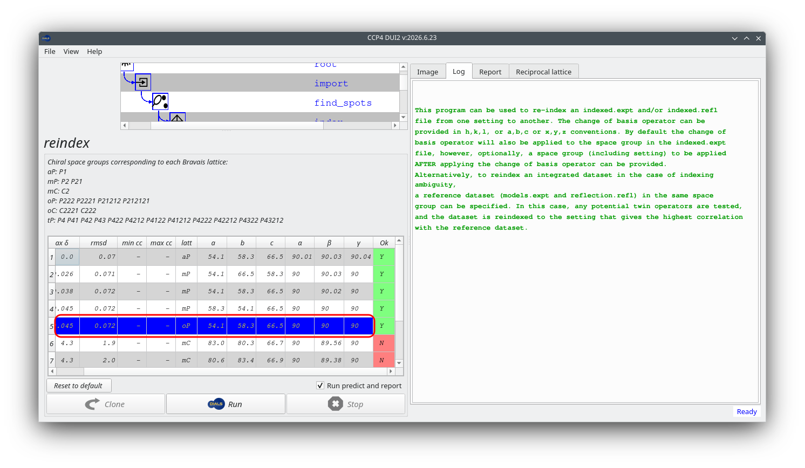
CHAPTER 2 · PROCESS
Step 7
Reindex
Select "reindex". DUI2 displays an interactive table of the solutions from the previous step.
Click the row for solution 5 — primitive orthorhombic (oP, P 2 2 2) — and DUI2 runs dials.reindex automatically.
The chosen solution should have a metric fit significantly closer to zero than the others, and be marked acceptable. If the highest-symmetry acceptable solution differs between branches, investigate before continuing.
DUI2 about to run reindex

Slide 47
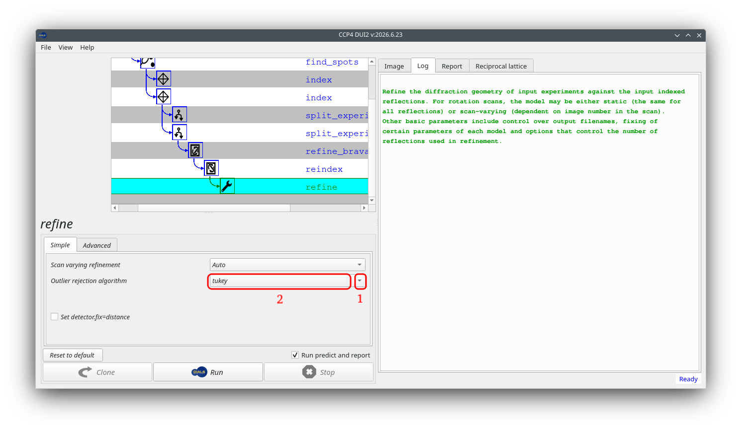
CHAPTER 2 · PROCESS
Step 8
Refine
Select "refine". Under the Simple tab, set Outlier rejection algorithm → tukey.
Click Run — scan-static and scan-varying refinement run for this lattice.
Check the Report tab: changes in cell parameters and orientation angles across the scan should look small and smooth.
DUI2 about to run refine

Slide 48
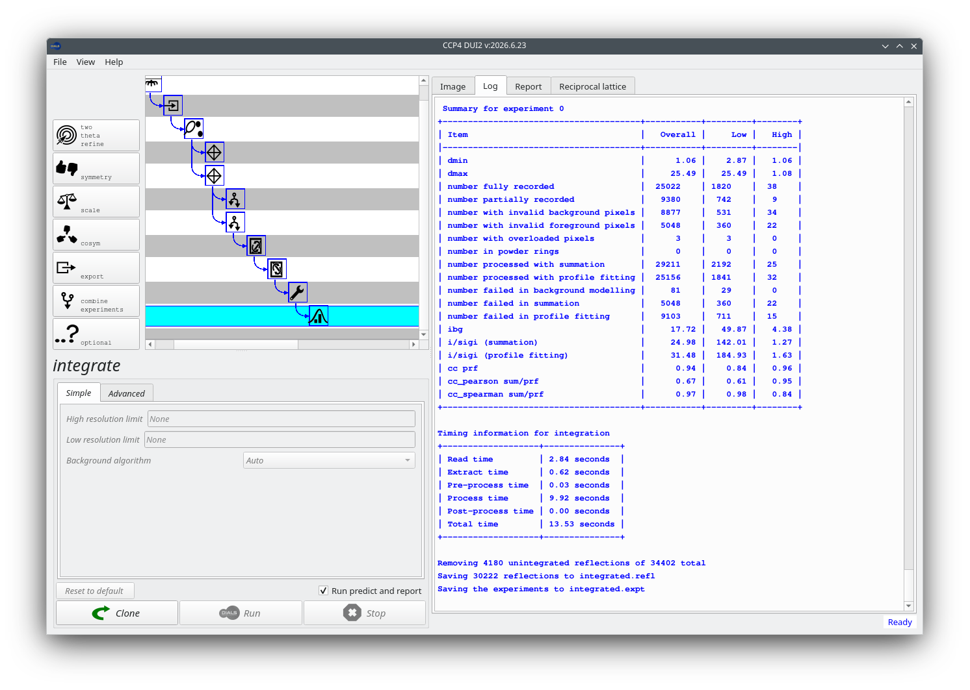
CHAPTER 2 · PROCESS
Step 9
Integrate
Select "integrate" and click Run with default parameters. Check the end of the log for "Summary for experiment 0" — I/σ(I) and cc_prf should look reasonable.
Log view after integrating one branch

Slide 49
CHAPTER 2 · PROCESS
Step 9 (continued)
Integrate
Once steps 6–9 are complete on one branch, return to the split experiments node, select the other branch, and repeat.
Log view after integrating both branches

Slide 50
CHAPTER 3
Post integration
With both branches refined and integrated, run symmetry, scaling, and export independently on each branch.
Determine symmetry · Scale · Export

Slide 51
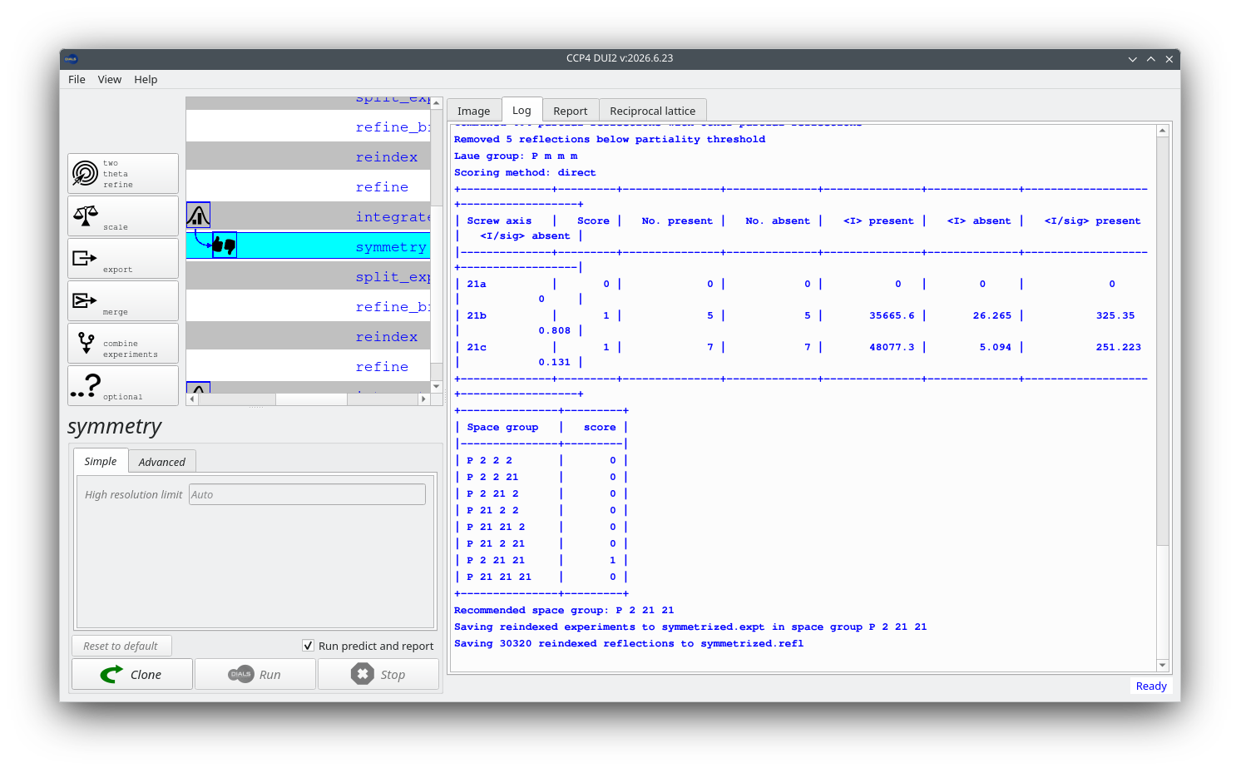
CHAPTER 3 · POST INTEGRATION
Step 10
Determine crystal symmetry
Select "symmetry" and click Run.
The analysis should return P m m m as the Laue group, with clear 2₁ screw axes indicating an orthorhombic space group (P 2 2₁ 2₁ for the first dataset — axis labelling may differ for other archive datasets).
No reflections test the 2₁ screw along a for this dataset — worth testing both P 2 2₁ 2₁ and P 2₁ 2₁ 2₁ during structure solution.
DUI2 with new symmetry applied

Slide 52
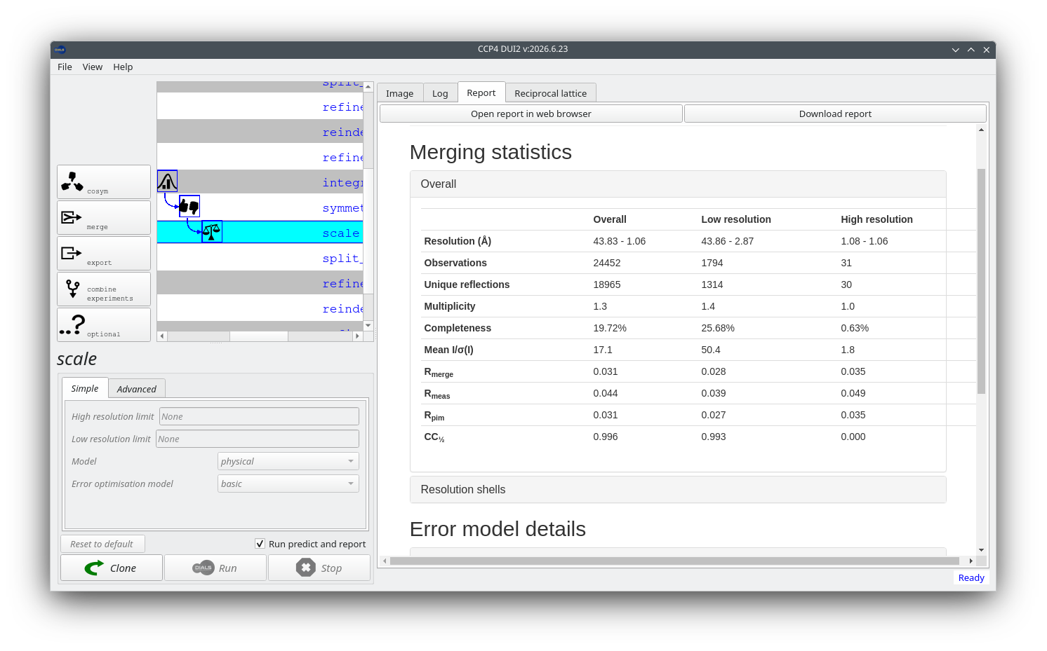
CHAPTER 3 · POST INTEGRATION
Step 11
Scale
Select "scale" and click Run with default parameters.
Check the Report tab for resolution-dependent statistics.
The data has not yet been merged at this stage — dials.scale reports merging statistics but retains all observations.
Report tab after scaling

Slide 53
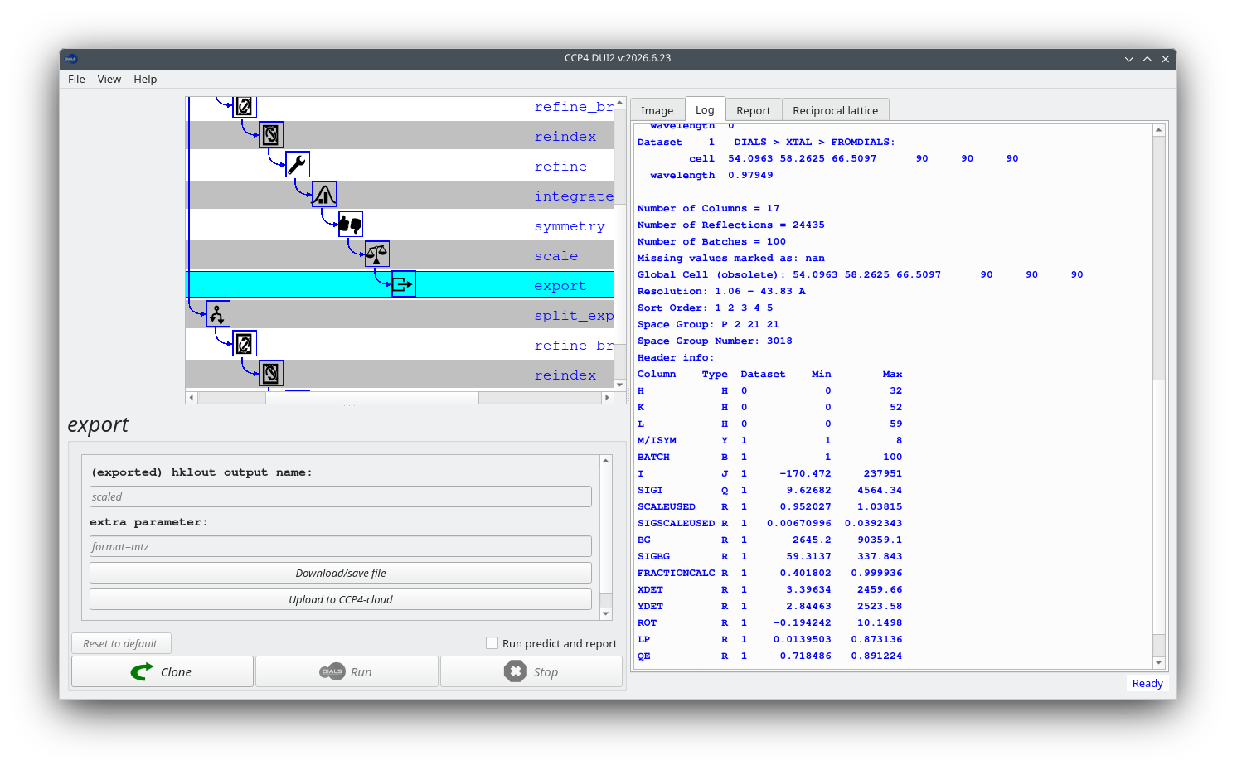
CHAPTER 3 · POST INTEGRATION
Step 12
Export
Select "export", click Run, then "Download/save file" to write the MTZ for this lattice. Repeat on the second branch for a separate MTZ per lattice.
Export and download/save MTZ

Slide 54
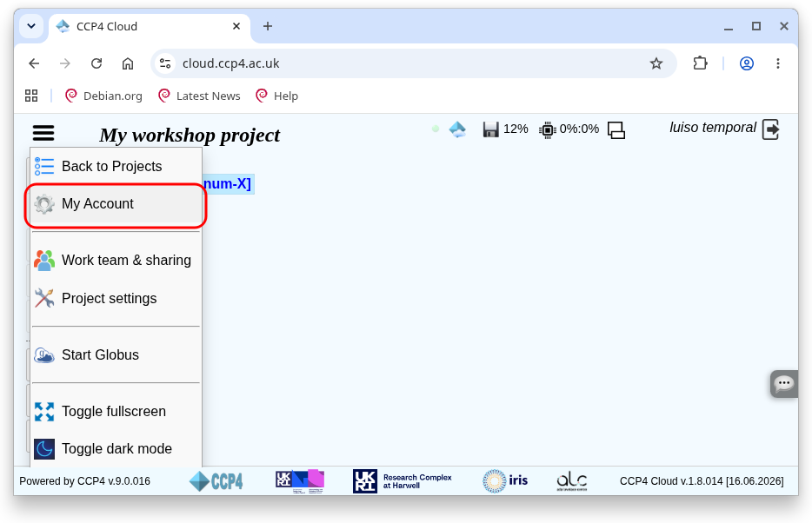
CHAPTER 3 · POST INTEGRATION
Step 12 (continued)
Export
To upload directly to CCP4 Cloud: note your project ID and "CloudRun Id" from My Account, then press "Upload to CCP4-cloud" in DUI2 and fill in the dialog — this creates a cloudrun node.
CCP4 Cloud project page

Slide 55
Summary
Discover
Single-lattice indexing exposed a second lattice via the Image, Log, Report, and Reciprocal lattice tabs; re-indexing with max_lattices=5 and splitting produced two independent branches.
Process
Each branch moved through Bravais settings, reindexing to the shared oP solution, refinement with Tukey outlier rejection, and integration.
Post integration
Each branch was independently assigned symmetry (P m m m Laue group), scaled, and exported to its own MTZ — optionally uploaded to CCP4 Cloud.

Slide 56

Thank you
luis.fuentes-montero@diamond.ac.uk
https://github.com/ccp4/DUI2/wiki
https://github.com/ccp4/DUI2/issues

