Slide 1
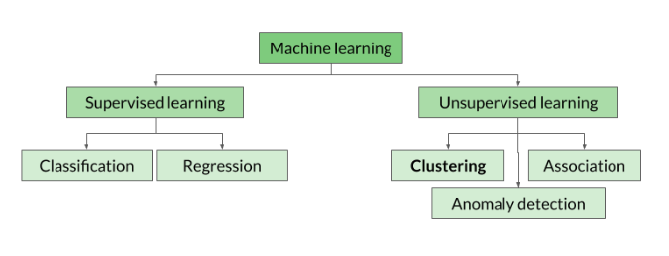

Slide 2
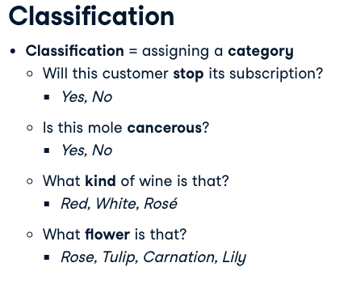
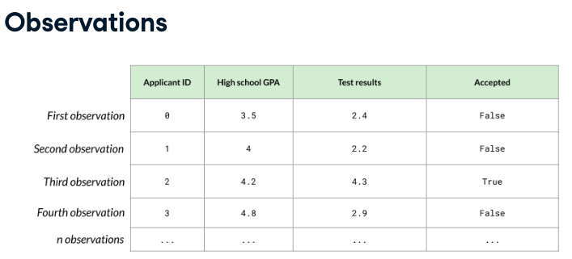
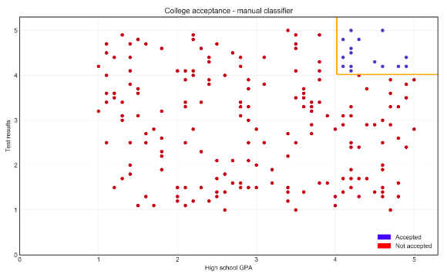

Slide 3
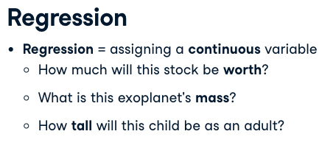
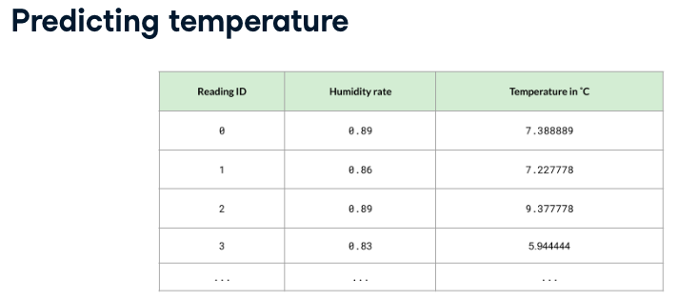
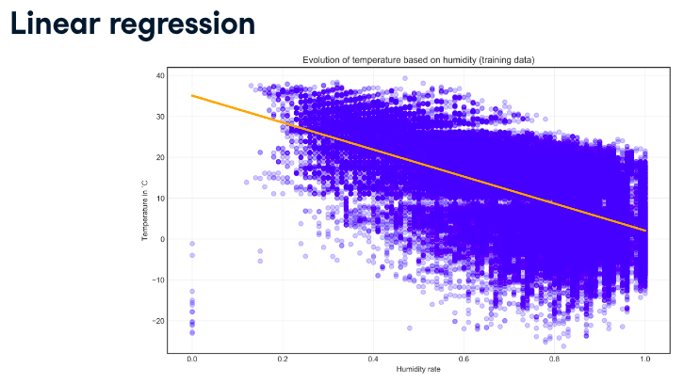

Slide 4
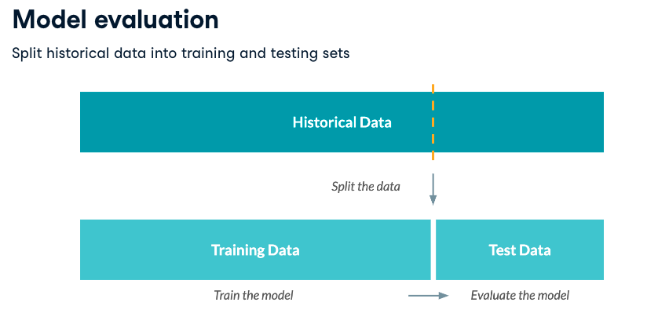

Slide 5
Predicciones de los Clasificadores.
The goal of evaluating a classification model is to better understand how its performance will extrapolate to future cases.
The goal is to maintain two vectors of data: one holding the correct or actual class values, and the other holding the predicted class values.
The actual class values come directly from the target in the test dataset. Predicted class values are obtained from the classifier built upon the training data, which is then applied to the test data.

Slide 6
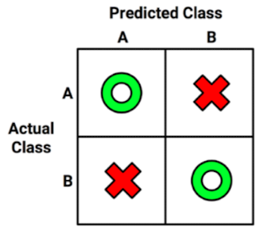
Confusion Matrix
A confusion matrix is a table that categorizes predictions according to whether they match the actual value.
When the predicted value is the same as the actual value, this is a correct classification. Correct predictions fall on the diagonal in the confusion matrix (denoted by O). The off-diagonal matrix cells (denoted by X) indicate the cases where the predicted value differs from the actual value. These are incorrect predictions.

Slide 7
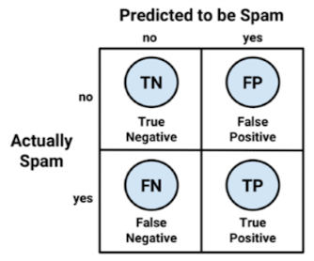
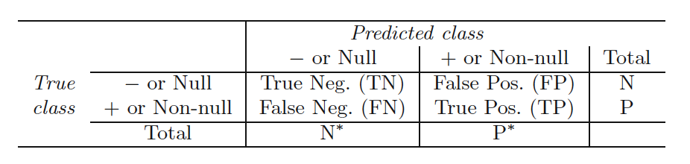
Confusion Matrix
The most common performance measures consider the model's ability to discern one class versus all others. The class of interest is known as the positive class, while all others are known as negative.
True positive (TP): Correctly classified as the class of interest
True negative (TN): Correctly classified as not the class of interest
False positive (FP): Incorrectly classified as the class of interest
False negative (FN): Incorrectly classified as not the class of interest

Slide 8

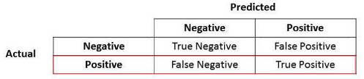
Accuracy
Accuracy is a proportion that represents the number of true positives and true negatives divided by the total number of predictions. It is also called success rate.

Slide 9

Error Rate
The error rate, is the porportion the proportion incorrectly classified examples (FP, FN), divided by the total number of predictions.

Slide 10

Kappa Statistic
The kappa statistic adjusts accuracy by accounting for the possibility of a correct prediction by chance alone. This is especially important for datasets with severe class imbalance because a classifier can obtain high accuracy simply by always guessing the most frequent class.
Kappa values range from zero to a maximum of one, which indicates perfect agreement between the model's predictions and the true values. Values less than one indicate imperfect agreement. Common interpretation is shown as follows:
• Poor agreement = less than 0.20
• Fair agreement = 0.20 to 0.40
• Moderate agreement = 0.40 to 0.60
• Good agreement = 0.60 to 0.80
• Very good agreement = 0.80 to 1.00
Pr(a) rproportion of actual agreement
Pr(e) expected agreement

Slide 11

Sensivity
The sensitivity of a model (also called the true positive rate), measures the proportion of positive examples that were correctly classified.

Slide 12

Specificity
The specificity of a model (also called the true negative rate), measures the proportion of negative examples that were correctly classified.

Slide 13
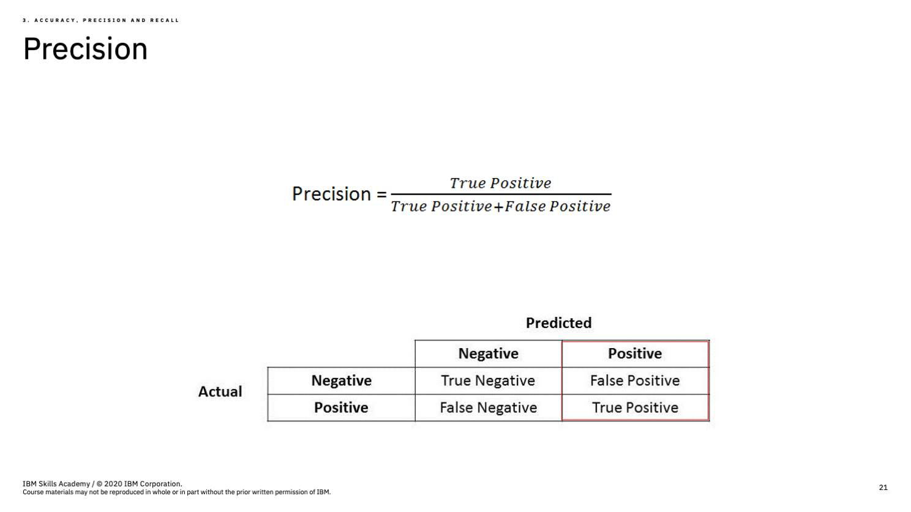
Precision is also called Positive Predicted Value. It is the fraction of Positive Predictions that are truly Positive.

Slide 14
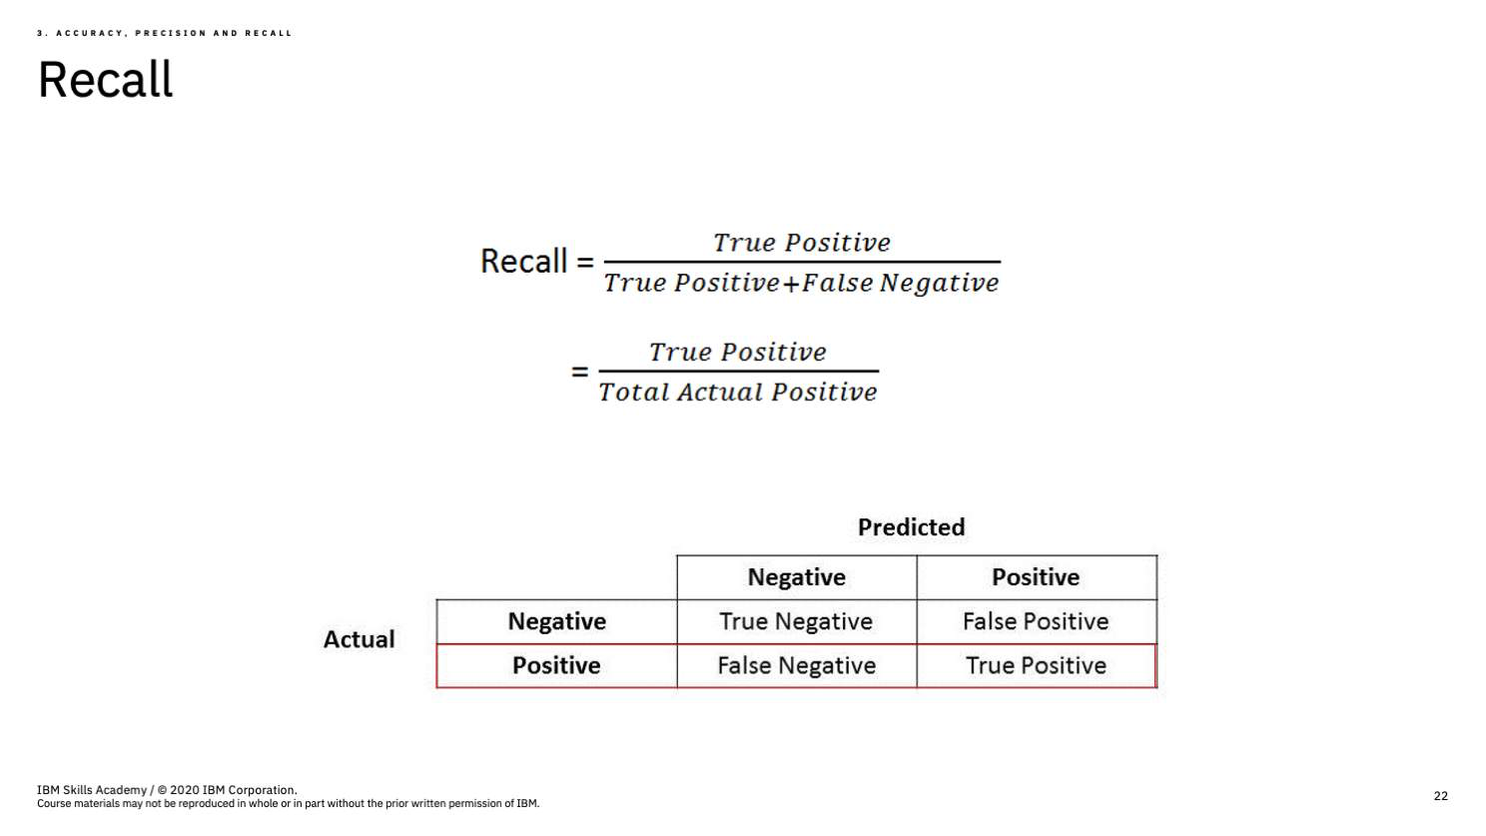
Recall is the fraction of all positives that are correctly identify. It is also know as the True Positive Rate

Slide 15
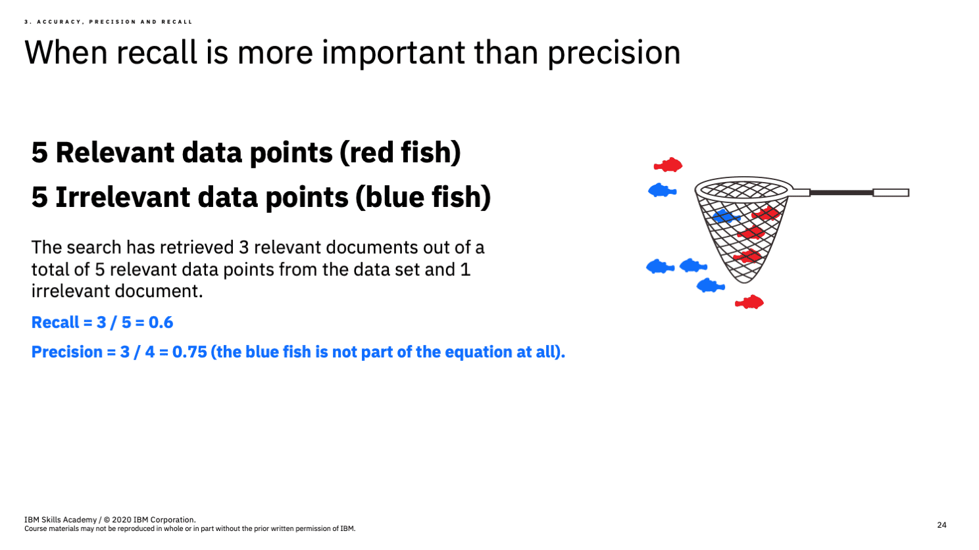
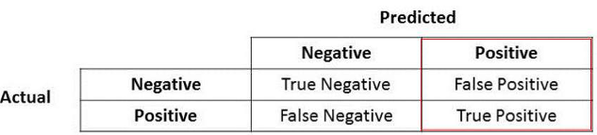
4
1
2
3

Slide 16
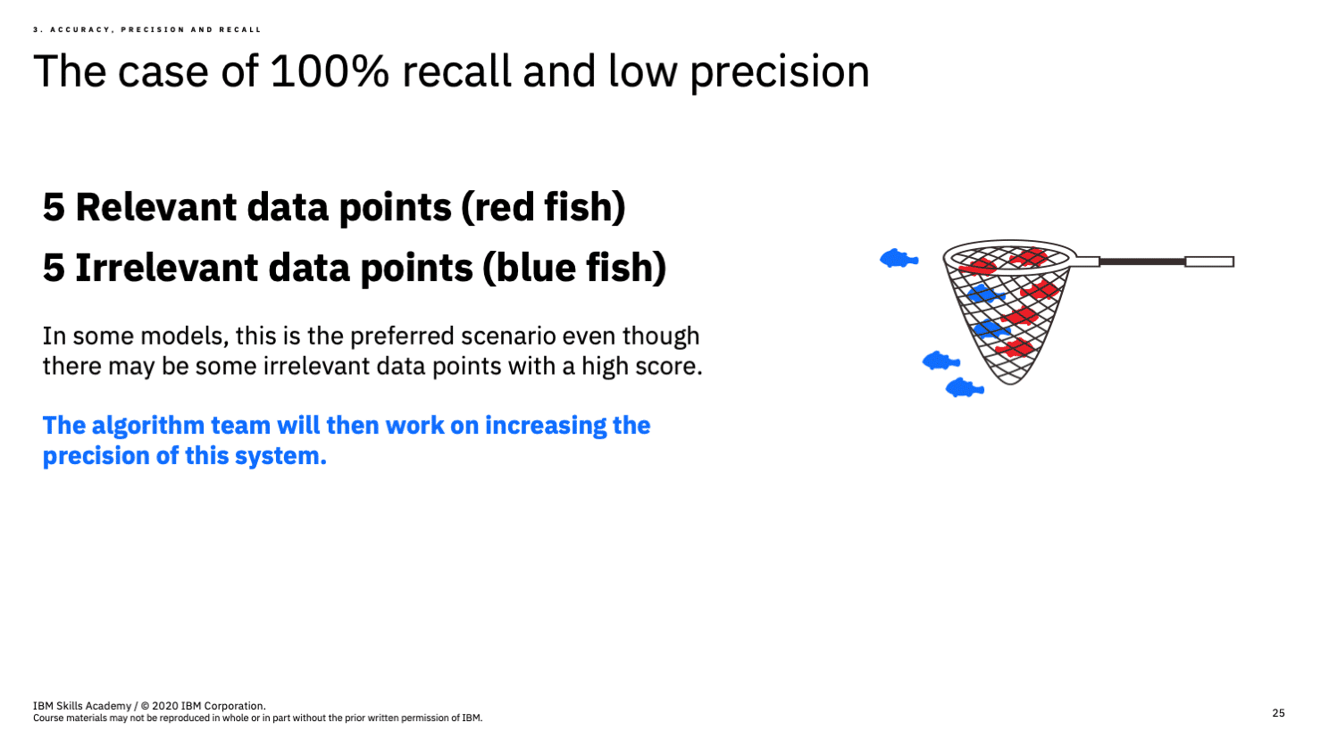
3
2
0
5

Slide 17
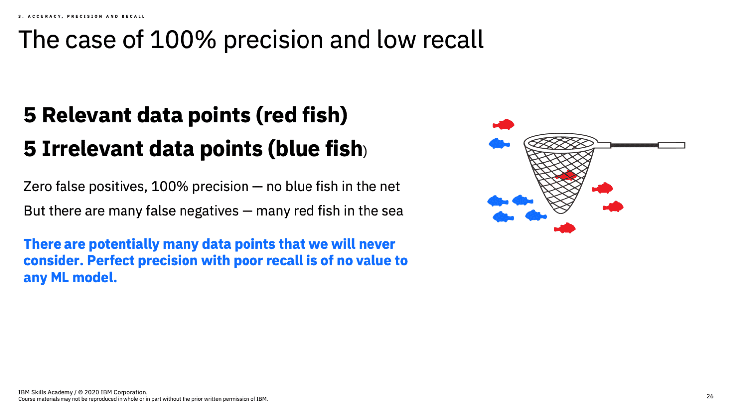
5
0
4
1

Slide 18
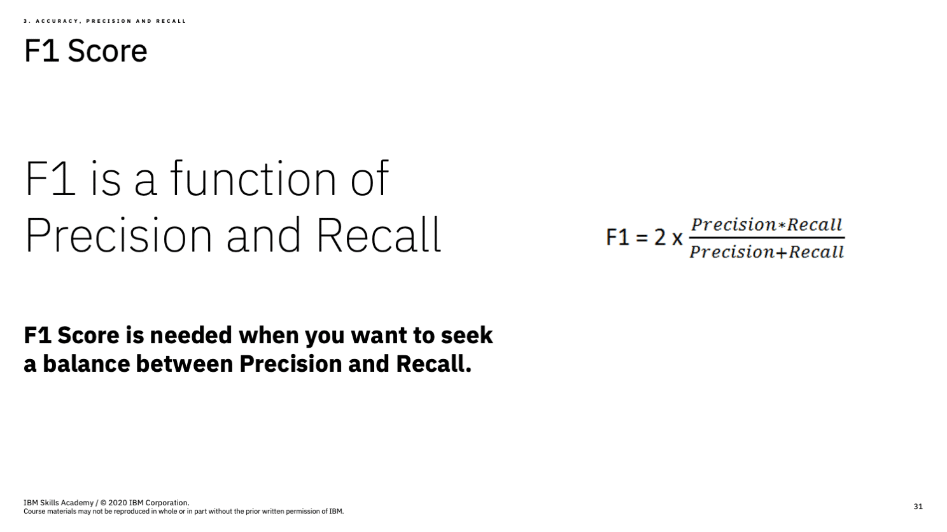
Since the F-measure describes model performance in a single number, it provides a convenient way to compare several models side-by-side.

Slide 19
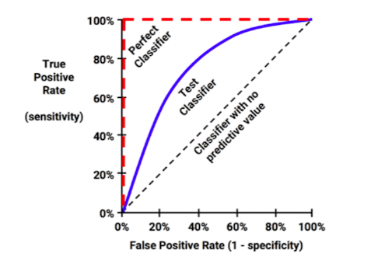
ROC curve
The receiver operating characteristic (ROC) curve is commonly used to examine the tradeoff between the detection of true positives while avoiding the false positives.

