Slide 1
Surfing Shark Attacks: Data Analysis & Insurance Insights
Dimitrios
Kinga
Luis Pablo
Ricardo

Slide 2
Project Overview
Dataset: Global Shark Attack File (GSAF) - worldwide shark attacks, including surfing.
Hypothesis: Insurance demand can be targeted to regions and demographics with greater risk.
Process: Data cleaning, filtering, and EDA to identify risk factors.

Slide 3
Unique Data Cleaning Methods
Regex filtering for 'Activity': Only surfing-related incidents.
Standardized country/state/sex/fatal columns.
Age binned into groups.
Dropped irrelevant columns, consolidated locations.

Slide 4
Wrangling Challenges & Solutions
Extensive missing/ambiguous data (sex, age, fatality).
Custom cleaning functions, regex, mapping, type conversion.
Iterative unique value checks and null counts.
Regex to group beach names for risk analysis.

Slide 5
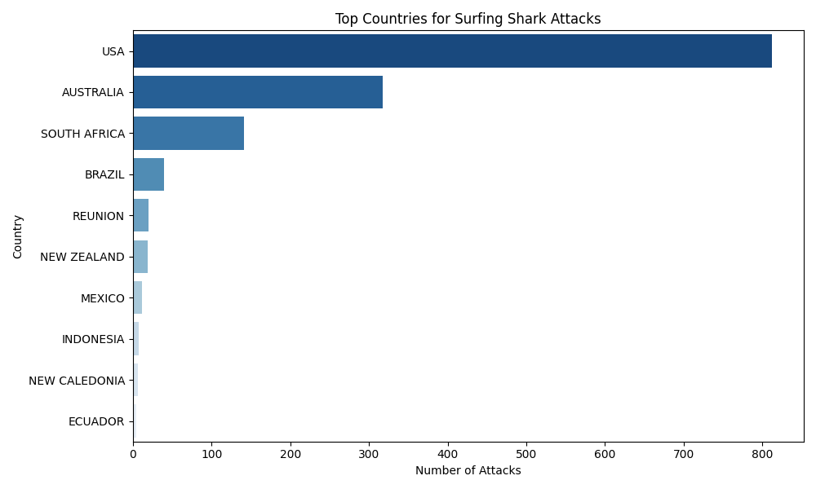
Top Countries for Surfing Shark Attacks

Slide 6
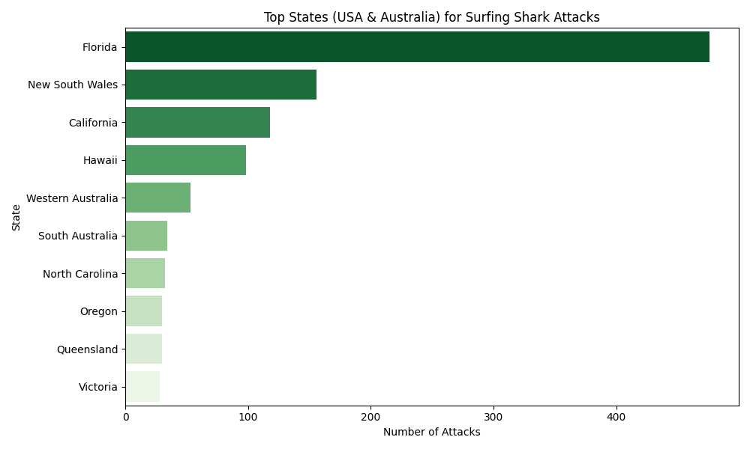
Top States (USA & Australia)

Slide 7
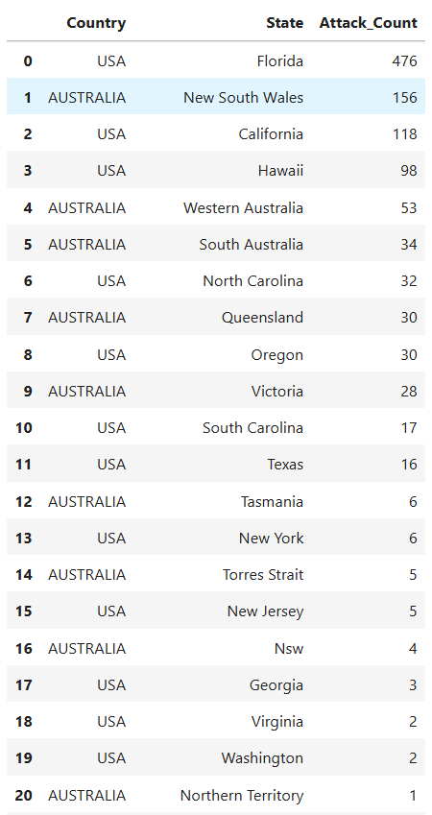
Top Beaches for Surfing Shark Attacks

Slide 8
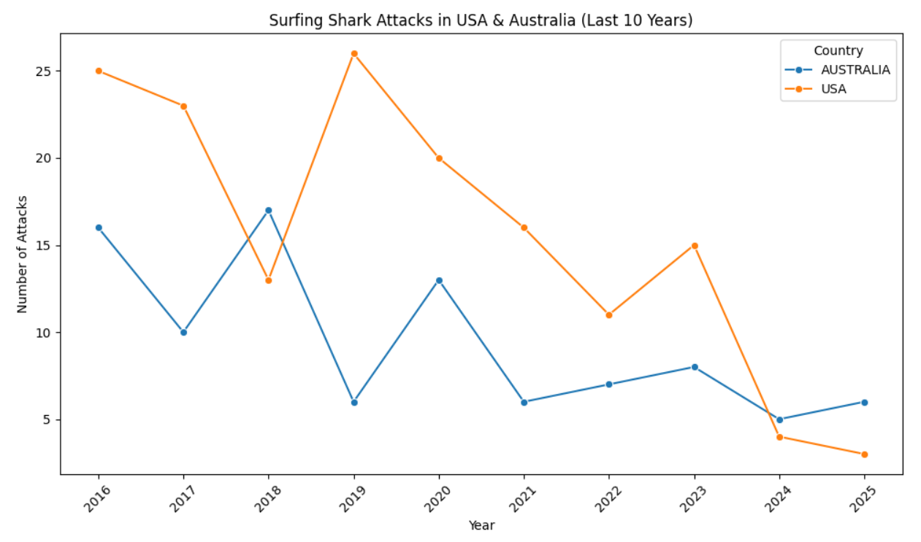
Surfing Shark Attacks Last 10 Years

Slide 9
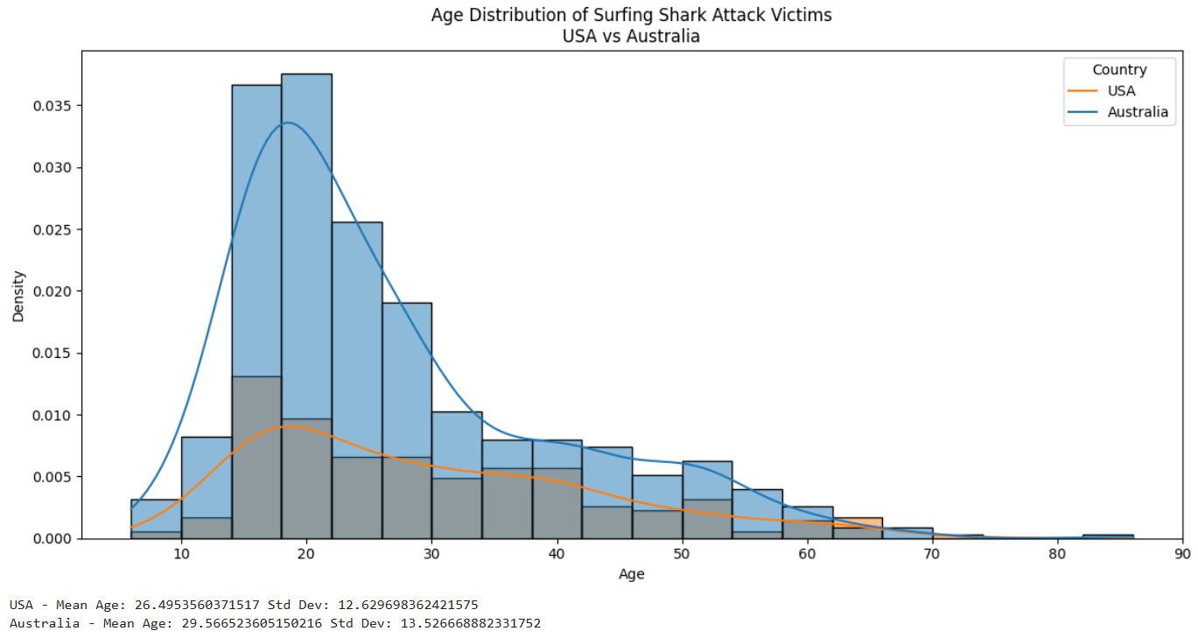
Victim Age Group Distribution

Slide 10
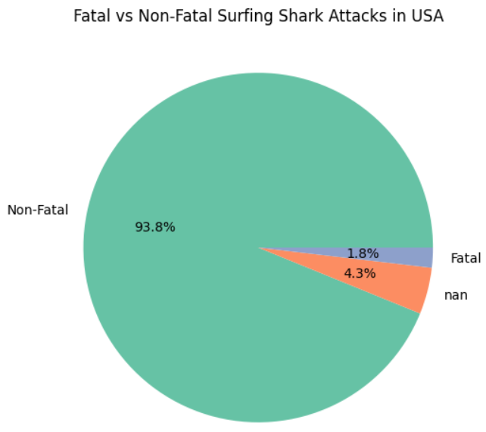
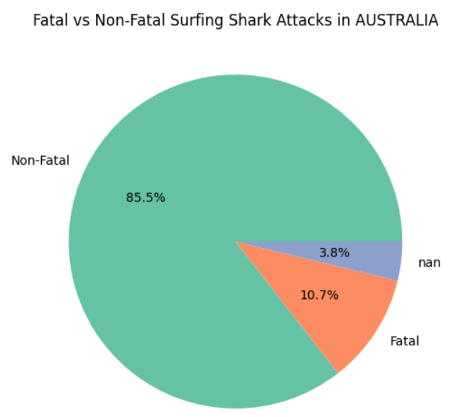
Fatal vs Non-Fatal Attacks

Slide 11
Major Obstacle & Lessons Learned
Non-standard/inconsistent entries (sex, age, fatality).
Resolution: Custom cleaning functions, regex, mapping.
Lesson: Data cleaning is most time-consuming and critical.

Slide 12
Conclusions & Insights
USA (esp. Florida, California, Hawaii) is highest risk market.
Most attacks are non-fatal; pricing can be location/season-specific.
Young males are most frequent victims.
Specific beaches (New Smyrna Beach, FL) are high risk.
Despite media focus, non-fatal injuries dominate.

Slide 13
Implications
Insurance: Risk-based pricing & targeted marketing are feasible.
Business: Focus on young male surfers in high-risk states/beaches.
Public Policy: Local interventions at high-risk beaches matter.

Slide 14
Thank You!
Surfing Shark Attacks: Data Analysis & Insurance Insights

