Slide 1

An exact method algorithm for single source capacitated facility location problems
Simulação e Otimização | MEI | 2022/2023
João Silva | Olavo Alves | Luís Silva

Slide 2
Introduction
In this presentation, we will approach the SSCFLP with the Exact Method Algorithm.
Firstly, we will discuss the SSCFLP with some approaches from literature. Our approach is then presented with computational results. Lastly, we compare our results (Optimal Solution and Gap) with the literature.
Óscar Oliveira / Simulação e Otimização (2022/23)
João Silva | Olavo Alves | Luís Silva

Slide 3
The SSCFLP
The SSCFLP is a problem where the goal is to minimize the total cost of opening and assigning customers to facilities from a set of potential locations and a set of customers, while determining which facilities should be opened and which customers should be assigned to each facility.
Óscar Oliveira / Simulação e Otimização (2022/23)
João Silva | Olavo Alves | Luís Silva

Slide 4
Approaches from literature
Repeated Matching Algorithm (Rönnqvist, M.)
Kernel Search (Guastaroba, G.)
Corridor Method (Caserta, M.)
Dual RAMP (Oliveira, Ó)
Ant Colony Optimization (Kumweang, K.)
Óscar Oliveira / Simulação e Otimização (2022/23)
João Silva | Olavo Alves | Luís Silva

Slide 5
Our approach
We decided to approach this problem using an exact method algorithm.
In order to reproduce the equations, we used the OR-Tools Library in Python.
The solver was used in 5 instances of datasets (Delmaire, Holmberg, OR-library, Yang, TBED1).
Óscar Oliveira / Simulação e Otimização (2022/23)
João Silva | Olavo Alves | Luís Silva

Slide 6
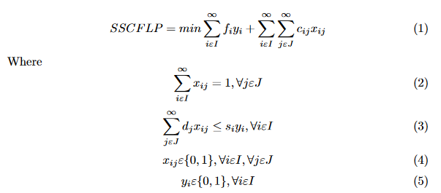
Equation of the problem
It contains the objective function, constraints and decision variables.
Óscar Oliveira / Simulação e Otimização (2022/23)
João Silva | Olavo Alves | Luís Silva

Slide 7
Results
Delmaire (52 OS out of 57)
Holmberg (71 OS out of 71)
OR-Library (9 OS out of 36)
Yang (9 OS out of 20)
TBED1 (0 OS out of 60)
*OS – Optimal Solutions
** Optimal Solutions considered when Z-Z* was 0 or ≈0
Óscar Oliveira / Simulação e Otimização (2022/23)
João Silva | Olavo Alves | Luís Silva

Slide 8
Conclusion
The results were pleasant, some algorithms could only be solved by changing the time limit for the Solver.
Exact Method algorithm uses a ton of resources. Works well in small instances.
Óscar Oliveira / Simulação e Otimização (2022/23)
João Silva | Olavo Alves | Luís Silva

Slide 9
An exact method algorithm for single source capacitated facility location problems
Simulação e Otimização | MEI | 2022/2023
João Silva | Olavo Alves | Luís Silva

